Slide 1


International Research Center on Big Data (RCBD)
Beihang University, Beijing, China
July 15, 2014

Slide 2
Overview
1. Introduction to RCBD
2. Research focus and outcome
3. Industrial collaborations
2

Slide 3
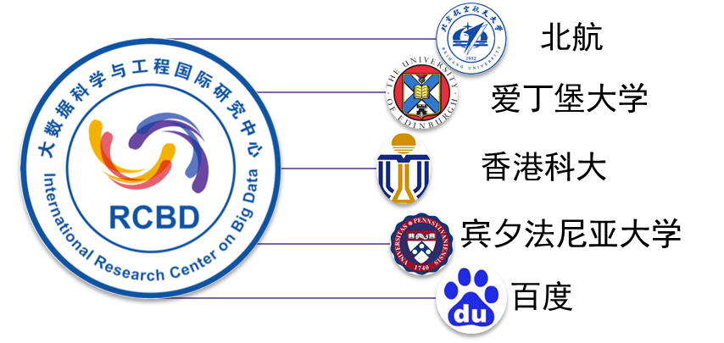
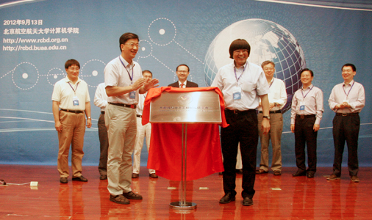

History of RCBD
International Research Centre on Big Data (RCBD)
Founded in September, 2012.
Led by Prof. Wenfei Fan (ACM Fellow, Fellow of the Royal Society of Edinburgh)
BUAA
Edinburgh
HKUST
UPenn
Baidu
In November 2013, RCBD was officially approved as “National Center for International Research” by Ministry of Science & Technology of China, the first one on big data in China.

Slide 4
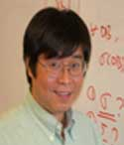



Chief Scientists
Wenfei Fan (Director)
Fellow of the ACM
Fellow of the Royal Society of Edinburgh Chair Professor, University of Edinburgh
Professor of “the one-thousand-talent scheme” at Beihang
Jiangzhong Li (Chief Scientist)
Professor of Harbin Institute of Technology
Chief Scientist of 973 Program
Lionel Ni (Chief Scientist)
Fellow of the IEEE
Professor of Hong Kong University of Science & Technology Adjunct Professor, Beihang University
Jie Xu (Chief Scientist)
Professor, Leeds University
Professor of “the one-thousand-talent scheme” at Beihang

Slide 5
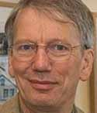
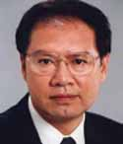
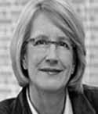
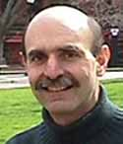
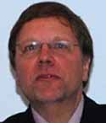

Academic Committee
Peter Buneman
Fellow of the Royal Society Fellow of the ACM Chair Professor, University of Edinburgh
Wei Li
Academician of the Chinese Academy of Sciences Professor, Beihang University
Susan Davidson
Fellow of the ACM Chair Professor, University of Pennsylvania
Scott Weinstein
Professor, University of Pennsylvania
Georg Gottlob
Fellow of the Royal Society Fellow of the ACM Chair Professor, Oxford University
Chaochen Zhou
Academician of the Chinese Academy of Sciences Professor, Peking University

Slide 6
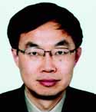
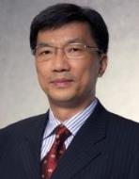
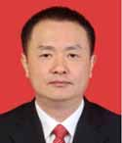


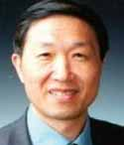
Steering Committee
Wenfei Fan
Fellow of the Royal Society of Edinburgh Fellow of the ACM Professor, University of Edinburgh
Jiang Lv
Vice President, Nanjing University
Academician of the Chinese Academy of Sciences
Jinpeng Huai
Academician of the Chinese Academy of Sciences President of Beihang University
Hong Mei
Academician of the Chinese Academy of Sciences Vice President, Shanghai Jiao Tong University
Wei Li
Academician of the Chinese Academy of Sciences Professor, Beihang University
Suning Tian
President of CBC Capital
Yanhong Li
President, CEO of Baidu
Lizhu Zhou
Professor, Tsinghua University

Slide 7
Overview
1. Introduction to RCBD
2. Research focus and outcome
3. Industrial collaborations
7

Slide 8
The Main Research Areas
Big Data Analyses: Theory and Application
Querying big data is a departure from our familiar database techniques and even the classical computational complexity theory. It introduces new fundamental problems and asks for radical changes to the conventional query evaluation paradigm!
Making Big Data Small
Big data ≠ MapReduce + machine learning.
Querying big data is as important as data mining.
MapReduce is not the only way to query big data!
Data Quality
Big data = data quantity + data quality

Slide 9
BD-Tractability Theory
Traditional computational complexity theory of almost 50 years:
The good: polynomial time computable (PTIME)
The bad: NP-hard (intractable)
The ugly: PSPACE-hard, EXPTIME-hard, undecidable…
What happens when it comes to big data?
Using SSD of 6G/s, a linear scan of a data set D would take
1.9 days when the size of D is of 1PB (10¹⁵B)
5.28 years when the size of D is of 1EB (10¹⁸B)
O(n) time is already beyond reach on big data in practice!
Polynomial-time algorithms are no longer tractable on big data

Slide 10
BD-Tractability Theory
NP and beyond
P
W. Fan, F. Geerts, F. Neven. Making Queries Tractable on Big Data with Preprocessing, VLDB 2013.
Parallel polylog time
BD-tractable
not
BD-tractable
Does it work? A linear scan of D in log(|D|) time:
15 seconds when the size of D is of 1 PB instead of 1.99 days
18 seconds when the size of D is of 1 EB rather than 5.28 years
10
BD-tractable queries: properly contained in P unless P = NC

Slide 11
Make Big Data Small: Exact Query Answering
Scale independent query processing
PODS ‘14, VLDB’14
|D_{Q} | ≤ M, Q(D) = Q(D_{Q})
Parallel scalable query processing
Q(D₁)
VLDB’12, VLDB’14
Q(D)
Q(D_{i})
Q(D_{n})
Bounded incremental query evaluation
TODS, 2013
Q(D+Δ)=Q(D)+Q(Δ)
Query answering using views
ICDE, 2014
Q(D)=Q’(V(D))
SQL queries and graph queries on social networks

Slide 12
Make Big Data Small: Approximate Query Answering
Query-driven approximate
Subgraph isomorphism
(NP-Complete)
Strong simulation
(O(n³))
Effectiveness
70%–80% of matches found by strong simulation are those found by subgraph isomorphism
capture more sensible matches in social graphs
Efficiency
from intractable to low polynomial time
Improvement: 100 times faster than subgraph isomorphism
TODS, 2014
VLDB, 2012

Slide 13
Make Big Data Small: Approximate Query Answering
Data-driven approximate
D
dynamic reduction
D_{α}
accesses a fraction D_{α} of D such that |D_{α}| ≤ α|D|
Computes Q(D_{α}) as approximate answers to Q(D), and
accuracy(Q, D, α) ≥ η
Q
Q
approximation
Q( D )
Q( D_{α} )
We can do personalized social search with α = 0.0015%, with 100% accuracy!
SIGMOD’14
1.5 * 10⁻⁶ * 1PB (10¹⁵B) = 15 * 10⁹ = 15GB
We are making big graphs of 1PB size as small as 15GB!
We can make big graphs of PB size fit into our memory!

Slide 14

Two Sides of a Coin: Data Quantity and Quality
When we talk about big data, we typically mean its :
What capacity of a system provides to cope with the sheer size of the data?
Is a query feasible on big data within our available resources?
How can we make our queries tractable on big data?
. . .
Veracity!
Can we trust the answers to our queries?
Dirty data routinely lead to misleading financial reports, strategic business planning decisions
loss of revenue, credibility and customers, disastrous consequences
The study of data quality is as important as data quantity

Slide 15
The Other Side of Big Data: Data Quality
Big data = quantity + quality!
Central issues for data quality
Object identification (data fusion): do two objects refer to the same real-world entity? What is the true value of the entity?
Data consistency: do our data values have conflicts?
Information completeness: does the database have enough information to answer our queries?
Data accuracy: is one value more accurate than another for a real-word entity?
Data currency: is our data out of data
TODS, TKDE, PODS, Information , SIGMOD, ICDE
15

Slide 16
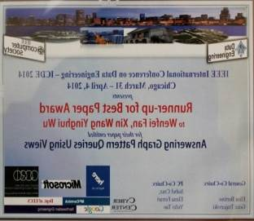
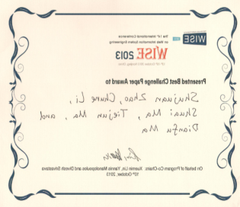
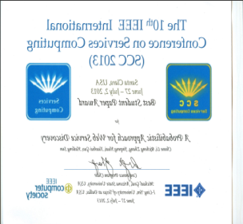
Research Outcome
Publications
30+ papers in TODS, VLDB J, PODS, SIGMOD, VLDB, ICDE, in less than 2 years
Funding
The National Basic Research Program of China, the Ministry of Science and Technology of China, 2014 – 2018, CNY 29,000,000.
The innovative team of National Science Foundation of China (NSFC), CNY 12,000,000.
Awards

Slide 17
Overview
1. Introduction to RCBD
2. Research focus and outcome
3. Industrial collaborations
17

Slide 18
Industrial Collaborations
We have been collaborating with Audaque,Google, Facebook, IBM, Yahoo and Huawei
Joint projects
Audaque: support big data techniques in their products
Google: research on knowledge base
Facebook: research on user targeted advertising
Funding
IBM and Yahoo!
Google (under negotiation)
Joint research lab
Huawei (under negotiation)
Scholarship: PhD studentships
Audaque
Huawei (under negotiation)

Slide 19
Future Plan for the Next Two Years
Research
Querying big data, graph pattern association for social marketing, knowledge fusion, data quality control with knowledge bases, …
The top big data research center in China and Asia
We already take global lead on several research topics
Systems
Grape: a parallel query system for graph pattern queries, a new model
Search engines by incorporating social data analysis
Data quality systems for big data, beyond ETL – by treating knowledge bases as master data
Applications of big data analysis: ongoing at Audaque
Take global lead on big data
We welcome strong partners, academic or industry

Slide 20

Thanks!

