Slide 1

Towards Certain Fixes with Editing Rules and Master Data
Wenfei Fan Shuai Ma Nan Tang Wenyuan Yu
University of Edinburgh
Jianzhong Li
Harbin Institute of Technology
Notes:
Removed title and logo

Slide 2
What is wrong with our data?
81 million National
Insurance numbers
but only 60 million
eligible citizens
In a 500,000 customer database, 120,000 customer records become invalid within 12 months
Data error rates in industry: 1% - 30% (Redman, 1998)
500,000 dead people
retain active
Medicare cards
Pentagon asked 200+
dead officers to re-enlist
Real-life data is often dirty

Slide 3




Dirty data is costly
In US, 98,000 deaths
each year were caused by
errors in medical data
Poor data costs US businesses $611 billion annually
Erroneously priced data in retail databases costs US customers $2.5 billion each year
1/3 of system development projects were forced to delay or cancel due to poor data quality
30%-80% of the development time and budget for data warehousing are for data cleaning
2000
2001
1998
These highlight the need for data cleaning
Notes:
The state of the art data cleaning tools
It is well agreed that the state of the art data cleaning tools is to make use of integrity rules

Slide 4
Integrity constraints
A variety of integrity constraints were developed to capture inconsistencies:
Functional dependencies (FDs)
Inclusion dependencies (INDs)
Conditional functional dependencies (CFDs)
Denial constraints
…
FN | LN | AC | phn | type | str | city | zip | item
Bob | Brady | 020 | 079172485 | 2 | 501 Elm St. | Edi | EH7 4AH | CD
020
Edi
[AC=020] →[city=Ldn]
[AC=131] →[city=Edi]
These constraints help us determine whether data is dirty or not, however…

Slide 5
Limitation of previous method
This does not ﬁx the error t[AC],
and worse still, messes up the
correct attribute t[city]
[AC=020] →[city=Ldn]
[AC=131] →[city=Edi]
FN | LN | AC | phn | type | str | city | zip | item
Bob | Brady | 020 | 079172485 | 2 | 501 Elm St. | Edi | EH7 4AH | CD
t
020
Ldn
Bob | Brady | 020 | 079172485 | 2 | 501 Elm St. | Edi | EH7 4AH | CD
Edi
Bob | Brady | 020 | 079172485 | 2 | 501 Elm St. | Edi | EH7 4AH | CD
131
Data cleaning methods based on integrity constraints only capture inconsistencies
Notes:
Fast
From Nan: I think that it is better that 1) The first arrow should be from Edi to Ldn, meaning that value is changed. In my mac, the arrow is between two phone numbers.
2) The second arrow is similar, should start from 020, and end with 131.

Slide 6
The quest for a new data cleaning approach
The previous methods do not guarantee that we have certain fixes – 100% correct fix. They do not work when repairing critical data
In fact we want a data cleaning method to guarantee the following:
Every update guarantees to fix an error, although we may not fix all the errors;
Repairing process does not introduce new error.
Seemingly minor errors mean life or death!
We need certain fixes when cleaning critical data
Notes:
The second last line, the “new error” should be “new errors”?

Slide 7
Outline
A approach to computing certain fixes
Data monitoring
Master data
Editing rules
Certain regions
Fundamental problems
Heuristic algorithms for computing certain regions
Experimental study
Notes:
“A approach to computing”: 1) An approach 2) to compute 我觉得这里用的不是一个词组“approach to”，所以to后面应该是 动词原型

Slide 8
How do we achieve certain fixes?
……
t
……
Data
Monitoring
far less costly to correct a tuple at the point of data entry than fixing it afterward.

Slide 9
How do we achieve certain fixes?
……
t
……
Master
Data
Data
Monitoring
Master data is a single repository of high-quality data that provides various applications with a synchronized, consistent view of its core
business entities.
FN | LN | AC | Hphn | Mphn | str | city | zip | DOB | gender
Robert | Brady | 131 | 6884563 | 079172485 | 501 Elm Row | Edi | EH7 4AH | 11/11/55 | M
Mark | Smiths | 020 | 6884563 | 075568485 | 20 Baker St. | Ldn | NW1 6XE | 25/12/67 | M
Master relation D_{m}
Notes:
color

Slide 10
How do we achieve certain fixes?
……
t
……
Master
Data
Data
Monitoring
Editing
Rules
Σ
Editing rules are a class of new data quality rules, which tell us how to fix data.

Slide 11
Editing Rules
1 – home phone
2 – mobile phone
certain
certain
type=2
FN | LN | AC | phn | type | str | city | zip | item
Bob | Brady | 020 | 079172485 | 2 | 501 Elm St. | Edi | EH7 4AH | CD
t₁
Robert
131
501 Elm Row
Input relation R
FN | LN | AC | Hphn | Mphn | str | city | zip | DOB | gender
Robert | Brady | 131 | 6884563 | 079172485 | 501 Elm Row | Edi | EH7 4AH | 11/11/55 | M
Mark | Smiths | 020 | 6884563 | 075568485 | 20 Baker St. | Ldn | NW1 6XE | 25/12/67 | M
s₁
s₂
φ1: ((zip, zip) → (AC, str, city), tp1 = ( ))
φ4: ((phn, Mphn) → (FN, LN), tp2[type] = (2))
Master relation D_{m}
Applying editing rules don’t introduce new errors
Notes:
Nan Tang: “Applying editing rules don’t”, here should be “does not”
reduce the example
lead the
make it less attributes..
compare
Ilustrate why we get that

Slide 12
Editing rules vs. integrity constraints
Dynamic semantics
Editing rules tell us which attributes to change and how to change them
Integrity constraints have static semantics.
Information from master data
Editing rules are defined on two relation (master relation and input relation).
Some integrity constraints (e.g. FDs, CFDs) are usually defined on a single relation.
Certain attributes
Editing rules rely on certain attributes
Integrity constraints don’t.
Editing rules are quite different from integrity constraints
Notes:
Nan Tang: “defined on two relation” should be “two relations”
Backup here

Slide 13
Regions
certain
FN | LN | AC | phn | type | str | city | zip | item
Bob | Brady | 020 | 079172485 | 2 | 501 Elm St. | Edi | EH7 4AH | CD
A region is a pair (Z, Tc),
(Z, Tc)
Z = (AC, phn, type)
Tc = {(0800, _, 1)} /* {(≠0800, any value, =1 )}*/
501 Elm Row
FN | LN | AC | Hphn | Mphn | str | city | zip | DOB | gender
Robert | Brady | 131 | 6884563 | 079172485 | 501 Elm Row | Edi | EH7 4AH | 11/11/55 | M
Mark | Smiths | 020 | 6884563 | 075568485 | 20 Baker St. | Ldn | NW1 6XE | 25/12/67 | M
Not satisfying (Z, Tc)
type ≠ 1
Not satisfying (Z, Tc)
t[Z] is not certain
φ1: ((zip, zip) → (AC, str, city), tp1 = ( ))
Satisfying (Z, Tc)
FN | LN | AC | phn | type | str | city | zip | item
Bob | Brady | 020 | 079172485 | 2 | 501 Elm St. | Edi | EH7 4AH | CD
Rob | Brady | 131 | 688456 | 1 | 501 Elm St. | Edi | EH7 4AH | BOOK
Robert | Brady | 131 | 6884563 | 1 | Null | Ldn | null | CD
×
×
√
Tuple t satisfying a region (Z, Tc): t[Z] is certain AND t[Z] match Tc
Notes:
Nan Tang: in take away message, “match” should be “matches”

Slide 14
Fundamental problems - Unique fixes
φ1: ((zip, zip) → (str, city), tp1 = ( ))
φ2: (((phn, Hphn), (AC, AC)) → (city), tp2[type, AC] = (1, 0800))
When t[AC, phn, zip, city] is certain, there exists a unique fix
When t[zip, AC, phn] is certain, there exists multiple fixes
Mary | Brady | 020 | 6884563 | 1 | 501 Elm St. | Edi | EH7 4AH | CD
501 Elm Row
Ldn
501 Elm Row
Edi
Mary | Brady | 020 | 6884563 | 1 | 501 Elm St. | Edi | EH7 4AH | CD
certain
certain
certain
FN | LN | AC | Phn | Type | Str | city | zip | item
Mary | Brady | 020 | 6884563 | 1 | 501 Elm St. | Edi | EH7 4AH | CD
t
Input relation R
FN | LN | AC | Hphn | Mphn | str | city | zip | DOB | gender
Robert | Brady | 131 | 6884563 | 079172485 | 501 Elm Row | Edi | EH7 4AH | 11/11/55 | M
Mark | Smiths | 020 | 6884563 | 075568485 | 20 Baker St. | Ldn | NW1 6XE | 25/12/67 | M
Master relation D_{m}
We must ensure that editing rules don’t introduce conflicts
Notes:
Nan Tang: “there exists” or “there exist”?

Slide 15
Consistency problem
Input : rules Σ, master relation D_{m}, input relaton R, region (Z, Tc)
Output:
True, if each tuple statisfying (Z, Tc) has a unique fix;
False, otherwise.
coNP-complete
Coverage problem is intractable
Notes:
Question:
two tuples in Dm

Slide 16
Unique fixes are not enough
φ1: ((zip, zip) → (AC, city, str), tp1 = ( ))
φ2: ((phn, Mphn) → (FN, LN), tp2[type] = (2))
φ3: (((phn, Hphn), (AC, AC) → (str, city, zip), tp3[type, AC] = (1, 0800))
Is t[FN, LN, item] correct?
certain
certain
FN | LN | AC | phn | type | str | city | zip | item
Robot | Brady | 131 | 688456 | 1 | 501 Elm St. | Edi | EH7 4AH | BOOK
t
501 Elm Row
Input relation R
FN | LN | AC | Hphn | Mphn | str | city | zip | DOB | gender
Robert | Brady | 131 | 6884563 | 079172485 | 501 Elm Row | Edi | EH7 4AH | 11/11/55 | M
s
Master relation D_{m}
Region (Z, Tc), where Z = (AC, phn, type, zip), Tc = {[_,_,_,_]}
Not all errors could be fixed even if it is consistent
16

Slide 17
Certain region
We say that (Z, Tc) is a certain region for (Σ, Dm), if for any tuple t satisfying (Z, Tc),
Not only tuple t has a unique fix, but also: all the attributes in tuple t could be correctly fixed.
φ1: ((zip, zip) → (AC, city, str), tp1 = ( ))
φ2: ((phn, Mphn) → (FN, LN), tp2[type] = (2))
φ3: (((phn, Hphn), (AC, AC) → (str, city, zip), tp3[type, AC] = (1, 0800))
We call this “certain fix”
certain
certain
FN | LN | AC | phn | type | str | city | zip | item
Robot | Brady | 131 | 079172485 | 2 | 501 Elm St. | Edi | EH7 4AH | BOOK
t
Robert
501 Elm Row
Input relation R
FN | LN | AC | Hphn | Mphn | str | city | zip | DOB | gender
Robert | Brady | 131 | 6884563 | 079172485 | 501 Elm Row | Edi | EH7 4AH | 11/11/55 | M
Master relation D_{m}
(Z, Tc) , where Z=(phn,type, zip, item) and
Tc[phn,type,zip]={[079172485,2,”EH7 4AH”]}
Certain fixes: all the attributes in t are guaranteed correct
Notes:
Nan Tang: “Not only” should be “not only”

Slide 18
Coverage problem
Input : rules Σ, master relation D_{m}, input relation R, region (Z,Tc)
Output:
True, if each tuple satisfying (Z, Tc) has a certain fix;
False, otherwise.
coNP-complete
Coverage problem is intractable

Slide 19
How do we achieve certain fixes?
t is clean now
We want find certain region (Z, Tc) with minimum |Z| : to reduce the users’ efforts on assuring the correctness of t[Z]
……
t
……
If t satisfies (Z, Tc),
we can fix all other
attributes in t.
Master
Data
Data
Monitoring
certain region
Editing
Rules
Σ
Computing
Candidate
Certain
Regions
Users
k certain regions
Users choose one (Z, Tc), and
assure the correctness of t[Z]
We compute a set of
certain regions
for users to choose
Computing candidate certain regions becomes the central problem
Notes:
Nan Tang: “We want find” should be “We want to find”

Slide 20
Challenges of computing certain regions
Compute the minimum Z that (Z, Tc)
is a certain region, and Tc ≠ Φ.
Problems | Complexity
Consistency | coNP-complete
Coverage | coNP-complete
Z-minimum | NP-complete
Z-valadating | NP-complete
Z-counting | #P-complete
Approximation-Hard
Computing optimal certain regions is challenging

Slide 21
Heuristic algorithm for computing certain regions
AC=020
zip=EH9
zip=NW1
str=20 Baker St
str=501 Elm Row
Adopt heuristic algorithm for
enumerating cliques
AC=131
zip=EH8
city=Ldn
city=Edi
Computing Reduced Compatible Graph G
Finding k maximal cliques in G
Generating a certain region for each maximal clique
We can guarantee to find a non-empty set of certain regions
Notes:
As simple as possible. Schema maping email

Slide 22
Experimental Study – Data sets
HOSP (Hospital Compare) data is publicly available from U.S. Department of Health & Human Services.
There are 37 editing rules designed for HOSP.
DBLP data is from the DBLP Bibliography.
There are 16 editing rules designed for DBLP.
TPC-H data is from the TPC-H dbgen generator.
There are 55 editing rules designed for TPC-H.
RAND data was randomly generated for scalability test.
Both real life and synthetic data were used to evaluate our algorithm

Slide 23
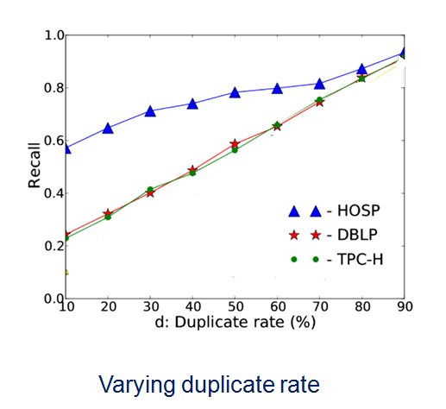
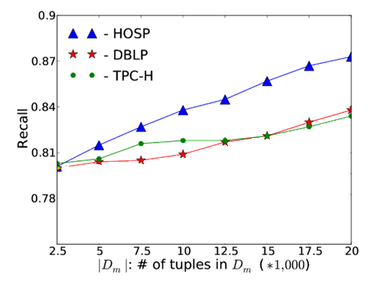
Tuple Level Recall
recall_{tuple} = # of corrected tuples / # of error tuples
Varying |D_{m}|
More informative master data is, the more tuples can be fixed
Notes:
Currently it need md, but
1 eye contact fix on sb.
2 transit
3 change examples
4 take too time
5 reduce the figures in exp
6 reduce complexities
7 on master data spend more time
8 different

Slide 24
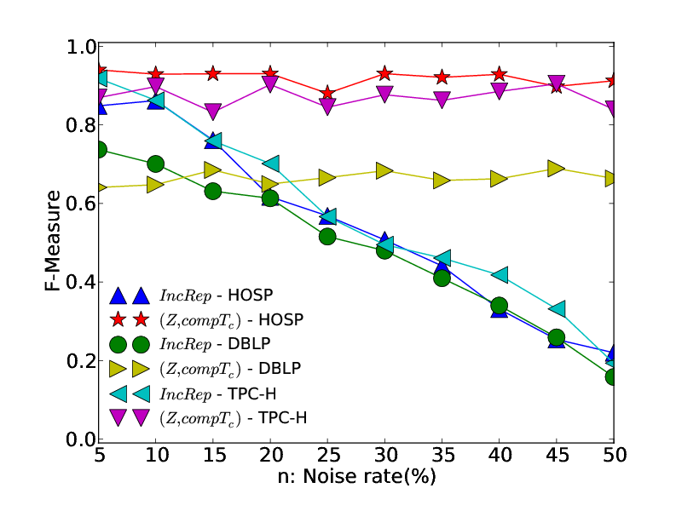
Attribute Level F-Measure
F-measure = 2(recall_{attr} · precision_{attr})/(recall_{attr} + precision_{attr})
We compared our approach with
IncRep – an incremental algorithm for
data repairing using CFDs.
Varying noise rate
Our approach generally out performs in F-Measure
Notes:
Nan Tang: in the takeaway message, “out performs“ are two words on my mac, which should be one word “outperforms”

Slide 25
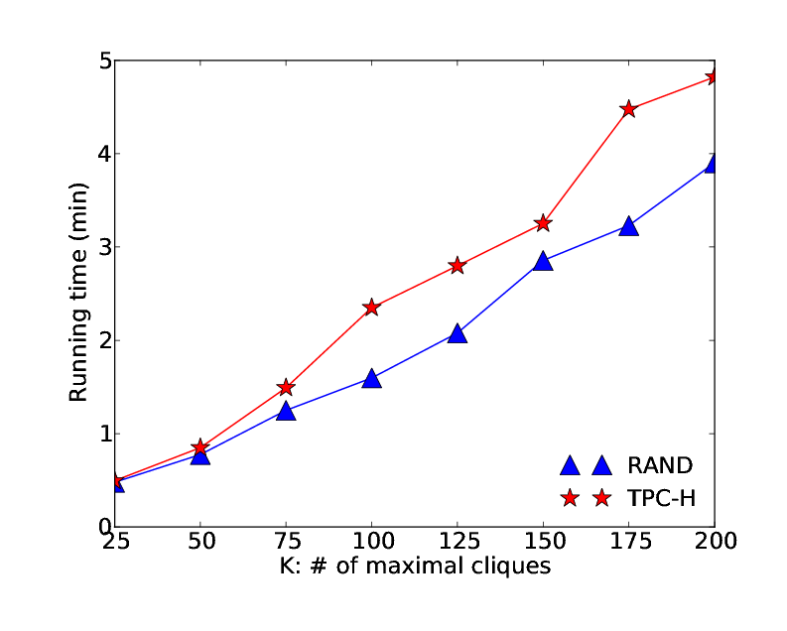
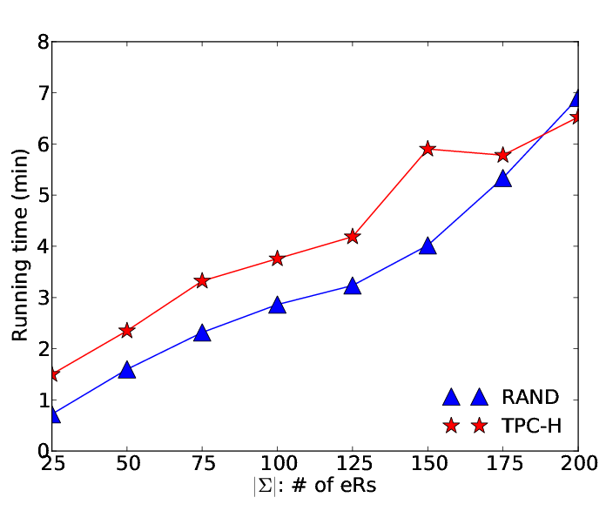
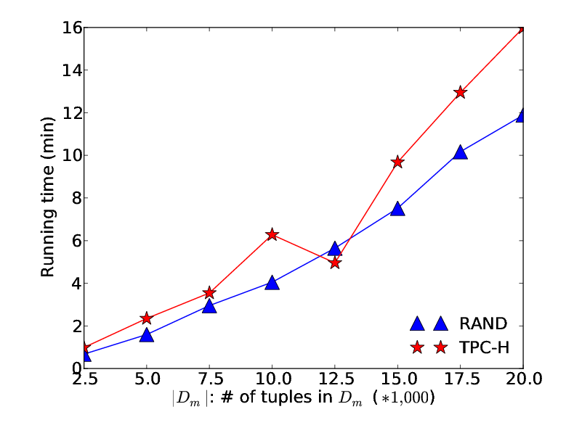
Scalability
Varying |Σ|
Varying # of maximal cliques
Varying |D_{m}|
Our algorithm scales well with large |Dm|, k and |Σ|
Notes:
Examples to show.

Slide 26
Conclusion
In the context of previous approachs, this one is to find certain fixes and guarantee the correctness of repairing.
……
t
……
Master
Data
Data
Monitoring
certain region
Fundamental problems and their complexity and approximation bounds
Editing
Rules
Σ
Computing
Candidate
Certain
Regions
User
k certain regions
Editing rules
A graph-based heuristic algorithm
A first step towards certain fixes with editing rules and master data
26

Slide 27
Future Work
……
t
……
Master
Data
Cleaning collection of data?
Data
Monitoring
certain region
Heuristic algorithm
for consistency?
Editing
Rules
Σ
Computing
Candidate
Certain
Regions
User
k certain regions
Discovering editing rules?
Naturally much more to be done
27
Notes:
Nan Tang: “Cleaning collection of data” should be “Cleaning a collection of data” or “Cleaning collections of data”

