Slide 1


Virtual Network Mapping: A Graph Pattern Matching Approach
Yang Cao^{1,2}, Wenfei Fan^{1,2}, Shuai Ma²
¹University of Edinburgh
²Beihang University
Notes:
Hello, everyone. My name is Ting. Since neither of my colleges, Yang, Wenfei, or Shuai can make the trip here.
So today I will help them do the presentation on their paper “Virtual Network Mapping: A Graph Pattern Matching Approach”.

Slide 2
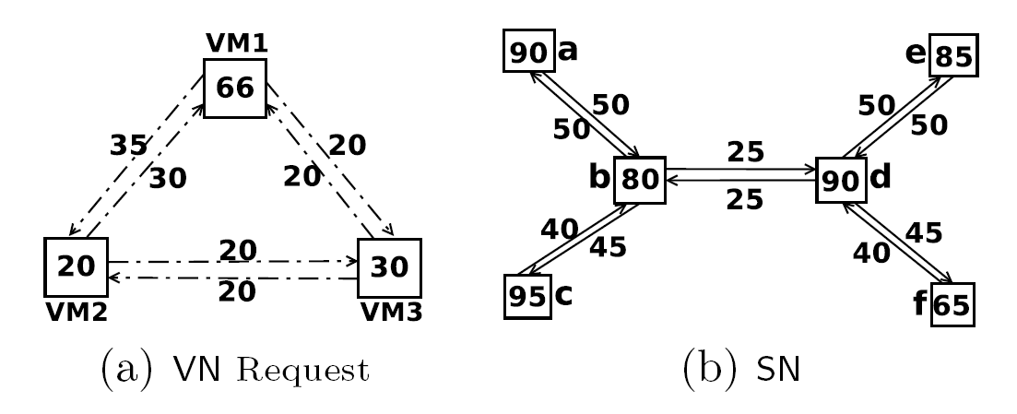
Virtual Network Mapping (VNM)
Input:
A substrate network (SN):
a network of physical machines
Substract nodes with CPU or storage capacities
Physical edges with bandwidth or latency
A virtual network (VN)
Virtual nodes (VMs, machines or routers)
with requirements on CPU or storage
Virtual links (i.e., edges) with requirements
on bandwidth or latency
Output:
Virtual network mapping: a deployment of VN in the SN
Hosting on substrate nodes on virtual nodes
Instantiating virtual links on physical paths
Constraints on the virtual nodes and links are satisfied
f: v∈ VN → v’∈ SN
g: link (u, v)∈VN → path (f(u), f(v)) ∈SN
VNM helps to deploy virtual network requests in a data center network (Amazon EC2 & distributed DBs) in response to real-time requests!
Notes:
Applications: managing distributed data in data-center(Amazon EC2) & distributed DBs.
VNM helps to deploy virtual networks in a data center network in response to real-time requests.

Slide 3
Existing Models on VNM in Different Settings
Virtual machine placement (VMP)
node mapping g: v∈ VN → v’∈ SN
the capacity of v is no greater than that of v’
Single-path VN embedding (VNE_{SP})
node mapping g: v∈ VN → v’∈ SN
edging mapping h: link (u, v)∈VN → path (g(u), g(v)) ∈SN
constraints on nodes and edges are satisfied
Multi-path VN embedding (VNE_{MP})
g: v∈ VN → v’∈ SN
h: link (u,v) → a set of paths from g(u) to g(v)
constraints on nodes and edges are satisfied
only nodes are considered
nodes and links are both considered
one virtual link can be mapped to multiple paths
However, many VN requests commonly found in practice could NOT be expressed
in any of theses models!
Notes:
Several models have been proposed to specify virtual network mapping in various settings.
For example, (1) virtual machine placement, which just to find a bunch of physical machines with enough capacity to host virtual machines with resource capacity requirements;
(2) Single-path VN embedding, which is to deploy a virtual network to a physical network with node to node mapping and edge to single path mapping;
(3) Multi-path VN embedding, which is to deploy a virtual network to a physical network such that one virtual link can be mapped to multiple paths.
However, there are a number of VN requests commonly found in practice, which cannot be expressed in any of these models.

Slide 4
Example 1: Mapping with Latency Constraints (VNM_{L})
Requirements on CPUs and latencies
latency sensitive applications: multimedia transmitting networks
g: v∈ VN → v’∈ SN
satisfying constraints on CPU
h: link (u, v)∈VN → path (g(u), g(v)) ∈SN
the sum of the latencies of edges on the path (g(u), g(v)) does not exceed the latency specified by (u, v)
Notes:
For example,
Virtual network mapping with latency constraints, which is to host virtual nodes with physical machines such that connectivity of the virtual nodes satisfy latency requirements.
(2) Priority mapping, where we want to give different priorities at run time to virtual links that share some physical links, and require the mapping only to provide bandwidth guarantee for the connection with the highest priority.
(3) Mapping with node sharing, which we allow distinct virtual nodes to be mapped to the same host of the physical network.
From these, we can find that
VNM may vary from practical requirements in terms of types of resource requirements which use different aggregation functions in the measurement.
Existing models are not capable of expressing such rich requirements.
It would also be an overkill to develop a model for each case and study it individually.
This highlights the need for developing a uniform model to characterize and study generic properties of VNM that pertains to all variants.

Slide 5
Example 2: Priority Mapping (VNM_{P})
Requirements on CPUs and bandwidths
g: v∈ VN → v’∈ SN
satisfying constraints on CPU
h: link (u, v)∈VN → path (g(u), g(v)) ∈SN
the minimum bandwidth of all edges on the path (g(u), g(v)) is no less than the bandwidth specified for (u,v)
we want to give different priorities at run time to virtual links that share some physical links, and require the mapping only to provide bandwidth guarantee for the connection with the highest priority
Notes:
For example,
Virtual network mapping with latency constraints, which is to host virtual nodes with physical machines such that connectivity of the virtual nodes satisfy latency requirements.
(2) Priority mapping, where we want to give different priorities at run time to virtual links that share some physical links, and require the mapping only to provide bandwidth guarantee for the connection with the highest priority.
(3) Mapping with node sharing, which we allow distinct virtual nodes to be mapped to the same host of the physical network.
From these, we can find that
VNM may vary from practical requirements in terms of types of resource requirements which use different aggregation functions in the measurement.
Existing models are not capable of expressing such rich requirements.
It would also be an overkill to develop a model for each case and study it individually.
This highlights the need for developing a uniform model to characterize and study generic properties of VNM that pertains to all variants.

Slide 6
Example 3: Mapping with Node Sharing (VNM_{SP(NS)})
Requirements on CPUs, bandwidths and node sharing
An extension of the single-path VN embedding (VNM_{SP})
g: v∈ VN → v’∈ SN
h: link (u, v)∈VN → path (g(u), g(v)) ∈SN
constraints on nodes and edges are satisfied
allowing mapping multiple virtual nodes to the same substrate nodes, i.e., node sharing
from the practical need from X-Bone
VNM varies from practical requirements (latency, high-priority connections, node sharing)
Existing models are not capable of expressing such requirements (e.g., VNM_{L}, VNM_{P}, VNE_{SP(NS)})
It would be an overkill to develop a model for each case and study it individually
A unified model is needed to express and analyze VNMs in various practical settings!
Notes:
For example,
Virtual network mapping with latency constraints, which is to host virtual nodes with physical machines such that connectivity of the virtual nodes satisfy latency requirements.
(2) Priority mapping, where we want to give different priorities at run time to virtual links that share some physical links, and require the mapping only to provide bandwidth guarantee for the connection with the highest priority.
(3) Mapping with node sharing, which we allow distinct virtual nodes to be mapped to the same host of the physical network.
From these, we can find that
VNM may vary from practical requirements in terms of types of resource requirements which use different aggregation functions in the measurement.
Existing models are not capable of expressing such rich requirements.
It would also be an overkill to develop a model for each case and study it individually.
This highlights the need for developing a uniform model to characterize and study generic properties of VNM that pertains to all variants.

Slide 7
Outline
A unified model to characterize VNMs in terms of
graph pattern matching
Complexity and approximation bounds for VNMs
Conclusion and Future work
Notes:
So in this work, the authors proposed a generic model to express all the VNM variants in terms of graph pattern matching.
And then study the complexity and approximation bounds for VNMs with various settings under the generic model.

Slide 8
Graph Pattern Matching Model for VNM
Virtual network (VN)
Weighted directed graphs
G_{P} = (V_{P}, E_{P}, f_{Vp}, f_{Ep} )
Vs: set of vitual nodes
Es: set of vitual links
f_{Vs}: resource requirements on nodes
f_{Es}: resource requirements on links
Virtual network matching (VNM)
A node mapping (g, r_{V}) from G_{P} to G_{S}
Function g: V_{P} → V_{S}, g(v)=v’
Function r_{V}: V_{P}×V_{S} → N
r_{V}(v,v’): the amount of resource of the v’ that is allocated to v
An edge mapping (h, r_{E}) from Gp to Gs
Function h: E_{P} → 2^{Es} , h((u,v)) is a subset of paths from g(u) to g(v)
Function r_{E}: (E_{P}, 2^{Es}) → N, r_{E}(e,p) is the amount of resource of the physical path p allocated to the virtual link e
Substrate network (SN)
Weighted directed graphs
G_{S} = (V_{S}, E_{S}, f_{Vs}, f_{Es})
Vs: set of substrate nodes
Es: set of physical edges
f_{Vs}: resource capacities on nodes
f_{Es}: resource capacities on edges
Notes:
Both the substrate network and virtual network are modeled as weighted directed graphs as normal.
And a virtual network mapping (VNM) consists of a node mapping and an edge mapping.
A node mapping is a pair of functions (gV, rV), where
gV is a function from the virtual network nodes to substrate network nodes; and
rV is an aggregation function which measures the resources of hosts in the substrate networks.
Similary, an edge mapping is also a pair of functions (gE, rE), where
gE maps a virtual link to possibly a set of physical paths in the substrate network, and r_E is an aggregation function that calculate the resources available from the host physical paths.
Intuitively, functions gV and gE specify the topology mapping from virtual network graph to substrate network graph;
rV and rE specify the aggregations for measuring the associated hosting physical nodes and paths.

Slide 9
Graph Pattern Matching Model for VNM (cont.)
A VN request to an SN G_{S}: (G_{P}, C )
G_{P}: VN
C : a set of of global constraints on VNM
Each constraint in C is one of the following
Node constraints
when a virtual node v is hosted by v’, then v’ must provide adequate resource: f_{Vp}(v) ≤r(v,v’)
when a subtracted node v’ host (possibly multiple) virtual nodes, v’ must have sufficient capacity to accommodate all those virtual nodes: f_{Vp}(v’)≥ sum{Rv(v, v’)| v’ ∈g(v)}
Edge constraints
when a virutal link e is mapped to a set of paths, those physical paths together satisfy the requirements of e: f_{Ep}(e) op agg{Re(e, p)| p ∈h(e)}, op ∈{≥, ≤}, agg ∈{min,max,sum}
Each physical link has sufficient bandwidth to host all virtual links that are mapped to some physical path containing e’
the bandwidth of each path p allocated to a virtual link e can not exceed the minimum bandwidth of the physical links on p.
All VN requests mentioned before can be formally expressed with the model
Find more formal discussions in the paper
Notes:
A virtual network request is a pair of graph pattern for modeling the virtual network and a set of global constraints on the virtual network mapping.
Here each constraint can have five possible forms which are formalized in the paper.
They can be classified into two classes, the node constraints and edge constraints.
Node constraints restrict that a virtual network mapping must map one virtual node to be only one single host in the substrate network, and the hosts must have enough resource capacities that satisfying the aggregation functions in the virtual network mapping.
Edge constraints require that a set of physical paths together satisfy the request on virtual links according to the aggregation function in the virtual network mapping, and physical link has sufficient resource to host all relevant virtual edges.
Note that all the virtual network mapping variants mentioned before can be expressed with the model.

Slide 10
Graph Pattern Matching Model for VNM (cont.)
A VN request (G_{P}, C) can be mapped to an SN G_{S} if
there exists node mapping (g, r_{V}) and edge mapping (h, r_{E})
all the constraints of C are satisfied
The VNM problem
Input: an VN request (G_{P}, C), an SN G_{S}
Question: whether (G_{P}, C) can be mapped to G_{S}?
Notes:
Based on the model, the paper studied fundamental problems for virtual network mapping.
The decision problem is to decide, given a VN request and a substrate network, whether there is a certain virtual network mapping from the VN request to the substrate network.
The authors also developed a cost function to measure the price of resources used for hosting the VN request.
Based on the cost measure, they also studied the minimum cost virtual network mapping function, which is to find minimum cost of virtual network mappings.

Slide 11
The Computational Complexity of VNM
upper bound
The VNM problem is
in NP regardless of what constraints are present
in PTIME when only node constraints are present, without node sharing
it becomes NP-complete when node sharing is requested
it is NP-complete in the presence of edge constraints
virtual machine placement (VMP)
all mapping extended with node sharing
All the results hold even when both VNs and SNs are DAGs
Priority mapping (VNM_{P})
mapping with latency constraints (VNM_{L})
single-path VN embedding (VNE_{SP})
multi-path VN embedding (VNE_{MP})

Slide 12
The Optimization Problem of VNM
Find a VNM mapping with “the lowest cost”
each node and edge in SN is associated with a price of the resources
the cost of a VNM mapping ((g, r_{V}), (h, r_{E})) from (G_{P}, C) to G_{S}
informally, the “sum” of all prices of nodes and edges involved in the mapping
the more CPU (bandwidth) resource is allocated, the higher the cost it incurs
when latency is considered, the cost of the edge mapping is determined only by edge mapping h, whereas the resource allocation function is irrelevant.
the cost function is motivated by economic models of network virtualization

Slide 13
The Optimization Problem of VNM
The minimum cost mapping problem
Input: an VN request (G_{P}, C), an SN G_{S} , a cost function c
Output: a mapping ((g, r_{V}), (h, r_{E})) from (G_{P}, C) to G_{S} with minimum cost
The VNM problem is
in PTIME for VMP without node sharing; however, when node sharing is quested, it becomes APX-hard
NPO-complete for VNM for VNM_{P}, VNE_{SP}, VNE_{MP}, VNM_{L}, VNMP_{(NS)}, VNE_{SP(NS)}, VNM_{L(NS)}
APX-hard when there is a unique node mapping in the presence of edge constraints. In particular, VNM_{P} does not admit ln(|V_{P}|)-approximation, unless P=NP
The NPO-hardness results remain intact even when both VNs and SNs are DAGs

Slide 14
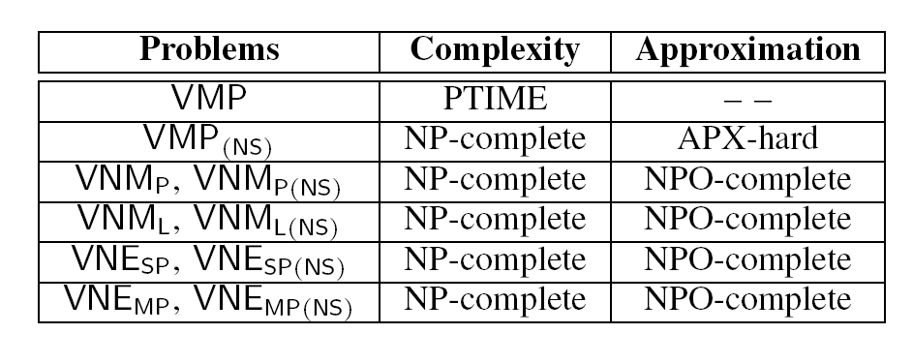
Summary of Complexity Results of VNM

Slide 15
Conclusion and Future Work
Summary
A uniform model for VNM based on graph pattern matching
Richer graph pattern matching semantics can be found in areas other than pure DB
DB ideas can help other areas to develop deeper understanding (and design algorithms)
Complexity and approximability analysis
Show why there are limited related works on efficient algorithms for VMP
Future work
Algorithms for new VN requests under the model
Partly done
Find more interesting semantics for graph pattern matching
Notes:
Now lets summarize the work.
This paper combines the ideas from real-life applications in the area of could computing and ideas of graph pattern matching.
It proposed a uniform model for virtual network mapping based on graph pattern matching.
From this, we can find that richer query semantics can be found in other areas such as networking and cloud computing, and classic ideas in database can be applied to help solve problems in related areas.
Following traditional database approach, the paper also investigate generic properties such as complexity and approximability based on the generic model, which is not commonly seen in the area of cloud computing and networking. This shows why there are limited related works on efficient algorithms for virtual network mapping and also tells us what part of the problems make this difficult.
Future work related to this can either be the algorithm part, which is to develop efficient algorithms for new VN request under the model, either by approximatioin aglrotihms when possible, or efficient algorithms for virtual network mapping with proper restrictions, or heuristic algorithms for generic cases.
Another direction is to borrow more interesting semantics from the area for the study of graph pattern matching.
Thanks for listening. That’s all for the talk.
Sorry that I can’t do the Q&A session since I’m not familiar with the work and have no background on this either.

