Slide 1



Relaxing Graph Pattern Matching With Explanations
Jia Li¹, Yang Cao², Shuai Ma¹
¹Beihang University, China
²University of Edinburgh, UK
University of Edinburgh

Slide 2
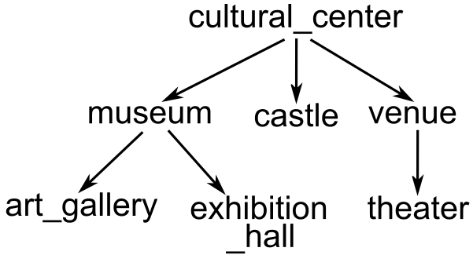

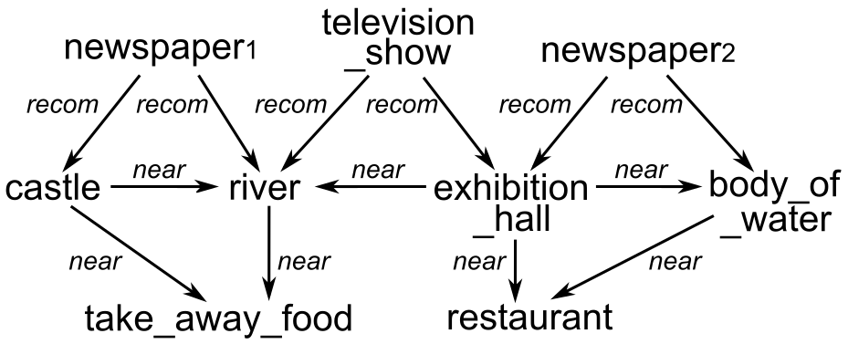
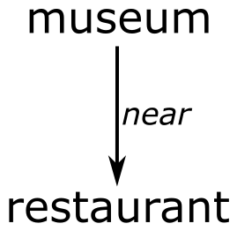
Background
Graph pattern matching
(Partial) Taxonomy T
Bijective function
Subgraph isomorphism
Too Restrictive to
find matches
is-a
Taxonomy subgraph isomorphism
Data graph G
Pattern graph Q

Slide 3
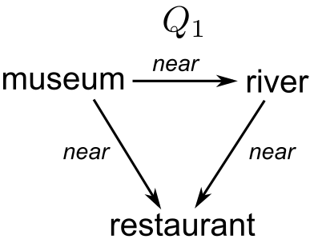
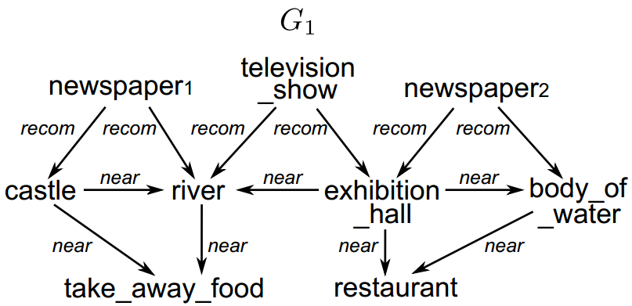
Background
Graph pattern matching
Bijective function
Subgraph isomorphism
Too Restrictive to
find matches
Still too restrictive
Taxonomy subgraph isomorphism
Relax the topological constraints of taxonomy isomorphism

Slide 4
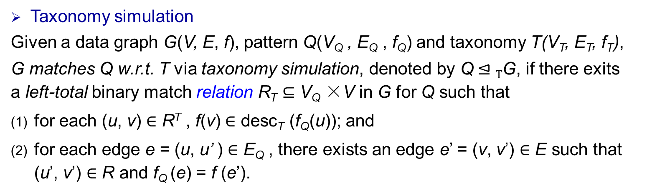
Taxonomy simulation
Taxonomy simulation
Given a data graph G(V, E, f), pattern Q(V_{Q} , E_{Q} , f_{Q}) and taxonomy T(V_{T}, E_{T}, f_{T}),
G matches Q w.r.t. T via taxonomy simulation, denoted by Q $⊴T$G, if there exits a left-total binary match relation R_{T} ⊆ V_{Q} ×V in G for Q such that
for each (u, v) $∈$ R^{T} , f(v) $∈$ desc_{T} (f_{Q}(u)); and
for each edge e = (u, u’ ) $∈$ E_{Q} , there exists an edge e’ = (v, v’) $∈$ E such that (u’, v’) $∈$ R and f_{Q} (e) = f (e’).
Relation instead of bijective function
Relaxed label matching

Slide 5
Taxonomy simulation
Match results for Q1 in G1
museum: exhibition_hall
river: river
restaurant: { take_away_food，
restaurant }
Relation-based structural mapping
Taxonomy-based label matching
It is in O(|Q||G|) time to compute taxonomy simulation
comes with no price w.r.t graph simulation!

Slide 6
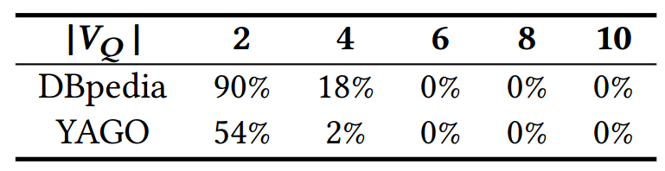
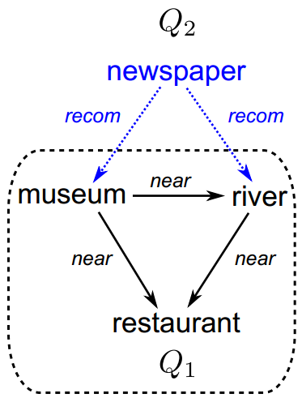
Taxonomy simulation
An experiment (percentage of patterns with non-empty match results)
No match results for Q2 in G1
We need to further relax taxonomy simulation for larger patterns

Slide 7
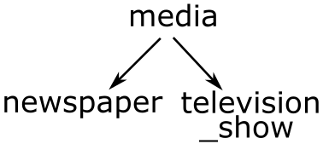
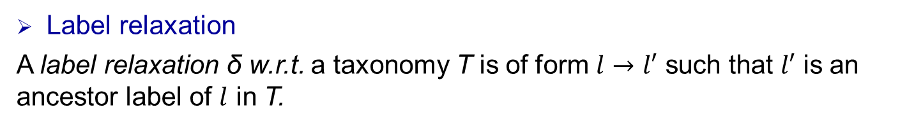
Taxonomy simulation relaxation
Label relaxation
A label relaxation δ w.r.t. a taxonomy T is of form $l→l′$ such that $l′$ is an ancestor label of $l$ in T.
Pattern relaxation
A pattern relaxation ∆ for Q w.r.t. T is a set of label relaxations for Q.
Q ⊕ ∆ is the relaxed pattern derived from Q by applying ∆.
Media
Taxonomy T
(Partial)
Relaxation

Slide 8
A relaxation framework
Ranking top-k relaxations.
Evaluating top-k relaxations.
Relaxation explanation.

Slide 9
Ranking top-k relaxations
Topological Ranking
Function
Relaxation Ratio: similarity distance to Q
Information Ratio: ability to capture answers
Diversified Topological
Ranking Function
Diversification Ratio: dissimilarity distance among
top-k relaxations
Problems:
Top-k pattern relaxation problem (kPR): topological ranking
Diversified top-k relaxation problem(kPR_{DF}): diversified topological ranking
Results:
kPR problem is in PTIME: in quadratic time, adopt Lawler’s procedure for computing top-k results
kPR_{DF} problem is NP-hard and APX-hard: reduction to well-solved maximum dispersion problem (maxDP)

Slide 10
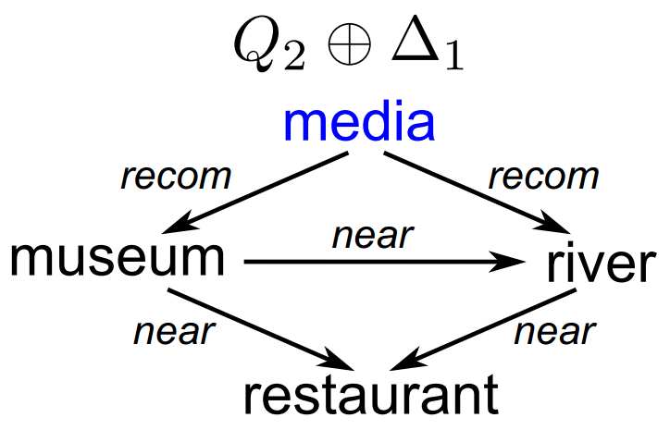
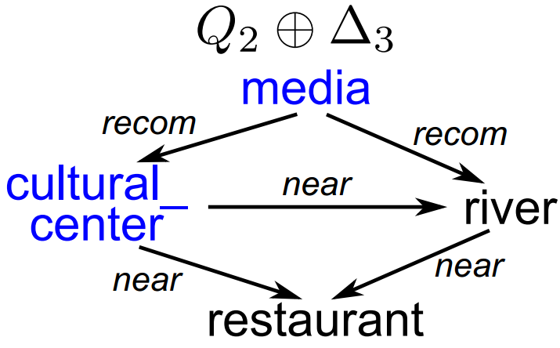




Evaluating top-k relaxations
Problem:
Given Q, G, T and k pattern relaxations ∆₁, . . . , ∆_{k}, we aim to compute answers to the relaxed patterns Q ⊕ ∆₁, . . . , Q ⊕ ∆_{k} in G w.r.t. T.
Pattern relaxations:
∆₁ = { }
∆₃ = { ， }
Almost the same
Label relaxations:
Q₂ ⊕ ∆₁(G) $⊆$ Q₂ ⊕ ∆₃(G)
Q₂ ⊕ ∆₁(G) can be derived from Q₂ ⊕ ∆₃(G) via bounded decremental taxonomy simulation
One pass of evaluation to compute both!

Slide 11
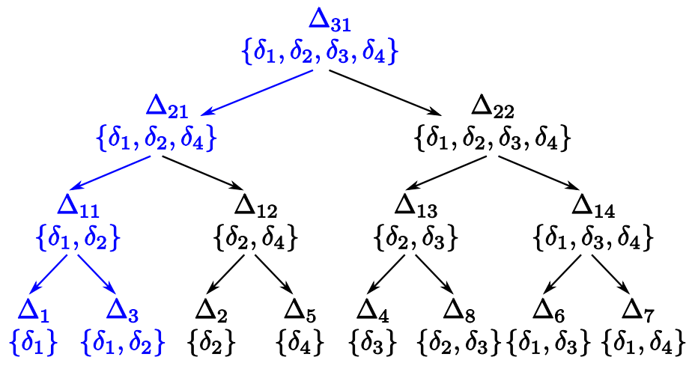
Evaluating top-k relaxations
Problem:
Given Q, G, T and k pattern relaxations ∆₁, . . . , ∆_{k}, we aim to compute answers to the relaxed patterns Q ⊕ ∆₁, . . . , Q ⊕ ∆_{k} in G w.r.t. T.
An algorithm to maximize computation sharing
Minimum pairing tree construction
Bounded decremental evaluation

Slide 12

Relaxation Explanation
Can we explain why we return a match by relaxation?
Explanation:
Given data graph G, pattern Q, taxonomy T , pattern relaxation ∆, and a node v in G that is in the match result (Q ⊕ ∆)(G) to the relaxed pattern Q ⊕ ∆,
an explanation for v w.r.t. ∆, denoted by E∆ (v), is a subset of ∆ such that v is in (Q ⊕ E∆(v))(G).
∆₃ = { ，
}
E∆₃ ( exhibition_hall ) = { }

Slide 13
Relaxation Explanation
Can we explain why we return a match by relaxation?
Explanation:
Given data graph G, pattern Q, taxonomy T , pattern relaxation ∆, and a node v in G that is in the match result (Q ⊕ ∆)(G) to the relaxed pattern Q ⊕ ∆,
an explanation for v w.r.t. ∆, denoted by E∆ (v), is a subset of ∆ such that v is in (Q ⊕ E∆(v))(G).
Problem:
Input: G, Q, T, ∆, v.
Output: minimum explanation for v in ∆.
Instances: MRE_{TF} , MRE_{DF}
Results:
MRE_{TF}: optimal linear algorithm
MRE_{DF}: NP-hard, parameterized algorithm by M

Slide 14
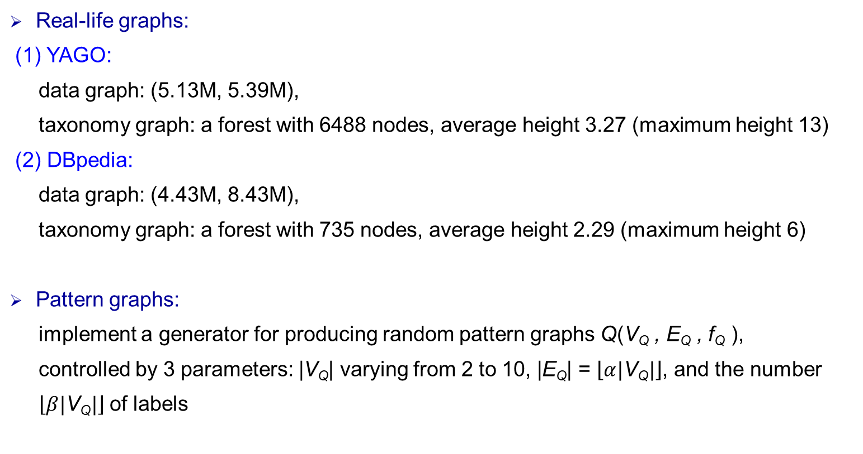
Experimental setting
Real-life graphs:
(1) YAGO:
data graph: (5.13M, 5.39M),
taxonomy graph: a forest with 6488 nodes, average height 3.27 (maximum height 13)
(2) DBpedia:
data graph: (4.43M, 8.43M),
taxonomy graph: a forest with 735 nodes, average height 2.29 (maximum height 6)
Pattern graphs:
implement a generator for producing random pattern graphs Q(V_{Q} , E_{Q} , f_{Q} ),
controlled by 3 parameters: |V_{Q}| varying from 2 to 10, |E_{Q}| = $\left\lfloor α|\text{V}\text{Q}|\right\rfloor$, and the number
$\left\lfloor β|\text{V}\text{Q}|\right\rfloor$of labels

Slide 15
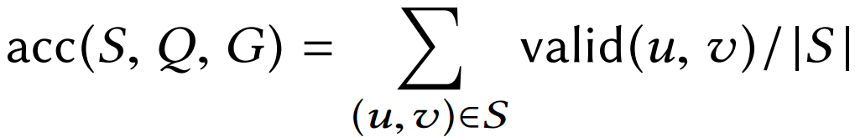
Effectiveness of taxonomy simulation and relaxation
Quality
DBpedia
Taxonomy simulation: 98%
Relaxations: 77%
YAGO
Taxonomy simulation: 94%
Relaxations: 71%

Slide 16
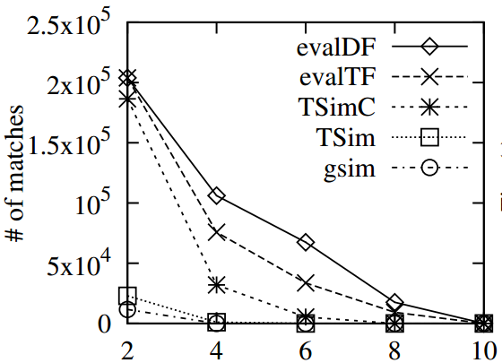
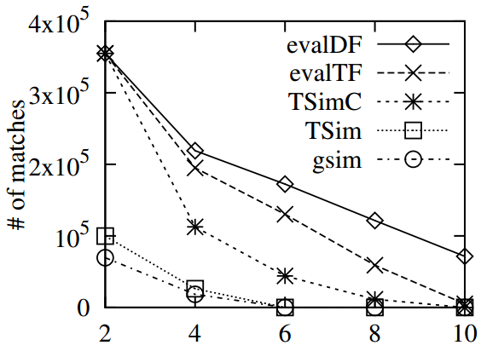
Effectiveness of taxonomy simulation and relaxation
Quantity (number of matches vs. |V_{Q}|)
Relaxation
Relaxation
Taxonomy
simulation
Taxonomy
simulation
Graph
simulation
Graph
simulation
Varying |V_{Q}| (YAGO)
Varying |V_{Q}| (DBpedia)
Taxonomy simulation vs. graph simulation
1,116 vs 0 (|V_{Q}|=4)
Taxonomy simulation vs. graph simulation
26,242 vs 18,384 (|V_{Q}|=4)
Relaxation vs. taxonomy simulation
50,543 vs 0 (|V_{Q}|=6)
Relaxation vs. taxonomy simulation
151,320 vs 0 (|V_{Q}|=6)
|V_{Q}| ≤ 4: Taxonomy simulation; |V_{Q}| > 4: Relaxation
16

Slide 17
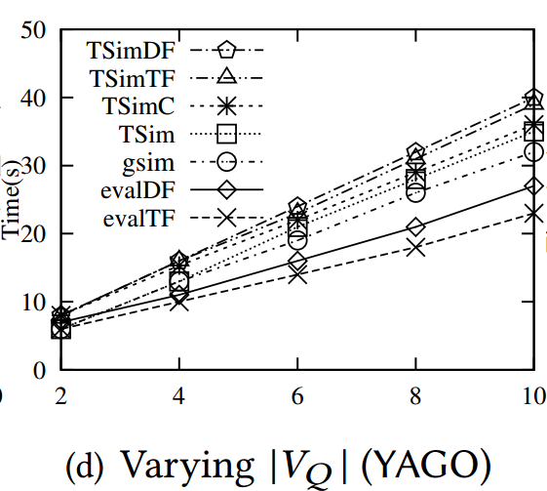
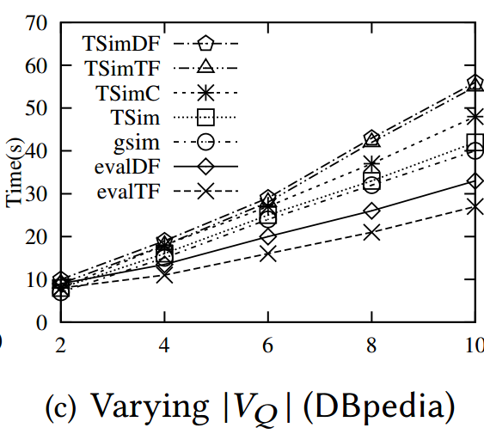
Efficiency of relaxation
Graph
simulation
Graph
simulation
Direct evaluation
Direct evaluation
Optimized
evaluation
Optimized
evaluation
Direct evaluation / optimized evaluation
1.57 times faster ( |V_{Q}|=6, YAGO )
1.62 times faster ( |V_{Q}|=6, DBpedia )

Slide 18
Summary
A framework for relaxing graph pattern matching queries
Taxonomy simulation by combining taxonomy with graph simulation
Relaxation framework for taxonomy simulation
Ranking functions for taxonomy simulation patterns
Computing top-k relaxed patterns
Evaluating top-k relaxed patterns
Relaxation explanation

Slide 19
Thanks!

Slide 20
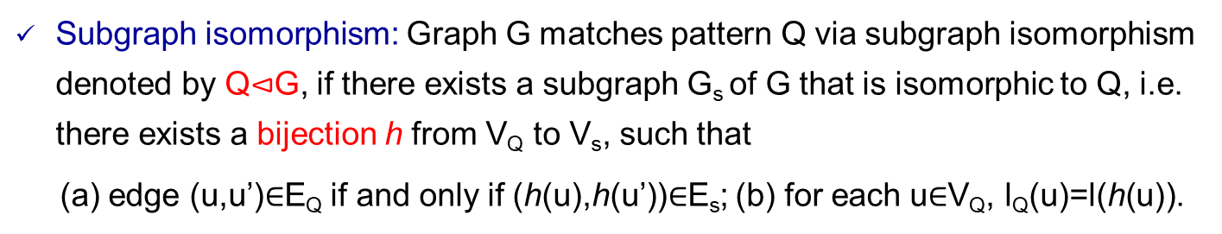
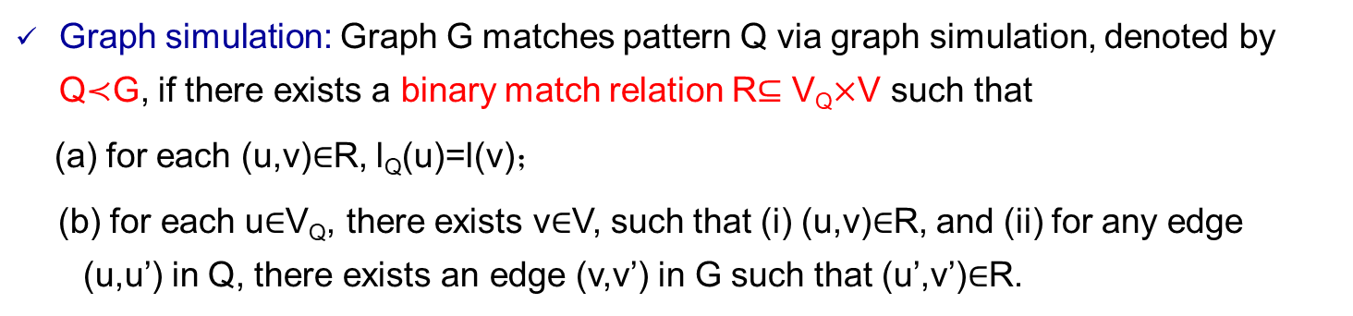
Subgraph isomorphism and graph simulation
Subgraph isomorphism: Graph G matches pattern Q via subgraph isomorphism denoted by Q$⊲$G, if there exists a subgraph G_{s} of G that is isomorphic to Q, i.e. there exists a bijection h from V_{Q} to V_{s}, such that
(a) edge (u,u’)$∈$E_{Q} if and only if (h(u),h(u’))$∈$E_{s}; (b) for each u$∈$V_{Q}, l_{Q}(u)=l(h(u)).
NP-hard
Graph simulation: Graph G matches pattern Q via graph simulation, denoted by Q$≺$G, if there exists a binary match relation R$⊆$ V_{Q}$×$V such that
(a) for each (u,v)$∈$R, l_{Q}(u)=l(v)；
(b) for each u$∈$V_{Q}, there exists v$∈$V, such that (i) (u,v)$∈$R, and (ii) for any edge (u,u’) in Q, there exists an edge (v,v’) in G such that (u’,v’)$∈$R.
Quadratic time

