Slide 1


Outlier Detection in Sparse Data with Factorization Machines
Mengxiao Zhu^{1,2}, Charu C. Aggarwal³, Shuai Ma^{1,2}, Hui Zhang^{1,2} and Jinpeng Huai^{1,2}
¹SKLSDE Lab, Beihang University, China
²Beijing Advanced Innovation Center for Big Data and Brain Computing
³IBM T. J. Watson Research Center, USA
Notes:
My name is . Today I will be presenting our recent work on outlier detection in sparse data with factorization machines, joint with my supervisor , and other colleges from Beihang Univ.

Slide 2



Motivation
Outlier Detection
Numerous applications in various domains
Widely studied in conventional (dense) data
distance-based, pattern-based… [Charu C. Aggarwal 2013]
Highly sparse data is very common
binary data, sparse numerical data, short text data,
massive-domain categorical data…
Charu C. Aggarwal. Outlier Analysis. Springer, 2013
Notes:
As we know, outlier detection has numerous applications in various domains, such as fraud detection, spam detection and intrusion detection. Therefore, the problem has been widely studied in conventional data, such as distance-based, pattern-based methods and so on.
However, in many cases, the data is extremely sparse, such as binary data, sparse numerical data, and even short text data. Furthermore, many categorical domains have a massive-domain property, that means the number of distinct values of an attribute is very large; (this is an indirect form of sparsity when the data is converted to binary form).

Slide 3
Motivation
Challenges in Sparse Data
How to capture true semantic distance because of underlying inter-attribute dependencies
Actor | Actress | Movie type | is outlier?
Bob | Carla | Drama | No
Cain | Alice | Drama | No
… | … | … | …
Bob | Alice | Drama | ?
Traditional methods fail:
Distance-based, eg. Hamming distance: HD(Bob, Alice)=2
Pattern-based, “Bob” and “Alice” don’t co-occur before
A new outlier detection method in sparse data is needed
Notes:
but, these domains are not very amenable to the use of traditional methods. The important challenge in sparse data is that how to capture true semantic distance as shown by an example.(because of underlying inter-attribute dependencies).
In the example, it may be the case that although actor bob and actress alice haven’ co-starred before, they often star in movies with the same type. So there is an inherent similarity between alice and bob..
However, traditional methods will not be able to capture such similarities. For example, The hamming distance is to measure the distance between names, and the distance is always 2. in addition, pattern based method is to measure the number of their co-occurrence, while they don’t co-occur before.
So a new effective method which can capture true semantic distance in sparse data is needed

Slide 4
Outline
Factorization Machines for Outlier Detection
Model Computation
Experimental Study
Summary
Notes:
To this end, we propose a factorization machines based method to attach the problem

Slide 5
Factorization Machines for Outlier Detection
Why Factorization Machines (FM)
A new model class that combines the advantages of SVM with factorization models, have been used for recommender systems [Steffen Rendle 2012]
Capture the inherent similarity between attribute values
Allow parameter estimation under very sparse data
Have a linear complexity
Challenges of Using Factorization Machines
Feature engineering for various domains
massive-domain categorical data
short text data
conventional numerical data
Model and distinguish outliers from normal data
Steffen Rendle. Factorization Machines with libFM. ACM TIST 3, 3(2012)
Notes:
So, why we select factorization machines, one is that factorization machines is a a [new ….], and have been used earlier in the context of recommender systems. Then, FM have the ability to [capture….], and, [parameter…] are allowed, furthermore, factorization machines are also very efficient and can be done with a linear complexity.
However, there are some challenges of using factorization machines for outlier detection in sparse data. Because fm needs vectors as the inputs, so the first one is feature engineering for various domains, including massive-domain categorical data, short text data, and conventional numerical data, which provides a unified way to perform outlier detection; the second one is how to model and distinguish outliers from normal data

Slide 6
Feature Engineering for Various Domains
(1) Massive-domain Categorical Data: Binarization
For each value of each attribute, a new binary attribute is created.
The dimensionality is equal to the total number of distinct values in the data set
The value of binary attribute is 0 or 1
User name | gender
alice | Female
bob | Male
cara | Female
… | …
alice | bob | cara | Female | Male | …
1 | 0 | 0 | 1 | 0 | …
0 | 1 | 0 | 0 | 1 | …
0 | 0 | 1 | 1 | 0 | …
… | … | … | … | … | …
Notes:
In the following, we introduce the feature engineering. Which goal is to convert the data records to vectors, and this is needed for fm.
For massive-domain categorical data, a simple approach is the process of binarization
For each value of each attribute, a new binary attribute is created. The dimensionality is equal to the total number of the distinct values. The value of binary attribute is 0 or 1

Slide 7
Feature Engineering for Various Domains
(2) Short Text Data
For each keyword, a new attribute is created.
The dimensionality is equal to the number of distinct keywords
Normalization: The value of the attribute is , if a text contain r non-zero keywords
text
hello world
rite review movie
…
hello | world | rite | review | movie | …
 |  | 0 | 0 | 0 | …
0 | 0 |  |  |  | …
… | … | … | … | … | …
Notes:
Similar to the process of binarization, in short text data, for each keyword, a new attribute is created, and the dimensionality is equal to the total number of distinct keywords, however, because each text may contain a different number of keywords, therefore, the attribute values are normalized. (divide one by sqrt r.

Slide 8
Feature Engineering for Various Domains
(3) Conventional Numerical Data: Discretization
assume: Attribute i: n records, Mean: , standard deviation:
At most (Φ+2) attributes are created for each numerical attribute
The rules of discretization is as follows:
xj lie in | Set to
 | Lie in one of equi-depth intervals, the value of that interval is 1
Notes:
In conventional numerical data sets, we use the process of discretization, let (mu) be the mean of the ith attribute and (sgima) be the standard deviation.
All data points in the range (mu i subtract sigma i, ) will be partitioned into intervals, then the process in the rang is similar to the process of binarization.
Further more, two attributes are created for marginal ranges individually.
In total at most () attributes are created for each numerical attribute. And the value of () is set depending on the size of the data

Slide 9
Modeling with Factorization Machines
Model
Construct a non-linear manifold with factorization machines
Definition of outlier score
Definition of objective function
outlier
manifold
Deviations from the manifold are tagged as outliers
Notes:
After feature engineering, we have an unified representation of data set, the next section is modeling with factorization machines using the sparse data set. The ideas of our model is that we first construct a non-linear manifold with factorization machines, and then define the outlier score based on the manifold, at last we define the objective function to learn the model. This is an example of the non-linear manifold and an outlier, deviations from the manifold are tagged as outliers.

Slide 10
Modeling with Factorization Machines
Non-linear Manifold
Assume all points can be modeled to lie on a second-order non-linear manifold
: sparse data set
：the global bias variable, : dimension-specific biases,
: k-dimensional vector, model interaction between attributes
Note:
An unsupervised avatar of factorization machines used in recommender systems.
Notes:
We assume that all points can be modeled to lie on a second-order non-linear manifold. (Because we should learn the similarity between two attributes by examining their co-occurrence with other attribute values, this implies that we need to learn at least second-order interactions between attributes to model the manifold structure.)
Here, g, b, and v are parameters, vi, vj are k-dimensional vector, these are the key to model interactions between attributes. We will give an example to explain this later
Note that this is an unsupervised avatar of factorization machines used in recommender systems. The main difference is that the right-hand side of the equation is 0 (rather than the value of the rating in a recommender system). This is because our goal is to design a model of the normal data points under the assumption that the majority of the points show normal behavior.

Slide 11
Modeling with Factorization Machines
Bob | Cain | Carla | Alice | Drama
1 | 0 | 1 | 0 | 1
0 | 1 | 0 | 1 | 1
… | … | … | … | …
1 | 0 | 0 | 1 | 1
is non-zero vector because of their co-occurrence with Drama
is non-zero
This model can capture the inherent similarity
Notes:
Here is the example , given the vector representation of movie information, estimate the interaction between alice and bob.
Because bob often co-occur with drama, and so does alice, so their parameter vector valice, vbob is non-zero vector
Although bob and alice don’t co-occur before, the dot product of valice and vbob is non-zero. So , in this way, this model can capture the inherent similarity

Slide 12
Modeling with Factorization Machines
Outlier Score
The distance of a point from the manifold as an outlier score:
: normalization for short text data sets, because the number of words in documents is often different.
is 1 for other data sets
Larger values of the score are more indicative of outlierness
Notes:
Then we define the outlier score. The distance of a point from the manifold as an outlier score, larger values of the score are more indicative of outlier-like behavior.
Here the reason to introduce LQ(Zp) for short text data is because the number of words in documents is often different.

Slide 13
Modeling with Factorization Machines
Objective Function
Parameters are determined by minimizing the mean-squared outlier scores of all the data points
Issues
Trivial solution when each parameter is set to 0
Non-convex optimization problem, often obtain a non-trivial solution
Large number of parameters make it prone to over-fitting
L2 regularization is applied
Notes:
In order to learn the model, we define the objective function. The parameters are determined by minimizing the mean-squared outlier scores of all the data points.
here, there are two issues need to be considered. First one is that it will lead to trivial solution in which each parameter is set to 0. however, this model involves a non-convex optimization problem, and it often obtains a non-trivial solution. Besides that, this model usually has a large number of model parameters, this make it prone to over-fitting. To overcome this, L2 regularization is applied.

Slide 14
Outline
Factorization Machines for Outlier Detection
Model Computation
Experimental Study
Summary
Notes:
next we show the model computation

Slide 15
Model Computation
Algorithm
perform feature engineering for various domains
Massive-domain categorical data, short text data, conventional numerical data
learn each parameter by solving optimization model
compute outlier score for each data point
larger value of the distance from the manifold are more indicative of outlierness
Notes:
the overall procedure works in three steps. It first perform feature engineering for three domains
After that, learn each parameter in the model by solving optimization model defined before
At last, compute outlier score for each data point
Here, the second step has not been introduced

Slide 16
Parameter Learning
Natural Approach: Gradient-descent
The update step is as follows:
is the step-size, corresponding to the learning rate
The update is performed for each parameter
This process is inefficient
each data point contributes to the partial derivative, one must compute a summation over a large number of data points
Notes:
A natural approach is gradient descent. And the update step is as follows,
But this process is inefficient, because each data point contributes to the partial derivative, one must compute a summation over a large number of data points

Slide 17
Parameter Learning
Stochastic Gradient Descent
The update step is as follows:
Perform update based on the contribution of a single randomly chosen point in the data.
Update only those b_{i}, v_{is} for which z_{pi} is non-zero
Computational Complexity
O(k*N)
k is a small constant, eg. 10 or 50;
N is the number of non-zero entries in the entire data set
Notes:
So we use the stochastic gradient descent, the idea is to perform the updates based on the contribution of a single randomly chosen point in the data.
Note that, in the process, we need to update only those bi, vis for which zpi is non-zero. (This is important in the sparse setting, because it leads to improved computational efficiency).
So our approach is very efficient and the overall computational complexity is approximately k times the number of non-zero entries in the entire data set.

Slide 18
Outline
Factorization Machines for Outlier Detection
Model Computation
Experimental Study
Summary
Notes:
The experimental study

Slide 19
Experimental Setups
Data Sets
Type | Datasets | Records | Attributes | Distinct values | Outliers (%)
Sparse Categorical data | Publication | 44484 | 11 | 203012 | 1.12
 | Food | 25629 | 11 | 84098 | 1.17
 | Imdb | 29145 | 11 | 178007 | 1.37
Short text data | Tweets | 2510 | 8.56 | 5431 | 1.51
 | GNewsT | 11299 | 6.23 | 9213 | 1.69
 | GNewsS | 11299 | 22.19 | 22311 | 1.69
Numerical data | Smtp | 95156 | 3 | 207 | 0.03
 | Shuttle | 45830 | 9 | 328 | 0.53
 | Annthyroid | 7200 | 6 | 317 | 7.42
Outlier injection on categorical data and short text data for ground-truth of outliers
Notes:
All experiments are conducted on three kinds of data sets. Note that we should perform outlier injection for ground-truth of outliers.

Slide 20
Experimental Setups
Algorithms:
KNN-Lin | KNN with Lin similarity measure [SDM’ 08]
KNN-OF | KNN with OF similarity measure [SDM’ 08]
CBRW | A very recent method based on random walk [IJCAI’ 16]
KNN-Text | KNN with cosine similarity measure [Springer’ 13]
LDA | A popular probability-based method [JMLR’ 03]
GSDPMM | A recent method based on Dirichlet Process Multinomial Mixture model [ICDE’ 16]
LOF | A widely used method based on the local density [Sigmod’ 00]
Parameters:
 | a | k | λ
Sparse Categorical data | 0.01 | 50 | 1
Short ext data | 0.1 | 50 | 0.2
Numerical data | 0.01 | 10 | 0.2
Implementation:
C/C++ with no parallelization
2 Intel Xeon 2.3GHz CPUs and 64GB of Memory
Notes:
We compare our approach with the popular and the state-of-the art solutions.
And we set different values of parameters for each kind of data sets.

Slide 21
Effectiveness Tests: Average Precision
(a) Sparse categorical data
Data sets | KNN-OF | KNN-Lin | CBRW | FMOutlier
Publication | 0.9309 | 0.0072 | 0.0170 | 0.9785
Food | 0.9670 | 0.0099 | 0.0114 | 1
Imdb | 0.9633 | 0.0127 | 0.0812 | 0.9991
Improves over (KNN-OF, KNN-Lin, CBRW) by (3.88%, 98.26%, 95.60%)
Notes:
For effectiveness, we use average precision to measure.
In sparse data, KNN-OF performs best, however, FMOutlier improves over it by 3.88%.

Slide 22
Effectiveness Tests: Average Precision
(a) Short text data
Data sets | KNN-Text | LDA | GSDPMM | FMOutlier
Tweets | 0.8282 | 0.0287 | 0.3412 | 0.9994
GNewsT | 0.7802 | 0.0193 | 0.5542 | 0.9980
GNewsS | 1 | 0.0212 | 0.8155 | 1
Improves over (KNN-Text, LDA, GSDPMM) by (12.97%, 97.61%, 42.88%)
Notes:
In short text data, KNN-text performs best, however, FMOutlier improves over it by 12.97%.

Slide 23
Effectiveness Tests: Average Precision
(a) Conventional numerical data
Data sets | LOF | FMOutlier
Smtp | 0.0434 | 0.5928
Shuttle | 0.1478 | 0.2909
Annthyroid | 0.1756 | 0.2348
Improves over(LOF) by (25.06%) for conventional numerical data
Notes:
In conventional numerical data, FMOutlir improves over LOF by 25.06%.

Slide 24
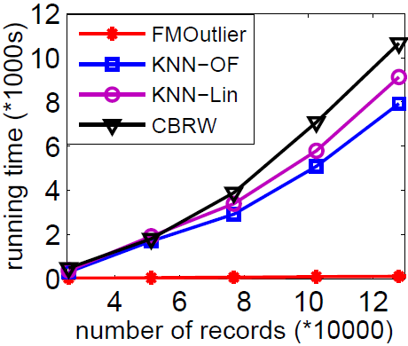
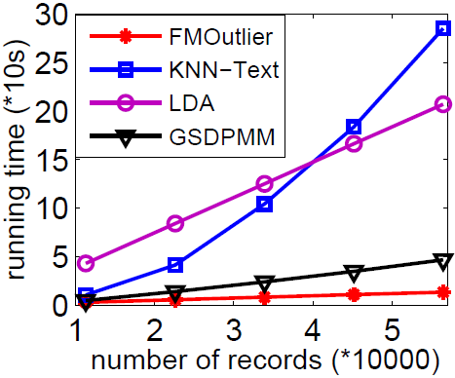
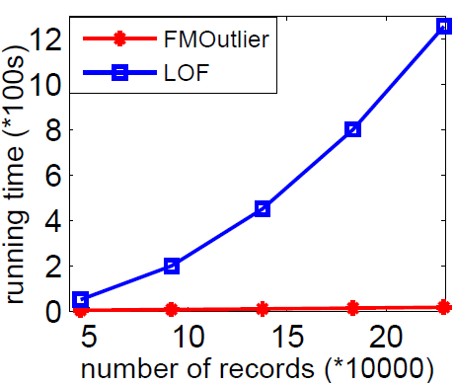
Efficiency Tests: Running Time
Efficiency comparison: with respect to the sizes of data sets
(a) Sparse categorical data
(b) Short text data
FMOutlier is on average (48.7, 56.2, 64.3), (12.6, 15.5, 2.8) and (46.4) times faster than (KNN-OF, KNN-Lin, CBRW), (KNN-Text, LDA, GSDPMM) and (LOF).
(c) numerical data
Notes:
For efficiency, we use the running time to measure.
When varying the number of records, we find that FMOutlier is very efficient and much faster than traditional methods.

Slide 25
Outline
Factorization Machines for Outlier Detection
Model Computation
Experimental Study
Summary
Notes:
To briefly summarize

Slide 26
Summary
An FM based approach to outlier detection
Outlier detection with FM:
feature engineering for three domains
unsupervised model
Dual advantages of effectiveness and efficiency
Notes:
In this work, we introduce an FM based approach to outlier detection;
And when perform outlier detection, we use feature engineering for three domains, build an unsupervised model with FM;
The experimental study shows that our approach has the dual advantages of effectiveness and efficiency.

Slide 27
Thanks! Q & A

