Slide 1


Incorporating User Grouping into Retweeting Behavior Modeling
Jinhai Zhu^{1,2}, Shuai Ma^{1,2}, Hui Zhang^{1,2}, Chunming Hu^{1,2} and Xiong Li³
¹SKLSDE Lab, Beihang University, China
²Beijing Advanced Innovation Center for Big Data and Brain Computing
³National Computer Network Emergency Response Technical Team/Coordination
Center of China
Notes:
Hello, everyone. My name is Jinhai Zhu. Today I will be presenting our recent work on Incorporating User Grouping into Retweeting Behavior Modeling, joint with my supervisor Ma Shuai and other colleges.

Slide 2
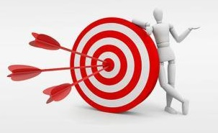

Motivation
Retweeting Behavior Modeling
Numerous applications in various domains.
Widely studied
Matrix Decomposition-based
Collaborative Filtering-based
Classification-based.
Notes:
As we know, Retweeting Behavior Modeling has numerous applications in various domains, such as recommendation system and activity analysis.
So, the problem has been widely studied, such as Matrix Decomposition-based, Collaborative Filtering-based，Classification-based methods and so on.

Slide 3
Motivation
Challenges in Retweeting Behavior Modeling of User Group
choose the right granularity of model
variety of features to be utilized for differentiating users
Traditional methods fail:
building a single model for all the users (model is too coarse)
Modeling for each user not practical (tremendous number of users)
Observation in social media applications
Users could fall into groups and each group shares representative behaviors.
A method Incorporating User Grouping into Retweeting Behavior Modeling is needed
Notes:
There are Challenges in Retweeting Behavior Modeling of User Group.such as choosing the right granularity of model (in other words: how many users share one model). Another Challenges is the variety of features to be utilized for differentiating users.
Already, there exist works of building a single model for all the users .Apparently, such model bears the limitation of being coarse. On the other hand, modeling each user is not practical, due to the tremendous number of users.
2. The key driver of our work is the observation that in social media applications, users could fall into groups and each group shares representative behaviors. As one example, consider the film Brave Heart. fans of this film are probably addicted to highland, bagpipe and war films, and thus likely to retweet blogs of these topics. Particularly, we study the retweeting behavior of users and our work can be readily generalized to other behaviors of “likes” and “comments” as well. In the realm of social network behavior modeling, few work has been done over grouping. But it has been proved to be effective in other fields such as economic behavior analysis.
A method Incorporating User Grouping into Retweeting Behavior Modeling is needed.

Slide 4
Outline
Overview of System GruBa
Feature Extraction
User Clustering
Group based Retweeting Behavior Modeling
Experimental Study
Summary
Notes:
next we show the Overview of our System. Here we name our system GruBa

Slide 5

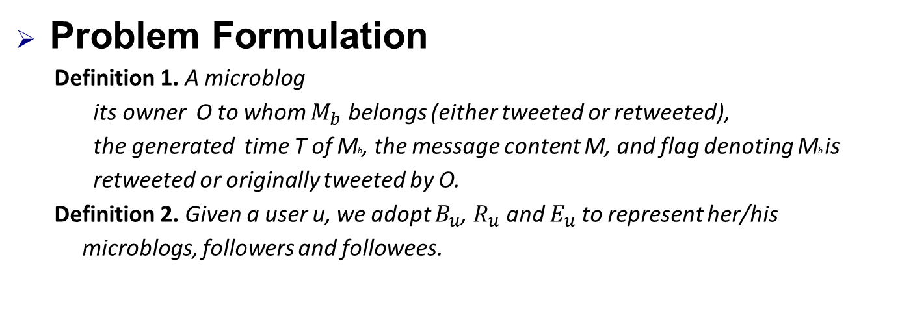
Overview of System GruBa
Problem Formulation
Definition 1. A microblog
its owner O to whom $M_{b}$ belongs (either tweeted or retweeted),
the generated time T of Mb, the message content M, and flag denoting Mb is
retweeted or originally tweeted by O.
Definition 2. Given a user u, we adopt $B_{u}$, $R_{u}$and $E_{u}$to represent her/his
microblogs, followers and followees.
Providing a set of users U and their associated microblogs B, GruBa builds a retweeting model for each group of U.
Given a microblog b and a follower f of its onwer b.O, 1 or 0 is returned regarding whether f retweets b or not.
Notes:
We consider the retweeting behavior of users in social media.
For simplicity, assuming the microblogs that a user can retweet come from those owned by her/his followees.Here we give the Definition of a microblog, all microblogs, followers and followees of a user.
Providing a set of users U and their associated microblogs B, system GruBa builds a retweeting model for each group of U, such that given a microblog b and
a follower f of its onwer b.O, i.e., f ∈ Rb.O, 1 or 0 is returned regarding whether f retweets b or not.

Slide 6
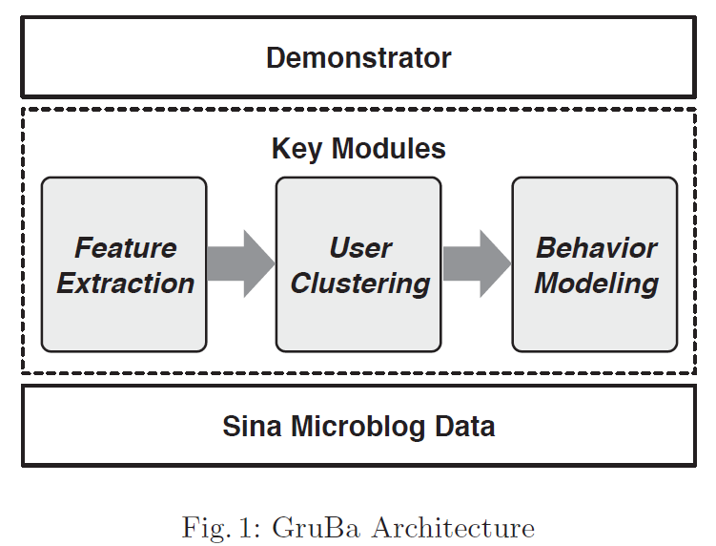
Overview of System GruBa
GruBa Framework
Notes:
As Figure shows, Gruba is designed from the ground up as a system for modeling users’ retweeting behavior in social media.
Sina Microblog Data is the data crawled to be processed by GruBa.
GruBa consists of three key modules.
(1) Feature Extraction: By coalescing the microblog data, each user is depicted
by a bunch of features, including features of Basics, Behavior and Interest.
These features are extracted from the stored Sina Weibo data by Feature Extraction module,and serve as the input of the User Clustering module.
(2) User Clustering: Providing the user-based features, User Clustering takes
charge of the clustering task such that each user falls into a proper group.
(3) Behavior Modeling: For each group obtained by User Clustering, Behavior
Modeling builds a retweeting model by employing both positive and negative samples(samples are microblogs labeled with retweeted and not retweeted).
Demonstrator. At the top layer of GruBa, it is the Demonstrator for visualizing
all aspects of the system.

Slide 7
Outline
Overview of System GruBa
Feature Extraction
User Clustering
Group based Retweeting Behavior Modeling
Experimental Study
Summary
Notes:
next we show the module Feature Extraction

Slide 8
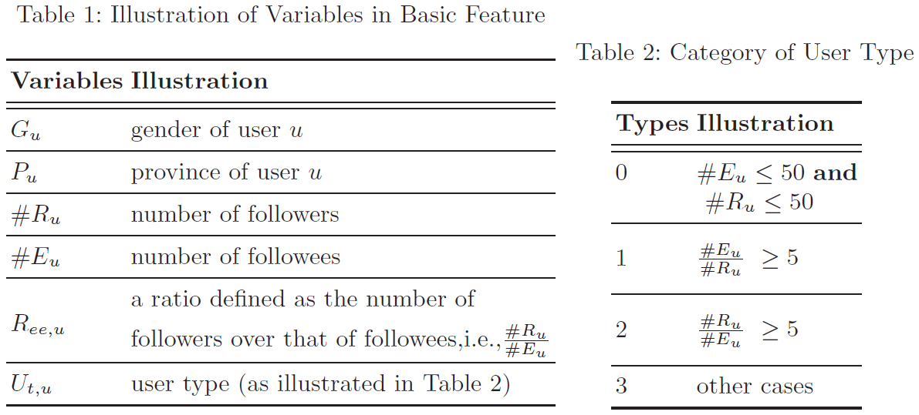
Feature Extraction
(1) Basic Feature
The Basic Feature employs a vector I to depict the basic characteristics of a user u. the variable details are illustrated in Table 1.
(2) Behavior Feature
Behavior Feature of a user u is certain statistics regarding the retweeting behavior of u.
Table 1
Table 2
Notes:
Each user is depicted by a bunch of features including features of Basics, Behavior and Interest.
The Basic Feature employs a vector I to depict the basic characteristics of a
user u. The variable details are illustrated in Table 1.
Unlike Basic Feature, the Behavior Feature of a user u is certain statistics
regarding the retweeting behavior of u. such as the number of owned microblogs, the average number of retweeted and tweeted microblogs per week, and so on.

Slide 9
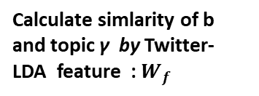


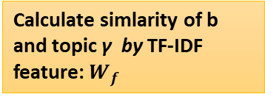
Feature Extraction
(3) Interest Feature
With a lexicon consisting of several topics, the interest feature of a user u is a normalized vector, in which each entry refers to the degree that u is interested in the corresponding topic.
A Microblog:b
Word Segment
The number of identical words of b and a topic γ satisfies a certain threshold, γ is labeled to b
Calculate simlarity of b and topic γ by Twitter-LDA feature : $W_{f}$
NO
Combine
explicit &implicit
features
$$sim\left(b,\text{γ}\right)= α×sim\left(W_{f},\text{γ}\right)$$
$$+(1−α)×sim(W_{t},\text{γ})$$
γ is found？
Calculate simlarity of b and topic γ by TF-IDF feature: $W_{f}$
YES
completed
Get top-k $\text{γ}\text{ ,}$ label to b
Notes:
Different from the slightly straightforward Basic Feature and Behavior Feature,
Interest Feature involves a process of labeling users with their interested
topics based on their tweeted and retweeted microblogs.
We have a lexicon made by some professionals. It consists of several topics, the interest feature of a user u is a normalized vector, in which each entry refers to the degree that u is interested in the corresponding topic.
The process of one microblogs is as follows:
Firstly, we perform Word Segment to Microblog:b ,

Slide 10
Outline
Overview of System GruBa
Feature Extraction
User Clustering
Group based Retweeting Behavior Modeling
Experimental Study
Summary
Notes:
next we show User Clustering

Slide 11
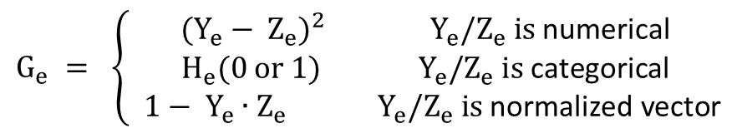

User Clustering
(1) K-Gru: Clustering in GruBa
Providing the Feature Data, the User Clustering module takes the charge of grouping each user concerned into a proper cluster:
The distance on each dimension $G_{e}$ is given by:
$$G_{e} = \left\{\begin{aligned}{(Y_{e}^{ }− Z_{e}^{ })}^{2} { Y}_{e}^{ }/Z_{e}^{ } \text{is} \text{numerical} \\ H_{e}(0 or 1) { Y}_{e}^{ }/Z_{e}^{ } \text{is} \text{categorical} \\ 1− Y_{e}^{ }∙Z_{e}^{ }{ Y}_{e}^{ }/Z_{e}^{ } \text{is} \text{normalized} \text{vector}\end{aligned}\right.$$
Group 1
Feature Data
K-Gru
Group 2
…
Notes:
In GruBa, the clustering rests on an optimized K-Prototype algorithm,
named K-Gru in this work.
K-Prototype that supports vector samples in which each dimension is of numerical/categorical, K-Gru could also handle the case where a dimension is one normalized vector.
By this , we divide users into several groups by user clustering.

Slide 12
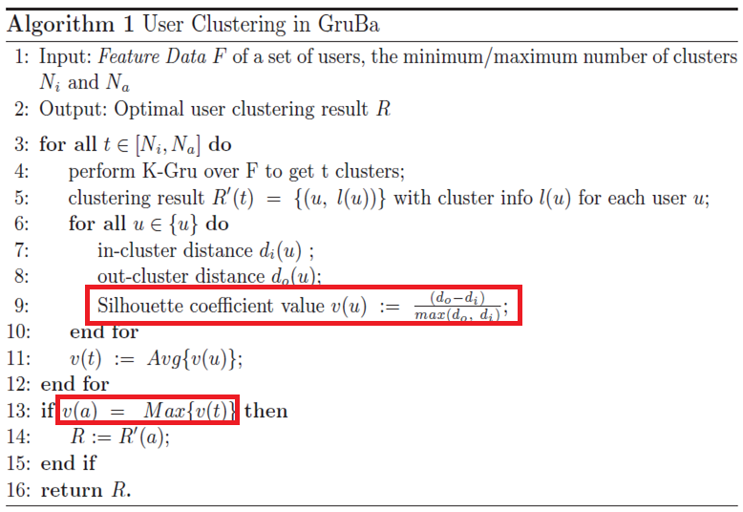
User Clustering
(2) Silhouette Coefficient Metric Computation
In system GruBa, the Silhouette coefficient metric serves as the fundamental criteria for deriving an optimal clustering result.
Notes:
Similar as K-Prototype, K-Gru randomly selects the cluster kernels among samples and employs the minimum distance between them to determine an initial result. then the clustering tasks are iterated until the results are stable.
In system GruBa, the Silhouette coefficient metric serves as the fundamental
criteria for deriving an optimal clustering result.
Providing a clustering result, each user is associated with a cluster.

Slide 13
Outline
Overview of System GruBa
Feature Extraction
User Clustering
Group based Retweeting Behavior Modeling
Experimental Study
Summary
Notes:
next we show the Group based Retweeting Behavior Modeling

Slide 14
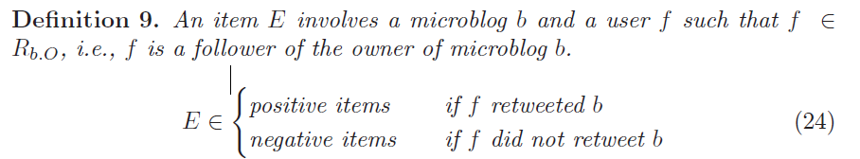
Group based Retweeting Behavior Modeling
(1) Problem Definition
Retweeting or not
Classification problem
random forest
Notes:
The modeling of retweeting behavior of groups is treated as a classification
problem, and we utilize the random forest classifier to address it. Details for
random forest are omitted here for time reason.
The advantage of this classification model lies in that it could integrate different features conveniently, and the obtained group behavior model could learn what a positive/negative item looks like e.
Here we give the definition of each item for modeling.

Slide 15






Group based Retweeting Behavior Modeling
(2) Items For Modeling
User Info
A list of aforementioned metrics
Microblog Info
1 The number that b has been retweeted, commented, liked.
2 The length of b.M (microblog message) .
3 The correlation between b and recent event.
Interaction Info
1
2 b versus the user u’s Interest Feature
3 b’s timestamp versus the time distribution of u’s retweeting behavior
4 Correlation between b and u’s short-term interest
Notes:
Each item E of data for Retweeting Behavior Modeling consists of three parts.
User Info.
contains a list of aforementioned metrics
(2) Microblog Info
refers to metrics related to the microblog b. we consider the correlation between b and recent event, where the latter is expressed as several core words returned by Ring. Here we compute TF-IDF weight Wf of b.M, and get correlation metric Ch of b and event by formula 7.
(3) Interaction Info
includes seven correlation metrics:
the number of owned microblogs, the number of retweeted microblogs over that of
originally tweeted，the average number of retweeted and tweeted microblogs per week。
microblog b versus the user u’s Interest Feature Pu (a.k.a. long-term/stable
interest in this work), and b’s timestamp versus the time distribution of u’s
retweeting behavior Prt,u. In addition, we consider u’s short-term interest, which is mined from u’s recent microblogs (e.g., within 30 days) and calculated by TF-IDF, namely Ws. The correlation between microblog b and u’s short-term
interest is computed by Wf and Ws (using formula 7).

Slide 16
Outline
Overview of System GruBa
Feature Extraction
User Clustering
Group based Retweeting Behavior Modeling
Experimental Study
Summary
Notes:
The experimental study

Slide 17

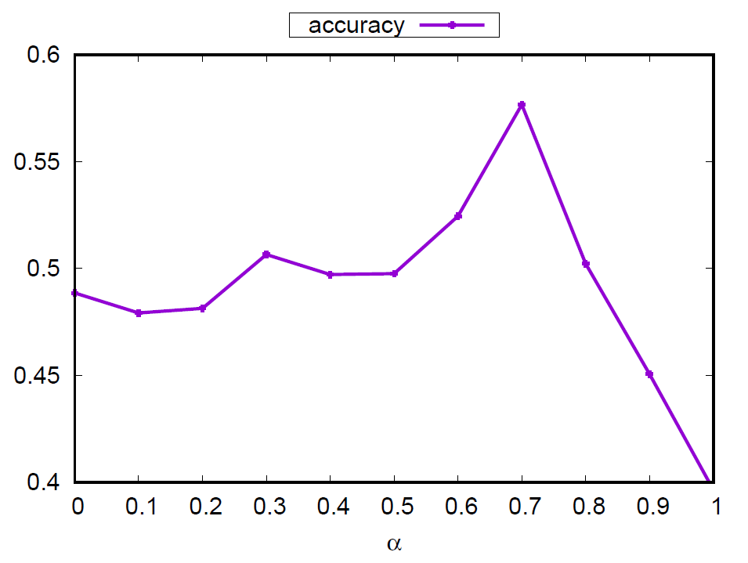
Experimental Study
Feature Extraction
(1)Data Set
A dataset containing 1000 labeld sina microblogs (with manually labeled topics for yardstick).
(2)Metric
accuracy:
(3)Result
Suppose the label set manually labeled for each microblog is A, the label set our method labeled is B.
System GruBa reaches the optimal results when α is 0.7.
In general, it performs well when α falls into [0, 0.8].
Notes:
Feature Extraction module, for practical reasons, we employed a smaller testing dataset (with manually labeled topics for yardstick) to obtain the proper value of α for extracting Interest Feature
And we set different values of parameters.
Fig. shows the testing results of using various α values. We report the interest accuracy with various α values. System GruBa reaches the optimal results when α is 0.7, upon which the interest feature extracting is performed for the overall dataset. In general, it performs well when α falls into [0, 0.8].

Slide 18
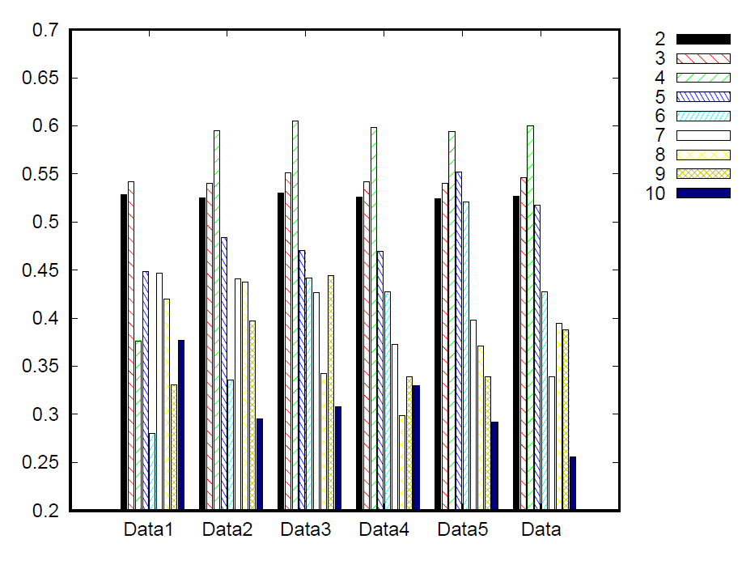
Experimental Study
User Clustering
(1)Data Set
Data containing the overall 43.5K users,and each of {Data1,. . . , Data5} contains 10K randomly selected users. (crawlered from Sina Weibo)
(2) Metric
Silhouette Coefficient
(3)Result
Except for Data1, solutions for {Data2,. . . , Data5,Data} are the best for 4 clusters.
Dividing users into 4 groups as a Reasonable result.
Notes:
User Clustering. we used different testing datasets, with Data containing the overall 43.5K users, and each of {Data1,. . . , Data5} contains 10K randomly selected users.
Fig. depicts the Silhouette coefficient values of multiple
clustering solutions, with the cluster number varied from 2 to 10.
Except for Data1, solutions for {Data2,. . . , Data5} and overall data are the best for 4 clusters.
So we supposed deviding users into 4 groups as a Reasonable result.

Slide 19
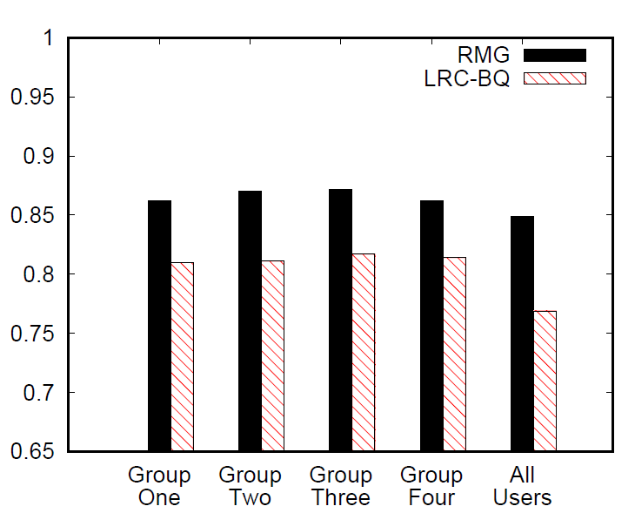
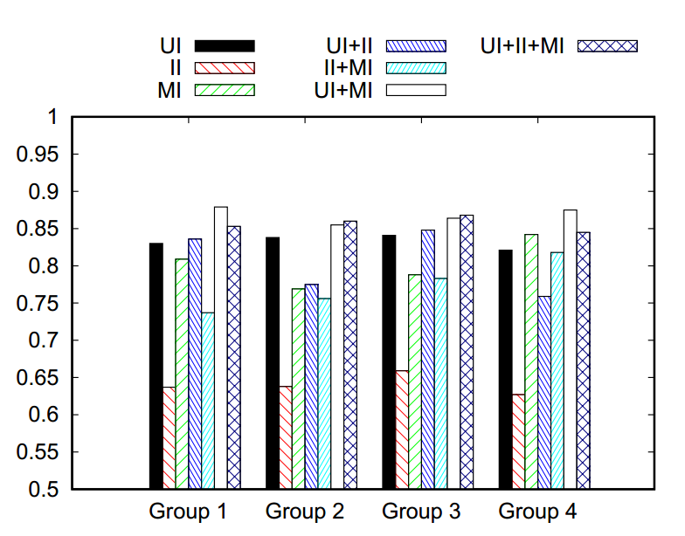

Experimental Study
Behavior Modeling
(1)Data Set
Data Items extracted from 43.5K users
(2) Algorithm for comparison
the state of the art approach LRC-BQ $[1]$
(3)Result
With user clustering, GruBa performs better than LRC-BQ in most cases
For GruBa, having user clustering is better than the alternative single group. Ditto for LRC-BQ.
[1]J. Zhang, B. Liu, J. Tang, T. Chen, and J. Li. Social influence locality for modeling retweeting behaviors. In IJCAI, 2013.
Notes:
As for Behavior Modeling,We compare our approach with the popular and the state-of-the art solutions.
(1) With user clustering, GruBa performs better than LRC-BQ in most cases.
(2) For GruBa, having user clustering is better than the alternative single group. Ditto for LRC-BQ.

Slide 20
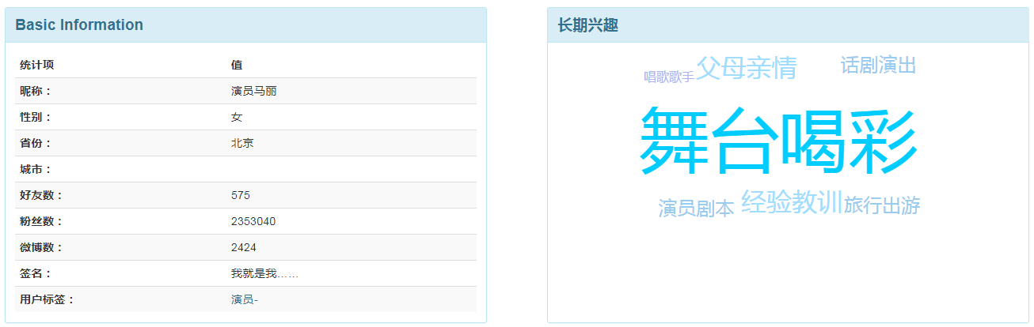
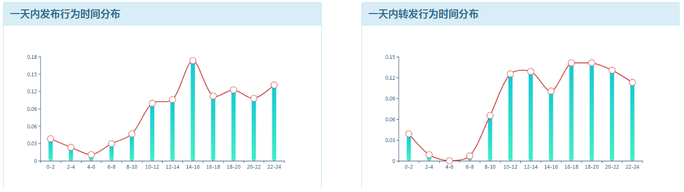
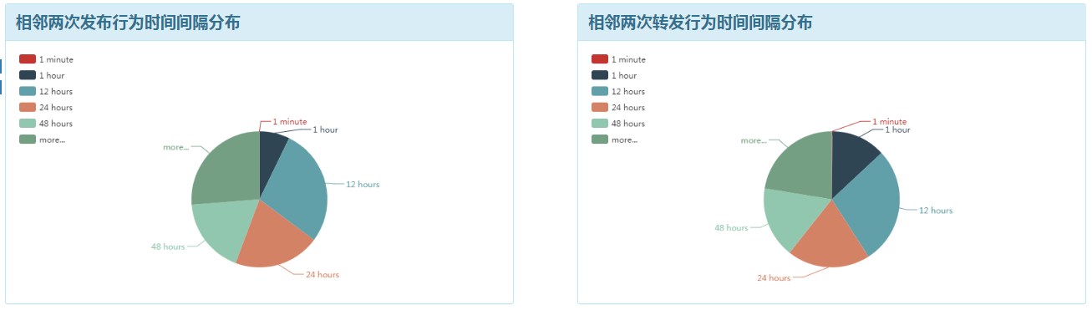
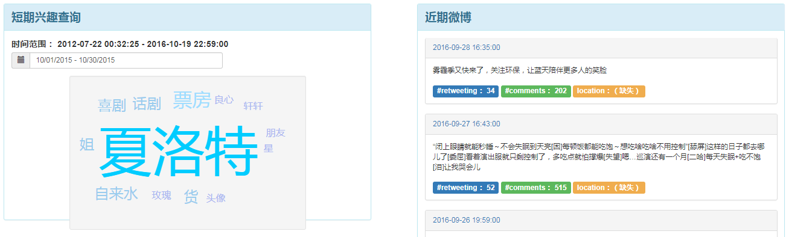
Experimental Study
Case Study for
Feature Extraction
Here we chose Mary (a
famous drama and movie
actress in China)
as an example.
Notes:
In this test, we show the results of our demo system for user features extraction. Considering the huge amount of users, we carefully selected one typical user for analysis. Here we chose Mary
(a famous drama and movie actress in China) as an example.
As to the long-term interest, she is interested with stage performance,drama,film and so on as shown in Fig. 5(b), which is consistent with her title. Mary’s short-term interest, e.g. from 10/01/2015 to 10/30/2015, is shown in Fig. 5(g), which indicates she had been busy with promoting her new drama (goodby mr loser)

Slide 21
Outline
Overview of System GruBa
Feature Extraction
User Clustering
Group based Retweeting Behavior Modeling
Experimental Study
Summary
Notes:
Here we give the Summary

Slide 22
Summary
Present a system with the novel perspective to model user behaviors over groups.
leverage user interests to facilitate the modeling of retweeting behavior and look into interests with various dimensions.
Offer a clustering method K-Gru to serve as an extension for standard K-Prototype algorithm.
Evaluate the performance of GruBa using real-world datasets, showcasing its benefits against competitive state of the art approaches.
Notes:
The contributions of our work are as follows:
(1) We present a system named GruBa with the novel perspective to model user
behaviors over groups instead of a single model for all users.
(2) We leverage user interests to facilitate the modeling of retweeting behavior
and look into interests with various dimensions, including long-term/short-term
interests and explicit/implicit interests.
(3) We offer a clustering method K-Gru to deal with complex vectors, serving
as an extension for standard K-Prototype algorithm.
(4) We evaluate the performance of GruBa using real-world datasets, showcasing
its benefits against competitive state of the art approaches.

Slide 23
Thanks! Q & A
Notes:
That is all,thank you.

