Slide 1


Easy First Relation Extraction with Information Redundancy
Shuai Ma^{1,2}, Gang Wang^{1,2}, Yansong Feng³, and Jinpeng Huai^{1,2}
¹SKLSDE Lab, Beihang University, China
²Beijing Advanced Innovation Center for Big Data and Brain Computing, Beijing, China
³Peking University, China
Notes:
My name is . Today I will be introducing our work on Relation Extraction with Information Redundancy based on easy first strategy.

Slide 2







Motivation
Relation Extraction (RE)
Crucial role for many knowledge based applications^{[1]}
RECOMMENDER SYSTEM
Two types of relation extractors:
Local (based on sentences) and global (based on corpora)
Global RE as a constrained optimization
Resolve conflict by the dependencies among facts
Mature optimization solvers, e.g., integer linear programming (ILP)
Challenges of ILP as a solver for RE
Time and memory may be unacceptable with the increase of data scale
[1] Liwei Chen, Yansong Feng, Songfang Huang, Yong Qin, Dongyan Zhao. Encoding Relation Requirements for Relation Extraction via Joint Inference. In ACL, 2014.
Notes:
As we know, relation extraction has an important role for many knowledge based applications
There are two types of extractors: local and global.
Global extractors are able to resolve conflict decisions by dependencies among facts to improve the performance, and formalize RE as a constrained optimization problem and solving it with integer linear programming
However, using ILP for RE as a blackbox solver is a challenging task. Time and memory is unacceptable with the increase of data scale

Slide 3
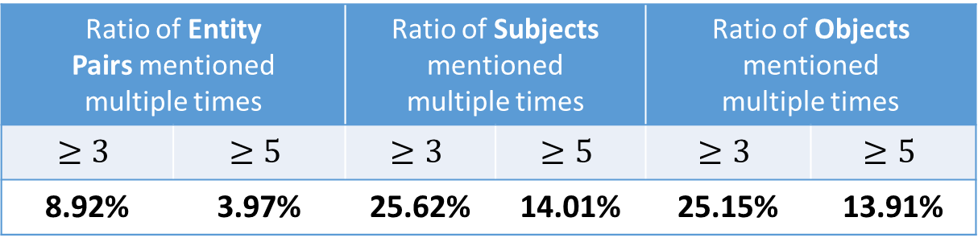
Motivation
Local predictions are the basis of global RE
Observation: redundant information are common
Redundancies are statistical characteristics of local results
#Mentions | #Entity Pairs | #Subjects | #Objects
53162 | 30864 | 11360 | 9709
Ratio of Entity Pairs mentioned multiple times |  | Ratio of Subjects mentioned multiple times |  | Ratio of Objects mentioned multiple times
$$≥3$$ | $$≥5$$ | $$≥3$$ | $$≥5$$ | $$≥3$$ | $$≥5$$
8.92% | 3.97% | 25.62% | 14.01% | 25.15% | 13.91%
How to utilize redundancies to effectively reduce the running time of ILP for RE?
Notes:
The predictions produced by local extractors are the basis of global extractors
We find redundant information are common in corpus
They are essentially the statistical characteristics of local results
Here is a dataset statistic, if there is no redundancy, the number of subjects, objects and entity pair should equal to the number of mentions.
But, we can see a lot of subjects, objects, and entity pairs repeat more than 3 or 5 times
So, how to utilize redundancies effectively to reduce the running time of ILP for RE?

Slide 4
Easy First RE with Redundancy
Why Easy First Strategy?
Easy (most confident) decisions are accurate
Eliminate conflict candidates with constraints
Reduce the number of remaining variables to consider
Achieve precision and efficiency improvement
Relation Extraction Process
Easy First Method
Traditional Methods
All Candidates
Remaining Candidates
Constraints
Collective Inference
Constraints
Refined ILP
Integer Linear Programming
Redundancies
Easy Decisions
Hard Decisions
Decisions
Notes:
We propose an easy first approach for RE by making use of information redundancies
Why do we use easy first?
There are a lot of most confident decisions in the local results, and they are accurate
We make the easy decisions first and eliminate conflict candidates by constraints
It will exclude a lot of wrong candidates and the number of remaining candidates decrease greatly
The approach achieve precision and efficiency improvement
The process of the traditional approaches is that consider all candidates to make decisions by using ILP .
The easy first approach use redundancy to distinguish the easy decisions from all candidates. To remaining candidates, it use the ILP to find an optimal configuration

Slide 5
Outline
Redundancies and Constraints
Easy First Relation Extraction
Experimental Study
Summary
Notes:
Now, we show our work in details

Slide 6


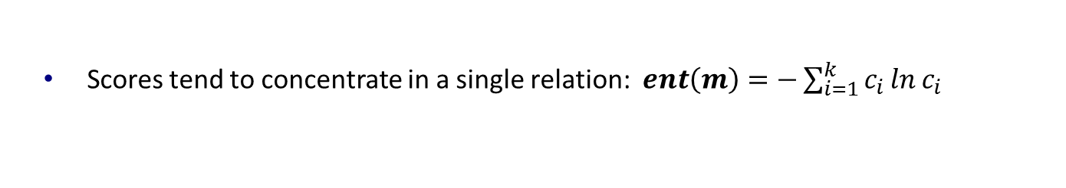
Redundancies for Easy Decisions
Characteristics of Easy Decisions
High certainty degree
Many repeated times
Most confident
Example of Local Results
 | Entity Pair (S, O) | Top-3 Candidate Relations (relation R: score C)
m₁ | Australia, Sydney | capital : 0.6 | birthPlace : 0.35 | nationality : 0.05
m₂ | Australia, Sydney | capital : 0.7 | country : 0.23 | birthPlace : 0.07
m₃ | Australia, Canberra | capital : 0.96 | birthPlace : 0.03 | unknown : 0.01
RC
0.18
0.57
Certainty Degree
Scores tend to concentrate in a single relation: $ent\left(m\right)=−\sum_{i=1}^{k}{c_{i}\ln{c_{i}}}$
(1) S-O Redundancy for Distinguishing Easy Decisions
Consider certainty degree and repeated times of mentions with
enforce that the more certain, the greater sum
same <subject, object, top-one relation>: $RC\left(s, r_{1}, o\right)=\sum_{m^{′}∈M_{s, o, r_{1}}}{α^{ent\left(m^{′}\right)}}$
Notes:
Easy Decisions have two characteristics: high certainty degree and many repeated times.
Let’s see a example
Each row is a mention, it corresponds a sentence in the corpus. It has subject, object and some candidate relations with scores
We define certainty degree to evaluate whether scores tend to concentrate in a single relation
To distinguish easy decisions, we consider both certainty degree and repeated times of mentions with same tuple
Alpha is a small positive number to enforce that the more certain, the greater redundancy score we can obtain
From the example, Canberra as the capital of Australia is more confident

Slide 7
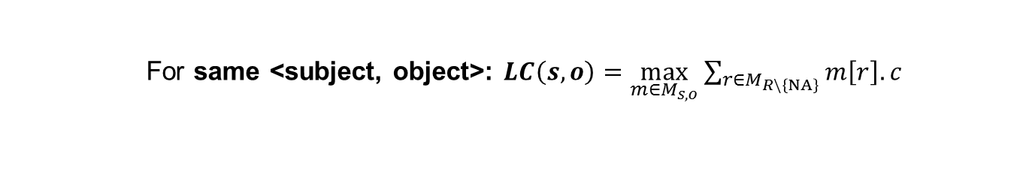

Redundancies for Hard Decisions
 | Entity Pair (S, O) | Top-3 Candidate Relations (relation R: score C)
m₁ | Australia, Sydney | capital : 0.6 | birthPlace : 0.35 | nationality : 0.05
m₂ | Australia, Sydney | capital : 0.7 | country : 0.23 | birthPlace : 0.07
m₃ | Australia, Canberra | capital : 0.96 | birthPlace : 0.03 | unknown : 0.01
(2&3) S-R and O-R redundancies
Whether a subject (or an object) meets the domain requirement of a relation
E.g. 𝑳𝑪(Australia, capital) > 𝑳𝑪(Australia, birthPlace) means
“Australia” tend to be the subject of capital rather than birthPlace
For same <subject, relation>: $LC\left(s,r\right)=\frac{\sum_{m∈M_{s}}{m\left[r\right].c}}{\sum_{m∈M_{s}}{\sum_{r^{′}∈R\backslash \left\{NA\right\}}{m\left[r\right].c}}}$
(4) R redundancies
Whether a subject and an object have a non-unknown relation
For same <subject, object>: $LC\left(s, o\right)=\max_{m∈M_{s, o}}{\sum_{r∈M_{R\backslash \left\{NA\right\}}}{m\left[r\right].c}}$
Notes:
We also find other redundancies
S-R and O-R redundancies evaluate whether a subject (or an object) meets the domain requirement of a relation. When computing the likelihood score, we use the scores of the same subjects and relations
For example, “Australia” tend to be the subject of capital rather than birthplace, the subject domain of capital and birthplace are country and person respectively
Finally, R redundancies evaluate whether a subject and an object have a relation. The Likelihood score selects prominent information to measure the probability
For example, there is a high probability of a relation between Australia and Canberra

Slide 8
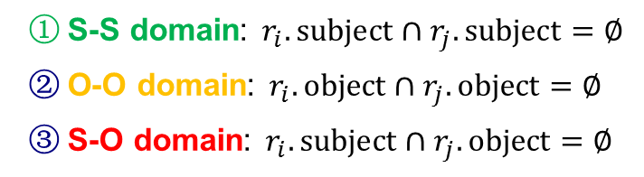
Constraints
Domain Constraints
Enforce constraints among the subject and object domains of relations.
Subject Domain | Relation | Object Domain
Countries | largestCity | Cities
Organizations | locationCity | Cities
Persons | nationality | Countries
S-S domain: $r_{i}.subject∩r_{j}.subject=∅$
O-O domain: $r_{i}.object∩r_{j}.object=∅$
S-O domain: $r_{i}.subject∩r_{j}.object=∅$
Uniqueness Constraints
Enforce the uniqueness of the subjects and objects of relations.
O (S) uniqueness: Given a object (or an object), the relation should have unique subjects (or objects)
Subject Domain | Relation | Object Domain
Persons | birthPlace | Cities
Countries | capital | Cities
Notes:
Now, we introduce the constraints
S-S domain constraint ensures the subjects of two relations with this constraints belong to different domain, that is, the subjects of two relations are disjoint
For example, it ensure relations largestCity and locationCity share no common entities between their subjects
O-O and S-O domain constraints have similar definition
For Uniqueness constraints, if a relation has O uniqueness constraints, given a object, it should have unique subjects
For example, relation capital has O uniqueness, because a city can be capital of only one country.

Slide 9
Outline
Redundancies and Constraints
Easy First Relation Extraction Framework
Easy Decisions Making
Hard Decisions Making
Experimental Study
Summary
Notes:
How to make use of the above constraints and redundancies?

Slide 10
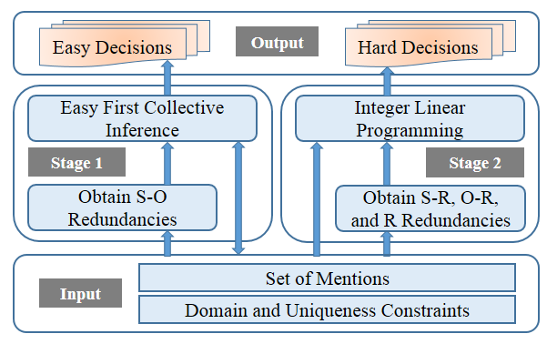
Easy First Relation Extraction Framework
Stage 1: Easy First Collective Inference
Utilize S-O redundancies
Make easy (most confident) decisions
Stage 2: Integer Linear Programming
Utilize S-R, O-R, and R redundancies
Make hard decisions with ILP
Notes:
First, our approach obtains S-O redundancies, and makes easy decisions with collective inference in the first stage.
Then it obtains other three redundancies, and makes hard decisions with ILP in the second stage.

Slide 11
Stage 1: Easy First Collective Inference
A set M of mentions produced by local extractor
1. Compute S-O redundancy scores for each <subject, object, top-one relation>
2. Sort tuples in descending order of the scores, and store them in a max-heap
To avoid error propagation, using the top-one relations of mentions only
The highest redundancy score is greater than 𝜖
1. Put the candidate with the highest redundancy score into the decisions set
Threshold 𝜖 distinguish easy decisions from hard ones based on S-O redundancies
2. Remove the conflict candidates directly based
on domain and uniqueness constraints
Stage 1 greatly reduces the variables and constraints encoded in the ILP
Easy Decisions E
Notes:
First, It computes the S-O redundancy scores for all tuples.
In the first stage, easy decisions must be highly accurate to avoid error propagation. So we consider the top-one relations only.
In the loop, we first put the candidate with the highest score into the decisions set
Once a decision is made, disagreements are resolved immediately with domain and uniqueness constraints directly
The above process is repeated until the highest score in the max-heap is less than a threshold (/'epsɪlɒn/), which is to ensure the correctness of decisions.
Stage 1 greatly reduces the variables and constraints encoded in the ILP

Slide 12
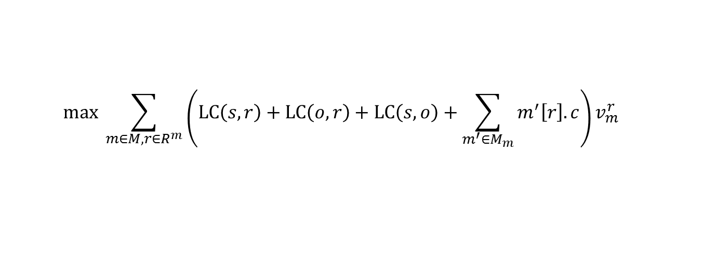
Stage 2: Integer Linear Programming
Hard Decisions Making
Find an optimal configuration for the remaining candidates
Utilize S-R, O-R, and R redundancies
Solve the disagreements by domain and uniqueness constraints
Adopt the ILP tool “IBM ILOG CPLEX”
Objective Function
Maximize the overall confidence of the made decisions
$$max \sum_{m∈M, r∈R^{m}}{\left(LC\left(s, r\right)+LC\left(o, r\right)+LC\left(s, o\right)+\sum_{m^{′}∈M_{m}}{m^{′}\left[r\right].c}\right)v_{m}^{r}}$$
①
②
① Encourage to select candidates meeting the domain requirements of relations
② Consider decisions produced by local extractors.
Notes:
In the second stage, our goal is to find an optimal configuration for the remaining candidates, making use of other three redundancies, solving the disagreements by domain and uniqueness constraints encoded in ILP, we use CPLEX to solve it
For each candidate, the objective function consists of two parts: The former is designed to encourage the model to select candidates meeting the domain requirements of relations, and the latter is designed to give consideration to decisions produced by local extractors.

Slide 13
Outline
Redundancies and Constraints
Easy First Relation Extraction Framework
Experimental Study
Summary
Notes:
Next, we show the experimental study

Slide 14
Experimental Setups
Datasets
Corpora | Datasets | Sentence level local extractors | Relations | Mentions | Mentions with unknown
DBpedia | DB_me | MaxEnt [ACL’ 14] | 51 | 53162 | 38654
 | DB_nn | NN [ACL’ 16]
Algorithms
eFIRE (Ours) | The easy FIrst approach for Relation Extraction with information redundancies
baseline | ILP based global method for RE [ACL’ 14]
CNN+ATT | Neural network-based methods with attention mechanism to use all informative sentences [ACL’ 16]
PCNN+ATT
Parameters: $α=0.05$, $ε=0.8$
Implementation: 2 Intel Xeon 2.6GHz CPUs and 64 GB of memory
Notes:
1. All experiments are conducted on two datasets.
2. We compare our approach with the popular and the state-of-the-art solutions.

Slide 15
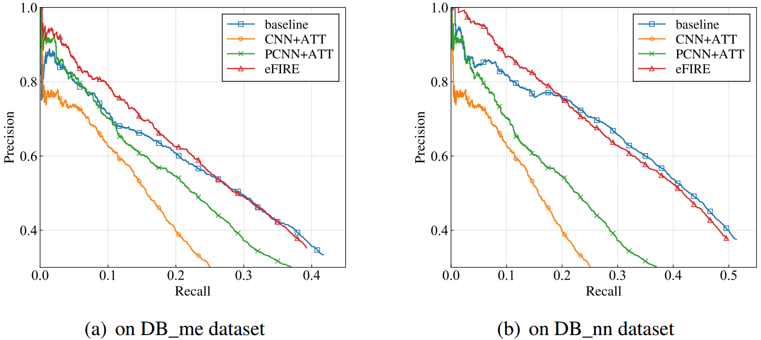
Overall performance: Effectiveness
Improve over the comparison methods in the low recall portion [0, 0.25]
Datasets | baseline | CNN+ATT | PCNN+ATT
DB_me | 4.80%↑ | 17.99%↑ | 7.69%↑
DB_nn | 4.36%↑ | 28.10%↑ | 17.82%↑
Notes:
For effectiveness, we use Precision-Recall Curve to measure.
Our approach performs best, and improves over them by 4%-28% in the low recall portion.

Slide 16
Overall performance: Efficiency
Datasets | Methods | Running Time (s) | # of ILP Variables | # of ILP Constraints
DB_me | baseline | 52.70 | 12353 | 293361
 | eFIRE | 1.88 | 8185 | 34931
 | CNN+ATT | 69.49 | - | -
 | PCNN+ATT | 34.55 | - | -
DB_nn | baseline | 15.82 | 11770 | 94498
 | eFIRE | 1.11 | 9678 | 24314
 | CNN+ATT | 69.49 | - | -
 | PCNN+ATT | 34.55 | - | -
Faster than all comparison methods on all datasets
Datasets | baseline | CNN+ATT | PCNN+ATT
DB_me | 28x↑ | 37x↑ | 18x↑
DB_nn | 14x↑ | 63x↑ | 31x↑
Notes:
For efficiency, our approach is 14-63 times faster than them

Slide 17
Outline
Redundancies and Constraints
Easy First Relation Extraction Framework
Experimental Study
Summary
Notes:
Now, we briefly summarize

Slide 18
Summary
An easy first approach for relation extraction by making use of information redundancies
Relation extraction with two stages:
Easy decisions making by easy first collective inference
Hard decisions making by integer linear programming
Dual advantages of effectiveness and efficiency
Notes:
In this work, we introduce an [fast … redundancies];
The framework first make easy decisions by collective inference; then make hard decisions by ILP
The experimental study shows that our approach has the dual advantages of effectiveness and efficiency.

Slide 19
Thanks! Q & A
Notes:
That’s all, Thank you

Slide 20
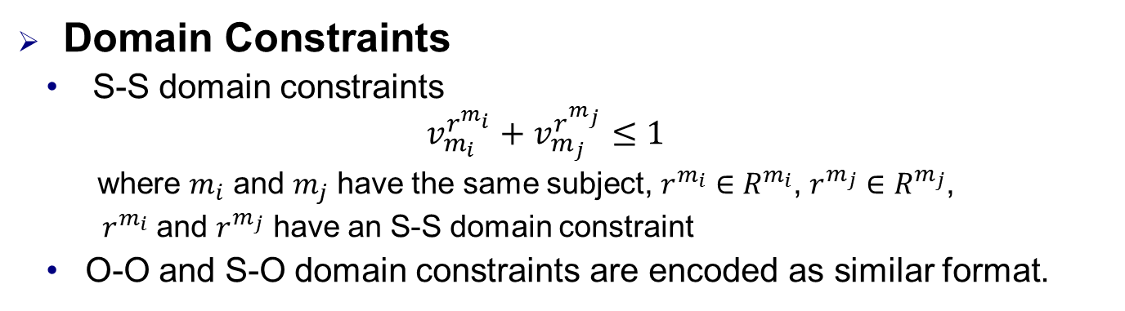
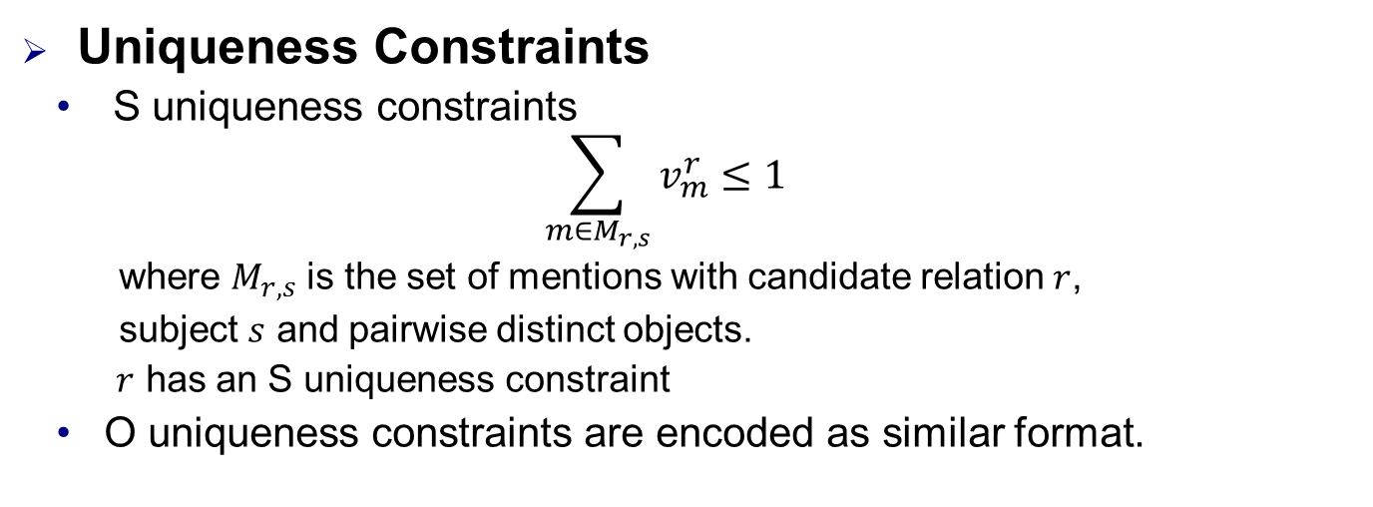
Constraints Encoded in ILP
Domain Constraints
S-S domain constraints
$$v_{m_{i}}^{r^{m_{i}}}+v_{m_{j}}^{r^{m_{j}}}≤1$$
where $m_{i}$ and $m_{j}$ have the same subject, $r^{m_{i}}∈R^{m_{i}}$, $r^{m_{j}}∈R^{m_{j}}$,
$r^{m_{i}}$ and $r^{m_{j}}$ have an S-S domain constraint
O-O and S-O domain constraints are encoded as similar format.
Uniqueness Constraints
S uniqueness constraints
$$\sum_{m∈M_{r, s}}{v_{m}^{r}}≤1$$
where $M_{r, s}$ is the set of mentions with candidate relation $r$,
subject $s$ and pairwise distinct objects.
$r$ has an S uniqueness constraint
O uniqueness constraints are encoded as similar format.
Notes:
The domain and uniqueness constraints are encoded to avoid conflict decisions
For S-S domain constraints, the framework ensure that ri and rj share no common entities between their subjects
For S uniqueness constraints, the framework ensure that there is only one object for a subject and a relation

Slide 21
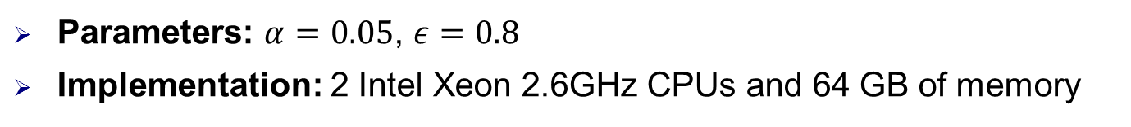
Experimental Setups
Datasets
Corpora | Datasets | Sentence level extractors | Relations | Mentions | Mentions with NA
DBpedia | DB_me | MaxEnt [ACL’ 14] | 51 | 53162 | 38654
 | DB_nn | NN [ACL’ 16]
Algorithms
baseline | ILP based global method for RE [ACL’ 14]
CNN+ATT | Neural network-based methods with attention mechanism to use all informative sentences [ACL’ 16]
PCNN+ATT
eFIRE (Ours) | The easy FIrst approach for Relation Extraction with information redundancies
eFIRE-1S | A variant of eFIRE that makes easy decisions with the easy first collective inference, and adopts the same ILP method in baseline for making the rest decisions.
eFIRE-2S | A variant of eFIRE that makes all decisions with the second stage of eFIRE, i.e., the ILP solver
Parameters: $α=0.05$, $ε=0.8$
Implementation: 2 Intel Xeon 2.6GHz CPUs and 64 GB of memory
Notes:
1. All experiments are conducted on two datasets.
They stem from a same corpus, and use different sentence level local extractor to output the conference scores.
One is a traditional maximum entropy model, the other is a neural network model.
2. We compare our approach with the popular and the state-of-the art solutions.
And, we implement two variants of our approaches to evaluate the impacts of two stages.
A variant of our approach

Slide 22
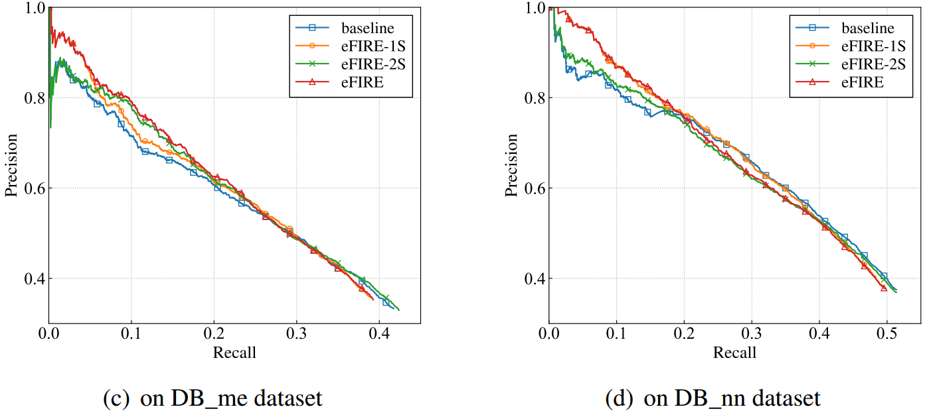
Improvement By Each Stage: Effectiveness
eFIRE-1S and eFIRE-2S outperform baseline in the low-recall portions of the P-R curves on all two datasets.
Those demonstrate the benefit of S-O, S-R, O-R, and R redundancies.
Notes:
Then, evaluate the impacts of two stages.
eFIRE-1S and eFIRE-2S outperform baseline on two datasets.
Those demonstrate the benefit of the redundancies.

Slide 23
Improvement By Each Stage: Efficiency
Datasets | Methods | Running Time (s) | # of ILP Variables | # of ILP Constraints
DB_me | baseline | 52.70 | 12353 | 293361
 | eFIRE | 1.88 | 8185 | 34931
 | eFIRE-1S | 1.90 | 8185 | 34931
 | eFIRE-2S | 52.35 | 12353 | 293361
DB_nn | baseline | 15.82 | 11770 | 94498
 | eFIRE | 1.11 | 9678 | 24314
 | eFIRE-1S | 1.20 | 9678 | 24314
 | eFIRE-2S | 15.81 | 11770 | 94498
Easy first collective inference using S-O redundancies can not only improve the effectiveness of decision making for RE, but also improve the efficiency
Notes:
The running time of eFIRE-1S is much less than that of baseline. This demonstrates that [Easy … efficiency]

Slide 24
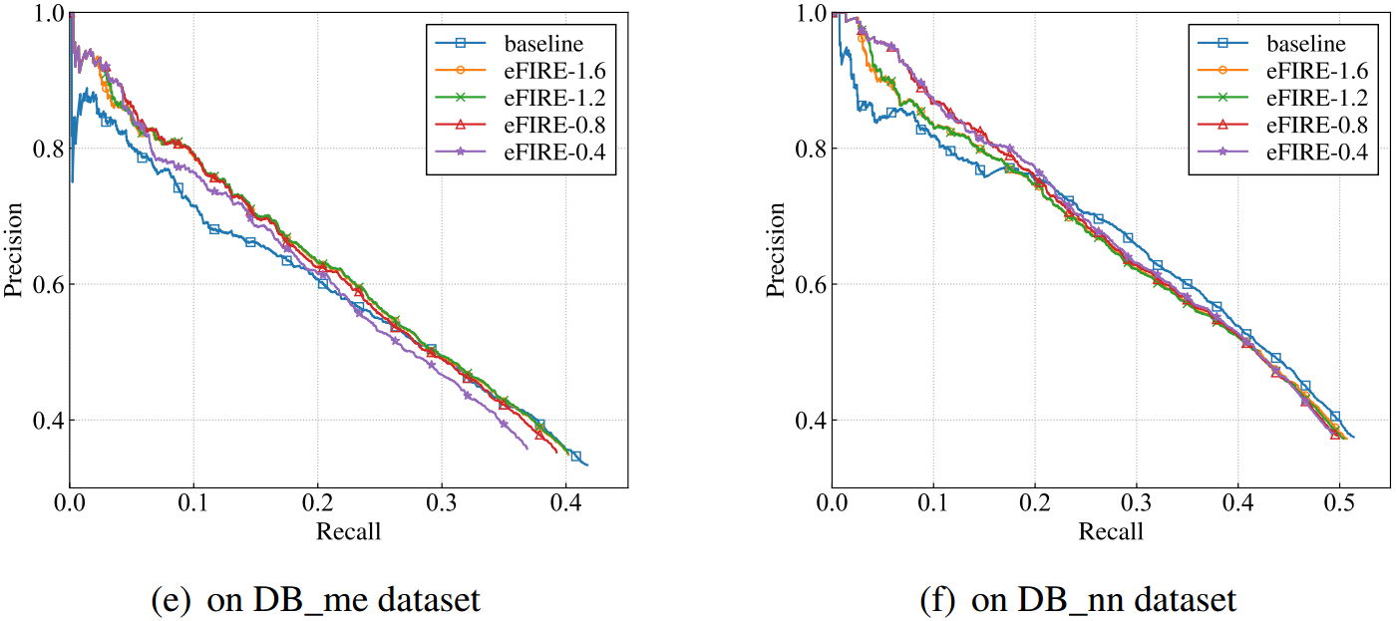

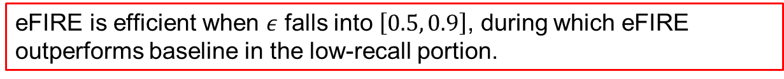
Setting verification of threshold$ε$: Effectiveness
eFIRE is efficient when $ε$ falls into $\left[0.5, 0.9\right]$, during which eFIRE outperforms baseline in the low-recall portion.
Notes:
Finally, we evaluate the impacts of different thresholds setting.
When threshold falls into a wide range, our approach outperforms baseline in the low-recall portion.

Slide 25
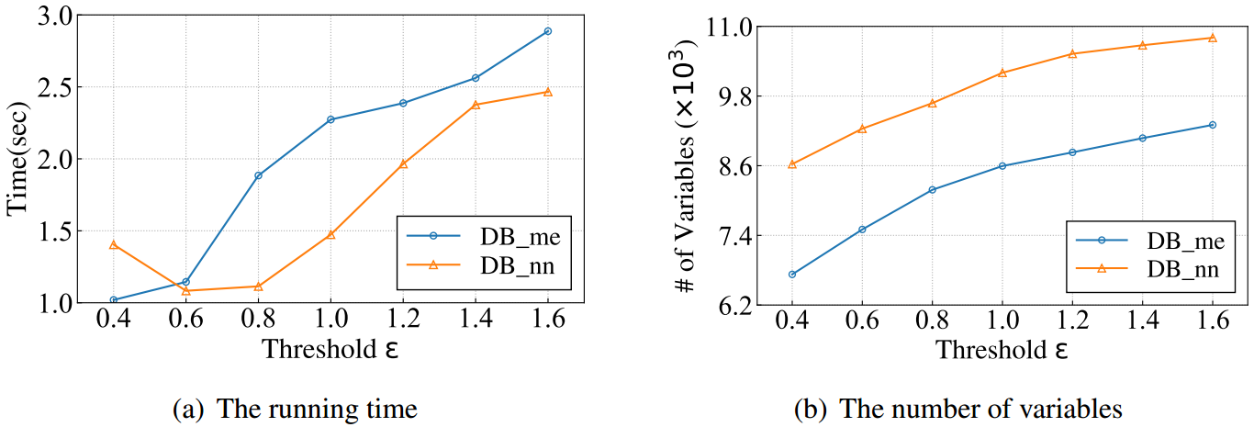
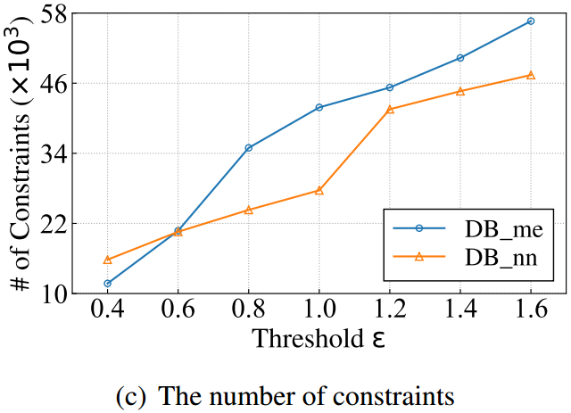

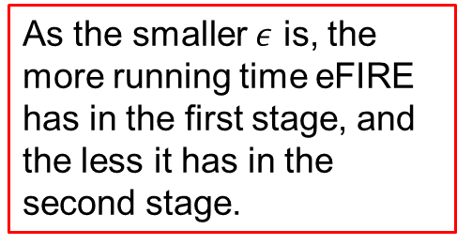
Setting verification of threshold$ε$: Efficiency
As the smaller $ε$ is, the more running time eFIRE has in the first stage, and the less it has in the second stage.
Notes:
Threshold obviously has an impact on the running time, As the smaller threshold is, the more running time the framework has in the first stage, and the less it has in the second stage.

