Slide 1



A Highly Non-Volatile Memory Scalable and Efficient File System
Fan Yang^{1,3}, Junbin Kang², Shuai Ma^{1,3}, Jinpeng Huai^{1,3}
¹SKLSDE Lab, Beihang University, China
²Tencent, China
³Beijing Advanced Innovation Center for Big Data and Brain Computing
Notes:
Good afternoon everyone.
I’m Yang Fan.
Today I’ll be presenting our research work: A highly non-volatile memory scalable and efficient file system, this is the joint work with JunBin Kang from tencent and my supervisor from Beihang university.

Slide 2
Outline
Non-Volatile Memories and NVM File Systems
Design Principles
System Implementation
Layout and Data Structures
Crash Consistency
Experimental Study
Conclusions
Notes:
This is the outline of our talk.
First of all, I will introduce Non-volatile memories and existing NVM file systems.

Slide 3

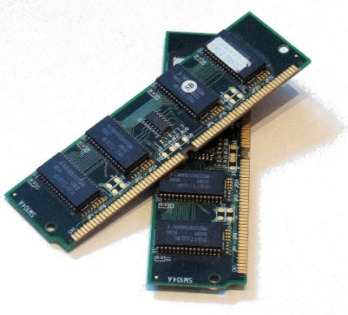
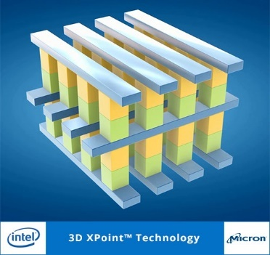
Non-Volatile Memories (NVMs)
PCM, STT-RAM, 3D-Xpoint
High performance
Byte-addressable
Non-volatile
Memory Bus
DRAM
NVM
File systems need to optimize for NVMs!
Notes:
As we already know, emerging non-volatile memory technologies such as PCM, STT-RAM, 3D-Xpoint (three-D cross point)
provide high performance comparable with DRAM and byte-addressable access through memory bus.
To fully exploit the characteristics, file systems need to optimize for NVMs.

Slide 4
NVM File Systems (NVMFSs)
Challenges
NVMs provides only 64-bit atomic writes
CPU may reorder store operations to NVMs
Enforcing write ordering is costly (cacheline flush) [1-3]
─ Providing consistency guarantees is costly
Reduce the number of cacheline flush
Improved consistency techniques
Shadow paging (e.g., BPFS [1])
Journaling (e.g., PMFS [2])
Log-structuring (e.g., NOVA [3])
Further exploit NVMs characteristics
[1] J.Condit, E.B.Nightingale, C.Frost, E.Ipek, B.C.Lee, D.Burger, and D.Coetzee, “Better I/O through byte-addressable, persistent memory,” SOSP’09.
[2] D.S.Rao, S.Kumar, A.Keshavamurthy, P.Lantz, D.Reddy,R.Sankaran, and J.Jackson, “System software for persistent memory,” EuroSys’14.
[3] J.Xu and S.Swanson, “NOVA: A log-structured file system for hybridvolatile/non-volatile main memories,” FAST’16.
Notes:
However, there are some challenges.
As the processor supports only 64-bit atomic writes to NVMs, file systems need to provide consistency mechanisms for larger updates.
And processors may reorder store operations, consistency mechanisms require to enforce write ordering by the cacheline flush and memory fence instructions.
But the flushing overhead is heavy.
To solve the above problems and exploit the high performance offered by NVMs, file systems need to reduce the number of cacheline flush and provide efficient consistency mechanisms.
There have been plenty of studies to reduce the overhead and provide consistency, such as shadow paging, journaling or log-structuring techniques.
However, fully exploiting the NVM characteristics remains necessary for file systems.

Slide 5
Existing NVMFSs
VFS ─ abstraction layer of file systems
Hierarchical naming
In-memory cache
- inode, dentry, inode_hashtable, dentry_hashtable
Synchronization
─ Updates of in-memory objects cause performance bottlenecks [1]
─ Global rename_lock leads to scalability bottleneck [2]
App
App
Virtual File System (VFS)
0
fileA
dirB
1
Traditional FSs
NVMFSs
2
dirA
I/O Bus
Memory Bus
…
global seqlock:
rename_lock
Disk
NVM
Slow/Block-based
Fast/Byte-addressable
dentry_hashtable
VFS becomes cumbersome on NVMs when performing directory operations
[1] H.Volos, S.Nalli, S.Panneerselvam, V.Varadarajan, P.Saxena, and M.M.Swift, “Aerie: flexible file-system interfaces to storage-class memory,” EuroSys’14.
[2] J.Kang, B.Zhang, T.Wo, C.Hu, and J.Huai, “Multilanes: A providing virtualized storage for os-level virtualization on many cores,” FAST’14.
Notes:
First, Existing NVMs file systems still need VFS to provide hierarchical naming, in-memory cache and synchronization.
But the in-memory cache, especially the dentry_hashtable, is designed to accelerate the slow access of traditional block-based storage devices.
With the development of fast and byte-addressable NVMs, they are no longer necessary, and the allocation, insertion and removal of the inode and dentry cause performance bottlenecks.
In addition, as a rename operation may involve the updates of two hash buckets, the rename_lock used in synchronization is a global sequence lock, leading to scalability bottlenecks.
So, VFS becomes cumbersome on NVMs when performing directory operations.

Slide 6
Existing NVMFSs
Journaling technique ─ metadata & data consistency
Copy-On-Write for file data updates
Log only metadata
― Heavy copy overhead for block-unaligned write operations
― Metadata is written and flushed twice
data
metadata
Copy-On-Write
Block-unit Index
0
1
1: Copy
2: Initialize and Insert
2: Modify
1: Log
3: Insert
block0
block1
block2
File data
Metadata
Journal
Providing Data consistency is a performance killer for common file system operations
Notes:
Second, to provide consistency, existing Journal-based NVMs file systems adopt Copy-On-Write for file data updates, and log only metadata to avoid writing data twice.
However, as they still organize the file data in block granularity,
Copy-on-write needs to first copy the unmodified data in the overwritten block to the new allocated space, and then modify the data and insert the new block.
The copy overhead will be extremely heavy if we only update a few bytes or random write to a big file.
In addition, they need to write and flush the metadata to both journal area and metadata area in NVMs,
which leads to double metadata writing and cacheline flushing.
So, supporting data consistency guarantee is a performance killer for common file system operations.

Slide 7
Outline
Non-Volatile Memories and NVM File Systems
Design Principles
System Implementation
Layout and Data Structures
Crash Consistency
Experimental Study
Conclusions
Notes:
To address the above performance and scalability issues, we redesign a NVM file system noseFS.
Now, I will present our design principles .

Slide 8
Design Principles
── Efficient and scalable directory operations
Dedicated lightweight naming
Hierarchical naming
Synchronization
─ Bypass in-memory cache in VFS
Simple and efficient global hash table for the file/directory organization in NVMs
─ Local locks support highly scalability
Fine-grained rename locks instead of the global rename_lock in VFS
App
App
App
Virtual File System (VFS)
noseFS
Disk FS
NVMFSs
I/O Bus
Memory Bus
Disk
NVM
Slow/Block-based
Fast/Byte-addressable
Notes:
First, in order to provide efficient and scalable directory operations,
we redesign the file system namespace, and propose the dedicated lightweight naming to offer hierarchical naming and synchronization like VFS.
To exploit the high performance and byte addressability of NVMs, we bypass the in-memory cache in VFS,
and use the simple and efficient global hash table in NVMs to organize files and directories.
Then user applications can access NVMs through noseFS directly, improving the performance of directory operations.
The redesigned namespace also enables the used of local locks to support high concurrent directory operations.
Especially for the rename operation, we use fine grained rename locks on each hash bucket instead of the global rename_lock on the global hash table like VFS.

Slide 9
Design Principles
── Highly efficient consistency guarantees
Lightweight consistency mechanism
Non-Copy-On-Write
Lightweight journaling
─ Eliminate copy overhead introduced by block-based Copy-On-Write
─ Reduce double metadata content writing and flushing overhead
data
metadata
Non-Copy-On-Write
Byte-unit Index
1: Initialize
(invalid)
address only
0
4096
6144
7168
1: Modify
2: Split &
Insert
2: Log
block0
block1
block2
3: Insert
(valid)
File data
Metadata
Journal
Goal: High performance, scalability and strong consistency guarantees
Notes:
Second, in order to provide highly efficient consistency guarantees,
we propose the Non-Copy-On-Write for file updates and the lightweight journaling .
The Non-Copy-On-Write aims to eliminate copy overhead introduced by the block-based Copy-On-Write.
As NVMs is byte-addressable, It’s achieved by the fine-grained byte-unit file index tree to substitute the conventional block grained organization.
For file updates, we write only the updated data in a new allocated space,
and then split the initial leaf node into multiple ones for the untouched parts of data. In this way, we avoid Copy-on-Write.
For journaling, we only record the address of new metadata instead of the its content.
In this way, our journaling further reduce the consistency overhead introduced by double metadata content writing and flushing.
In short, our design principles aim at high performance and scalability file system with strong consistency guarantees on many core systems.

Slide 10
Outline
Non-Volatile Memories and NVM File Systems
Design Principles
System Implementation
Layout and Data Structures
Crash Consistency
Experimental Study
Conclusions
Notes:
Now, I will introduce the implementation details of our file system noseFS.

Slide 11
Metadata structure in noseFS ── Achieving the lightweight naming
The redesigned namespace
Pinode ─ single fixed-size structure to store metadata of a file/directory
Global hash table ─ simple structure in NVMs to organize pinodes
─ Unify inode and dentry to reduce the number of cacheline flush
Synchronization
Per-bucket Read-Copy-Update (RCU) locks ─ updates of one bucket (open, unlink, etc)
Per-bucket seqlocks ─ updates of two buckets (rename), instead of global seqlock rename_lock
─ Enable local locks to support high concurrent directory operations
Buckets
Lock simultaneously in ascending order
0
pinode
pinode
Lock(&bucket0->seqlock);
Lock(&bucket2->seqlock);
...
Unlock(&bucket2->seqlock);
Unlock(&bucket0->seqlock);
1
2
pinode
...
Notes:
For the redesigned namespace of noseFS, we unify the inode and dentry into a single fixed-size structure called pinode, to store all the metadata of a file or directory.
Then the number of cacheline flush can be reduced.
We organize pinodes using a simple and efficient global hash table in NVMs.
As we bypass the in-memory cache in VFS, the highly concurrent directory operations can be supported.
We use per-bucket rcu locks like VFS to protect the insertion and removal from each hash bucket.
And for the updates of two hash buckets caused by a rename operation, we use per-bucket sequence locks instead of the global seqlock like VFS.
To avoid deadlock, noseFS locks the two buckets simultaneously in ascending order of the hash values.
Finally we achieve the dedicated lightweight naming for directory operations.

Slide 12
File structure in noseFS ── Achieving the Non-Copy-On-Write
The file index tree
Byte-unit extent ─ continuous region of file data (leaf node)
Extent-based B+ tree in DRAM
Extents list in NVMs
─ Byte granularity instead of block granularity
root
Byte-unit extent
block_number;
block_len;
start_offset;
data_size;
Block
Info
pinode
index
index
Occupied
Info
extent
extent
extent
extent
data covered space
data uncovered space
File Data Blocks
Notes:
To achieve Non-On-Copy-Write, we use the fine-grained file index tree to organize file data.
The file index tree in noseFS is the widely used extent-based B+ tree (B plus tree).
But each extent represents a continuous region of file data in NVMs in byte granularity instead of block granularity.
It records not only the continuous blocks info but also the start offset and size of the occupied region in bytes.
As a file index tree can be rebuilt from its leaf nodes, we build it in DRAM,
and only records the extents list in NVMs to make the NVMs structure simple and efficient.

Slide 13
Journal in noseFS ── Achieving the lightweight journaling
Directory & File journal
Multiple directory logs
Per-pinode file logs
─ Increase the concurrency
pinodeB
pinodeA
0
1
dir_log0
pinodeC
2
dir_log1
3
4
dir_log2
pinodeE
pinodeD
5
Directory & File log entry
Metadata address ─ the 4-byte number of metadata
8-byte directory log entry
8-byte file log entry
─ Reduce the log entry size
directory log
log tail
<op_type, pino>
…
file log
<log tail>
<old eno, latest eno>
…
Notes:
To provide strong and efficient consistency guarantee, noseFS provides directory and file journals separately for directory and file operations.
Both journals use multiple logs to increase the concurrency.
For directory journal, all hash buckets are evenly mapped to all directory logs to reduce contention.
For file journal, each pinode has its own log file.
To further reduce the journaling overhead, we reduce the log entry size and records only the metadata address.
Each directory log entry records the operation type and the address of the updated pinode.
Each file log entry records the address of the old and latest versions of updated extents.
Then we can redo the updates according to the differences of the two versions during recovery.

Slide 14
Outline
Non-Volatile Memories and NVM File Systems
Design Principles
System Implementation
Layout and Data Structures
Crash Consistency
Experimental Study
Conclusions
Notes:
Based on the data structures, I will next introduce how could noseFS provide crash consistency guarantees.

Slide 15
Crash Consistency
Lightweight journaling ─ redo journaling
Updates are atomically logged before being committed
8-byte atomic updates
Step 1: Allocate and initialize
(invalid)
Extents
Pinodes
Data blocks
Step 2: Record log entries
Directory/file log
Tail
Consistent
Step 3: Update log tail
Directory/file log
Tail
Redo
Step 4: Commit updates
(valid)
0
Pinodes
1
Extents
...
Step 5: Clean the log
Directory/file log
Tail
Consistent
Provide strong metadata and data consistency guarantees
Notes:
Consistency in noseFS is enforced by using the redo journaling,
which means the updates are atomically logged and made durable before being committed to the file system.
It consists of the following five steps.
First, it allocates new pinodes, extents and data blocks with invalid bits in NVMs to write the new data.
Second, it logs all of the updates.
Third, it atomically updates the log tail to commit the entire log entries. Here we use the processor supported 8-byte atomic in-place write to update the 8-byte log tail.
Fourth, it commits the updates to NVMs, which means it sets the valid bits of pinodes and extents, and updates the global hash table and the extents lists in NVMs.
Finally, it cleans the log by atomically updating the log tail to reduce the log size and simplify the recovery.
Then if a crash happens before finishing step3, the file system in NVMs keeps consistent without being affected.
If a crash happens after atomically updating the log tails, noseFS reads the directory and file journal to redo the updates.
And if a crash happens after cleaning the log, all of the updates have been committed and the file system is consistent.
Therefore, noseFS provides strong metadata and data consistency guarantees.

Slide 16
Crash Consistency
Atomic-mmap [1]
Return new pages when accessing memory-mapped region
Atomically write the memory-mapped pages back to the file when synchronization
─ Heavy copy overhead
App
mmap I/O
Synchronization:
Atomically updates
the whole accessed region
mmap
read
write
Lightweight atomic-mmap
Set dirty flags to the modified pages
Synchronize only the dirty pages & Make them clean
─ Further reduce consistency overhead
[1] J.Xu and S.Swanson, “NOVA: A log-structured file system for hybridvolatile/non-volatile main memories,” FAST’16.
Notes:
noseFS also support atomic-mmap to provides consistency for memory mapped files.
One of the existing NVM file systems NOVA already supports atomic-mmap.
When accessing the memory-mapped region, it returns the address of the new allocated space.
When synchronizing the updates, it atomically writes all of the memory-mapped pages back to the file.
However, the unmodified pages are read only and do not need to be synchronized at all.
So this approach introduces heavy copy overhead if an application modifies only a small portion of a memory-mapped region.
To improve the performance, we propose the lightweight atomic-mmap.
When applications access memory-mapped files, noseFS tracks the process of page fault handling and records the modified pages with dirty flags.
When synchronization, noseFS updates only the dirty pages, instead of the whole accessed pages, and cleans the dirty flags.
If there are no updates to these pages, they will not be synchronized again.
By this way, we can reduce the consistency overhead for memory mapped files.

Slide 17
Outline
Non-Volatile Memories and NVM File Systems
Design Principles
System Implementation
Layout and Data Structures
Crash Consistency
Experimental Study
Conclusions
Notes:
Next, I will present the experimental study to show the efficiency of the above design and implementation.

Slide 18
Experimental Setup
Experimental environment
Intel Xeon E7 server with four 10-core processors
750GB DRAM and 150GB PMEM
Linux kernel 4.6.5
File systems
noseFS, NOVA [1] , PMFS [2] , Ext4-DAX [3] , XFS-DAX [4]
Benchmarks ─ performance & concurrency
Micro-benchmarks: create/unlink/rename/write/mmap
Filebench (Fileserver and Varmail)
[1] J.Xu and S.Swanson, “NOVA: A log-structured file system for hybridvolatile/non-volatile main memories,” FAST’16
[2] D.S.Rao, S.Kumar, A.Keshavamurthy, P.Lantz, D.Reddy,R.Sankaran, and J.Jackson, “System software for persistent memory,” EuroSys’14
[3] “Support ext4 on nv-dimms,” https://lwn.net/Articles/609652/.
[4] “xfs: DAX support,“ https://lwn.net/Articles/635514/.
Notes:
We use an Intel server with four 10-core processors,
and the emulation of NVMs is based on 150GB DRAM that is treated by operating system as a persistent memory region.
We evaluate noseFS against four file systems.
EXT4 and XFS are the traditional file systems supported on NVMs.
NOVA and PMFS are the open-source NVM file systems.
We use micro-benchmarks and filebench to evaluate the performance and scalability of noseFS.

Slide 19
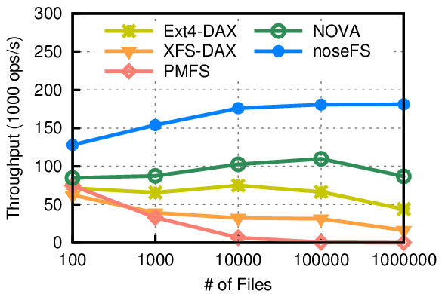
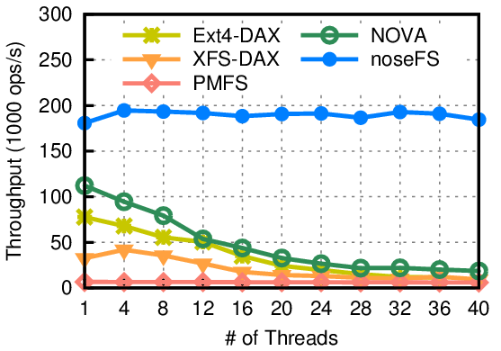
Effect of the lightweight naming
(a) rename (single thread)
(b) rename (multiple threads)
+ 51% to 109%
near-linear scalability
Provide highly efficient and concurrent directory operations
Notes:
We first test the directory operations to show the effect of the lightweight naming.
These are the results for rename operations, which show noseFS provides the highest throughput.
The left figure shows the throughput of noseFS outperforms NOVA from 51% to 109%
This is mainly due to the unification of inode and dentry, and organization of the efficient global hash table in NVMs.
And the right figure shows that only noseFS supports high concurrent rename operations because of the fine-grained rename locks.

Slide 20
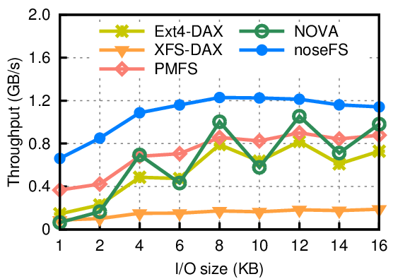
Effect of the lightweight consistency
(a) append (single thread)
(b) atomic-mmap
(write and fsync for memory-maped files)
+ 15% to 914%
+ 26.9x to 389.6x
File size | 1MB | 4MB | 8MB | 12MB
NOVA | 7.351 | 2.041 | 1.031 | 0.694
noseFS | 204.8 | 250.98 | 303.907 | 271.087
Throughput of memory-mapped I/O (In MB/s)
4KB-block-unaligned writes bring obviously highest performance
Provide higher performance with same mmap consistency guarantee
Notes:
We then test the file operations to show the effect of the lightweight consistency mechanism.
These are the results for write operations, which show noseFS provides the highest throughput.
The left figure shows the throughput of noseFS outperforms NOVA from 914% to 15% for append.
Especially for the block-unaligned writes, noseFS brings the obviously performance improvement.
This is mainly due to Non-Copy-on-Write that eliminates the copy overhead, and the lightweight journaling.
We also test mmap operations to show the effect of lightweight atomic-mmap.
The right figure shows the total throughput of write and fsync operations of noseFS outperforms NOVA from 26.9 times to 389.6 times.
This is because of the lightweight synchronization, that updates only the modified pages.

Slide 21
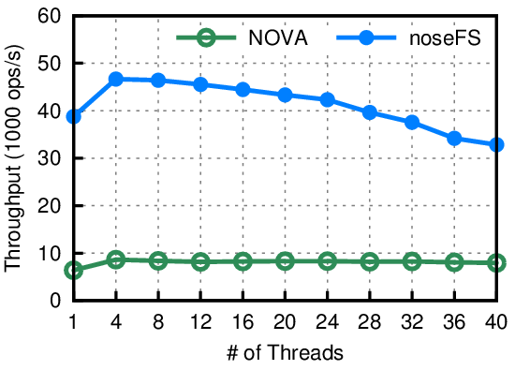
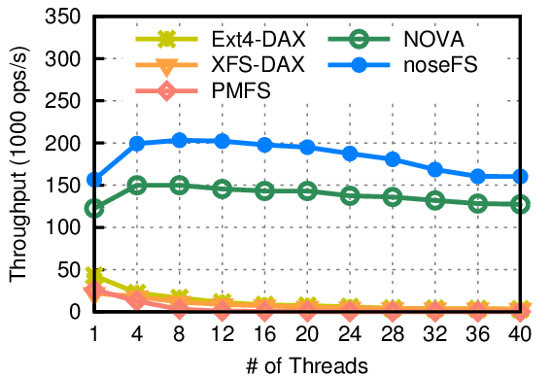
Filebench ─ simulate complex workloads
(a) Fileserver (128KB files & 1KB I/O sizes)
(b) Varmail (16KB files & 4KB I/O sizes)
+ 3.1x to 5.1x
+ 25% to 36%
noseFS performs better for real world applications
Notes:
We finally evaluate the performance of noseFS for real world applications using fileserver and Varmail.
The results show that noseFS also provides the highest throughput and achieves high scalability.
The left figure shows that noseFS outperforms NOVA from 3.1 times to 5.1 times with 1KB write size,
because of the block-unaligned write operations.
And the right figure shows that noseFS outperforms NOVA from 25% to 36% with 4KB write size,
because of the faster directory operations.

Slide 22
Outline
Non-Volatile Memories and NVM File Systems
Design Principles
System Implementation
Layout and Data Structures
Crash Consistency
Experimental Study
Conclusions
Notes:
Finally I will close our talk with a brief summary.

Slide 23
Conclusions
Design a dedicated lightweight naming
Bypass the in-memory cache in VFS to provide high efficiency
Enable the fine-grained locks to support high concurrency
Develop a lightweight consistency mechanism
Non-Copy-On-Write to avoid redundant copy overhead
Lightweight journaling to reduce logging overhead
Propose a lightweight atomic-mmap
Track dirty pages to achieve consistency with low overhead
noseFS ─ A highly scalable, efficient and consistency file system for NVMs
Notes:
To conclude, we design a highly scalable, efficient and consistent NVM file system noseFS,
by designing a dedicated lightweight naming, and developing a lightweight consistency mechanism.
We also propose a lightweight atomic-mmap, which tracks dirty pages to achieve consistency with low overhead.

Slide 24
Thank you!
Q & A
Notes:
Ok, thank you. Any question?

Slide 25
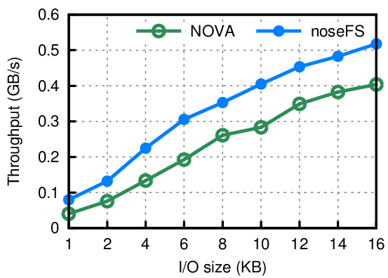
Effect of the lightweight consistency
(a) append (single thread)
(b) random write (single thread)
+ 15% to 914%
+ 26% to 97%
(a) 4KB-block-unaligned writes bring obviously highest performance
(b) Copy overhead is larger than the overhead of heavy file index tree
Notes:
In noseFS, the write offset and I/O size affect the scale of the file index tree.
Random write operations with small I/O sizes can bring a large number of extent fragments, resulting the slow search, insertion and removal.
However, according to figure b, the redundant copy overhead remains larger than the overhead introduced by the heavy file index tree.

Slide 26
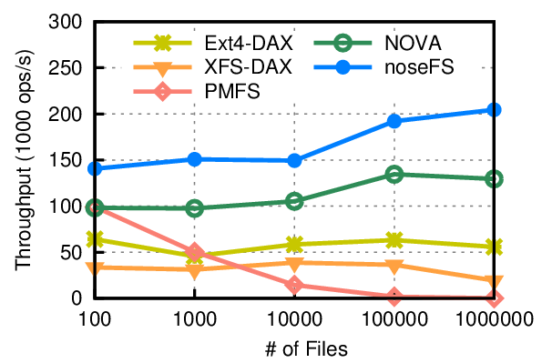
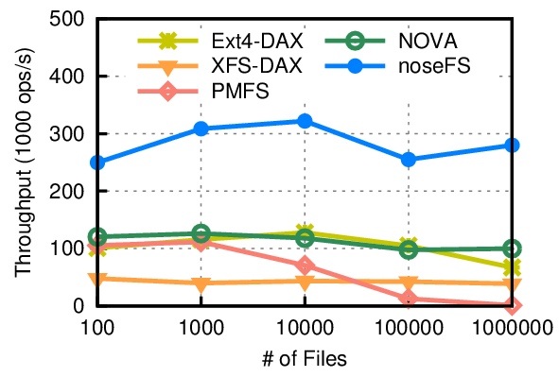
Effect of the lightweight naming
create (single thread)
(b) unlink (single thread)
+ 42% to 58%
+ 107% to 179%
Provide highly efficient and concurrent directory operations
Notes:
First of all, we perform create, unlink and rename operations to evaluate the effect of the lightweight naming.
As can be seen from figure a to c, noseFS provides the highest throughput for the three directory operations.
The improvement is mainly due to the updates of single pinode, the insertion and removal from efficient global hash table, and the lightweight directory journaling.
And figure d shows that only noseFS supports high concurrent rename operations because of the fine-grained rename locks.

