Slide 1

Query Independent Scholarly Article Ranking
Shuai Ma, Chen Gong, Renjun Hu, Dongsheng Luo, Chunming Hu, Jinpeng Huai
SKLSDE Lab, Beihang University, China
Beijing Advanced Innovation Center for Big Data and Brain Computing

Slide 2



Query Independent Scholarly Article Ranking
Goal: giving static ranking based on scholarly data only
Applications
Playing a key role in literature recommendation systems, especially in the cold start scenario
For search engines, determining the ranking of results
WSDM Cup 2016 http://www.wsdm-conference.org/2016/wsdm-cup.html

Slide 3
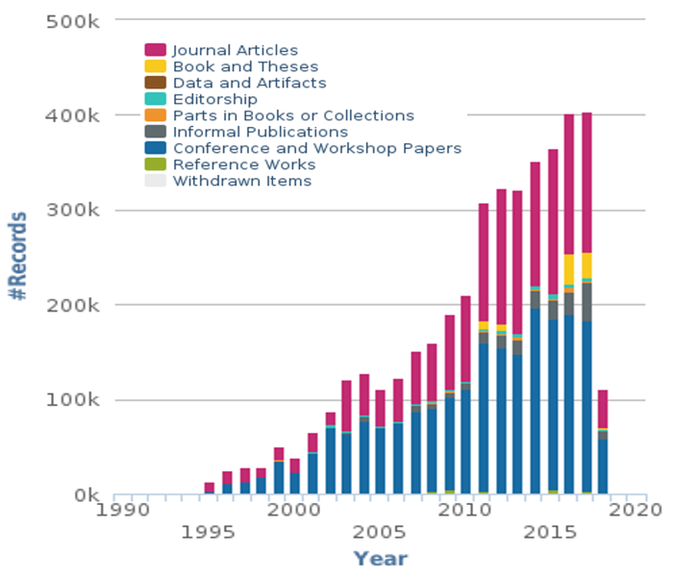
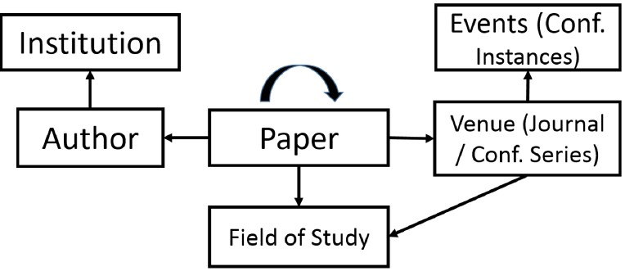
Challenges
Heterogeneous, evolving & dynamic
Multiple types of entities involve with different contributions
Entities and their importance evolve with time
Academic data is dynamic and continuously growing
The Microsoft Academic Graph [Sinha et al. 2015]
New Records per year of dblp Database
Arnab Sinha, et al. An Overview of Microsoft Academic Service (MAS) and Applications. In WWW, 2015.
https://dblp.uni-trier.de/statistics/newrecordsperyear.html

Slide 4
Outline
Ranking Model
Our Time Weighted PageRank
Ranking with Importance Assembling
Ranking Computation
Dynamic Ranking Computation
Experimental Study
Summary

Slide 5
Why Weighted PageRank?
Traditional PageRank
Assumption of equally propagating
Articles are equally influenced by references
Bias: favor older articles while underestimate new ones
Not all citations are equal ^{[Valenzuela et al. 2015]}
Different articles typically have different impacts
Weighted PageRank
Key: how to determine the weights (differentiate impacts)
M. Valenzuela, V. Ha and O. Etzioni. Identifying Meaningful Citations. In AAAI Workshop, 2015.

Slide 6
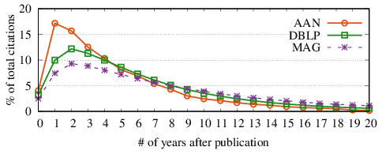
Intuitions of Impacts of Articles
Time decaying
Most previous work simply decays exponentially ^{[1-4]}
When to decay?
[1] X. Li, B. Liu and P. Yu. Time sensitive ranking with application to publication search. In ICDM, 2008.
[2] Y. Wang et al. Ranking scientific articles by exploiting citations, authors, journals and time information. In AAAI, 2013.
[3] H. Sayyadi and L. Getoor. Future rank: Ranking scientific articles by predicting their future pagerank. In SDM, 2009.
[4] D. Walker et al. Ranking scientific publications using a model of network traffic. Journal of Statistical Mechanics: Theory and Experiment, 2007.

Slide 7
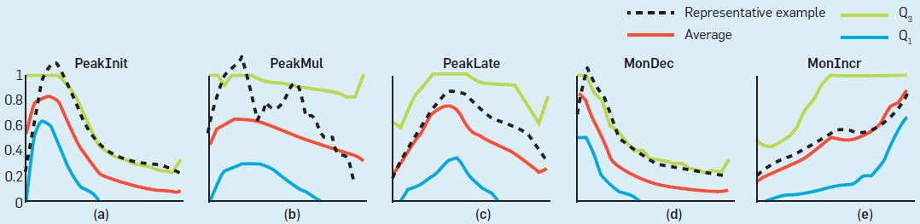
When to Decay
Different patterns for different articles ^{[Chakraborty et al. 2015]}
Categorized by when articles reach their citation peaks
PeakInit, PeakMul, PeakLate, MonDec, MonIncr, Other
Different Citation Patterns[Chakraborty et al. 2015]
Decaying only after the peak time of each individual article
Tanmoy Chakraborty, Suhansanu Kumar, Pawan Goyal, Niloy Ganguly, et al. On the categorization of scientific citation profiles in computer sciences. Commun. ACM 2015.

Slide 8
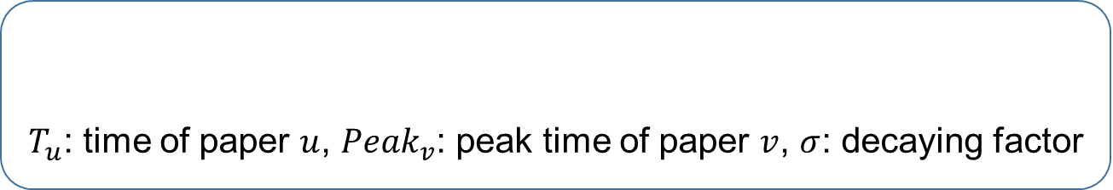
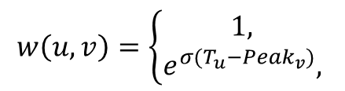


Our Time-Weighted PageRank
Importance propagation based on time-weighted impacts
Time-weighted impact
$T_{u}$: time of paper $u$, ${Peak}_{v}$: peak time of paper $v$, $σ$: decaying factor
$$w\left(u,v\right)=\left\{\begin{aligned}1, \\ &e^{σ(T_{u}−{Peak}_{v})}, \end{aligned}\right.$$
$$T_{u}<{Peak}_{v}$$
$$T_{u}≥{Peak}_{v}$$
Decaying with time only after the peak time
Each individual article has its own peak time
Remarks
Considering the temporal information and dynamic impacts
Alleviating the bias through decayed time-weighted impacts

Slide 9
Outline
Ranking Model
Our Time Weighted PageRank
Ranking with Importance Assembling
Ranking Computation
Dynamic Ranking Computation
Experimental Study
Summary

Slide 10
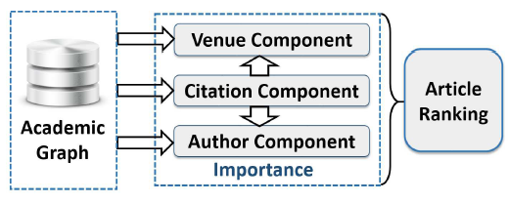
Why Importance Assembling?
Cold start case: ranking new articles
No citations yet: only using citation information fails
Venue and author information should be incorporated
Observation
Multiple types of entities involve with different contributions
Assembling the different contributions of citation, venue and author components

Slide 11
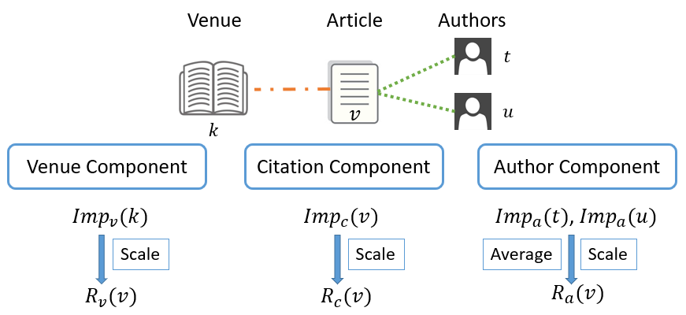

Ranking with Importance Assembling
Importance is defined as a combination of the prestige and popularity
favoring those with recent citations
$Imp\left(v\right)={Prs\left(v\right)}^{λ}{Pop\left(v\right)}^{1−λ},$ $λ$: importance weighing factor
favoring those with citations soon after publication
Final ranking
$$R\left(v\right)=αR_{c}\left(v\right)+βR_{v}\left(v\right)+(1−α−β)R_{a}(v)$$
𝛼 and 𝛽: aggregating parameters

Slide 12
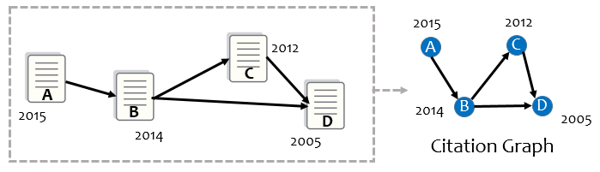
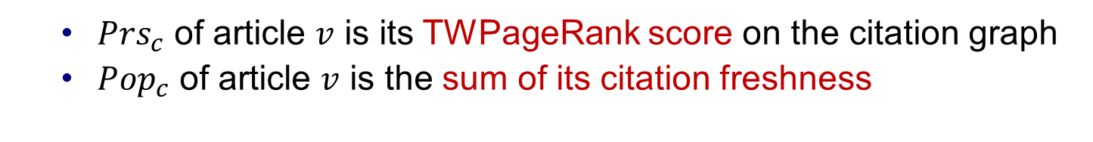
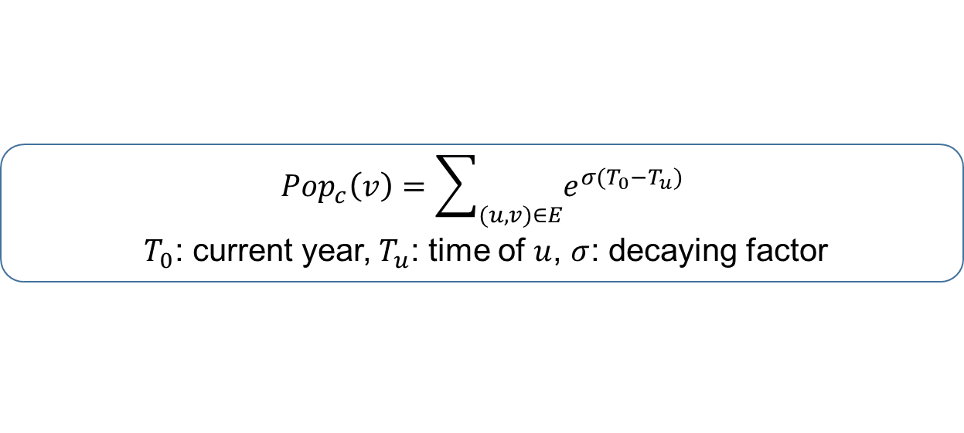
Importance Computation
Citation component
${Prs}_{c}$ of article $v$ is its TWPageRank score on the citation graph
${Pop}_{c}$ of article $v$ is the sum of its citation freshness
$${Pop}_{c}\left(v\right)=\sum_{(u,v)∈E}{e^{σ(T_{0}−T_{u})}}$$
$T_{0}$: current year, $T_{u}$: time of $u$, $σ$: decaying factor
Venue component
Constructing a venue graph and computing in similar way
Author component
Using average prestige and popularity of his/her published articles

Slide 13
Outline
Ranking Model
Our Time Weighted PageRank
Ranking with Importance Assembling
Ranking Computation
Dynamic Ranking Computation
Experimental Study
Summary

Slide 14
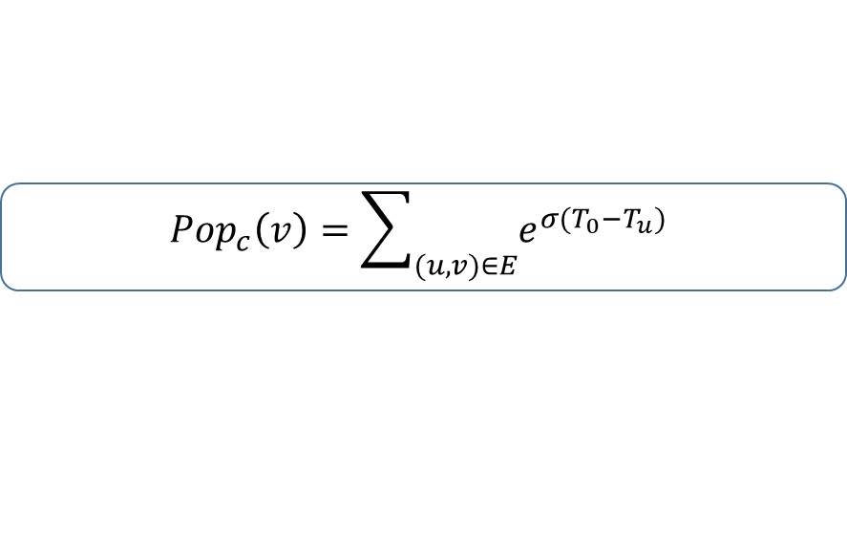
Batch Algorithm batSARank
Importance
Popularity computation
Can be done by scanning all citations once
Prestige computation
Traditionally computed by TWPageRank in an iterative manner and is the most expensive computation
Adopting block-wise computation method batTWPR ^{[Berkhin 2005]}
Treating each strong connected component (SCC) as a block
Processing blocks one by one following topological orders
The edges between blocks are only scanned once
$$Imp\left(v\right)={Prs\left(v\right)}^{λ}{Pop\left(v\right)}^{1−λ}$$
$${Pop}_{c}\left(v\right)=\sum_{(u,v)∈E}{e^{σ(T_{0}−T_{u})}}$$
P. Berkhin. Survey: A survey on pagerank computing. Internet Mathematics, vol. 2, no. 1, pp. 73–120, 2005.

Slide 15
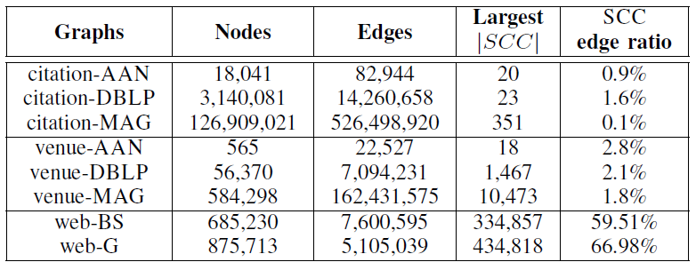
Why Adopting Block-wise Method?
Observation:
citations obey a natural temporal order
SCC edge ratios are small for citation and venue graphs
Based on statistics of scholarly data,
block-wise method is a good choice for TWPageRank
Time complexity analysis
Taking t=100 for example, algorithm batTWPR only needs to scan 4|E| edges on citation and venue graphs, but over 59|E| edges on Web graphs.

Slide 16
Outline
Ranking Model
Our Time Weighted PageRank
Ranking with Importance Assembling
Ranking Computation
Dynamic Ranking Computation
Experimental Study
Summary

Slide 17
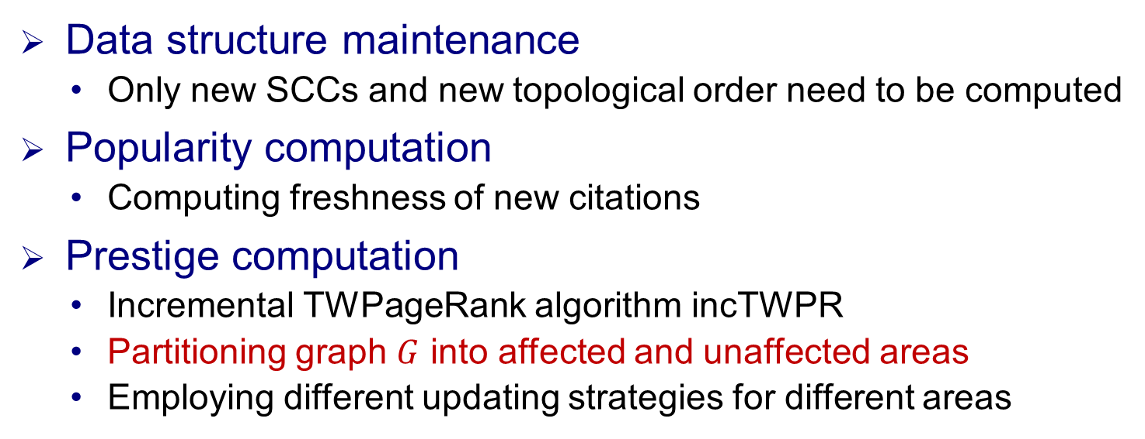
Incremental Algorithm incSARank
Observation on scholarly data
Data only increases without decreasing
Citation relationships obey a natural temporal order
The original block-wise graph and topological order do NOT change
The existing popularity simply needs to be scaled
Data structure maintenance
Only new SCCs and new topological order need to be computed
Popularity computation
Computing freshness of new citations
Prestige computation
Incremental TWPageRank algorithm incTWPR
Partitioning graph $G$ into affected and unaffected areas
Employing different updating strategies for different areas

Slide 18
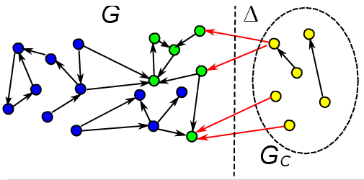
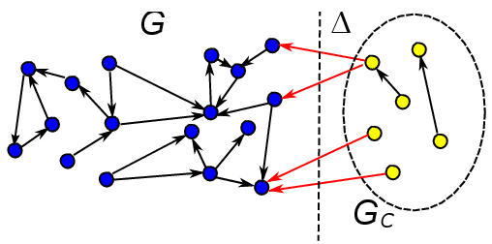
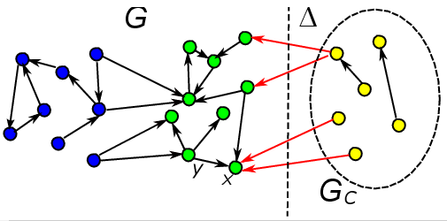
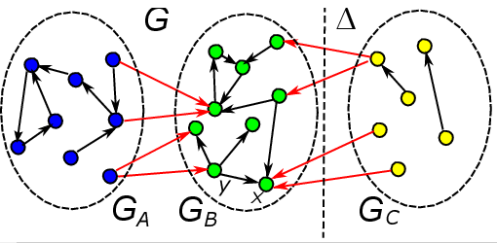
Affected and Unaffected Area Analysis
Affected area
Nodes that are reachable from newly added nodes
Nodes with outgoing edges having weight changes
Nodes that are reachable from other affected nodes
The rest of the original graph is unaffected area
Unaffected Area
Affected Area

Slide 19
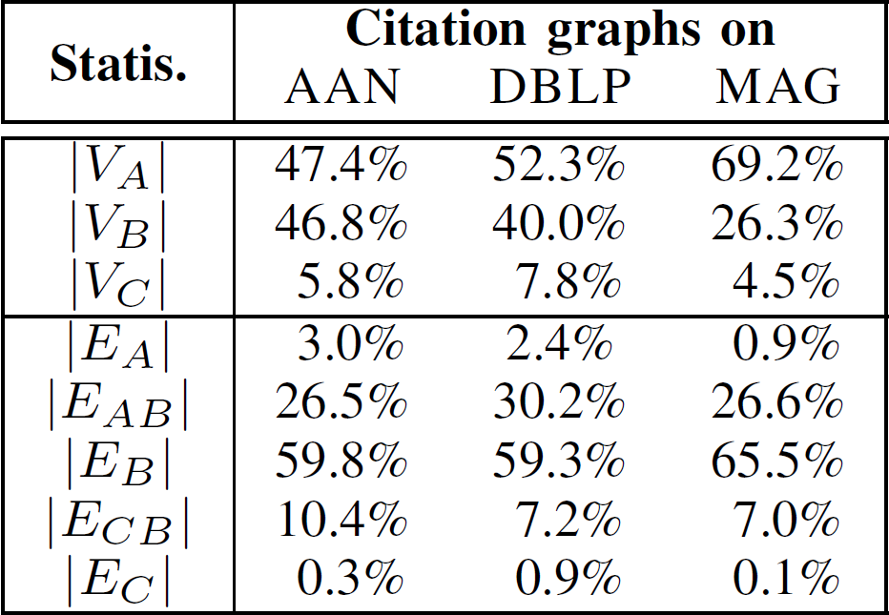
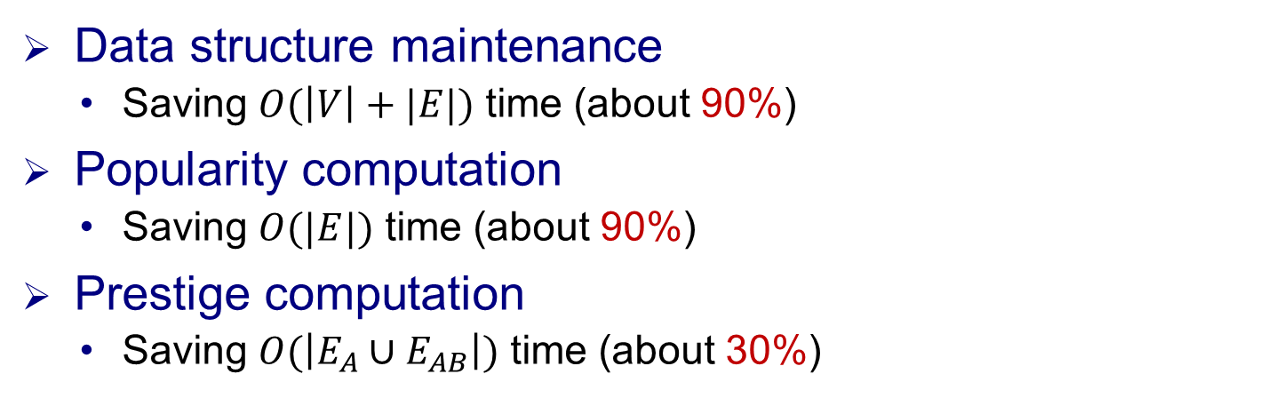


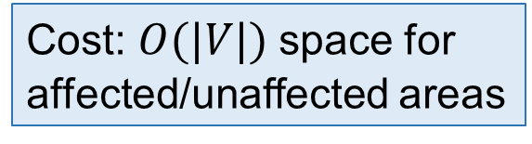
Time Complexity Analysis
Data structure maintenance
Saving $O(\left|V\right|+|E|)$ time (about 90%)
Popularity computation
Saving $O(|E|)$ time (about 90%)
Prestige computation
Saving $O(\left|E_{A}∪E_{AB}\right|)$ time (about 30%)
Cost: $O(|V|)$ space for affected/unaffected areas
$$V$$
$$E$$

Slide 20
Outline
Ranking Model
Our Time Weighted PageRank
Ranking with Importance Assembling
Ranking Computation
Dynamic Ranking Computation
Experimental Study
Summary

Slide 21
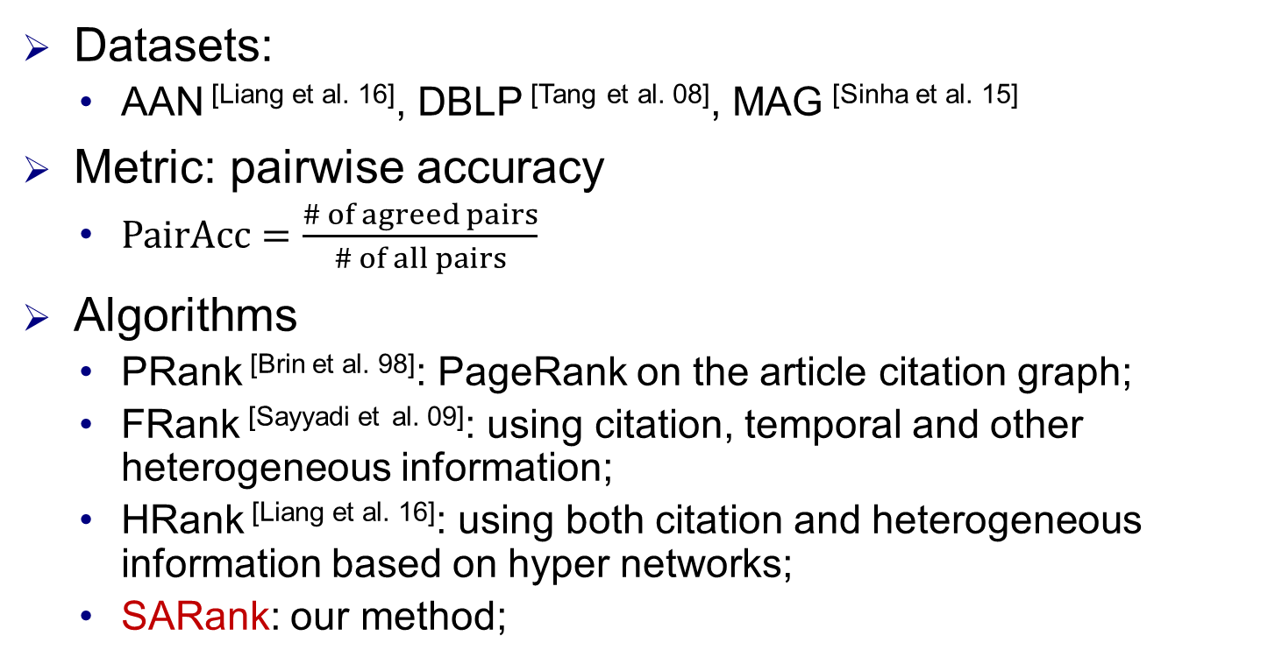
Experimental Settings
Datasets:
AAN ^{[Liang et al. 16]}, DBLP ^{[Tang} ^{et al. 08]}, MAG ^{[Sinha et al. 15]}
Metric: pairwise accuracy
$PairAcc=\frac{\# of agreed pairs}{\# of all pairs}$
Algorithms
PRank ^{[Brin et al. 98]}: PageRank on the article citation graph;
FRank ^{[Sayyadi et} ^{al. 09]}: using citation, temporal and other heterogeneous information;
HRank ^{[Liang et al. 16]}: using both citation and heterogeneous information based on hyper networks;
SARank: our method;
R. Liang and X. Jiang, Scientific ranking over heterogeneous academic hypernetwork, in AAAI, 2016.
J. Tang, J. Zhang, L. Yao, et al., Arnetminer: Extraction and mining of academic social networks, in KDD, 2008. A. Sinha, Z. Shen, Y. Song, et al., An overview of microsoft academic service (MAS) and applications, in WWW, 2015.
S. Brin and L. Page, The anatomy of a large-scale hypertextual web search engine, Computer Networks, 1998.
H. Sayyadi and L. Getoor, Future rank: Ranking scientific articles by predicting their future pagerank, in SDM, 2009.

Slide 22
Experimental Settings
Ground-truth:
RECOM ^{[Liang et al. 16]}, which assumes articles with more recommendations are more important
PFCTN for article ranking in a concerned year (splitting year)
Simply using citation numbers for fair evaluation
Past and future citations contribute equally
Articles in the same pairs must be in similar research fields and published in the same years
Articles with more PF citations are more important
total # of PF citations
x years
x years
past
future
start year
splitting year
current year
R. Liang and X. Jiang, Scientific ranking over heterogeneous academic hypernetwork, in AAAI, 2016.

Slide 23
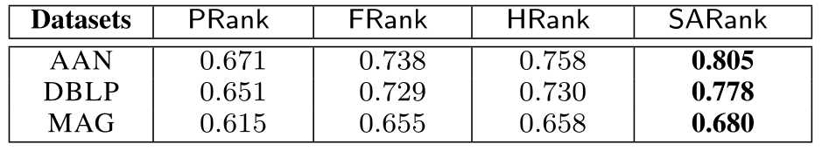
Effectiveness with RECOM
SARank consistently ranks better with RECOM
Note: RECOM is originally given on AAN, and we extend it to DBLP and MAG through exact title matching.

Slide 24
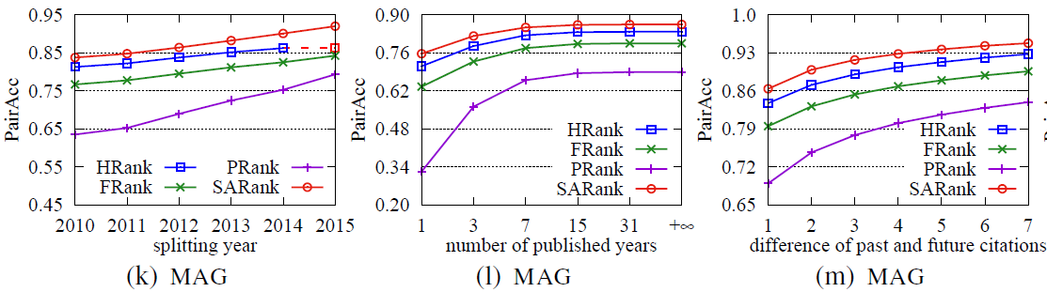
Effectiveness with PFCTN
+16.7%, +7.2%, +2.9%
+23.6%, +8.3%, +3.2%
+13.4%, +6.0%, +2.4%
# of published years
SARank consistently ranks better with PFCTN
start year
article published
splitting year
current year
ranking data

Slide 25
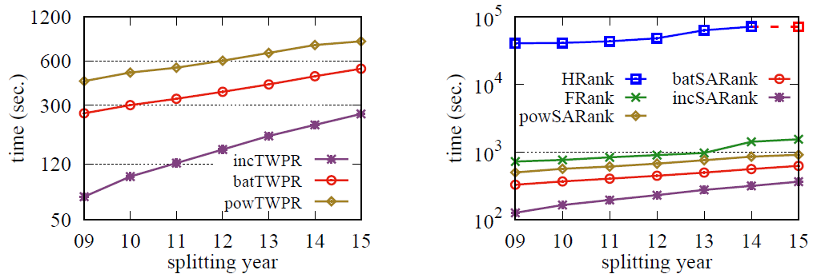
Efficiency
(2.5, 4.1) times faster
(2.0, 3.0, 4.4, 245) times faster
MAG
MAG
Batch and incremental algorithms are more efficient

Slide 26
Outline
Ranking Model
Time Weighted PageRank
Ranking with Importance Assembling
Ranking Computation
Dynamic Ranking Computation
Experimental Study
Summary

Slide 27
Summary
Proposing a scholarly article ranking model SARank
Time-Weighted PageRank algorithm
Assembling the importance of articles, venues and authors
Developing efficient ranking computation algorithms
Block-wise computation for TWPageRank
Incremental algorithm by affected/unaffected area division
Experimentation study
SARank consistently ranks better
Batch and incremental algorithms are more efficient
PFCTN, a new benchmark for article ranking

Slide 28
Thanks! Q&A

Slide 29
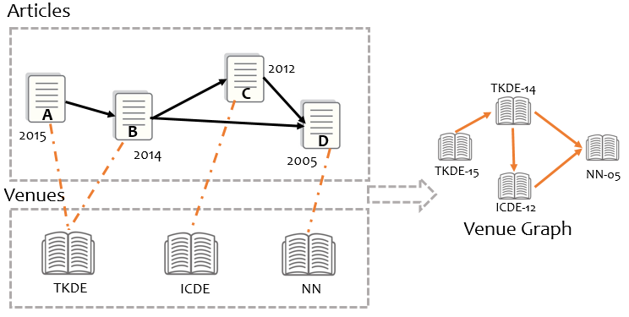
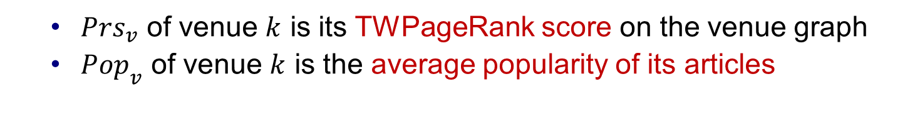
Components Computation
Venue component
Treating the venue in each year individually and its importance is the sum of importance in all individual years
${Prs}_{v}$ of venue $k$ is its TWPageRank score on the venue graph
${Pop}_{v}$ of venue $k$ is the average popularity of its articles

Slide 30
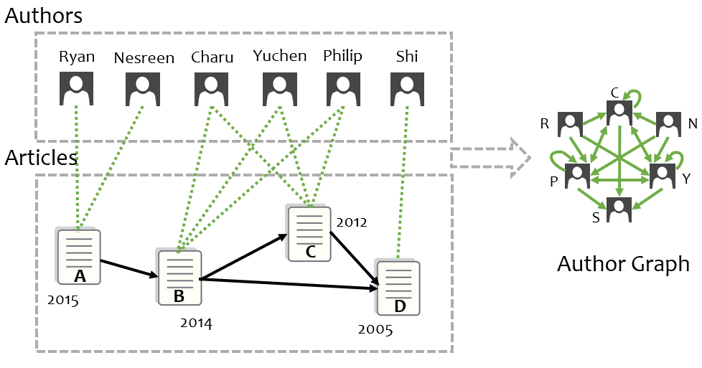

Components Computation
Author component
Compute the TWPagerank on the author citation graph is computationally expensive
${Prs}_{a}$ of author $u$ is the average prestige of his/her articles
${Pop}_{a}$ of author $u$ is the average popularity of his/her articles

Slide 31
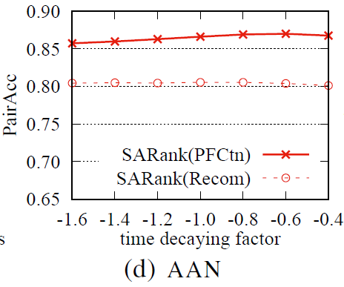
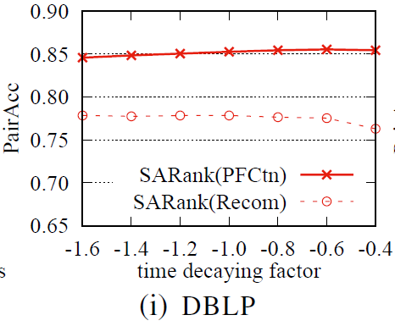
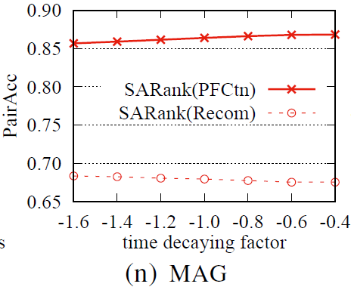
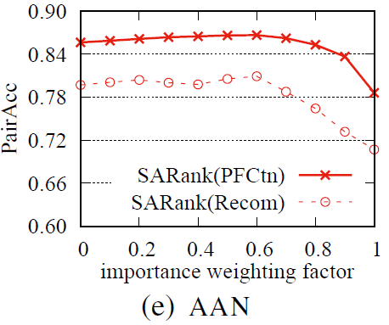
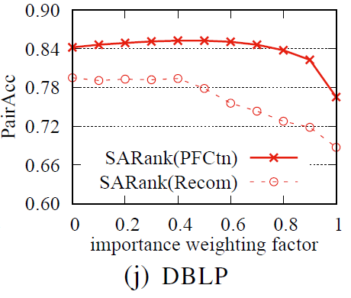
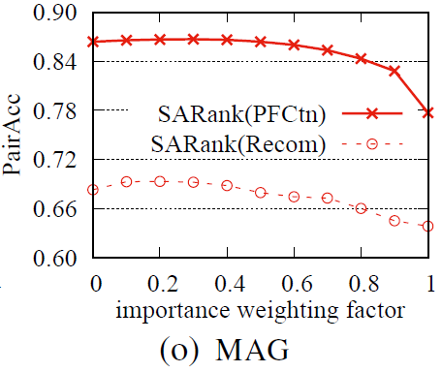
Impacts of Parameters
Time decaying factor $σ$ barely affects the result
The PairAcc of combining prestige and popularity is generally better than using prestige or popularity alone

Slide 32
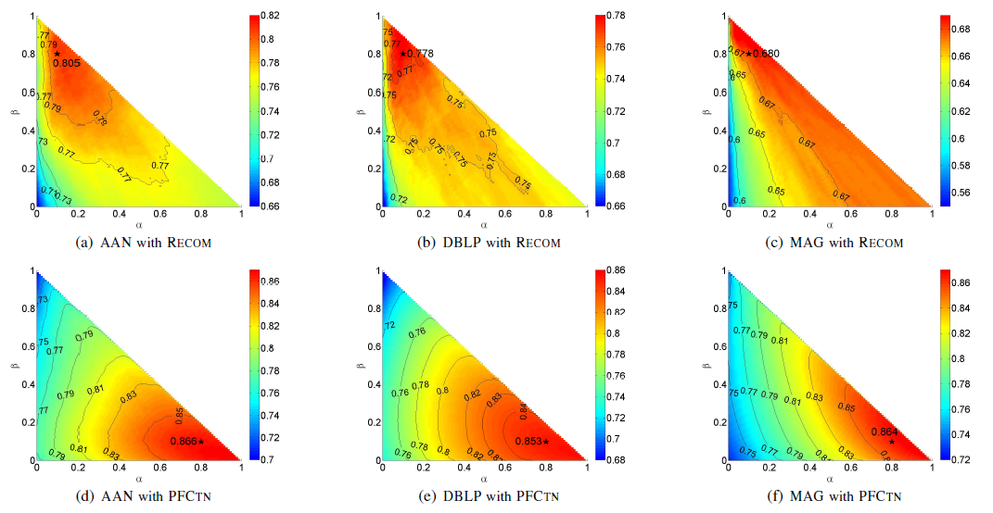
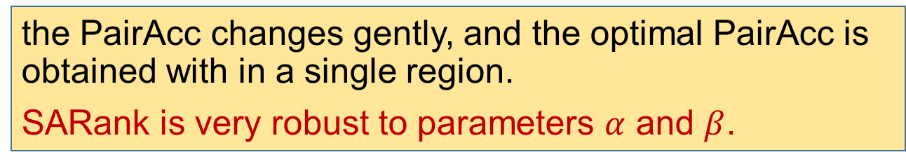
Impacts of Parameters 𝛼 and 𝛽
the PairAcc changes gently, and the optimal PairAcc is obtained with in a single region.
SARank is very robust to parameters $α$ and $β$.

Slide 33
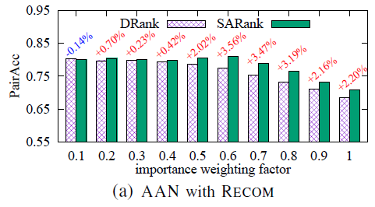
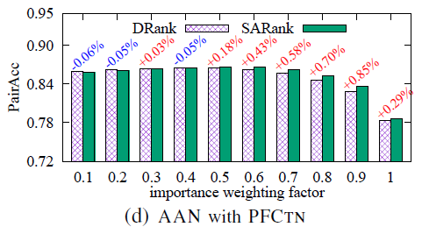
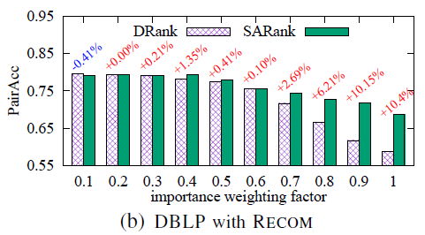
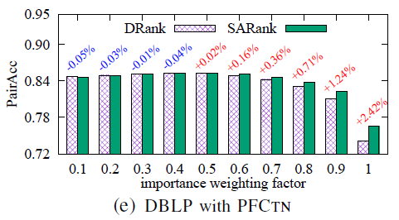
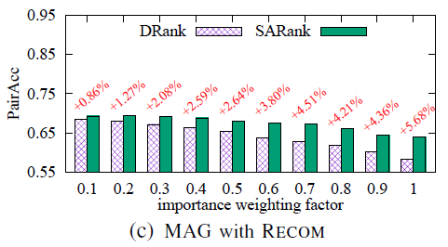
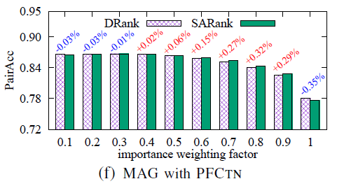
SARank vs. DRank(exponentially decay directly)
TWPR generally ranks better than directly decaying

