Slide 1

Query Independent Scholarly Article Ranking
Shuai Ma, Chen Gong, Renjun Hu, Dongsheng Luo, Chunming Hu, Jinpeng Huai
SKLSDE Lab, Beihang University, China
Beijing Advanced Innovation Center for Big Data and Brain Computing
Notes:
My name is . Today I will be presenting our recent work on query independent scholarly article ranking, joint with my supervisor and other colleagues from Beihang Univ.

Slide 2



Query Independent Scholarly Article Ranking
Goal: giving static ranking based on scholarly data only
Applications
Playing a key role in literature recommendation systems, especially in the cold start scenario
For search engines, determining the ranking of results
WSDM Cup 2016 http://www.wsdm-conference.org/2016/wsdm-cup.html
Notes:
The goal of this work is giving a static ranking based on the scholarly data only, regardless of the query. Such a ranking plays …, also for search engines ...

Slide 3
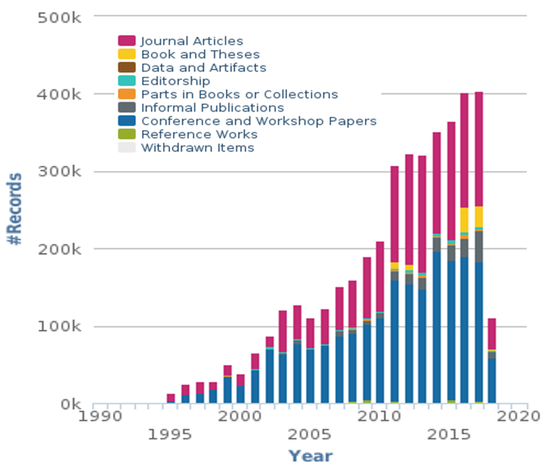
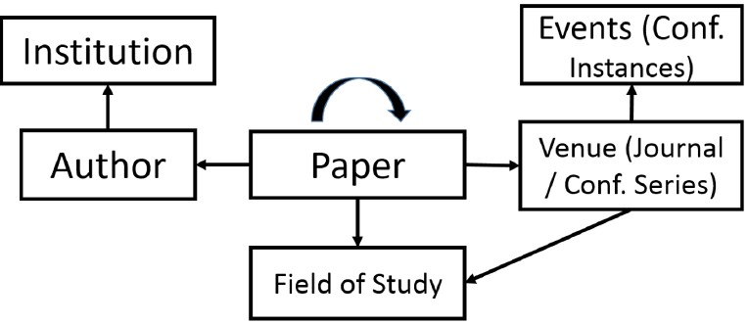
Challenges
Heterogeneous, evolving & dynamic
Multiple types of entities involve with different contributions
Entities and their importance evolve with time
Academic data is dynamic and continuously growing
The Microsoft Academic Graph [Sinha et al. 2015]
New Records per year of dblp Database
Arnab Sinha, et al. An Overview of Microsoft Academic Service (MAS) and Applications. In WWW, 2015.
https://dblp.uni-trier.de/statistics/newrecordsperyear.html
Notes:
The challenges come from 3 aspects.
1. first, is heterogeneous, as shown in the left picture. multiple types of entities involve in this task. Moreover, different entities also make different contributions to article ranking
2. second, the importance of articles evolves with time.
3. finally, academic…

Slide 4
Outline
Ranking Model
Our Time Weighted PageRank
Ranking with Importance Assembling
Ranking Computation
Dynamic Ranking Computation
Experimental Study
Summary
Notes:
here is the outline of today’s talk. I will introduce our ranking model, the batch and incremental algorithms for ranking computation. Followed by exp results and summary.
The first part of our ranking model is the time-weighted PR which is the key component to evaluate the importance of articles.

Slide 5
Why Weighted PageRank?
Traditional PageRank
Assumption of equally propagating
Articles are equally influenced by references
Bias: favor older articles while underestimate new ones
Not all citations are equal ^{[Valenzuela et al. 2015]}
Different articles typically have different impacts
Weighted PageRank
Key: how to determine the weights (differentiate impacts)
M. Valenzuela, V. Ha and O. Etzioni. Identifying Meaningful Citations. In AAAI Workshop, 2015.
Notes:
To illustrate its motivation, we start from traditional PageRank which propagates importance equally.
The underlying assumption…is that articles ... This will lead to a bias such that it favors older articles with a large number of citations while underestimates new ones which barely have citations.
However, as observed by previous work, not all …, …, and there is a need to differentiate
Hence, we propose to use weighted PageRank. And its key is …, which …in our case.

Slide 6
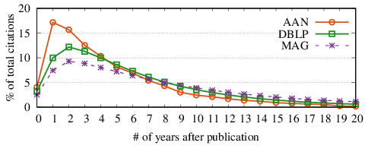
Intuitions of Impacts of Articles
Time decaying
Most previous work simply decays exponentially ^{[1-4]}
When to decay?
[1] X. Li, B. Liu and P. Yu. Time sensitive ranking with application to publication search. In ICDM, 2008.
[2] Y. Wang et al. Ranking scientific articles by exploiting citations, authors, journals and time information. In AAAI, 2013.
[3] H. Sayyadi and L. Getoor. Future rank: Ranking scientific articles by predicting their future pagerank. In SDM, 2009.
[4] D. Walker et al. Ranking scientific publications using a model of network traffic. Journal of Statistical Mechanics: Theory and Experiment, 2007.
Notes:
For the impacts of articles, the first intuition is time decaying.
And we collect the citation statistics on 3 scholarly datasets and the result reveals the universal citation pattern such that the number of citations declines after it reaches the peak.
However, most previous work simply exploits such temporal information in the form of exponential decay, which might be wrong according to the statistics. And this raises the question that when to decay

Slide 7
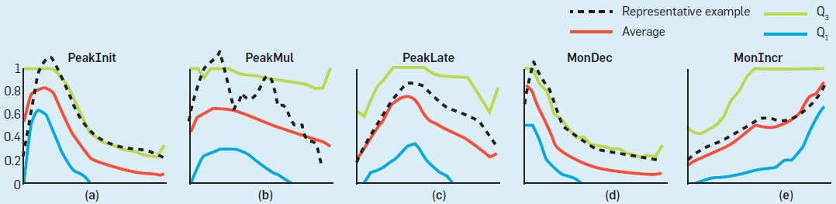
When to Decay
Different patterns for different articles ^{[Chakraborty et al. 2015]}
Categorized by when articles reach their citation peaks
PeakInit, PeakMul, PeakLate, MonDec, MonIncr, Other
Different Citation Patterns[Chakraborty et al. 2015]
Decaying only after the peak time of each individual article
Tanmoy Chakraborty, Suhansanu Kumar, Pawan Goyal, Niloy Ganguly, et al. On the categorization of scientific citation profiles in computer sciences. Commun. ACM 2015.
Notes:
Based on a commun ACM paper, different articles indeed have different citation patterns categorized by the time when they reach their citation peaks. As we can see, most patterns have a single peak, except the peak multiple pattern.
Combining with the previous universal citation pattern, we hence exploit decaying…

Slide 8
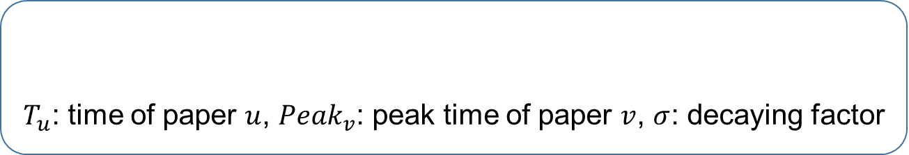
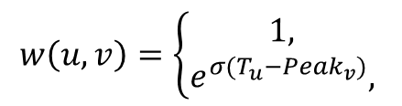


Our Time-Weighted PageRank
Importance propagation based on time-weighted impacts
Time-weighted impact
$T_{u}$: time of paper $u$, ${Peak}_{v}$: peak time of paper $v$, $σ$: decaying factor
$$w\left(u,v\right)=\left\{\begin{aligned}1, \\ &e^{σ(T_{u}−{Peak}_{v})}, \end{aligned}\right.$$
$$T_{u}<{Peak}_{v}$$
$$T_{u}≥{Peak}_{v}$$
Decaying with time only after the peak time
Each individual article has its own peak time
Remarks
Considering the temporal information and dynamic impacts
Alleviating the bias through decayed time-weighted impacts
Notes:
We then propose TWPageRank that propagate importance based on time-weighted impacts
which is defined in this equation, where Tu is …. the impact only decay after the peak time. note that, …
By these, the time-weighted PageRank…

Slide 9
Outline
Ranking Model
Our Time Weighted PageRank
Ranking with Importance Assembling
Ranking Computation
Dynamic Ranking Computation
Experimental Study
Summary
Notes:
We next introduce our ranking function by assembling the importance

Slide 10
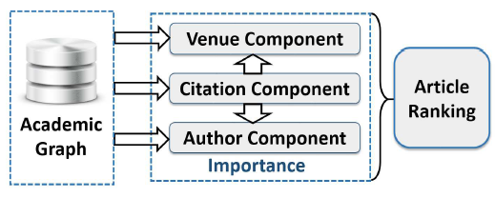
Why Importance Assembling?
Cold start case: ranking new articles
No citations yet: only using citation information fails
Venue and author information should be incorporated
Observation
Multiple types of entities involve with different contributions
Assembling the different contributions of citation, venue and author components
Notes:
It is motivated from the cold start case that to rank newly published article. Since no citations is observed yet, only … fails to give a reasonable rank. On the other hand, venue ...
The observation is that …
To this end, our model assembles the … which compute the importance of article, venue and author respectively. These importance are assembled to produce the final article ranking

Slide 11
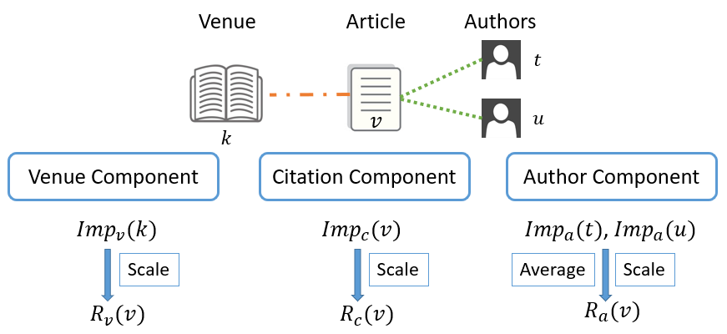

Ranking with Importance Assembling
Importance is defined as a combination of the prestige and popularity
favoring those with recent citations
$Imp\left(v\right)={Prs\left(v\right)}^{λ}{Pop\left(v\right)}^{1−λ},$$λ$: importance weighing factor
favoring those with citations soon after publication
Final ranking
$$R\left(v\right)=αR_{c}\left(v\right)+βR_{v}\left(v\right)+(1−α−β)R_{a}(v)$$
𝛼 and 𝛽: aggregating parameters
Notes:
In our model, the importance ... Intuitively, prestige favors …, and popularity favors ….
Given an article v published in venue k by authors t and u, we have importance of article v from citation component as in the middle... These importance are properly scaled, averaged and combined to produce the final ranking.
Next we’ll introduce the detail for three components to compute importance

Slide 12
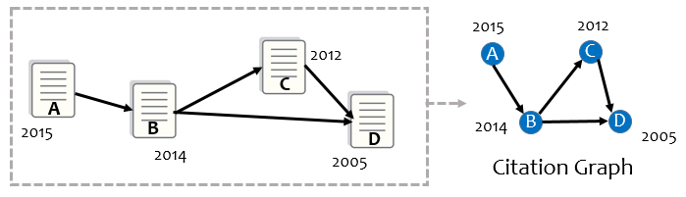
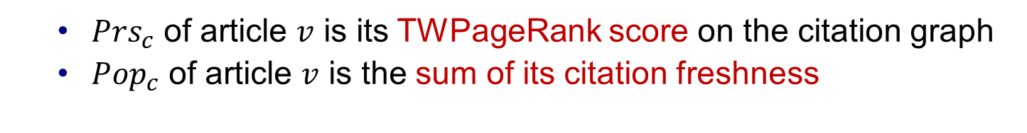
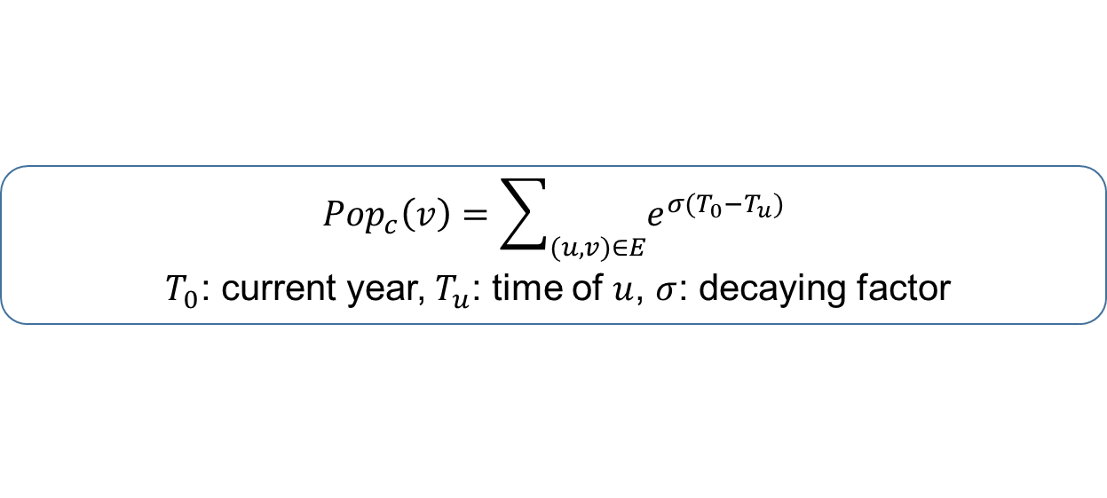
Importance Computation
Citation component
${Prs}_{c}$ of article $v$ is its TWPageRank score on the citation graph
${Pop}_{c}$ of article $v$ is the sum of its citation freshness
$${Pop}_{c}\left(v\right)=\sum_{(u,v)∈E}{e^{σ(T_{0}−T_{u})}}$$
$T_{0}$: current year,$T_{u}$: time of $u$, $σ$: decaying factor
Venue component
Constructing a venue graph and computing in similar way
Author component
Using average prestige and popularity of his/her published articles
Notes:
Citation component computes the importance of articles using the citation information
a citation graph is firstly constructed that a node denotes an article and a directed edge denotes a citation relationship
The prestige of articles is derived by applying TWPageRank on the citation graph, and each article v is assigned the corresponding TWPageRank score as its prestige
The popularity of an article is .., defined as the equation, where T0 is …
The venue component … of citation component
As for the author component, the author citation graph is very expensive to construct. Alternatively, we use the average …

Slide 13
Outline
Ranking Model
Our Time Weighted PageRank
Ranking with Importance Assembling
Ranking Computation
Dynamic Ranking Computation
Experimental Study
Summary
Notes:
We next introduce our efficient batch algorithm for ranking computation

Slide 14
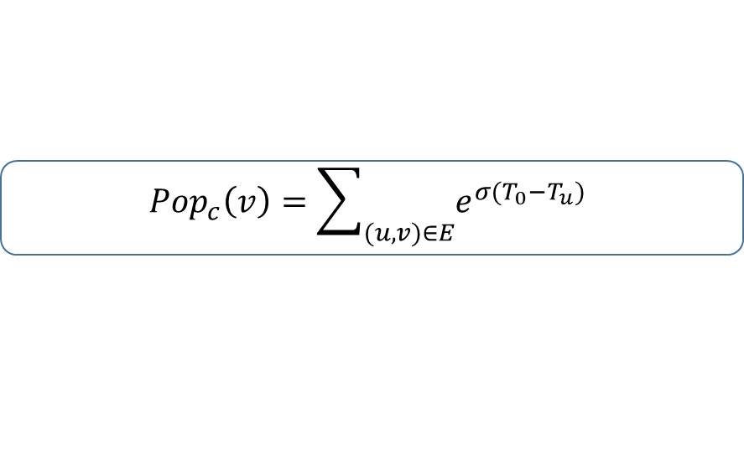
Batch Algorithm batSARank
Importance
Popularity computation
Can be done by scanning all citations once
Prestige computation
Traditionally computed by TWPageRank in an iterative manner and is the most expensive computation
Adopting block-wise computation method batTWPR ^{[Berkhin 2005]}
Treating each strong connected component (SCC) as a block
Processing blocks one by one following topological orders
The edges between blocks are only scanned once
$$Imp\left(v\right)={Prs\left(v\right)}^{λ}{Pop\left(v\right)}^{1−λ}$$
$${Pop}_{c}\left(v\right)=\sum_{(u,v)∈E}{e^{σ(T_{0}−T_{u})}}$$
P. Berkhin. Survey: A survey on pagerank computing. Internet Mathematics, vol. 2, no. 1, pp. 73–120, 2005.
Notes:
Recall that the importance…
For popularity computation, …
For prestige computation, the prestige of articles and venues is computed by TWPageRank on citation and venue graphs, which is usually computed …
Hence, we adopt... The main idea of the block-wise computation is that each strongly connected component (SCC) of the graph is treated as a block, and blocks are processed one by one following the topological order of the block-wise graph
By these, the …

Slide 15
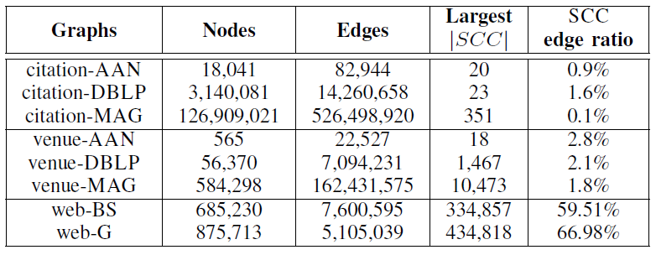
Why Adopting Block-wise Method?
Observation:
citations obey a natural temporal order
SCC edge ratios are small for citation and venue graphs
Based on statistics of scholarly data,
block-wise method is a good choice for TWPageRank
Time complexity analysis
Taking t=100 for example, algorithm batTWPR only needs to scan 4|E| edges on citation and venue graphs, but over 59|E| edges on Web graphs.
Notes:
We next answer why adopting block-wise method. Observe that, citations …, that is, an article only cites those published earlier. and the SCC edge ratio which are edges inside sccs is essentially …
To verify this observation, we also collect the statistics of citation/venue graphs and Web graphs. As we can see in the table, the scc edge ratios are greater than 59% in web graphs while that are less than 3% in citation and venue graphs.
Taking the iteration times t=100…
The block-wise method is proposed for web graph, but based on our statistics, it is a good choice for TWPR on scholarly data

Slide 16
Outline
Ranking Model
Our Time Weighted PageRank
Ranking with Importance Assembling
Ranking Computation
Dynamic Ranking Computation
Experimental Study
Summary
Notes:
Considering the dynamic nature of scholarly data, we also propose an incremental algorithm for dynamic ranking computation.

Slide 17
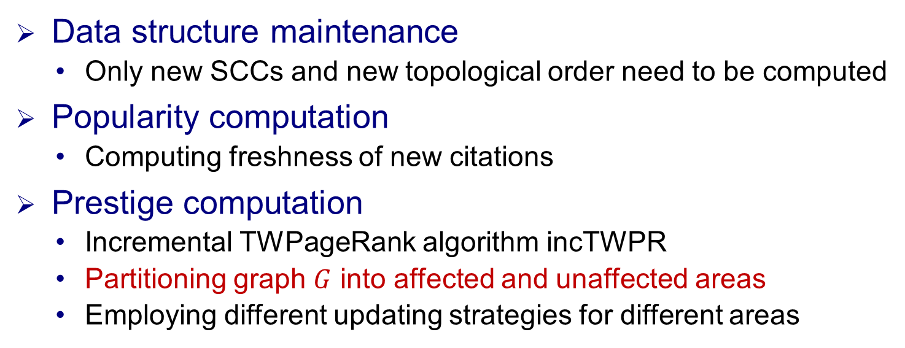
Incremental Algorithm incSARank
Observation on scholarly data
Data only increases without decreasing
Citation relationships obey a natural temporal order
The original block-wise graph and topological order do NOT change
The existing popularity simply needs to be scaled
Data structure maintenance
Only new SCCs and new topological order need to be computed
Popularity computation
Computing freshness of new citations
Prestige computation
Incremental TWPageRank algorithm incTWPR
Partitioning graph $G$ into affected and unaffected areas
Employing different updating strategies for different areas
Notes:
For scholarly data. First, ... second, …, in the sense that an article only cites those published earlier.
As a result, given an update…
That is, for data structures maintainance, only…
For popularity computation, it is convenient to maintain dynamically, we only need to …
On the other hand, we propose an incremental TWPR algorithm for prestige computation, which ...

Slide 18
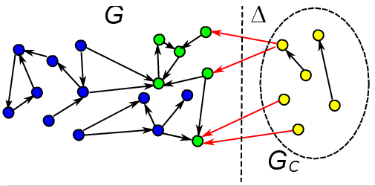
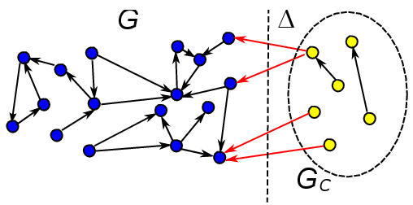
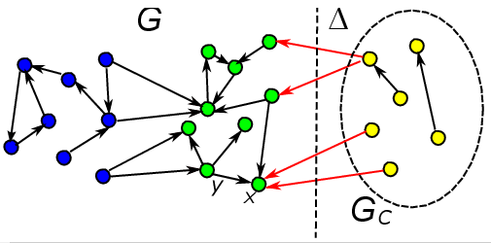
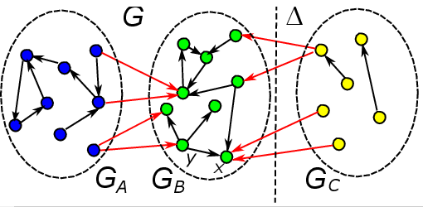
Affected and Unaffected Area Analysis
Affected area
Nodes that are reachable from newly added nodes
Nodes with outgoing edges having weight changes
Nodes that are reachable from other affected nodes
The rest of the original graph is unaffected area
Unaffected Area
Affected Area
Notes:
We next introduce how to find the affected area. Given an update , first, … are affected. Second, …are affected. For example, here the node x has a change of peak time, which makes the weight of the edge (y, x) change, so the node y belongs to the affected area. Third, … are also affected. Finally, And the rest …

Slide 19
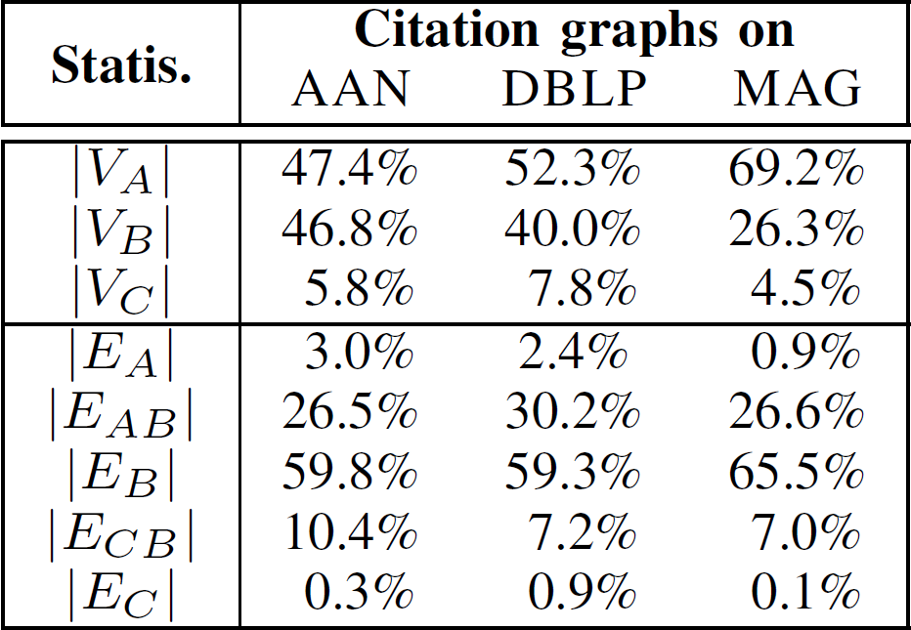
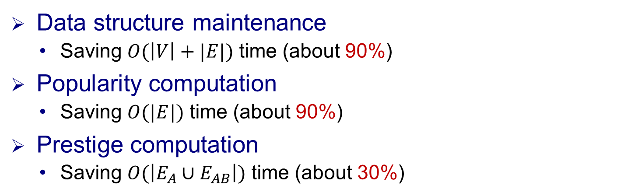


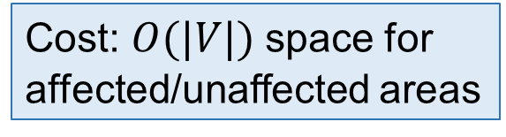
Time Complexity Analysis
Data structure maintenance
Saving $O(\left|V\right|+|E|)$ time (about 90%)
Popularity computation
Saving $O(|E|)$ time (about 90%)
Prestige computation
Saving $O(\left|E_{A}∪E_{AB}\right|)$time (about 30%)
Cost: $O(|V|)$space for affected/unaffected areas
$$V$$
$$E$$
Notes:
Our incremental algorithm is more efficient
Specifically, for data structure maintenance, it saves O(V plus E) time which is about 90% of computation in batch algorithm, here V constitute Va and Vb and E constitude Ea Eab Eb
For popularity computation, it saves O(E) time which also account for about 90%
For prestige computation, it saves O(E subscript a plus E subscript ab) time, which account for about 30% of total
All these are done at an extra cost of O(V) space

Slide 20
Outline
Ranking Model
Our Time Weighted PageRank
Ranking with Importance Assembling
Ranking Computation
Dynamic Ranking Computation
Experimental Study
Summary
Notes:
We next present the experimental results

Slide 21
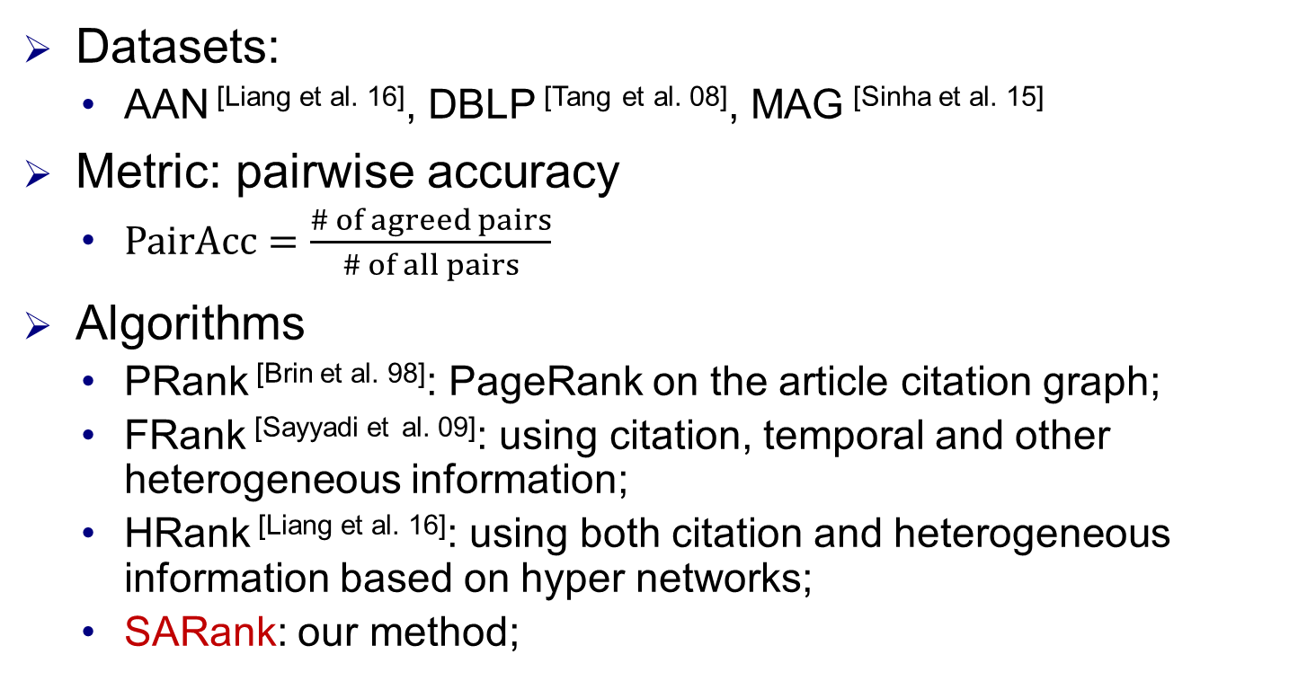
Experimental Settings
Datasets:
AAN^{[Liang et al. 16]}, DBLP^{[Tanget al. 08]}, MAG^{[Sinha et al. 15]}
Metric: pairwise accuracy
$PairAcc=\frac{\# of agreed pairs}{\# of all pairs}$
Algorithms
PRank^{[Brin et al. 98]}: PageRank on the article citation graph;
FRank^{[Sayyadi etal. 09]}: using citation, temporal and other heterogeneous information;
HRank^{[Liang et al. 16]}: using both citation and heterogeneous information based on hyper networks;
SARank: our method;
R. Liang and X. Jiang, Scientific ranking over heterogeneous academic hypernetwork, in AAAI, 2016.
J. Tang, J. Zhang, L. Yao, et al., Arnetminer: Extraction and mining of academic social networks, in KDD, 2008. A. Sinha, Z. Shen, Y. Song, et al., An overview of microsoft academic service (MAS) and applications, in WWW, 2015.
S. Brin and L. Page, The anatomy of a large-scale hypertextual web search engine, Computer Networks, 1998.
H. Sayyadi and L. Getoor, Future rank: Ranking scientific articles by predicting their future pagerank, in SDM, 2009.
Notes:
we first introduce the experimental settings.
We chose three datasets to test our approach
and the metric is pairwise accuracy, which is the number of agreed pairs over the number of all pairs
We compared our approach with three methods. PRank uses PageRank… the other 2 are based on heterogeneous information

Slide 22
Experimental Settings
Ground-truth:
RECOM ^{[Liang et al. 16]}, which assumes articles with more recommendations are more important
PFCTN for article ranking in a concerned year (splitting year)
Simply using citation numbers for fair evaluation
Past and future citations contribute equally
Articles in the same pairs must be in similar research fields and published in the same years
Articles with more PF citations are more important
total # of PF citations
x years
x years
past
future
start year
splitting year
current year
R. Liang and X. Jiang, Scientific ranking over heterogeneous academic hypernetwork, in AAAI, 2016.
Notes:
We constructed two sets of ground-truth, which are article pairs with importance orders
It is hard to evaluate the ranking fairly for all methods. We further develop pfctn, … , namely splitting year
For fair evaluation, we … and we believe … equally to the importance of articles
Divide each dataset into two parts with a splitting year, and use the data after the splitting year to count future citation. Then the same period of time before the splitting year are used to count past citations.
Moreover, articles in the same pairs …
Finally, articles with…

Slide 23
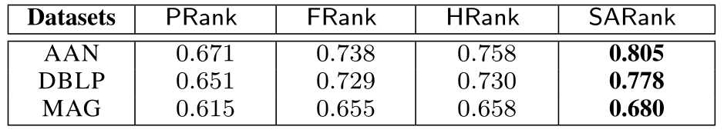
Effectiveness with RECOM
SARank consistently ranks better with RECOM
Note: RECOM is originally given on AAN, and we extend it to DBLP and MAG through exact title matching.
Notes:
In the first set of our tests, we used benchm RECOM to evaluate the effectiveness of our approach, the results of pairacc are shown in the table. As we can see, SARank consistently ranks better with RECOM

Slide 24
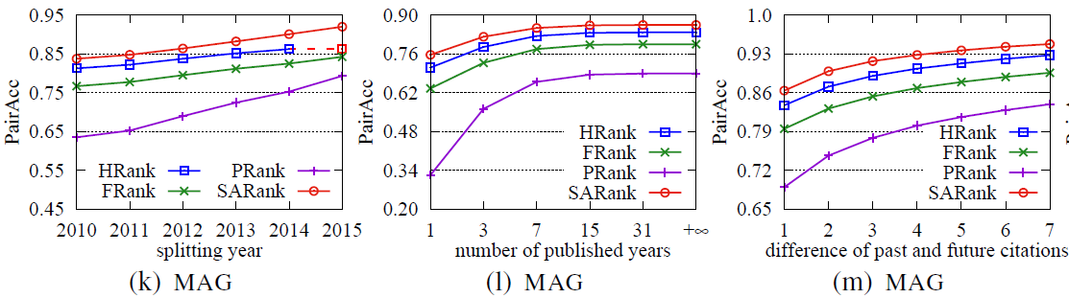
Effectiveness with PFCTN
+16.7%, +7.2%, +2.9%
+23.6%, +8.3%, +3.2%
+13.4%, +6.0%, +2.4%
# of published years
SARank consistently ranks better with PFCTN
start year
article published
splitting year
current year
ranking data
Notes:
We then used benchmark pfctn to evaluate the effectiveness. Here we only show the results on MAG dataset as examples.
we varied three factors, the length of past and future period, by varying the splitting year. the number of published years of articles, and the difference of past and futures citation counts. For last 2 factors, we fixed the splitting year to default value and for all test, only the data before splitting year are used for ranking.
Our algorithms improve the pairacc by 2 to 23 percents

Slide 25
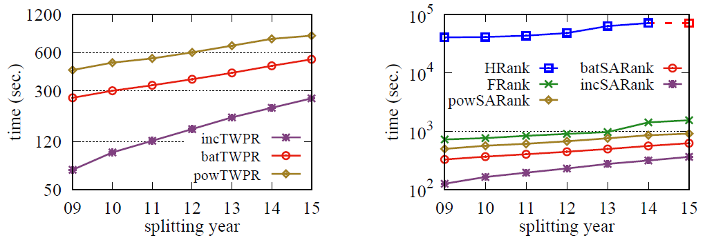
Efficiency
(2.5, 4.1) times faster
(2.0, 3.0, 4.4, 245) times faster
MAG
MAG
Batch and incremental algorithms are more efficient
Notes:
We also evaluate the efficiency. our incremental algorithm for TWPR is 2.5, 4.1 times faster than batch algorithm and power computation. Our incremental algorithm for ranking computation is 2, 3, 4.4, 245 times faster than our batch algorithm, power computation, Frank and Hrank, respectively.

Slide 26
Outline
Ranking Model
Time Weighted PageRank
Ranking with Importance Assembling
Ranking Computation
Dynamic Ranking Computation
Experimental Study
Summary
Notes:
We close this talk with a brief summary.

Slide 27
Summary
Proposing a scholarly article ranking model SARank
Time-Weighted PageRank algorithm
Assembling the importance of articles, venues and authors
Developing efficient ranking computation algorithms
Block-wise computation for TWPageRank
Incremental algorithm by affected/unaffected area division
Experimentation study
SARank consistently ranks better
Batch and incremental algorithms are more efficient
PFCTN, a new benchmark for article ranking
Notes:
In this work, we [proposing …], by TWPR algorithm and importance assembling.
we propose efficient batch and incremental algorithms. The batch algorithm exploits block wise computation for TWPR. And the incremental algorithm is based on …
We conduct an experimental study to illustrate the effectiveness and efficiency. We construct a new benchmark for scholarly article ranking evaluation. we will make it public and encourage use and comments

Slide 28
Thanks! Q&A
Notes:
Question?

Slide 29
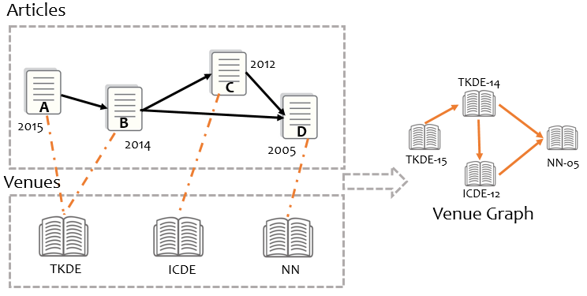
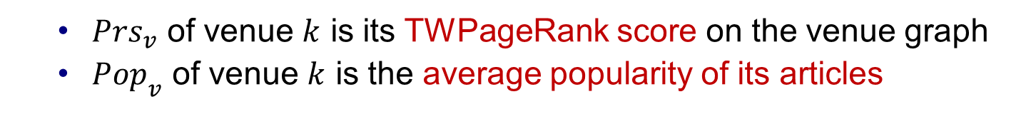
Components Computation
Venue component
Treating the venue in each year individually and its importance is the sum of importance in all individual years
${Prs}_{v}$ of venue $k$ is its TWPageRank score on the venue graph
${Pop}_{v}$ of venue $k$ is the average popularity of its articles
Notes:
The second component computes the importance of venues with their associated articles.
As the importance of a venue evolves with time, we treat the venue in each year individually, and its importance is the sum of importance in all individual years.
A venue graph is firstly constructed using the citation information among venues that a node represents a venue in a specific year, and a direct edge denotes that there exist citations between articles published in 2 venues
The prestige of a venue in a specific year is its twpr score on the venue graph and the popularity of a venue in a specific year is defined as the average popularity of its articles

Slide 30
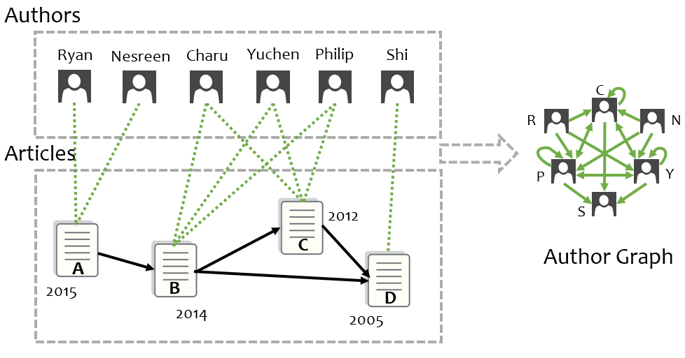

Components Computation
Author component
Compute the TWPagerank on the author citation graph is computationally expensive
${Prs}_{a}$ of author $u$ is the average prestige of his/her articles
${Pop}_{a}$ of author $u$ is the average popularity of his/her articles
Notes:
The author component computes the importance of authors with their published articles
One way to do this is to construct an author citation graph similarly to venue graph. However, it is easy to see that for each citation, the corresponding two sets of authors are fully connected, which makes it computationally expensive to compute the prestige of authors on such an author citation graph with TWPageRank.
Hence, we choose to evaluate the prestige of an author with the average prestige of all articles published by the author, and the popularity of an author is …

Slide 31
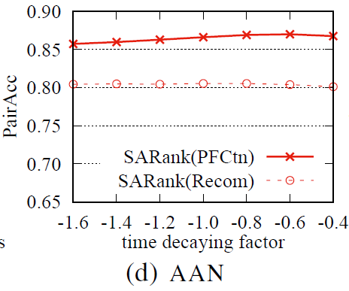
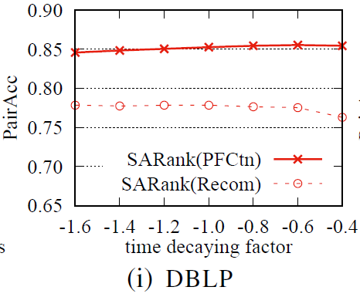
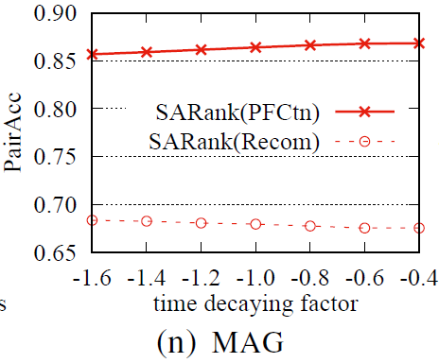
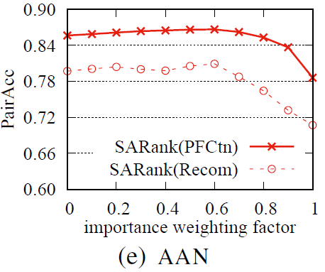
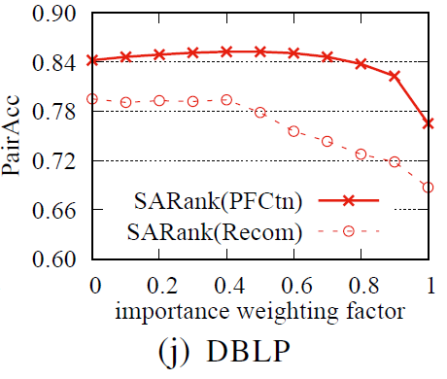
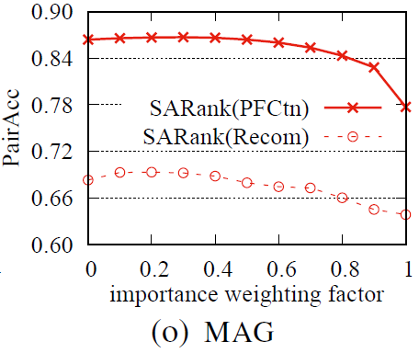
Impacts of Parameters
Time decaying factor $σ$barely affectsthe result
The PairAcc of combining prestige and popularity is generally better than using prestige or popularity alone

Slide 32
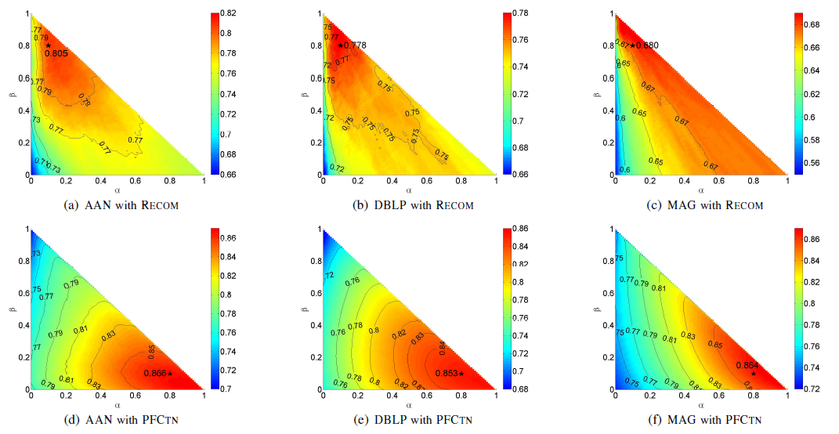
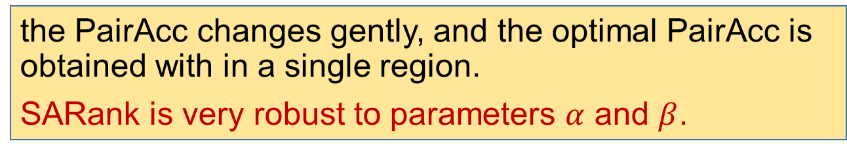
Impacts of Parameters 𝛼 and 𝛽
the PairAcc changes gently, and the optimal PairAcc is obtained with in a single region.
SARank is very robust to parameters $α$and $β$.

Slide 33
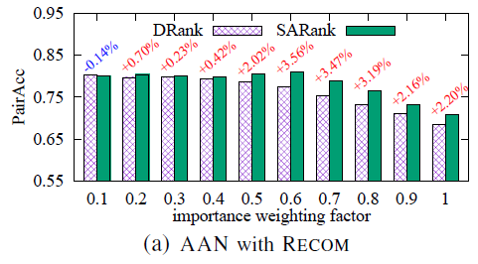
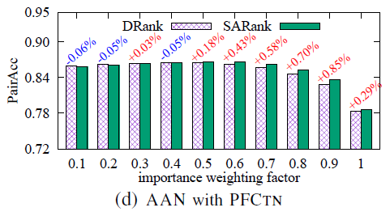
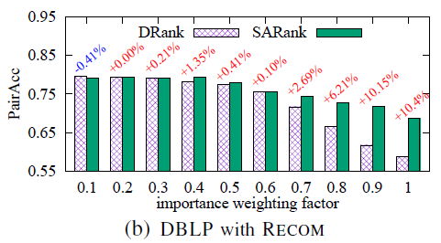
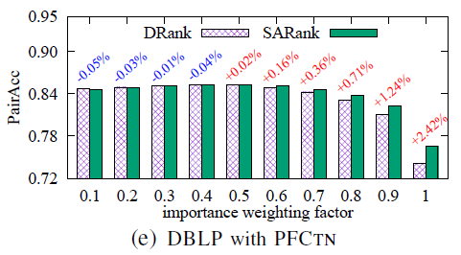
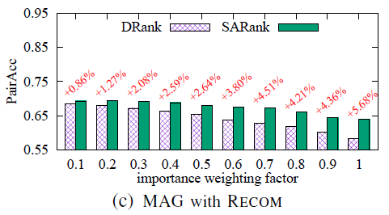
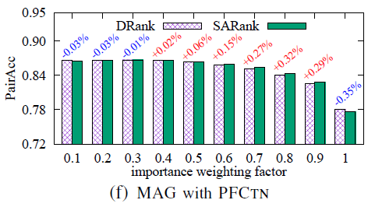
SARank vs. DRank(exponentially decay directly)
TWPR generally ranks better than directly decaying

