Slide 1


Dynamic News Recommendation with
Hierarchical Attention Network
Hui Zhang^{1,2}, Xu Chen³, Shuai Ma^{1,2}
¹SKLSDE Lab, Beihang University, China
²Beijing Advanced Innovation Center for Big Data and Brain Computing
³School of Software, Tsinghua University, China
Notes:
Good afternoon, everyone.
My name is Hui Zhang.
Today I will be presenting our work: Dynamic News Recommendation with Hierarchical Attention Network.
This is a joint work with Xu Chen and Shuai Ma.

Slide 2
Outline
News Recommendation Problem
DNA: A Dynamic Model with Hierarchical Attention Network
Experimental Study
Conclusions
Notes:
This is the outline of our talk.
Now, we introduce the news recommendation problem.

Slide 3



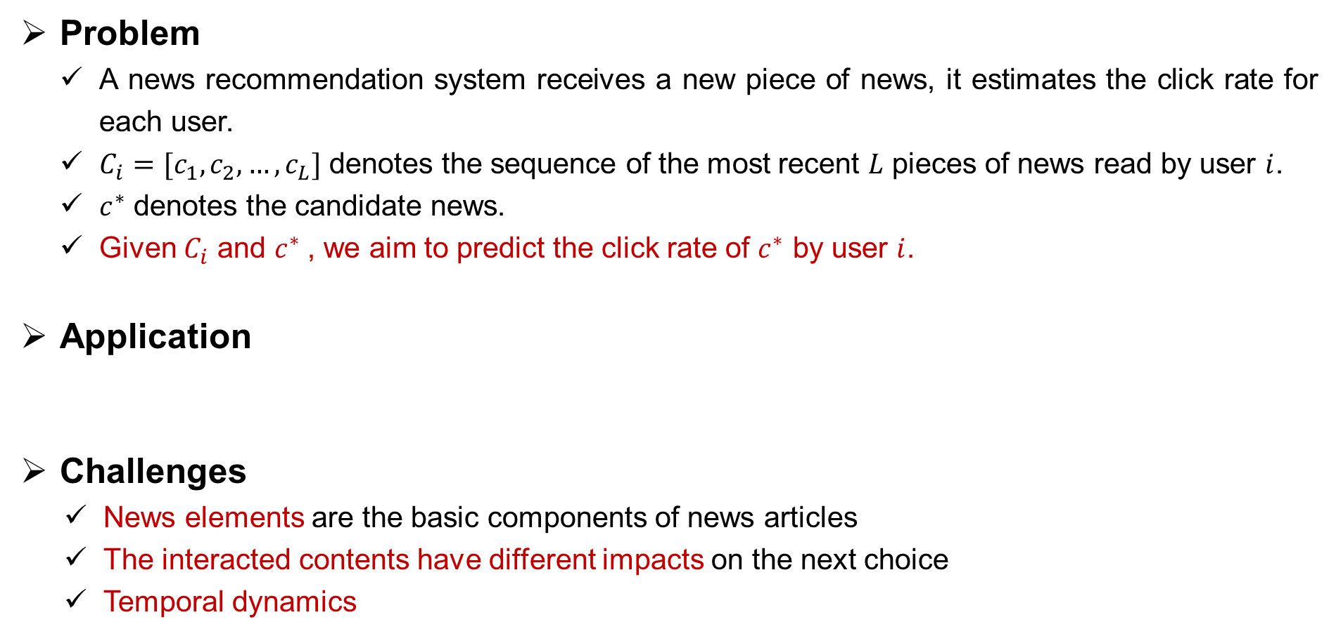
News Recommendation Problem
Problem
A news recommendation system receives a new piece of news, it estimates the click rate for each user.
$C_{i}=[c_{1},c_{2},…,c_{L}]$ denotes the sequence of the most recent $L$ pieces of news read by user $i$.
$c^{∗}$ denotes the candidate news.
Given $C_{i}$ and $c^{∗}$, we aim to predict the click rate of $c^{∗}$ by user $i$.
Application
Challenges
News elements are the basic components of news articles
The interacted contents have different impacts on the next choice
Temporal dynamics
Notes:
Assuming there is a news recommendation system offering services to a set of users.
Once the system receives a new piece of news, it estimates the click rate for each user.
$C_{i}$ (C i) denotes the sequence of the most recent $L$ pieces of news read by user $i$.
$c^{∗}$ (C star) denotes the candidate news.
Given the above two, we aim to predict the click rate of $c^{∗}$ by user i.
Nowadays, this problem is widely deployed to on-line news platforms, such as google news and bing news.
However, there are some challenges.
First, News elements are the basic components of news articles.
Second, the previously interacted contents usually have different impacts on the next choice.
Third, the temporal dynamics is significant in news recommendation.

Slide 4
Outline
The News Recommendation Problem
DNA: A Dynamic Model with Hierarchical Attention Network
Experimental Study
Conclusions
Notes:
To this end, we propose DNA model.

Slide 5
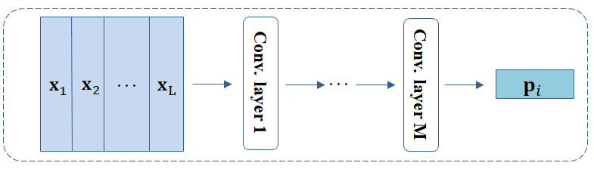
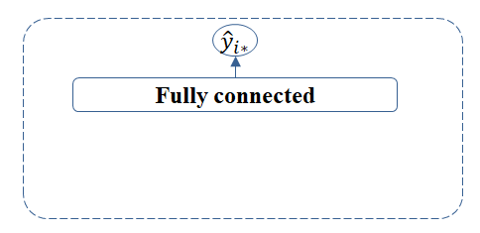
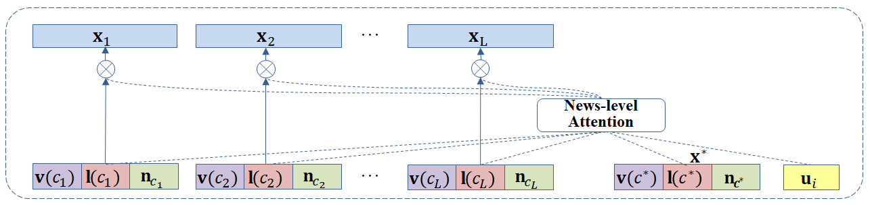
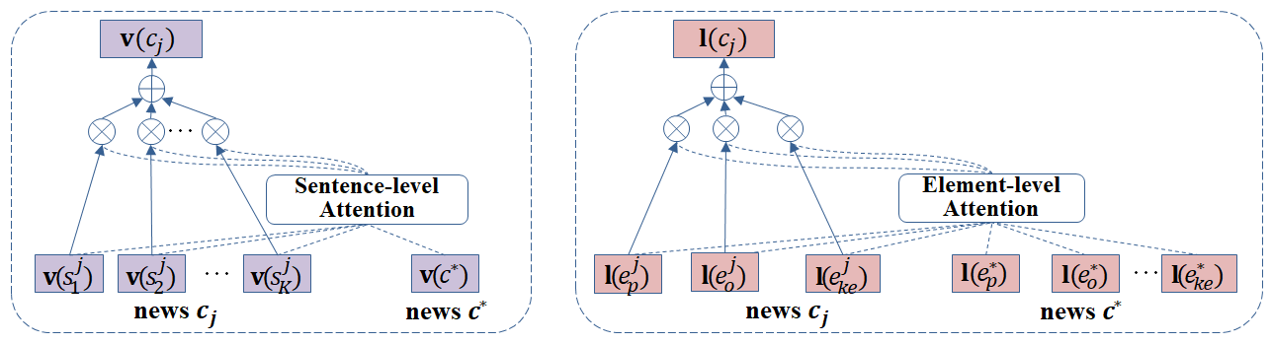
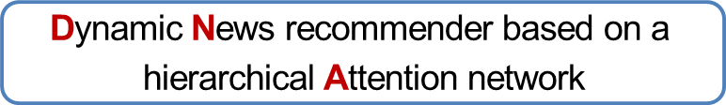

Our DNA Model
News elements
5W1H(who, when, where, what, why, how)
defined by ourselves (person, organization, time, location, keywords)
Multiple granularities
news-level : $\left[c_{1},c_{2},…,c_{L}\right]$
sentence-level: $\left[s_{1}^{j},s_{2}^{j},…,s_{K}^{j}\right]$
element-level : $\{e_{p}^{j},e_{o}^{j},e_{t}^{j},e_{l}^{j},e_{ke}^{j}\}$
Input & output
input: sequence $C_{i}$, candidate news $c^{∗}$
output: click rate of $c^{∗}$ by user $i$
Main components
hierarchical attention layers
convolutional layers
fully-connected layers
$$\text{D}\text{ynamic} \text{N}\text{ews} \text{recommender} \text{based} \text{on} \text{a} \text{hierarchical} \text{A}\text{ttention} \text{network}$$
Notes:
First we introduce news elements that are known as five W one H.
We define them by ourselves that are person, organization, time, location and keywords.
They can be easily extracted by NLP tools.
News articles can be modeled from multiple granularities: news-, sentence- and element-level.
Formally, c, s and e represent news, sentence and element respectively.
The inputs of DNA are news sequence $C_{i}$ and candidate news $c^{∗}$, and the output is the click rate.
It has three main components:
The first is the hierarchical attention layers. Specifically, the lower layer contains the sentence- and element-level attention. The upper layer is the news-level attention.
The second is the convolutional layers.
The third is the fully-connected layers.

Slide 6
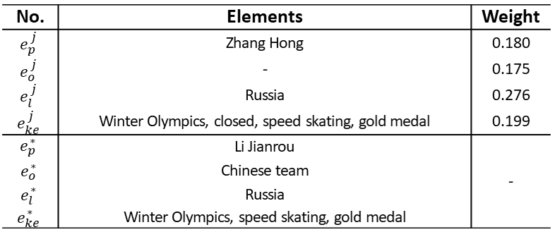
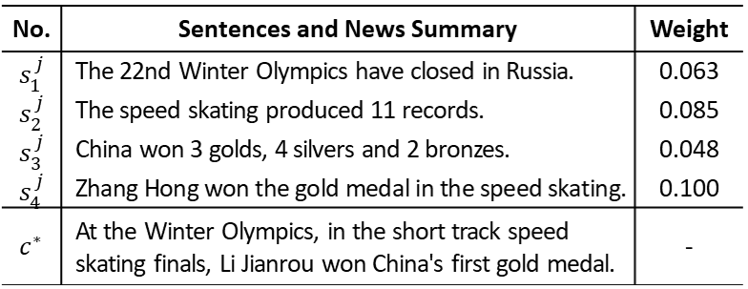
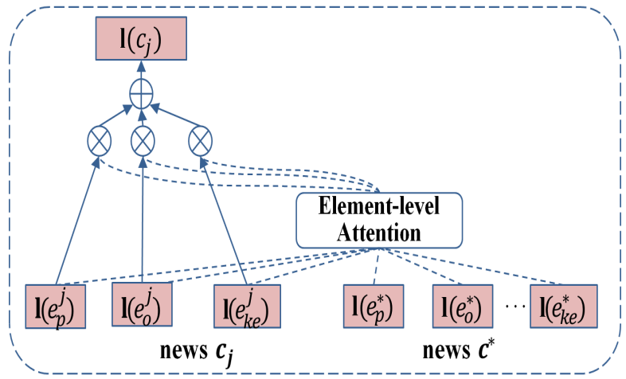
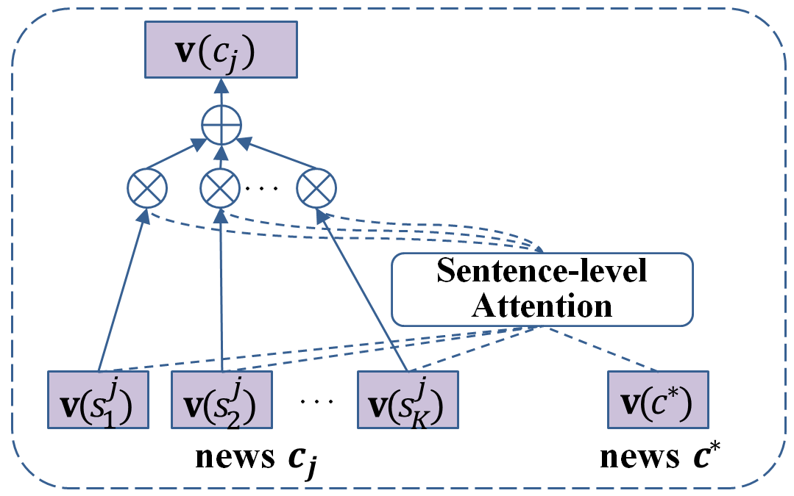
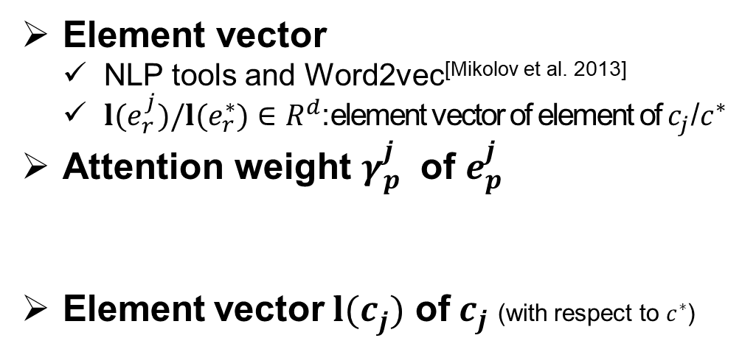
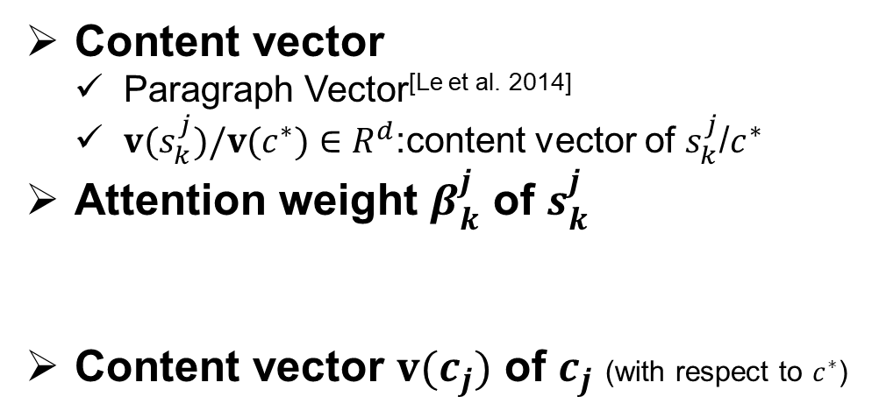
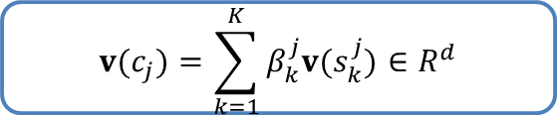
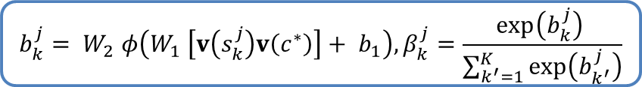
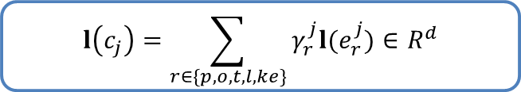
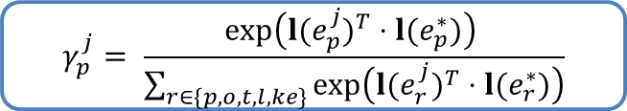
Sentence-level Attention & Element-level Attention
Content vector
Paragraph Vector^{[Le et al. 2014]}
${v(s}_{k}^{j})/{v(c}^{∗})∈R^{d}$:content vector of $s_{k}^{j}$/$c^{∗}$
Attention weight $β_{k}^{j}$ of $s_{k}^{j}$
Content vector $v(c_{j})$ of $c_{j}$ (with respect to $c^{∗}$)
Element vector
NLP tools and Word2vec^{[Mikolov et al. 2013]}
${l(e}_{r}^{j})/{l(e}_{r}^{∗})∈R^{d}$:element vector of element of $c_{j}$/$c^{∗}$
Attention weight $γ_{p}^{j}$ of $e_{p}^{j}$
Element vector ${l(c}_{j}^{})$ of $c_{j}$ (with respect to $c^{∗}$)
$$b_{k}^{j}= W_{2} φ\left(W_{1} \left[v\left(s_{k}^{j}\right)v\left(c^{∗}\right)\right]+ b_{1}\right), β_{k}^{j}=\frac{exp\left(b_{k}^{j}\right) }{\sum_{k^{′}=1}^{K}{exp\left(b_{k^{′}}^{j}\right)}}$$
$$γ_{p}^{j}= \frac{exp\left({{l(e}_{p}^{j})}^{T}⋅{l(e}_{p}^{∗})\right) }{\sum_{r∈\{p,o,t,l,ke\}}{exp\left({{l(e}_{r}^{j})}^{T}⋅{l(e}_{r}^{∗})\right)}}$$
$$v(c_{j})=\sum_{k=1}^{K}{β_{k}^{j}v(s_{k}^{j})}∈R^{d}$$
$$l\left(c_{j}\right)=\sum_{r∈\{p,o,t,l,ke\}}{γ_{r}^{j}l(e_{r}^{j})}∈R^{d}$$
Q. V. Le and T. Mikolov. Distributed representations of sentences and documents. In ICML, 2014.
T. Mikolov, K. Chen, G. Corrado, and J. Dean. Efficient estimation of word representations in vector space. In ICLR, 2013.
Notes:
First of all, we introduce the sentence-level attention.
We utilize Paragraph Vector to obtain content vectors.
And we compute attention weight for each sentence.
Then the content vector of news $c_{j}$ is calculated as a weighted sum.
The table presents a case study. It shows that sentences that are content-relevant to the candidate news are assigned large weights.
Next, we introduce the element-level attention.
It is similar to the sentence-level attention.
However, in the first step, we apply NLP tools to extract elements and utilize Word2vec to obtain element vectors.
We also present a case study and get a similar conclusion.

Slide 7

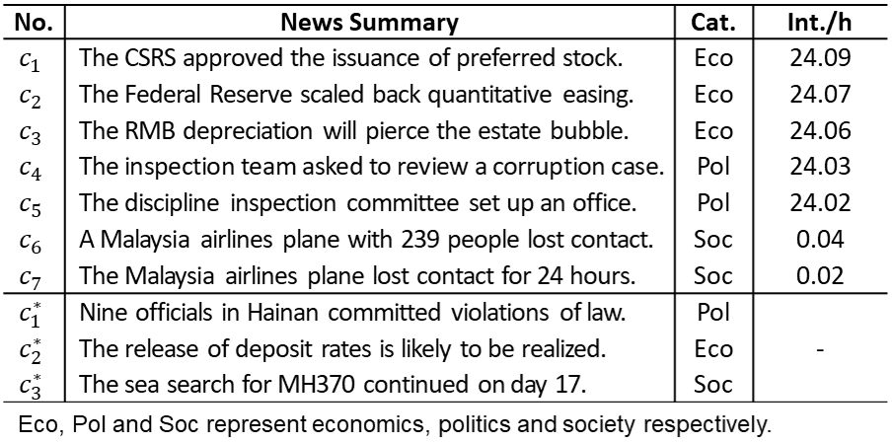
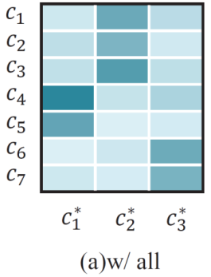
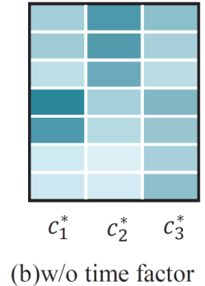
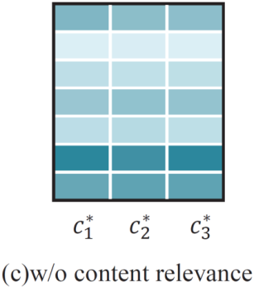
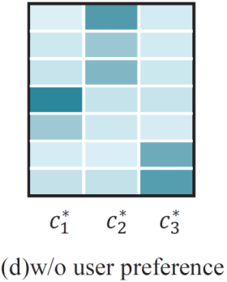
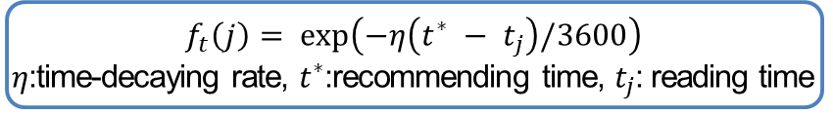


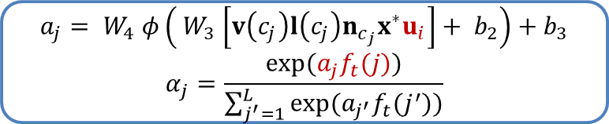
News-level Attention
news embedding
user embedding
Attention weight $α_{j}$ of $c_{j}$
Time-decaying factor $f_{t}\left(j\right)$
Representation $x_{j}$ of $c_{j}$ (with respect to $c^{∗}$)
$$a_{j}= W_{4} φ\left({ W}_{3} \left[v\left(c_{j}\right)l\left(c_{j}\right)n_{c_{j}}x^{∗}u_{i}\right]+ b_{2}\right)+b_{3}$$
$$α_{j}=\frac{exp(a_{j}f_{t}(j))}{\sum_{j^{′}=1}^{L}{exp(a_{j^{′}}f_{t}(j^{′}))}}$$
$$f_{t}\left(j\right)= exp\left(−η\left(t^{∗} − t_{j}\right)/3600\right)$$
$η$:time-decaying rate, $t^{∗}$:recommending time, $t_{j}$: reading time
$$x_{j} =α_{j} [v\left(c_{j}\right)l(c_{j})n_{c_{j}}]∈R^{3d}$$
dynamics / content relevance / user preferences
Lei Li , et al. Modeling and broadening temporal user interest in personalized news recommendation. In ESWA, 2014.
Notes:
Then, we introduce the news-level attention.
In this layer, we learn an embedding for each news and each user.
News embedding provides a way to measure similarity and user embedding reflects user preferences.
So far, we have obtained content vector, element vector and news embedding for each news.
Based on them, we compute attention weight for each news.
In this process, we incorporate the time-decaying factor.
We aim to model the temporal dynamics of user reading behaviors.
This idea comes from that people tend to read similar news contents in a short time.
Finally, we compute the representation of news $c_{j}$.
The table presents a case study.
In short, the attention weights are related to the dynamics, the content relevance to c* and the consistency with user preferences.

Slide 8
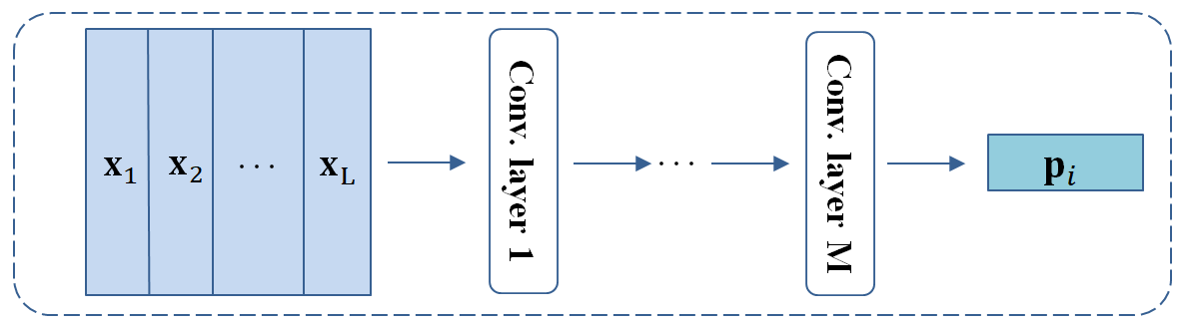
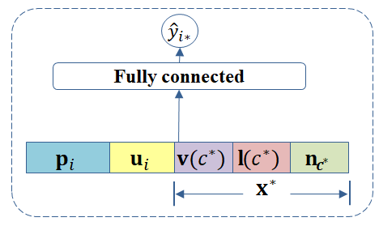
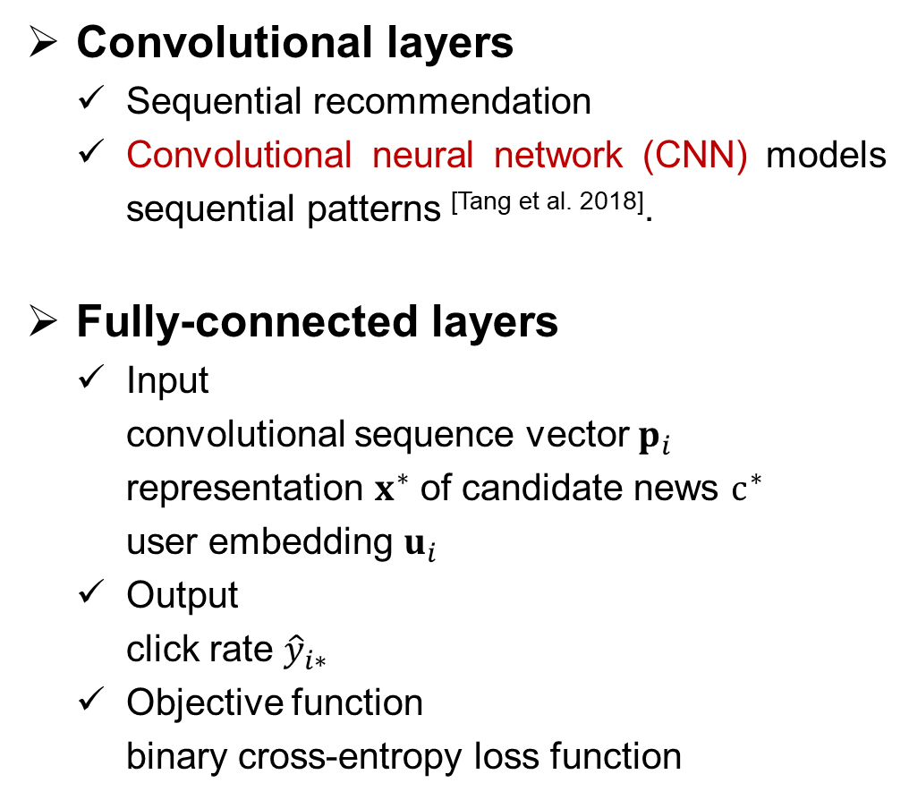
Convolutional Layers & Fully-connected Layers
Convolutional layers
Sequential recommendation
Convolutional neural network (CNN) models sequential patterns ^{[Tang et al. 2018]}.
Fully-connected layers
Input
convolutional sequence vector $p_{i}$
representation $x^{∗}$ of candidate news $c^{∗}$
user embedding $u_{i}$
Output
click rate ${\hat{y}}_{i∗}$
Objective function
binary cross-entropy loss function
convolutional sequence vector
J. Tang and K. Wang. Personalized top-n sequential recommendation via convolutional sequence embedding. In WSDM, 2018.
Notes:
Due to the sequential characteristic of news-reading, we exploit multiple convolutional layers to capture sequential patterns.
In the last layer, we obtain the convolutional sequence vector pi for user i.
Finally, we feed these vectors into the fully-connected layers to estimate the click rate.

Slide 9
Outline
The News Recommendation Problem
DNA: A Dynamic Model with Hierarchical Attention Network
Experimental Study
Conclusions
Notes:
Now, we show the experimental study.

Slide 10
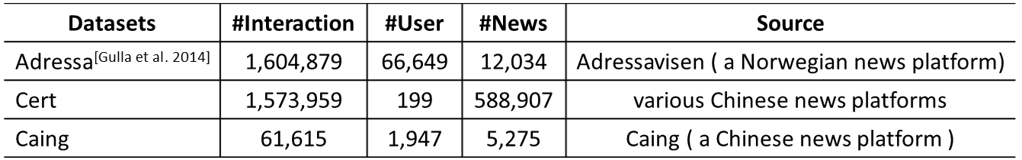
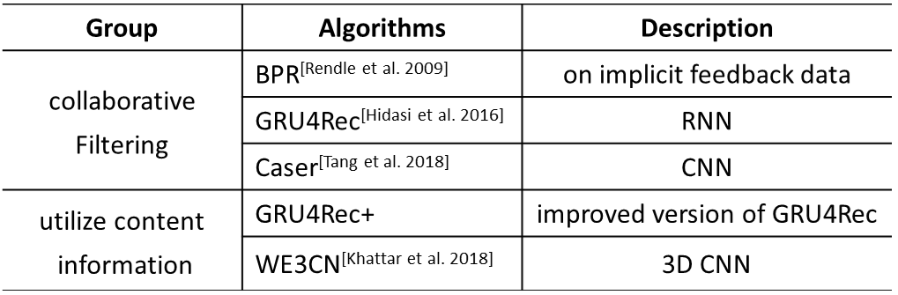
Experimental Setup
Real-world Datasets
Algorithms
Metrics
Hit Ratio (HR)
Normalized Discounted Cumulative Gain (NDCG)
J. A. Gulla, et al. The adressa dataset for news recommendation. In Proceedings of the International Conference on Web Intelligence, 2017.
S. Rendle, C. Freudenthaler, Z. Gantner, and L. Schmidt-Thieme. BPR: bayesian personalized ranking from implicit feedback. In UAI, 2009.
B. Hidasi, A. Karatzoglou, L. Baltrunas, and D. Tikk. Session-based recommendations with recurrent neural networks. In ICLR, 2016.
J. Tang and K. Wang. Personalized top-n sequential recommendation via convolutional sequence embedding. In WSDM, 2018.
D. Khattar, V. Kumar, V. Varma, and M. Gupta. Weave&rec: A word embedding based 3-d convolutional network for news recommendation. In CIKM, 2018.
Notes:
We conduct experiments on three real-world datasets that contain reading logs from news platforms.
The first dataset is in Norwegian and the last two are in Chinese.
We compare our model with the following algorithms.
The first group only includes collaborative filtering algorithms, that are BPR, GRU4Rec and Caser.
The second group includes algorithms that utilize content information, that are GRU4Rec+ and WE3CN.

Slide 11
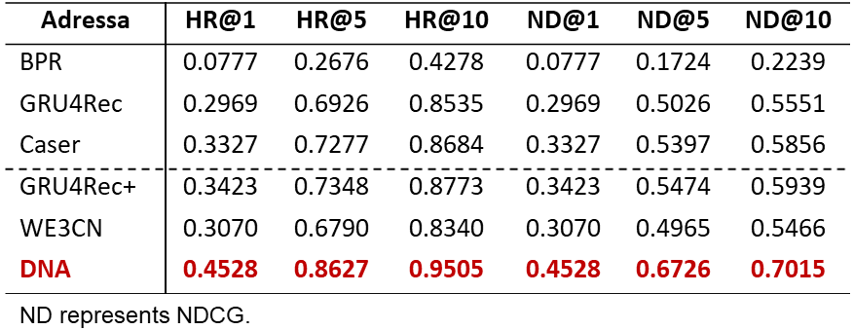
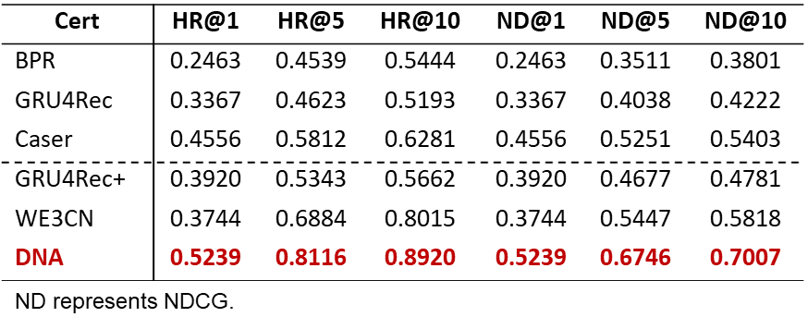
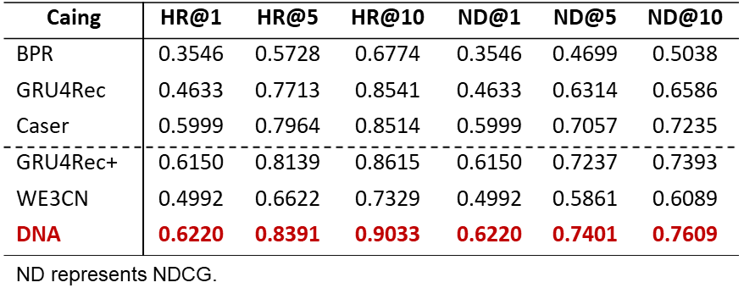
Performance Comparison
DNA consistently performs better than others.
Sequential information improves performance.
Content information improves performance.
Notes:
We compare our DNA model with other algorithms on three datasets.
The results indicate that our DNA model consistently performs better than others.
Moreover, sequential information and content information both improve performance.

Slide 12
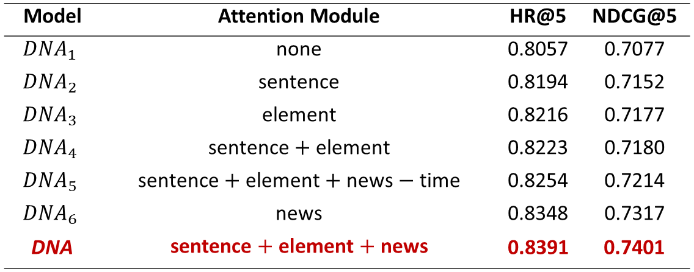
Impacts of Attention
The sentence-, element- and news-level attention modules all improve performance significantly, and the time-decaying factor is also effective.
Notes:
Then we evaluate the impacts of attention.
Without any attention modules, the first row of the table performs the worst.
With sentence-, element- and news-level attention respectively, all three models achieve better performance.
In short, these attention modules all improve performance significantly, and the time-decaying factor is also effective.

Slide 13
Outline
The News Recommendation Problem
DNA: A Dynamic Model with Hierarchical Attention Network
Experimental Study
Conclusions
Notes:
Let’s summarize our talk.

Slide 14
Conclusions
Proposing DNA model for news recommendation
multi-granularity modeling: sentence-level, element-level, news-level
hierarchical attention layers: discriminate influences of previously interacted contents
time-decaying factor: temporal dynamics
Experimental study
DNA model consistently performs better than others
The attention modules all improve performance
Future work
investigate more time functions
incorporate more information, e.g., knowledge graph
Notes:
We propose DNA model for news recommendation.
It models news articles from multiple granularities, designs the hierarchical attention layers and incorporates the time-decaying factor.
In experimental study, DNA model consistently performs better than others.
The following is our future work.

Slide 15
Thanks!
Q & A
Notes:
That’s all. Thank you for listening.

Slide 16
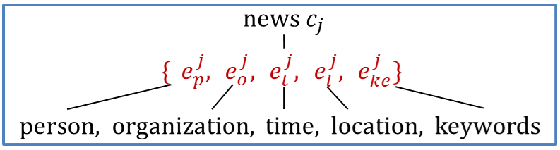
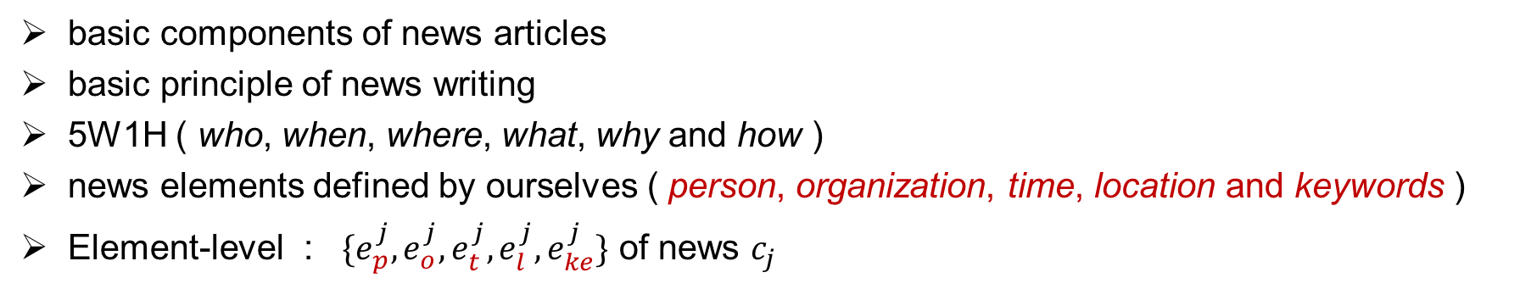
News elements
basic components of news articles
basic principle of news writing
5W1H ( who, when, where, what, why and how )
news elements defined by ourselves ( person, organization, time, location and keywords )
Element-level : $\{e_{p}^{j},e_{o}^{j},e_{t}^{j},e_{l}^{j},e_{ke}^{j}\}$ of news $c_{j}$
Notes:
The relationship between each e and the corresponding element is shown in the figure.

Slide 17







Convolutional Layers
Process of convolution
Feature map $E∈ R^{L×3d}$
…
$$x_{1}^{}$$
$$x_{2}^{}$$
$$x_{L}^{}$$
new feature map
$$E^{′}∈ R^{(L−h+1)×m}$$
convolution filters $F^{q}∈ R^{h×3d}$
$×m$
J. Tang and K. Wang. Personalized top-n sequential recommendation via convolutional sequence embedding. In WSDM, 2018.

Slide 18
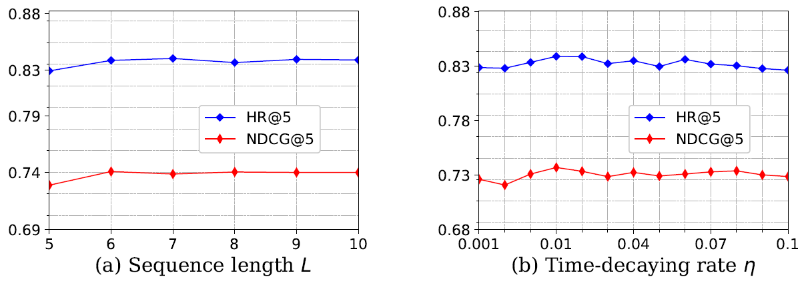
Parameter Sensitivity

