Slide 1


Dual-View Variational Autoencoders for Semi-Supervised Text Matching
Zhongbin Xie and Shuai Ma
SKLSDE Lab, Beihang University, China
Beijing Advanced Innovation Center for Big Data and Brain Computing

Slide 2
Outline
Introduction
Dual-View Variational Autoencoder
Model Architecture
Objective
Model Implementation
Implicit Co-Training
Experiments
Summary

Slide 3
Outline
Introduction
Dual-View Variational Autoencoder
Model Architecture
Objective
Model Implementation
Implicit Co-Training
Experiments
Summary

Slide 4
Introduction
Text Matching
To compute the matching degree between two sentences and determine their relationship.
Related NLP tasks: Paraphrase Identification, Question Answering, Natural Language Inference, etc.
Sentence 1: I am making a presentation at IJCAI’19.
Sentence 2: I am speaking in front of a large audience.
Relationship: ENTAILMENT

Slide 5
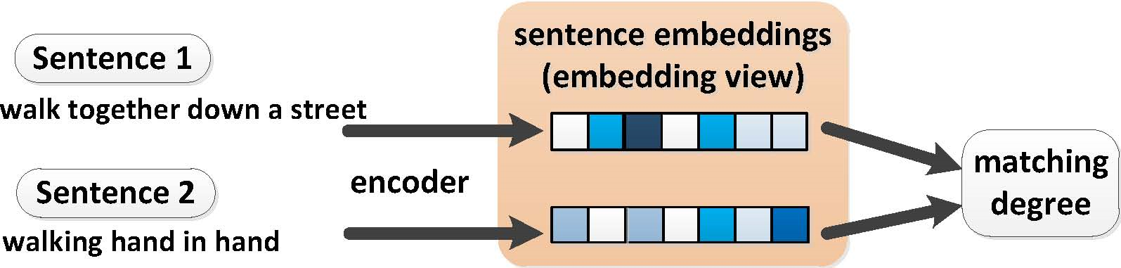
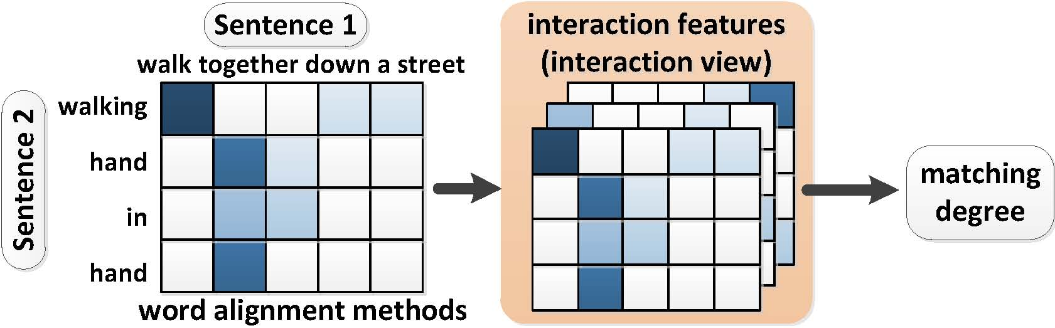
Introduction Two categories of supervised matching models [Lan and Xu, 2018]
Sentence encoding-based models: leverage sentence-level embeddings features
Sentence pair interaction models: leverage word alignment methods (interaction matrices, attention, etc.) to get word-level interaction features
Wuwei Lan and Wei Xu. Neural network models for paraphrase identification, semantic textual similarity, natural language inference, and question answering. In COLING, 2018.

Slide 6
Introduction Motivations
Semi-supervised matching models at present:
VAE + Sentence encoding-based models [Shen et al., 2018; Bowman et al., 2016]
Limited to sentence-level embedding features, leaving out the word-level interaction features
We propose to unify the sentence-level embedding features and the word-level interaction features within a VAE:
Take the two kinds of features as two distinct views of a sentence pair
In each of the generative and inference model of a VAE, we adopt a matching model on one of the two views
Dual-View Variational Autoencoder (DV-VAE)
have been proved to be important in the supervised case
Dinghan Shen, Yizhe Zhang, Ricardo Henao, Qinliang Su, and Lawrence Carin. Deconvolutional latent-variable model for text sequence matching. In AAAI, 2018.
Samuel R. Bowman, Luke Vilnis, Oriol Vinyals, Andrew M. Dai, Rafal J´ozefowicz, and Samy Bengio. Generating sentences from a continuous space. In CoNLL, 2016.

Slide 7
Outline
Introduction
Dual-View Variational Autoencoder
Model Architecture
Objective
Model Implementation
Implicit Co-Training
Experiments
Summary

Slide 8
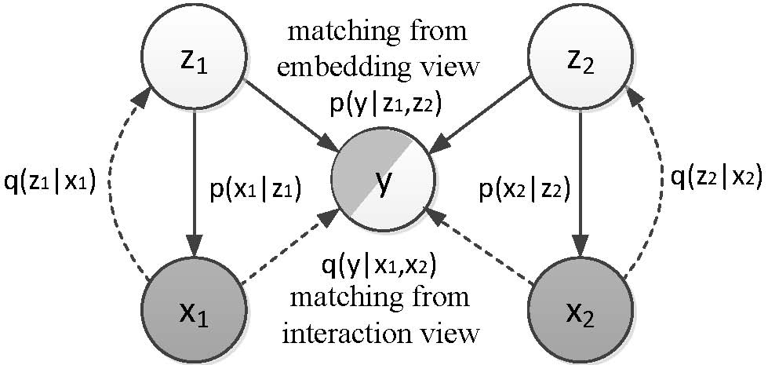
Dual-View Variational Autoencoder Model Architecture - Probabilistic Graphical Model
x₁, x₂ are two sentences
z₁, z₂ are two latent variables used to generate x₁ and x₂
y is the matching degree (discrete value, classification problem)

Slide 9
Dual-View Variational Autoencoder Model Architecture - Generative & Inference Model
Generative Model (solid lines):
$$p_{θ}\left(x_{1},x_{2},y,z_{1},z_{2}\right)={p(z_{1})p}_{θ}\left(x_{1}|z_{1}\right){p(z_{2})p}_{θ}\left(x_{2}|z_{2}\right)p_{θ}\left(y|z_{1},z_{2}\right)$$
embedding matcher
(sentence encoding-based model)
decoder
Inference Model (dashed lines):
$$q_{φ}\left(z_{1},z_{2} | x_{1},x_{2},y\right)=q_{φ}\left(z_{1} | x_{1}\right)q_{φ}\left(z_{2} | x_{2}\right)$$
(labeled case)
(unlabeled case)
$$q_{φ}\left(z_{1},z_{2},y | x_{1},x_{2}\right)=q_{φ}\left(y | x_{1},x_{2}\right)q_{φ}\left(z_{1} | x_{1}\right)q_{φ}\left(z_{2} | x_{2}\right)$$
interaction matcher
(sentence pair interaction model)
encoder
9

Slide 10
Outline
Introduction
Dual-View Variational Autoencoder
Model Architecture
Objective
Model Implementation
Implicit Co-Training
Experiments
Summary

Slide 11


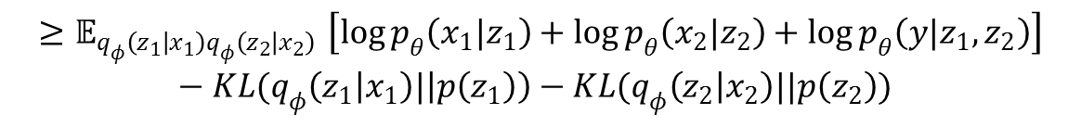


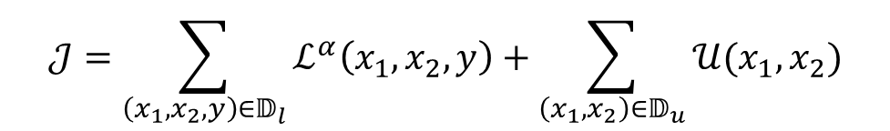
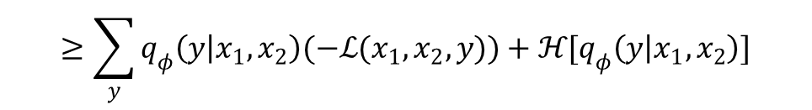
Dual-View Variational Autoencoder Objective (variational lower bounds)
Labeled case (x₁,x₂,y):
$$\log{p_{θ}\left(x_{1},x_{2},y\right)}$$
$${≥𝔼}_{q_{φ}\left(z_{1} | x_{1}\right)q_{φ}\left(z_{2} | x_{2}\right)}\left[\log{p_{θ}\left(x_{1}|z_{1}\right)}+\log{p_{θ}\left(x_{2}|z_{2}\right)}+\log{p_{θ}\left(y|z_{1},z_{2}\right)}\right]−KL(q_{φ}\left(z_{1} | x_{1}\right)|\left|p\left(z_{1}\right)\right)−KL(q_{φ}\left(z_{2} | x_{2}\right)||p\left(z_{2}\right))$$
$$≡−ℒ(x_{1},x_{2},y)$$
$$ℒ^{α}\left(x_{1},x_{2},y\right)= ℒ\left(x_{1},x_{2},y\right)+α[−\log{q_{φ}\left(y | x_{1},x_{2}\right)}]$$
Unlabeled case (x₁,x₂):
$$\log{p_{θ}\left(x_{1},x_{2}\right)}$$
$$≥\sum_{y}{q_{φ}\left(y | x_{1},x_{2}\right)(−ℒ(x_{1},x_{2},y))}+ℋ[q_{φ}\left(y | x_{1},x_{2}\right)]$$
$$≡−𝒰(x_{1},x_{2})$$
Objective:
$$𝒥=\sum_{\left(x_{1},x_{2},y\right)∈𝔻_{l}}{ℒ^{α}\left(x_{1},x_{2},y\right)}+\sum_{\left(x_{1},x_{2}\right)∈𝔻_{u}}{𝒰(x_{1},x_{2})}$$

Slide 12
Outline
Introduction
Dual-View Variational Autoencoder (DV-VAE)
Model Architecture
Objective
Model Implementation
Implicit Co-Training
Experiments
Summary

Slide 13
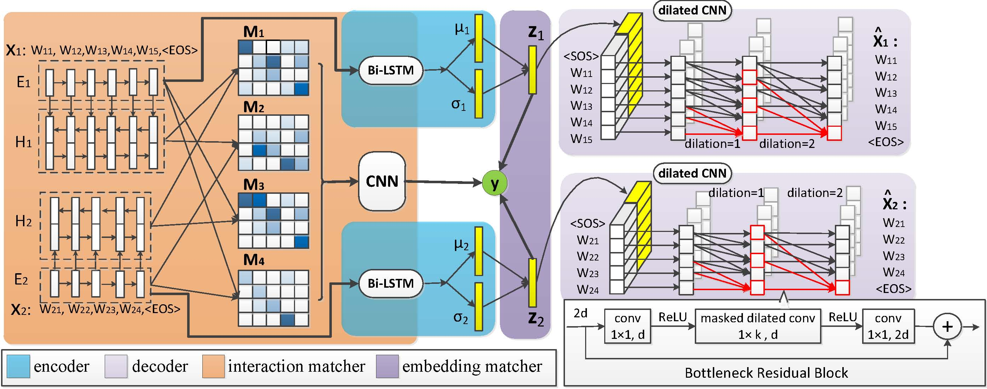
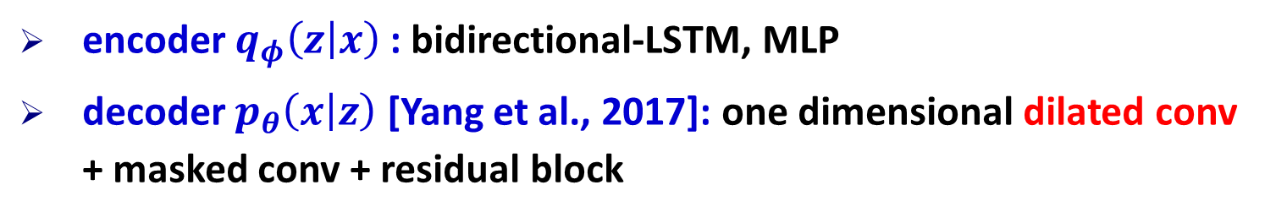
Dual-View Variational Autoencoder Model Implementation
encoder $q_{φ}\left(z | x\right)$: bidirectional-LSTM, MLP
decoder $p_{θ}\left(x | z\right)$ [Yang et al., 2017]: one dimensional dilated conv + masked conv + residual block
Zichao Yang, Zhiting Hu, Ruslan Salakhutdinov, and Taylor Berg-Kirkpatrick. Improved variational autoencoders for text modeling using dilated convolutions. In ICML, 2017.

Slide 14
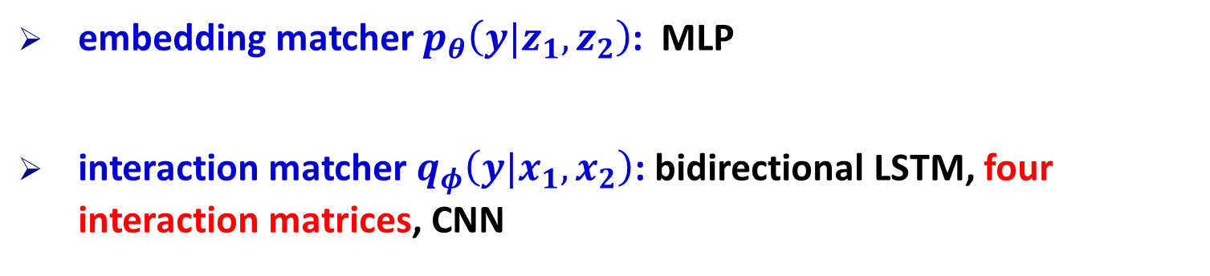
Dual-View Variational Autoencoder Model Implementation
embedding matcher $p_{θ}\left(y|z_{1},z_{2}\right)$: MLP
interaction matcher $q_{φ}\left(y|x_{1},x_{2}\right)$: bidirectional LSTM, four interaction matrices, CNN
$$p_{θ}\left(y|z_{1},z_{2}\right)=softmax(MLP[z_{1};z_{2};z_{1}−z_{2};z_{1}⊙z_{2}])$$

Slide 15
Outline
Introduction
Dual-View Variational Autoencoder (DV-VAE)
Model Architecture
Objective
Model Implementation
Implicit Co-Training
Experiments
Summary

Slide 16
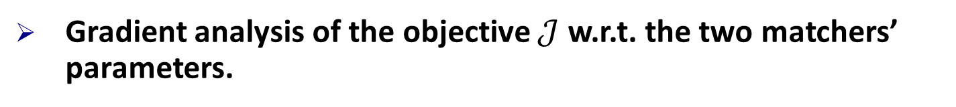
Implicit Co-Training How the two matchers are simultaneously trained in DV-VAE?
Gradient analysis of the objective $𝒥$ w.r.t. the two matchers’ parameters.
Conclusion:
On labeled examples, the two matchers are independently trained, just as in supervised learning.
On unlabeled examples,
Provides reward signals
embedding matcher
interaction matcher
Provides weighting coefficient
An alternative way of providing pseudo labels for each other on unlabeled data (implicit Co-Training).

Slide 17
Outline
Introduction
Dual-View Variational Autoencoder (DV-VAE)
Model Architecture
Objective
Model Implementation
Implicit Co-Training
Experiments
Summary

Slide 18
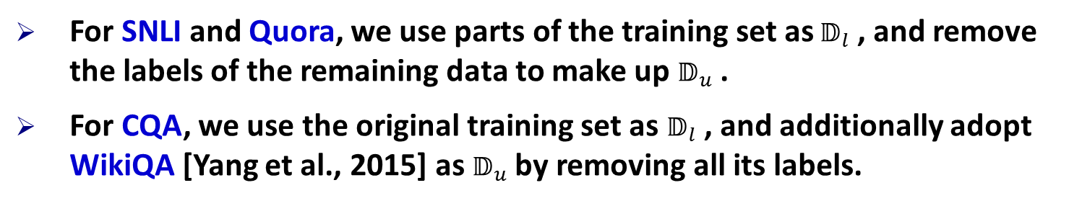
Experiments Experimental Setup
Datasets
Datasets (Text Matching Problem) | #Train | #Dev | #Test | #Classes
SNLI (Natural Language Inference) | 549,367 | 9,842 | 9,842 | 3
Quora (Paraphrase Identification) | 384,348 | 10,000 | 10,000 | 2
CQA (Community Question Answering) | 16,541 | 1,645 | 1,0976 | 3
For SNLI and Quora, we use parts of the training set as$𝔻_{l}$ , and remove the labels of the remaining data to make up $𝔻_{u}$ .
For CQA, we use the original training set as $𝔻_{l}$ , and additionally adopt WikiQA [Yang et al., 2015] as $𝔻_{u}$ by removing all its labels.
Yi Yang, Wen-tau Yih, and Christopher Meek. Wikiqa: A challenge dataset for open-domain question answering. In EMNLP, 2015.

Slide 19
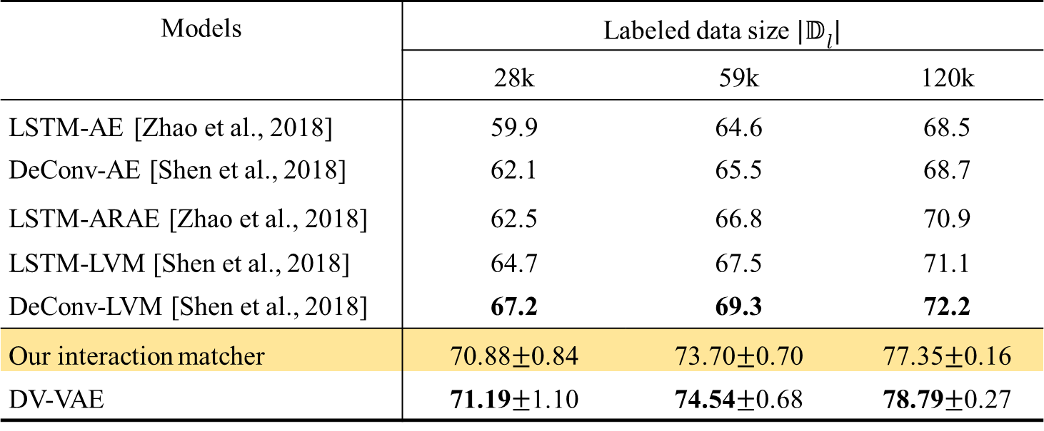
Experiments Matching accuracy on SNLI (in %)
Models | Labeled data size ${|𝔻}_{l}|$
 | 28k | 59k | 120k
LSTM-AE [Zhao et al., 2018] | 59.9 | 64.6 | 68.5
DeConv-AE [Shen et al., 2018] | 62.1 | 65.5 | 68.7
LSTM-ARAE [Zhao et al., 2018] | 62.5 | 66.8 | 70.9
LSTM-LVM [Shen et al., 2018] | 64.7 | 67.5 | 71.1
DeConv-LVM [Shen et al., 2018] | 67.2 | 69.3 | 72.2
Our interaction matcher | 70.88$±$0.84 | 73.70$±$0.70 | 77.35$±$0.16
DV-VAE | 71.19$±$1.10 | 74.54$±$0.68 | 78.79$±$0.27
Demonstrate the importance of incorporating the interaction view in DV-VAE
Verify DV-VAE’s effectiveness on using unlabeled data to improve supervised learning
Dinghan Shen, Yizhe Zhang, Ricardo Henao, Qinliang Su, and Lawrence Carin. Deconvolutional
latent-variable model for text sequence matching. In AAAI, 2018.
Junbo Jake Zhao, Yoon Kim, Kelly Zhang, Alexander M. Rush, and Yann LeCun. Adversarially
regularized autoencoders. In ICML, 2018.

Slide 20
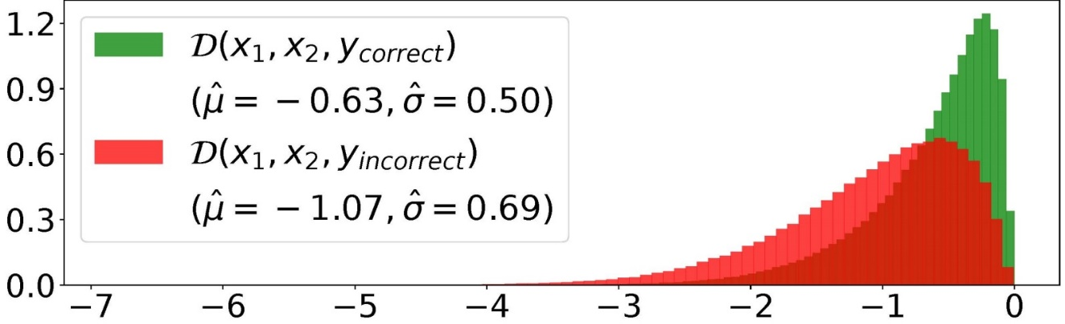

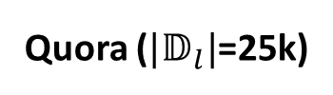
Experiments Model Visualization
Visualize the distributions of the reward signals,
The reward signal can distinguish between correct and incorrect ys predicted by the interaction matcher.
Demonstrate the REINFORCE analogy in the implicit co-training mechanism.
Quora (${|𝔻}_{l}|$=25k)
Generate sentence pairs and their matching degrees by sampling from DV-VAE.
DV-VAE can generate meaningful sentence pairs and correct relationships.
Demonstrate DV-VA’Es capability of learning the data manifold useful for semi-supervised learning.
x₁: a group of people are riding on a roller coaster .
x₂: there is a group of people playing soccer .
y: CONTRADICTION
SNLI (${|𝔻}_{l}|$=28k)
20
20

Slide 21
Outline
Introduction
Dual-View Variational Autoencoder (DV-VAE)
Model Architecture
Objective
Model Implementation
Implicit Co-Training
Experiments
Summary

Slide 22
Summary
Proposed Dual-View Variational Autoencoder (DV-VAE) to unify the embedding view and the interaction view of a sentence pair.
Analyzed the training process of DV-VAE and revealed an implicit Co-Training mechanism.
Verified DV-VAE’s effectiveness on semi-supervised text matching through 3 challenging datasets.
22
22

Slide 23
Thanks! Q&A
23

Slide 24
Appendix 4-1
Derivation of the Generative & Inference Model
24

Slide 25
Dual-View Variational Autoencoder Model Architecture - Generative Model
Generative Model (solid lines):
$$p_{θ}\left(x_{1},x_{2},y,z_{1},z_{2}\right)={p(z_{1})p}_{θ}\left(x_{1}|z_{1}\right){p(z_{2})p}_{θ}\left(x_{2}|z_{2}\right)p_{θ}\left(y|z_{1},z_{2}\right)$$
embedding matcher
(sentence encoding-based model)
decoder
Inference Model (dashed lines)
25

Slide 26

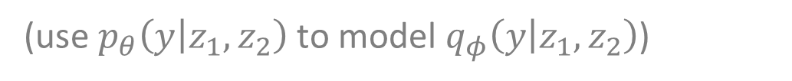

Dual-View Variational Autoencoder Model Architecture - Inference Model
Factorizing the variational posterior $q_{φ}\left(z_{1},z_{2},y | x_{1},x_{2}\right)$
Factorization order 1 (z₁, z₂, y):
$q_{φ}\left(z_{1},z_{2},y | x_{1},x_{2}\right)=q_{φ}\left(z_{1} | x_{1}\right)q_{φ}\left(z_{2} | x_{2}\right)$ $q_{φ}\left(y | z_{1},z_{2}\right)$
(conditionally independent variables are left out)
$=q_{φ}\left(z_{1} | x_{1}\right)q_{φ}\left(z_{2} | x_{2}\right)$ $p_{θ}\left(y | z_{1},z_{2}\right)$
(1)
(use $p_{θ}\left(y | z_{1},z_{2}\right)$ to model $q_{φ}\left(y | z_{1},z_{2}\right)$)
Factorization order 2 (y, z₁, z₂):
$$q_{φ}\left(z_{1},z_{2},y | x_{1},x_{2}\right)=q_{φ}\left(y | x_{1},x_{2}\right)q_{φ}\left({z_{1}, z}_{2} | {x_{1}, x}_{2}, y\right)$$
(2)
interaction matcher
(sentence pair interaction model)
Consistency assumption (in analogy to Co-Training):
$$q_{φ}\left(y | x_{1},x_{2}\right)=p_{θ}\left(y | z_{1},z_{2}\right)$$
(3)

Slide 27
Dual-View Variational Autoencoder Model Architecture - Inference Model
With (1), (2), (3), we obtain the Inference Model (dashed lines):
$$q_{φ}\left(z_{1},z_{2} | x_{1},x_{2},y\right)=q_{φ}\left(z_{1} | x_{1}\right)q_{φ}\left(z_{2} | x_{2}\right)$$
(labeled case)
$$q_{φ}\left(z_{1},z_{2},y | x_{1},x_{2}\right)=q_{φ}\left(y | x_{1},x_{2}\right)q_{φ}\left(z_{1} | x_{1}\right)q_{φ}\left(z_{2} | x_{2}\right)$$
(unlabeled case)
interaction matcher
(sentence pair interaction model)
encoder

Slide 28
Appendix 4-2
Derivation of Variational Lower Bounds
28

Slide 29

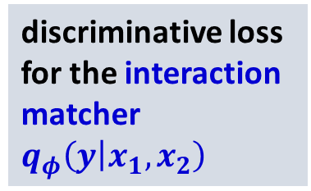

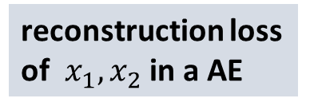
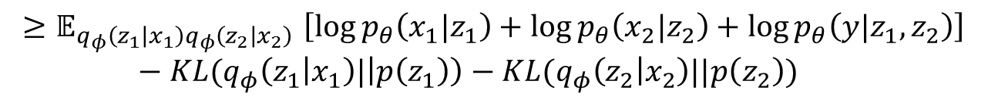
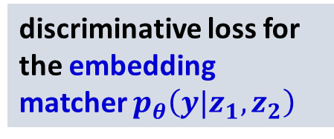

Dual-View Variational Autoencoder Objective (variational lower bounds)
Labeled case (x₁,x₂,y):
$$\log{p_{θ}\left(x_{1},x_{2},y\right)}$$
$${≥𝔼}_{q_{φ}\left(z_{1} | x_{1}\right)q_{φ}\left(z_{2} | x_{2}\right)}\left[\log{p_{θ}\left(x_{1}|z_{1}\right)}+\log{p_{θ}\left(x_{2}|z_{2}\right)}+\log{p_{θ}\left(y|z_{1},z_{2}\right)}\right]−KL(q_{φ}\left(z_{1} | x_{1}\right)|\left|p\left(z_{1}\right)\right)−KL(q_{φ}\left(z_{2} | x_{2}\right)||p\left(z_{2}\right))$$
$$≡−ℒ(x_{1},x_{2},y)$$
reconstruction loss of $x_{1},x_{2}$ in a AE
discriminative loss for the embedding matcher $p_{θ}\left(y|z_{1},z_{2}\right)$
Rewrite:
$$ℒ\left(x_{1},x_{2},y\right)=−ℛ\left(x_{1},x_{2}\right)−𝒟\left(x_{1},x_{2}\right)$$
$$+KL(q_{φ}\left(z_{1} | x_{1}\right)|\left|p\left(z_{1}\right)\right)+KL(q_{φ}\left(z_{2} | x_{2}\right)||p\left(z_{2}\right))$$
Labeled Objective:
discriminative loss for the interaction matcher $q_{φ}\left(y | x_{1},x_{2}\right)$
$$ℒ^{α}\left(x_{1},x_{2},y\right)= ℒ\left(x_{1},x_{2},y\right)+α[−\log{q_{φ}\left(y | x_{1},x_{2}\right)}]$$

Slide 30
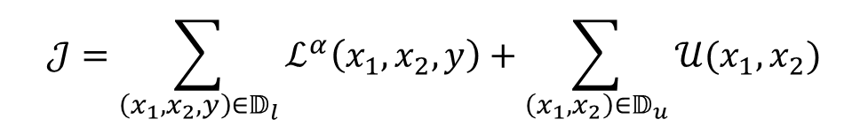

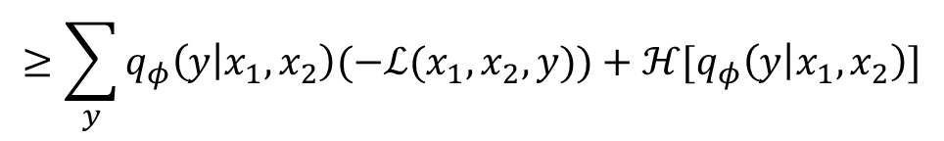

Dual-View Variational Autoencoder Objective (variational lower bounds)
Unlabeled case (x₁,x₂):
$$\log{p_{θ}\left(x_{1},x_{2}\right)}$$
$$≥\sum_{y}{q_{φ}\left(y | x_{1},x_{2}\right)(−ℒ(x_{1},x_{2},y))}+ℋ[q_{φ}\left(y | x_{1},x_{2}\right)]$$
$$≡−𝒰(x_{1},x_{2})$$
Overall Objective:
$$𝒥=\sum_{\left(x_{1},x_{2},y\right)∈𝔻_{l}}{ℒ^{α}\left(x_{1},x_{2},y\right)}+\sum_{\left(x_{1},x_{2}\right)∈𝔻_{u}}{𝒰(x_{1},x_{2})}$$

Slide 31
Appendix 4-3
Detailed Explanation of Implicit Co-Training
31

Slide 32
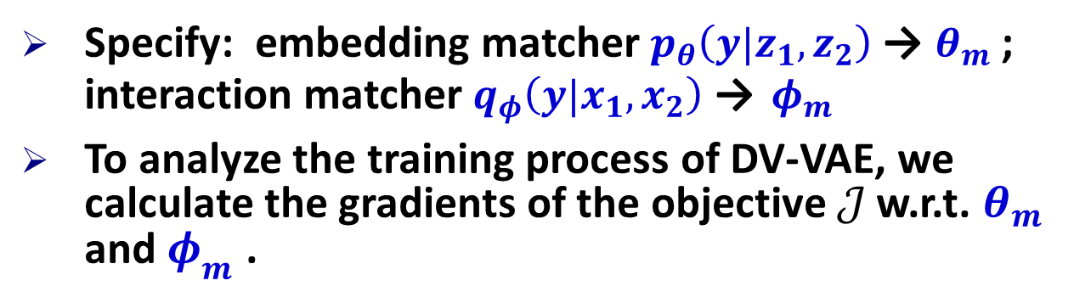
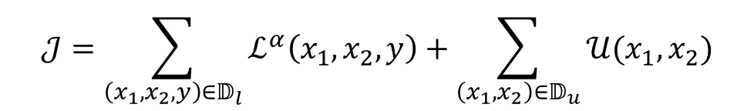
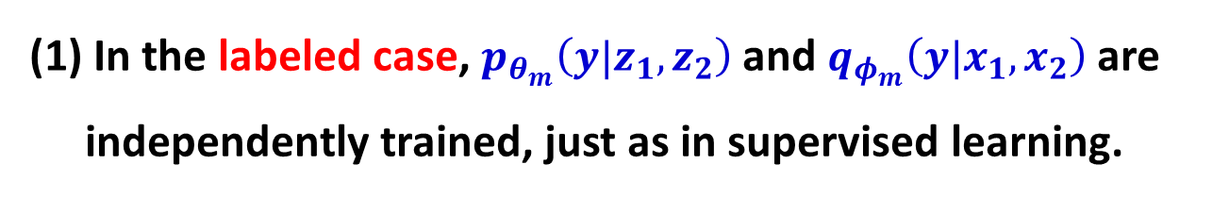
Implicit Co-Training How the two matchers are simultaneously trained in DV-VAE?
Specify: embedding matcher $p_{θ}\left(y|z_{1},z_{2}\right)$ → $θ_{m}$ ; interaction matcher $q_{φ}\left(y|x_{1},x_{2}\right)$ → $φ_{m}$
To analyze the training process of DV-VAE, we calculate the gradients of the objective $𝒥$ w.r.t. $θ_{m}$ and $φ_{m}$ .
$$𝒥=\sum_{\left(x_{1},x_{2},y\right)∈𝔻_{l}}{ℒ^{α}\left(x_{1},x_{2},y\right)}+\sum_{\left(x_{1},x_{2}\right)∈𝔻_{u}}{𝒰(x_{1},x_{2})}$$
Labeled Objective
Unlabeled Objective
(1) In the labeled case, $p_{θ_{m}}\left(y|z_{1},z_{2}\right)$ and $q_{φ_{m}}\left(y|x_{1},x_{2}\right)$are independently trained, just as in supervised learning.

Slide 33
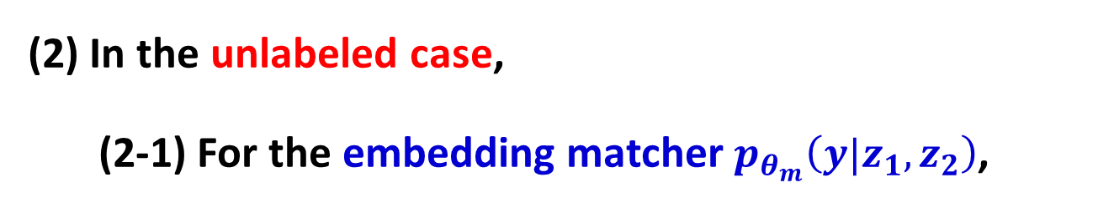
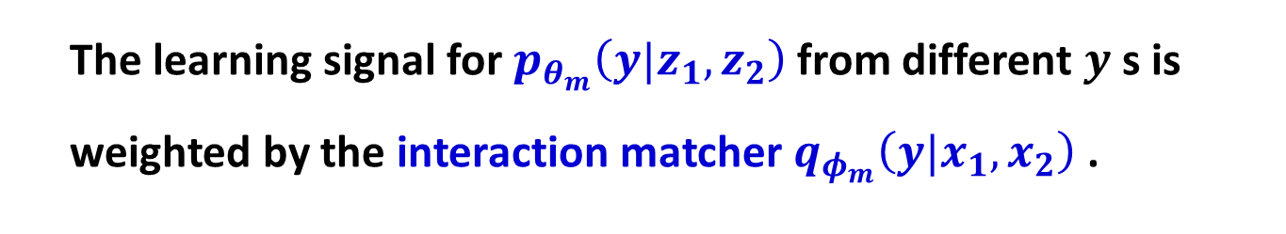
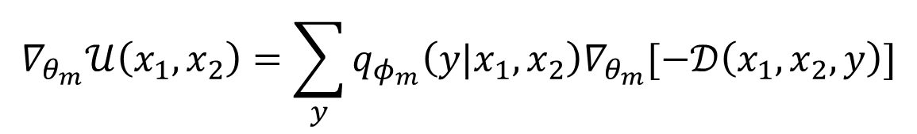
Implicit Co-Training How the two matchers are simultaneously trained in DV-VAE?
(2) In the unlabeled case,
(2-1) For the embedding matcher $p_{θ_{m}}\left(y|z_{1},z_{2}\right)$,
$$∇_{θ_{m}}𝒰\left(x_{1},x_{2}\right)=\sum_{y}{q_{φ_{m}}\left(y|x_{1},x_{2}\right)∇_{θ_{m}}[−𝒟\left(x_{1},x_{2},y\right)]}$$
(4)
The learning signal for $p_{θ_{m}}\left(y|z_{1},z_{2}\right)$ from different $y$s is weighted by the interaction matcher $q_{φ_{m}}\left(y|x_{1},x_{2}\right)$ .

Slide 34


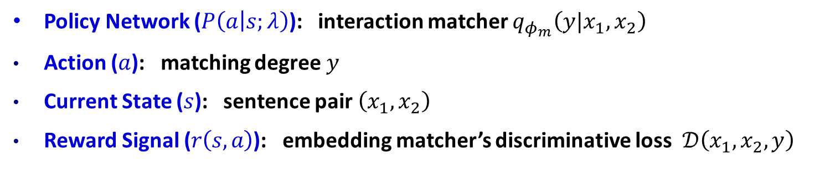
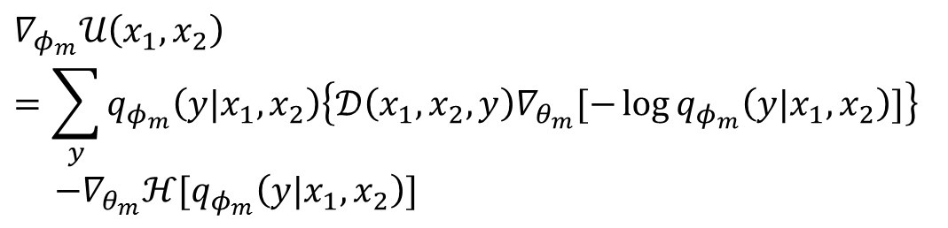
Implicit Co-Training How the two matchers are simultaneously trained in DV-VAE?
(2-2) For the interaction matcher $q_{φ_{m}}\left(y|x_{1},x_{2}\right)$,
$$∇_{φ_{m}}𝒰\left(x_{1},x_{2}\right)$$
$$=\sum_{y}{q_{φ_{m}}\left(y|x_{1},x_{2}\right)\left\{𝒟\left(x_{1},x_{2},y\right)∇_{θ_{m}}[−\log{q_{φ_{m}}\left(y|x_{1},x_{2}\right)}]\right\}}$$
$$−∇_{θ_{m}}ℋ[q_{φ_{m}}\left(y|x_{1},x_{2}\right)]$$
(5)
By analogy to the REINFORCE algorithm [Xu, et al., 2017]
$$∆λ∝𝔼_{P\left(a | s;λ\right)}[r\left(s,a\right)∇_{λ}\log{P\left(a | s;λ\right)}]$$
Policy Network ($P\left(a | s;λ\right)$): interaction matcher $q_{φ_{m}}\left(y|x_{1},x_{2}\right)$
Action ($a$): matching degree $y$
Current State ($s$): sentence pair $\left(x_{1},x_{2}\right)$
Reward Signal ($r\left(s,a\right)$): embedding matcher’s discriminative loss $𝒟\left(x_{1},x_{2},y\right)$
Weidi Xu, Haoze Sun, Chao Deng, and Ying Tan. Variational autoencoder for semi-supervised text classification. In AAAI, 2017.

Slide 35
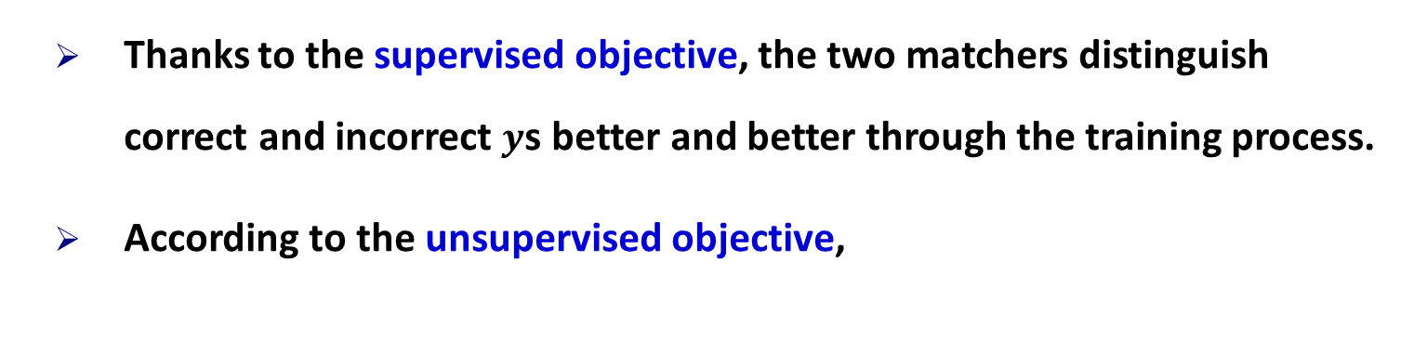

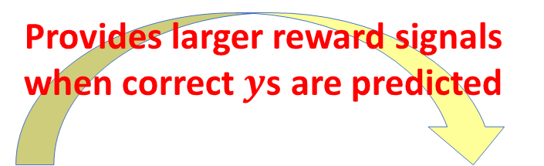
Implicit Co-Training Implicit Co-Training:
Thanks to the supervised objective, the two matchers distinguish correct and incorrect $y$s better and better through the training process.
According to the unsupervised objective,
Provides larger reward signals when correct $y$s are predicted
embedding matcher
interaction matcher
Provides larger weights for discriminative gradients with correct $y$s
An alternative way of providing pseudo labels for each other on unlabeled data (Co-Training).

Slide 36
Appendix 4-4
More Experimental Results
36

Slide 37
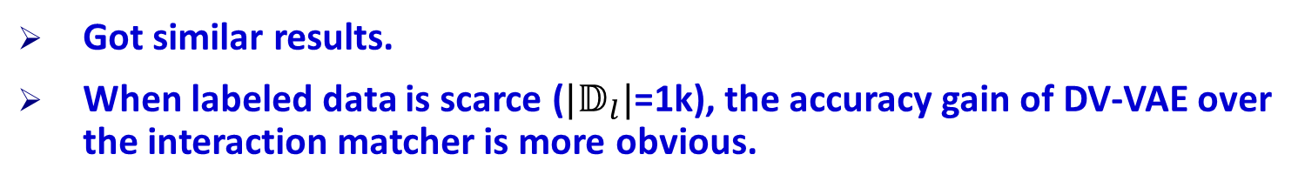
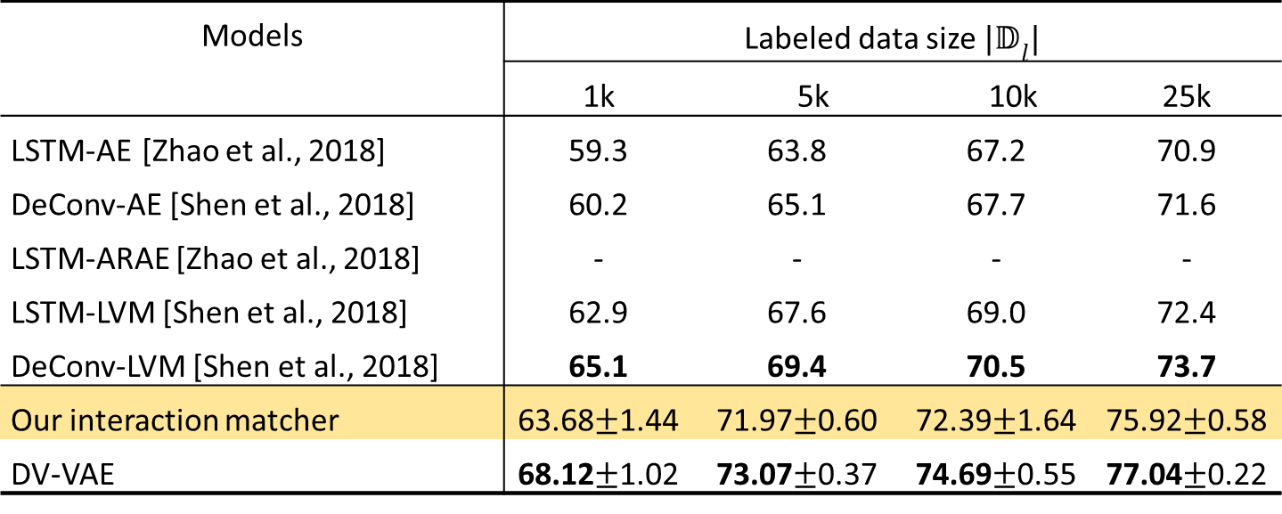
Experiments Matching accuracy on Quora (in %)
Models | Labeled data size ${|𝔻}_{l}|$
 | 1k | 5k |  | 10k | 25k
LSTM-AE [Zhao et al., 2018] | 59.3 | 63.8 | 67.2 |  | 70.9
DeConv-AE [Shen et al., 2018] | 60.2 | 65.1 | 67.7 |  | 71.6
LSTM-ARAE [Zhao et al., 2018] | - | - | - |  | -
LSTM-LVM [Shen et al., 2018] | 62.9 | 67.6 | 69.0 |  | 72.4
DeConv-LVM [Shen et al., 2018] | 65.1 | 69.4 | 70.5 |  | 73.7
Our interaction matcher | 63.68$±$1.44 | 71.97$±$0.60 | 72.39$±$1.64 |  | 75.92$±$0.58
DV-VAE | 68.12$±$1.02 | 73.07$±$0.37 | 74.69$±$0.55 |  | 77.04$±$0.22
Got similar results.
When labeled data is scarce (${|𝔻}_{l}|$=1k), the accuracy gain of DV-VAE over the interaction matcher is more obvious.
Dinghan Shen, Yizhe Zhang, Ricardo Henao, Qinliang Su, and Lawrence Carin. Deconvolutional
latent-variable model for text sequence matching. In AAAI, 2018.
Junbo Jake Zhao, Yoon Kim, Kelly Zhang, Alexander M. Rush, and Yann LeCun. Adversarially
regularized autoencoders. In ICML, 2018.
37

Slide 38
Experiments Matching accuracy on CQA (in %)
Models | Accuracy
Attentive-LSTM | 73.6
Match-LSTM | 74.3
ARC-II | 71.5
MatchPyramid | 71.7
MV-LSTM | 73.5
MultiGranCNN | 74.3
KEHNN + prior knowledge [Wu et al., 2018] | 75.3
Our interaction matcher | 74.4
DV-VAE+ 29k unlabeled WikiQA sentence pairs | 76.6
DV-VAE outperforms all the supervised baselines by leveraging unlabeled WikiQA data.
Unlabeled data is equivalent to prior knowledge ?
Yu Wu, Wei Wu, Can Xu, and Zhoujun Li. Knowledge enhanced hybrid neural network for text
matching. In AAAI, 2018
38
38

Slide 39


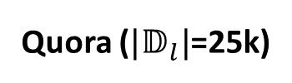
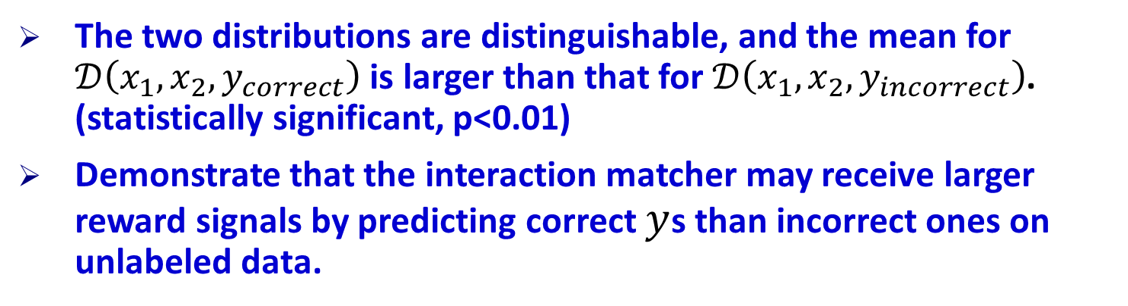
Experiments Distribution of the Reward Signal $𝒟\left(x_{1},x_{2},y\right)$
Distribution of $𝒟\left(x_{1},x_{2}, y_{correct}\right)$ and$𝒟\left(x_{1},x_{2},y_{incorrect}\right)$ on $𝔻_{u}$.
Quora (${|𝔻}_{l}|$=25k)
The two distributions are distinguishable, and the mean for $𝒟\left(x_{1},x_{2}, y_{correct}\right)$ is larger than that for $𝒟\left(x_{1},x_{2}, y_{incorrect}\right)$. (statistically significant, p<0.01)
Demonstrate that the interaction matcher may receive larger reward signals by predicting correct $y$s than incorrect ones on unlabeled data.
39
39

Slide 40
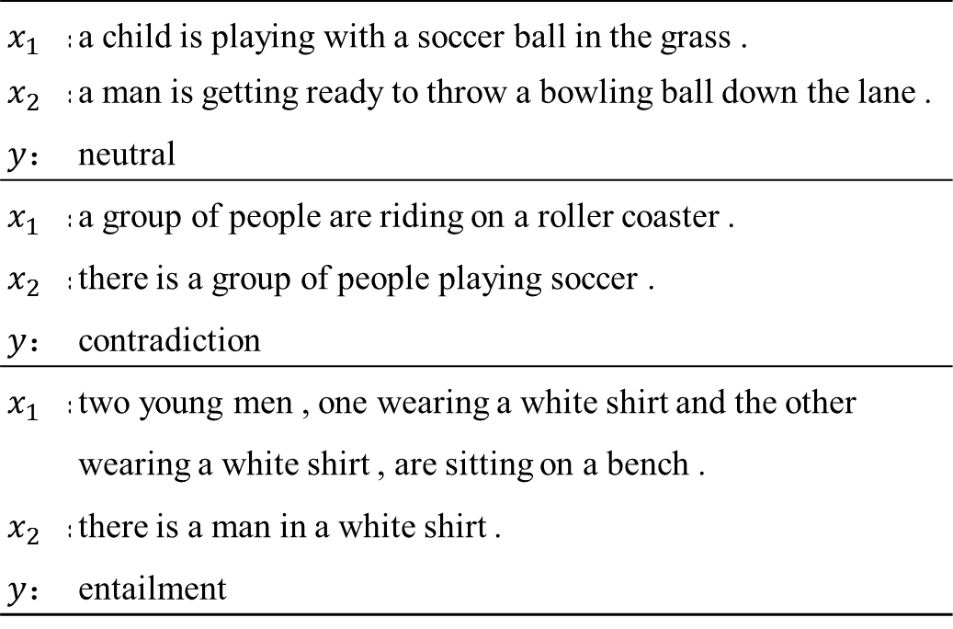

Experiments Generating labeled sentence pairs from DV-VAE
SNLI (${|𝔻}_{l}|$=28k)
$x_{1}$： | a child is playing with a soccer ball in the grass .
$x_{2}$： | a man is getting ready to throw a bowling ball down the lane .
$y$： | neutral
$x_{1}$： | a group of people are riding on a roller coaster .
$x_{2}$： | there is a group of people playing soccer .
$y$： | contradiction
$x_{1}$： | two young men , one wearing a white shirt and the other wearing a white shirt , are sitting on a bench .
$x_{2}$： | there is a man in a white shirt .
$y$： | entailment
Can generate meaningful sentence pairs as well as the correct relationship.
Demonstrate the capability of DV-VAE to learn the data manifold.
40
40

