Slide 1
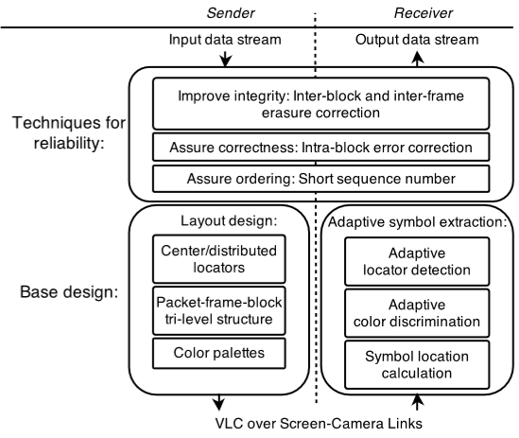
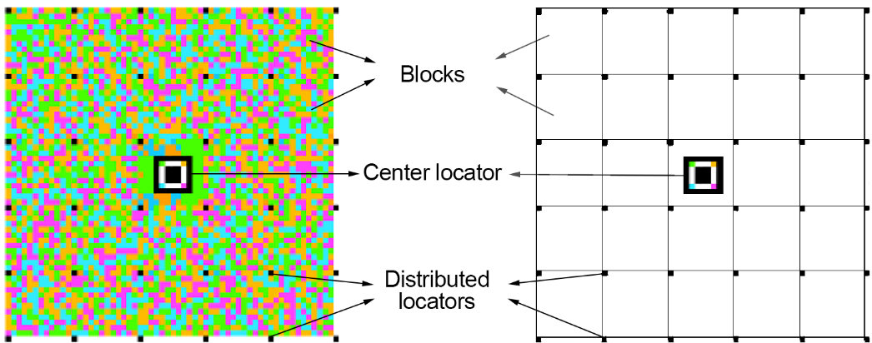
A Robust Barcode System for Data Transmissions
over Screen-Camera Links
Anran Wang¹, Shuai Ma¹, Chunming Hu¹, Jinpeng Huai¹, Chunyi Peng², Guobin Shen³
¹Beihang University, ²The Ohio State University, ³Microsoft Research
A layered barcode layout
A novel packet-frame-block barcode layout.
Adaptive symbol extraction
Our adaptive symbol extraction methods can locate available distributed locators even if a portion of the barcode is unavailable.
Techniques for reliability
Based on the observation of the error distribution, we apply three different error correction codes on blocks, frames and packets respectively.
RDCode not only enhances the transmission reliability by addressing the smartphone limitations and user behavior uncertainty, but also improves the transmission rate.
More Details: Anran Wang, Shuai Ma, Chunming Hu, Jinpeng Huai, Chunyi Peng, and Guobin Shen. Enhancing reliability to boost the throughput over screen-camera links. In MobiCom, 2014.

