Slide 1


One-pass Error-bounded Trajectory Simplification
Xuelian Lin, Shuai Ma, Han Zhang, Tianyu Wo and Jinpeng Huai
{linxl, mashuai, zhanghan, woty, huaijp}@buaa.edu.cn

Slide 2

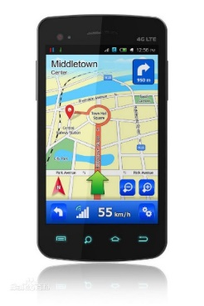

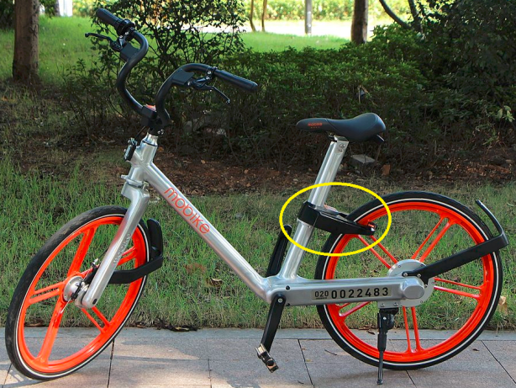


GPS sensors are everywhere
Vehicles
Sharing bikes
Smartphones
Smart wearable devices
GPS data points
P(x, y, t)
where x is latitude, y is longitude, and t is time.
e.g. (34.6259, 111.4085, 1499644819000)
Notes:
Nowadays , gps sensors are everywhere, they are deployed in cars, sharing bikes, smartphones, smart wearable devices, and so on.
These sensors collect positions of moving objects, each position information is a triple, including x, y and t, where x is latitude, y is longitude, and t is time.

Slide 3
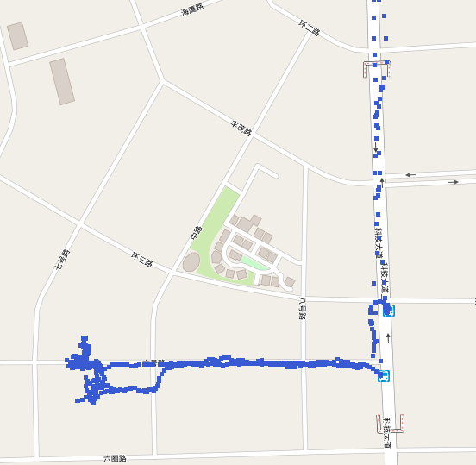
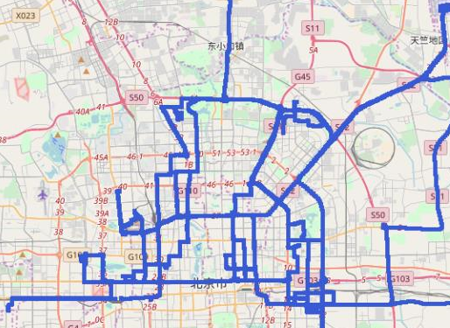
Trajectory data is big
A Trajectory T[P0,…, Pn] is a sequence of data points in a monotonically increasing order of their associated time values (i.e., Pi.t < Pj .t for any 0≤ i < j ≤ n)
Sensors on | Time (s) per point | Points per day | Number of Sensors | total points per day
Truck | 1-30 | 2.88K - 86.4K | 20K | 57.6M - 1.728G
Service Car | 1-5 | 17.28k- 86.4K | 100K | 1.728G - 8.64G
Sharing bikes | 1-10 | 8.64K - 86.4K | 1M | 9.6G - 96G
Smartphones | 1-60 | 1.44K - 86.4K | 10M | 14.4G - 864G
Notes:
The data points collected by a sensor forms a trajectory, which is a sequence of data points in a monotonically increasing order of their associated time values.
Different sensors collect data points at diffirent sampling rates.
For example, a gps sensor in a truck collects a data point at every 1 to 30 seconds, which produces 2.88K – 86.4K points every day. For a company having 20K trucks, it is 57.6M to 1.728 billion points every day.

Slide 4
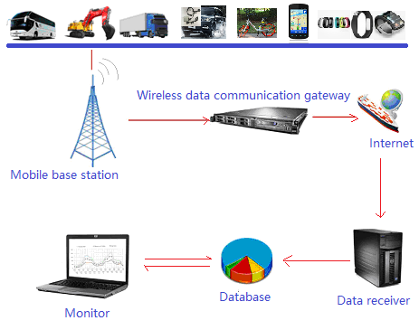
Motivation
The uploading and saving of the raw GPS data is
wasting of network bandwidth and Storage space
slowing the performance of queries
Line-based trajectory simplification (trajectory simplification for convenience) algorithms alleviate this issue, and are commonly used in practice.
Notes:
waste of CPU resource, energies, …

Slide 5
Outline
The trajectory simplification problem: analyses and challenges
One-pass Error-bounded Approach
Experimental Study
Conclusion

Slide 6
Trajectory simplification
Trajectory simplification technologies remove redundant points from the original trajectory
A raw trajectory is seen as a fine consecutive piece-wise line segments.
After simplified, it is replaced by a coarse consecutive piece-wise line segments
Example of trajectory simplification

Slide 7
Problem statement
The “Min-#” problem of trajectory simplification
Compression ratio: to get the minimal number of line segments to represent the original trajectory
Error-bounded: to ensure that the distance of any original point to its corresponding line segment is less than a pre-defined threshold ζ
ζ
Notes:
Advantages:
simple and easy to implement,
no need of extra knowledge and suitable for freely moving objects,
bounded errors, and
good compression ratios

Slide 8
Challenges
The optimal algorithm has a time complexity of O(N²)
Sub-optimal algorithms
Good (near optimal) compression ratios
Error-bounded
Algorithm | Type | Time complexity | Space complexity
Douglas-Peucker (DP) | Batch | O(n²) | O(n)
Theo Pavlidis (TP) | Batch | O(n²/K) | O(n)
Opening windows (OPW) | Online | O(n²) | O(n)
Bounded quadrant system (BQS) | Online | O(n²) | O(n)
Global distance checking: a point is checked multiple times.
They are not efficient enough for compressing big trajectory data, especially with limited computing resources, e.g., mobile devices.
Notes:
W. Chan and F. Chin. Approximation of polygonal curves with minimum number of line segments or minimal error. International Journal of Computational Geometry Applications, 6, 1996.
These algorithm commonly apply a global distance checking policy, a point is checked multiple times during the whole process,
This makes them have high time complexity and space complexity, hence, they are …

Slide 9
Objective
One-pass error-bounded approach applying a local distance checking method
Desired features:
One-pass: each point is checked only once
O(n) time and O(1) space complexities
Error bounded
Good compression ratio
The same as the above algorithms
Is there such an algorithm satisfying all these features?
Notes:
Hence, we define the features of the new approaches.

Slide 10
Outline
The trajectory simplification problem: analyses and challenges
One-pass Error-bounded Approach
Experimental Study
Conclusion

Slide 11
(1) The naïve local distance checking
Error bound ζ
> ζ/2
Directed line segment
Start Point
Learning from dead reckoning (in position tracking)
and Reumann’s method (in computer graphics)
Features of the naïve approach
One-pass
O(1) time and O(1) space for each point
Error bounded by ζ
Poor compression ratios
Notes:
Then it checks the distance of point after P1 to the directed line segment in turn
Until there is a point has a distance larger than half zeta.
In this example , p3 is the point, so, it output the line segment p0P2, and repeat the same process start from p2.
…
This is because the directed line segment keep static once we generate it.

Slide 12
(2) Swing the directed line segment L
If we can dynamically adjust the directed line segment L and make L more close to the new data point, then it is potential to represent more data points.
(1) P_{s+2} to L₁
(2) P_{s+3} to L₂
(3) P_{s+4} to L₃
Example: a dynamic L may represent more data point than a static L
The question is whether we can swing it or not?
Notes:
Keep the Error bounded feature: if a point, say P_{e}, is outputted, then any point P in [P_{s}, P_{e}] has a distance less than ζ to the line segment P_{s}P_{e}.
→ A better compression ratio
If it swings too little, it may be close to the basic approach.
If it swings too much, it may lead to no error bound.
We next show how we can achieve this

Slide 13
(2) Swing the directed line segment L --- Partitioning the data points
Partition the space into Zones around P_{s} with a step length of ζ/2
The middle of Z_{j} to P_{s} has a distance j* ζ/2
Divide the data points into active and inactive points
Active points: the first point falls in a zone. e.g., P₂, P₄, P₅
Inactive points: other points. e.g., P₁, P₃, P₆, P₇
P_{s} =

Slide 14

(2) Swing the directed line segment L --- Updating L according to point type
For the first active point, e.g, P₂
R_{i} is the directed line segment connecting the start point P_{s} and point P_{i}, e.g., R₂ = P₀P₂.
j is the index of a zone that P_{i} is belonging to. For P₂, j=1
Active points: P₂, P₄, P₅ Inactive points: P₁, P₃, P₆, P₇

Slide 15

(2) Swing the directed line segment L --- Updating L according to point type
For inactive points: e.g., P₁, P₃
Active points: P₂, P₄, P₅ Inactive points: P₁, P₃, P₆, P₇

Slide 16

(2) Swing the directed line segment L --- Updating L according to point type
For the other active points, e.g., P₄, P₅
Where ped(P_{s+i}, L_{i-1}) is the perpendicular Euclidean distance of P_{s+i} to line segment L_{i-1}
Active points: P₂, P₄, P₅ Inactive points: P₁, P₃, P₆, P₇
Notes:
Its angle is updated with a carefully designed number such that it keeps the error bound, and at the same time, achieves a good compression ratio.
Where ped(P_{s+i}, L_{i-1}) is the perpendicular Euclidean distance of P_{s+i} to line segment L_{i-1}

Slide 17
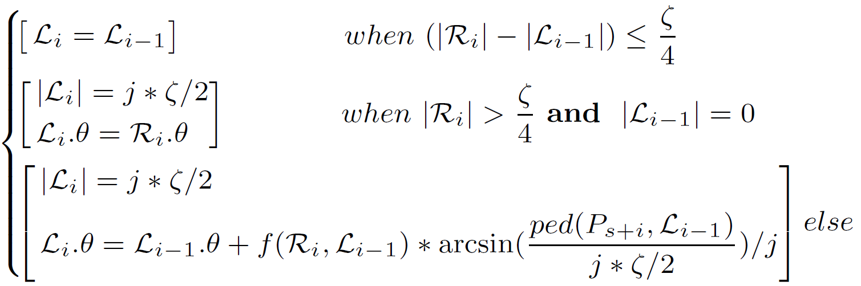
(2) Swing the directed line segment L --- Updating L by Fitting Function F
The Fitting Function F
Proposition 1 & Theorem 2:
updating of L can be computed in O(1) time and O(1) space,
each data point is checked once, and
the distance is error-bounded
Inactive points
The first active point
Other active points

Slide 18
(3) Algorithm OPERB
One-Pass ERror-Bounded trajectory simplification algorithm (OPERB)
Outputs points belonging to the original trajectory
Runs in O(n) time and O(1) space
Error-bounded

Slide 19
(4) Optimization technologies
Optimization technologies further improve the compression ratios of OPERB
(1) Choosing the first active point after the start point
(2) Adjusting the distance condition:
(3) Making the directed line segment L more close to the active points
(4) Incorporating missing active points
(5) Absorbing data points after the end point

Slide 20
(5) Algorithm OPERB-A
A line segment R_{i} is anomalous if it only represents two data points of the original trajectory.
Notes:
We also find in the compressed line segments, there are anomalous line segment that each anomalous line segment only represents…

Slide 21
(5) Algorithm OPERB-A
OPERB-A: Aggressive OPERB
Allows interpolating new data points into a trajectory under certain conditions
Runs in O(n) time and O(1) space
Error-bounded

Slide 22
Outline
The trajectory simplification problem: analyses and challenges
One-pass Error-bounded Approach
Experimental Study
Conclusion

Slide 23
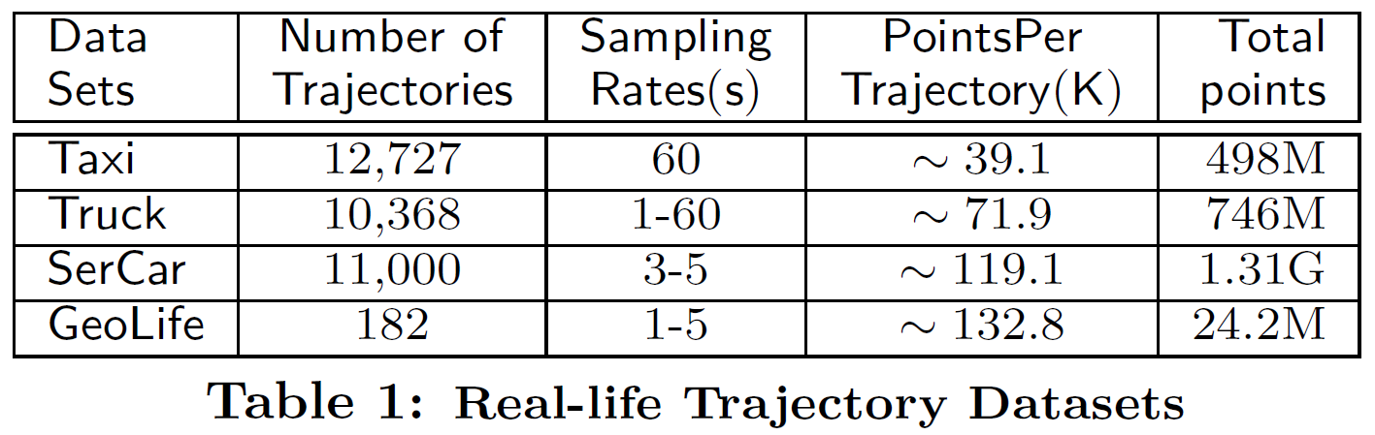
Configuration
Algorithms
Algorithm OPERB
Algorithm OPERB-A
Algorithm Douglas-Peucker (DP) : a classic batch algorithm with an excellent compression ratio
Algorithm Fast BQS (FBQS), the fastest existing algorithm
Real-life datasets
Main metrics
Execution time
Compression ratio (here, the lower compression ratios are the better)

Slide 24
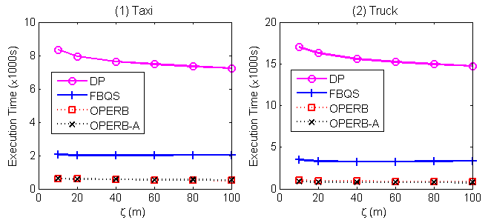
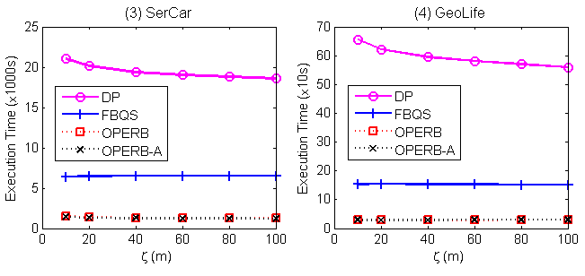
Execution time
OPERB and OPERB-A are the fastest algorithms
They are on average (13.9, 17.4, 14.7, 20.6) times faster than DP, and (4.1, 4.1, 5.4, 5.2) times faster than FBQS on (Taxi, Truck, SerCar, GeoLife), respectively.

Slide 25
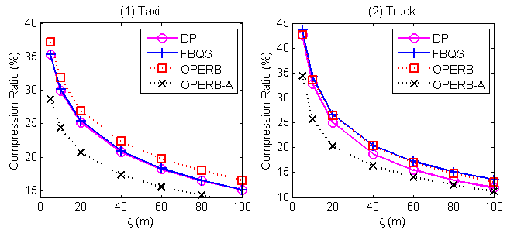
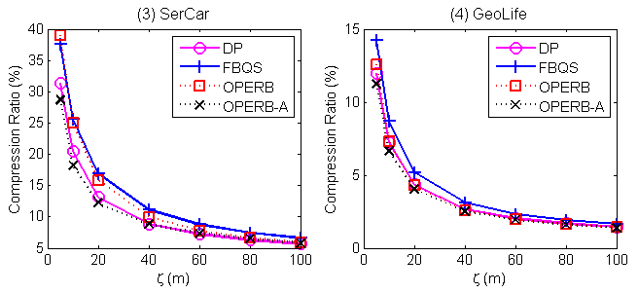
Compression ratio
OPERB is comparable with FBQS and DP.
OPERB-A has the best compression ratios on all datasets and nearly all ζ.

Slide 26
Outline
The trajectory simplification problem: analyses and challenges
One-pass Error-bounded Approach
Experimental Study
Conclusion

Slide 27
4. Conclusion
one-pass error-bounded trajectory simplification
a local distance checking approach
O(1) time and O(1) space complexity for each point
algorithms
OPERB
OPERB-A that further allows interpolating data points
5 optimization technologies
Efficiency and Effectiveness
OPERB and OPERB-A are the fastest algorithms
The compression ratio of OPERB is comparable with FBQS and DP. OPERB-A has the best compression ratios on all datasets and nearly all ζ.

Slide 28
Thanks for listening！
Q & A

Slide 29
Trajectory Datasets and Full version of Our VLDB 2017 paper
http://mashuai.buaa.edu.cn/traj.html
1. Full Version with More Proof and Experimental Details [ pdf ]
2. Trajectory Datasets
Taxi trajectory data
Truck trajectory data
3. Open source (to be appeared in Sep.)

Slide 30
Advantages of line simplification
simple and easy to implement,
no need of extra knowledge and suitable for freely moving objects,
bounded errors, and
good compression ratios

Slide 31
Global distance checking
In the following example, P₆ is checked 4 times, i.e., to line segments P₀P₁₄, P₀P₁₀, P₅P₁₀ and P₅P₈.
Example of the Global Distance Checking of Algorithm Douglas-Peucker

Slide 32
(4) Optimization technologies
Optimization technologies further improve the compression ratios of OPERB
(1) Choosing the ‘first’ active point after P_{s}
Jump P₁, P₂, P₃

Slide 33


(4) Optimization technologies
Optimization technologies further improve the compression ratios of OPERB
(2) Adjusting the distance condition:
= max {ped(P₆, L₅)}
= ped(P₆, L₅)
= max {ped(P₄, L₃), ped(P₅, L₄), ped(P₇, L₆)}
= ped(P₄, L₃)
Notes:
If the sum of d_max plus and d_max_minus is less than zeta, then the process goes on, no matter that d_max plus or d_max_minus is large than half zeta.

Slide 34
(4) Optimization technologies
Optimization technologies further improve the compression ratios of OPERB
(2) Adjusting the distance condition:
= max {ped(P₆, L₅)} = ped(P₆, L₅)
= max {ped(P₄, L₃), ped(P₅, L₄), ped(P₇, L₆)}
= ped(P₄, L₃)

Slide 35
(4) Optimization technologies
Optimization technologies further improve the compression ratios of OPERB
(1) Choosing the first active point after P_{s}
(2) Adjusting the distance condition:
(3) Making the directed line segment L more close to the active points
ped(P₅, L₄) <
= ped(P₄, L₃)
we use ped(P₄, L₃) instead of ped(P₅, L₄) to update L₅

Slide 36
(4) Optimization technologies
Optimization technologies further improve the compression ratios of OPERB
(1) Choosing the first active point after P_{s}
(2) Adjusting the distance condition:
(3) Making the directed line segment L more close to the active points

Slide 37
Cases Study
Taxi - raw data
Taxi - OPERB

Slide 38
The distribution of line segments of OPERB

