Slide 1

One-pass Trajectory Simplification Using the Synchronous Euclidean Distance
Xuelian Lin, Jiahao Jiang, Shuai Ma*, Yimeng Zuo & Chunming Hu
{linxl, jiangjh, mashuai, zuoym, hucm}@buaa.edu.cn
The VLDB Journal,volume 28, pages 897–921 (2019)

Slide 2
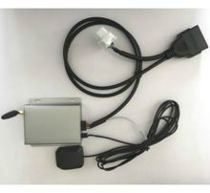
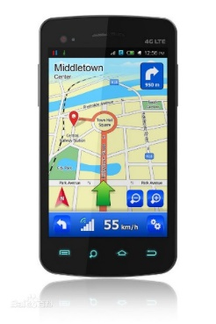

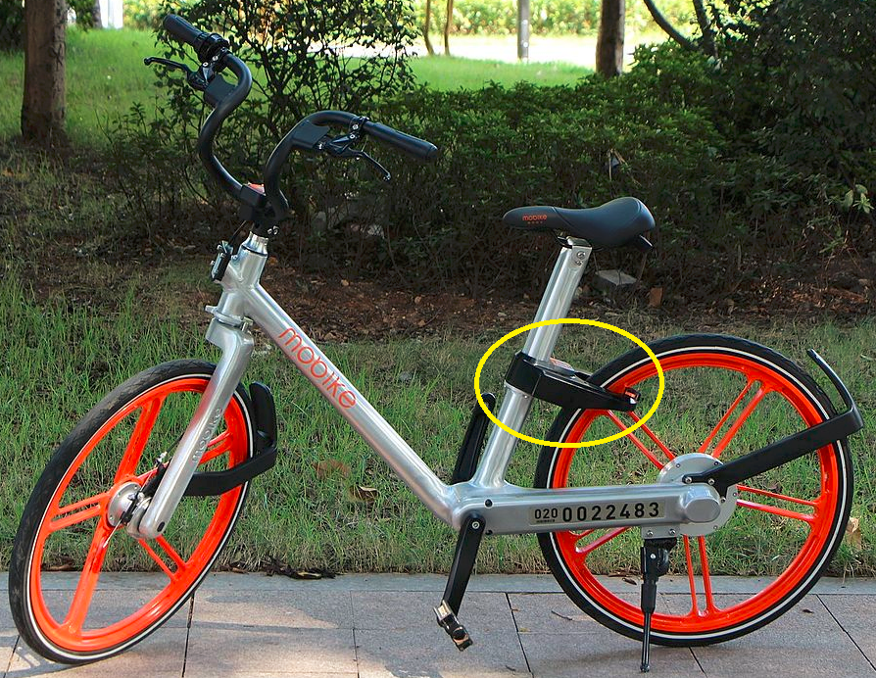


GPS sensors are everywhere
Vehicles
Sharing bikes
Smartphones
Smart wearable devices
GPS data points
P(x, y, t)
where x is latitude, y is longitude, and t is time.
e.g. (34.6259, 111.4085, 1499644819000)
Notes:
Nowadays , gps sensors are everywhere, they are deployed in cars, sharing bikes, smartphones, smart wearable devices, and so on.
These sensors collect positions of moving objects, each position information is a triple, including x, y and t, where x is latitude, y is longitude, and t is time.

Slide 3
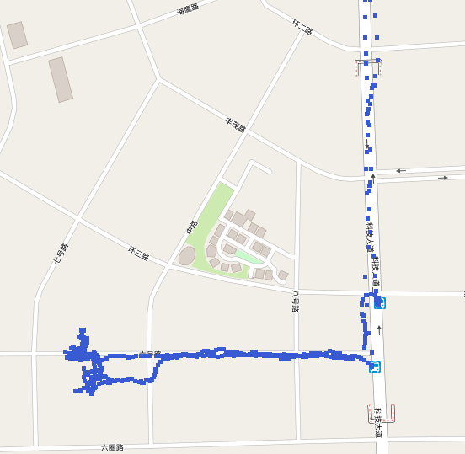
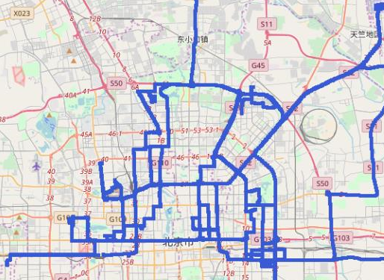
Trajectory data
A Trajectory T[P0,…, Pn] is a sequence of data points in a monotonically increasing order of their associated time values (i.e., Pi.t < Pj .t for any 0≤ i < j ≤ n)
The uploading and saving of the raw GPS data
wastes network bandwidth and storage space, and
slows the performance of queries
Notes:
The data points collected by a sensor forms a trajectory, which is a sequence of data points in a monotonically increasing order of their associated time values.
Different sensors collect data points at different sampling rates.
For example, a gps sensor in a truck collects a data point at every 1 to 30 seconds, which produces 2.88K – 86.4K points every day. For a company having 20K trucks, it is 57.6M to 1.728 billion points every day.

Slide 4
Trajectory Simplification
Trajectory simplification technologies remove redundant points from the original trajectory
A distance metric (e.g., the Synchronous Euclidean Distance, SED) is needed to decide which point could be removed.
Trajectory simplification algorithms using SED have been developed, including
batch algorithms (e.g., Douglas-Peucker [20])
online algorithms (e.g., SQUISH-E [23])
Q
The SED of point P to line segment |PsPe| is |PQ|, where Q is the point on the line segment that the moving object would appear at time P.t if it moved from Ps to Pe at a uniform speed.

Slide 5
Challenges
The current line simplification methods using SED still have high time and/or space complexities, which hinder their utilities in resource-constrained devices.
What we need of a trajectory simplification method:
Error bounded (by SED)
Efficient: O(n) time and O(1) space complexities
Effective: good compression ratio

Slide 6
One-pass and error bounded Trajectory Simplification Using SED
Spatio-temporal Cone Intersection using the Synchronous Euclidean Distance (CISED)
Error bounded (by SED)
Efficient
Effective
Two versions
CISED-S: Strong simplification that only has original points in its outputs
CISED-W: Weak simplification that allows interpolated data points in its outputs.

Slide 7
Key ideas of CISED
Consider a sub-trajectory Ts[Ps,…, Ps+k] and an error boundε:
1. Presents data points in a x-y-t 3D space, taking point Ps as the origin
2. Logically builds a Spatio-temporal Cone for each point Ps+i, i∈[1, k]
ε

Slide 8
Key ideas of CISED
Consider a sub-trajectory Ts[Ps,…, Ps+k] and an error boundε:
3. If those cones have some common intersection, then points {Ps+1,…, Ps+k-1} can be removed.

Slide 9
Key ideas of CISED
Consider a sub-trajectory Ts[Ps,…, Ps+k] and an error boundε:
4. The existing of common intersection of those cones can be checked by the intersection of circles on a plane of t=tc.
intersection of circles

Slide 10
Key ideas of CISED
Consider a sub-trajectory Ts[Ps,…, Ps+k] and an error boundε:
5. The intersection of circles is further approximated by the intersection of their Inscribed regular polygons.
6. Speedup Inscribed Regular Polygon Intersection

Slide 11
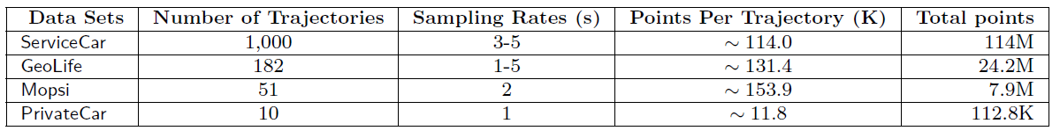
Experimental Setting
Algorithms (using SED)
Algorithm CISED-S
Algorithm CISED-W
Algorithm Douglas-Peucker (DP) [20] : a classic batch algorithm with an excellent compression ratio
Algorithm SQUISH-E [23], the fastest existing algorithm
Real-life datasets

Slide 12
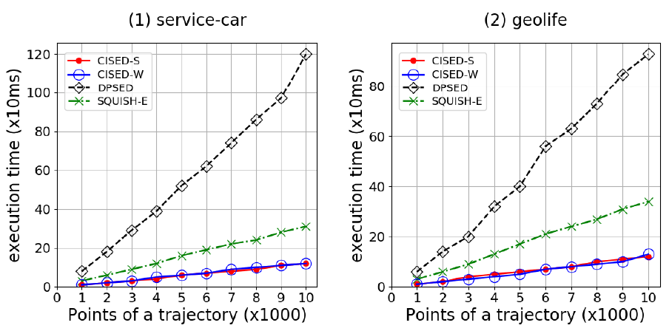
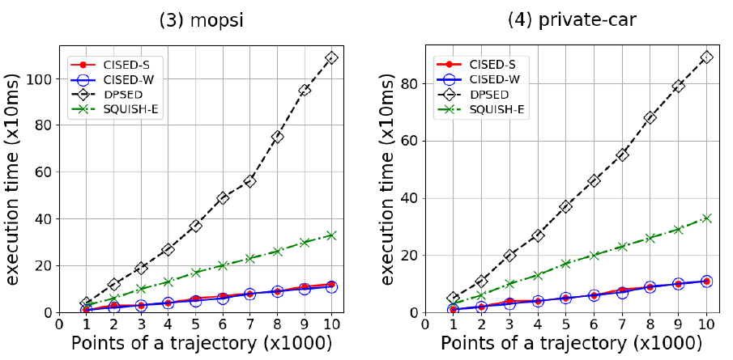
Experimental Results: Execution time
CISED(s) are the fastest algorithm(s)

Slide 13
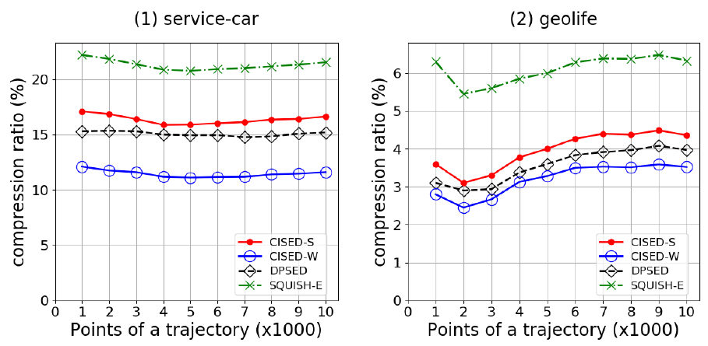
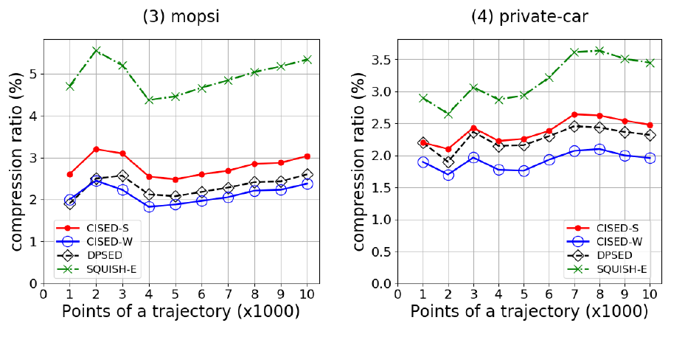
Experimental Results: Compression ratio
CISED is comparable with DP and better than SQUISH-E

Slide 14
Thanks！

