Slide 1
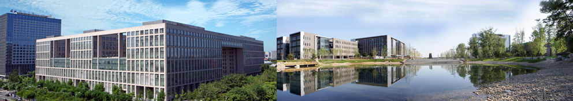
How to Write/Read a Paper
北京航空航天大学
马帅

Slide 2
是甄士隐还是贾雨村？
请大家斟酌！
☺一家之言☺

Slide 3
How to Evaluate a Paper?
Novelty of the problem (25%)
Technical depth (25%)
Writing (25%)
Experiments (25%)

Slide 4
How to Get the Idea?
Positive
For any idea, you can always do something
Negative
Extremely challenging to get good ideas.
Repeated work is NOT called research!
Observation – using your brain
Refine, refine and refine, but with an expectation in your mind!
Explain by examples

Slide 5
How to Get the Solution?
Complexity analysis
PTIME, NP, EXPTIME, …
Approximation analysis for NPC problems
With performance guarantees
Heuristic solutions
With certain properties
No fixed rules to follow for algorithm design
Fully understand the problem
Designed algorithms based on the special characteristics for the problem itself

Slide 6
How to Write the Paper?
It is art - very difficult!
Practice, practice and practice!
Writing, writing and writing!
Proofreading, proofreading, and proofreading!
If people could not understand your writing, they could not evaluate your work.
Sir Isaac Newton
Two good habits
Writing down and remember good sentences when you are reading papers
Ask your “friends”, who could speak truth to you, to check what you have written

Slide 7
How to do Experiments?
Design experimental plans
Show people the idea is good, and the solution is good
Datasets
Real life data
Synthesized data
Always remember what you need to show to people!

Slide 8
Stages of Paper Submission
Submission
Feedback (optional)
Shepherd (optional)
Acceptance/Rejection notification
Preparing camera ready
Experimental repeatability (optional)
Attend conference/present your work
Make big noises
Show people your good work

Slide 9
Two Rules
WWH rule
What, why, how
Think about everything from the view point of reviewers

Slide 10
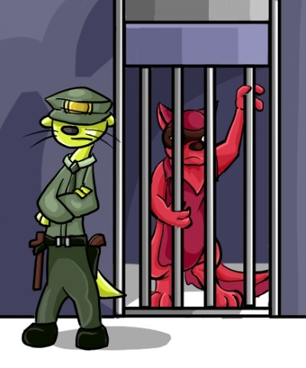
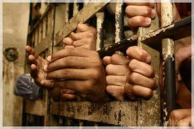
One Warning
NO plagiarism!!!

Slide 11

谢谢

