Slide 1

Ensemble Enabled Weighted PageRank
Dongsheng Luo, Chen Gong, Renjun Hu, Liang Duan
Shuai Ma, Niannian Wu, Xuelian Lin
TeamBUAA

Slide 2
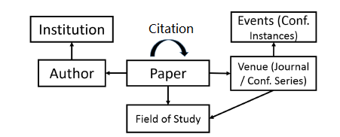
Problem & Challenges
Problem: rank nodes in a heterogeneous graph based on query-independent node importance
Challenges: dynamism & heterogeneity
Entities and their importance evolve with time
Multiple types of entities involve with different contributions
The Heterogeneous Microsoft Academic Graph [1]
[1] Arnab Sinha, et al. An Overview of Microsoft Academic Service (MAS) and Applications. In WWW, 2015.

Slide 3
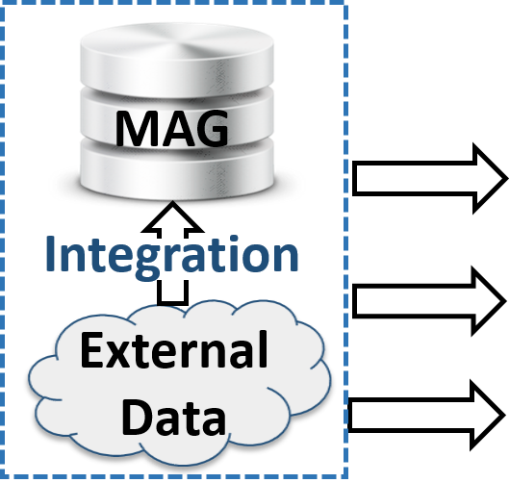

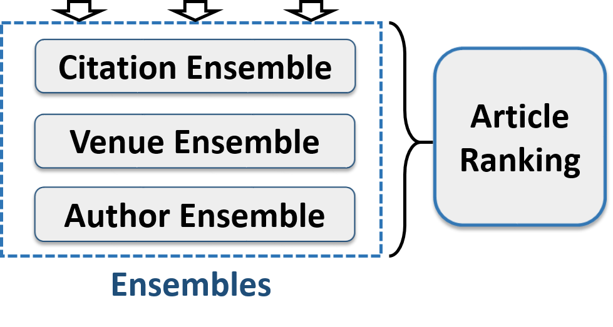
Solution: Ensemble enabled Weighted PageRank
Deal with the dynamism in data
Deal with the data missing problem
Assemble the contributions of heterogeneous entities

Slide 4
Outline
Ensemble enabled Weighted PageRank
Time Weighted PageRank
Citation, Venue and Author Ensembles
Incorporating External Data
Evaluation
Summary

Slide 5
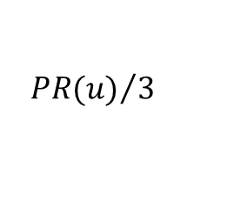
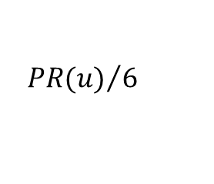

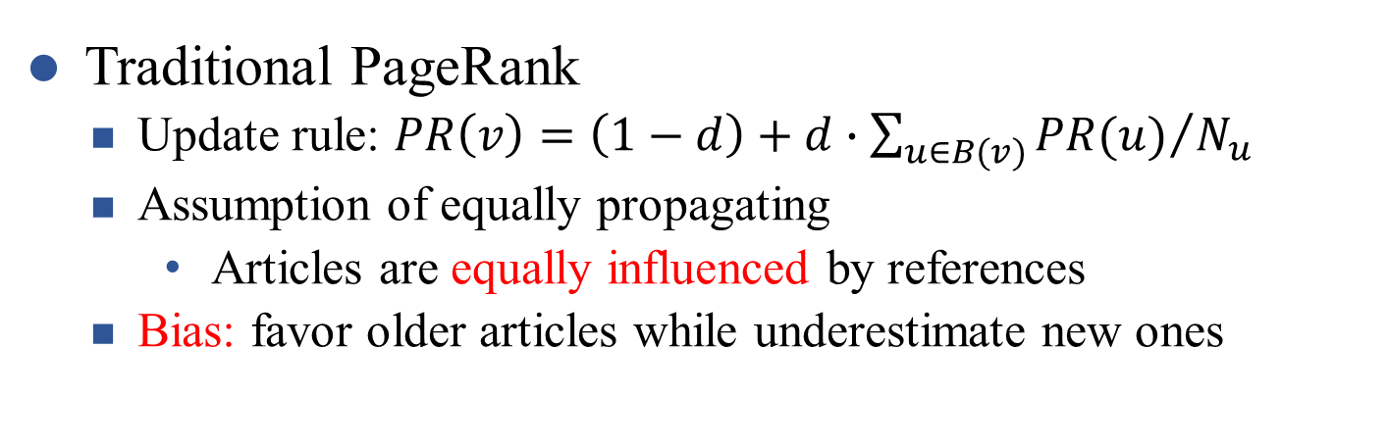
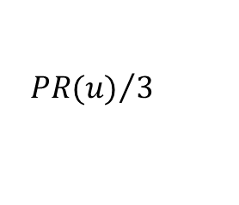
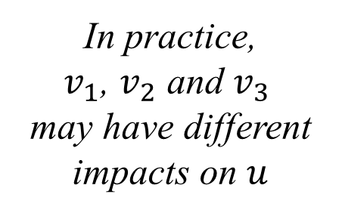

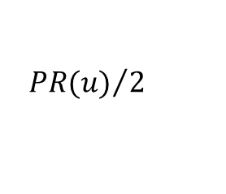


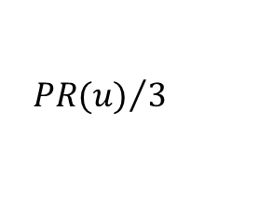
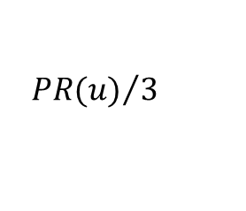


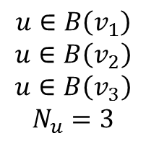


Why Weighted PageRank?
Traditional PageRank
Update rule: $PR\left(v\right)=\left(1−d\right)+d∙\sum_{u∈B(v)}{{PR(u)}/{N_{u}}}$
Assumption of equally propagating
Articles are equally influenced by references
Bias: favor older articles while underestimate new ones
PageRank
Weighted PageRank
$$v_{1}$$
$$v_{1}$$
$${PR(u)}/3$$
In practice,
$v_{1}$, $v_{2}$ and $v_{3}$
may have different impacts on $u$
$${PR(u)}/6$$
$$u$$
$${PR(u)}/3$$
$$v_{2}$$
$$u$$
$${PR(u)}/3$$
$$v_{2}$$
$$u∈B\left(v_{1}\right)$$
$$u∈B\left(v_{2}\right)$$
$$u∈B\left(v_{3}\right)$$
$$N_{u}=3$$
$${PR(u)}/3$$
$${PR(u)}/2$$
equally propagating
discriminately propagating
$$v_{3}$$
$$v_{3}$$

Slide 6
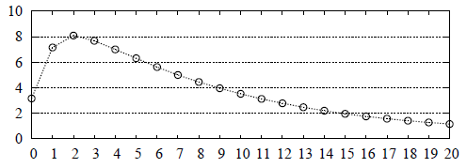

Time-Weighted PageRank
How to evaluate the weights (impacts of articles) for discriminately propagating?
Original WPR[1]: based on popularity while ignore dynamism
Intuitions of impacts of articles
Time decaying
The number of citations is a good indicator
total # of citations ($x{10}^{7}$)
Time-Weighted
# of years after publication
[1] Wenpu Xing and Ali Ghorbani. Weighted PageRank Algorithm. In CNSR, 2004.

Slide 7
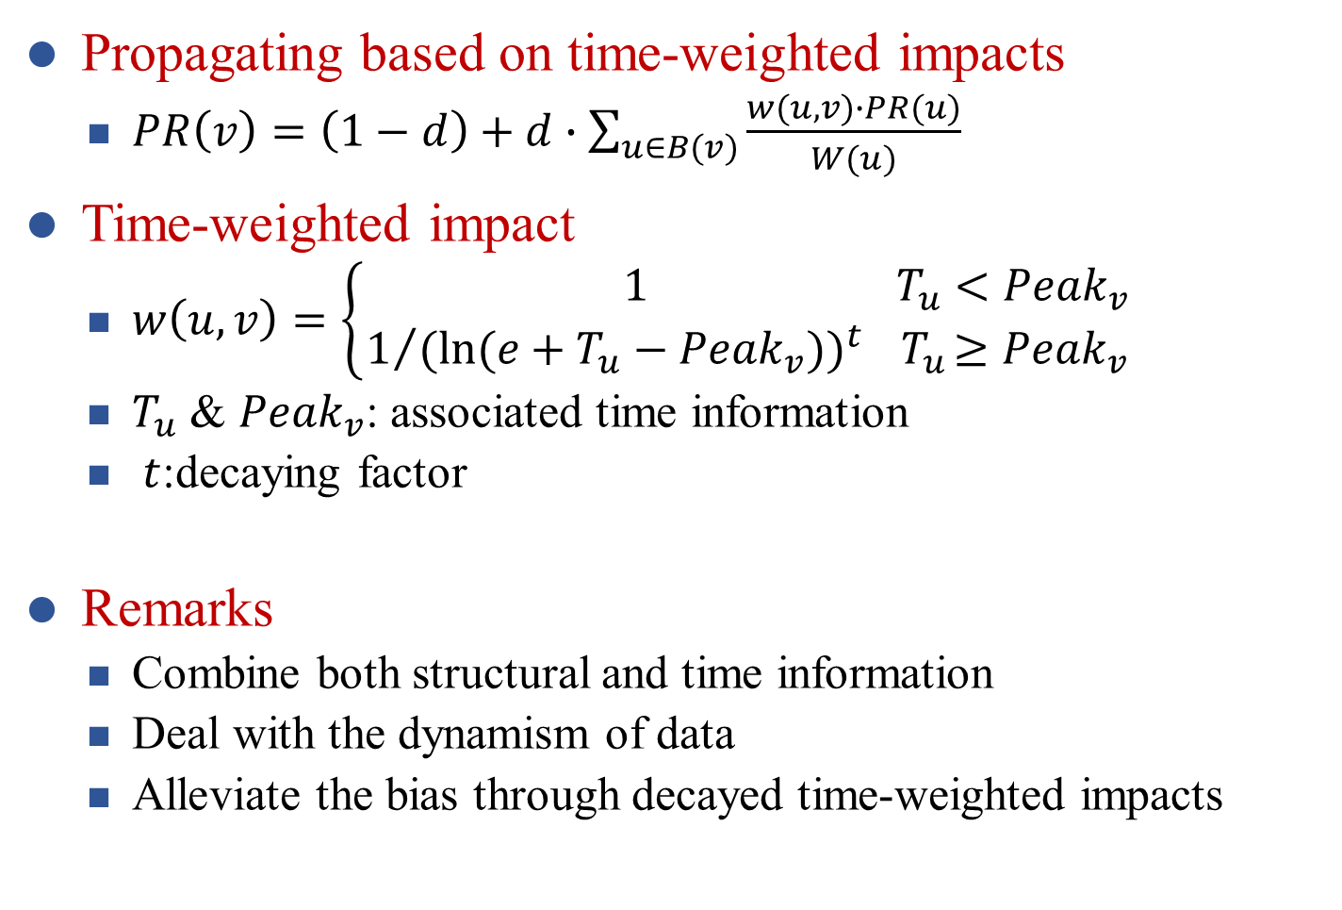
Time-Weighted PageRank
Propagating based on time-weighted impacts
$PR\left(v\right)=\left(1−d\right)+d∙\sum_{u∈B(v)}{\frac{w(u,v)∙PR(u)}{W(u)}}$
Time-weighted impact
$w\left(u,v\right)=\left\{\begin{aligned} 1 { T}_{u}<{Peak}_{v} \\ 1/{{(ln⁡(e+T_{u}−{Peak}_{v}))}^{t}}{ T}_{u}≥{Peak}_{v}\end{aligned}\right.$
$T_{u}$ & ${Peak}_{v}$: associated time information
$t$:decaying factor
Remarks
Combine both structural and time information
Deal with the dynamism of data
Alleviate the bias through decayed time-weighted impacts

Slide 8
Outline
Ensemble enabled Weighted PageRank
Time Weighted PageRank
Citation, Venue and Author Ensembles
Incorporating External Data
Evaluation
Summary

Slide 9
Why Ensembles?
Case study: to rank a new article
No seen citations: only using citation information fails
Venue and author information can be incorporated
Observation
Articles can be ranked according to various factors, e.g. citations, venues, authors
Ensemble Model
Each ensemble exploits single type of entities
Assemble various ensembles: assemble the different contributions of the heterogeneous entities

Slide 10
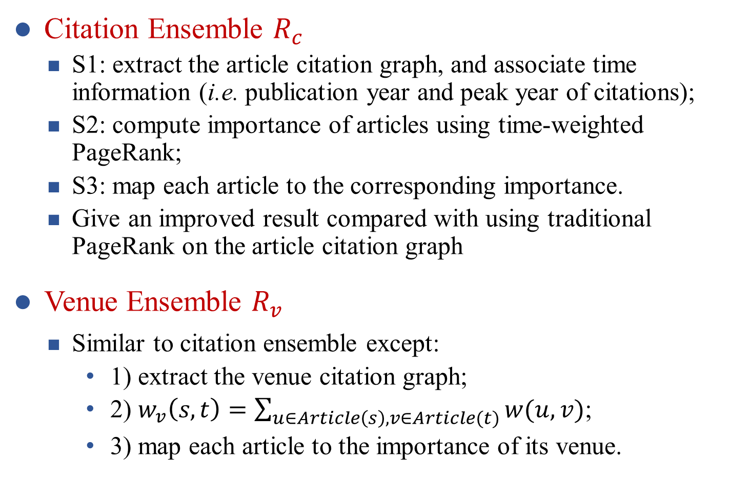
Citation, Venue & Author Ensembles
Citation Ensemble $R_{c}$
S1: extract the article citation graph, and associate time information (i.e. publication year and peak year of citations);
S2: compute importance of articles using time-weighted PageRank;
S3: map each article to the corresponding importance.
Give an improved result compared with using traditional PageRank on the article citation graph
Venue Ensemble $R_{v}$
Similar to citation ensemble except:
1) extract the venue citation graph;
2) $w_{v}\left(s,t\right)=\sum_{u∈Article\left(s\right),v∈Article(t)}{w(u,v)}$;
3) map each article to the importance of its venue.

Slide 11
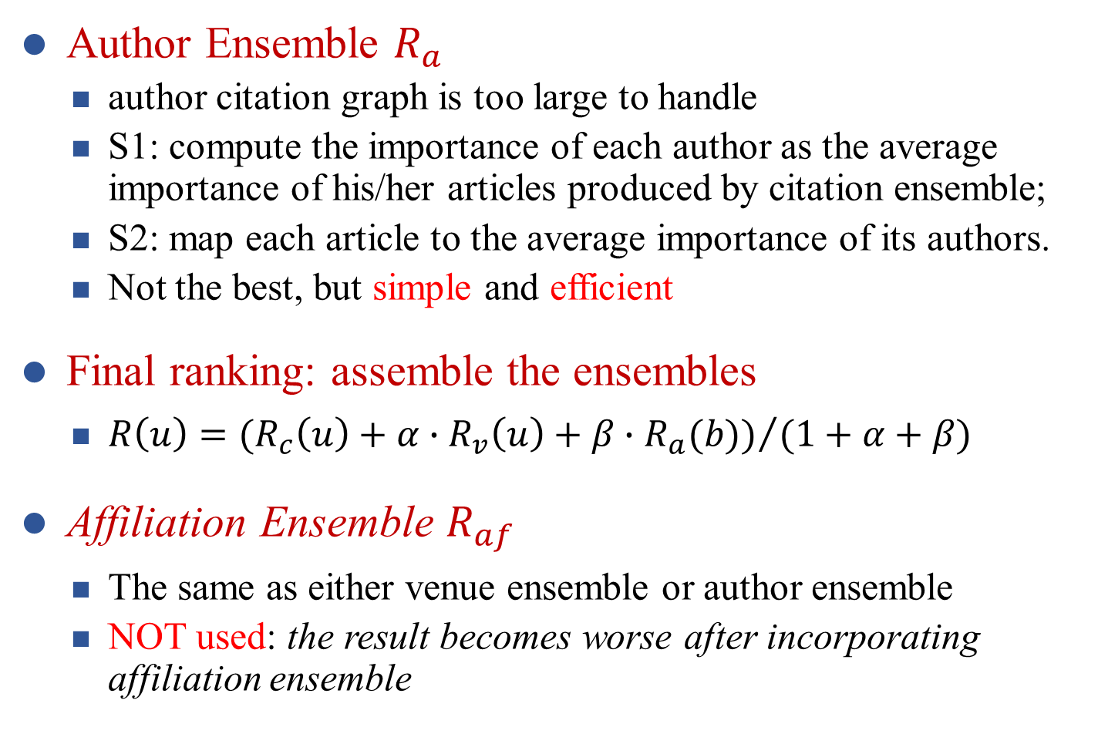
Citation, Venue & Author Ensembles
Author Ensemble $R_{a}$
author citation graph is too large to handle
S1: compute the importance of each author as the average importance of his/her articles produced by citation ensemble;
S2: map each article to the average importance of its authors.
Not the best, but simple and efficient
Final ranking: assemble the ensembles
$R\left(u\right)={(R_{c}\left(u\right)+α∙R_{v}\left(u\right)+β∙R_{a}(b))}/{(1+α+β)}$
Affiliation Ensemble $R_{af}$
The same as either venue ensemble or author ensemble
NOT used: the result becomes worse after incorporating affiliation ensemble

Slide 12
Outline
Ensemble enabled Weighted PageRank
Time Weighted PageRank
Citation, Venue and Author Ensembles
Incorporating External Data
Evaluation
Summary

Slide 13
Use External Data
WHY using external data?
Data missing problem in MAG
64% (77M/120M) articles have no venues (phase 1)
articles without venues are underestimated
Fill in missing venues using external data
Collect raw data from publicly available Digital Libraries;
Remove stop words, numbers and years;
9th International Conference on Web Search and Data Mining, 2016
Link collected venue names to existing ones in MAG
Combine name similarities and topic similarities
Fill in (collect) venues for 0.34M (2.8M) articles

Slide 14
Outline
Ensemble enabled Weighted PageRank
Time Weighted PageRank
Citation, Venue and Author Ensembles
Incorporating External Data
Evaluation
Summary

Slide 15
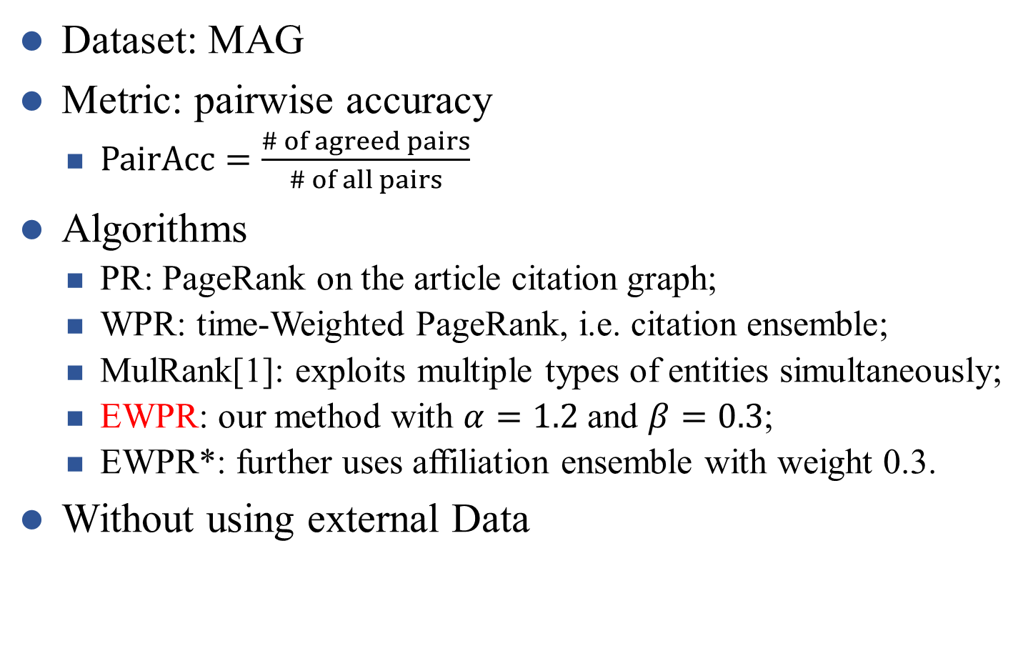
Experimental Settings
Dataset: MAG
Metric: pairwise accuracy
$PairAcc=\frac{\# of agreed pairs}{\# of all pairs}$
Algorithms
PR: PageRank on the article citation graph;
WPR: time-Weighted PageRank, i.e. citation ensemble;
MulRank[1]: exploits multiple types of entities simultaneously;
EWPR: our method with $α=1.2$ and $β=0.3$;
EWPR*: further uses affiliation ensemble with weight 0.3.
Without using external Data
All pairs: {a>b}, {a>c}, {b>c}
Ranking: {a>b}, {a>c}, {b<c}
Agreed pairs: {a>b}, {a>c}
PairAcc = 2/3
[1] Xiaorui Jiang, et al. Towards an Effective and Unbiased Ranking of Scientific Literature through Mutual Reinforcement. In CIKM, 2012.

Slide 16

Experimental Results
Exp-1: PR vs. WPR
WPR outperforms PR by dealing with dynamism of data
Exp-2: WPR vs. EWPR
EWPR outperforms WPR by combining contributions of heterogeneous entities
Exp-3: MulRank vs. EWPR
EWPR performs better since MulRank suffers from error propagation in noisy data
Exp-4: EWPR vs. EWPR*
EWPR performs better since affiliation ensemble has negative effects

Slide 17
Outline
Ensemble enabled Weighted PageRank
Time Weighted PageRank
Citation, Venue and Author Ensembles
Incorporating External Data
Evaluation
Summary

Slide 18
Summary
Problem: rank nodes in a heterogeneous graph based on query-independent node importance
Challenges: Dynamism & Heterogeneity
Solution: ensemble enabled Weighted PageRank
Time-weighted PageRank deals with the dynamism in data
Ensemble model assembles the contributions of the heterogeneous entities
Using external data to deal with the data missing problem

Slide 19
Thanks! Q&A

