Slide 1

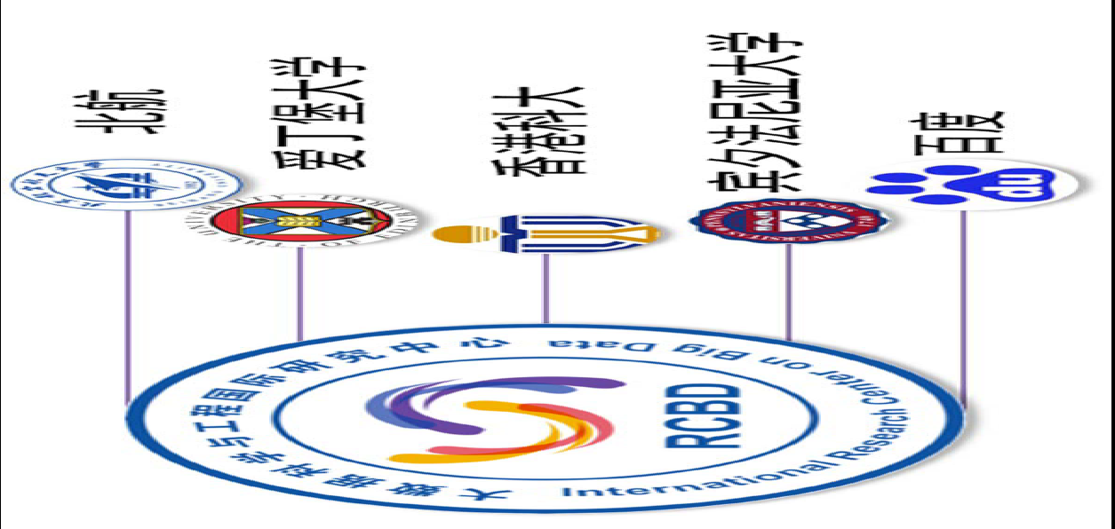
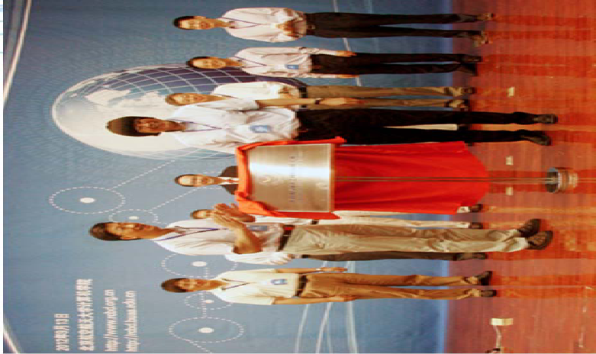
北航大数据科学与工程国际联合研究中心
International Research Centre on Big Data (RCBD)
Founded in September, 2012.
Led by Prof. Wenfei Fan (ACM Fellow, Fellow of the Royal Society of Edinburgh, Scotland) .
Research Topics
Big Data Analysis: Theory and Applications
Data Quality: The Other Side of Big Data
Querying Big Data beyond MapReduce
Querying Big Social Data

Slide 2




973 Grant on Big Data at Beihang
网络信息空间大数据计算的基础研究(2014-2018)
Chief Scientist: Prof. Jinpeng Huai.
8 institutes involved
Focus on “computing theory and practice on Big Data”
http://cnbigdata.org/

