Slide 1
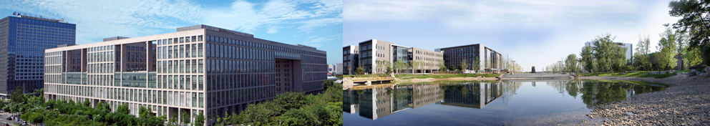

工作与论文个人体会
马 帅

Slide 2
甄士隐语
贾雨村言
☺个人体会☺
2

Slide 3
工作体会

Slide 4

从项目申请看，
我是个失败者！
自然基金的中比率
大约3次中1次
我自然基金申请历程：
5次仅中1次
4

Slide 5
当老师之后，
工作如何开展？
身份转变
博士(博士后) —〉老师
事情变多：
教学、科研(申请、结题等)
带学生、学院实验室的事情
。。。
精力有限
想清楚自己想要什么
5

Slide 6
如何寻找好学生？
合作
从大三学生中寻找
打铁还需自身硬
6

Slide 7

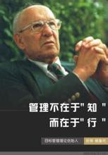
关于制定目标，
“SMART”法则？
S (specific) ：明确，不能只是形容概括
M (measurable)：可衡量，需要量化
A (attainable) ：可达到的，不能是遥不可及的
R (relevant) ：结果导向：与长远目标具有相关性
T (time-based)：有时限的
(Peter F. Drucker)
现代管理学之父
7

Slide 8
论文体会

Slide 9
How to Evaluate a Paper?
Novelty of the problem (25%)
Technical depth (25%)
Writing (25%)
Experiments (25%)

Slide 10
How to Get the Idea?
Positive
For any idea, you can always do something
Negative
Extremely challenging to get good ideas.
Repeated work is NOT called research!
Observation – using your brain
Refine, refine and refine, but with an expectation in your mind!
Explain by examples

Slide 11
How to Get the Solution?
Complexity analysis
PTIME, NP, EXPTIME, …
Approximation analysis for NPC problems
With performance guarantees
Heuristic solutions
With certain properties
No fixed rules to follow for algorithm design
Fully understand the problem
Designed algorithms based on the special characteristics for the problem itself

Slide 12
How to Write the Paper?
It is art - very difficult!
Practice, practice and practice!
Writing, writing and writing!
Proofreading, proofreading, and proofreading!
If people could not understand your writing, they could not evaluate your work.
Sir Isaac Newton
Two good habits
Writing down and remember good sentences when you are reading papers
Ask your “friends”, who could speak truth to you, to check what you have written

Slide 13
How to do Experiments?
Design experimental plans
Show people the idea is good, and the solution is good
Datasets
Real life data
Synthesized data
Always remember what you need to show to people!

Slide 14
Stages of Paper Submission
Submission
Feedback (optional)
Shepherd (optional)
Acceptance/Rejection notification
Preparing camera ready
Experimental repeatability (optional)
Attend conference/present your work
Make big noises
Show people your good work

Slide 15
Two Rules
WWH rule
What, why, how
Think about everything from the view point of reviewers

Slide 16
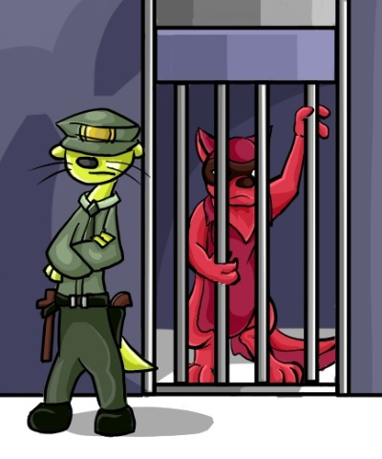
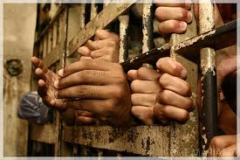
One Warning
NO plagiarism!!!

Slide 17
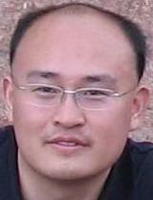
Homepage: http://mashuai.buaa.edu.cn
Email: mashuai@buaa.edu.cn
18611343686
QQ：906632048
谢谢

