Slide 1


Processing Big Graphs
Xuemin Lin
School of Computer Science and Engineering
University of New South Wales
Sydney, Australia
&
AIDA
East China Normal University
Shanghai, China

Slide 2
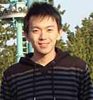
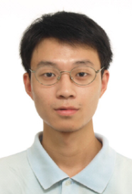
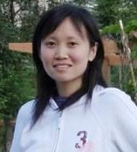
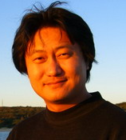

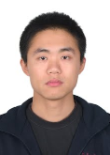
People Involved in Graph based Research
Dr Haichuan Shang
Tokyo University
Dr Weiren Yu
Imperial College
Dr Wenjie Zhang
CSE, UNSW
Dr Ying Zhang
UTS
Dr Gaoping Zhu
Microsoft
Dr Xiang Zhao NUDT

Slide 3


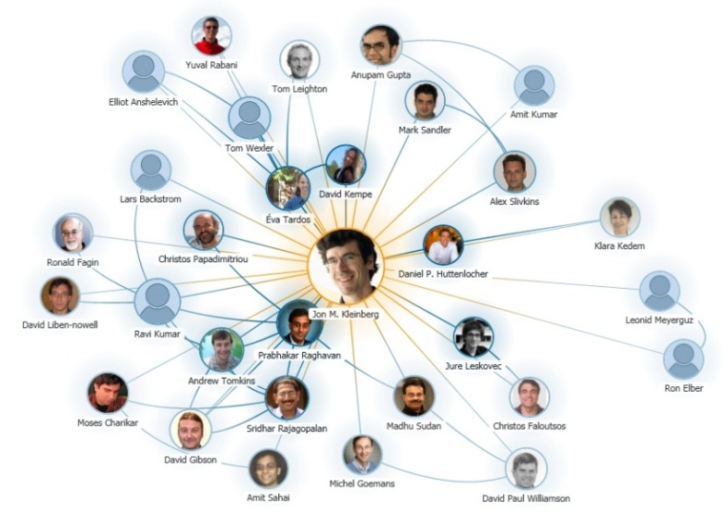
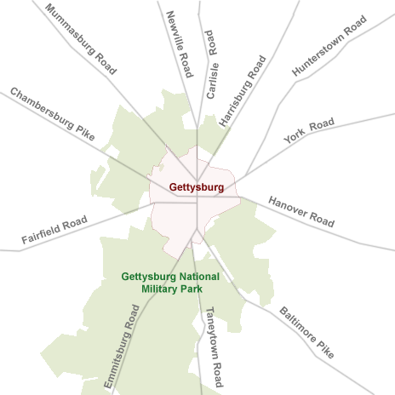
Graphs Can Model Complex Data Structures in Real World!
Chemical Compounds
Social Network
Collaboration Graph
Road Network

Slide 4
Graphs Can Model Complex Data Structures in Real World!
Supporting Primitive Graph Operators Important and Imperative!
Chemical Compounds
Social Network
Collaboration Graph
Road Network

Slide 5
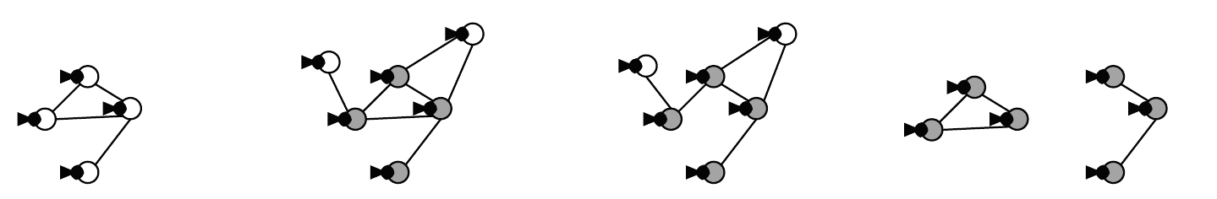
Graph Structure Search
Substructure Search
Retrieve graphs in DB which contain the query graph
Superstructure Search
Retrieve graphs in DB which are contained in the query graph
All-matches
Enumerate all matches of a given (small) graph from a big graph
Query Graph
Substructure
Search
Superstructure
Search
NP-Complete!

Slide 6
Results
Substructure Search (VLDB’08)
Recent Work:
Given a twig pattern (rooted tree) T and a directed graph G, find the top-k matches of T in G.
Optimal algorithm: linear regarding T for generating each match.
Given a query graph g and a big data graph G (no labels), enumerate all matches of g from G.
instance optimal on average

Slide 7
Graph Structure Search
Substructure Similarity Search
Retrieve graphs in DB which have some components of the query graph
Superstructure Similarity Search
Retrieve graphs in DB which are approximately contained by the query graph
All Similarity Matches
Retrieve all approximate matches of a given query in a data graph
Query Graph
Substructure
Similarity Search

Slide 8
Results
Substructure Similarity Search (SIGMOD’10)
Superstructure Similarity Search (ICDE’10)
Edit Distance based Graph Similarity Join (ICDE’12,VLDBJ2013,VLDB2014)
Similarity All-Matching (SIGMOD’12)

Slide 9
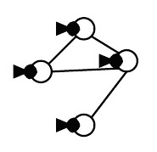
Pair-wise Similarity Search
Rank node-pairs in a graph based on link structure
3
Pair-wise Simialrity
Search
1
2
4
Results:
SimRank Similarity Search (ICDE13,VLDB14,ICDE2014)
SimFusion+ Similarity Search (SIGIR’12)

Slide 10
Other Results
Connectivity
(2x SIGMOD13)
“Optimal Computational Class over MapReduce”
(SIGMOD2014)

Slide 11




Graphs are Big!
2.1 billion webpages in 2000
15 billion links in 2000
1.23 billon active users in 2013
117 billion friendships in 2013
645 million users in 2013
1.7 billion tweets/month in 2013
1.4 billion webpages in 2002
6.6 billion links in 2002

Slide 12
Why MapReduce?
Scalability for big data
Widely used in Google, Facebook, Yahoo, Amazon, etc.
Scalable to hundreds/thousands of machines
Stability
Fundamental algorithms for scans, joins, and sorts
Usually small number of rounds
Simplicity
Only two functions need to be implemented: Map and Reduce
Easy to be integrated with various information (e.g., structure, text, location, etc.)

Slide 13

A Good MapReduce Algorithm?
Minimum Communication cost?
Minimum CPU Cost?
Minimum Memory Consumption?
Minimum Number of Rounds?
We just need to compute using one machine!
We need to define various constraints for each machine!
One standard is not enough!

Slide 14
MapReduce Class (MRC)
Proposed by Karloff et al. SODA’10
To define basic requirements for MapReduce
S: size of objects in the problem
t: number of machines in the system
ε: a constant with 0<ε<1
Disk: O(|S|^{1-ε})/machine, O(|S|^{2-2ε}) total
Memory: O(|S|^{1-ε})/machine, O(|S|^{2-2ε}) total
Communication/round: O(|S|^{1-ε})/machine, O(|S|^{2-2ε}) total
CPU/round: O(poly(|S|))/machine
Number of Rounds: O(poly(log|S|))

Slide 15
Minimal MapReduce Class (MMC)
Proposed by Tao et al. SIGMOD’13
To define the minimal requirements for MapReduce
S: size of objects in the problem
t: number of machines in the system
T_{seq}: the time to solve the same problem on a single sequential machine
Disk: O(|S|/t)/machine, O(|S|) total
Memory: O(|S|/t)/machine, O(|S|) total
Communication/round: O(|S|/t)/machine, O(|S|) total
CPU/round: O(T_{seq}/t)/machine
Number of Rounds: O(1)

Slide 16
MMC: Not Suitable for Graph
Bound for communications unrealistic
Graph G(V,E) with n=|V| nodes and m=|E| edges
Memory constraint in MMC : all edges/nodes are distributed evenly in all machines
A common graph operation: exchange data among all adjacent nodes
Communication is dependent on the number of cross-machine edges

Slide 17
MMC: Not Suitable for Graph
E_{i,j}: the set of edges (u,v) that u is in machine i, and v is in machine j
The communication constraint in MMC is formalized as:
Cannot guarantee max_{1≤i≤t}(Σ_{1≤j≤t,j≠i}|E_{i,j}|) ≤O((m+n)/t)
Note: minimizing max1≤i≤t(Σ1≤j≤t,j≠i|Ei,j|) is NP-hard
max_{1≤i≤t}(Σ_{1≤j≤t,j≠i}|E_{i,j}|)≤O((m+n)/t)

Slide 18
MRC: Not Scalable for Big Graph
A class for graph is defined in MRC (Karloff et al. in SODA’10)
Graph G(V,E) with n=|V| nodes and m=|E| edges
c: a constant with n^{1+c}≤m
Disk: O(n^{1+c/2})/machine, O(m^{1+c/2}) total
Memory: O(n^{1+c/2})/machine, O(m^{1+c/2}) total
Communication/round: O(n^{1+c/2})/machine, O(m^{1+c/2}) total
CPU/round: O(poly(m))/machine
Number of Rounds: O(1)
However: cannot process graph with large n, due to O(n^{1+c/2}) memory per machine

Slide 19
A New Class for Graph: SGC
Disk: O(m/t)/machine, O(m) total
Same as MMC
Memory: O(1)/machine, O(t) total
To ensure the robustness requirement
Only consider the memory used in map and reduce phases
Even stronger than MMC
Communication/round: Õ(m/t)/machine, O(m) total
Relax MMC
CPU/round: Õ(m/t)/machine, O(m) total
Relax MMC
Only consider the CPU used in map and reduce phases
Number of Rounds: O(log(n))
Relax MMC
Given the above constraints, O(1) round is impossible for most graph problems.

Slide 20
A Comparison (Classes for Graph)
 | MRC | MMC | SGC
Disk/machine | O(n^{1+c/2}) | O(m/t) | O(m/t)
Disk total | O(m^{1+c/2}) | O(m) | O(m)
Memory/machine | O(n^{1+c/2}) | O(m/t) | O(1)
Memory total | O(m^{1+c/2}) | O(m) | O(t)
Communication/machine | O(n^{1+c/2}) | O(m/t) | Õ(m/t)
Communication total | O(m^{1+c/2}) | O(m) | O(m)
CPU/machine | O(poly(m)) | O(T_{seq}/t) | Õ(m/t)
CPU total | O(poly(m)) | O(T_{seq}) | O(m)
Number of rounds | O(1) | O(1) | O(log(n))

Slide 21
Conclusions and Remarks:
Real-time graph processing is a hard problem.
Many open problems to be resolved.
Positive and negative results.
Thank you!

Slide 22

Pagerank Computation
Given: directed graph G(V,E)
r_{i}(v): the pagerank of v in round i, initialized as 1/|V|
r_{i}(v)=α/|V|+(1-α)Σ_{u in nbrin(v)}r_{i-1}(u)/d_{out}(u)
α: a parameter in (0,1); nbr_{in}(v): in neighbor of v; d_{out}(u): out degree of u

Slide 23
Pagerank Computation in SGC
Step 1: initialization
Step 2: iteratively update pagerank
Based on r_{i}(v)=α/|V|+(1-α)Σ_{u in nbrin(v)}r_{i-1}(u)/d_{out}(u)
Can be processed using a NE join followed by a EN join
Step 3: return Π_{id,r}(V_{r})
V_{r}=Π_{id,cnt(id2)->d,1/|V|->r}(V E)
EN
id,id₁
E_{r}=Π_{id1,id2,r/d->p}(V_{r} E)
V_{r}=Π_{id,d,α/|V|+(1-α)sum(Er.p)->r}(V_{r} E_{r})
NE
id,id₁
EN
id,id₂

Slide 24
Other Algorithms in SGC
Breadth First Search (BFS)
Update the level i nodes in the i-th round using a NE join followed by a EN join
Graph Keyword Search (KWS)
Each node in the graph contains text information
Input a list of keywords
Output the set of nodes that can reach all keywords within distance r_{max}
Can be processed similar to BFS by expanding from multiple keyword nodes simultaneously
Connected Component (CC) Computation
Finish in O(log(n)) rounds
Share similar idea with O(log(n)) CRCW PRAM algorithms
Minimum Spanning Forest (MSF) Computation
Finish in O(log(n)) rounds
Based on the Sollin’s Algorithm.

Slide 25
Conclusions and Remarks:
Real-time graph processing is a hard problem.
Many open problems to be resolved.
Positive and negative results.
Thank you!

Slide 26
Comparison with State-of-the-art
Connected Component (CC) Computation
HashToMin and HashGToMin (Rastogi et al. ICDE’13)
Minimum Spanning Forest (MSF) Computation
OneRoundMSF (Karloff et al. SODA’10)
MultiRoundMSF (Lattanzi et al. SPAA’11)
 | HashToMin | HashGToMin | CC (SGC)
Memory/Machine | O(1) | O(n) | O(1)
Communication/round | O(log(n) m) | O(m) | O(m)
Number of rounds | expected O(log(n)) | expected O(log(n)) | O(log(n))
 | OneRoundMSF | MultiRoundMSF | MSF (SGC)
Memory/Machine | O(n^{1+c/2}) | O(n^{1+ε}) | O(1)
Communication/round | O(m^{1+c/2}) | O(m) | O(m)
Number of rounds | O(1) | O((log_{n}(m)-1)/ε) | O(log(n))

Slide 27
Experimental Setup
Cluster: 17 machines, including 1 master and 16 slaves
Each machine
4 Intel Xeon 2.4GHz CPUs and 15GB RAM
64-bit Ubuntu Linux
Algorithm implementation: Hadoop (version 1.2.1) with java 1.6
MapReduce Settings
Java heap size: 2048MB
Block size: 128MB
Data replication factor of HDFS: 3
I/O buffer size: 128KB
Parameters
n: graph size (20%, 40%, 60%, 80%, 100%)
t: number of slaves (4, 7, 10, 13, 16)

Slide 28
Datasets
Real dataset: Twitter
41, 652, 230 nodes and 1, 468, 365, 182 edges
Average degree 71 and max degree 3, 081, 112
Diameter: around 24
Real dataset: Friendster
65, 608, 366 nodes and 1, 806, 067, 135 edges
Average degree 55 and max degree 5124
Diameter: around 32

Slide 29
Experiments (CC)
Vary n (Twitter)
Vary n (Friendster)
Vary t (Twitter)
Vary t (Friendster)

Slide 30
Experiments (MSF)
Vary n (Twitter)
Vary n (Friendster)
Vary t (Twitter)
Vary t (Friendster)

