Slide 1


搜索意图在搜索空间的快速准确匹配
方法和技术
Xuemin Lin
School of Computer Science and Engineering
University of New South Wales
Sydney, Australia
&
SEI
East China Normal University
Shanghai, China

Slide 2
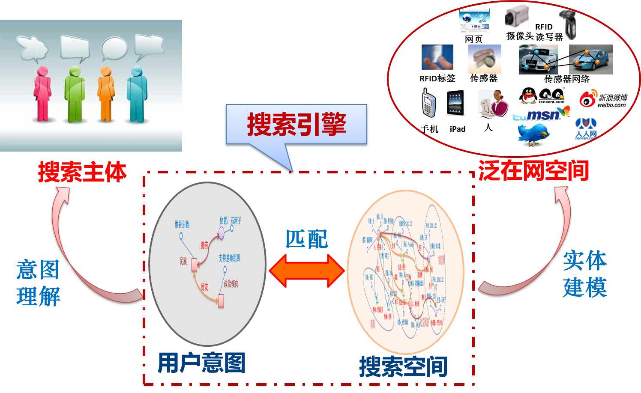
用户意图在搜索空间的匹配
挑战：
数据的多源、异构、多态、不确定、海量性

Slide 3
多源、异构、多态、不确定、海量
多源：各数据来源不同
带来数据间可能的conflict, duplications, etc.
匹配结果冗余及有错。
异构：各数据用不同的数据模型来表达；多态：各数据来源于不同的模态
怎样进行精准快速的cross查询。
不确定：数据recording手段的limits 导致不确定性
怎样进行有效的概化查询。
海量：巨大的数据量
结合复杂的匹配问题使得实时查询更具挑战。

Slide 4
多源、异构、多态：
Data preprocessing: data cleansing and integration - may lose information, may not always possible, and cannot support dynamic data.
Challenge: Real-time fusion - indexing, fusion model, etc
不确定：概化查询
Independent Probabilistic Distribution and Possible World are well studied: many limits.
Challenge: New probabilistic model and correlation model.
海量：实时查询 - even linear time not practical when data volume is PB.
Challenge: indexing, volume reduction, and parallel computation，positive and negative results.

Slide 5
研究内容
面向用户意图模型的高效智能化的排序
面向实体动态属性的搜索意图匹配
多目标混合准则的搜索的匹配
基于图模型的搜索意图匹配
搜索匹配方法的并行化计算

Slide 6
面向用户意图模型的高效智能化的排序
Various ranking mechanisms have been studied over Web data, Relational data, Spatial/-Temporal data, Graph data, Uncertain data, MM data, etc.
Semantically: applications & contexts aware ranking mechanisms, fuse information together, etc.
Computationally: Indexing and real-time ranking technologies (high dimensional data, data in complex forms, complex ranking models, etc.)
面向实体动态属性和多目标混合准则make the challenges tougher!

Slide 7


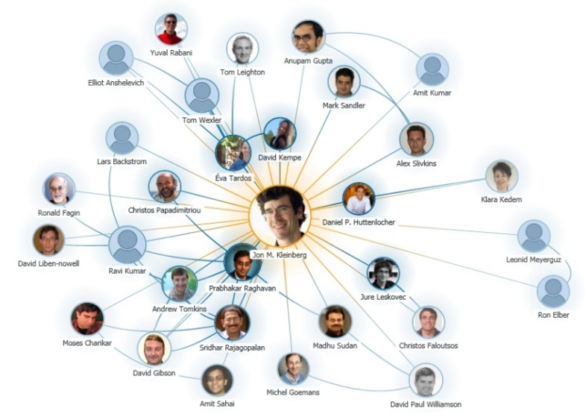
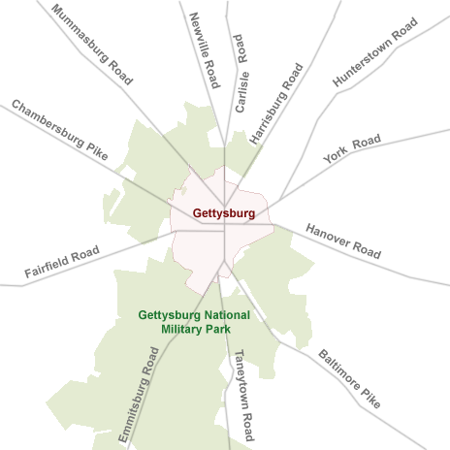
Graphs Can Model Complex Data Structures in Real World!
Chemical Compounds
Social Network
Collaboration Graph
Road Network

Slide 8
Graphs Can Model Complex Data Structures in Real World!
Supporting Primitive Graph Operators Important and Imperative!
Chemical Compounds
Social Network
Collaboration Graph
Road Network

Slide 9
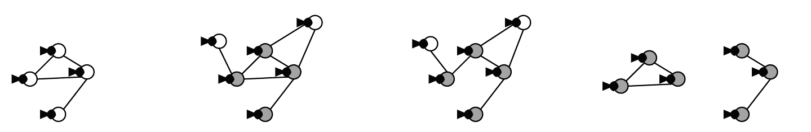
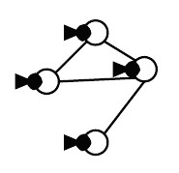
Graph Structure Search
Substructure Search
Retrieve graphs in DB which contain the query graph
Substructure Similarity Search
Retrieve graphs in DB which have some components of the query graph
Superstructure Search
Retrieve graphs in DB which are contained in the query graph
Pair-wise Structure Search
Rank node-pairs in a graph based on link structure
3
1
2
4
Substructure
Search
Substructure
Similarity Search
Superstructure
Search
Pair-wise Structure
Search
Query Graph

Slide 10
Results
Many breakthroughs from UIUC, UNSW, CUHK, Edinburgh, Google, Microsoft, etc.
UNSW:
Substructure Search (VLDB’08)
Substructure Similarity Search (SIGMOD’10)
Superstructure Similarity Search (ICDE’10)
Edit Distance based Graph Similarity Join (ICDE’12,VLDBJ2013,VLDB2014)
Similarity All-Matching (SIGMOD’12)
SimRank Similarity Search (ICDE13,VLDB14,ICDE2014)
SimFusion+ Similarity Search (SIGIR’12)
Connectivity (2x SIGMOD13)
Not well studied: unlabeled graphs, ranking search (e.g. top-k), etc.

Slide 11
Other Operators
Reachability between two nodes in a directed graph.
UNSW, AT&T Lab, Oxford, Tokyo U, CUHK, etc
Shortest paths in a graph.
GIT, Tokyo, Boston University, HKUST, etc
Pattern match extends the existing model of substructure.
UNSW, Waterloo, HKUST, Arizona State University, CUHK, etc
Graph Simulation (Edinburgh, etc.)

Slide 12
Other Operators
keyword search:
UNSW, Hebrew U of Jerusalem, UCSD, UIUC, CUHK, Google, etc
dense subgraph mining: cliques or quasi-cliques
UNSW, Brown University, CUHK, SFU, etc.
community search: densely connected subgraph containing specific query nodes
Cornell, Stanford, KAIST, Microsoft, UBC, etc.
graph clustering/partition:
CMU, Cornell University, UC Berkeley, UCSB, etc.

Slide 13




并行化计算
2.1 billion webpages in 2000
15 billion links in 2000
1.23 billon active users in 2013
117 billion friendships in 2013
645 million users in 2013
1.7 billion tweets/month in 2013
1.4 billion webpages in 2002
6.6 billion links in 2002

Slide 14
并行化计算
MapReduce, BSP, etc.
Many algorithms developed.
Challenges: Positive and Negative Results
Positive Results:
Poly-logarithmic algorithms: relational operator and PRAM model (VLDB2013)
Optimal Computation Class for Spatial Data on MapReduce (SIGMOD2013)
Optimal Computational Class for Graph Data on MapReduce (SIGMOD2014)

Slide 15
Why MapReduce?
Scalability for big data
Widely used in Google（X）, Facebook, Yahoo, Amazon, etc.
Scalable to hundreds/thousands of machines
Stability
Fundamental algorithms for scans, joins, and sorts
Usually small number of rounds
Simplicity
Only two functions need to be implemented: Map and Reduce
Easy to be integrated with various information (e.g., structure, text, location, etc.)

Slide 16
MapReduce Class (MRC)
Proposed by Karloff et al. SODA’10
To define basic requirements for MapReduce
S: size of objects in the problem
t: number of machines in the system
ε: a constant with 0<ε<1
Disk: O(|S|^{1-ε})/machine, O(|S|^{2-2ε}) total
Memory: O(|S|^{1-ε})/machine, O(|S|^{2-2ε}) total
Communication/round: O(|S|^{1-ε})/machine, O(|S|^{2-2ε}) total
CPU/round: O(poly(|S|))/machine
Number of Rounds: O(poly(log|S|))

Slide 17
Minimal MapReduce Class (MMC)
Proposed by Tao et al. SIGMOD’13
To define the minimal requirements for MapReduce
S: size of objects in the problem
t: number of machines in the system
T_{seq}: the time to solve the same problem on a single sequential machine
Disk: O(|S|/t)/machine, O(|S|) total
Memory: O(|S|/t)/machine, O(|S|) total
Communication/round: O(|S|/t)/machine, O(|S|) total
CPU/round: O(T_{seq}/t)/machine
Number of Rounds: O(1)

Slide 18
MMC: Not Suitable for Graph
Bound for communications unrealistic
Graph G(V,E) with n=|V| nodes and m=|E| edges
Memory constraint in MMC : all edges/nodes are distributed evenly in all machines
A common graph operation: exchange data among all adjacent nodes
Communication is dependent on the number of cross-machine edges

Slide 19
MRC: Not Scalable for Big Graph
A class for graph is defined in MRC (Karloff et al. in SODA’10)
Graph G(V,E) with n=|V| nodes and m=|E| edges
c: a constant with n^{1+c}≤m
Disk: O(n^{1+c/2})/machine, O(m^{1+c/2}) total
Memory: O(n^{1+c/2})/machine, O(m^{1+c/2}) total
Communication/round: O(n^{1+c/2})/machine, O(m^{1+c/2}) total
CPU/round: O(poly(m))/machine
Number of Rounds: O(1)
However: cannot process graph with large n, due to O(n^{1+c/2}) memory per machine

Slide 20
A New Class for Graph: SGC
Disk: O(m/t)/machine, O(m) total
Same as MMC
Memory: O(1)/machine, O(t) total
To ensure the robustness requirement
Only consider the memory used in map and reduce phases
Even stronger than MMC
Communication/round: Õ(m/t)/machine, O(m) total
Relax MMC
CPU/round: Õ(m/t)/machine, O(m) total
Relax MMC
Only consider the CPU used in map and reduce phases
Number of Rounds: O(log(n))
Relax MMC
Given the above constraints, O(1) round is impossible for most graph problems.

Slide 21
A Comparison (Classes for Graph)
 | MRC | MMC | SGC
Disk/machine | O(n^{1+c/2}) | O(m/t) | O(m/t)
Disk total | O(m^{1+c/2}) | O(m) | O(m)
Memory/machine | O(n^{1+c/2}) | O(m/t) | O(1)
Memory total | O(m^{1+c/2}) | O(m) | O(t)
Communication/machine | O(n^{1+c/2}) | O(m/t) | Õ(m/t)
Communication total | O(m^{1+c/2}) | O(m) | O(m)
CPU/machine | O(poly(m)) | O(T_{seq}/t) | Õ(m/t)
CPU total | O(poly(m)) | O(T_{seq}) | O(m)
Number of rounds | O(1) | O(1) | O(log(n))

Slide 22
Conclusions and Remarks:
Develop 搜索空间的快速精准匹配technology 是一个极大的挑战：
Semantically, many issues need to be resolved including matching models, fusion models, approximation, and evaluations.
Computationally, indexing, parallel processing techniques, evaluating parallel programing models, and positive & negative results.
Systems.
Thank you!

