Slide 1
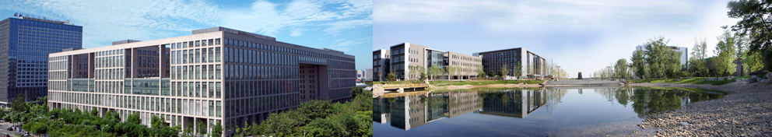

On Big Data at Beihang
Shuai Ma

Slide 2

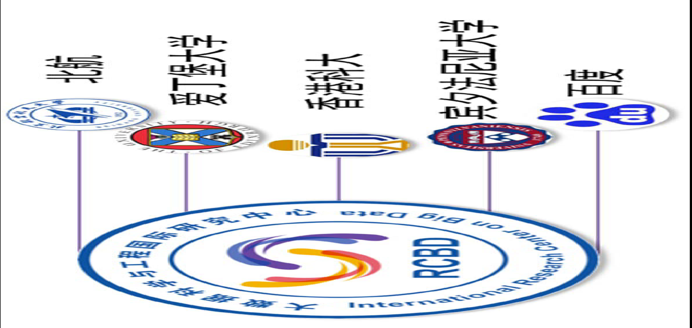
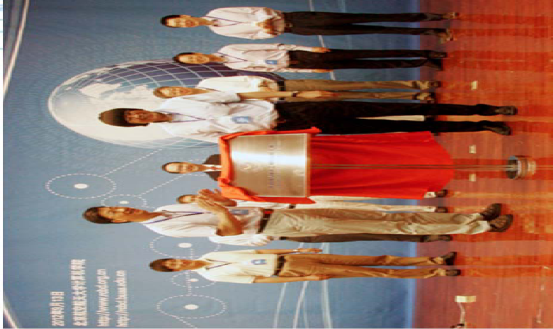
National Center for International Research
International Research Center on Big Data (RCBD)
Founded in September, 2012.
Led by Prof. Wenfei Fan (ACM Fellow, Fellow of the Royal Society of Edinburgh, Scotland) .
Research Topics
Big Data Analysis: Theory and Applications
Data Quality: The Other Side of Big Data
Querying Big Data beyond MapReduce
Querying Big Social Data

Slide 3




973 National Basic Research Program
Fundamental research on big data (2014-2018)
Focus on “computing theory and practice on Big Data”
Chief Scientist: Prof. Jinpeng Huai.
8 institutes involved
http://cnbigdata.org/

Slide 4

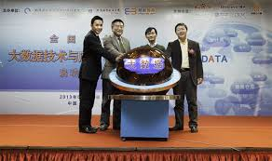
Joint Education
First software engineering degree in Big Data in China on January 18, 2013.
School of Software
School of Computer science and engineering
International Research Center on Big Data
Industries

Slide 5











Course design
Probability and statistics
Introduction to Algorithms
Operations systems, Networking and distributed systems
Databases management
Data warehouse
Data Mining
Machine learning and pattern recognition
Information Retrieval
Programming languages
Mapreduce/hadoop
NoSQL database
Data visualization
Social data analysis
Business Intelligence
Multivariate Statistics Analysis
Computational Advertising
Frontiers of Computer science

Slide 6







Collaboration with Industries
Notes:
来自美国纽约州立宾汉姆顿大学、亚利桑那州立大学等美国知名大学的计算机领域的知名教授，也包括来自百度、微软、阿里云、腾讯、中国移动等知名IT企业的技术专家。

Slide 7


Introduction to Data Science
Online course, by Professor Bill Howe from University of Washington
https://www.coursera.org/course/datasci
Topics include:
Introduction
Relational Databases, Relational Algebra
MapReduce
NoSQL
Basic Statistical Analysis
Topics in Machine Learning
Visualization
Graph Analytics
Perspectives Beyond MapReduce
Notes:
fresh students
Sophomore students
junior student
Senior studnet

Slide 8
Esstial IT Component- IT2017 Information Technology
ITA-IMA Information Management [40 hours]
ITA-IMA 01 History and overview [1]
ITA-IMA 02 Concepts and fundamentals [8]
ITA-IMA 03 Database query languages [9]
ITA-IMA 04 Data Organization architectures [8]
ITA-IMA 05 Data modeling [7]
ITA-IMA 06 Managing the database environment [5]
ITA-IMA 07 Special-purpose databases [2]
ITA-IMA Information Management [40 hours]
ITA-IMA 01 History and overview [1]
ITA-IMA 02 Concepts and fundamentals [8]
ITA-IMA 05 Data modeling [7]
ITA-IMA 03 Database query languages [9]
ITA-IMA 04 Data Organization architectures [8]
ITA-IMA 06 Managing the database environment [5]
ITA-IMA 07 Special-purpose databases [2]
Notes:
{database, machine learning, statistical learning, data mining, visualization analysis }

Slide 9
IT Applied Domains Component- IT2017 Information Technology
ITA-BDA Big Data [30 hours]
ITA-BDA01 History and overview [1]
ITA-BDA02 Applications [8]
ITA-BDA02 Applications [4]
ITA-BDA03 Science and foundations [7]
ITA-BDA04 Infrastructures [5]
ITA-BDA05 Management [5]
ITA-BDA05 Data Management [6]
ITA-BDA06 Search and mining [4]
ITA-BDA06 Data Analytics [7]
Notes:
{database, machine learning, statistical learning, data mining, visualization analysis }

Slide 10
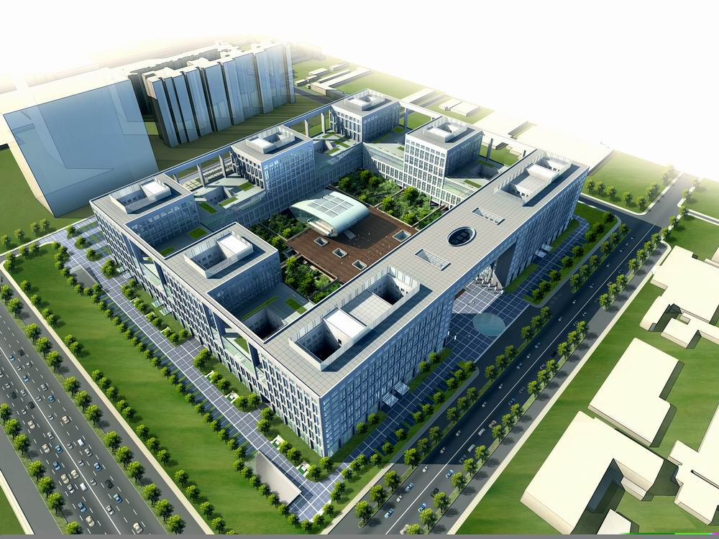
Thanks!

