Slide 1
The Big Tent of IT Undergraduate Education in China
Ming Zhang
Peking University

Slide 2
ACM Ed Council at China
Chair主席：Ming Zhang, Peking U. 北大张铭
CS: Zheng Qin, Intel 秦征; Wenzhi Chen, Zhejiang U浙大陈文智
CE：Weidong Liu, Tsinghua U. 清华刘卫东
SE：Qing Liu, Tongji U. 同济刘琴
IT：Ming Zhang 北大张铭; Bo Li, Xian Jiaotong U. 西安交大李波
IS：Wenjun Wu, Beihang U. 北航吴文峻
Secretary 秘书：Long Zhang, HEP Press 高教社张龙

Slide 3
Outline
Overview
Background
IT undergrads programs
Conclusion

Slide 4
Overview
Information Technology (IT) ≠ Computer Science (CS)
IT industry: hardware, software, electronics, semiconductors, internet, telecom equipment, Ecommerce, etc.
IT Education (ITE) ≠ CS Education (CSE)
IT programs no longer limits to Computer Science and Technology (CST) & Software Engineering (SE)

Slide 5
Background: National College Entrance Examination in China
Limited education resources vs. large population
The examination is notoriously tough
Unlike SAT and ACT
Exclusive factor in Chinese college admission
Extremely low acceptance ratio in top-tier universities
Peking University (3,715 out of 9.15 million in 2012)
Tsinghua University (3,380 out of 9.15 million in 2012)

Slide 6
Background: National College Entrance Examination in China

Slide 7
Background: IT Related Undergraduate Programs
As college students increase rapidly, IT related undergraduate education has been a boom
IT major became the most popular major in terms of total enrollment
Accounted for 28% among all the engineering majors
Common disciplines in the Department of Computer Science and Technology
Computer architecture
Micro computer system
Parallel computing
Artificial intelligence, computer graphics
Computer aided design
Etc.

Slide 8
Background: Gap Between Education & Employment
A tough start in the tight job market
7 million fresh graduates in 2013 (highest ever)
70% no offer (by May 2013)
IT major gets a red card for 4 years
A large number of unemployment
Low employment rates
Low average wages

Slide 9
Background: Gap Between Education & Employment
However, China IT industry shows robust growth!
Gross output value in IT related industry (values in y-axis are measured in billion RMB)

Slide 10
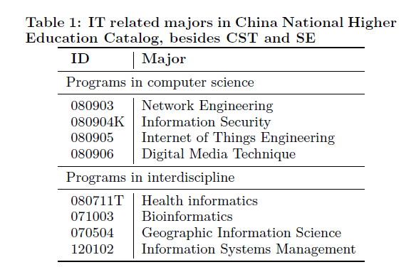
IT education adjusted
Seeing the gap, IT related majors in China National Higher Education has been adjusted
IT related majors in
China National Higher
Education Catalog,
besides CST and SE

Slide 11
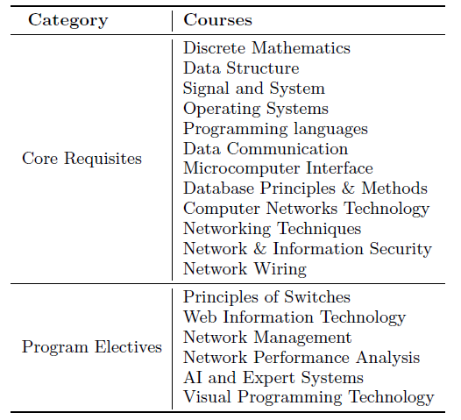
Network Engineering (out of CS)
Provide preparation for the field of information technology with a concentration in Network Engineering.
Established in 1998
In more than 270 colleges and universities, including universities listed in 985 project and 211 project
Curriculum of Network Engineering (excerpt)

Slide 12
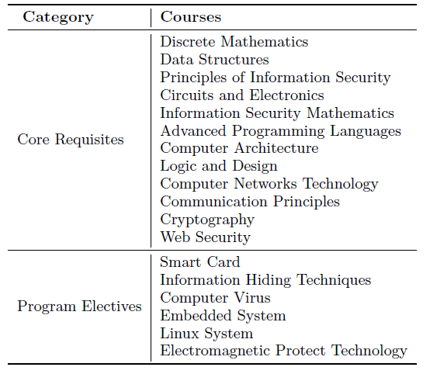
Information Security (out of CS)
Provide a wide range of technical skills in information security and risk management
Established in 2001 in Wuhan University
In more than 70 colleges and universities,
Curriculum of Information Security (excerpt)

Slide 13
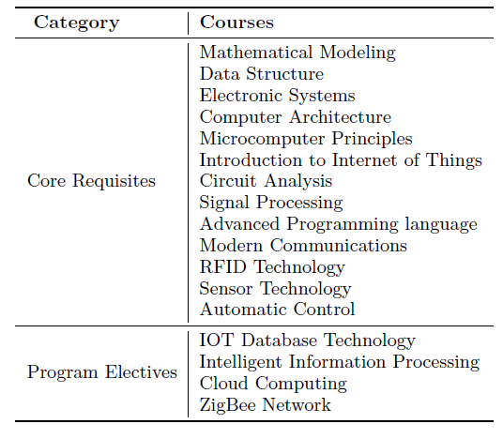
Internet of Things Engineering (out of CS)
Internet of Things: translate the success of the online network effect into the inclusion of everyday objects.
Established in 2010
In more than 30 colleges and universities,
Curriculum of Internet of Things Engineering (excerpt)

Slide 14
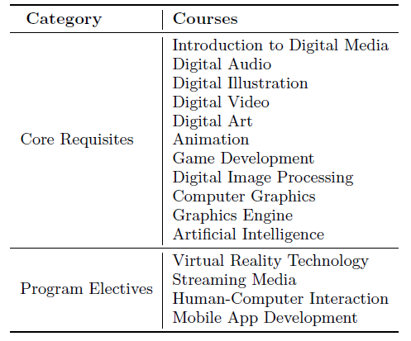
Digital Media Techniques (out of CS)
Digital Media Technique: collection, processing, storage, transmission, management, security and output.
Established in 2004
In more than 100 colleges and universities
Curriculum of Digital Media Techniques (excerpt)

Slide 15
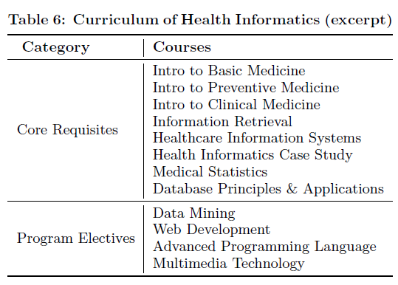
Health Informatics (interdisciplinary)
Health informatics: a discipline at the intersection of information science, computer science, and health care
Began in 1985
Medical Library and Information Science in Bethune University of Medical Sciences (today’s Jilin University).
In more than 40 colleges and universities
Curriculum of Health Informatics (excerpt)

Slide 16
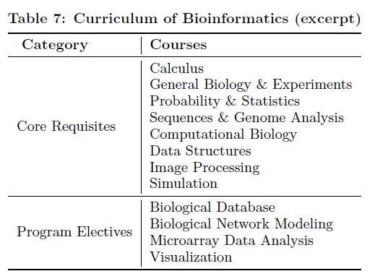
Bioinformatics (interdisciplinary)
Bioinformatics: at the intersection of biology, information technology, and applied mathematics.
Established in 1996
Peking University
In more than 150 colleges and universities
Curriculum of bioinformatics (excerpt)

Slide 17
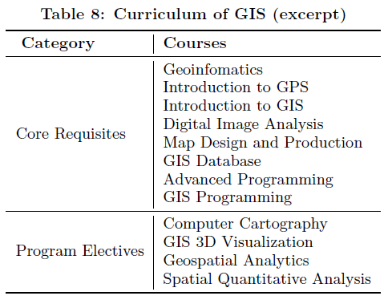
Geographic Information Engineering (interdisciplinary)
Geographic information Science: discipline that focuses on spatial information and information technology
Established in 1998
In more than 180 colleges and universities
Curriculum of Geographic Information Engineering (excerpt)

Slide 18
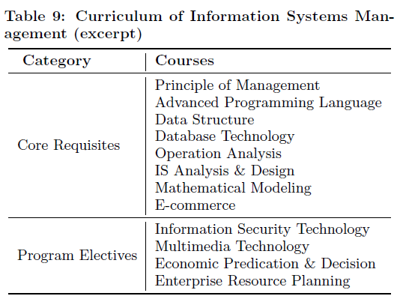
Information System Management (interdisciplinary)
Information Systems Management: interdisciplinary requiring aspects of computer science, economics and management
Established in 1999
Fudan University
In more than 100 colleges and universities
Curriculum of Information Systems Management (excerpt)

Slide 19
Conclusion
Remarkable growth of IT programs in China
Programs in Computer Science
Network Engineering Information Security
Internet of Things Engineering Digital Media Technique
Programs in Interdisciplinary
Health Informatics Bioinformatics
Geographic Information Science Information System Management
Needs further improvements
Narrow the skill gap between education and employment

Slide 20
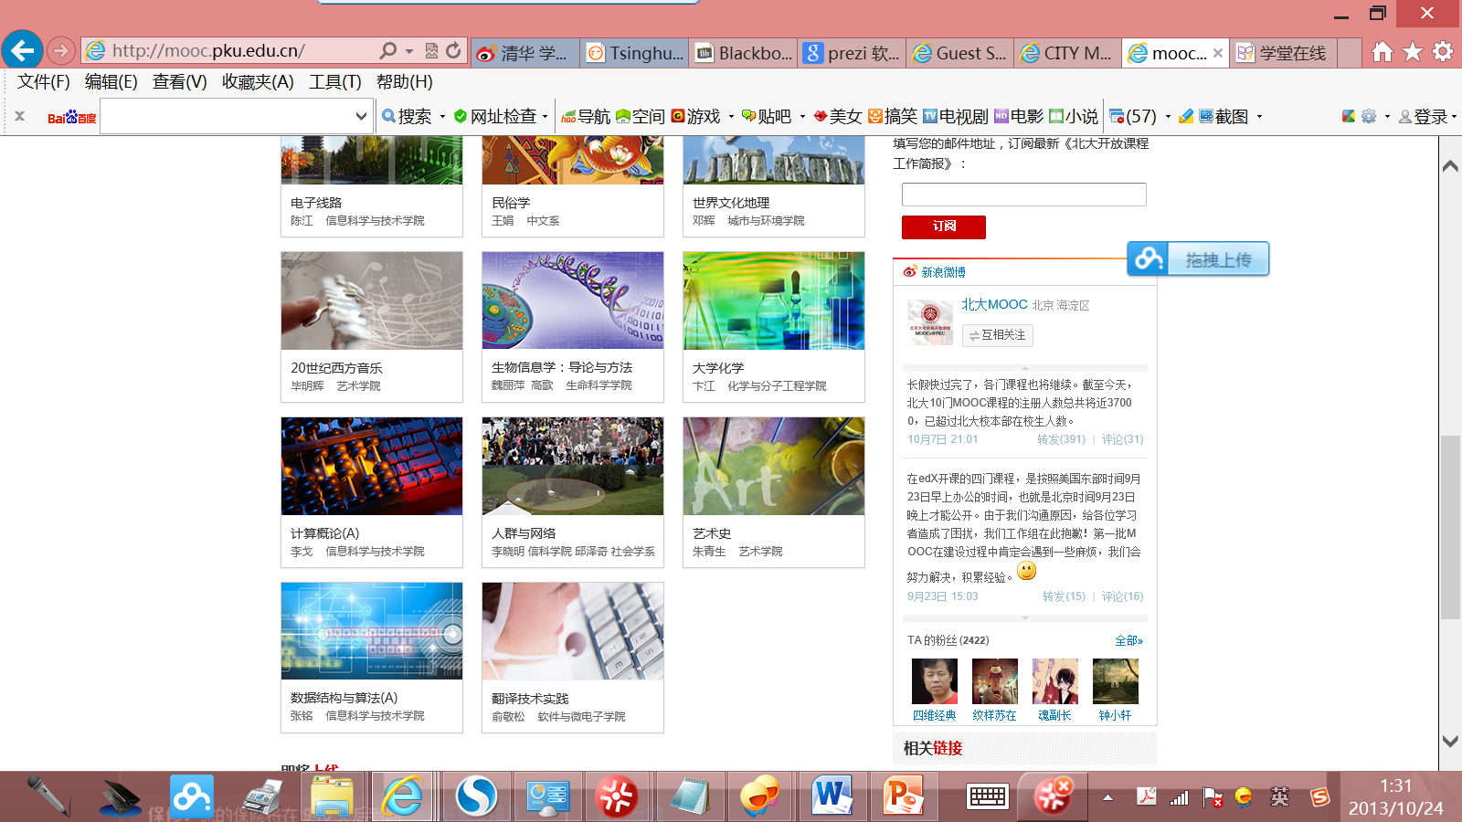
MOOC in China http://mooc.pku.edu.cn

Slide 21
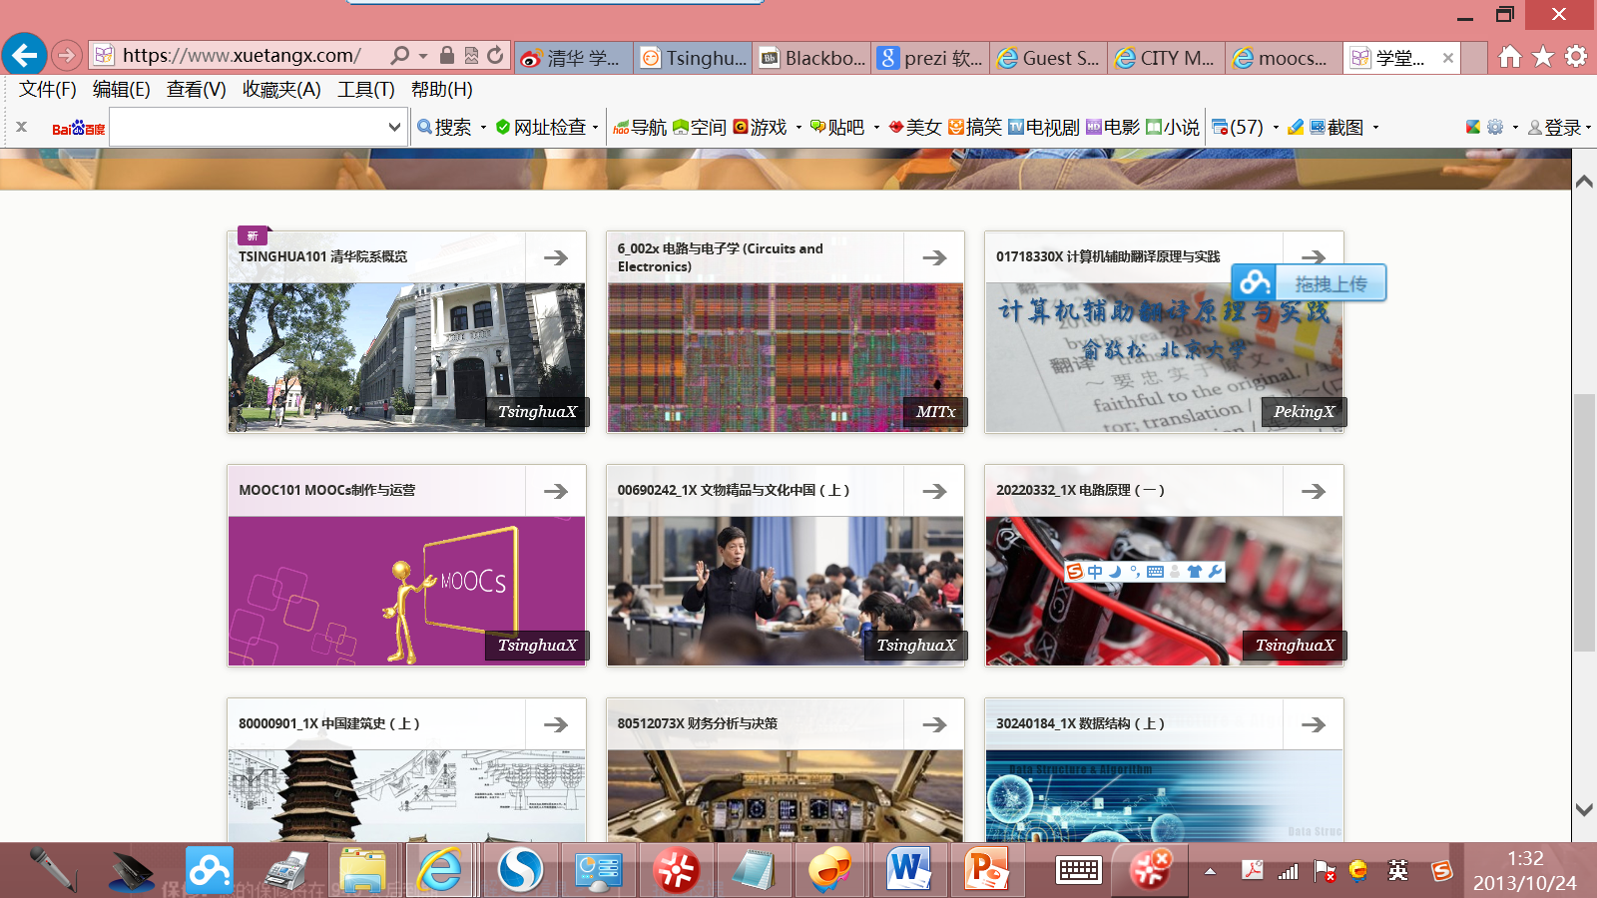
MOOC in China https://www.xuetangx.com/

Slide 22
Thanks!

