Slide 1
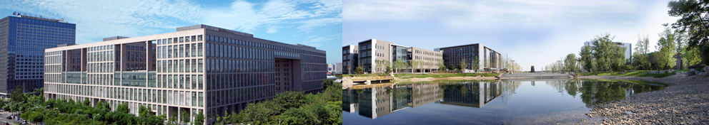

学术研究方法浅论
马 帅

Slide 2
提纲
科研是什么？
如何读/写论文
书籍推荐
是甄士隐言？
还是贾雨村？
☺一家之言☺

Slide 3
科研是什么？

Slide 4

科研是什么之创新性
工程强调的是work
科研强调的是innovation

Slide 5
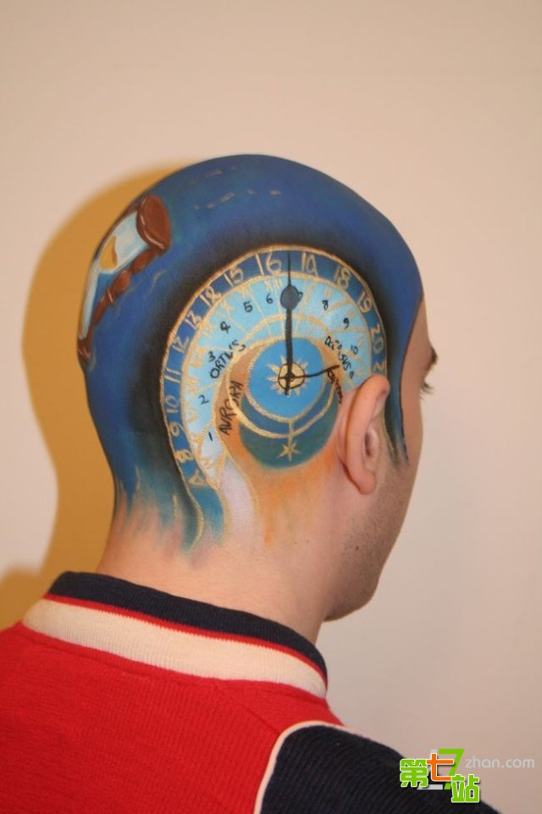
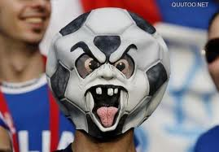
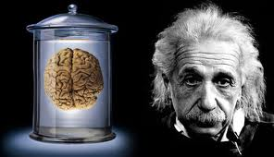
科研是什么之疯狂的脑袋

Slide 6
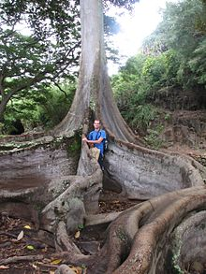

科研是什么之根深叶茂

Slide 7
科研是什么之节点控制

Slide 8



科研是什么之合作与独立

Slide 9
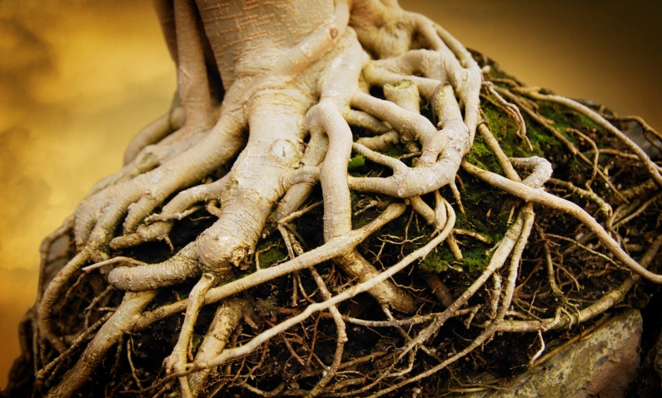
科研是什么之根与主干
坚持主流研究方向
要有“根”，要有“主干”
可以有“细枝”，可以有“末梢”
根
系统
主干
分布式计算、
软件与服务、
数据库/数据挖掘

Slide 10
科研是什么之集中优势兵力
瞄准一个列表（会议和期刊）
三点要求：
博士生和硕士生文章只能发表列表中的会议和期刊（专利不算数）
发表文章前需要争得导师签字同意
杜绝剽窃-可耻
不满足两点要求者，实验室一律不给报销

Slide 11
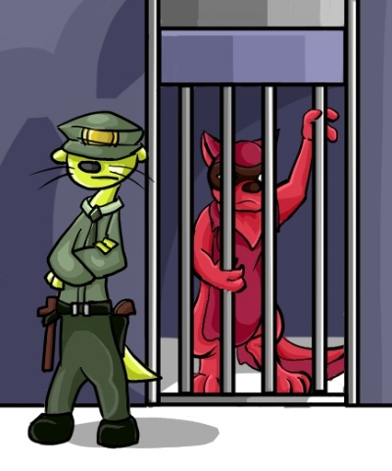
科研是什么之学术道德
违法必究，执法必严！

Slide 12
科研是什么之。 。 。

Slide 13
How to read/write papers

Slide 14
How to Evaluate a Paper?
Novelty of the problem (25%)
Technical depth (25%)
Writing (25%)
Experiments (25%)

Slide 15
How to Get the Idea?
Positive
For any idea, you can always do something
Negative
Extremely challenging to get good ideas.
Repeated work is NOT called research!
Observation – using your brain
Refine, refine and refine, but with an expectation in your mind!
Explain by examples

Slide 16
How to Get the Solution?
Complexity analysis
PTIME, NP, EXPTIME, …
Approximation analysis for NPC problems
With performance guarantees
Heuristic solutions
With certain properties
No fixed rules to follow for algorithm design
Fully understand the problem
Designed algorithms based on the special characteristics for the problem itself

Slide 17
How to Write the Paper?
It is art - very difficult!
Practice, practice and practice!
Writing, writing and writing!
Proofreading, proofreading, and proofreading!
If people could not understand your writing, they could not evaluate your work.
Sir Isaac Newton
Two good habits
Writing down and remember good sentences when you are reading papers
Ask your “friends”, who could speak truth to you, to check what you have written

Slide 18
How to do Experiments?
Design experimental plans
Show people the idea is good, and the solution is good
Datasets
Real life data
Synthesized data
Always remember what you need to show to people!

Slide 19
Stages of Paper Submission
Submission
Feedback (optional)
Shepherd (optional)
Acceptance/Rejection notification
Preparing camera ready
Experimental repeatability (optional)
Attend conference/present your work
Make big noises
Show people your good work

Slide 20
Two Rules
WWH rule
What, why, how
Think about everything from the view point of reviewers

Slide 21
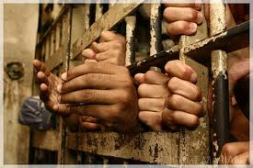
One Warning
NO plagiarism!!!

Slide 22
Book Recommendation

Slide 23

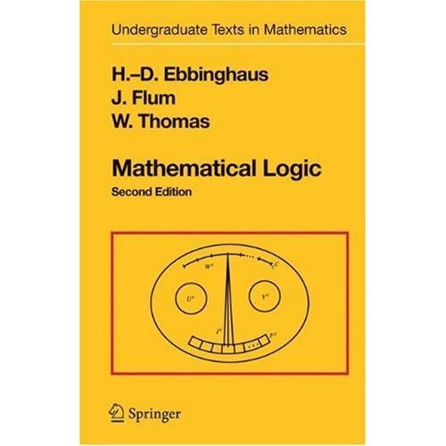
Databases and Logic

Slide 24


Computational Complexity

Slide 25
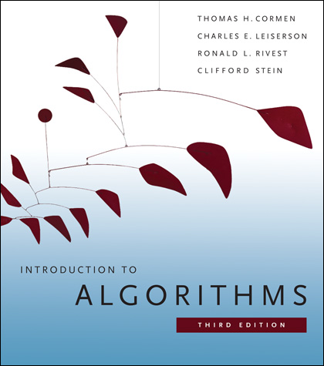
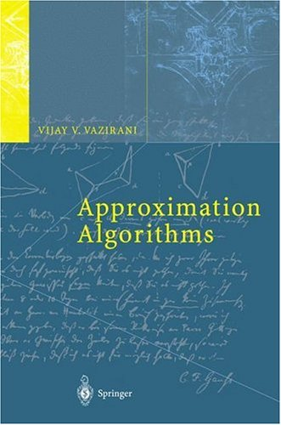

Algorithms

Slide 26
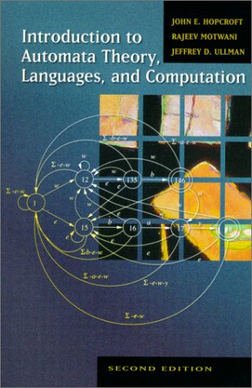

Formal Languages

Slide 27
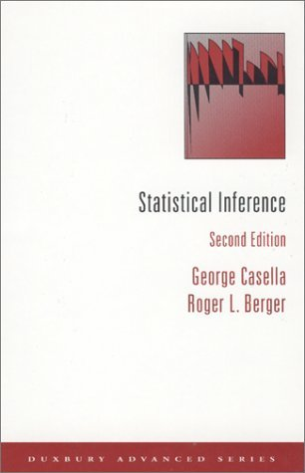
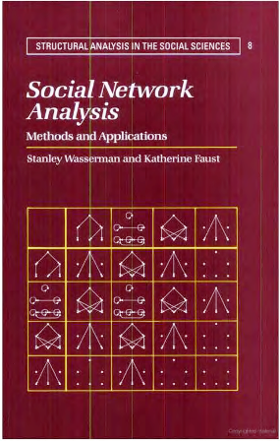
Statistics and Social Networks

Slide 28
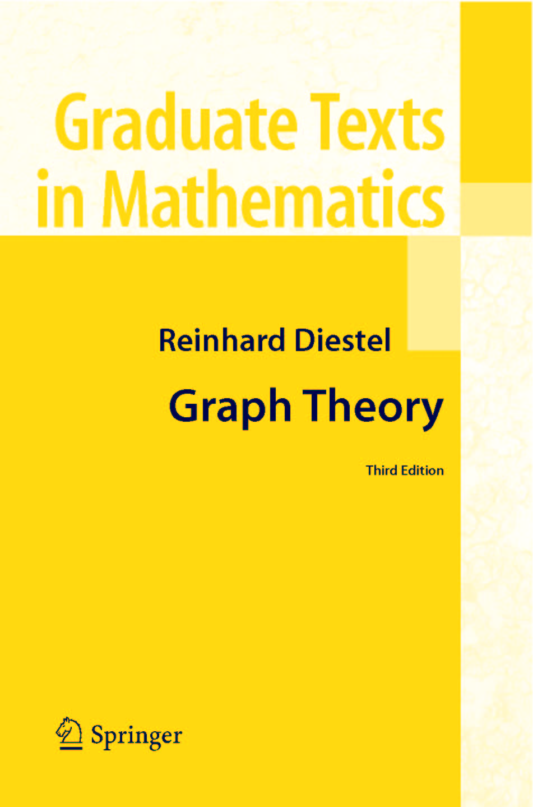
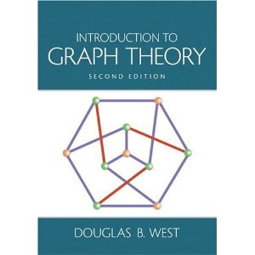
Graph Theory

Slide 29
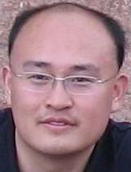
Homepage: http://mashuai.buaa.edu.cn
Email: mashuai@buaa.edu.cn
谢谢

