Slide 1

Ensemble Enabled Weighted PageRank
Dongsheng Luo, Chen Gong, Renjun Hu, Liang Duan
Shuai Ma, Niannian Wu, Xuelian Lin
TeamBUAA

Slide 2
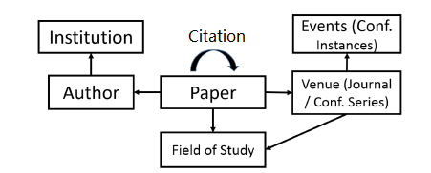
Problem & Challenges
Problem: rank nodes in a heterogeneous graph based on query-independent node importance
Challenges: dynamism & heterogeneity
  Entities and their importance evolve with time
  Multiple types of entities involve with different contributions
The Heterogeneous Microsoft Academic Graph [1]
[1] Arnab Sinha, et al. An Overview of Microsoft Academic Service (MAS) and Applications. In WWW, 2015.

Slide 3
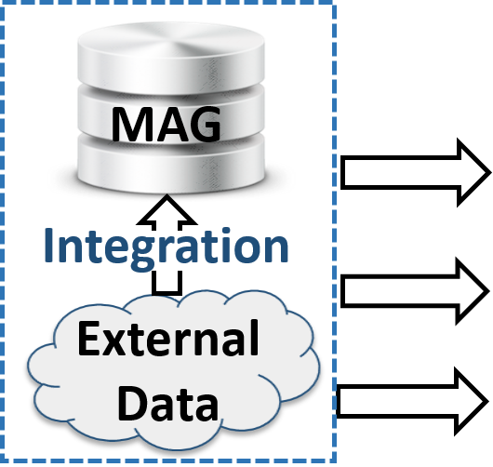

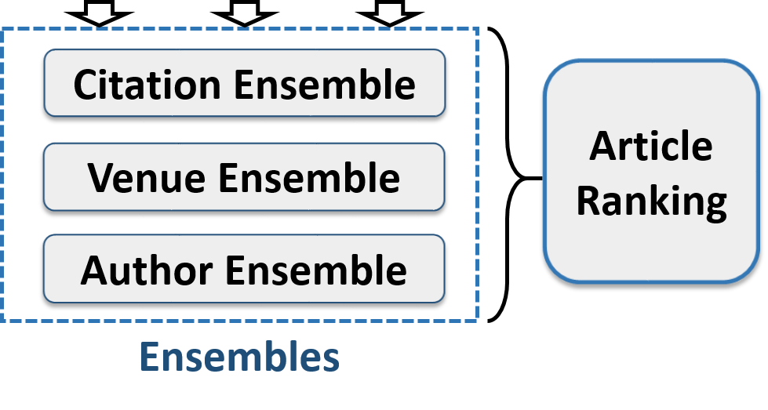
Solution: Ensemble enabled Weighted PageRank
Deal with the
dynamism in data
Deal with the data missing problem
Assemble the contributions of heterogeneous entities

Slide 4
Outline
Ensemble enabled Weighted PageRank
  Time Weighted PageRank
  Citation, Venue and Author Ensembles
  Incorporating External Data
Evaluation
Summary

Slide 5
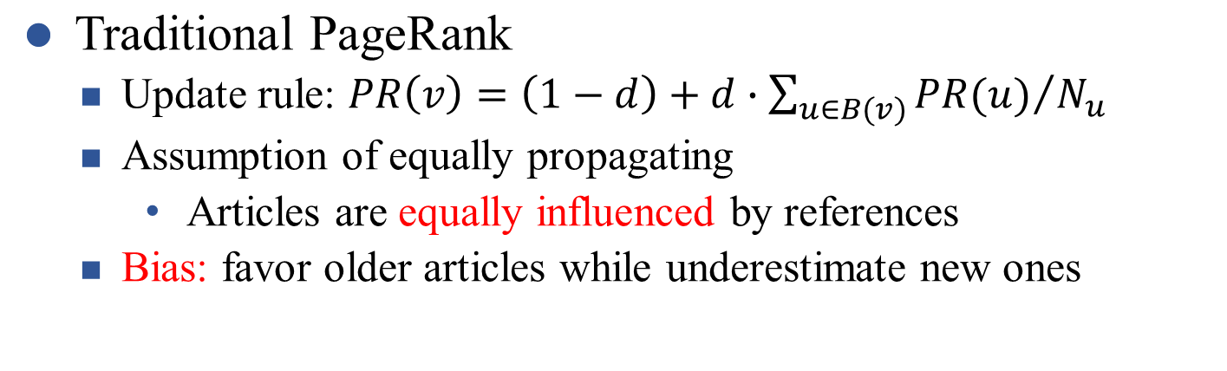



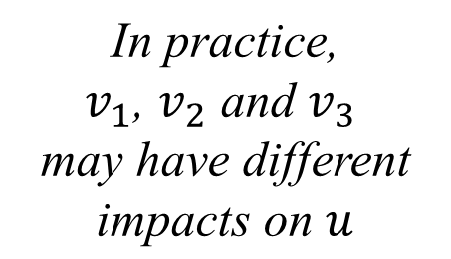







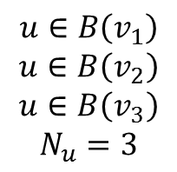




Why Weighted PageRank?
PageRank
Weighted PageRank
equally propagating
discriminately propagating

Slide 6

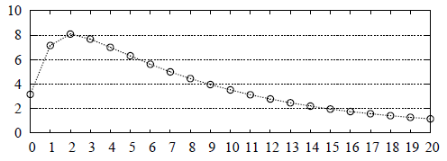
Time-Weighted PageRank
How to evaluate the weights (impacts of articles) for discriminately propagating?
  Original WPR[1]: based on popularity while ignore dynamism
  Intuitions of impacts of articles
    Time decaying
    The number of citations is a good indicator
Time-Weighted
# of years after publication
[1] Wenpu Xing and Ali Ghorbani. Weighted PageRank Algorithm. In CNSR, 2004.

Slide 7
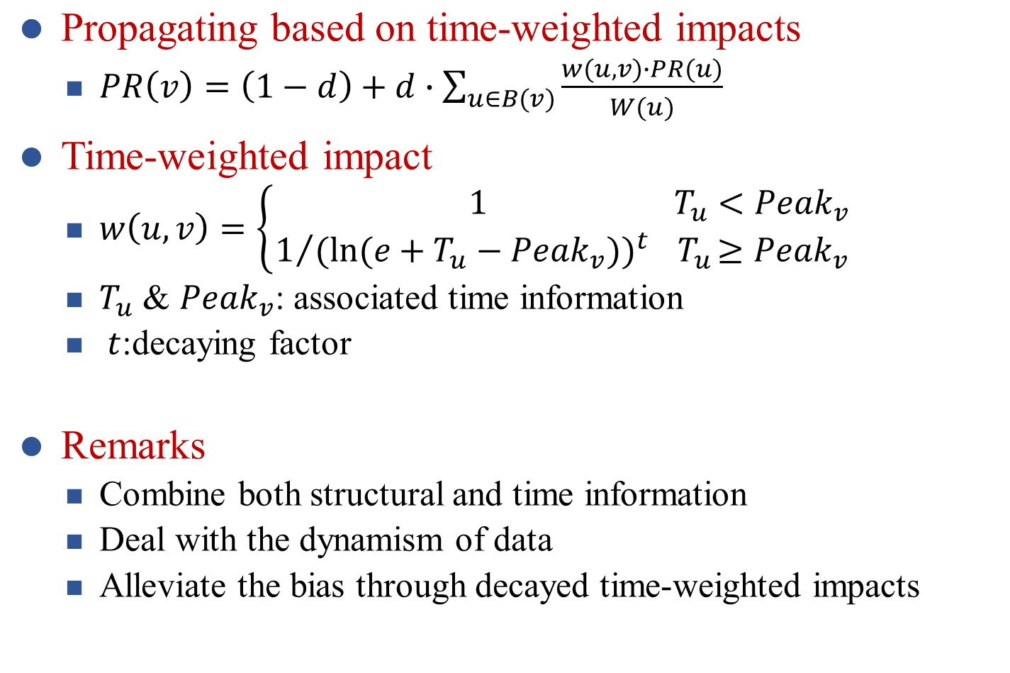
Time-Weighted PageRank

Slide 8
Outline
Ensemble enabled Weighted PageRank
  Time Weighted PageRank
  Citation, Venue and Author Ensembles
  Incorporating External Data
Evaluation
Summary

Slide 9
Why Ensembles?
Case study: to rank a new article
  No seen citations: only using citation information fails
  Venue and author information can be incorporated
Observation
  Articles can be ranked according to various factors, e.g. citations, venues, authors
Ensemble Model
  Each ensemble exploits single type of entities
  Assemble various ensembles: assemble the different contributions of the heterogeneous entities

Slide 10
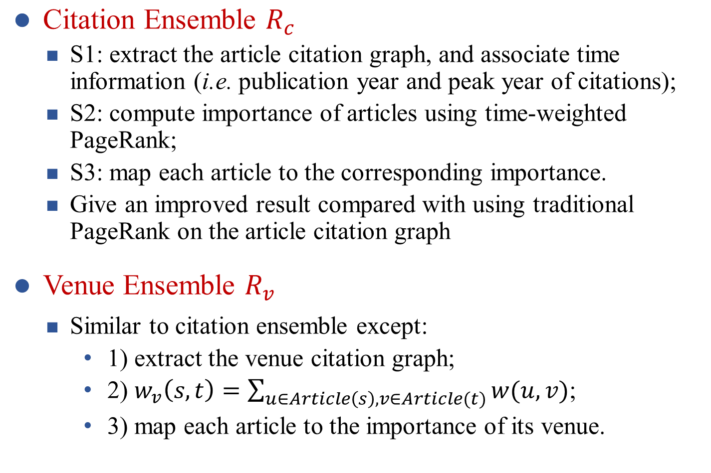
Citation, Venue & Author Ensembles

Slide 11
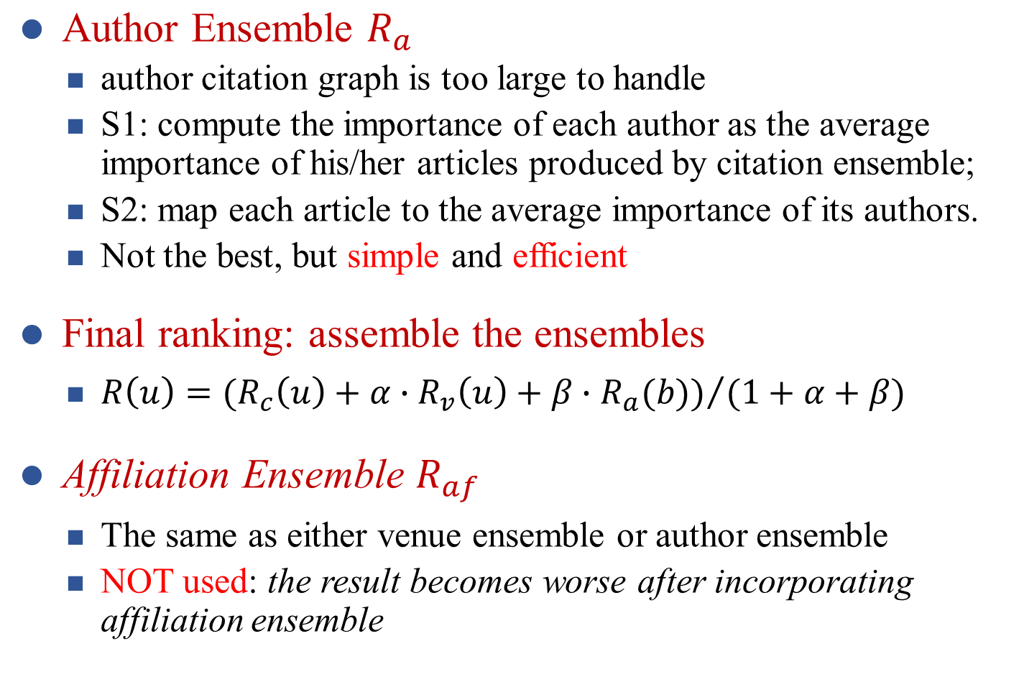
Citation, Venue & Author Ensembles

Slide 12
Outline
Ensemble enabled Weighted PageRank
  Time Weighted PageRank
  Citation, Venue and Author Ensembles
  Incorporating External Data
Evaluation
Summary

Slide 13
Use External Data
WHY using external data?
  Data missing problem in MAG
    64% (77M/120M) articles have no venues (phase 1)
    articles without venues are underestimated
Fill in missing venues using external data
  Collect raw data from publicly available Digital Libraries;
  Remove stop words, numbers and years;
    9th International Conference on Web Search and Data Mining, 2016
  Link collected venue names to existing ones in MAG
    Combine name similarities and topic similarities
Fill in (collect) venues for 0.34M (2.8M) articles

Slide 14
Outline
Ensemble enabled Weighted PageRank
  Time Weighted PageRank
  Citation, Venue and Author Ensembles
  Incorporating External Data
Evaluation
Summary

Slide 15
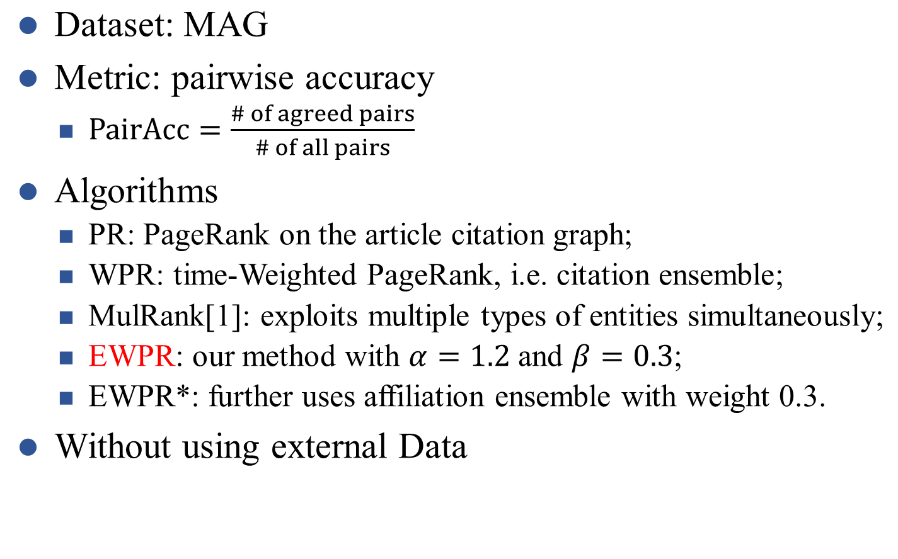
Experimental Settings
All pairs: {a>b}, {a>c}, {b>c}
Ranking: {a>b}, {a>c}, {b<c}
Agreed pairs: {a>b}, {a>c}
PairAcc = 2/3
[1] Xiaorui Jiang, et al. Towards an Effective and Unbiased Ranking of Scientific Literature through Mutual Reinforcement. In CIKM, 2012.

Slide 16

Experimental Results
Exp-1: PR vs. WPR
  WPR outperforms PR by dealing with dynamism of data
Exp-2: WPR vs. EWPR
  EWPR outperforms WPR by combining contributions of heterogeneous entities
Exp-3: MulRank vs. EWPR
  EWPR performs better since MulRank suffers from error propagation in noisy data
Exp-4: EWPR vs. EWPR*
  EWPR performs better since affiliation ensemble has negative effects

Slide 17
Outline
Ensemble enabled Weighted PageRank
  Time Weighted PageRank
  Citation, Venue and Author Ensembles
  Incorporating External Data
Evaluation
Summary

Slide 18
Summary
Problem: rank nodes in a heterogeneous graph based on query-independent node importance
  Challenges: Dynamism & Heterogeneity
Solution: ensemble enabled Weighted PageRank
  Time-weighted PageRank deals with the dynamism in data
  Ensemble model assembles the contributions of the heterogeneous entities
  Using external data to deal with the data missing problem

Slide 19
Thanks!
Q&A

