Slide 1
A Quick Introduction to Approximate Query Processing Part-III
CS286, Spring’2007
Minos Garofalakis

Slide 2
Decision Support Systems
Data Warehousing: Consolidate data from many sources in one large repository.
  Loading, periodic synchronization of replicas.
  Semantic integration.
OLAP:
  Complex SQL queries and views.
  Queries based on spreadsheet-style operations and “multidimensional” view of data.
  Interactive and “online” queries.
Data Mining:
  Exploratory search for interesting trends and anomalies. (Another lecture!)

Slide 3

Motivation
Decision
Support
Systems
(DSS)
SQL Query
Exact Answer
Long Response Times!
Exact answers NOT always required
  DSS applications usually exploratory: early feedback to help identify “interesting” regions
  Aggregate queries: precision to “last decimal” not needed
    e.g., “What percentage of the US sales are in NJ?” (display as bar graph)
  Preview answers while waiting. Trial queries
  Base data can be remote or unavailable: approximate processing using locally-cached data synopses is the only option

Slide 4
Approximate Query Processing using Data Synopses
Decision
Support
Systems
(DSS)
SQL Query
Exact Answer
GB/TB
Long Response Times!
Compact Data Synopses
“Transformed” Query
Approximate Answer
KB/MB
FAST!!
How to construct effective data synopses ??

Slide 5
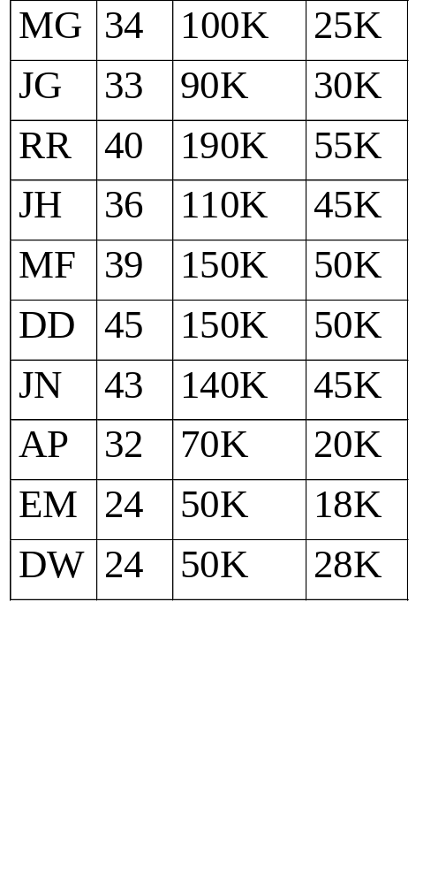
Relations as Frequency Distributions
name
salary
sales
age
One-dimensional distribution
tuple
counts
Age (attribute domain values)
Three-dimensional distribution
tuple counts
8 10 10
age
30 20 50
25 8 15
sales
salary

Slide 6
Outline
Intro & Approximate Query Answering Overview
  Synopses, System architectures, Commercial offerings
One-Dimensional Synopses
  Histograms: Equi-depth, Compressed, V-optimal, Incremental maintenance, Self-tuning
  Samples: Basics, Sampling from DBs, Reservoir Sampling
  Wavelets: 1-D Haar-wavelet histogram construction & maintenance
Multi-Dimensional Synopses and Joins
Set-Valued Queries
Discussion & Comparisons
Advanced Techniques & Future Directions

Slide 7
Outline
Intro & Approximate Query Answering Overview
  Synopses, System architecture, Commercial offerings
One-Dimensional Synopses
  Histograms, Samples, Wavelets
Multi-Dimensional Synopses and Joins
  Multi-D Histograms, Join synopses, Wavelets
Set-Valued Queries
  Using Histograms, Samples, Wavelets
Discussion & Comparisons
Advanced Techniques & Future Directions
  Dependency-based, Workload-tuned, Streaming data

Slide 8
Sampling for Multi-D Synopses
Taking a sample of the rows of a table captures the attribute correlations in those rows
  Answers are unbiased & confidence intervals apply
  Thus guaranteed accuracy for count, sum, and average queries on single tables, as long as the query is not too selective
Problem with joins [AGP99,CMN99]:
  Join of two uniform samples is not a uniform sample of the join
  Join of two samples typically has very few tuples
3 1 0 3
7 3 7 1 4 2 4
0 1 2 1 2 7 0 8
5 1 9 1 0 7 1
3 8 2 0
0 1
2 3
4 5
6 7 8 9
Foreign Key Join
40% Samples in Red
Size of Actual Join = 30
Size of Join of samples = 3

Slide 9
Join(Samples) == Sample(Join)
R.X
S.X
a1
a
a2
a
a
b1
b
b
b
b2
Join result = {a1, a2, b1, b2}
Probability for a base tuple to be selected = 1/r
Prob[select a1 and a2] = 1/r^3
Prob[select a1 and b1] = 1/r^4

Slide 10
Small Results for Join(samples)
Foreign key join of R and S (R→S)
  Join result size = |R|
1% sample from both R and S ➔ 0.01% sample from the join result!!
  Each tuple from sample(R) joins with a single tuple from S
  Probability that tuple is kept is only 1% !

Slide 11
Join Synopses for Foreign-Key Joins [AGP99]
Based on sampling from materialized foreign key joins
  Typically < 10% added space required
  Yet, can be used to get a uniform sample of ANY foreign key join
  Plus, fast to incrementally maintain
Significant improvement over using just table samples
  E.g., for TPC-H query Q5 (4 way join)
    1%-6% relative error vs. 25%-75% relative error, for synopsis size = 1.5%, selectivity ranging from 2% to 10%
    10% vs. 100% (no answer!) error, for size = 0.5%, select. = 3%

Slide 12
Join Synopses
Schema-based sample summaries from FK join results
TPC-D schema
L
O
PS
P
C
S
N
R

Slide 13
Join Synopses: Key Observations
R1
R2
…
Rk
“Source relation”
One-to-one correspondence between tuples in source relation and those in result of chain of FK-joins
Sample(R1) joined with R2, …, Rk = sample(FK-join chain)
To get a sample of a subchain of FK-joins “rooted” at source, just project away irrelevant attributes!
Join synopses = set of such sample joins for every source and maximal FK-join-chain in the schema!
  Can be used to answer ANY FK-join query over the given schema!

Slide 14
Join Synopses: Optimizations and Maintenance
R1
R2
…
Rk
“Source relation”
Propose techniques for allocating space across join-synopses in order to minimize overall error metrics
Incremental maintenance is easy, using “reservoir-sampling”-style techniques

Slide 15
Multi-dimensional Haar Wavelets
Basic “pairwise averaging and differencing” ideas carry over to multiple data dimensions
Two basic methodologies -- no clear winner [SDS96]
  Standard Haar decomposition
  Non-standard Haar decomposition
Discussion here: focus on non-standard decomposition
  See [SDS96, VW99] for more details on standard Haar decomposition
  [MVW00] also discusses dynamic maintenance of standard multi-dimensional Haar wavelet synopses

Slide 16
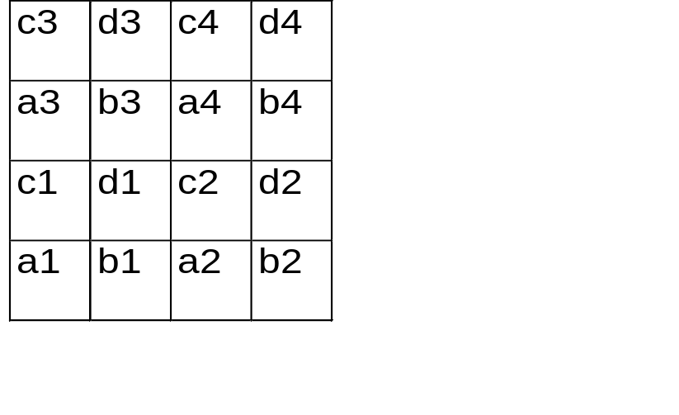
Two-dimensional Haar Wavelets -- Non-standard decomposition
A1 = (a1+b1+c1+d1)/4
Detail coeff = (a1+b1-c1-d1)/4
Detail coeff = (a1-b1+c1-d1)/4
Detail coeff = (a1-b1-c1+d1)/4
A = (A1+A2+A3+A4)/4
Detail coeff = (A1+A2-A3-A4)/4
Detail coeff = (A1-A2+A3-A4)/4
Detail coeff = (A1-A2-A3+A4)/4
-
+
+
-
-
+
+
-
+
-
+
A3
A4
+
-
A1
A2
-
+
+
-

Slide 17
Two-dimensional Haar Wavelets -- Non-standard decomposition
(a+b-c-d)/4
(a-b-c+d)/4
-
+
Averaging &
Differencing
+
-
c
d
(a+b+c+d)/4
(a-b+c-d)/4
a
b
+
-
“Supports”
Wavelet Transform Array:
RECURSE

Slide 18
Two-dimensional Haar Wavelets -- Non-standard decomposition
Data Array
After averaging and differencing
3
4
3
4
-1
0
-1
0
1
2
1
2
2.5
-.5
2.5
-.5
3
4
3
4
-1
0
-1
0
1
2
1
2
2.5
-.5
2.5
-.5
After distributing results
Final wavelet transform array
-1
-1
0
0
0
0
-1
-1
-1
-1
0
0
-1
-1
0
0
2.5
2.5
-.5
-.5
0
0
-.5
-.5
2.5
2.5
-.5
-.5
2.5
0
-.5
-.5
RECURSE

Slide 19
Non-standard Two-dimensional Haar Basis -- Coefficient Supports
-
-
-
+
-
+
+
+
+
-
+
-
-
-
-
+
-
+
+
+
+
-
+
-
-
-
+
+
-
+
-
+
+
-
+
+
-
+
-
+
-
Notes:
10

Slide 20
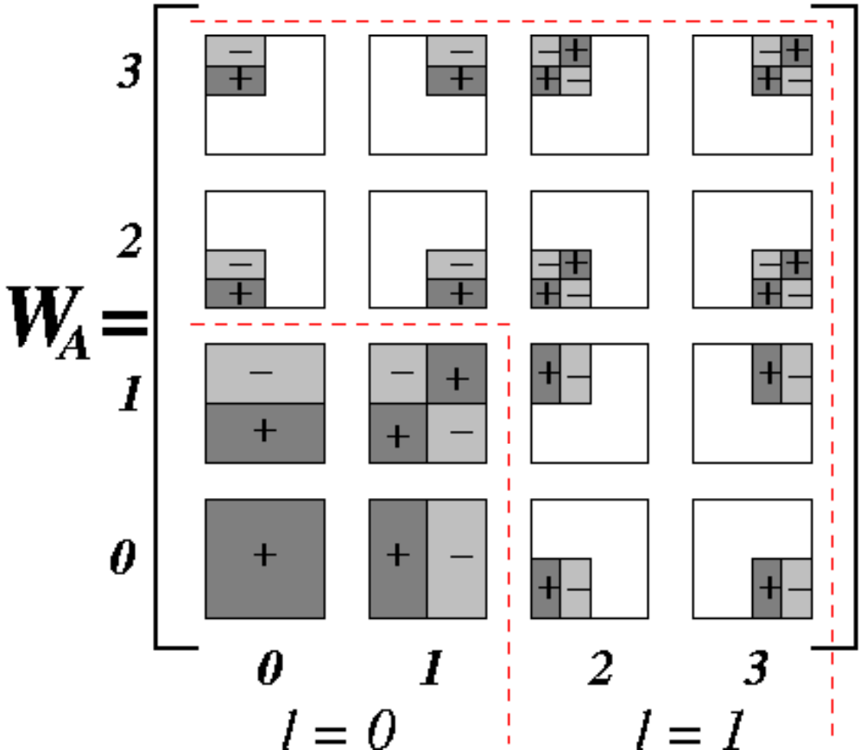
Multi-dimensional Haar Wavelets
Haar decomposition in d dimensions = d-dimensional array of wavelet coefficients
  Coefficient support region = d-dimensional rectangle of cells in the original data array
  Sign of coefficient’s contribution can vary along the quadrants of its support
Support regions & signs for the 16 nonstandard 2-dimensional Haar coefficients of a 4X4 data array A

Slide 21


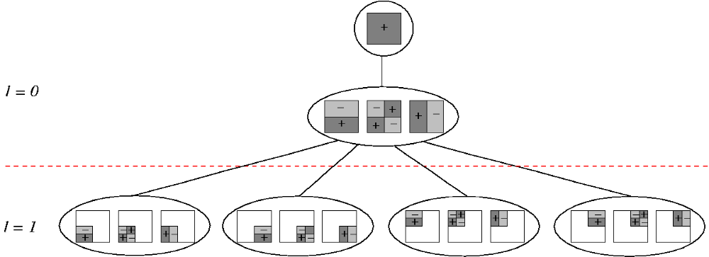
Multi-dimensional Haar Error Trees
Conceptual tool for data reconstruction – more complex structure than in the 1-dimensional case
  Internal node = Set of (up to) coefficients (identical support regions, different quadrant signs)
  Each internal node can have (up to) children (corresponding to the quadrants of the node’s support)
Maintains linearity of reconstruction for data values/range sums
Error-tree structure for 2-dimensional
4X4 example (data values omitted)

Slide 22
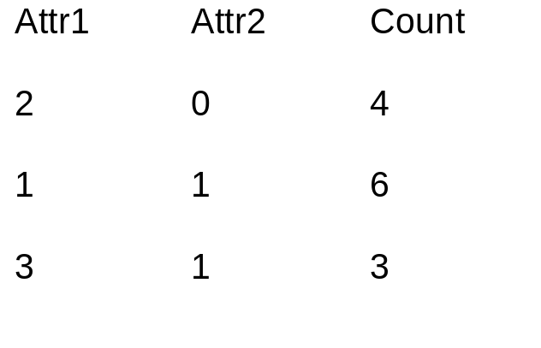
Constructing the Wavelet Decomposition
Joint Data Distribution
Array
Relation (ROLAP)
Representation
Attr2
3
2
1
0
₆
₃
₄
0 1 2 3
Attr1
Joint data distribution can be very sparse!
Key to I/O-efficient decomposition algorithms: Work off the ROLAP representation
  Standard decomposition [VW99]
  Non-standard decomposition [CGR00]
Typically require a small (logarithmic) number of passes over the data
Notes:
11

Slide 23
Range-sum Estimation Using Wavelet Synopses
Coefficient thresholding
  As in 1-d case, normalizing by appropriate constants and retaining the largest coefficients minimizes the overall L2 error
Range-sums: selectivity estimation or OLAP-cube aggregates [VW99] (“measure attribute” as count)
Only coefficients with support regions intersecting the query hyper-rectangle can contribute
  Many contributions can cancel each other [CGR00, VW99]
Contribution to range sum = 0
Only nodes on the path to range endpoints can have nonzero contributions
(Extends naturally to multi-dimensional
range sums)
Decomposition
Tree (1-d)
+
-
Query Range
Notes:
11

Slide 24
Outline
Intro & Approximate Query Answering Overview
One-Dimensional Synopses
Multi-Dimensional Synopses and Joins
Set-Valued Queries
  Error Metrics
  Using Histograms
  Using Samples
  Using Wavelets
Discussion & Comparisons
Advanced Techniques & Future Directions
Conclusions

Slide 25
Approximating Set-Valued Queries
Problem: Use synopses to produce “good” approximate answers to generic SQL queries -- selections, projections, joins, etc.
  Remember: synopses try to capture the joint data distribution
  Answer (in general) = multiset of tuples
Unlike aggregate values, NO universally-accepted measures of “goodness” (quality of approximation) exist
Query Answer
Subset Approximation
(e.g., from 20% sample)
“Better” Approximation
S
a
l
a
r
y
Age

Slide 26
Error Metrics for Set-Valued Query Answers
Need an error metric for (multi)sets that accounts for both
  differences in element frequencies
  differences in element values
Traditional set-comparison metrics (e.g., symmetric set difference, Hausdorff distance) fail
Proposed Solutions
  MAC (Match-And-Compare) Error [IP99]: based on perfect bipartite graph matching
  EMD (Earth Mover’s Distance) Error [CGR00, RTG98]: based on bipartite network flows

Slide 27
Using Histograms for Approximate Set-Valued Queries [IP99]
Store histograms as relations in a SQL database and define a histogram algebra using simple SQL queries
Implementation of the algebra operators (select, join, etc.) is fairly straightforward
  Each multidimensional histogram bucket directly corresponds to a set of approximate data tuples
Experimental results demonstrate histograms to give much lower MAC errors than random sampling
Potential problems
  For high-dimensional data, histogram effectiveness is unclear and construction costs are high [GKT00]
  Join algorithm requires expanding into approximate relations
    Can be as large (or larger!) than the original data set

Slide 28
Set-Valued Queries via Samples
Applying the set-valued query to the sampled rows, we very often obtain a subset of the rows in the full answer
  E.g., Select all employees with 25+ years of service
  Exceptions include certain queries with nested subqueries (e.g., select all employees with above average salaries: but the average salary is known only approximately)
Extrapolating from the sample:
  Can treat each sample point as the center of a cluster of points (generate approximate points, e.g., using kernels [BKS99, GKT00])
  Alternatively, Aqua [GMP97a, AGP99] returns an approximate count of the number of rows in the answer and a representative subset of the rows (i.e., the sampled points)
    Keeps result size manageable and fast to display

Slide 29
Approximate Query Processing Using Wavelets [CGR00]
Reduce relations into compact wavelet-coefficient synopses
Entire query processing in the compressed (wavelet) domain
Query Results in Wavelet Domain
_{Querying in Wavelet Domain}
_{Render}
Compressed domain (FAST)
_{Wavelet Synopses}
_{Final Approximate Results}
Relation domain (SLOW)
_{Approximate Relations}
_{Querying in Relation Domain}
_{Render}

Slide 30
Wavelet Query Processing
Each operator (e.g., select, project, join, aggregates, etc.)
  input: set of wavelet coefficients
  output: set of wavelet coefficients
Finally, rendering step
  input: set of wavelet coefficients
  output: (multi)set of tuples
render
set of coefficients
join
project
select
select
set of
coefficients
set of
coefficients

Slide 31
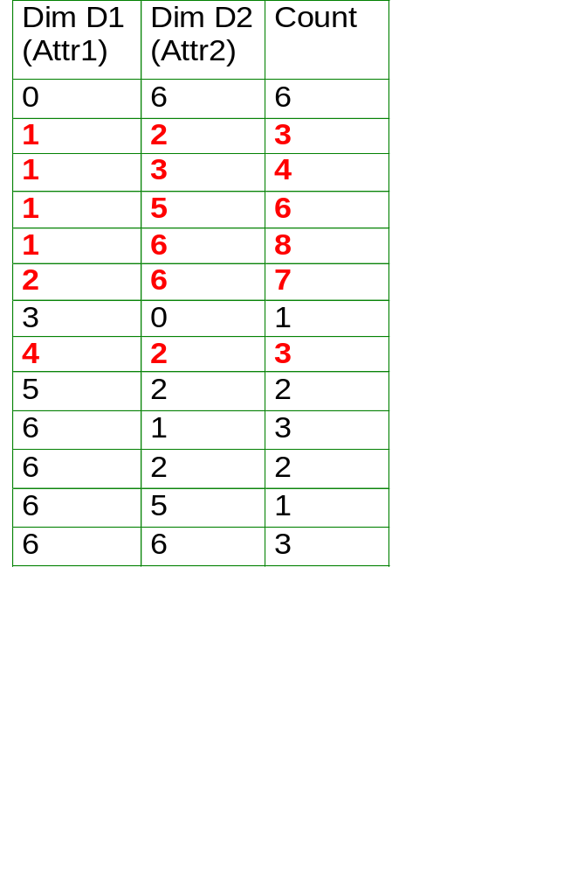
Selection -- Relational Domain
Relation
Joint Data Distribution Array
₃
₂
₁
₃
_{Dim.}
_{D1}
₂
₃
₁
₇
₃
₄
₆
₈
₆
_{Dim. D2}
_{Query Range}
In relational domain, interested in only those cells inside query range
In wavelet domain, interested in only the coefficients that contribute to those cells

Slide 32
Selection -- Wavelet Domain
_{D1}
_{D1}
+
-
+
-
_{Query}
_{Range}
+
-
+
-
+
+
-
-
-
+
-
+
_{D2}
_{D2}

Slide 33
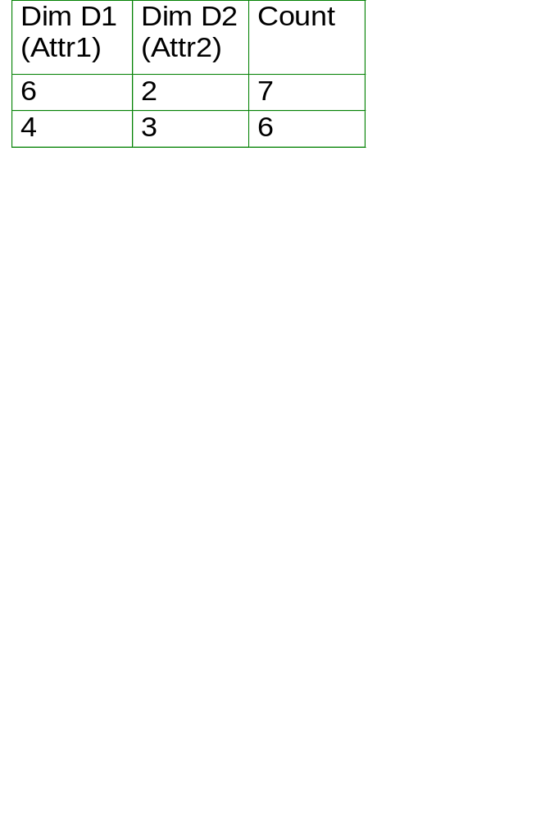
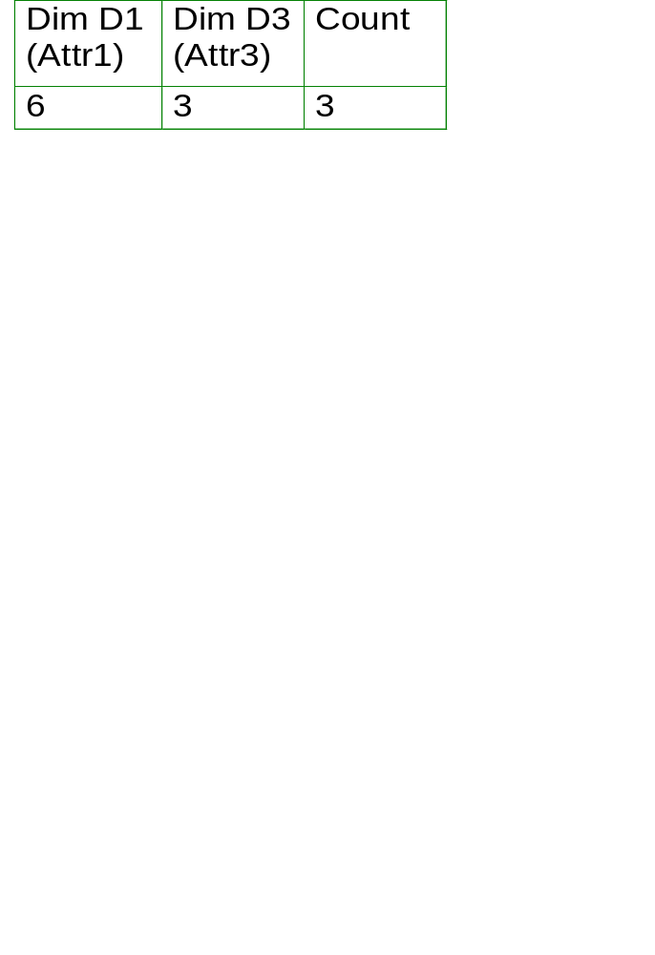
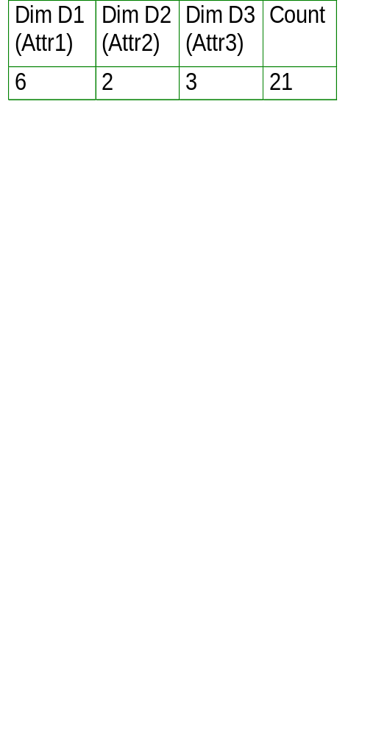
Equi-join -- Relational Domain
Coefficients A1 (+) and A3 (-) contribute to this cell
Coefficients B2 (+), and B3 (+) contribute to this cell
Relation 1
₇
₃
₆
_{Join Dim.}
_{D1}
Relation 2
_{Join along D1}
_{Dim. D2}
_{Dim. D3}
Joint Data Distribution
of Relation 1
Joint Data Distr.
of Relation 2
Relational domain: Join count= 7*3 = (A1-A3)*(B2+B3)
Wavelet domain: A1*B2 + A1*B3 - A3*B2 - A3*B3
Consider all pairs of coefficients: (1) check joinability (overlap in join dimension(s)), (2) compute output coefficients

Slide 34
Equi-join -- Wavelet Domain
v1
_{D1}
v2
_{D1}
+
-
+
-
+
-
_{D1}
_{D2}
_{D3}
_{D1}
-
v = v1 * v2
Join output coefficient:
+
_{D3}
_{D2}

Slide 35
Wavelet Query Processing
Each operator (e.g., select, project, join, aggregates, etc.)
  input: set of wavelet coefficients
  output: set of wavelet coefficients
Finally, rendering step
  input: set of wavelet coefficients
  output: (multi)set of tuples
render
set of coefficients
join
project
select
select
set of
coefficients
set of
coefficients

Slide 36
Outline
Intro & Approximate Query Answering Overview
One-Dimensional Synopses
Multi-Dimensional Synopses and Joins
Set-Valued Queries
Discussion & Comparisons
Advanced Techniques & Future Directions
Conclusions

Slide 37
References (2)
[BFH75] Y.M.M. Bishop, S.E. Fienberg, and P.W. Holland. “Discrete Multivariate Analysis”. The MIT Press, 1975.
[BGR01] S. Babu, M. Garofalakis, and R. Rastogi. “SPARTAN: A Model-Based Semantic Compression System for Massive Data Tables”. ACM SIGMOD 2001.
  Proposes a novel, “model-based semantic compression” methodology that exploits mining models (like CaRT trees and clusters) to build compact, guaranteed-error synopses of massive data tables.
[BKS99] B. Blohsfeld, D. Korus, and B. Seeger. “A Comparison of Selectivity Estimators for Range Queries on Metric Attributes”. ACM SIGMOD 1999.
  Studies the effectiveness of histograms, kernel-density estimators, and their hybrids for estimating the selectivity of range queries over metric attributes with large domains.
[CCM00] M. Charlikar, S. Chaudhuri, R. Motwani, and V. Narasayya. “Towards Estimation Error Guarantees for Distinct Values”. ACM PODS 2000.
[CDD01] S. Chaudhuri, G. Das, M. Datar, R. Motwani, and V. Narasayya. “Overcoming Limitations of Sampling for Aggregation Queries”. IEEE ICDE 2001.
  Precursor to [CDN01]. Proposes a method for reducing sampling variance by collecting outliers to a separate “outlier index” and using a weighted sampling scheme for the remaining data.
[CDN01] S. Chaudhuri, G. Das, and V. Narasayya. “A Robust, Optimization-Based Approach for Approximate Answering of Aggregate Queries”. ACM SIGMOD 2001.
[CGR00] K. Chakrabarti, M. Garofalakis, R. Rastogi, and K. Shim. “Approximate Query Processing Using Wavelets”. VLDB 2000. (Full version to appear in The VLDB Journal)

Slide 38
References (3)
[Chr84] S. Christodoulakis. “Implications of Certain Assumptions on Database Performance Evaluation”. ACM TODS 9(2), 1984.
[CMN98] S. Chaudhuri, R. Motwani, and V. Narasayya. “Random Sampling for Histogram Construction: How much is enough?”. ACM SIGMOD 1998.
[CMN99] S. Chaudhuri, R. Motwani, and V. Narasayya. “On Random Sampling over Joins”. ACM SIGMOD 1999.
[CN97] S. Chaudhuri and V. Narasayya. “An Efficient, Cost-Driven Index Selection Tool for Microsoft SQL Server”. VLDB 1997.
[CN98] S. Chaudhuri and V. Narasayya. “AutoAdmin “What-if” Index Analysis Utility”. ACM SIGMOD 1998.
[Coc77] W.G. Cochran. “Sampling Techniques”. John Wiley & Sons, 1977.
[Coh97] E. Cohen. “Size-Estimation Framework with Applications to Transitive Closure and Reachability”. JCSS, 1997.
[CR94] C.M. Chen and N. Roussopoulos. “Adaptive Selectivity Estimation Using Query Feedback”. ACM SIGMOD 1994.
  Presents a parametric, curve-fitting technique for approximating an attribute’s distribution based on query feedback.
[DGR01] A. Deshpande, M. Garofalakis, and R. Rastogi. “Independence is Good: Dependency-Based Histogram Synopses for High-Dimensional Data”. ACM SIGMOD 2001.

Slide 39
References (4)
[FK97] C. Faloutsos and I. Kamel. “Relaxing the Uniformity and Independence Assumptions Using the Concept of Fractal Dimension”. JCSS 55(2), 1997.
[FM85] P. Flajolet and G.N. Martin. “Probabilistic counting algorithms for data base applications”. JCSS 31(2), 1985.
[FMS96] C. Faloutsos, Y. Matias, and A. Silbershcatz. “Modeling Skewed Distributions Using Multifractals and the `80-20’ Law”. VLDB 1996.
  Proposes the use of “multifractals” (i.e., 80/20 laws) to more accurately approximate the frequency distribution within histogram buckets.
[GGM96] S. Ganguly, P.B. Gibbons, Y. Matias, and A. Silberschatz. “Bifocal Sampling for Skew-Resistant Join Size Estimation”. ACM SIGMOD 1996.
[Gib01] P. B. Gibbons. “Distinct Sampling for Highly-Accurate Answers to Distinct Values Queries and Event Reports”. VLDB 2001.
[GK01] M. Greenwald and S. Khanna. “Space-Efficient Online Computation of Quantile Summaries”. ACM SIGMOD 2001.
[GKM01a] A.C. Gilbert, Y. Kotidis, S. Muthukrishnan, and M.J. Strauss. “Optimal and Approximate Computation of Summary Statistics for Range Aggregates”. ACM PODS 2001.
  Presents algorithms for building “range-optimal” histogram and wavelet synopses; that is, synopses that try to minimize the total error over all possible range queries in the data domain.

Slide 40
References (5)
[GKM01b] A.C. Gilbert, Y. Kotidis, S. Muthukrishnan, and M.J. Strauss. “Surfing Wavelets on Streams: One-Pass Summaries for Approximate Aggregate Queries”. VLDB 2001.
[GKT00] D. Gunopulos, G. Kollios, V.J. Tsotras, and C. Domeniconi. “Approximating Multi-Dimensional Aggregate Range Queries over Real Attributes”. ACM SIGMOD 2000.
[GKS01a] J. Gehrke, F. Korn, and D. Srivastava. “On Computing Correlated Aggregates over Continual Data Streams”. ACM SIGMOD 2001.
[GKS01b] S. Guha, N. Koudas, and K. Shim. “Data Streams and Histograms”. ACM STOC 2001.
[GLR00] V. Ganti, M.L. Lee, and R. Ramakrishnan. “ICICLES: Self-Tuning Samples for Approximate Query Answering“. VLDB 2000.
[GM98] P. B. Gibbons and Y. Matias. “New Sampling-Based Summary Statistics for Improving Approximate Query Answers”. ACM SIGMOD 1998.
  Proposes the “concise sample” and “counting sample” techniques for improving the accuracy of sampling-based estimation for a given amount of space for the sample synopsis.
[GMP97a] P. B. Gibbons, Y. Matias, and V. Poosala. “The Aqua Project White Paper”. Bell Labs tech report, 1997.
[GMP97b] P. B. Gibbons, Y. Matias, and V. Poosala. “Fast Incremental Maintenance of Approximate Histograms”. VLDB 1997.

Slide 41
References (6)
[GTK01] L. Getoor, B. Taskar, and D. Koller. “Selectivity Estimation using Probabilistic Relational Models”. ACM SIGMOD 2001.
  Proposes novel, Bayesian-network-based techniques for approximating joint data distributions in relational database systems.
[HAR00] J. M. Hellerstein, R. Avnur, and V. Raman. “Informix under CONTROL: Online Query Processing”. Data Mining and Knowledge Discovery Journal, 2000.
[HH99] P. J. Haas and J. M. Hellerstein. “Ripple Joins for Online Aggregation”. ACM SIGMOD 1999.
[HHW97] J. M. Hellerstein, P. J. Haas, and H. J. Wang. “Online Aggregation”. ACM SIGMOD 1997.
[HNS95] P.J. Haas, J.F. Naughton, S. Seshadri, and L. Stokes. “Sampling-Based Estimation of the Number of Distinct Values of an Attribute”. VLDB 1995.
  Proposes and evaluates several sampling-based estimators for the number of distinct values in an attribute column.
[HNS96] P.J. Haas, J.F. Naughton, S. Seshadri, and A. Swami. “Selectivity and Cost Estimation for Joins Based on Random Sampling”. JCSS 52(3), 1996.
[HOT88] W.C. Hou, Ozsoyoglu, and B.K. Taneja. “Statistical Estimators for Relational Algebra Expressions”. ACM PODS 1988.
[HOT89] W.C. Hou, Ozsoyoglu, and B.K. Taneja. “Processing Aggregate Relational Queries with Hard Time Constraints”. ACM SIGMOD 1989.

Slide 42
References (7)
[IC91] Y. Ioannidis and S. Christodoulakis. “On the Propagation of Errors in the Size of Join Results”. ACM SIGMOD 1991.
[IC93] Y. Ioannidis and S. Christodoulakis. “Optimal Histograms for Limiting Worst-Case Error Propagation in the Size of join Results”. ACM TODS 18(4), 1993.
[Ioa93] Y.E. Ioannidis. “Universality of Serial Histograms”. VLDB 1993.
  The above three papers propose and study serial histograms (i.e., histograms that bucket “neighboring” frequency values, and exploit results from majorization theory to establish their optimality wrt minimizing (extreme cases of) the error in multi-join queries.
[IP95] Y. Ioannidis and V. Poosala. “Balancing Histogram Optimality and Practicality for Query Result Size Estimation”. ACM SIGMOD 1995.
[IP99] Y.E. Ioannidis and V. Poosala. “Histogram-Based Approximation of Set-Valued Query Answers”. VLDB 1999.
[JKM98] H. V. Jagadish, N. Koudas, S. Muthukrishnan, V. Poosala, K. Sevcik, and T. Suel. “Optimal Histograms with Quality Guarantees”. VLDB 1998.
[JMN99] H. V. Jagadish, J. Madar, and R.T. Ng. “Semantic Compression and Pattern Extraction with Fascicles”. VLDB 1999.
  Discusses the use of “fascicles” (i.e., approximate data clusters) for the semantic compression of relational data.
[KJF97] F. Korn, H.V. Jagadish, and C. Faloutsos. “Efficiently Supporting Ad-Hoc Queries in Large Datasets of Time Sequences”. ACM SIGMOD 1997.

Slide 43
References (8)
  Proposes the use of SVD techniques for obtaining fast approximate answers from large time-series databases.
[Koo80] R. P. Kooi. “The Optimization of Queries in Relational Databases”. PhD thesis, Case Western Reserve University, 1980.
[KW99] A.C. Konig and G. Weikum. “Combining Histograms and Parametric Curve Fitting for Feedback-Driven Query Result-Size Estimation”. VLDB 1999.
  Proposes the use of linear splines to better approximate the data and frequency distribution within histogram buckets.
[Lau96] S.L. Lauritzen. “Graphical Models”. Oxford Science, 1996.
[LKC99] J.H. Lee, D.H. Kim, and C.W. Chung. “Multi-dimensional Selectivity Estimation Using Compressed Histogram Information”. ACM SIGMOD 1999.
  Proposes the use of the Discrete Cosine Transform (DCT) for compressing the information in multi-dimensional histogram buckets.
[LM01] I. Lazaridis and S. Mehrotra. “Progressive Approximate Aggregate Queries with a Multi-Resolution Tree Structure”. ACM SIGMOD 2001.
  Proposes techniques for enhancing hierarchical multi-dimensional index structures to enable approximate answering of aggregate queries with progressively improving accuracy.
[LNS90] R.J. Lipton, J.F. Naughton, and D.A. Schneider. “Practical Selectivity Estimation through Adaptive Sampling”. ACM SIGMOD 1990.
  Presents an adaptive, sequential sampling scheme for estimating the selectivity of relational equi-join operators.

Slide 44
References (9)
[LNS93] R.J. Lipton, J.F. Naughton, D.A. Schneider, and S. Seshadri. “Efficient sampling strategies for relational database operators”, Theoretical Comp. Science, 1993.
[MD88] M. Muralikrishna and D.J. DeWitt. “Equi-Depth Histograms for Estimating Selectivity Factors for Multi-Dimensional Queries”. ACM SIGMOD 1988.
[MPS99] S. Muthukrishnan, V. Poosala, and T. Suel. “On Rectangular Partitionings in Two Dimensions: Algorithms, Complexity, and Applications”. ICDT 1999.
[MVW98] Y. Matias, J.S. Vitter, and M. Wang. “Wavelet-based Histograms for Selectivity Estimation”. ACM SIGMOD 1998.
[MVW00] Y. Matias, J.S. Vitter, and M. Wang. “Dynamic Maintenance of Wavelet-based Histograms”. VLDB 2000.
[NS90] J.F. Naughton and S. Seshadri. “On Estimating the Size of Projections”. ICDT 1990.
  Presents adaptive-sampling-based techniques and estimators for approximating the result size of a relational projection operation.
[Olk93] F. Olken. “Random Sampling from Databases”. PhD thesis, U.C. Berkeley, 1993.
[OR92] F. Olken and D. Rotem. “Maintenance of Materialized Views of Sampling Queries”. IEEE ICDE 1992.
[PI97] V. Poosala and Y. Ioannidis. “Selectivity Estimation Without the Attribute Value Independence Assumption”. VLDB 1997.

Slide 45
References (10)
[PIH96] V. Poosala, Y. Ioannidis, P. Haas, and E. Shekita. “Improved Histograms for Selectivity Estimation of Range Predicates”. ACM SIGMOD 1996.
[PSC84] G. Piatetsky-Shapiro and C. Connell. “Accurate Estimation of the Number of Tuples Satisfying a Condition”. ACM SIGMOD 1984.
[Poo97] V. Poosala. “Histogram-Based Estimation Techniques in Database Systems”. PhD Thesis, Univ. of Wisconsin, 1997.
[RTG98] Y. Rubner, C. Tomasi, and L. Guibas. “A Metric for Distributions with Applications to Image Databases”. IEEE Intl. Conf. On Computer Vision 1998.
[SAC79] P. G. Selinger, M. M. Astrahan, D. D. Chamberlin, R. A. Lorie, and T. T. Price. “Access Path Selection in a Relational Database Management System”. ACM SIGMOD 1979.
[SDS96] E.J. Stollnitz, T.D. DeRose, and D.H. Salesin. “Wavelets for Computer Graphics”. Morgan-Kauffman Publishers Inc., 1996.
[SFB99] J. Shanmugasundaram, U. Fayyad, and P.S. Bradley. “Compressed Data Cubes for OLAP Aggregate Query Approximation on Continuous Dimensions”. KDD 1999.
  Discusses the use of mixture models composed of multi-variate Gaussians for building compact models of OLAP data cubes and approximating range-sum query answers.
[V85] J. S. Vitter. “Random Sampling with a Reservoir”. ACM TOMS, 1985.

Slide 46
References (11)
[VL93] S. V. Vrbsky and J. W. S. Liu. “Approximate—A Query Processor that Produces Monotonically Improving Approximate Answers”. IEEE TKDE, 1993.
  Uses class hierarchies on the data to iteratively fetch blocks relevant to the answer, producing tuples certain to be in the answer while narrowing the possible classes containing the answer.
[VW99] J.S. Vitter and M. Wang. “Approximate Computation of Multidimensional Aggregates of Sparse Data Using Wavelets”. ACM SIGMOD 1999.
This is only a partial list of references on Approximate Query Processing. Further important references can be found, e.g., in the proceedings of SIGMOD, PODS, VLDB, ICDE, and other conferences or journals, and in the reference lists given in the above papers.

Slide 47
Additional Resources
Related Tutorials
  [FJ97] C. Faloutsos and H.V. Jagadish. “Data Reduction”. KDD 1998.
    http://www.research.att.com/~drknow/pubs.html
  [HH01] P.J. Haas and J.M. Hellerstein. “Online Query Processing”. SIGMOD 2001.
    http://control.cs.berkeley.edu/sigmod01/
  [KH01] D. Keim and M. Heczko. “Wavelets and their Applications in Databases”. IEEE ICDE 2001.
    http://atlas.eml.org/ICDE/index_html
Research Project Homepages
  The AQUA and NEMESIS projects (Bell Labs)
    http://www.bell-labs.com/project/{aqua, nemesis}/
  The CONTROL project (UC Berkeley)
    http://control.cs.berkeley.edu/
  The Approximate Query Processing project (Microsoft Research)
    http://www.research.microsoft.com/research/dmx/ApproximateQP/
  The Dr. Know project (AT&T Research)
    http://www.research.att.com/~drknow/

