Slide 1


International Research Center on Big Data (RCBD)
Beihang University, Beijing, China
July 15, 2014

Slide 2
Overview
1. Introduction to RCBD
2. Research focus and outcome
3. Industrial collaborations

Slide 3
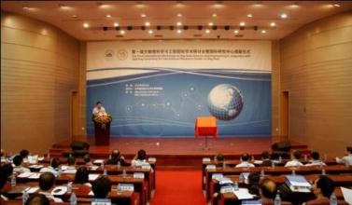
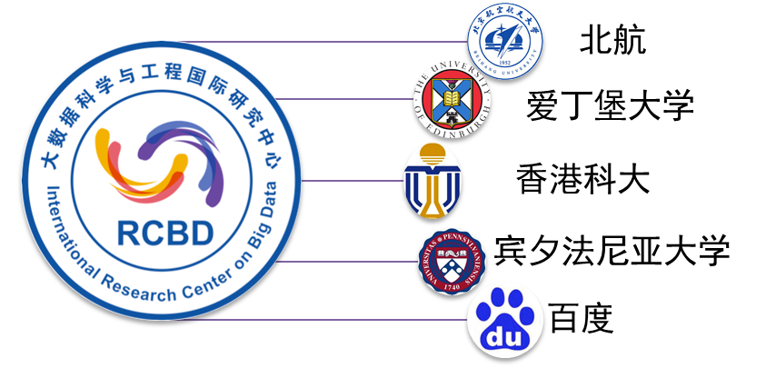
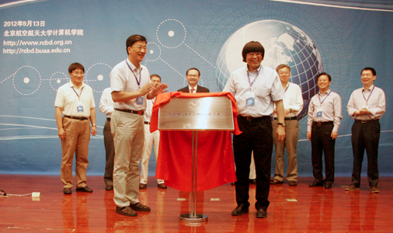

The history of RCBD
The International Research Center on Big Data (RCBD) was established in September 2012, at Beihang University (BUAA), Beijing, China
BUAA
University of Edinburg
HKUST
UPenn
Beidu
In November 2013, the National Center for International Research was approved, the first one on big data in China.

Slide 4
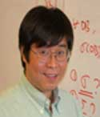



Chief Scientists
Wenfei Fan
Fellow of the Royal Society of Edinburgh
Fellow of the ACM
Chair Professor, University of Edinburgh, Director of RCBD
Jiangzhong Li
Professor of Harbin Institute of Technology
Chief Scientist of RCBD.
Lionel Ni
Professor of Hong Kong University of Science & Technology
Adjunct Professor, Beihang University
Chief Scientist of RCBD
Jie Xu
Professor, Leeds University
Chief Scientist of RCBD

Slide 5
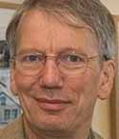
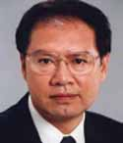
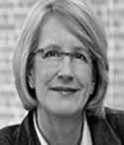
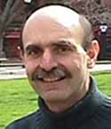
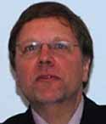

Academic Committee
Peter Buneman
Fellow of the Royal Society
Fellow of the ACM
Chair Professor, University of Edinburgh
Wei Li
Academician of the Chinese Academy of Sciences
Professor, Beihang University
Susan Davidson
Fellow of the ACM
Chair Professor, University of Pennsylvania
Scott Weinstein
Professor, University of Pennsylvania
Georg Gottlob
Fellow of the Royal Society
Fellow of the ACM
Chair Professor, Oxford University
Caochen Zhou
Academician of the Chinese Academy of Sciences
Professor, Peking University

Slide 6


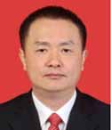



Steering Committee
Wenfei Fan
Fellow of the Royal Society of Edinburgh
Fellow of the ACM
Professor, University of Edinburgh
Jiang Lv
Vice President, Nanjing University
Academician of the Chinese Academy of Sciences
Jinpeng Huai
Academician of the Chinese Academy of Sciences
President of Beihang University
Hong Mei
Academician of the Chinese Academy of Sciences
Professor, Shanghai Jiao Tong University
Wei Li
Academician of the Chinese Academy of Sciences
Professor, Beihang University
Suning Tian
President of CBC Capital
Yanhong Li
President, CEO of Baidu
Lizhu Zhou
Professor, Tsinghua University

Slide 7
Overview
1. Introduction to RCBD
2. Research focus and outcome
3. Industrial collaborations

Slide 8
The Main Research Areas
Big Data Analyses: Theory and Application
Querying big data is a departure from our familiar database techniques and even the classical computational complexity theory. It introduces new fundamental problems and asks for radical changes to the conventional query evaluation paradigm!
Making Big Data Small
Big data ≠ MapReduce + machine learning.
Querying big data is as important as data mining.
MapReduce is not the only way to query big data, not even the best!
Data Quality
Big data = data quantity + data quality

Slide 9
BD-Tractability Theory
Traditional computational complexity theory of almost 50 years:
  The good: polynomial time computable (PTIME)
  The bad: NP-hard (intractable)
  The ugly: PSPACE-hard, EXPTIME-hard, undecidable…
What happens when it comes to big data?
Using SSD of 6G/s, a linear scan of a data set D would take
  1.9 days when D is of 1PB (10¹⁵B)
  5.28 years when D is of 1EB (10¹⁸B)
O(n) time is already beyond reach on big data in practice!
Polynomial-time algorithms are no longer tractable on big data

Slide 10
BD-Tractability Theory
NP and beyond
P
W. Fan, F. Geerts, F. Neven. Making Queries Tractable on Big Data with Preprocessing, VLDB 2013.
Parallel polylog time
BD-tractable
not
BD-tractable
Does it work? A linear scan of D in log(|D|) time:
15 seconds when D is of 1 PB instead of 1.99 days
18 seconds when D is of 1 EB rather than 5.28 years
BD-tractable queries: properly contained in P unless P = NC

Slide 11
Making big graphs small: Exact query answers
Scale independent query processing
PODS ‘14, VLDB’14
  |D_{Q} | ≤ M, Q(D) = Q(D_{Q})
  Parallel scalable query processing
Q(D₁)
VLDB’12, VLDB’14
Q(D)
Q(D_{i})
Q(D_{n})
  Bounded incremental query evaluation
TODS, 38(3), 2013
Q(D+Δ)=Q(D)+Q(Δ)
  Query answering using views
ICDE 2014
  Q(D)=Q’(V(D))
SQL queries and graph queries on social network

Slide 12

Make big data small: Approximate query answering
Qurey-driven approximate
Subgraph isomorphism
(NP-Complete)
  Strong simulation
(O(n³))
Effectiveness
  70%–80% of matches found by strong simulation are those found by subgraph isomorphism
  capture more sensible matches in social graphs
Efficiency
  from intractable to low polynomial time
  Improvement: 100 times faster than subgraph isomorphism
TODS, 39(1), 2014

Slide 13
Make big data small: Approximate query answering
Data-driven approximate
D
dynamic reduction
D_{α}
accesses a fraction D_{α} of D such that |D_{α}| ≤ α|D|
computes as Q(D_{α}) as approximate answers to Q(D), and
accuracy(Q, D, α) ≥ η
Q
Q
approximation
Q( D )
Q( D_{α} )
We can do personalized social search with α = 0.0015%, with 100% accuracy!
SIGMOD’14
1.5 * 10⁻⁶ * 1PB (10¹⁵B) = 15 * 10⁹ = 15GB
We are making big graphs of PB size as small as 15GB!
We can make big graphs of PB size fit into our memory!

Slide 14

The two sides of a coin: data quantity+data quality
When we talk about big data, we typically mean its quantity:
  What capacity of a system provides to cope with the sheer size of the data?
  Is a query feasible on big data within our available resources?
  How can we make our queries tractable on big data?
  . . .
Veracity!
Can we trust the answers to our queries?
Dirty data routinely lead to misleading financial reports, strategic business planning decision
  loss of revenue, credibility and customers, disastrous consequences
The study of data quality is as important as data quantity

Slide 15
The other side of big data: data quality
Big data = quantity + quality!
Central issues for data quality
  Object identification (data fusion): do two objects refer to the same real-world entity? What is the true value of the entity?
  Data consistency: do our data values have conflicts?
  Information completeness: does the database have enough information to answer our queries?
  Data accuracy: is one value more accurate than another for a real-word entity?
  Data currency: is our data out of data
TODS, TKDE, PODS, Information , SIGMOD, ICDE

Slide 16
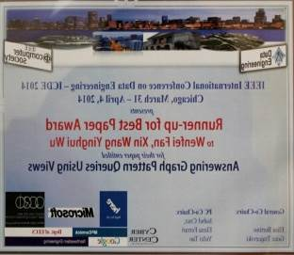
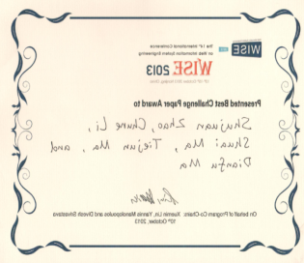
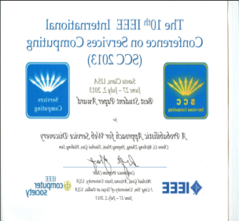
Research outcome
Publications
  30+ papers in TODS, VLDB J, PODS, SIGMOD, VLDB, ICDE, in less than 2 years
Funding
    The National Basic Research Program of China (973 Program), the Minister of Science and Technology, China, 2014 – 2018, CNY 29,000,000. The innovative team of NSFC, 12,000,000.
Awards

Slide 17
Overview
1. Introduction to RCBD
2. Research focus and outcome
3. Industrial collaborations

Slide 18
Industrial collaborations
We have been collaborating with Audaque,Google, Facebook, IBM, Yahoo and Huawei
  Joint projects
    Audaque: support big data techniques in their products
    Google: research on knowledge base
    Facebook: research on user targeted advertising
  Fundings
    IBM and Yahoo
    Google (under negotiation)
  Joint research lab
    Huawei (under negotiation)
  Scholarship: PhD studentships
    Audaque
    Huawei (under negotiation)

Slide 19
Future plan for the next two years
Research
  Querying big data, graph pattern association for social marketing, knowledge fusion, data quality control with knowledge bases, …
  The top big data research center in China and Asia
    We already take global lead on several subjects
Systems
    Grape: a parallel query system for graph pattern queries, a new model
    Search engines by incorporating social data analysis
    Data quality systems for big data, beyond ETL – by treating knowledge bases as master data
    Applications of big data analysis: ongoing at Audaque
Take global lead on big data
We welcome strong partners, academic or industry

Slide 20

Thanks!

