Slide 1


Improving Spectral Clustering with
Deep Embedding and Cluster Estimation
Liang Duan^{1,2}, Charu Aggarwal³, Shuai Ma^{1,2}, Saket Sathe³
¹SKLSDE Lab, Beihang University, China
²Beijing Advanced Innovation Center for Big Data and Brain Computing
³IBM T. J. Watson Research Center, New York, USA

Slide 2




Motivation (1)
Clustering is to group a set of data points into multiple groups or clusters
  High similarity: points within a cluster
  Very dissimilar: points in other clusters
Spectral Clustering (SC): one of the most popular clustering algorithms!
  (1) Construct similarity matrix A from X (Gaussian similarity function or KNN graph)
  (2) Find the k largest eigenvectors of
  (3) Apply k-means on normalized Y to cluster
Advantages:
  Easy to implement
  Can be solved efficiently (complexity is O(n²(d + k)))
  Often performs better than other traditional clustering algorithms, such as k-means

Slide 3
Motivation (2)
Spectral Clustering would be insufficient!
  Work poorly on complex and high-dimensional data
  Require the user to supply the number of clusters (k)
Curse of dimensionality
Not always clear in practical applications
Extensions of Spectral Clustering:
  Combine linear embedding and spectral clustering: SEC [TNN’11], …
  Replace the eigenvalue decomposition with deep autoencoder: GraphEncoder [AAAI’14], …
Estimation of the Number of Clusters (k):
  Run multiple k-means to find the best k: DB, SS, CH [J CLASSIF’10], …
  Split k-means centroids to search the optimal k: X-means [ICML’00], G-means [NIPS’04], …
[1] F. Nie, Z. Zeng, I. W. Tsang, D. Xu, C. Zhang, “Spectral embedded clustering: A framework for in-sample and out-of-sample spectral clustering,” TNN, vol. 22, no. 11, pp. 1796–1808, 2011.
[2] F. Tian, B. Gao, Q. Cui, E. Chen, T.-Y. Liu, “Learning deep representations for graph clustering,” AAAI, 2014.
[3] M. M.-T. Chiang, B. Mirkin, “Intelligent choice of the number of clusters in k-means clustering: An experimental study with different cluster spreads,” Journal of Classification, vol. 27, no. 1, pp. 3–40, 2010.
[4] D. Pelleg, A. Moore, “X-means: Extending k-means with efficient estimation of the number of clusters,” ICML, 2000.
[5] G. Hamerly, C. Elkan, “Learning the k in k-means,” NIPS, 2004.

Slide 4
Outline
SCDE: Spectral Clustering with Deep Embedding
SCDE+: Improving SCDE with Estimation of the Number of Clusters
  Estimation of the Number of Clusters
  SCDE+ Framework
Experimental Study
Summary

Slide 5
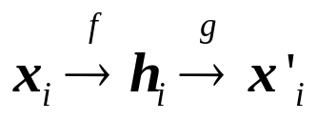
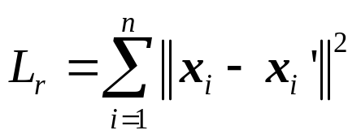




SCDE: Spectral Clustering with Deep Embedding
Spectral Clustering relies on its similarity matrix
  K-nearest neighbor graph: Euclidean distance
  Fully connected graph: Gaussian similarity function
Ineffective for high-dimensional and complex data!
Extract deep embedding for spectral clustering
  More effective representation for clustering
  Low-dimensional data representation
Steps:
  Train a deep autoencoder: with loss
  Obtain deep embedding:
  cluster with spectral clustering
Time complexity:

Slide 6


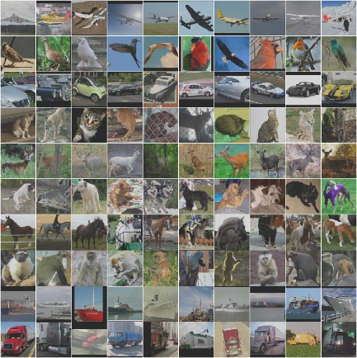
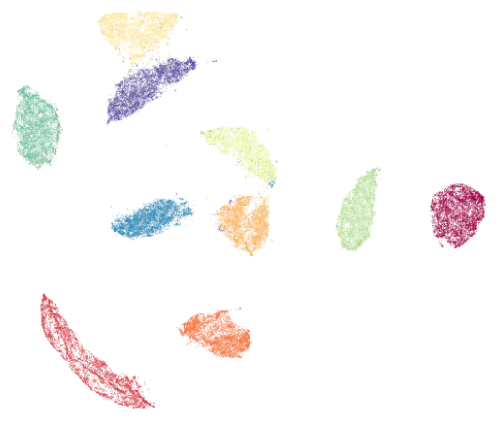
SCDE: Spectral Clustering with Deep Embedding
Framework of SCDE
Decoder
Encoder
Input
Deep embedding
Output
x
h
x'
Spectral
Clustering
h

Slide 7
Outline
SCDE: Spectral Clustering with Deep Embedding
SCDE+: Improving SCDE with Estimation of the Number of Clusters
  Estimation of the Number of Clusters
  SCDE+ Framework
Experimental Study
Summary

Slide 8

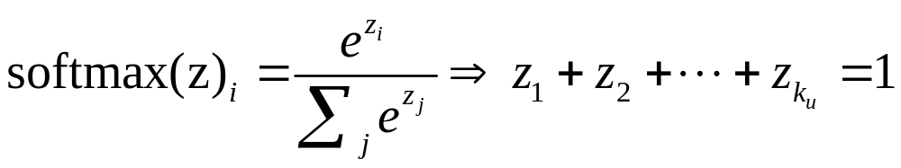
SCDE+: SCDE with Estimation of the Number of Clusters
Estimation of the Number of Clusters
  Softmax Autoencoder (SA)
    the innermost hidden layer uses the softmax activation function
Input Layer
Nonlinear Activations
(e.g., ReLU)
Output Layer
x₁
x’₁
x₂
z₁
x’₂
x₃
x’₃
z₂
z_{i}: the probability that the data point x belongs to cluster C_{i}
x₄
x’₄
x₅
Softmax Activation
x’₅
Basic idea:
using the softmax autoencoder as a clustering method.
counting the number of cluster labels assigned by the softmax autoencoder as the estimation.

Slide 9

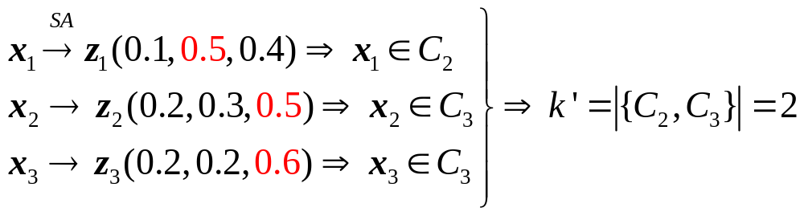
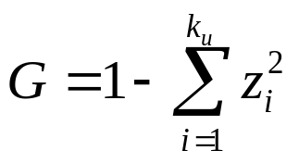
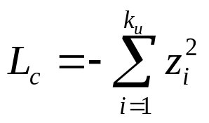
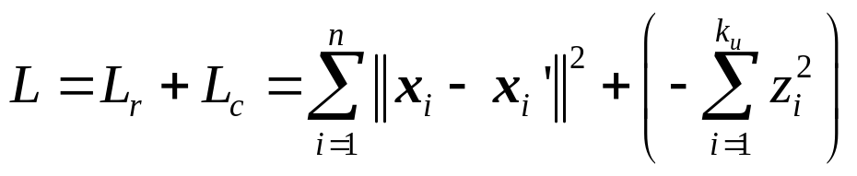
SCDE+: SCDE with Estimation of the Number of Clusters
Estimation of the Number of Clusters
Example: Given a data set
A high-quality clustering will generate probabilistic distribution that is nearly deterministic!
Gini index:
Cluster coherence loss:
loss function:
Reconstruction loss
Cluster coherence loss

Slide 10
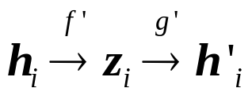
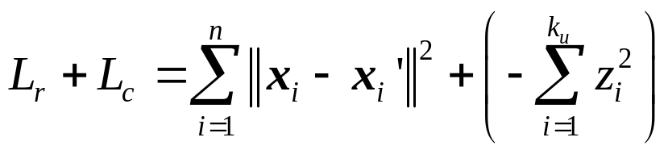


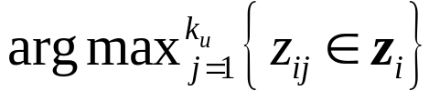


SCDE+: SCDE with Estimation of the Number of Clusters
Integrate SA Estimation Method into SCDE
Steps:
  Train a deep autoencoder: with loss
  Obtain deep embedding:
  Train a softmax autoencoder: with loss
  Obtain cluster membership probabilities:
  count the distinct labels
  cluster with spectral clustering
Time complexity:

Slide 11
SCDE+: SCDE with Estimation of the Number of Clusters
Framework of SCDE+
Encoder
Decoder
Input
Deep embedding
Output
x
h
x'
Softmax Autoencoder
h
k’
Spectral
Clustering

Slide 12
Outline
SCDE: Spectral Clustering with Deep Embedding
SCDE+: Improving SCDE with Estimation of the Number of Clusters
  Estimation of the Number of Clusters
  SCDE+ Framework
Experimental Study
Summary

Slide 13
Experimental Study
Datasets (4 image datasets + 2 text datasets)
Dataset | # Samples | Dimension | # Clusters |  | Dataset | # Samples | Dimension | # Clusters
MNIST | 70,000 | 784 | 10 |  | STL-10 | 13,000 | 4,096 | 10
Fashion-MNIST | 70,000 | 784 | 10 |  | Reuters-8 | 10,000 | 2,000 | 8
USPS | 11,000 | 256 | 10 |  | 20Newsgroups | 18,846 | 2,000 | 20
Evaluation Metrics
  Normalized Mutual Information (NMI), Adjusted Rand Index (ARI)
Algorithms
  Clustering
    SCDE, SCDE+ (our methods)
    k-means, SC, Spectral Embedding Clustering (SEC), NMF+SC, Deep Embedded Clustering (DEC)
  Estimating the number of clusters
    Softmax Autoencoder (SA)
    X-means, G-means, Davies-Bouldin Index (DB), Silhouette Statistic (SS)

Slide 14
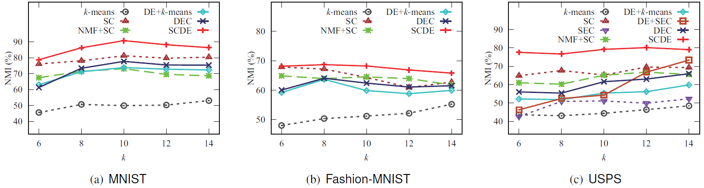
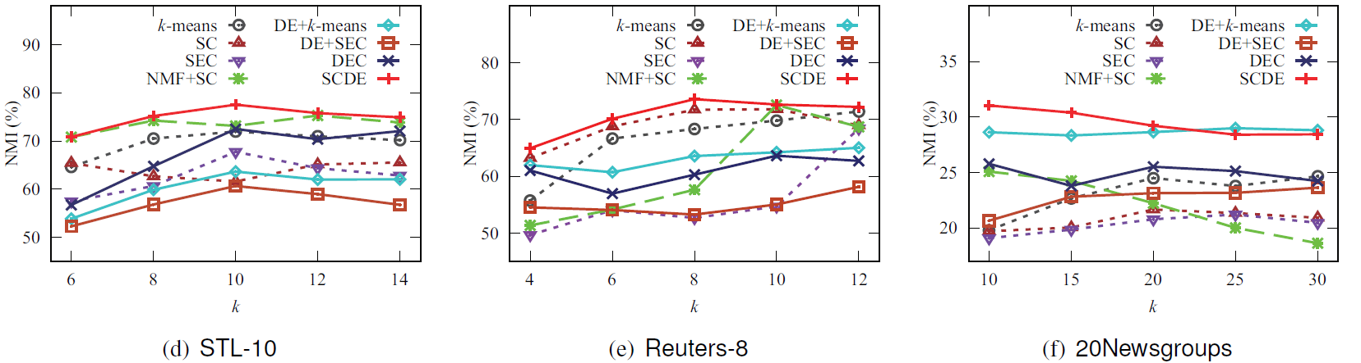
Experimental Results (1-1)
Clustering with Different Numbers of Clusters (k)
NMI
Achieves the highest NMI!
SCDE performs better than other comparison methods!

Slide 15
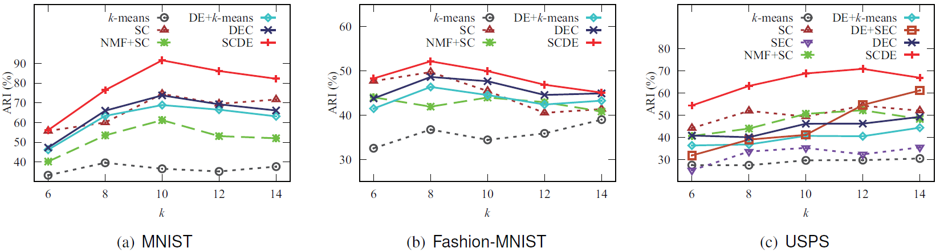
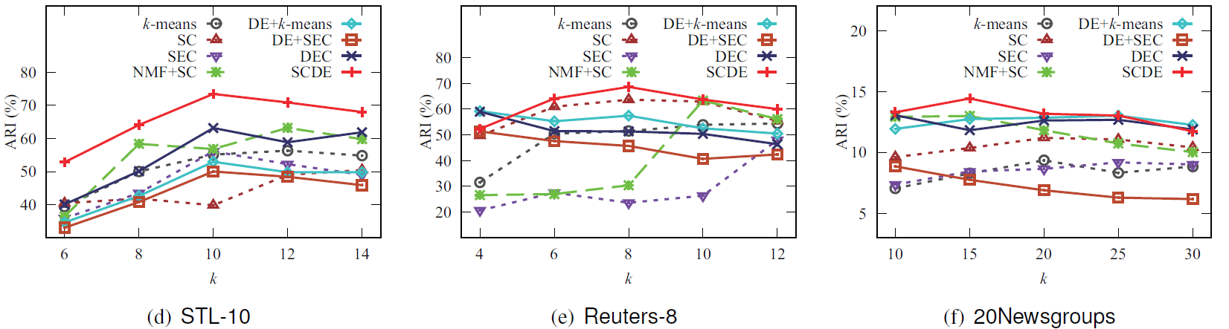
Experimental Results (1-2)
Clustering with Different Numbers of Clusters (k)
ARI
Achieves the highest ARI!
SCDE performs better than other comparison methods!

Slide 16
Experimental Results (2)
Estimation of the Number of Clusters
Method | MNIST | Fashion-MNIST | USPS | STL-10 | Reuters-8 | 20Newsgroups |  | MNIST | Fashion-MNIST | USPS | STL-10 | Reuters-8 | 20Newsgroups
 | k |  |  |  |  |  |  | Time (sec.)
Ground Truth | 10 | 10 | 10 | 10 | 8 | 20 |  | - | - | - | - | - | -
X-means | 20 | 20 | 20 | 20 | 16 | 40 |  | 357 | 321 | 19 | 235 | 56 | 470
G-means | 15 | 16 | 20 | 20 | 16 | 40 |  | 732 | 647 | 41 | 605 | 121 | 1892
DB | 20 | 3 | 18.8 | 6.6 | 2 | 34.8 |  | 912 | 785 | 37 | 588 | 114 | 1840
SS | 2 | 2 | 5 | 3 | 15.4 | 2 |  | 2972 | 2935 | 88 | 664 | 150 | 2232
SA (ours) | 11.2 | 12 | 6.6 | 2.8 | 12.6 | 31.6 |  | 85 | 88 | 10 | 56 | 24 | 59
DE+X-means | 20 | 20 | 20 | 20 | 16 | 40 |  | 1304 | 1328 | 169 | 474 | 164 | 508
DE+G-means | 9 | 19.4 | 20 | 16 | 16 | 40 |  | 1301 | 1352 | 172 | 475 | 165 | 550
DE+DB | 10.8 | 6.2 | 17.8 | 8.8 | 14.4 | 25 |  | 1313 | 1340 | 169 | 473 | 162 | 536
DE+SS | 9 | 5.2 | 12.2 | 7.8 | 14.8 | 2 |  | 2475 | 2413 | 222 | 512 | 196 | 701
DE+SA (ours) | 10.2 | 9.2 | 9.6 | 9.8 | 8 | 20.8 |  | 1301 | 1327 | 167 | 469 | 162 | 494
Faster then other methods!
Very close to the ground truth number!
SA is effective and efficient to find the correct number of clusters!

Slide 17
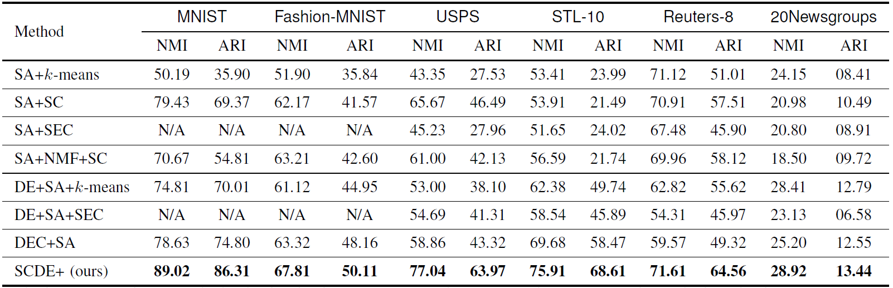
Experimental Results (3)
Clustering with Estimation of k
MNI improvements (DEC+SA): (13%, 7%, 31%, 9%, 20%, 15%)
SCDE+ can find a correct number of clusters and outperform other methods!

Slide 18
Outline
SCDE: Spectral Clustering with Deep Embedding
SCDE+: Improving SCDE with Estimation of the Number of Clusters
  Estimation of the Number of Clusters
  SCDE+ Framework
Experimental Study
Summary

Slide 19
Summary
Conclusions
  Improving SC with deep embedding and estimation of the number of clusters
    Learn the deep embedding based on a multilayer autoencoder
    Estimate the number of clusters by a softmax autoencoder trained on the deep embedding
  Extensive experiments on image and text datasets
    Find a correct number of clusters
    Performs better than comparison methods, such as DEC, NMF-SC, SEC, SC and k-means
Future Work
  Optimizing the deep embedding, estimation of the number of clusters and clustering simultaneously
  Applying our estimation method to other clustering methods
  Dealing with large-scale datasets

Slide 20
Thank you!
Q & A

Slide 21
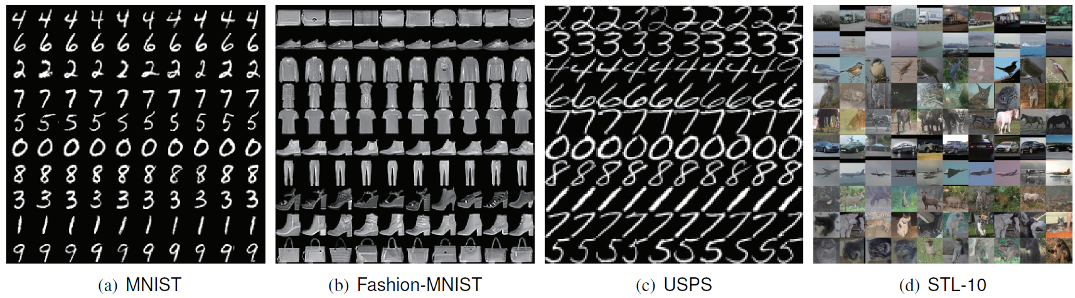
Experimental Results
Top 10 scoring images of each cluster from the results of SCDE
Each row contains the top 10 scoring elements from one cluster.
SCDE performs better than other comparison methods!

Slide 22
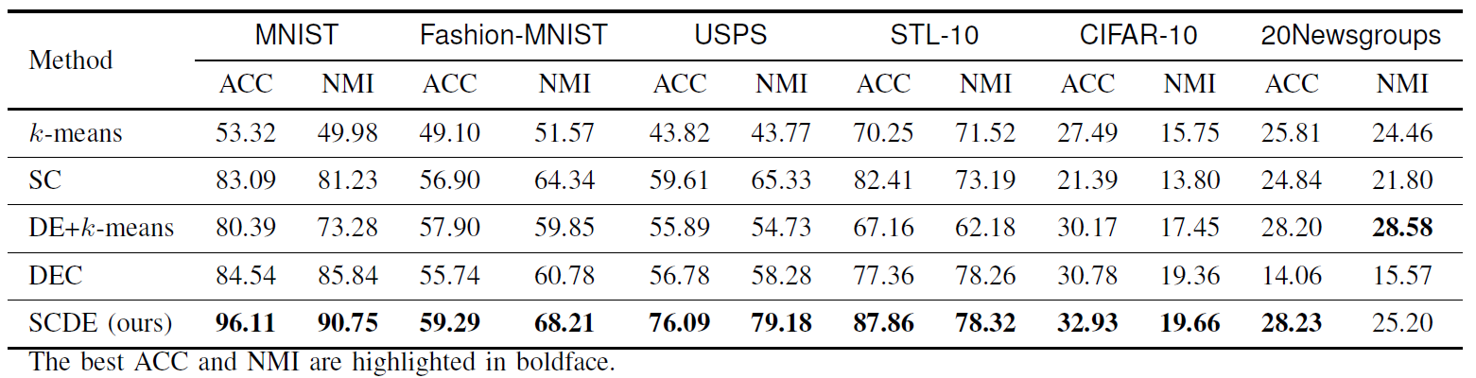
Experimental Results
Comparison of clustering ACC (%) and NMI (%) with giving k
SCDE performs better than other comparison methods!

Slide 23
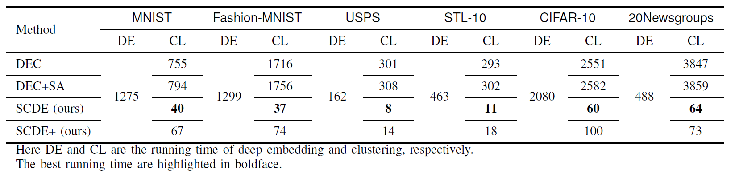
Experimental Results
Running time (sec.) compared with DEC on all datasets
SCDE and SCDE+ are much faster than DEC and DEC+SA in clustering phase!

