Slide 1

New Models for Graph Pattern Matching
Shuai Ma (马 帅)

Slide 2

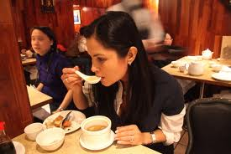
Food Web: Predator-Prey Interactions
Notes:
Life is crucial for everyone, even sharks!

Slide 3


Social Networks: Relationships
Real-life graph data processing is challenging!

Slide 4
Outline
Graph pattern matching
P-homomorphism
Bounded graph simulation
Graph pattern queries
Strong simulation

Slide 5
Graph Pattern Matching
Given two graphs G1 (pattern graph) and G2 (data graph),
  decide whether G1 matches G2 (Boolean queries)
  identify “subgraphs” of G2 that match G1
Applications
  Web mirror detection/ Web site classification
  Complex object identification
  Software plagiarism detection
  Social network/biology analyses
  …
Challenges
  Identifying matching models (matching semantics)
  Balance between complexity and expressive power
A variety of emerging real -life applications!

Slide 6
Outline
Graph pattern matching
P-homomorphism
Bounded graph simulation
Graph pattern queries
Strong simulation

Slide 7
Traditional Subgraph Isomorphism
Pattern graph Q(V_{Q}, E_{Q}), subgraph Gs(V_{S}, E_{S}) of data graph G
  Q matches Gs if there exists a bijective function f: V_{Q}→ V_{S} satisfying
    for each node u in Q, u and f(u) have the same label; and
    an edge (u, u‘) in Q iff (f(u), f(u')) is an edge in Gs
Goodness
  Keep structure topology between Q and Gs
Badness
  May return exponential number of matched subgraphs
  Decision problem: NP-complete - low efficiency
  In emerging applications, too restrictive to find sensible matches
New matching models are needed in practice!

Slide 8




















P-Homomorphism
Edge-to-path
mappings
A.Home
B.Index
books
sports
digital
books
audio
categories
booksets
DVDs
CDs
textbooks
abooks
albums
arts
school
audio books
features
genres
albums
G₁
G₂
Subgraph isomorphism/graph homomorphism is too restrictive!

Slide 9

P-Homomorphism
A new matching model referred to as P-homomorphism
  Label matching is enforced
  Edges are allowed to be mapped to nonempty paths
Complexity bounds of decision and optimization problems
  NP-hardness
  Approximation hardness
Approximation algorithms with performance guarantees
Publication on P-homomorphism (alphabetic order)
  Wenfei Fan, Jianzhong Li, Shuai Ma, Hongzhi Wang, and Yinghui Wu, Graph Homomorphism Revisited for Graph Matching, VLDB 2010
A first step towards revising conventional notions of graph matching

Slide 10
Outline
Graph pattern matching
P-homomorphism
Bounded graph simulation
Graph pattern queries
Strong simulation

Slide 11
Traditional Graph Simulation
Pattern graph Q(V_{Q}, E_{Q}) matches data graph G(V, E), via graph simulation, if there exists a binary relation S ⊆ V_{Q} ╳ V such that
  for each (u, v) ∈ S, u and v have the same label; and
  for each node u in Q, there exists v in G such that
    (u, v) ∈ S, and for each edge (u, u‘) in Q, there exists
    an edge (v, v‘) in G such that (u',v') ∈ S
Goodness
  Quadratic time solvable
Badness
  Lose structure topology (however there are applications that do not need strong restrictions)
Graph simulation is in PTIME!

Slide 12
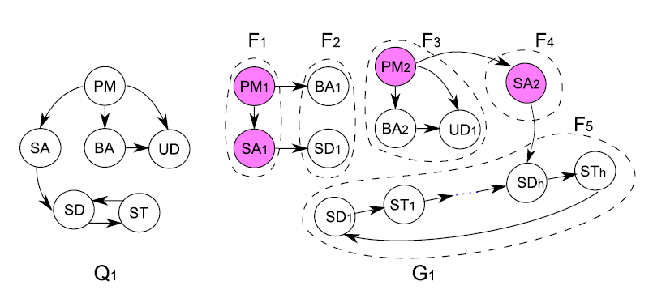

Traditional Graph Simulation
Set up a team to develop a new software product
Subgraph isomorphism is too strict for emerging applications

Slide 13
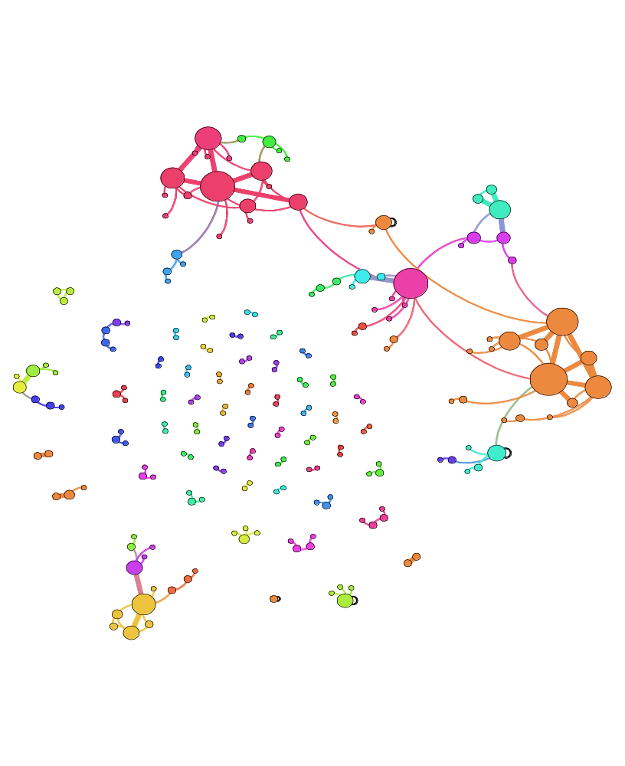
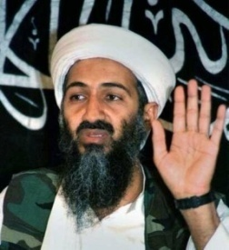
Terrorist Collaboration Network
“Those who were trained to fly didn’t know the others. One group of people did not know the other group.” (Osama Bin Laden, 2001)
Notes:
Life is crucial for everyone, even sharks!

Slide 14






Bounded Graph Simulation
Identify all suspects in the drug ring
B
B
A1
Am/S
AM
S
W
W
3
1
W
3
W
W
W
FW
W
W
Drug trafficking: Pattern and Data Graphs
Subgraph isomorphism is too strict for emerging applications

Slide 15
Bounded Graph Simulation
G=(V, E) matches P=(V_{p}, E_{p}) via bounded simulation, if there exists a binary relationS ⊆ V_{p} × V such that:
  for each u∈ V_{p,} there exists v∈ V such that (u,v)∈ S
  for each (u,v)∈ S, the attributes f_{A}(v) satisfies the predicate f_{v}(u)
  each (u,u’) in E_{p} is mapped to a bounded path from v to v’ in G, (u’,v’)∈ S
Graph simulation
  A special case of bounded graph simulation
A departure from traditional graph simulation

Slide 16
Bounded Graph Simulation
A new matching model referred to as bounded simulation
A cubic-time algorithm for bounded simulation
Incremental algorithms with performance guarantees
  Analyses of incremental complexity
Publication on bounded simulation (alphabetic order)
  Wenfei Fan, Jianzhong Li, Shuai Ma, Nan Tang, Yinghui Wu, and Yunpeng Wu, Graph Pattern Matching: From Intractable to Polynomial Time, VLDB 2010
A second step towards revising conventional notions of graph matching: from intractable to PTIME

Slide 17
Outline
Graph pattern matching
P-homomorphism
Bounded graph simulation
Graph pattern queries
Strong simulation

Slide 18
Graph Pattern Queries
A further extension of graph simulation, by
  allowing edge types;
  enforcing node matching conditions;
  mapping edges to paths specified with regular expressions;
  changing node mapping to edge matching.
Reachability queries and bounded simulation are special cases of graph pattern queries
Further extensions of graph simulation, but remains in PTIME

Slide 19
Graph Pattern Queries
A new matching model referred to as graph pattern queries
Fundamental problems
  Query containment, query equivalence, query minimization
  All are solvable in cubic time
Two cubic time algorithms for graph pattern queries
Publication on graph pattern queries (alphabetic order)
  Wenfei Fan, Jianzhong Li, Shuai Ma, Nan Tang, and Yinghui Wu , Adding Regular Expressions to Graph Reachability and Pattern Queries, ICDE 2011
A third step towards revising conventional notions of graph matching

Slide 20
Outline
Graph pattern matching
P-homomorphism
Bounded graph simulation
Graph pattern queries
Strong simulation

Slide 21
Strong Simulation
Subgraph isomorphism
  Goodness
    Keep (strong) structure topology
  Badness
    May return exponential number of matched subgraphs
    Decision problem: NP-complete
    In certain scenarios, too restrictive to find sensible matches
Graph simulation
  Goodness
    Solvable in quadratic time
  Badness
    Lose structure topology (how much? open question)
    Only return a single matched subgraph
Balance between complexity and the capability to capturing topology!

Slide 22
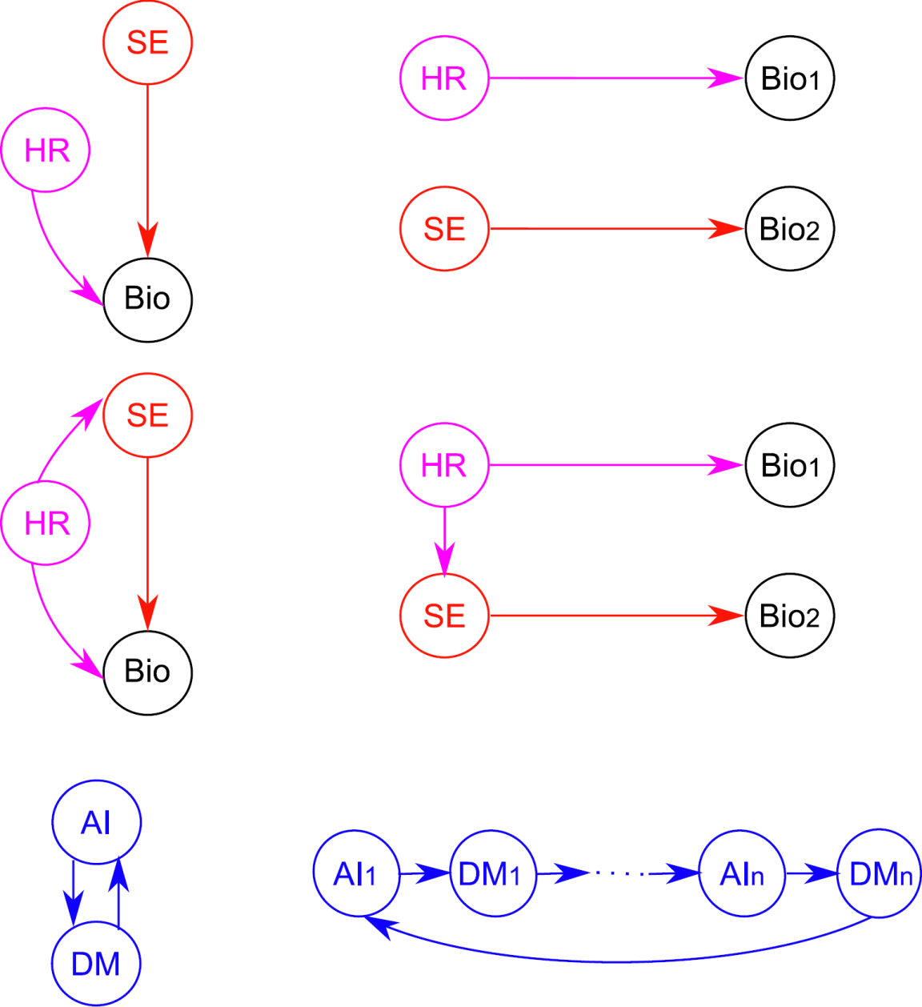
Strong Simulation
Disconnected
Graph simulation loses graph structures
Tree
Long cycle

Slide 23
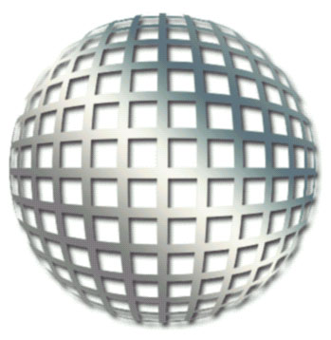
Strong Simulation
Duality (dual simulation)
  Both child and parent relationships
  Simulation considers only child relationships
Locality
  Restricting matches within a ball
  When social distance increases, the closeness of relationships decreases and the relationships may become irrelevant
The semantics of strong simulation is well defined
  The results are unique
Strong simulation: bring duality and locality into graph simulation

Slide 24
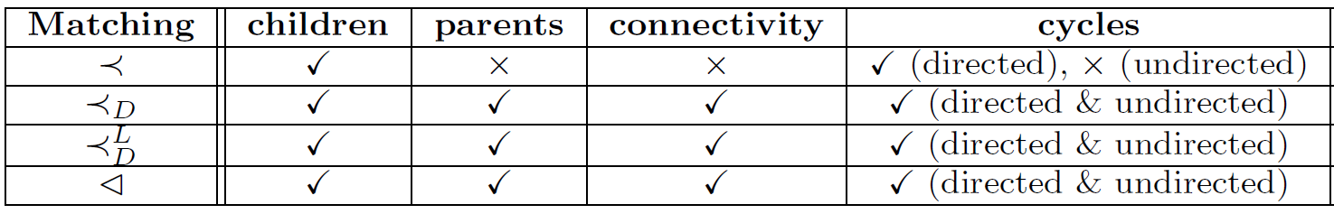
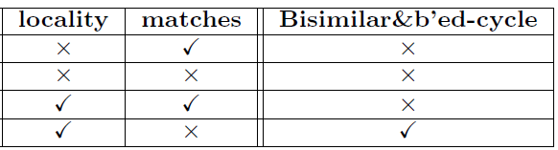
Strong Simulation
Subgraph
Isomorphism
Strong
Simulation
Dual
Simulation
Graph
Simulation
Topology preservation and bounded matches

Slide 25
Strong Simulation
A new matching model referred to as strong simulation
A cubic time algorithm
Three main optimization techniques
  Query minimization
    An O(n²) algorithm
  Dual simulation filtering
    First compute the match graph of dual simulation, then project on each ball of the data graph
  Connectivity pruning
    Based on the connectivity theorem
A distributed algorithm
  Data locality property
  Boundary nodes and radius
Publication on strong simulation (alphabetic order)
  Yang Cao Wenfei Fan, Jinpeng Huai, Shuai Ma, and Tianyu Wo, Capturing Topology in Graph Pattern Matching. VLDB 2012
A fourth step towards revising conventional notions of graph matching

Slide 26
Summary
Weakness of traditional matching models
  Subgraph isomorphism
  Graph simulation
New matching models for emerging applications
  P-homomorphism
  Bounded graph simulation
  Graph pattern queries
  Strong simulation
    Well-balanced between complexity and expressive power
  Future work
    More to be done …
New models that capture the need of emerging applications!

Slide 27
Questions?
Email: shuai.ma@gmail.com OR
mashuai@act.buaa.edu.cn
Homepage: http://mashuai.buaa.edu.cn

