Slide 1


Extending Dependencies with Conditions
Loreto Bravo University of Edinburgh
Wenfei Fan University of Edinburgh & Bell Laboratories
Shuai Ma University of Edinburgh

Slide 2
Outline
Why Conditional Dependencies?
  Data Cleaning
  Schema Matching
Conditional Inclusion Dependencies (CINDs)
  Definition
  Static Analysis
    Satisfiability Problem
    Implication Problem
    Inference System
  Static Analysis of CFDs+CINDs
Satisfiability Checking Algorithms (CFDs+CINDs)
Summary and Future Work

Slide 3
Motivation
Data Cleaning
  Real life data is dirty!
  Specify consistency using integrity constraints
    Inconsistencies emerge as violations of constraints
  Constraints considered so far: traditional
    Functional Dependencies - FD
    Inclusion Dependencies - IND
    . . .
Schema matching: needed for data exchange and data integration
  Pairings between semantically related source schema attributes and target schema attributes
  expressed as inclusion dependencies (e.g., Clio)

Slide 4
Example: Amazon database
Schema:
  book(id, isbn, title, price, format)
  CD(id, title, price, genre)
  order(id, title, type, price, country, county)
book
CD
id | isbn | title | price
a23 | b32 | H. Porter | 17.99
a56 | b65 | Snow white | 7.94
id | title | price | genre
a12 | J. Denver | 17.99 | country
a56 | Snow White | 7.94 | a-book
id | title | type | price | country | county
a23 | H. Porter | book | 17.99 | US | DL
a12 | J. Denver | CD | 7.94 | UK | Reyden
order

Slide 5
Data cleaning with inclusion dependencies
Definition of Inclusion Dependencies (INDs)
  R1[X] ⊆ R2[Y], for any tuple t1 in R1, there must exist a tuple t2 in R2, such that t2[Y]=t1[X]
Example Inclusion dependency:
  book[id, title, price] ⊆ order[id, title, price]
id | isbn | title | price | format
a23 | b32 | H. Porter | 17.99 | Hard cover |  | t3
a56 | b65 | Snow White | 17.94 | audio |  | t4
book
id | title | type | price | country | county
a23 | H. Porter | book | 17.99 | US | DL |  | t1
a12 | J. Denver | CD | 7.94 | UK | Reyden |  | t2
order
Notes:
Mention foreign key is a special case of IND

Slide 6
Data cleaning meets conditions
How to express?
  Every book in order table must also appear in book table
Traditional inclusion dependencies:
  order[id, title, price] ⊆ book[id, title, price]
order
id | title | type | price | country | county
a23 | H. Porter | book | 17.99 | US | DL |  | t1
a12 | J. Denver | CD | 7.94 | UK | Reyden |  | t2
book
id | isbn | title | price | format
a23 | b32 | H. Porter | 17.99 | Hard cover |  | t3
a56 | b65 | Snow White | 17.94 | audio |  | t4
This inclusion dependency does not make sense!

Slide 7
Data cleaning meets conditions
order
id | title | type | price | country | county
a23 | H. Porter | book | 17.99 | US | DL |  | t1
a12 | J. Denver | CD | 7.94 | UK | Reyden |  | t2
book
id | isbn | title | price | format
a23 | b32 | H. Porter | 17.99 | Hard cover |  | t3
a56 | b65 | Snow White | 17.94 | audio |  | t4
Conditional inclusion dependency:
  order[id, title, price, type =‘ book’] ⊆ book[id, title, price]

Slide 8
Schema matching with inclusion dependencies
Schema Matching:
  Pairings between semantically related source schema attributes and target schema attributes, which are de facto inclusion dependencies from source to target (e.g., Clio)
order
id | title | type | price | country | county
id | isbn | title | price
id | title | price | genre
book
CD
Traditional inclusion dependencies:
  book[id, title, price] ⊆ order[id, title, price]
  CD[id, title, price] ⊆ order[id, title, price]
Notes:
A schema matching is a pairing of attributes (or groups of attributes) from the source schema and attributes of the target schema such that pairs are likely to be semantically related.

Slide 9
Schema matching meets conditions
order
id | title | type | price | country | county
book
CD
id | isbn | title | price
id | title | price | genre
Traditional inclusion dependencies:
  order[id, title, price] ⊆ book[id, title, price]
  order[id, title, price] ⊆ CD[id, title, price]
These inclusion dependencies do not make sense!
Notes:
A schema matching is a pairing of attributes (or groups of attributes) from the source schema and attributes of the target schema such that pairs are likely to be semantically related.

Slide 10
Schema matching meets conditions
order
id | title | type | price | country | county
book
CD
id | isbn | title | price
id | title | price | genre
Conditional inclusion dependencies:
  order[id, title, price; type =‘ book’] ⊆ book[id, title, price]
  order[id, title, price; type = ‘CD’] ⊆ CD[id, title, price]
The constraints do not hold on the entire order table
order[id, title, price] ⊆ book[id, title, price] holds only if type = ‘book’
order[id, title, price] ⊆ CD[id, title, price] holds only if type = ‘CD’

Slide 11
Conditional Inclusion Dependencies (CINDs)
(R1[X; Xp] ⊆ R2[Y; Yp], Tp):
  R1[X] ⊆ R2[Y]: embedded traditional IND from R1 to R2
  attributes: X ∪ Xp ∪ Y ∪ Yp
  Tp: a pattern tableau
  tuples in Tp consist of constants and unnamed variable _
Example:
CD[ id, title, price; genre = ‘a-book’] ⊆book[ id, title, price; format = ‘audio’]
Corresponding CIND:
  (CD[id, title, price; genre] ⊆book[id, title, price; format], Tp)
id | title | price | genre | id | title | price | format
_ | _ | _ | a-book | _ | _ | _ | audio
Tp
Notes:
Mention, Tp could have more than one pattern tuple

Slide 12
INDs as a special case of CINDs
R1[X] ⊆ R2[Y]
X: [A1, …, An]
Y : [B1, …, Bn]
As a CIND: (R1[X; nil] ⊆ R2[Y; nil], Tp)
pattern tableau Tp: a single tuple consisting of _ only
CINDs subsume traditional INDs
A1 | … | An | B1 | … | Bn
_ | _ | _ | _ | _ | _

Slide 13
Static Analysis of CINDs
Satisfiability problem
  INPUT: Give a set Σ of constraints
  Question: Does there exist a nonempty instance I satisfying Σ?
Whether Σ itself is dirty or not
For INDs the problem is trivially true
For CFDs (to be seen shortly) it is NP-complete
Good news for CINDs
  Proposition: Any set of CINDs is always satisfiable
I╠ Σ
Notes:
All classes of constraints have some essential problems

Slide 14
Static Analysis of CINDs
Implication problem
  INPUT: set Σ of constraints and a single constraint φ
  Question: for each instance I that satisfies Σ, does I also satisfy φ?
Remove redundant constraints
PSPACE-complete for traditional inclusion dependencies
Theorem. Complexity bounds for CINDs
  Presence of constants
  PSPACE-complete in the absence of finite domain attributes
    Good news – The same as INDs
  EXPTIME-complete in the general setting
Σ╠ φ
Notes:
Explain what is finite domain

Slide 15
Finite axiomatizability of CINDs
φ is implied by Σ iff it can be computed by the inference system
  INDs have such Inference System
  Good news: CINDs too!
  1-Reflexivity
  2-Projection and Permutation
  3-Transitivity
IND Counterparts
Sound and Complete in the
Absence of Finite Attributes
4-Downgrading
5-Augmentation
6-Reduction
7-F-reduction
8-F-upgrade
Finite Domain Attributes
Theorem. The above eight rules constitute a sound and complete
inference system for implication analysis of CINDs
Notes:
Given a set of inference rules can definitely help the implication analysis
Usually finite domains will make the problem tricky

Slide 16
Axioms for CINDs: finite domain reduction
New CINDs can be inferred by axioms
(R1[X; A] ⊆ R2[Y; Yp], Tp),
  dom(A) = { true, false}
X | A | Y | Yp
_ | true | _ | d |  | tp1
_ | false | _ | d |  | tp2
Tp
then (R1[X; Xp] ⊆ R2[Y; Yp], tp),
X | Y | Yp
_ | _ | d

Slide 17
Static analyses: CIND vs. IND
In the absence of finite-domain attributes:
 | satisfiability | implication | finite axiom’ty
CIND | O(1) | PSPACE-complete | yes
IND | O(1) | PSPACE-complete | yes
General setting with finite-domain attributes:
 | satisfiability | implication | finite axiom’ty
CIND | O(1) | EXPTIME-complete | yes
IND | O(1) | PSPACE-complete | yes
CINDs retain most complexity bounds of their traditional counterpart

Slide 18
Conditional Functional Dependencies (CFDs)
An extension of traditional FDs
Example: cust([country = 44, zip] → [street])
Name | country | zip | street
Bob | 44 | 07974 | Tree Ave.
Joe | 44 | 07974 | Tree Ave.
Ben | 01 | 01202 | Elem Str.
Jim | 01 | 01202 | Oak Ave.

Slide 19
Static analyses: CFD + CIND vs. FD + IND
 | satisfiability | implication | finite axiom’ty
CFD + CIND | undecidable | undecidable | No
FD + IND | O(1) | undecidable | No
CINDs and CFDs properly subsume FDs and INDs
Both the satisfiability analysis and implication analysis are
  beyond reach in practice
  This calls for effective heuristic methods
Notes:
For implication say: “It is not surprising that…”
For Sat “It is surprising…”

Slide 20
Satisfiability Checking Algorithms
Before using a set of CINDs for data cleaning or schema matching we need to make sure that they make sense (that they are clean)
We need to find heuristics to solve the satisfiability problem
  Input: A set Σ of CFDs and CINDs
  Output: true / false
We modified and extended techniques used for FDs and INDs
  For example: Chase, to build a “canonical” witness instance, i.e., I╠ Σ

Slide 21
Chase_{CFDs+CINDs} – Terminate case
Σ = {ϕ1, ψ1}
  ϕ1=(R2(G → H), (_ || c)) - CFD
  ψ1=(R2[G; nil] ⊆ R1[F; nil], (_ || _) ) - CIND
R1
R2
R1
R2
E | F |  | G | H
 |  |  | V_{G1} | V_{H1}
ϕ1
E | F |  | G | H
 |  |  | V_{G1} | c
ψ1
R1
R2
E | F |  | G | H
V_{E1} | V_{G1} |  | V_{G1} | c
Done!
Notes:
The chase is a very useful tool for reasoning about dependencies that highlights a strong connection between dependencies and tableau queries

Slide 22
Chase_{CFDs+CINDs} – Loop case
Σ = {ϕ1, ψ1, ψ2}
  ϕ1=(R2(G → H), (_ || c)) - CFD
  ψ1=(R2[G; nil] ⊆ R1[F; nil], (_ || _) ) - CIND
  ψ2=(R1[E; nil] ⊆ R2[G; nil], (_ || _) )
R1
R2
ψ1
R1
R2
E | F |  | G | H
 |  |  | V_{G1} | c
E | F |  | G | H
V_{E1} | V_{G1} |  | V_{G1} | c
ψ1
ψ2
E | F |  | G | H
V_{E1} | V_{G1} |  | V_{G1} | c
V_{E2} | V_{E1} |  | V_{E1} | c
Infinite
application
of
ψ1 and ψ2
Loop!
E | F |  | G | H
V_{E1} | V_{G1} |  | V_{G1} | c
 |  |  | V_{E1} | c
ψ2

Slide 23
More about the checking algorithms
Simplification of the chase:
  The fresh variables are taken from a finite set
  We avoid the infinite loop of the chase by limiting the size of the witness instance
If the algorithm returns:
    True: we know the constraints are satisfiable
    False: there may be false negative answers – the problem is undecidable and the best we can get is a heuristic
In order to improve accuracy of the algorithm we use:
  Optimization techniques

Slide 24
Example optimization techniques
Node( Relation): related to CFDs
Edge: related to CINDS
Ψ2, Ψ3
Ψ4
R3
R4
R1
R2
Ψ5
R5
R6
Ψ1
Unsatisfiability Propagation
IF
  CFDs on R4 is unsatisfiable
  There is a CIND Ψ4: (R3[X; nil] ⊆ R4[Y; Yp], tp)
THEN
  R3 must be empty!
Notes:
We also have other tricks which appear on our paper

Slide 25
CFDs+CINDs satisfiability checking - experiments
Experimental Settings
  Accuracy tested for satisfiable sets of CFDs and CINDs
    The data sets where generated by ensuring the existence of a witness database that satisfies them
  Scalability tested for random sets of CFDs and CINDs
  Each experiment was run 6 times and the average is reported
  # of constraints: up to 20,000
  # of relations: up to 100
  Ratio of finite attributes: up to 25%
  An Intel Pentium D 3.00GHz with 1GB memory
Notes:
More detailed settings are on our paper

Slide 26
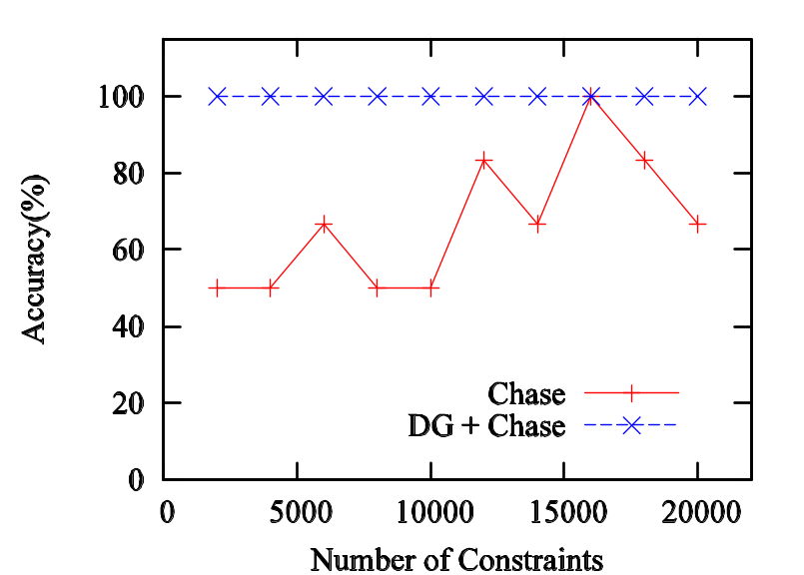
CFDs+CINDs satisfiability checking - experiments
Algorithm:
1. Chase : modified version Chase
2. DG+Chase: graph optimization based Chase
Accuracy testing is based satisfiable sets of CFDs and CINDs
Notes:
Which guarantee termination

Slide 27
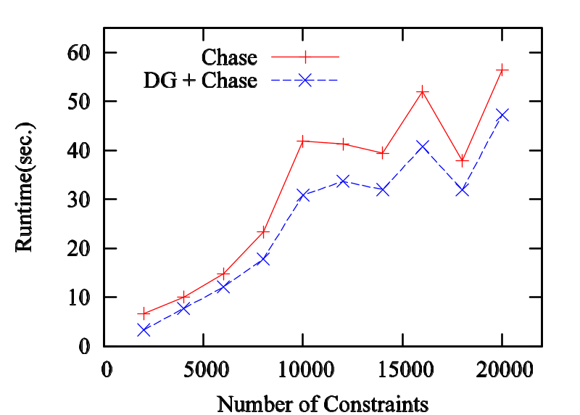
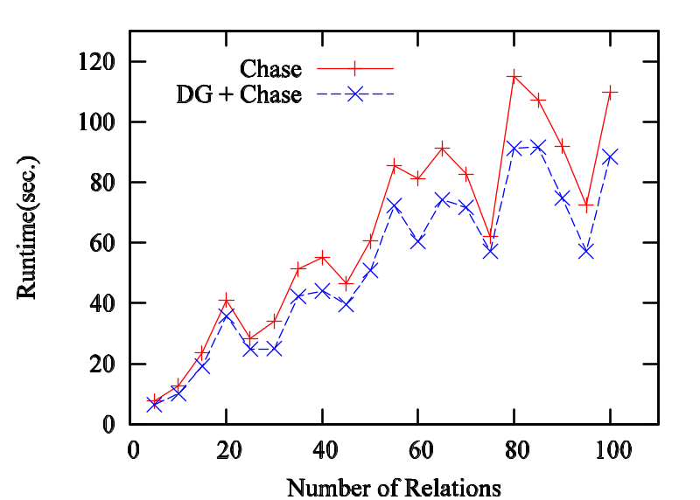
CFDs+CINDs satisfiability checking - experiments
Scalability testing is based on random sets of CFDs and CINDs
Notes:
Color graphs

Slide 28
Summary and future work
New constraints: conditional inclusion dependencies
  for both data cleaning and schema matching
  complexity bounds of satisfiability and implication analyses
  a sound and complete inference system
Complexity bounds for CFDs and CINDs taken together
Heuristic satisfiability checking algorithms for CFDs and CINDs
Open research issues:
  Deriving schema mapping from the constraints
  Repairing dirty data based on CFDs + CINDs
  Discovering CFDs + CINDs
Towards a practical method
for data cleaning and schema matching
Notes:
There is naturally much more to be done. In practice one often needsto find a minimal cover of a given set $\Sigma$ of constraints,namely, a set $\Sigma_{{\it mc}}$ that is equivalent to $\Sigma$ butcontains no redundancy. The computation of $\Sigma_{{\it mc}}$involves implication analysis, which is undecidable for \CINDs and\CFDs. Thus it is practical to develop heuristic algorithms forchecking implication of \CFDs and \CINDs.Another interesting topic is propagation of \CFDs and\CINDs through \SQL views. This is needed when deriving schemamapping from the constraints~\cite{clio05}.We are also investigating SQL-based techniques for detecting \CIND violations inreal-life data along the same line as~\cite{CFD} for data cleaning.Finally, effective use of\CINDs and \CFDs in schema matching and data cleaning requires a fulltreatment.

