Slide 1
Propagating Functional Dependencies with Conditions
Wenfei Fan | University of Edinburgh & Bell Laboratories
Shuai Ma | University of Edinburgh
Yanli Hu | National University of Defense Technology
Jie Liu | Chinese Academy of Sciences
Yinghui Wu | University of Edinburgh

Slide 2
Dependency propagation: The problem
Sources
Target
view
data integration
∑
Given a set ∑ of functional dependencies (FDs) that hold on some of the sources
Questions:
  Do these dependencies hold on the target?
  How to compute the set of the view dependencies?

Slide 3
Dependency propagation: An example
Sources R_{s}: customers in the UK, USA and Netherlands
R_{S}(AC: int, phn: int, name: string, street: string, city: string, zip: string)
Source dependencies:
  An FD on R_{UK}, for UK customers
ƒ₁: R_{UK}(zip→street)
  FDs on R_{UK} and R_{NL}, for UK and Netherlands sources
ƒ₂: R_{UK}(AC →city) ƒ₃: R_{NL}(AC →city)
View definition: V = Q₁ ∪ Q₂ ∪ Q₃,
  Q₁: select AC, phn, name, street, city, zip, ‘44’ as CC from R_{UK}
  Q₂: select AC, phn, name, street, city, zip, ‘01’ as CC from R_{USA}
  Q₃: select AC, phn, name, street, city, zip, ‘31’ as CC from R_{NL}
Question: Does any of these source FDs hold on the view?

Slide 4
Source FDs may NOT hold on the target
View V = Q₁ ∪ Q₂ ∪ Q₃, where
  Q₁: select AC, phn, name, street, city, zip, ‘44’ as CC from R_{UK}
  Q₂: select AC, phn, name, street, city, zip, ‘01’ as CC from R_{USA}
  Q₃: select AC, phn, name, street, city, zip, ‘31’ as CC from R_{NL}
ƒ₁: R_{UK}(zip→street)
ƒ₂: R_{UK}(AC→city)
ƒ₃: R_{NL}(AC→city)
 | AC | phn | name | street | city | zip | CC
t₁: | 20 | 1234567 | Mike | Portland | LDN | W1B 1JL | 44
t₂: | 20 | 3456789 | Rick | Portland | LDN | W1B 1JL | 44
t₃: | 610 | 3456789 | Joe | Copley | Darby | 19082 | 01
t₄: | 610 | 1234567 | Mary | Walnut | Darby | 19082 | 01
t₅: | 20 | 3456789 | Marx | Kruise | Amsterdam | 1096 | 31
t₆: | 36 | 1234567 | Bart | Grote | Almere | 1316 | 31
D_{UK}: {t₁, t₂}, D_{USA}: {t₃, t₄}, D_{NL}: {t₅, t₆}

Slide 5
The FDs indeed hold, but under conditions
Source Dependencies
View Dependencies
ƒ₁: R_{UK}(zip→street)
ƒ₂: R_{UK}(AC→city)
ƒ₃: R_{NL}(AC→city)
ϕ₁: R([CC = ‘44’, zip] → [street])
ϕ₂: R([CC = ‘44’, AC] → [city])
ϕ₃: R([CC = ‘31’, AC] → [city])
 | AC | phn | name | street | city | zip | CC
t₁: | 20 | 1234567 | Mike | Portland | LDN | W1B 1JL | 44
t₂: | 20 | 3456789 | Rick | Portland | LDN | W1B 1JL | 44
t₃: | 610 | 3456789 | Joe | Copley | Darby | 19082 | 01
t₄: | 610 | 1234567 | Mary | Walnut | Darby | 19082 | 01
t₅: | 20 | 3456789 | Marx | Kruise | Amsterdam | 1096 | 31
t₆: | 36 | 1234567 | Bart | Grote | Almere | 1316 | 31
FDs are propagated, but as CFDs rather than FDs!

Slide 6
Dependency Propagation
Dependency propagation: ∑ |＝_{v} ϕ
  Input: a view V, a set ∑ of source dependencies (FDs or CFDs), and a single CFD ϕ on the view
  Question: is ϕ propagated from ∑ via V?
    For any source instance D, if D |= ∑ then the view V(D) |= ϕ
Implication problem: ∑ |＝ ϕ
  For any database D, if D |= ∑ then the same database D |= ϕ
  A special case of dependency propagation problem, when the views are the identity mappings
Source Dependencies ∑ ＝ { ƒ₁, ƒ₂, ƒ₃ }
ƒ₁: R_{UK}(zip→street)
ƒ₂: R_{UK}(AC→city)
ƒ₃: R_{NL}(AC→city)
∑ |＝ ƒ₁, ƒ₂, ƒ₃
∑ |≠_{v} ƒ₁, ƒ₂, ƒ₃

Slide 7
Why bother?
Data exchange: views derived from TGDs from the source to the target, source dependencies, and target dependencies
  Is a target dependency guaranteed to hold (propagated)?
Data integration:
  Constraint checking: do certain constraints hold on the integrated data? How to check it on a virtual view?
  Update management: an insertion of (CC = 44, AC = 20, city = EDI, …) can be rejected without checking the data
  Query optimization: rewriting queries on the view by making use of the derived target dependencies
Data quality: no need to check, e.g., zip→street on target data taken from the UK source
. . .

Slide 8
Conditional functional dependencies (CFDs): review
CFD: R (X → Y, t_{p}), where
X → Y: traditional functional dependency (FD) on R
Pattern tuple t_{p}:
  Attributes: X ∪ Y
  For each A in X (or Y), t_{p}[A] is either a constant or a wild card (unnamed variable) _
Example:
  ϕ₁: R([CC, zip] → [street], (44, _ || _))
  ϕ₃: R([CC, AC] → [city], (31, _ || _))
  ƒ₁: R_{UK}(zip → street, (_ || _)), special case of CFDs
View CFDs of a special form: R (A → B, ( x || x ) ), where
A and B are attributes of R, x is a special variable
To express domain constraints (A = B)

Slide 9
View definitions: A brief overview
A relational Schema ℜ = {S₁, … , S_{n}}
SPC query Q = ∏_{Y}(R_{c} x E_{s}), where
  R_{c} = {(A₁:a₁, … A_{m}: a_{m})}
  E_{s} = σ_{F}(R₁ x … x R_{n})
    F is a conjunction of equality atoms of the form A = B and
    A = ‘a’ for a constant ‘a’ in dom(A)
    R_{j} is ρ(S) for some S in ℜ
SPCU query Q = V₁ ∪ … ∪ V_{n} , where
  V_{i} is an SPC query
Example
  Q₁ = {(CC : 44)} x R_{UK}, Q₂ = {(CC : 01)} x R_{USA}, Q₃ = {(CC : 31)} x R_{NL}
  R = Q₁ ∪ Q₂ ∪ Q₃

Slide 10
Dependency Propagation from FDs to FDs
It is believed that the propagation problem from FDs to FDs is
  in PTIME for SPCU views
  undecidable for views defined in relational algebra
This PTIME result holds only if all attributes have an infinite domain
When we define a schema, we specify domains of attributes
R_{S}(AC: int, phn: int, name: string, street: string, city: string, zip: string)
In practice, it is common to find attributes with a finite domain: Boolean, Date, etc
The general setting: finite-domain attributes may be present
Theorem. The propagation problem from source FDs to view FDs is coNP-complete for SC views in the general setting

Slide 11
Dependency Propagation from FDs to FDs
View Language
SP
SC
PC
SPC
SPCU
RA
Infinite Domain Only
PTIME
PTIME
PTIME
PTIME
PTIME
Undecidable
General Setting
PTIME
coNP-complete
PTIME
coNP-complete
coNP-complete
Undecidable
There is interaction between domain constraints and dependency propagation

Slide 12
Dependency Propagation from FDs to CFDs
The same complexity as its counterpart from FDs to FDs
View Language
SP
SC
PC
SPC
SPCU
RA
Infinite Domain Only
PTIME
PTIME
PTIME
PTIME
PTIME
Undecidable
General Setting
PTIME
coNP-complete
PTIME
coNP-complete
coNP-complete
Undecidable
View CFDs alone do not make our lives harder

Slide 13
Dependency Propagation from CFDs to CFDs
View Language
S
P
C
SPC
SPCU
RA
Infinite Domain Only
PTIME
PTIME
PTIME
PTIME
PTIME
Undecidable
General Setting
coNP-complete
coNP-complete
coNP-complete
coNP-complete
coNP-complete
Undecidable
Source CFDs complicate the propagation analysis

Slide 14
Propagation Cover Problem
Sources
Target
view
data integration
Problem Statement
Input:
  a view V
  a set ∑ of source dependencies (CFDs)
Output: A propagation cover ∑_{c}
  a cover of all view CFDs propagated from ∑ via V
∑
∑_{c}

Slide 15
Finding Propagation Cover: Nontrivial even for FDs
Example
  R(A₁, B₁, C₁, … , A_{n}, B_{n}, C_{n}, D)
  ∑: A_{i} → C_{i}, B_{i} → C_{i} for i ∈ [1, n], C₁, … , C_{n} → D
  V = ∏_{A1, B1, … , An, Bn, D} (R), dropping C_{i} attributes
The propagation cover ∑_{c} contains
  all FDs of the form η₁, … , η_{n} → D, where η_{i} is either A_{i} or B_{i} for i ∈ [1, n]
  at least 2^{n} FDs, where the size of input is O(n)
In contrast
  The implication problem for FDs is in linear time
  The dependency propagation problem is in PTIME for Projection views

Slide 16
Propagation Cover Problem: Harder for CFDs
Already hard for FDs and P views
More intricate for CFDs and SPC views
  Possibly infinitely many CFDs, while at most exponentially many FDs
    ϕ : R(A → B, t_{p}), t_{p}[A] draws values from an infinite dom(A)
  Trivial FDs, but nontrivial CFDs
    e.g., AX → A, ϕ : R(AX → A, t_{p}), t_{p}=(_, d_{X} || a)
  Transitivity involves pattern tuples
    For FDs, A → B, B → C yield A → C
    For CFDs: pattern tableaux have to be matched:
    if (X → Y, tp), (Y → Z, tp’) and tp ≤ tp’, then (X → Z, tp[X] || tp’[Z])
  Interaction between domain constraints and CFDs

Slide 17
Algorithm for Computing Minimal Cover of View CFDs
Input: Source CFDs Σ and SPC view V
Output: A minimal cover of views CFDs propagated from Σ via V
  No redundant CFDs: no proper subset is a cover
  No redundant attributes/patterns: all CFDs are left-reduced
PropCFD_SPC: Key idea
  An extension the Reduction by Resolution (RBR) algorithm
    First proposed by G. Gottlob (PODS 1987)
    Computing propagated cover of FDs over Projection views
    In Polynomial time in many practical cases
  Domain constraints are also represented as CFDs
PropCFD_SPC has the same complexity as RBR
RBR is for FDs and P views
PropCFD_SPC is for CFDs and SPC views

Slide 18
Algorithm PropCFD_SPC
Input
  V = ∏_{Y}(σ_{F}(R₁×R₂×R₃)), where
    Y = {A, B, C, D, H, J}
    F = {A = H, D = G, E = K }
  Σ = {ψ₁, ψ₂}, where
    ψ₁ = R₂(CD→E, (_, c || a))
    ψ₂ = R₃(KGH→J, (_, c, b || _))
Step1: Σ = MinCover(Σ);
Step2: (a) EQ = ComputeEQ(σ_{F}(R₁×R₂×R₃), Σ)
    (b) choose representative rep(eq) for each eq class
R₁ | A | B | R₂ | C | D | E | R₃ | K | G | H | J
A, H
B
C
D, G
E, K
J

Slide 19
Algorithm PropCFD_SPC
Step 3: (a) Substitute each A∈eq with rep(eq) in CFDs
ψ₁ = R₂(CD→E, (_, c || a))
ψ₁’ = CD→E, (_, c || a)
ψ₂ = R₃(KGH→J, (_, c, b || _))
ψ₂’ = EDA →J, (_, c, b || _)
A, H
B
C
D, G
E, K
J
(b) Remove attributes not in Y={A, B, C, D, H, J} from EQ
A, H
B
C
D
J
Step 4: Σ_{c} = RBR(Σ_{v}, EGK)
Σ_{v} = {ψ₁', ψ₂' }
C
D
E
E
D
A
J
Ф₁ = CDA →J, ( _, c, b || _ )
Step 5: Σ_{d} = EQ2CFD(EQ)
Ф₂ = A →H, ( x || x )
Output: MinCover(Σ_{c} ∪ Σ_{d} ) = {Ф₁, Ф₂}

Slide 20
Experimental Study
Investigate the impact of
  The source CFDs and the complexity of SPC views
CFD generator
  Input: ℜ, m, n, LHS, var%
  Output: A set Σ consisting of source CFDs
SPC view generator
  Input: ℜ, |Y|, |F|, |E_{c}|
  Output: An SPC view π_{Y}(σ_{F}(Ec))
Experimental Settings
  # of relations at least 10, each with 10 to 20 attributes
  # of CFDs ∈ [200, 2000], LHS ∈ [3, 9], var% ∈[40%, 50%]
  SPC View: |Y| ∈ [5, 50], |F| ∈ [1, 10], |Ec| ∈ [2, 11]
  1 PC, 3.00GHz Intel (R) Pentium (R) D processor, 1GB of memory
  An average of 5 tests on each dataset

Slide 21
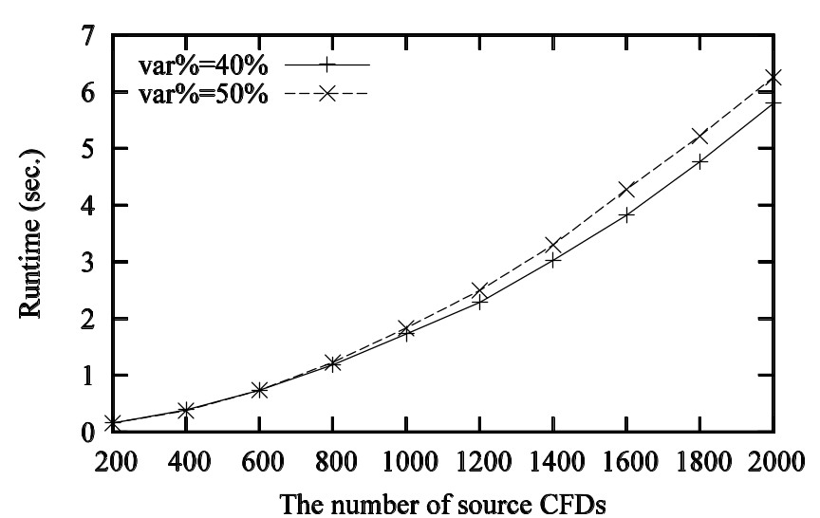
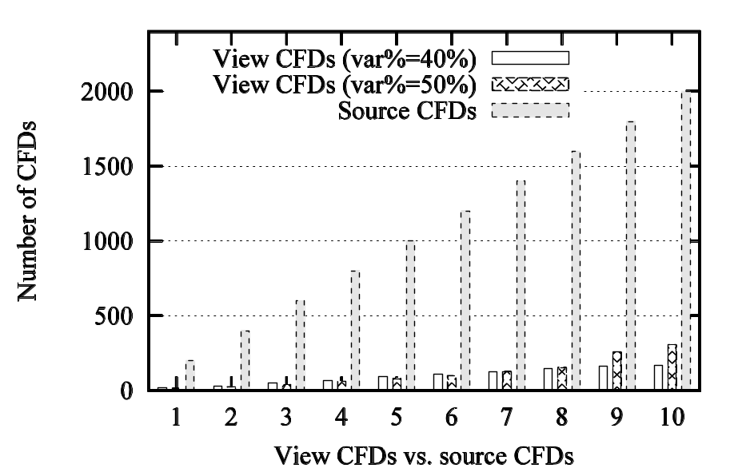
Varying CFDs on the Source (|Y|=25, |F|=10, |E_{c}|=4)
Scales well w.r.t | Σ |
Cardinality of the minimal cover
of propagated CFDs is smaller than | Σ |

Slide 22
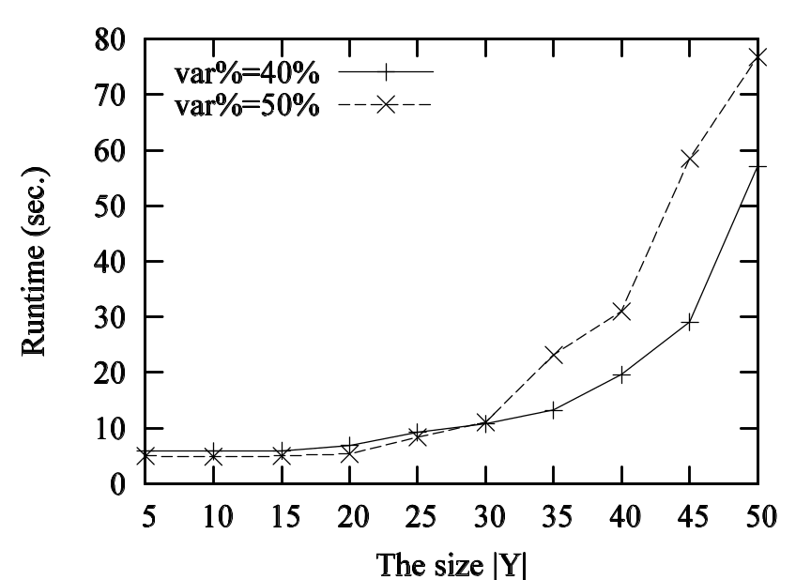
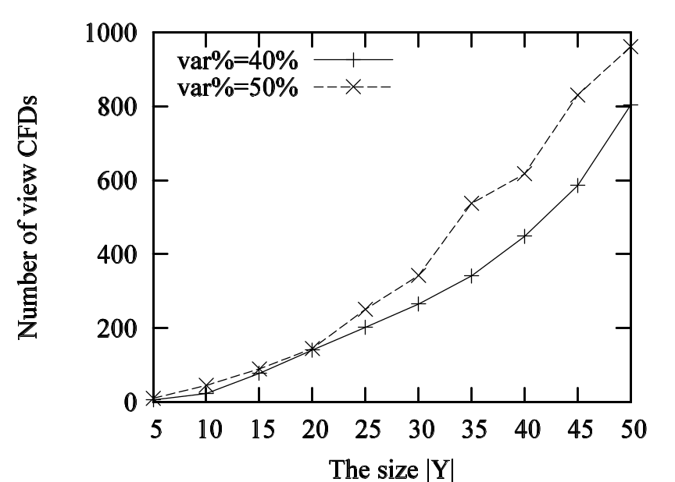
Varying Projection Attributes (|Σ|=2000,|F| =10,|E_{c}|=4)
Runtime sensitive to |Y|
The larger the size |Y|, the more the view CFDs

Slide 23
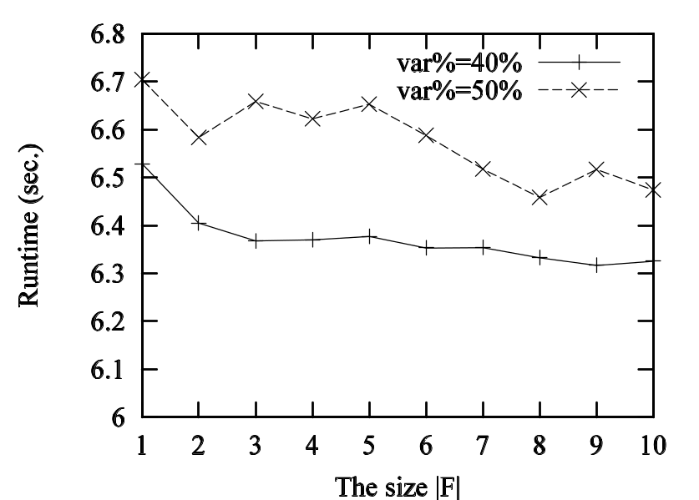
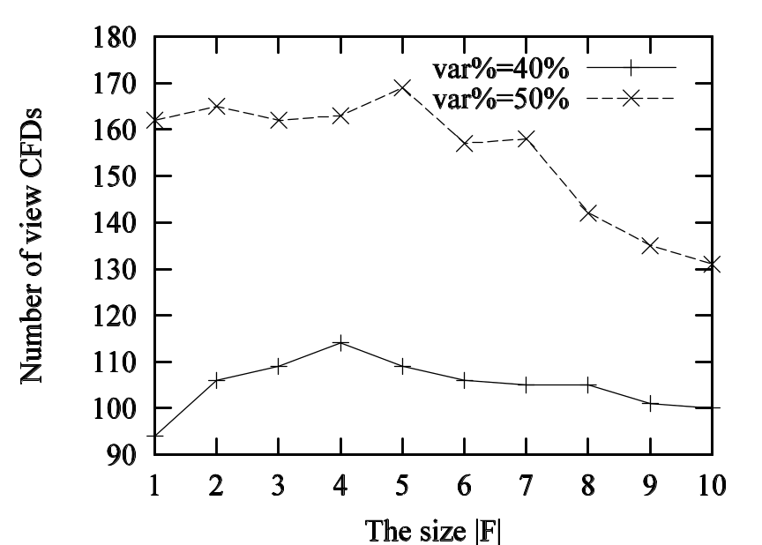
Varying Selection Condition (|Σ|=2000,|Y|=25,|E_{c}|=4)
The larger the size |F|,
the smaller the Runtime
Cardinality of the minimal cover
of propagated CFDs goes up and down

Slide 24
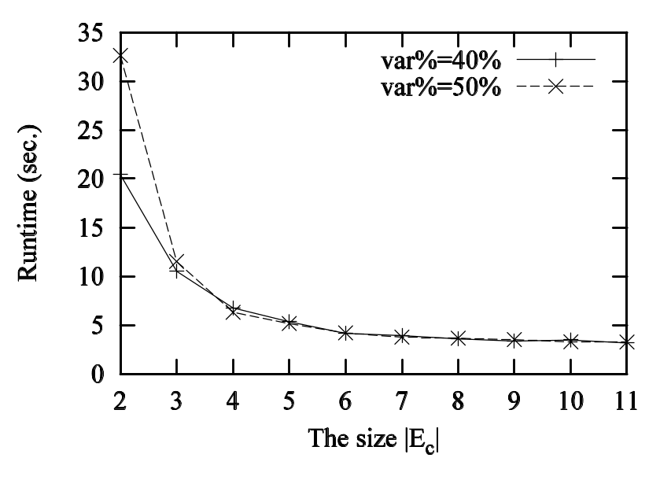
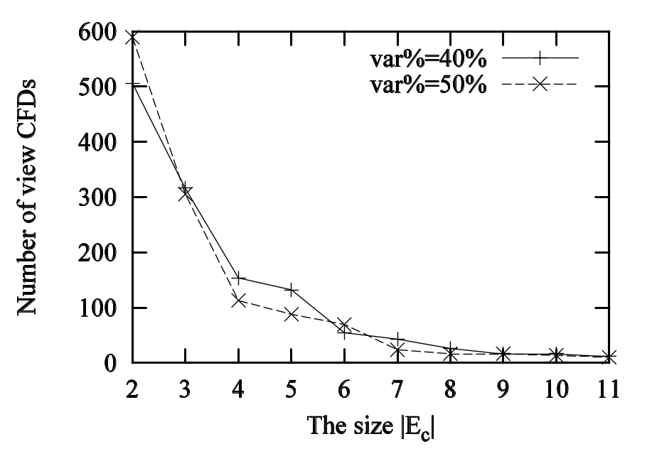
Varying Number of Relations (|Σ|=2000, |F|=10, |Y|=25)
The larger the size |E_{c}|,
the smaller the Runtime
Cardinality of the minimal cover
of propagated CFDs goes down

Slide 25
Summary
A complete picture of complexity bounds on dependency propagation for
  from source FDs/CFDs to view FDs/CFDs
  via views in various fragments of relational algebra
The first complexity results on dependency propagation in the general setting, namely, in presence of finite-domains
A practical algorithm for computing minimal propagation cover for CFDs via SPC views, without incurring extra complexity:
  the same complexity as its counterpart for FDs via P views
Open research issues:
  adding union: for SPCU views
  adding finite-domain attributes
A useful tool for analyzing constraints in data exchange/integration

