Slide 1


Reasoning about Record Matching Rules
Wenfei Fan ^{1, 2} Xibei Jia ¹ Shuai Ma ¹
¹University of Edinburgh ²Bell Labs
Jianzhong Li
Harbin Institute of Technology

Slide 2
Record matching
To identify tuples (from one or more unreliable relations) that refer to the same real-world object.
FN | LN | address | tel | DOB | gender
Mark | Smith | 10 Oak St, EDI, EH8 9LE | 3256777 | 10/27/97 | M
the same person?
FN | LN | post | phn | when | where | amount
M. | Smith | 10 Oak St, EDI, EH8 9LE | null | 1pm/7/7/09 | EDI | $3,500
… | … | … | … | … | … | …
Max | Smith | PO Box 25, EDI | 3256777 | 2pm/7/7/09 | NYC | $6,300
Record linkage, entity resolution, data deduplication, merge/purge, …

Slide 3

Why bother?
Data quality, data integration, payment card fraud detection, …
Records for card holders
FN | LN | address | tel | DOB | gender
Mark | Smith | 10 Oak St, EDI, EH8 9LE | 3256777 | 10/27/97 | M
fraud?
Records for transaction logs
FN | LN | post | phn | when | where | amount
M. | Smith | 10 Oak St, EDI, EH8 9LE | null | 1pm/7/7/09 | EDI | $3,500
… | … | … | … | … | … | …
Max | Smith | PO Box 25, EDI | 3256777 | 2pm/7/7/09 | NYC | $6,300
World-wide losses in 2006: $4.84 billion (www.sas.com)

Slide 4
Nontrivial: A longstanding problem
Real-life data is often dirty: errors in the data sources
Data is often represented differently in different sources
FN | LN | address | tel | DOB | gender
Mark | Smith | 10 Oak St, EDI, EH8 9LE | 3256777 | 10/27/97 | M
FN | LN | post | phn | when | where | amount
M. | Smith | 10 Oak St, EDI, EH8 9LE | null | 1pm/7/7/09 | EDI | $3,500
… | … | … | … | … | … | …
Max | Smith | PO Box 25, EDI | 3256777 | 2pm/7/7/09 | NYC | $6,300
Pairwise comparing attributes via equality only does not work!

Slide 5
Matching rules (Hernndez & Stolfo, 1995)
IF card[LN, address] = trans[LN, post] AND card[FN] and trans[FN] are similar, THEN identify the two tuples
card
FN | LN | address | tel | DOB | gender
Mark | Smith | 10 Oak St, EDI, EH8 9LE | 3256777 | 10/27/97 | M
≈
=
Match
trans
FN | LN | post | phn | when | where | amount
M. | Smith | 10 Oak St, EDI, EH8 9LE | null | 1pm/7/7/09 | EDI | $3,500
… | … | … | … | … | … | …
Max | Smith | PO Box 25, EDI | 3256777 | 2pm/7/7/09 | NYC | $6,300
Accommodate errors in the data sources

Slide 6
A new class of dependencies for record matching
  card[LN, address] = trans[LN, post] ∧ card[FN] ≈ trans[FN] → card[X] ⇔ trans[Y]
  card[tel] = trans[phn] → card[address] ⇔ trans[post]
Identifying attributes (not necessarily entire records), across sources
X
card
FN | LN | Address | tel | DOB | gender
Mark | Smith | 10 Oak St, EDI, EH8 9LE | 3256777 | 10/27/97 | M
Y
trans
FN | LN | post | phn | when | where | amount
M. | Smith | 10 Oak St, EDI, EH8 9LE | null | 1pm/7/7/09 | EDI | $3,500
… | … | … | … | … | … | …
Max | Smith | PO Box 25, EDI | 3256777 | 2pm/7/7/09 | NYC | $6,300
2^{(m*n)} configurations
What attributes to compare? How to compare them?

Slide 7
Deducing new dependencies from given ones
  card[LN,address] = trans[LN,post] ∧ card[FN] ≈ trans[FN] → card[X] ⇔ trans[Y]
  card[tel] = trans[phn] → card[address] ⇔ trans[post]
deduction
  card[LN, tel] = trans[LN, phn] ∧ card[FN] ≈ trans[FN] → card[X] ⇔ trans[Y]
card
FN | LN | address | tel | DOB | gender
Mark | Smith | 10 Oak St, EDI, EH8 9LE | 3256777 | 10/27/97 | M
Radically different
Match
trans
FN | LN | post | phn | when | where | amount
Max | Smith | PO Box 25, EDI | 3256777 | 2pm/7/7/09 | NYC | $6,300
Matched by the deduced rule, but NOT by the given ones!

Slide 8
Error correction, data enrichment, …
  1. card[LN,address] = trans[LN,post] ∧ card[FN] ≈ trans[FN] → card[X] ⇔ trans[Y]
  2. card[LN, tel] = trans[LN, phn] ∧ card[FN] ≈ trans[FN] → card[X] ⇔ trans[Y]
  3. card[tel] = trans[phn] → card[address] ⇔ trans[post]
FN | LN | address | tel | DOB | gender
Mark | Smith | 10 Oak St, EDI, EH8 9LE | 3256777 | 10/27/97 | M
inconsistent
1
FN | LN | post | phn | when | where | amount
M. | Smith | 10 Oak St, EDI, EH8 9LE | null | 1pm/7/7/09 | EDI | $3,500
… | … | … | … | … | … | …
Max | Smith | PO Box 25, EDI | 3256777 | 2pm/7/7/09 | NYC | $6,300
Match
2
enrich
The need for matching dependencies and for reasoning about them

Slide 9
Outline
Matching dependencies (MDs): a departure from traditional dependencies
  Dynamic semantics, similarity operators, across relations
Reasoning about matching dependencies
  A sound and complete inference system
  A low polynomial algorithm
Relative candidate keys (RCKs): matching rules
  Deducing RCKs from MDs: an exponential-time problem
  An effective (heuristic) polynomial-time algorithm
  Applications: record matching, blocking, windowing
Experimental study
A dependency theory for record matching

Slide 10
Matching dependencies (MDs)
(R1[A1] ≈₁ R2[B1] ∧ . . . ∧ R1[Ak] ≈_{k} R2[Bk]) → R1[Z1] ⇔ R2[Z2]
(Aj,Bj): pair of attributes in (R1, R2)
≈_{j} : similarity operator (equality, edit distance, q-gram, jaro distance, …)
(Z1, Z2): lists of attributes in (R1, R2), of the same length
⇔: matching operator (identify two lists of attributes via updates)
  R1[X]: card[X] , R2[Y]: trans[Y]
  card[LN, address] = trans[LN, post] ∧ card[FN] ≈ trans[FN] → card[X] ⇔ trans[Y]
  card[tel] = trans[phn] → card[address] ⇔ trans[post]
  card[LN, tel] = trans[LN, phn] ∧ card[FN] ≈ trans[FN] → card[X] ⇔ trans[Y]
Semantic relationship on attributes across different sources

Slide 11
Dynamic semantics
ϕ = (R1[A1] ≈₁ R2[B1] ∧ . . . ∧ R1[Ak] ≈_{k} R2[Bk]) → R1[Z1] ⇔ R2[Z2]
(D1, D2) satisfies ϕ iff for all (t1, t2) ∈ D1,
if t1[A1] ≈₁ t2[B1] ∧ . . . ∧ t1[Ak] ≈_{k} t2[Bk] in D1
  then (t1, t2) ∈ D2, and t1[Z1] = t2[Z2] in D2
If (t1, t2) match the LHS, then their RHS are updated and equalized
tel | address | …
3256777 | 10 Oak St, EDI
tel | address | …
3256777 | 10 Oak St, EDI, EH8 9LE
phn | post | …
3256777 | PO Box 25, EDI
phn | post | …
3256777 | 10 Oak St, EDI, EH8 9LE
D1
D2
Two instances are needed to cope with the dynamic semantics

Slide 12
An extension of functional dependencies (FDs)?
MD: (R1[A1] ≈₁ R2[B1] ∧ . . . ∧ R1[Ak] ≈_{k} R2[Bk]) → R1[Z1] ⇔ R2[Z2]
developed for schema design for “clean” data
  FD: tel → address
to accommodate unreliable data
similarity operators vs. equality (=) only
across different relations (R1, R2) vs. on a single relation
dynamic semantics (matching operator ⇔) vs. static semantics
tel | address | …
3256777 | 10 Oak St, EDI
3256777 | PO Box 25, EDI
tel | address | …
3256777 | 10 Oak St, EDI, EH8 9LE
3256777 | 10 Oak St, EDI, EH8 9LE
violation
of the FD
D1
D2
satisfying
the MD
A departure from traditional dependency theory

Slide 13
An inference system for deduction of MDs
  Recall Armstrong’s axioms for FDs
There is a finite set of axioms sound and complete for MD deduction
Example: MD ϕ is provable from {ϕ1, ϕ2} by using the inference system
ϕ1: card[tel] = trans[phn] → card[address] ⇔ trans[post]
Augmentation Rule
ϕ’1: card[LN, tel] = trans[LN, phn] → card[LN, address] ⇔ trans[LN, post]
ϕ2: card[LN,address] = trans[LN,post] ∧ card[FN] ≈ trans[FN] → card[X] ⇔ trans[Y]
Transitivity Rule
ϕ: card[LN, tel] = trans[LN, phn] ∧ card[FN] ≈ trans[FN] → card[X] ⇔ trans[Y]
More involved than Armstrong’s axioms (11 axioms vs. 3)
two relations, generic reasoning for similarity operators

Slide 14
An algorithm for deducing MDs from given MDs
Algorithm: MDClosure
Input: a set Σ of MDs and a single ϕ
Output: yes if ϕ can be deduced from Σ, in O(n²) time
Main ideas:
Store deduced MDs in a table M
Process M based on inference rules, until M becomes stable
  If the LHS of an MD is in M, then its RHS is added to M
Return yes if the RHS of ϕ is in M, and no otherwise
The algorithm is well designed to have low complexity - O(n²)
comparable to O(n) time for FDs
The deduction analysis can be conducted efficiently

Slide 15
An algorithm for deducing MDs from given MDs
Example: MD ϕ can be deduced from {ϕ1, ϕ2}
ϕ1: card[tel] = trans[phn] → card[address] ⇔ trans[post]
ϕ2: card[LN,address] = trans[LN,post] ∧ card[FN] ≈ trans[FN] → card[X] ⇔ trans[Y]
ϕ: card[LN, tel] = trans[LN, phn] ∧ card[FN] ≈ trans[FN] → card[X] ⇔ trans[Y]
Step1: M = {card[LN, tel] = trans[LN, phn], card[FN] ≈ trans[FN] }
add the LHS of ϕ
Step2: M = M ∪ {card[address] = trans[post] }
apply ϕ1
Step3: M = M ∪ {card[X] = trans[Y]}
apply ϕ2
Return yes
A match may be found by deduced MDs, but NOT by given ones

Slide 16
Relative Candidate Keys (RCKs)
relative to R1[X] and R2[Y]
Ultimate goal: to decide whether R1[X] and R2[Y] refer to the same object
(R1[A1] ≈₁ R2[B1] ∧ . . . ∧ R1[Ak] ≈_{k} R2[Bk]) → R1[X] ⇔ R2[Y]
(R1[A1, …, Ak], R2[B1, …, Bk] || [≈₁ , . . ., ≈_{k}])
what to compare and how to compare
  R1[X]: card[X] , R2[Y]: trans[Y]
  card[LN,address] = trans[LN,post] ∧ card[FN] ≈ trans[FN] → card[X]⇔trans[Y] ⇒ (card[LN, address, FN], trans[LN, post, FN] || [=, =, ≈])
  card[tel] = trans[phn] → card[address] ⇔ trans[post] NOT an RCK
  card[LN, tel] = trans[LN, phn] ∧ card[FN] ≈ trans[FN] → card[X] ⇔ trans[Y]
  ⇒ (card[LN, tel, FN], trans[LN, phn, FN] || [=, =, ≈])
A departure from candidate keys: similarity, different sources

Slide 17
What is special about RCKs?
Matching rules: identify records from unreliable data sources
Optimization: efficiency is a big issue for record matching
  blocking
only records in the same block are compared
D
B1
discriminating
attributes
B2
B3
  windowing (sorted neighborhood)
window of a fixed size; only records in the same window are compared;
D
D
sliding
window
sorting
via keys
The match quality is highly dependent on the choices of keys

Slide 18
Deducing quality RCKs from MDs
Input: a set Σ of MDs, (R1[X], R2[Y]), and a number k
Output: a set Γ of top k RCKs deduced from Σ
  A quality metric:
nonredundancy
the diversity of attributes
the lengths of attributes
the accuracy of attributes
exponential
time
  Nontrivial:
first compute ALL RCKs, and then pick the top-k
The deduction analysis can be conducted efficiently

Slide 19
A heuristic algorithm for deducing quality RCKs
Algorithm: findRCKs
Input: a set Σ of MDs, (R1[X], R2[Y]), and a number k
Output: a set Γ of top k RCKs deduced from Σ, in O(k*n³) time
Main ideas
A notion of completeness
  if RCKs deduced from Σ are already “covered” by smaller RCKs in Γ
Deduction
  (R1[X], R2[Y] || [=, …, =]) itself is an RCK
Make use of algorithm MDClosure to deduce RCKs
n: the size of Σ (meta-data)
A new RCK
(R1[V1, Z1], R2[V2, Z2] || [≈,…, ≈] )
(R1[U1] ≈ R2[U2] → R1[Z1] ⇔ R2[Z2])
(R1[V1,U1], R2[V2, U2] || [≈,…, ≈] )
One can efficiently deduce keys for matching, blocking, windowing

Slide 20
A heuristic algorithm for deducing quality RCKs
Example: Given a set {ϕ1, ϕ2} of MDs, (card[X], trans[Y]) , deduce RCKs {rck1, rck2, rck3}.
ϕ1: card[LN,address] = trans[LN,post] ∧ card[FN] ≈ trans[FN] → card[X] ⇔ trans[Y]
ϕ2: card[tel] = trans[phn] → card[address] ⇔ trans[post]
Step1: rck1 = (card[X], trans[Y] || [=, …, =])
Step2: rk2 = (card[LN, address, FN], trans[LN, post, FN] || [=, =, ≈])
Step3: rck2 = miniminze(rk2)
Apply ϕ1 to rck1
Step4: rk3 = (card[LN, tel, FN], trans[LN, phn, FN] || [=, =, ≈])
Step5: rck3 = miniminze(rk3)
Apply ϕ2 to rck2
Return {rck1, rck2, rck3}.
Minimize: remove redundant attribute pairs in an RCK

Slide 21
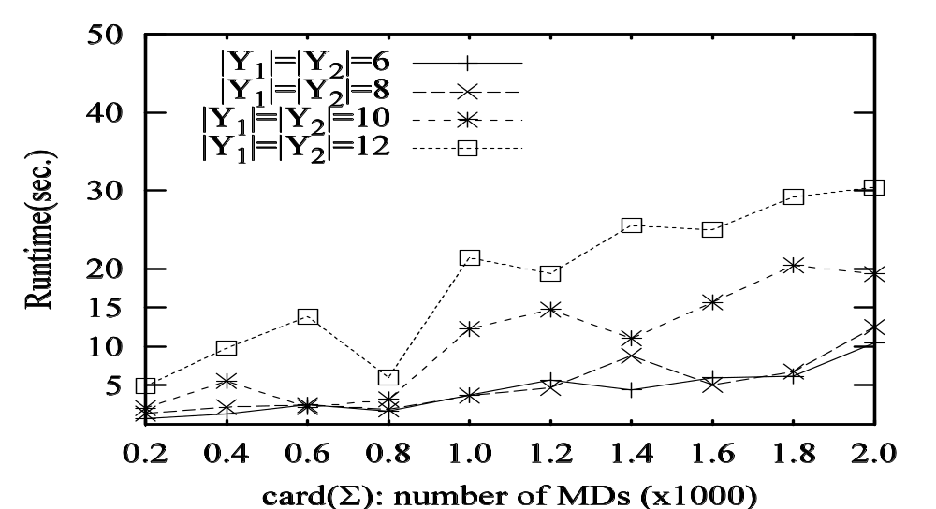
Experimental study: The reasoning algorithms
also scales well with k – the number of RCKs
scales well with the number of MDs
The algorithm scales well (100 seconds for 2k MDs & 50 RCKs)

Slide 22
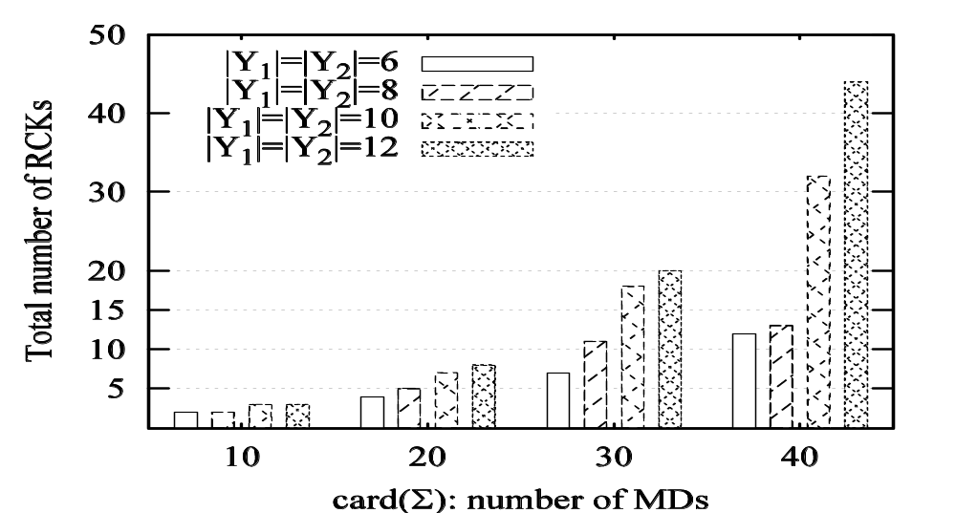
The number of RCKs derived
Quality: reasonably diverse
Sufficient quality RCKs can be deduced from a small number of MDs

Slide 23
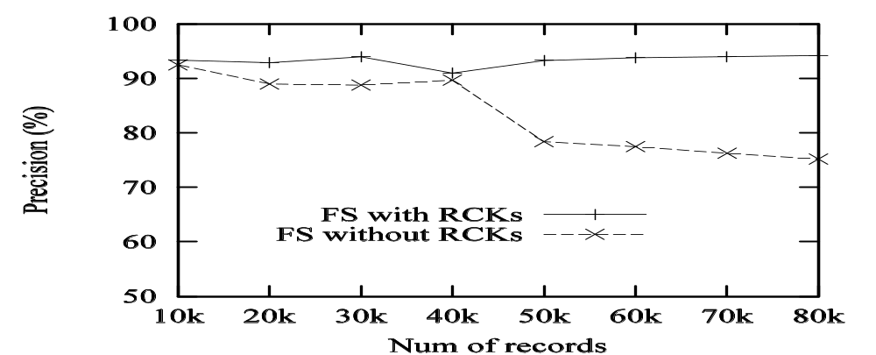
Experimental study: Match quality (FS)
Fellegi-Sunter method – a statistical method in action
Credit payment data scraped from the Web (relations of arity 21 and 13, with (X, Y) of length 11)
7 MDs, using Damerau-Levenshtein distance, soundex for similarity
Precision (to all matches found), recall (to all true matches)
improving the precision without lowering the recall
RCKs indeed improve the match quality (up to 20%)

Slide 24
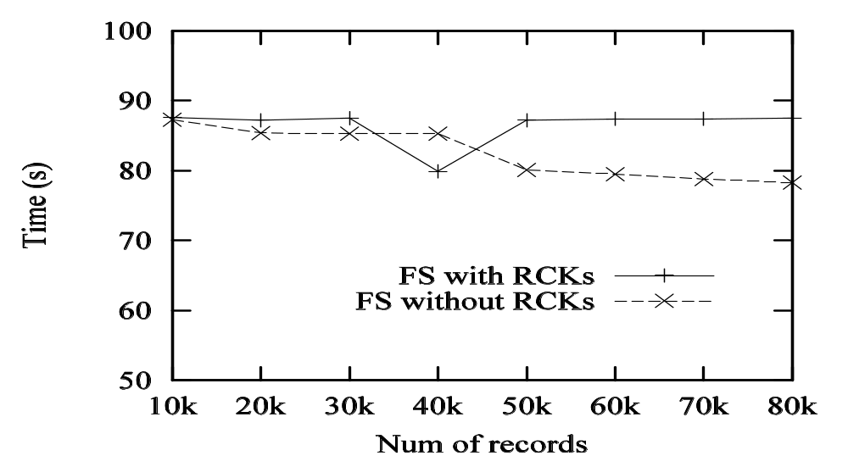
Experimental study: Efficiency (FS)
comparable performance
RCKs do not incur extra cost while improving match quality

Slide 25
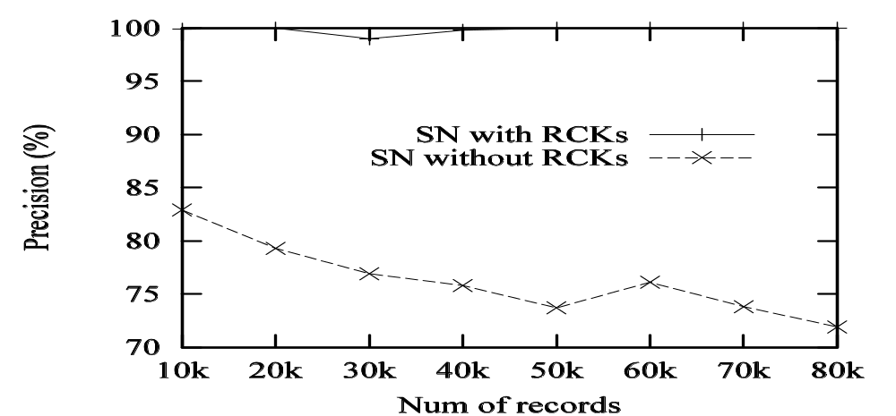
Experimental study: Precision (SN)
Sorted neighborhood method – a rule-based method
insensitive to data size
RCKs consistently improve the precision (by 20%)

Slide 26
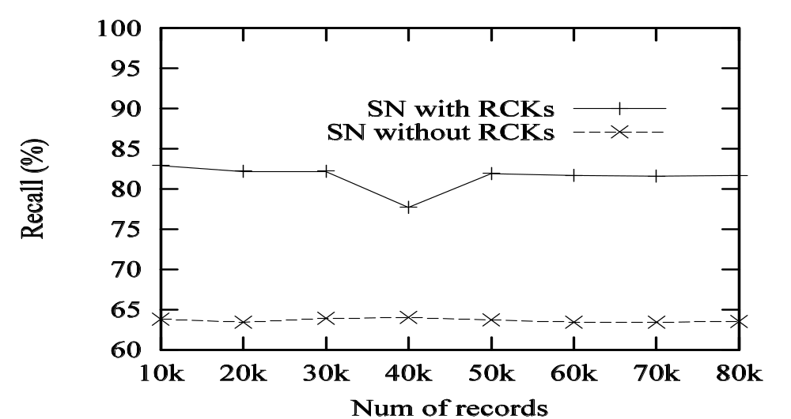
Experimental study: Recall (SN)
RCKs consistently improve the recall (by 20%)

Slide 27
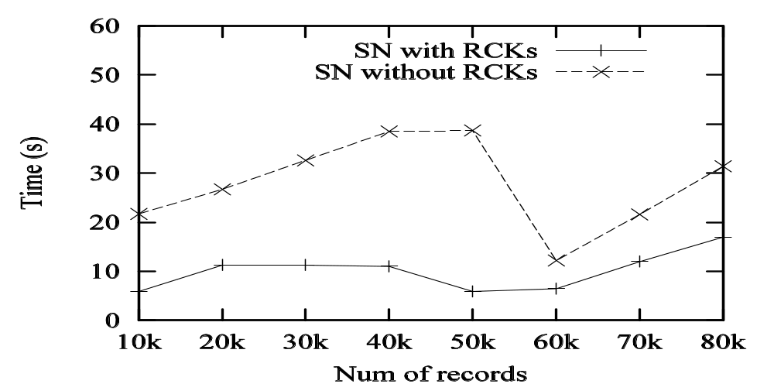
Experimental study: Efficiency (SN)
by 30%
RCKs reduce the number of comparisons and improve efficiency

Slide 28
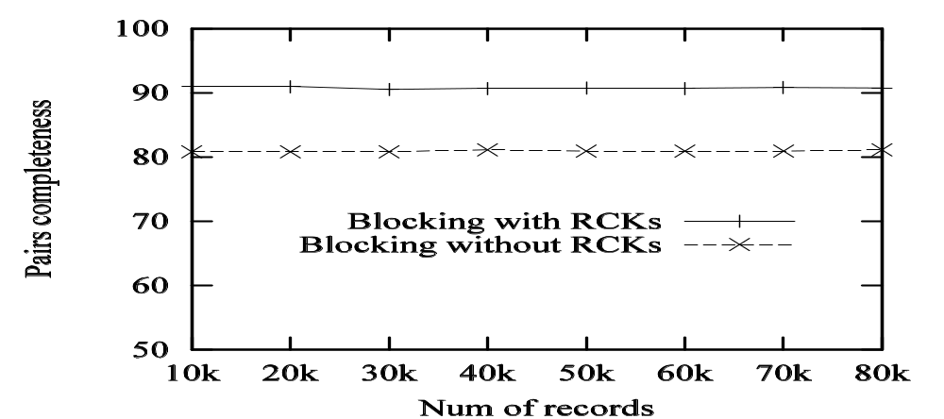
Experimental study: Blocking
Partial RCKs as keys for blocking
Pair completeness: S/N, numbers of matches with and without blocking
similar results for windowing
RCKs make effective blocking (windowing) keys

Slide 29
Summary
A dependency theory for matching unreliable records
  Matching dependencies, relative candidate keys: dynamic semantics, similarity operators, across unreliable data sources
  A sound and complete inference system
  An O(n²)-time algorithm for the deduction analysis
  An efficient (heuristic) algorithm for deducing quality RCKs
Record matching, optimization (blocking, windowing)
Future work
  Negative rules: if condition then NO match
  Conditions with constants
  Interaction of record matching and data repairing: being treated as separated processes
A practical tool for deducing matching rules

