Slide 1

Social Connect

Slide 2
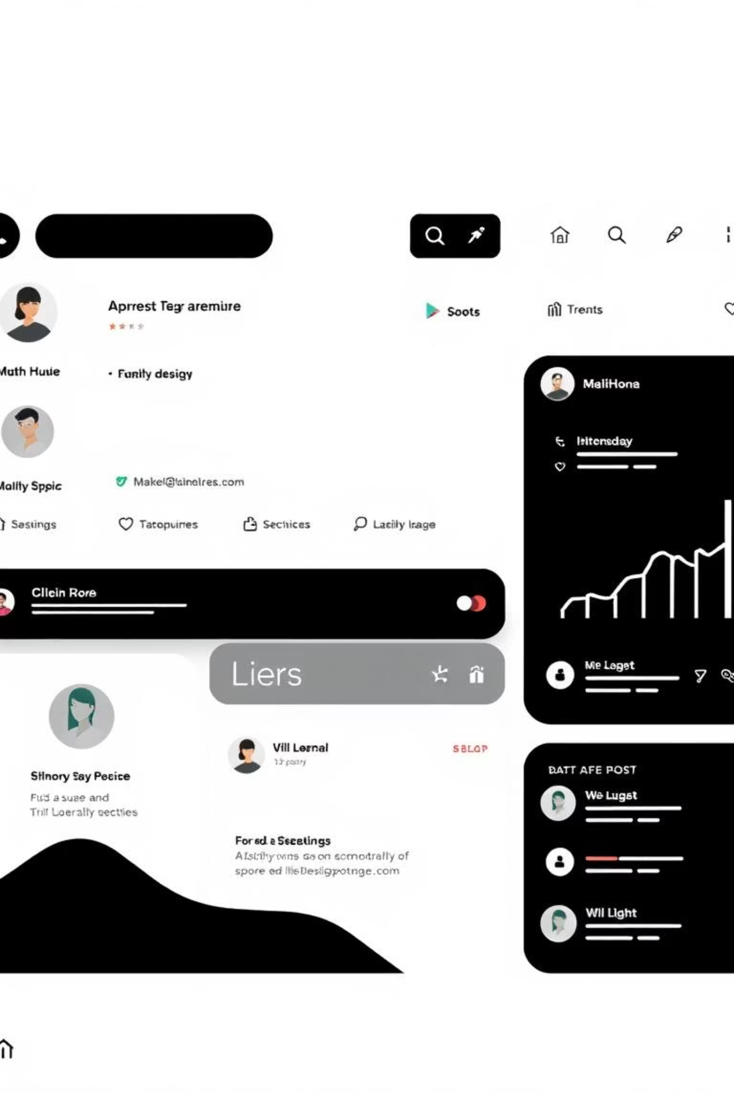
Project Overview
Social Connect is a secure, Java-based platform designed for connecting users, sharing content, and fostering online interaction. It includes role-based access, data persistence, and moderation features, mirroring modern social media platforms.

Slide 3


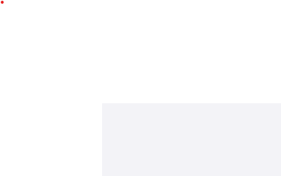
User Roles in Social Connect
Regular User
Admin User
Register & log in
Platform moderation & safety
Create & manage posts
View all users & posts
Interact with content (like, comment)
Approve verification requests
Follow other users
Review reported comments
Manage account privacy
Ban & unban users
Report content
Enforce platform rules

Slide 4




Follow & Unfollow System
The follow system allows users to build social connections.
How Follow Works
Each user maintains:
A user can follow another user
Followers list
Following list
Follow relationships are saved persistently
Unfollow
Users can unfollow at any time
Both followers and following lists are updated accordingly

Slide 5
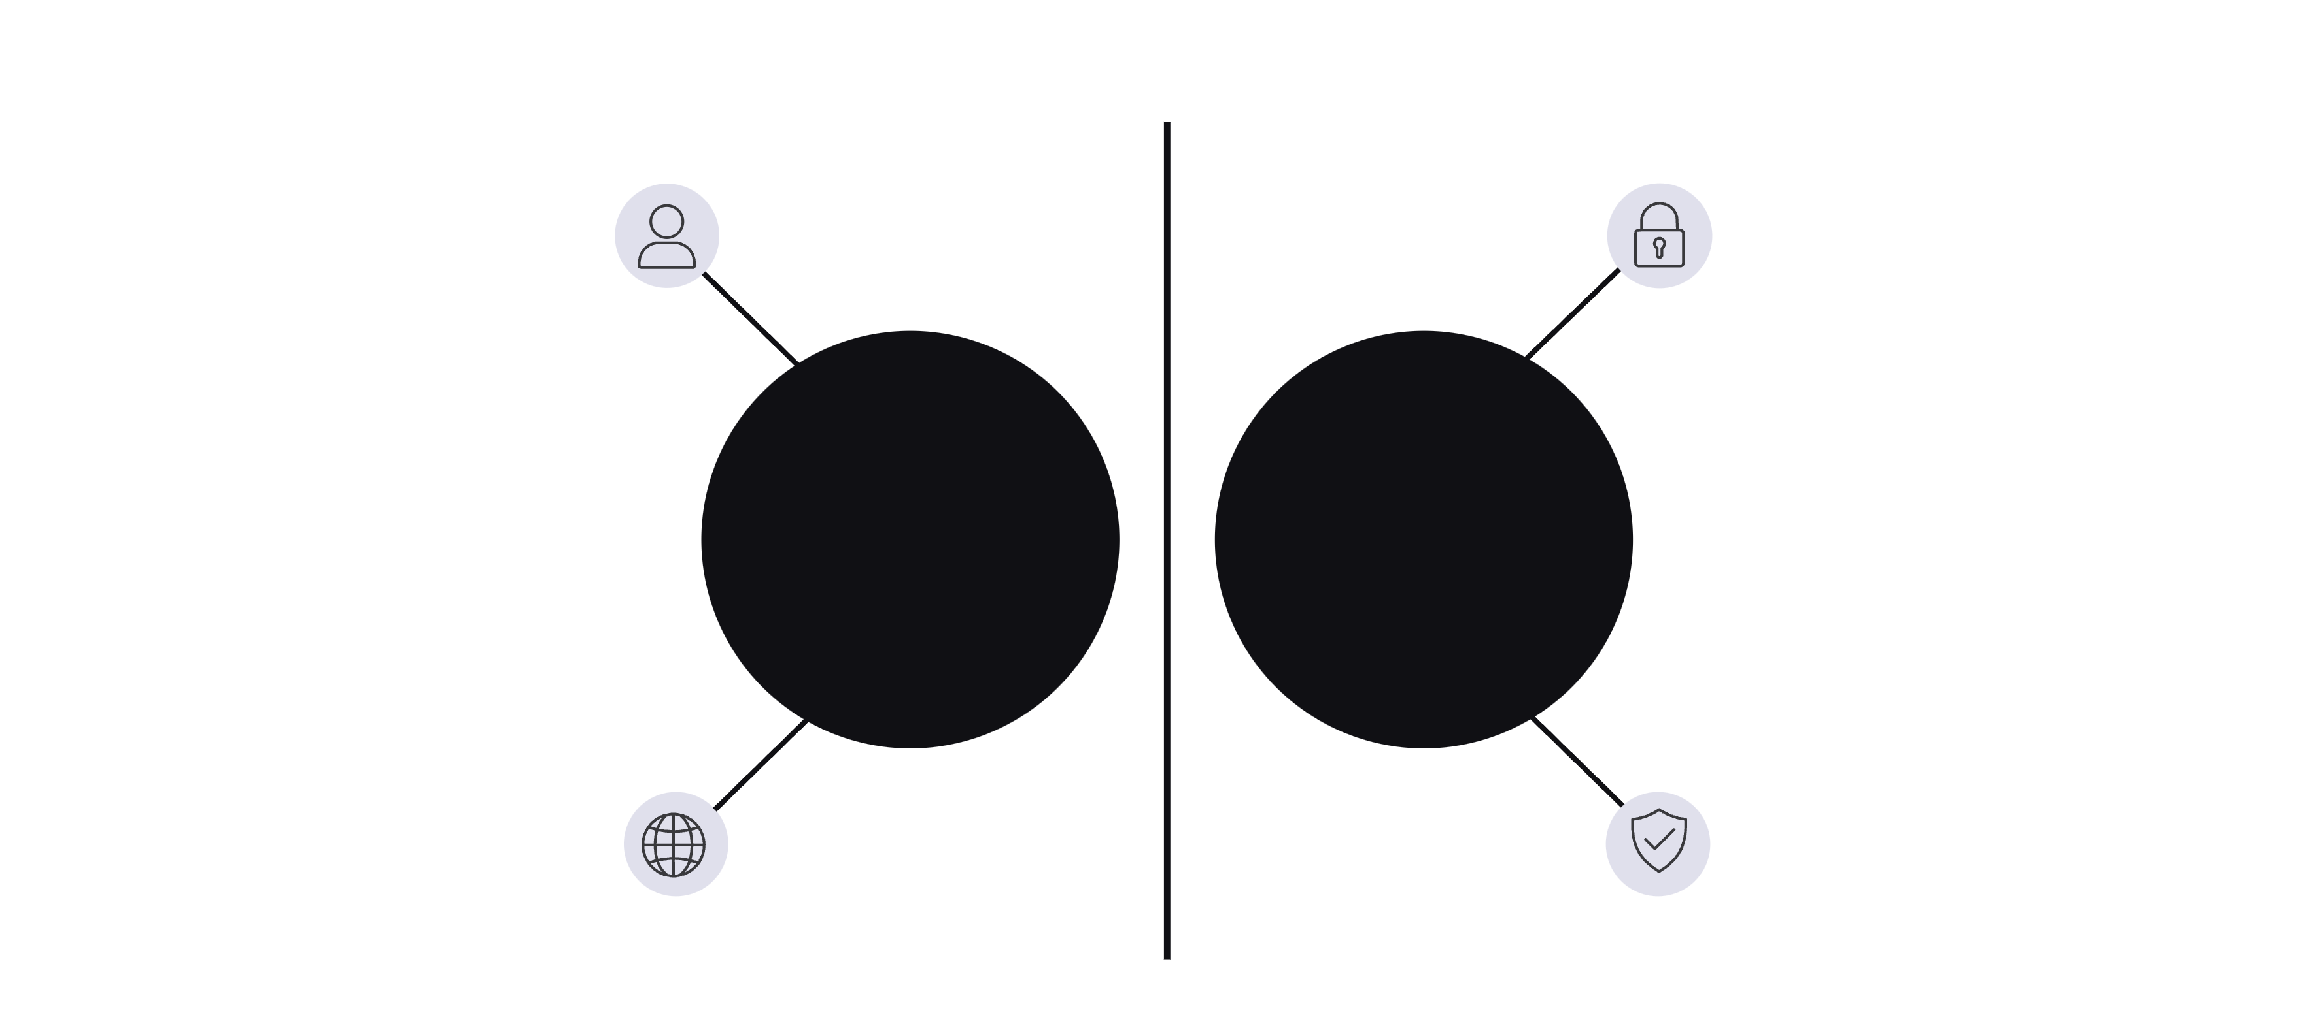




Public and Private Account Functionality
Anyone can follow instantly
Follow requests require approval
Public Account
Private Account
Posts visible to all users
Only approved followers can view and interact
Benefits
Improves user privacy
Mimics real-world social media behavior
Adds realistic access control logic

Slide 6
Post Management System
Posts are the core interaction feature, forming the basis of user engagement.
Post Structure
All posts inherit from an abstract Post class, ensuring consistency across different types.
Common Attributes:
Post ID
Author details
Timestamp
Likes list
Comments list
TextPost
ImagePost
Contains textual content
Contains an image and optional caption
Ideal for status updates and brief messages
Showcases multimedia support and visual storytelling
Post Visibility Rules
Public Account: Posts are visible to everyone.
Private Account: Posts are visible only to approved followers.

Slide 8
Likes System
User Interaction
Uniqueness
Users can like or unlike posts.
Each user can like a post only once.
Tracking
Real-time Updates
Likes are tracked using user IDs.
Like count updates dynamically.

Slide 9
Comment System
Comments enable discussions under posts, enriching user engagement.
Unique Identification
Post Association
Data Integrity
Each comment has a unique ID.
Comments are linked to a specific post.
Comments are stored securely and persistently.

Slide 10
Comment Reporting System
To prevent misuse and maintain a positive community environment, users can report inappropriate comments.
Report Details
Admin Action
Comment ID
Admin reviews reported comments and takes appropriate action.
Reporter ID

Slide 11
Verification System
Verification builds trust.
Workflow
01
02
03
User requests verification
Request is saved
Admin reviews request
04
05
Admin approves or rejects
Verified badge is assigned

Slide 12
Data Persistence & Security
Role of DataPersistence.java
System Workflow Application Start
Saves and loads all system data
Encrypted data is loaded
Encrypts files using AES-128
User states, followers, and privacy settings restored
Automatically migrates old data formats
During Usage
Protects sensitive user information
All changes update in-memory data
Stored Data Includes
Periodic secure saving
Users
Application Close
Posts
Final encrypted save
Followers & following data
Privacy settings
Reports
Verification requests
Ban status
ID counters
Scope of the Project
Current Scope
Secure authentication
Role-based access
Follow/unfollow system
Public & private accounts
Post creation and interaction
Verification system
Admin moderation (ban/unban)
Encrypted persistence

Slide 13
Conclusion
Social Connect is a realistic and secure social networking application. It incorporates modern social media features such as privacy control, following system, and admin moderation, making it both educational and practically valuable.

