Slide 1
EE450: High Voltage Engineering
Lecture 17-19

Slide 2
Outline
Generation of High Impulse Voltages
Impulse Voltages
Impulse Voltage Generator
Multistage Impulse Generator Circuit
Triggering of Impulse Generators
Switching Impulse Voltages
Generation of Switching Impulse Voltages

Slide 3
Impulse Voltages
Impulse voltages are required in high voltage tests to simulate the stresses due to:
Lightning strikes
Switching operations
Impulse voltage is a unidirectional voltage which rises quickly without appreciable oscillations, to a peak value and then falls less rapidly to zero.
An impulse voltage is specified by three parameters:
Peak value
Wavefront time
Wavetail time
For example, 1000 kV, 1/50 μs impulse waveform has a peak value of 1000 kV that is attained in 1 μs and 500 kV on the wave-tail is reached after 50 μs.

Slide 4
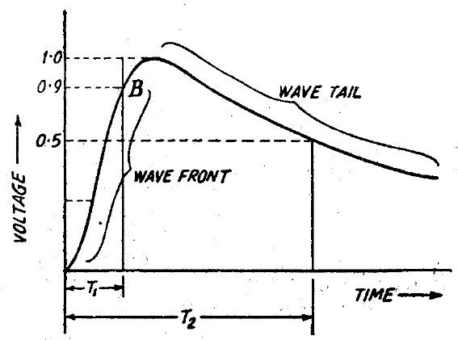
Impulse Voltages

Slide 5

Impulse Voltages
Mathematically, the impulse voltage waveform is expressed as,
where α₁ and α₂ are constants that depend on the specifications of the wave.
Although the actual shape of both kinds of overvoltages varies strongly, it became necessary to standardize them for the testing and simulation purposes.
For lightning impulse voltage, the standard waveshapes are,
- BS: 1/50 μs
- AS: 1.5/40 μs
- IS: 1.2/50 μs

Slide 6
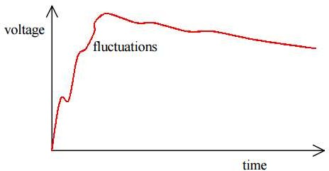
Impulse Voltages
It is difficult to obtain a smooth slope within the first voltage rise as the capacitance of measuring system along with the stray capacitances and inductances may cause oscillations.

Slide 7
Impulse Voltages
The ‘virtual origin’ O₁ is deﬁned as point where the line AB cuts the time axis.
The ‘front time’ T₁, a virtual parameter, is deﬁned as 1.67 times the interval T between the instants when the impulse is 30% and 90% of the peak value for the lightning impulses.
– T₁ (or T_{f}) = 1.25 (t_{90%} – t_{10%}) ± 30%
– T₁ (or T_{f}) = 1.67 (t_{90%} – t_{30%}) ± 30%
– T₂ (or T_{t}) = T₂ ± 20%

Slide 8
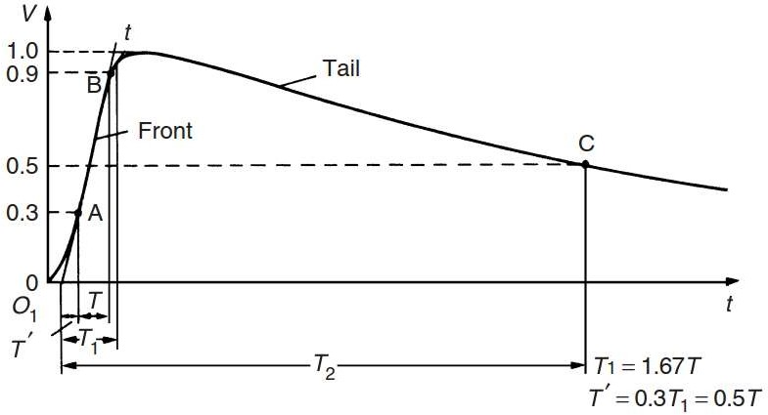
Impulse Voltages
0.1
A

Slide 9

Impulse Voltages
Impulse voltages are of two types,
Full-impulse wave
Chopped wave
Full impulse wave: develops its complete waveshape without flashover or puncture
Chopped wave: wave is one in which flash-over occurs causing the voltage to fall extremely rapidly. The rapid fall may have a very severe effect on power system equipment.

Slide 10
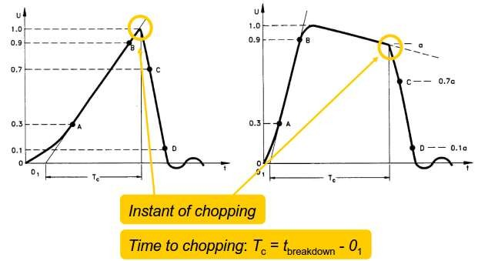
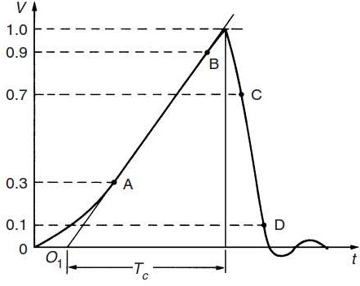
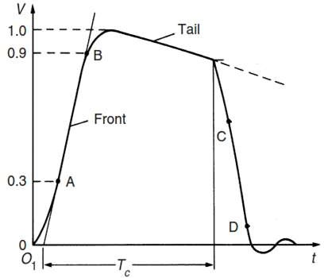
Impulse Voltages

Slide 11
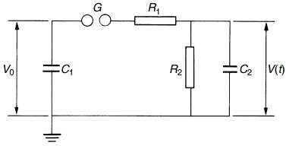
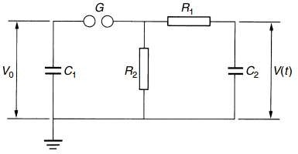
Impulse Voltage Generator
The basic circuit is applicable to both LI and SI.
Impulse voltages are generated by discharging high voltage capacitors through switching gaps into a network of resistors and capacitors.
Circuit a
Circuit b

Slide 12
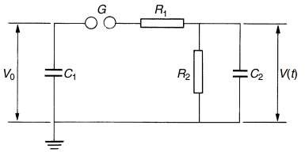
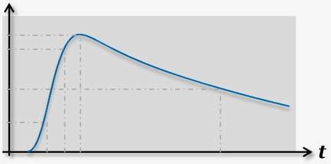
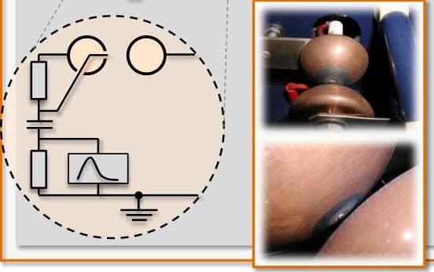
Impulse Voltage Generator
C₁ = Stage capacitance
R₁ = Wavefront control resistance R₂ = Wavetail control resistance C₂ = Load capacitance
For practical impulse generators, R₂ >> R₁
C₁ >> C₂

Slide 13
Impulse Voltage Generator
Capacitor C₁ is charged and the switch is closed.
Switch is typically a triggered sphere gap
The charge in C₁ is distributed quickly between load capacitance C₂ so that the voltage over both becomes equal
During this distribution phase some energy is transformed into heat mainly by damping resistance R₁ (determines impulse voltage front T₁)
Once C₂ is charged, voltage has reached its maximum value (impulse voltage peak U_{p})
Next, the discharge phase starts. Remaining energy is transformed into heat mainly in discharge resistance
R₂ (determines impulse voltage tail T₂).

Slide 14
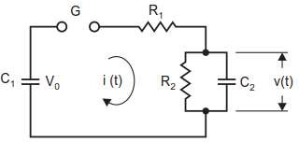
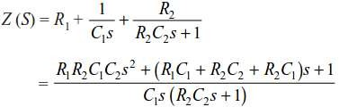
Impulse Voltage Generator
Circuit a
After the gap sparks over, let the current in the generator circuit be i (t) at any time t. Using Laplace transform, the impedance of the circuit is:

Slide 15
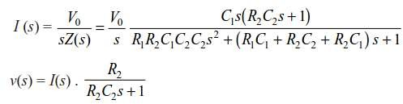
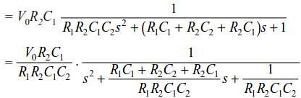
Impulse Voltage Generator

Slide 16
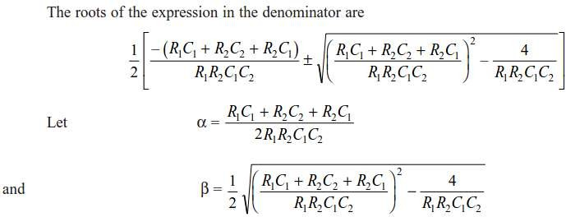

Impulse Voltage Generator

Slide 17
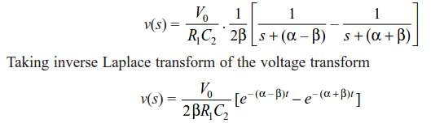
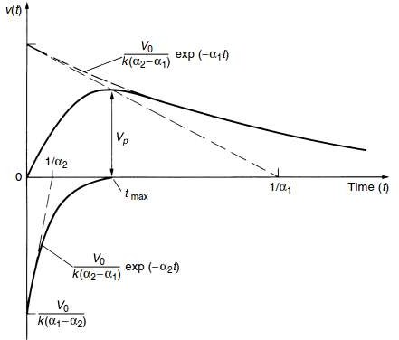
Impulse Voltage Generator

Slide 18
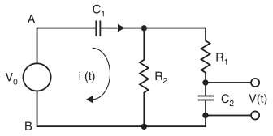
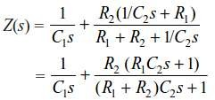
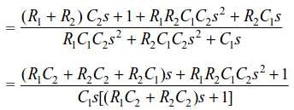
Impulse Voltage Generator
Circuit b

Slide 19
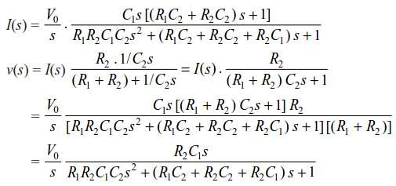
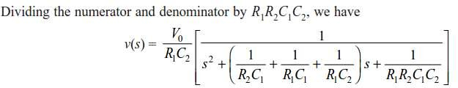
Impulse Voltage Generator

Slide 20
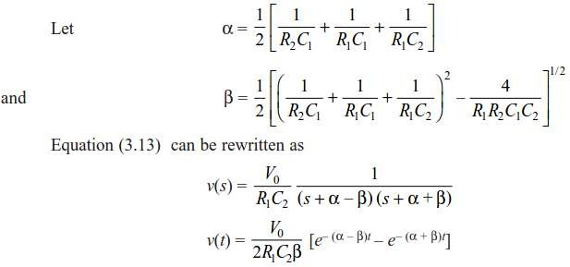
Impulse Voltage Generator

Slide 21
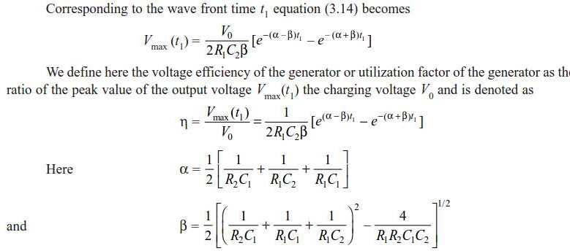
Impulse Voltage Generator

Slide 22
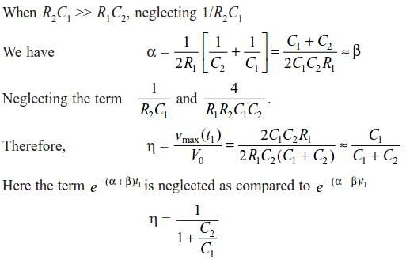
Impulse Voltage Generator
Page 22

Slide 23
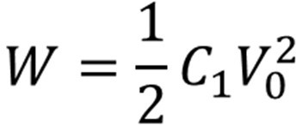
Impulse Voltage Generator
Therefore, higher the generator capacitance, the higher is the efficiency of the generator.
The most significant parameter of an impulse generator is the energy stored within the discharge capacitance that is,
The energy stored within the discharge capacitance determines the cost of generator and is one of the ratings of an impulse generator.

Slide 24
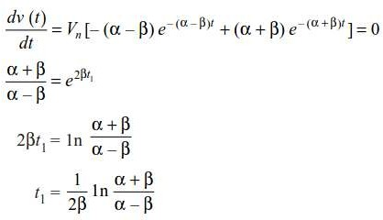
Impulse Voltage Generator
Let t₁ be the wave front time and t₂ the wave tail time, then both α and β must have unique values irrespective of the particular circuit used.
At time t = t₁, the slope of the wave is zero, therefore, t₁ can be obtained from the relation dv(t)/dt = 0:

Slide 25




Impulse Voltage Generator
The peak value of the voltage is then given by,
To obtain t₂, substitute t = t₂ in above equation and the voltage is half of what it is when t = t₁ in the same equation i.e.
Let t₂ = Kt₁, where K is a constant,

Slide 26
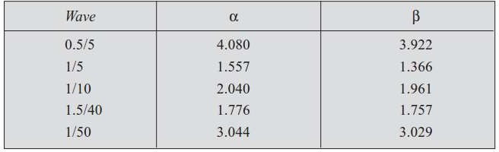
Impulse Voltage Generator

Slide 27
Multistage Impulse Generator Circuit
Single-stage impulse generator is impractical for the generation of voltages above 100 kV due to following limitations:
High DC voltage source is required to charge the stage capacitance C₁.
Practical difficulties encountered in switching of very high voltages with a spark gap.
Physical size of components become bulky and expensive.
Occurence of corona discharges from leads
For higher voltages basic circuits are constructed on top of each other to create n stage generators suggested by Erwin Marx (1923), popularly known as Marx Generator.

Slide 28
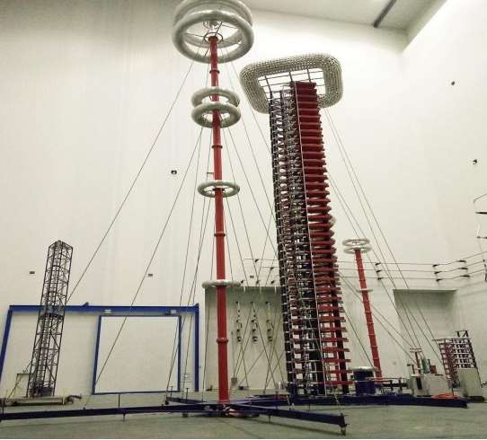
7200 kV, 720 kJ, 36 stage Marx’s Generator

Slide 29
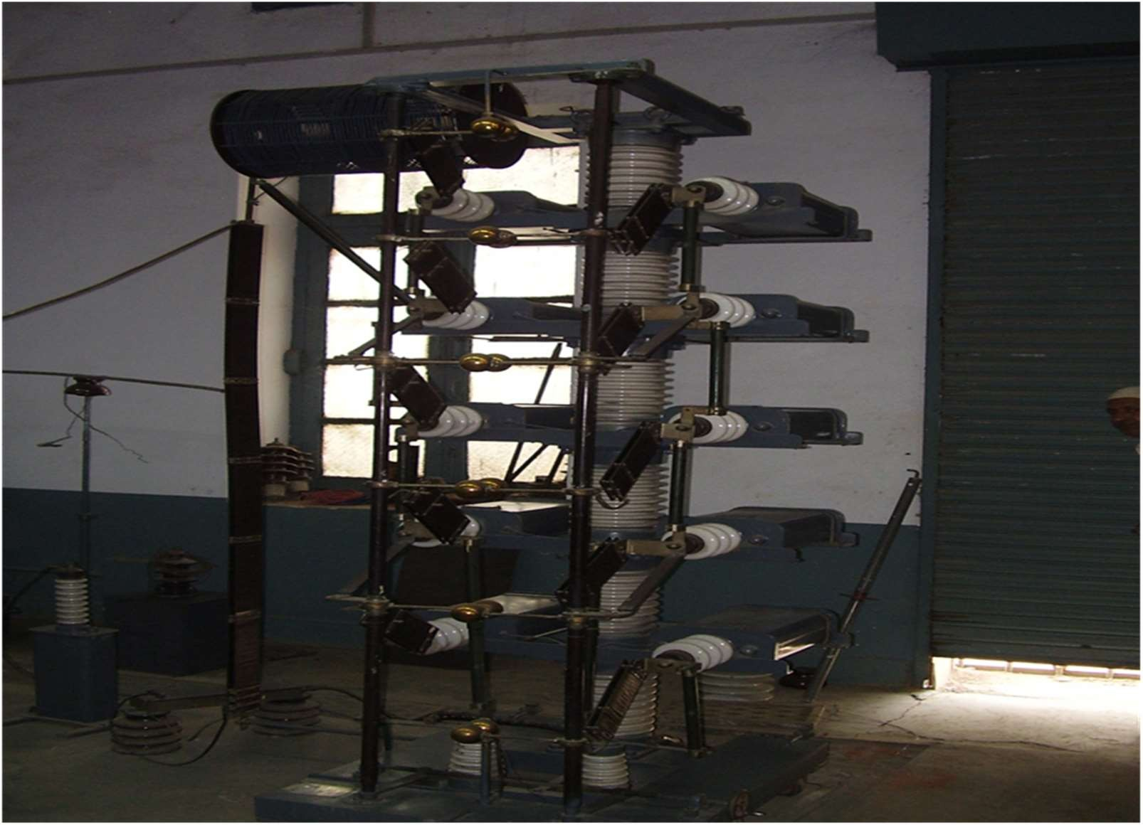
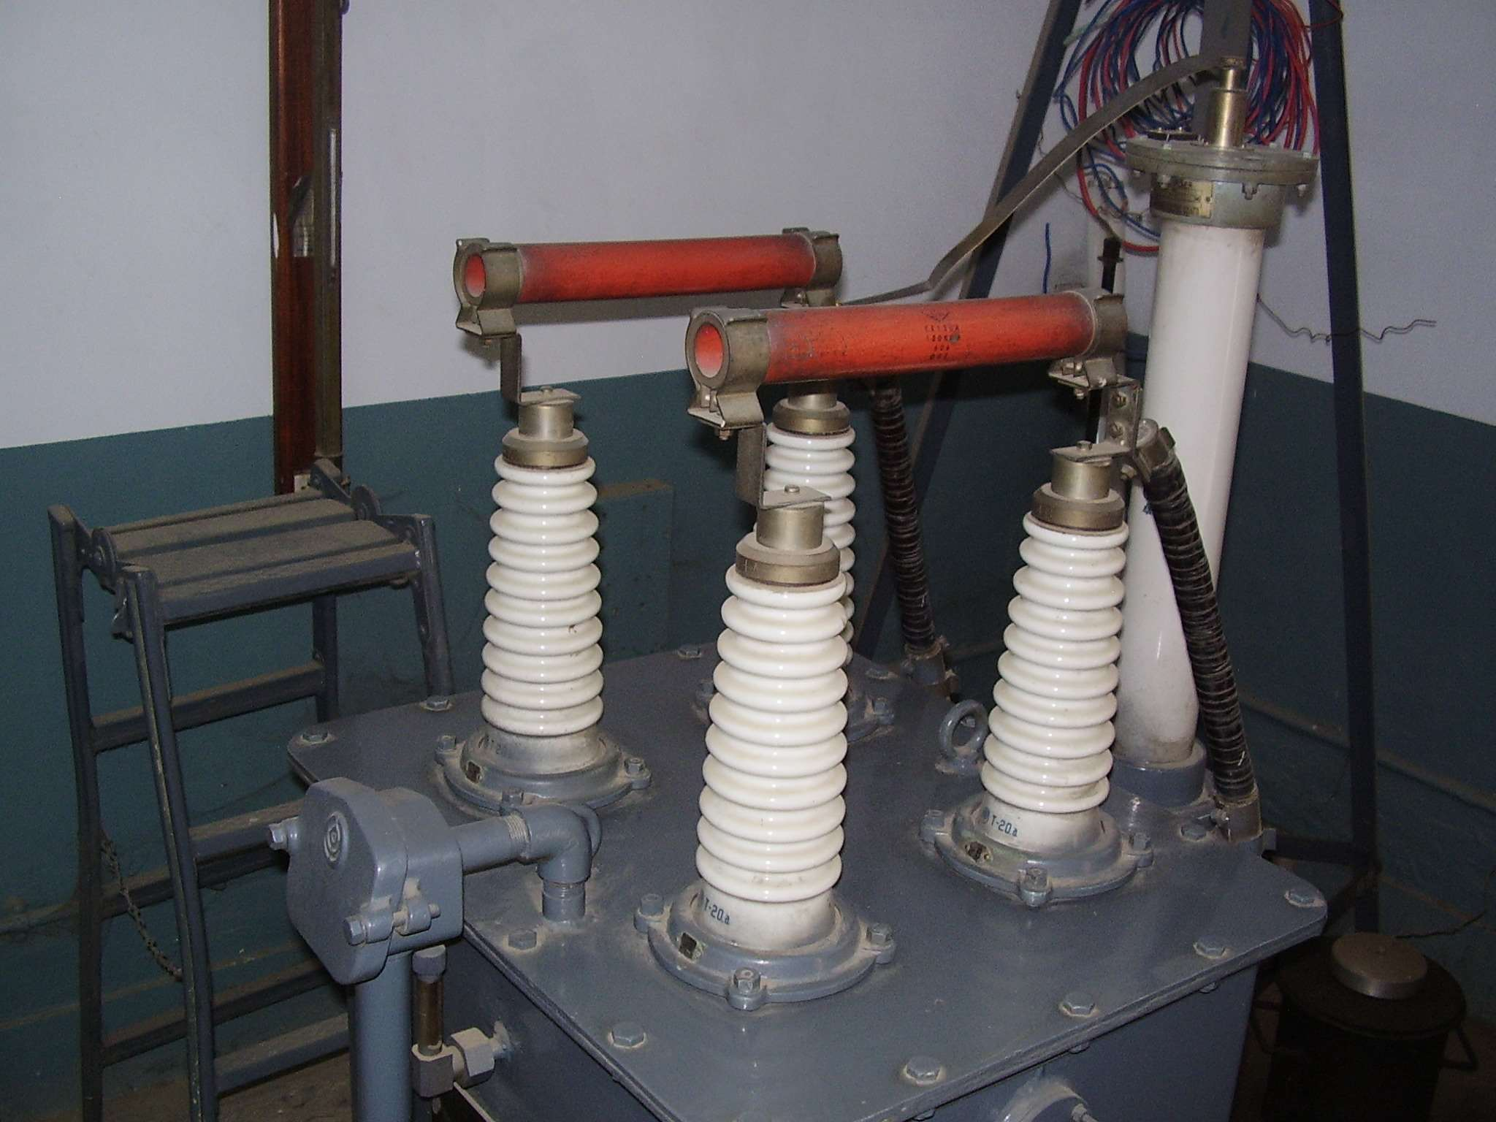
Multistage Impulse Generator Circuit
UET’s 500 kV,
Marx’s Generator
Page 29

Slide 30
Multistage Impulse Generator Circuit
Working Principle
Capacitors are charged in parallel to the desired voltage.
Next, the first spark gap is triggered. This causes rapid change in the potential across the spark gaps of higher stages.
Consequently, the breakdown of the subsequent gaps takes place causing the stage capacitancors to be connected in series
Output voltage is the product of charging voltage and the number of stages
i.e. U₀ = n∙ U_{c.}
Page 30

Slide 31
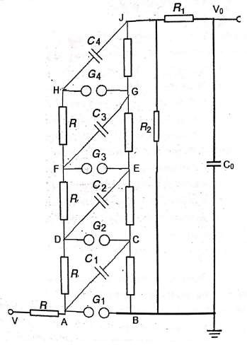

Slide 32
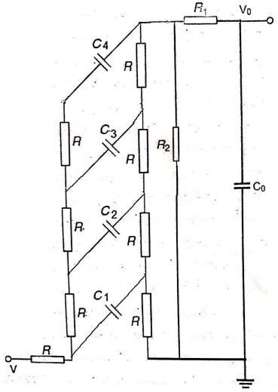
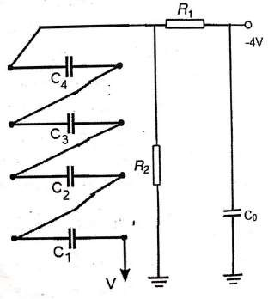
Charging of stage capacitances
Discharging of stage capacitances

Slide 33
Multistage Impulse Generator Circuit
In multi-stage impulse generator circuit, the wavefront control resistor R₁ is placed between the generator and the load.
Such a single ‘external’ front resistor, however, has to withstand for a short time the full rated voltage and therefore is inconveniently long or may occupy much space.
This disadvantage can be avoided if either a part of this resistance is distributed or if it is completely distributed within the generator.
The circuit can be modified, in which in addition the series connection of the capacitors C₁’ and gaps (as proposed originally by Goodlet) is changed to an equivalent arrangement.

Slide 34
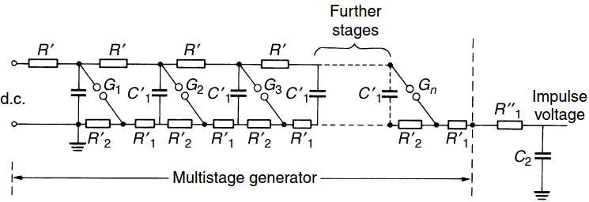
Multistage Impulse Generator Circuit
Multistage impulse generator with distributed discharge and front resistors
R₂’ : Discharge (or wave-tail control) resistors.
R₁’ : Internal front resistors.
R₁’’ : External front resistor

Slide 35



Multistage Impulse Generator Circuit
If the generator has ﬁred, the total discharge capacitance C₁ may be calculated as,
The effective front resistance R₁ as,
The effective discharge resistance R₂ – neglecting the charging resistances R’ is,
where n is the number of stages

Slide 36
Triggering of Impulse Generators
Triggering of impulse generator is a term used to initiate the firing of impulse
generator through the breakdown of the spark gap.
In a multi-stage impulse generator, it is desired that the triggering takes place first at the stage no. 1 and then, in sequence at the higher stages.
There are three ways of triggering an impulse generator:
Fix the gap distance between the spheres and increase the stage applied dc voltage till the flashover occurs.
Set the gap distance between the spheres large enough, apply a desired voltage across them and then reduce the gap distance till flashover takes place.
Fix both, the desired stage voltage and corresponding gap distance within prescribed limits, then apply the trigger pulse to the trigatron on the first stage.

Slide 37
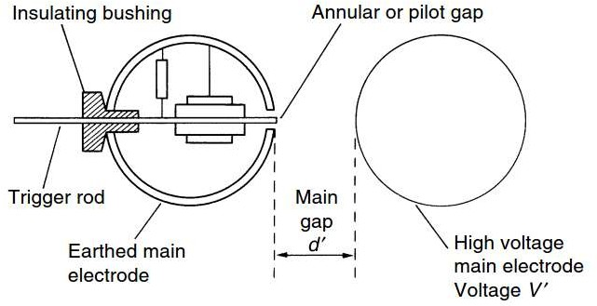
Triggering of Impulse Generators

Slide 38

Triggering of Impulse Generators
Trigatron is a type of triggerable spark gap switch designed for high voltage applications.
A trigatron consists essentially of three-electrodes. The main electrodes are for the high current switching path, and a smaller third electrode serves as the trigger.
The main electrode - indicated as HV and the earthed electrode are equal size spherical electrodes in the first stage of the generator.
A small hole, drilled in the earthed electrode, holds a metal rod through it inside with the help of a bushing. The annular gap formed between the rod and the surrounding sphere is typically about 1 mm.
The trigger electrode with the shape of a metal rod is located inside and insulated from the main electrode by an annular clearance.

Slide 39
Triggering of Impulse Generators
During normal operation, the voltage between the main electrodes is lower than the breakdown voltage corresponding to their distance and the dielectric (usually air) between them.
To switch the device, a high voltage pulse is applied to the triggering electrode. This ionizes the medium between it and one of the main electrodes, producing a spark which shortens the thickness of non-ionized medium between the electrodes.
The triggering spark also generates ultraviolet light and free electrons in the main gap. This leads to the rapid breakdown of the main gap, resulting in a low resistance arc between the main electrodes.
The arc will continue to conduct until current flow drops sufficiently to extinguish it.

Slide 40
Switching Impulse Voltages
Switching surges are overvoltages that occur due to sudden opening or closing of a circuit breaker or due to arcing at a fault point in the power system.
These overvoltages are short-duration transient voltages, the magnitude of which is dependent on the system voltage.
In transmission line operating operating above 220 kV, switching surges are considered as an important factor in the design of insulation.
As per IEC standard, the standard switching impulse voltage is defined as,
- t₁ = 250 μs ±20%
- t₂ = 2500 μs ±60%

Slide 41
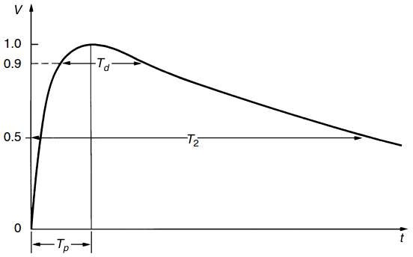
Generation of Switching Impulse Voltages

Slide 42
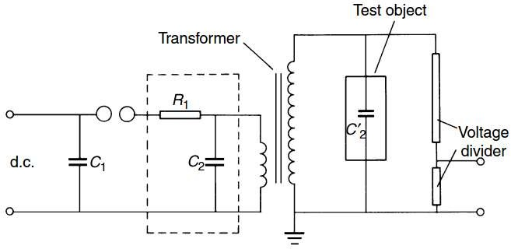
Generation of Switching Impulse Voltages
An initially charged capacitor C₁ is discharged into the waveshaping circuit R₁, C₂ as well as into the L.V. winding of the transformer.
The elements R₁ and C₂ or other suitable components, in the dotted rectangle, may be used to control the waveshape.

Slide 43


Generation of Switching Impulse Voltages
Neglecting any losses within the circuit, the voltage across the test object would therefore start with a (1-cos ωt) function, and as T_{p} = T/2 = π/f_{r}, where f_{r} is the resonance frequency, the time to crest is approximately,
Neglecting the transformer ratio,

Slide 44
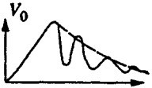
Generation of Switching Impulse Voltages
The switching overvoltages experienced in power systems are not unique. They have front rise times up to several milliseconds and considerably longer tails.
Investigations are sometimes made with unusual waveshapes as unidirectional damped oscillating voltages with a frequency ranging from few Hz to few kHz.
Therefore, with switching surges it is not always necessary to produce double- exponential waveform to simulate switching overvoltages.
Furthermore, the physical phenomena of disruptive discharges in many insulating systems are often related to the front of switching impulses only.

Slide 45
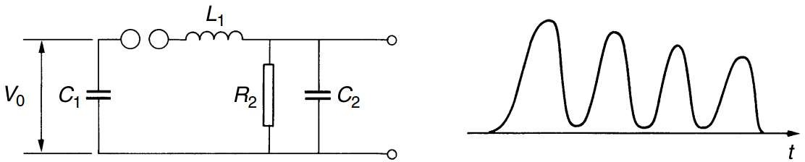
Generation of Switching Impulse Voltages
If the front resistor R₁ is replaced by a series inductance L₁, the resulting circuit described by Bellaschi and Rademacher could be used for the generation of high switching impulse voltages up to 500 kV.
The circuit is a damped series resonant circuit whose output voltage is nearly doubled compared to the charging voltage V₀.
Therefore, the first increase of the voltage may be used as the front of a switching impulse voltage.

Slide 46
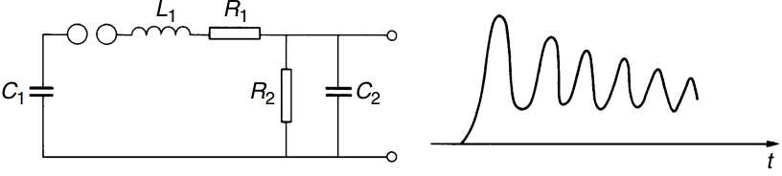
Generation of Switching Impulse Voltages
The second circuit uses an additional resistor R₁ in series to L₁, and is therefore, simply a pure impulse voltage circuit with a high inductance within the discharge circuit.
Therefore, unidirectional damped oscillations are produced.

Slide 47
Suggested Readings
Suggested Reading: Chapter 2 (Kuffeel and Zaengl’s book

Slide 48
THANK YOU FOR YOUR ATTENTION

