Slide 1
EE450: High Voltage Engineering
Lecture 14-15

Slide 2
Outline
Generation of High Voltages
Generation of High Voltages
Generation of High DC Voltages
Rectifier Circuits
Cascaded Circuits
Electrostatic Generators
Page 2

Slide 3
Generation of High Voltages
Generation of high voltage and current is required for two purposes:
Testing of high voltage equipment
To study the breakdown characteristics of insulating materials
Page 3

Slide 4
Generation of High Voltages
Modern power systems are operating at higher and higher power frequency ac voltage levels.
Insulation level provided to the power system equipment is of major concern to power engineers.
The insulation of the high voltage equipment must be able to withstand:
Normal system voltage
Abnormal voltages
Accordingly, the high voltage equipment need to tested at high voltages before they can be actually put into service.
Page 4

Slide 5
Generation of High Voltages
Despite all the progress, the physical phenomenon of breakdown observed in insulating materials can be partially explained by the theoretical models.
For complete understanding of breakdown phenomenon, the experiments should be performed in the laboratories.
The breakdown mechanism in insulating materials is different under AC, DC and impulse voltages. Hence, high voltage laboratories should be capable of generating different types of high testing voltages.
Thus, the experimentation constitute the backbone of teaching, research and industrial requirements.
Page 5

Slide 6
Generation of High Voltages
Test voltages can be classified into following categories:
High Voltage Direct Current (HVDC)
High Voltage Alternating Current (HVAC) at power frequency
High Voltage Alternating Current (HVAC) at high frequency
High Impulse Voltage – Lightning and Switching
High Current – AC, DC and Impulse
The amplitude of the test voltages have been standarized as per international standards, and there is not much freedem in the selection of high voltage equipment.
Page 6

Slide 7
Generation of High Voltages
In high engineering, the equipment testing are classified into two categories:
High voltage testing
High current testing
High voltage testing is mainly used to determine the breakdown strength of insulation.
Breakdown means failure of insulation, that is accompanied by the flow of large current.
A current-limiting resistor should be used to limit the high current during breakdown testing of insulation.
The current under failure conditions is limited to small values, typically less than 1 A for dc or ac voltages and few amperes for impulse or transient voltages.
Page 7

Slide 8
Generation of High Voltages
In high current testing, high currents (several kA) are required to pass through the high voltage equipment for estimating:
Thermal stability of equipment such as surge arresters, switchgears, cables etc.
Tripping characteristics of the circuit breaker
Therefore, test facilities require both high voltage and high current generators for testing purposes.
Page 8

Slide 9
Generation of High DC Voltages
High DC voltages are required for various applications:
Insulation testing of cables and capacitors
Charging unit of impulse generator
Fundamental investigations in discharge physics and dielectric behaviour
Generation circuits for high voltage DC are:
Rectifier circuits
Voltage multiplier circuits
Electrostatic generators
Page 9

Slide 10
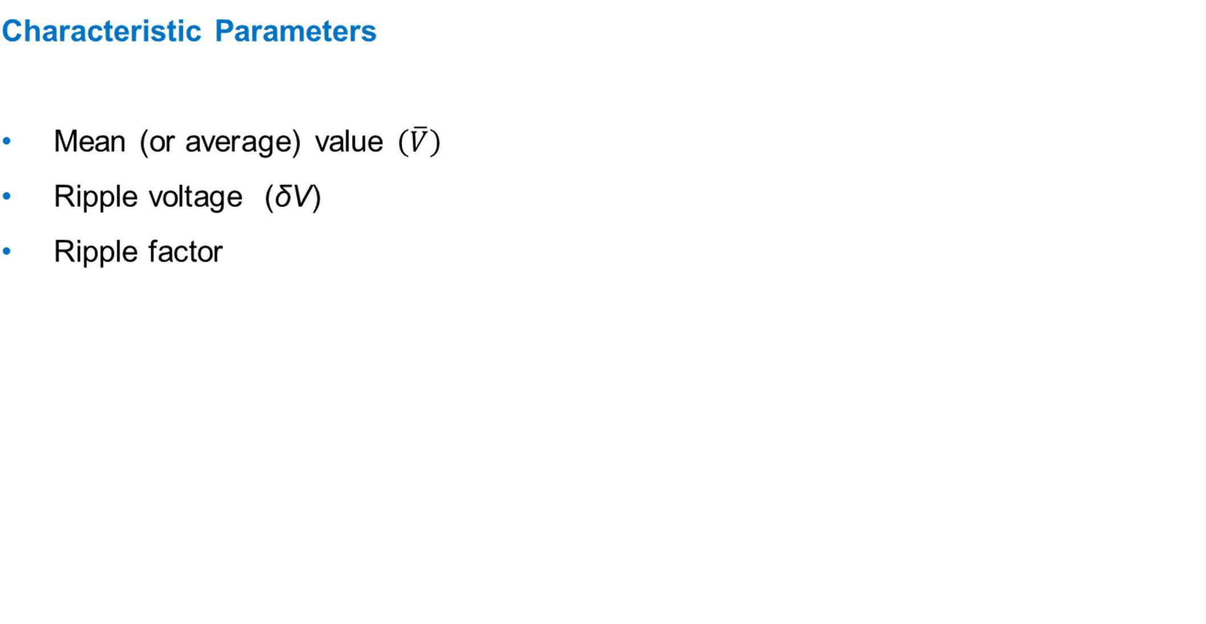

Generation of High DC Voltages

Slide 11





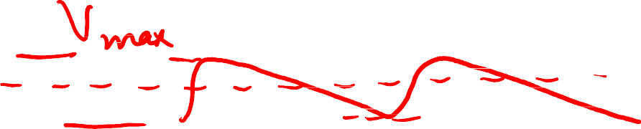









Slide 12
Rectifier Circuits
Rectifier circuits convert AC voltage into DC voltage.
The size and rating of the equipment depends on the size of HV single-phase step- up transformer, and the diodes.
The output voltage of high voltage rectifiers is limited up to ±100 kV. Above this voltage, the size of transformer and cost of diodes make the equipment practically uneconomical.
A typical commenly used half wave rectifiers produce output voltages up to ±30 kV.

Slide 13
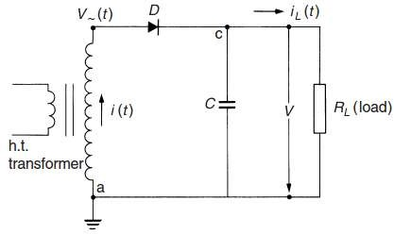
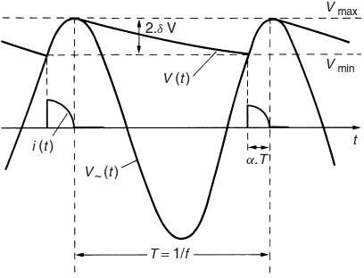
Rectifier Circuits
Half-wave Rectifier Circuit

Slide 14

Rectifier Circuits
Ripple voltage δV is given by,
Limitations of half-wave rectifers,
The size of the circuits is very large if high and pure DC output voltages are desired.
The HV side of the transformer may gets saturated if the amplitude of the DC current is comparable with the nominal alternating current of the transformer.

Slide 15
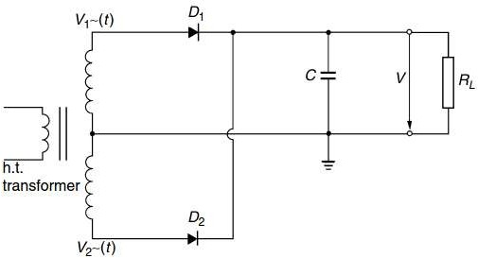
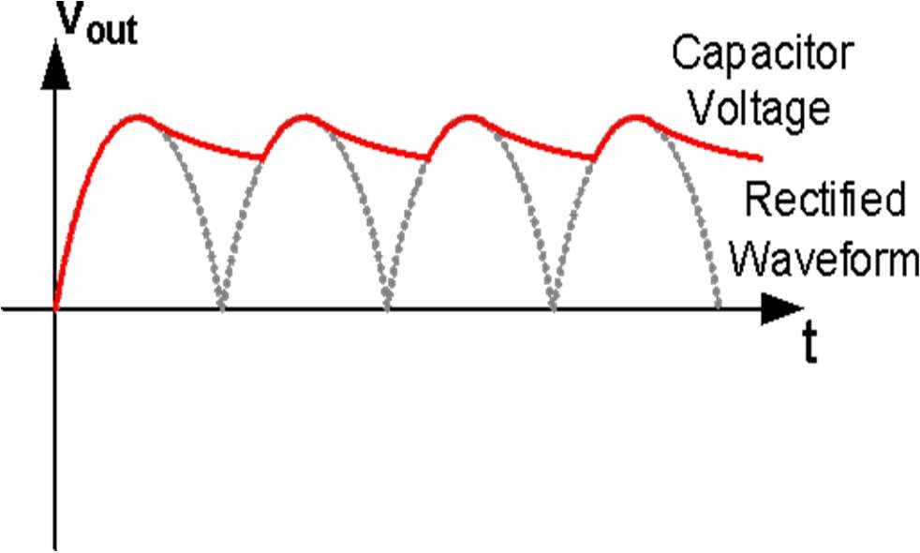
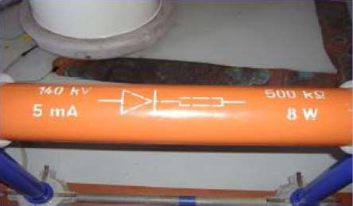
Rectifier Circuits
Biphase half-wave (or full-wave) rectiﬁer circuit

Slide 16
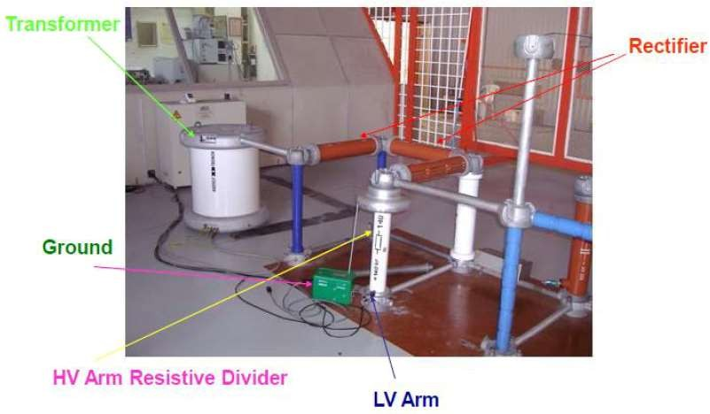
Rectifier Circuits

Slide 17
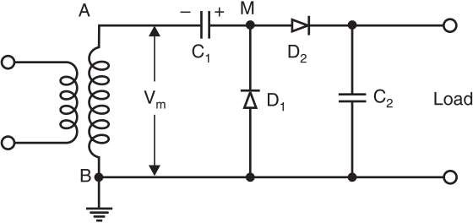
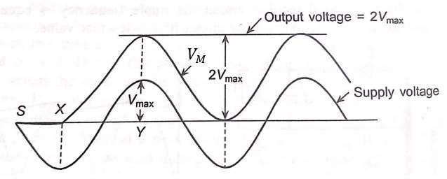
Voltage Multiplier Circuits
Greinacher’s voltage doubler circuit

Slide 18
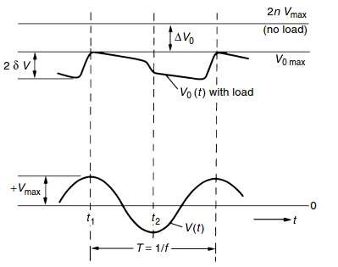
Voltage Multiplier Circuits
When R ≠ ∞, V_{out} will be less than 2 V_{max} due to following reasons:
During the non-conduction period, C₂ supplies the load current
During each cycle, C₁ replenishes the charge lost by C₂ in supplying the load.

Slide 19
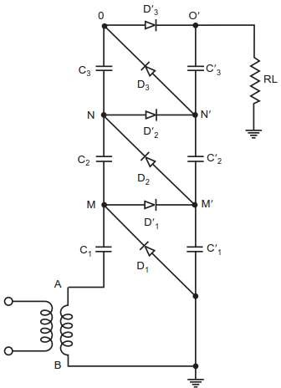
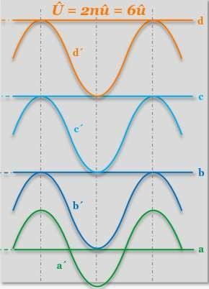
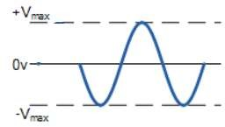
Cascaded Circuits
Cockroft-Walton voltage multiplier circuit

Slide 20
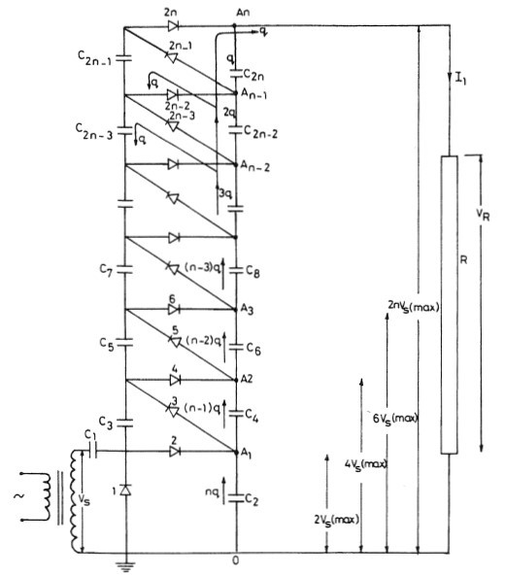
Cascaded Circuits
Page 20

Slide 21
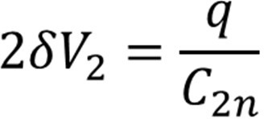
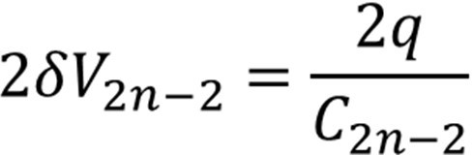
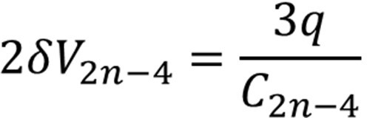
Cascaded Circuits
The number of stages n has a large effect on voltage drop ΔV and ripple amplitude
δV.
Let q be the charge transferred from C_{2n} to the load per cycle with a ripple voltage at capacitor C_{2n}:
Simultaneously, C_{2n-2} transfers a charge q to the load and q to C_{2n-1}, so the ripple voltage at capacitor C_{2n-2} is:
Similarly, C_{2n-4} transfers a charge q to the load, q to C_{2n-3}, and q to C_{2n-1} with a ripple voltage at capacitor C_{2n-4}:

Slide 22
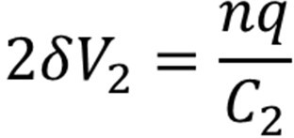
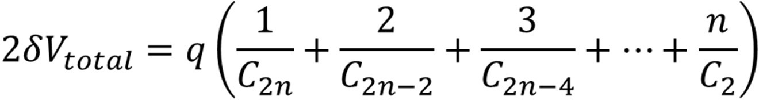
Cascaded Circuits
Proceeding in the same way, the ripple voltage at C₂ is:
Hence, the total ripple voltage is:
It is quite evident that the capacitors near the ground terminal (e.g., C₂) are the major contributors to the ripple voltage. If their capacitances are chosen suitably large, the total ripple voltage can be reduced significantly.
However, this is not practical, as a transient overvoltage would overstress the smaller capacitors.

Slide 23
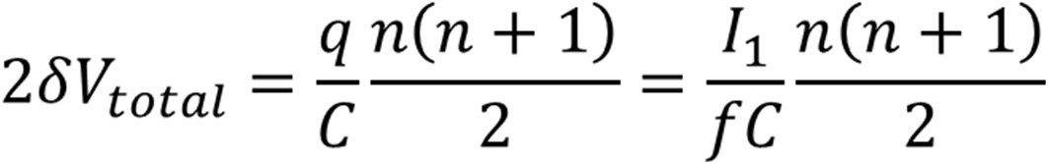
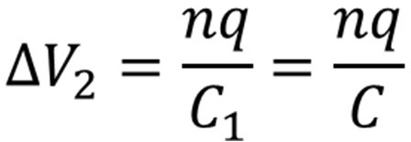
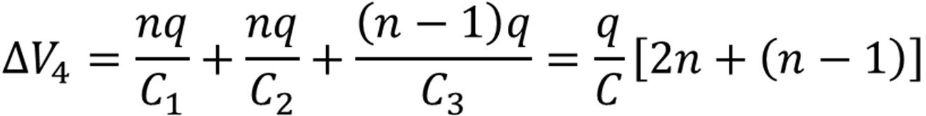
Cascaded Circuits
When all of the cascade’s capacitance C are equal, the total ripple voltage is given by:
In addition to the ripple voltage, there is a voltage drop which is the difference between the theoretical no-load and on-load voltages.
Voltage drop across the capacitor C₂:
Voltage drop across the capacitor C₄:

Slide 24
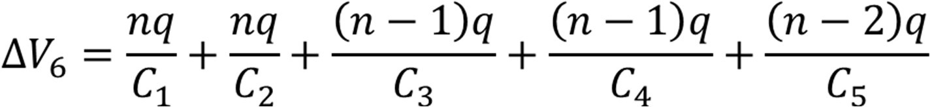
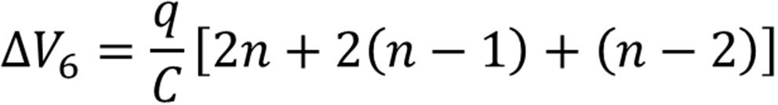
Cascaded Circuits
Voltage drop across the capacitor C₆:
Voltage drop across the third stage capacitor C_{2n}:
Adding all voltage drops,

Slide 25
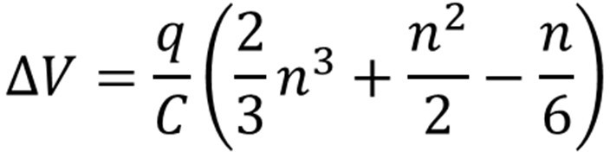
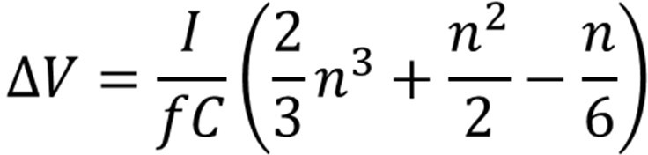
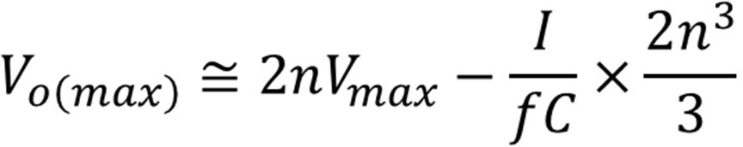
Cascaded Circuits
It is to be noted that voltage drop ΔU and ripple voltage δV are smaller with higher frequency and capacitance.
For the case n = 4, the maximum output voltage is given by,

Slide 26
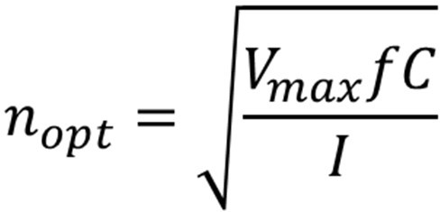
Cascaded Circuits
For a given load, however, V₀ may rise initially with the number of stages n, but reaches an optimum value and even decreases if n is too large.
With respect to constant values of I, V_{max}, f and C – the optimum number of stages can be obtained by differentiating the above equation with respect to n, then

Slide 27
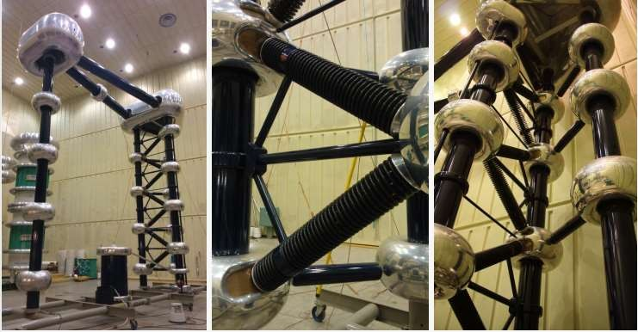
Cascaded Circuits
1.2 MV Cascaded DC Generator

Slide 28
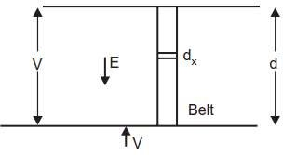
Electrostatic Generators
In electrostatic generators, the electric charges are moved against the force of electric fields, thereby converting mechanical energy into electric energy.
An insulated belt is moving with uniform velocity ν in an electric field of strength
E (x).
Suppose the width of the belt is b and the charge density σ. For a length dx of the belt, then the charge dq is given by,
dq = σ bdx.
The force experienced by this charge
(or the force experienced by the belt) is given by,
dF = Edq = E σ bdx F = σb ʃ Edx

Slide 29
Electrostatic Generators
Normally the electric field is uniform, then
F = σbV
The power required to move the belt is given by,
P = Force × Velocity
= Fv = σbVν
Now, the current I = dq/dt = σ b dx/dt = σbv
The power required to move the belt is given by,
P = Fν = σbVν = VI
Assuming no losses, the power output is also equal to VI.

Slide 30
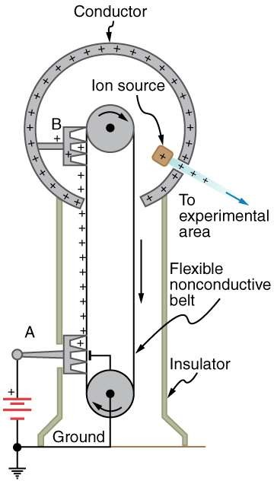
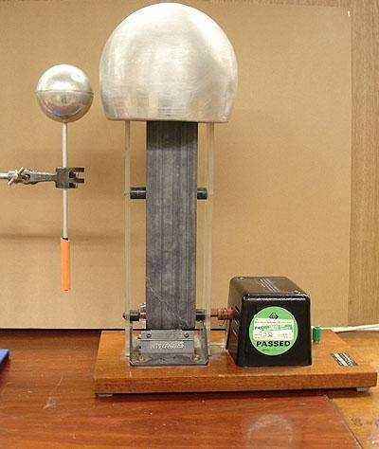
Van de Graff Generator
Page 30

Slide 31
Van de Graff Generator
For a uniform and homogeneous fields, the electric stress on the belt is given by,
E = σ/ε₀ ε_{r} = 1
σ should be so chosen that E remains below the breakdown stress of the medium.
If E = 30 kV/cm, ε₀ = 8.85 x 10⁻¹² F/m, then
σ = 26.562 x 10⁻⁶ C/m²
If b = 1 m, v = 10-30 m/s, i.e. 10 m/s, then
I = σbv = 265 μA
σ can be increased by using gases of high dielectric strength so that E could be increased without the inception of ionization of the medium surrounding the HT terminal.
Page 31

Slide 32
Van de Graff Generator
Advantages
Very high voltages can be generated
Ripple-free output
Precision and flexibility of control
Disadvantages
Low output current
Limitations on belt velocity due to its tendency for vibration.
Page 32

Slide 33
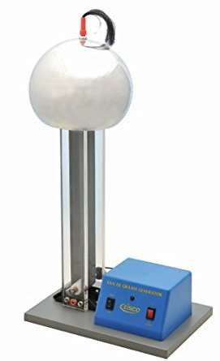
Van de Graff Generator
Van De Graaff Generator, Motor Driven, up to 200 kV
Page 33

Slide 34
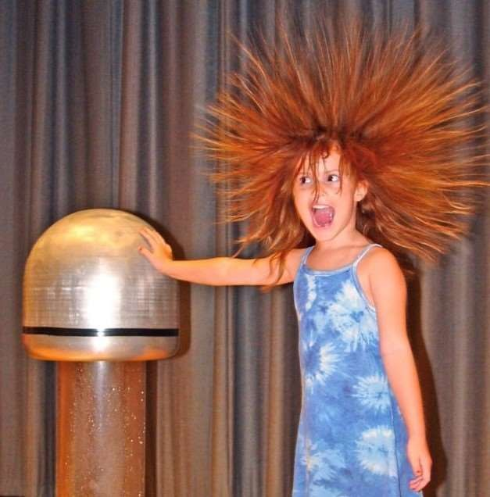
Van de Graff Generator
Hair-raising experience produced by Van de Graff generator ???
Page 34

Slide 35
Suggested Readings
Suggested Reading: Chapter 2 (Kuffeel and Zaengl’s book)
Page 35

Slide 36
THANK YOU FOR YOUR ATTENTION

