Slide 1
EE450: High Voltage Engineering
Lecture 20, 21

Slide 2
Outline
Measurement of High Voltages
Measurement of High Voltages
Voltage Dividers
Resistive Voltage Dividers
Resistive-Capacitive Voltage Dividers
Capacitive Voltage Dividers
Damped Capacitive Voltage Dividers
Page 2

Slide 3
Measurement of High Voltages
Different types of high voltages are generated in the laboratory to determine the breakdown voltage of insulating materials.
The high voltage equipment have large stray capacitances with respect to the grounded structures and hence, large voltage gradients are set up.
The intensity of stray electric ﬁelds can be controlled by providing proper clearance between the equipment and the grounded structures to avoid ﬂashover.
A person handling these equipment and the measuring devices must be protected against these over voltages.
Page 3

Slide 4
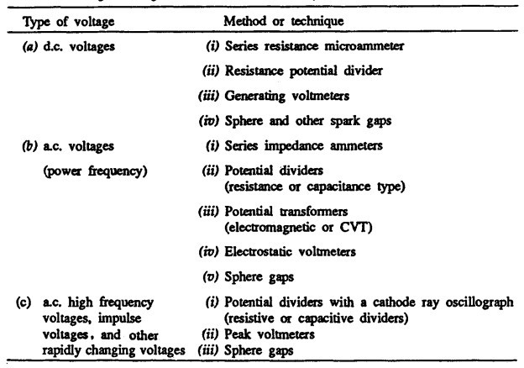
Measurement of High Voltages
Page 4

Slide 5
Voltage Dividers
A potential divider consists of two impedances, Z₁ and Z₂, connected in series, to which the voltage to be measured is applied.
The components that constitute the impedances are referred to as the high- and low- voltage arms of the divider.
The connection between the low-voltage arm and the measuring instrument must be made through a shielded coaxial cable to avoid the adverse effects of stray capacitance between that connection and the high-voltage arm.
Thus, a potential divider converts the applied high-voltage into a low-voltage signal compatible with the electronic measuring equipment.
The essential requirement is that the wave shape to be measured is correctly reproduced on the oscillograph with a known voltage reduction ratio.
Page 5

Slide 6
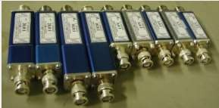
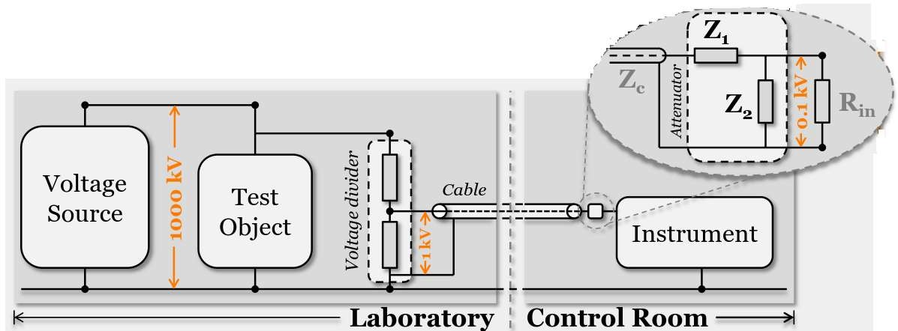
Voltage Dividers
Page 6

Slide 7
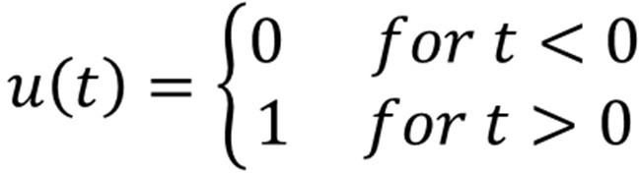

Voltage Dividers
Measuring system can be represented by a two-port passive (four-terminal) network.
For the sake of analysis, the response of this two-port network can be determined by the application of unit-step voltage, or chopped impulse voltage at the input.
The input voltage of the measuring system is represented by a unit step function,
If input voltage = A_{i} u (t), then output voltage = A_{o} w (t),
where w (t) is the response of the circuit to the step function
The response w (t) could be slowly rising curve reaching the final value or damped transient oscillations.
Page 7

Slide 8
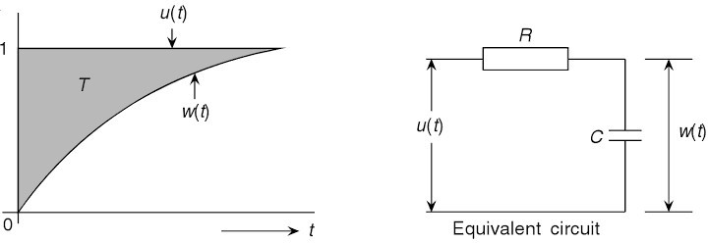
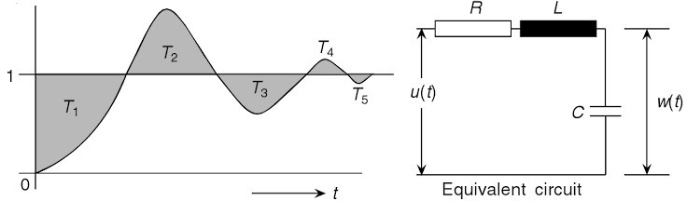
Voltage Dividers
Page 8

Slide 9
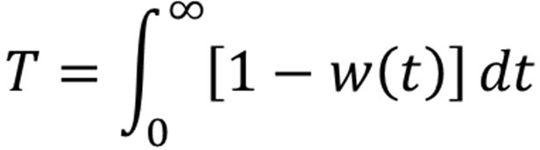
Voltage Dividers
The response behavior is defined in terms of response time that measures how much the output voltage lags behind the input voltage when the input is a linearly rising voltage. Mathematically,
For a well-designed system, the response time should be as small as possible.
According to IEC publication No. 60060-1, a maximum overshoot of
3% is allowed for the full impulse wave
5% for an impulse wave chopped on the front at times shorter than 1 μs
Page 9

Slide 10
Voltage Dividers
In order to fulfil these requirements, the response time of the divider must not exceed 0.2 μs for full impulse waves 1.2/50 μs or 1.2/5 μs or impulse waves chopped on the tail.
If the impulse wave is chopped on the front at time shorter than 1 μs, the response time must be not greater than 5% of the time to chopping.
Page 10

Slide 11

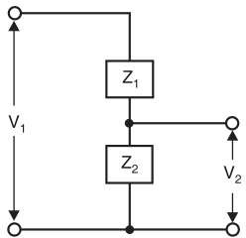


Voltage Dividers
If the voltage to be measured is V₁ and sampled voltage V₂, then
If the impedances are pure resistances, then
In case pure capacitances are used,
The voltage V₂ is normally only a few hundred volts and hence, the value of Z₂ is so chosen that V₂ across it gives sufficient deflection on a CRO.
Page 11

Slide 12
Voltage Dividers
Advantages of potential dividers:
Most accurate and convenient method
Provide a continuous measurement of all the types of applied high voltages i.e. dc, ac and impulse voltages.
The suitability of the type of divider depends on the type of voltage as well as the range of magnitude of the voltage to be measured.
Accordingly, there are following types of potential dividers:
Pure resistive,
Pure capacitive,
Series/parallel combination of resistance and capacitance.
Page 12

Slide 13
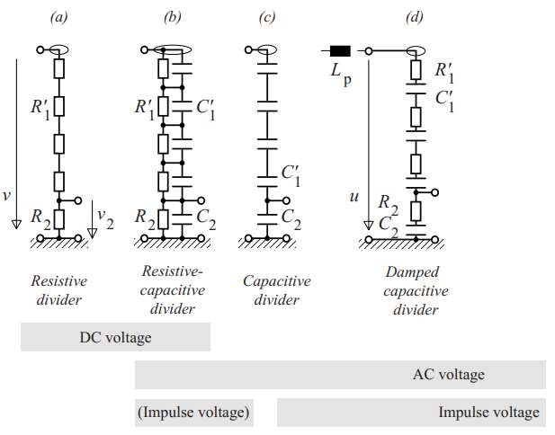
Voltage Dividers
R_{d}
Page 13

Slide 14
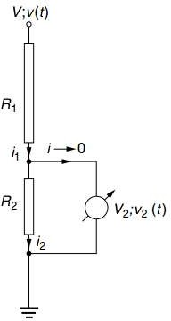
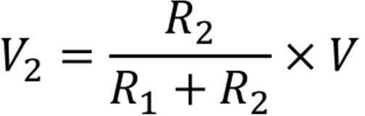
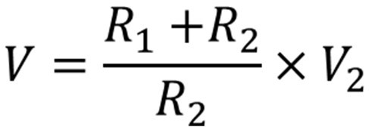
Resistive Voltage Dividers
Pure resistive arm or divider can be used for the measurement of dc and ac voltages at power frequency.
A resistance potential divider with an electrostatic or high impedance voltmeter is shown in figure.
The magnitude of high voltage, that is, the dc voltage across the low voltage arm R₂ is given by,
High voltage magnitude, V is given by,
Page 14

Slide 15
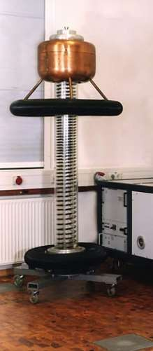
Resistive Voltage Dividers
R₁ is usually implemented as a series connection of a plurality of
individual resistors, which are often arranged in the form of a helix.
R₁ has a high ohmic value but should allow a current magnitude of at least 0.5 mA at rated voltage.
The resistor chain R₁ is housed in a highly insulating tube filled with dry air or insulating oil, the insulating medium being circulated for better
heat dissipation.
The lower resistor R₂ is generally a parallel connection of a large number of individual resistors, often housed separately from R₁ in a
metal box at the bottom of the voltage divider. This allows an easy change of the lower resistor R₂ to obtain a different division ratio.
Page 15

Slide 16


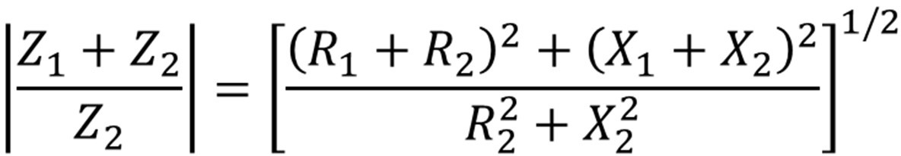
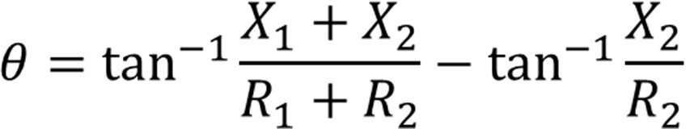
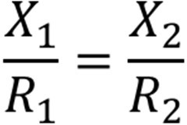
Resistive Voltage Dividers
In the case of AC voltages,
The magnitude of the divider ratio is,
The output voltage V₂ will be shifted in phase from the measured voltage V₁ by,
Therefore, for the output voltage V₂ to represent V₁ faithfully, this phase shift should vanish. This can be achieved by,
Page 16

Slide 17
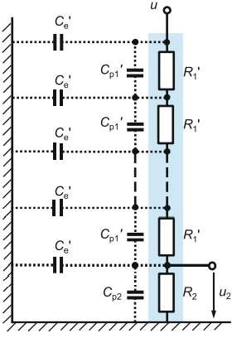
Resistive Voltage Dividers
The high-ohmic design and large dimensions of DC voltage dividers limit their bandwidth, so that the ripple of the DC voltage cannot be often measured correctly.
This is mainly due to the distributed stray capacitances C_{e}′ of the voltage divider to ground, through which the AC component of the DC voltage flows as shown in Figure.
The distributed stray capacitances to ground causes a non-linear voltage distribution along a resistor column and overstresses individual elements during breakdown of a test object.
Equivalent circuit diagram of a high- ohmic DC voltage divider with distributed capacitances C_{e}′ to ground and parallel capacitances C_{p1}′ and C_{p2}′.
Page 17

Slide 18
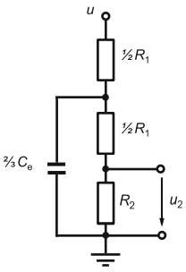
Resistive Voltage Dividers
Depending on the dimensions of the voltage divider, the stray capacitances are in the order of 15–20 pF/m.
This stray capacitance will vary according to the distance of a point from earth on the length of the resistor.
If the parallel capacitances C_{p1}′ are negligible, a simplified equivalent circuit diagram of the high-ohmic DC voltage divider can be developed used in which a capacitance 2/3C_{e} is connected in parallel to (R₁/2 + R₂).
The reason is that since R₁ >> R₂, approximately ⅔ C_{e},
that is, two-third of the total stray capacitance to earth will be located approximately at the center of the resistive column.
Simplified equivalent circuit for negligible parallel capacitances C_{p1}′ and C_{p2}
Page 18

Slide 19


Resistive Voltage Dividers
The point where the effect of stray capacitance to earth is averaged, divides the total R₁ into two identical resistances each having a value of R₁/2, and the parallel combination of these resistances gives an equivalent resistance of R₁/4.
Due to the charged stray capacitances, high transient voltages can occur in the event of a sudden switch-off or failure of the DC voltage supply, resulting in damage or destruction of the resistors, particularly in the upper region of the voltage divider.
Page 19

Slide 20
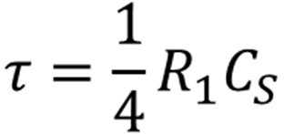
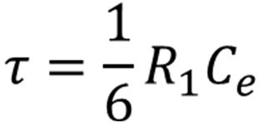
Resistive Voltage Dividers
The time constant of the divider becomes,
Since C_{s} = ⅔ C_{e},
Design Problem: Design a resistive voltage divider for 1 MV, 1.2/50 μs impulse voltage using standard resistors available, for a 2 m high vertical cylindrical divider with a distributed capacitance to ground of 15 pF/m height, with T = 50 ns.
Page 20

Slide 21
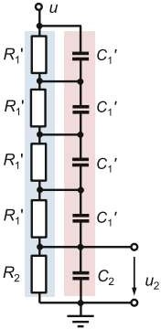
Resistive-Capacitive Voltage Divider
In order to improve the transfer behavior, the capacitors C₁′ and C₂ are occasionally added in parallel to the individual resistor stages R₁ ′ und R₂ of the voltage divider.
This divider is also called parallel-mixed RC divider.
The general requirement for the time constants of the upper and lower divider parts is R₁C₁ = R₂C₂.
The parallel capacitor chain of this resistive-capacitive voltage divider reduces the effect of stray capacitances and minimize the danger that transient overvoltages destroy the resistors.

Slide 22
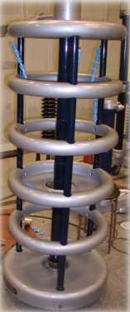
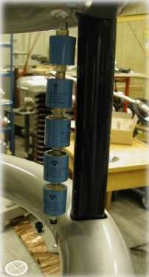
Resistive-Capacitive Voltage Divider

Slide 23
Capacitive Voltage Dividers
Resistive potential dividers suffer from two main drawbacks:
Power losses
Stray capacitance to earth
These factors limit the use of resistive potential dividers to voltages below 100 kV at 50 Hz and even lower voltages at higher frequencies.
Therefore, capacitive potential dividers are more suitable to use with AC voltage, particularly at high voltages and high frequencies.
Capacitive voltage dividers cannot be used for DC voltage measurements, since a completely undefined resistive divider ratio results from undefined insulation resistances and from the load impedance.

Slide 24
Capacitive Voltage Dividers
Capacitive high-voltage dividers generally consist of a number of series-connected capacitors arranged one above the other.
The high AC voltage is applied to the top electrode of the divider, and a true-to-scale reduced voltage is available for measurement at the output terminal, i.e. at the lowest capacitor.
The output voltage, which is usually limited to not more than 2 kV, is then evaluated by an analog or digital measuring device.

Slide 25

Capacitive Voltage Dividers
The capacitive voltage divider has inductances of the components and high-voltage leads as well as stray capacitances to ground and to electrodes, e.g. to the torus electrode on the divider top.
In the case of capacitive AC voltage dividers, the distributed stray capacitances C_{e}′ must be taken into account because they affect the division ratio and the frequency behavior.
The current i_{e}′ flowing through C_{e}′, in particular the higher frequency components, does not reach the capacitor C₂ and is thus lost in the measurement result.
Therefore, the stray current leads to a division ratio different from the theoretical value (C₁ + C₂)/C₁ of the simple series connection with C₁ and C₂.

Slide 26
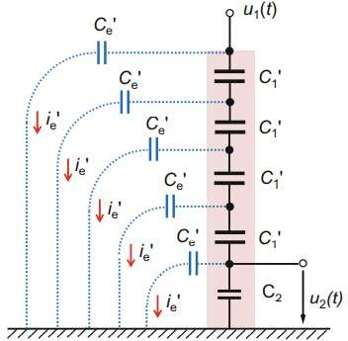
Capacitive Voltage Dividers
Capacitive voltage divider with distributed stray capacitances C_{e}′ to ground

Slide 27
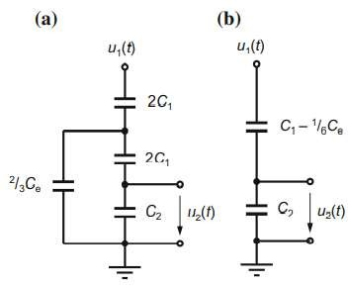
Capacitive Voltage Dividers
All partial capacitances C_{e}′ are assumed to be approximately equal.
In the usual vertical arrangement of the voltage divider, the stray capacitance to ground is in the range 15–20 pF/m, depending on the diameter of the voltage divider.
Accordingly, two equivalent circuit diagrams are proposed:
Simple equivalent circuit diagrams of a capacitive voltage divider taking into account the stray capacitance C_{e}.
Parallel capacitance 2/3C_{e},
Reduced high-voltage capacitance C₁
– 1/6C_{e}

Slide 28
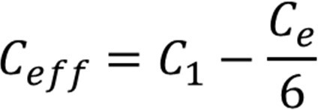
Capacitive Voltage Dividers
In the Figure a, a capacitance 2/3C_{e} is connected in parallel to half of the high- voltage capacitance.
In Figure b, C₁ is reduced by a factor of 1/6C_{e} so that the effective capacitance C_{eff} in the high-voltage branch is:
Both diagrams show that the effective high-voltage capacitance C₁ is reduced by a part of the ground capacitance C_{e}.
In other words, the division ratio becomes larger and the output voltage u₂ is reduced.

Slide 29
Capacitive Voltage Dividers
Furthermore, both equivalent circuit diagrams show that the transfer behavior of a capacitive voltage divider for frequencies up to the kHz range can be assumed to be approximately frequency-independent.
Due to the stray capacitances, the exact division ratio u₁/u₂ cannot be calculated from C₁ and C₂ but must be determined from measurements.
The division ratio of voltage dividers is predominantly dimensioned such that the maximum output voltage u₂ (t) at the rated input voltage is usually 1 kV or 2 kV.

Slide 30
Capacitive Voltage Dividers
Design of capacitive voltage divider
Select a capacitor required for the low voltage arm of a capacitive voltage divider to provide a peak voltage of 200 V on the oscilloscope when the high voltage arm of the divider has capacitance of 1 nF and the voltage of 1 MV peak is to be measured. Neglect the surge impedance of the delay cable.
Design a capacitive voltage divider for a voltage of up to 100 kV (RMS) to be measured with a conventional low voltage voltmeter to give a full-scale deflection of 200 V for the maximum RMS voltage to be measured.
Page 30

Slide 31

Damped Capacitive Voltage Divider
The damped capacitive impulse voltage divider, also called universal divider, is particularly well suited for measuring AC, lightning impulse voltages and other fast transient voltages up to the UHV range, usually in conjunction with a digital recorder at the divider output.
The damped capacitive divider consists of a large number of series connected resistors and capacitors in the high- and low-voltage parts.
Figure shows the internal damping resistors R₁ ′ in series with the capacitors C₁ ′ in the high-voltage part and R₂ ′ in series with C₂ ′ in the low-voltage part.
Due to the distributed damping resistors, the oscillations which occur with rapidly changing voltages in the purely capacitive voltage divider by the traveling waves are successfully suppressed.
Page 31

Slide 32
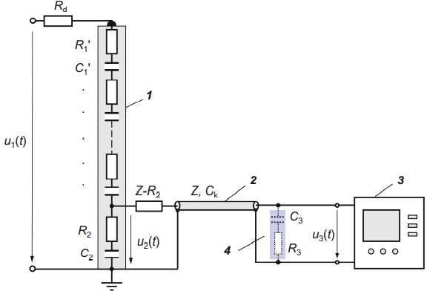
Damped Capacitive Voltage Divider
The damped capacitive impulse voltage divider works as a capacitive divider for low signal frequencies and as a resistive divider for high frequencies.
Measuring system with damped capacitive voltage divider and digital recorder.
Damped capacitive impulse voltage divider,
Coaxial cable with wave impedance Z and cable capacitance C_{k},
Digital recorder,
Burch termination C₃R₃ for longer coaxial cable
Page 32

Slide 33
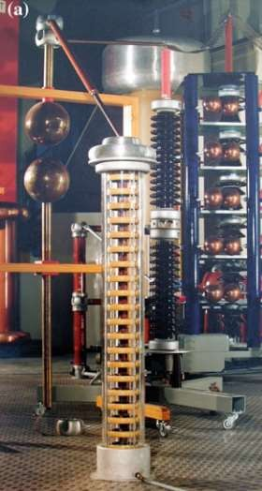
Damped Capacitive Voltage Divider
Page 33

Slide 34
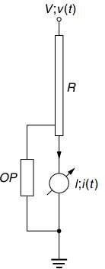
Series Ammeter with High Ohmic Resistors
Ohm’s law provides a method to reduce high voltages to
measurable quantities, i.e. adequate currents or low voltages.
The simplest method employs a microammeter in series with a resistor R of sufﬁciently high value to keep the loading of an
h.v. source as small as possible.
Thus, for a pure resistance R, the measured quantities are related to the unknown high voltage by,
V = I x R
Assuming the voltage drop in the meter is negligible, as the impedance of the meter is only few ohms compared to few hundred mega-ohms of the series resistance R.
Page 34

Slide 35
Series Ammeter with High Ohmic Resistors
In case the series resistance R fails or flashes over, heavy current will flow through micro-ammeter.
To divert this current, a paper gap, a neon glow tube, or a zener diode with a suitable series resistance is connected across the meter as a protection against high voltages.
The resistance is constructed from a large number of wire wound resistors in series.
The ohmic value of the series resistance R is chosen such that a current of 1-10 μA is allowed for full-scale deflection.
The voltage drop in each resistor element is chosen to avoid surface flashovers and discharges (5 kV/cm in air and 20 kV/cm in good oil is allowed).
Page 35

Slide 36

Series Ammeter with High Ohmic Resistors
The material for resistive elements is usually a carbon-alloy with temperature coefficient less than 10⁻⁴/ .
The resistor chain is provided with corona free terminations.
The limitations in the series resistance design are:
Power dissipation and source loading
Temperature effects and long time stability
Voltage dependence of resistive elements
Sensitivity to mechanical stresses
Page 36

Slide 37
THANK YOU FOR YOUR ATTENTION

