Slide 1
EE450: High Voltage Engineering
Lecture 24, 25

Slide 2
Outline
Non-destructive Testing of Insulation
High voltage testing
Non-ideal dielectrics
Insulation resistance
Measurement of insulation resistance
Dielectric constant
Complex Permittivity
Dielectric strength
Losses in a dielectric
Schering bridge
Page 2

Slide 3
High Voltage Testing
The insulation materials are subjected to varying degrees of TEAM (thermal, electrical, ambient and mechanical) stresses. For example:
Electrical stresses (normal operational voltage, overvoltages due to switching, lightning, and faults)
Environmental conditions (UV-radiations, pollution, dirt, dust particles, temperature, pressure and humidity etc.)
The degradation of the dielectric would cause changes in its dielectric parameters and reduce the anticipated lifespan of a dielectric material.
To ensure the reliable operation of power system, the dielectric parameters of the various insulations should be monitored through appropriate testing methods.
Page 3

Slide 4
High Voltage Testing
High voltage testing is mainly classified into two categories:
Destructive insulation testing
Non-destructive insulation testing
In destructive testing, the objective is to investigate the breakdown voltages of insulation under AC, DC, and impulse voltages.
No conclusion could be drawn regarding the cause of breakdown from the knowledge of the breakdown voltage.
No information can be obtained regarding the life expectancy.
Possibility of permanent failure of insulating material.
Page 4

Slide 5
High Voltage Testing
In non-destructive testing, tests related to dielectric properties of insulation are performed that permit early detection of insulation faults.
It is expected that these materials work satisfactorily if such parameters vary over a certain ranges that may occasionally occur in the system.
Therefore, the high voltage testing involves the measurement of following parameters:
Insulation resistance offered by dielectrics
Dielectric constant
tan δ
Dielectric strength
Partial discharges
Page 5

Slide 6
Non-ideal Dielectrics
By definition, the term dielectric indicate the storage of electric charges. All dielectric materials are capable of storing electrostatic energy in their electric field.
The source of the energy is the applied external field.
The storage of energy within the dielectric takes place due to a shift in the position of bound internal charges. This process is called polarization.
When the direct voltage is applied, the dielectric material will polarize such that the separation or storage of charges takes place.
A pure or ideal dielectric is one which behaves as a charge storage element. This means that when the voltage source is disconnected, the potential shall remain the same, theoretically, up to an infinite time.
Page 6

Slide 7
Non-ideal Dielectrics
In case the potential reduces with time, the dielectric material is considered as a non-ideal.
In addition to the charge stored in the dielectric material, a charge dissipative process takes place in all dielectrics. This effect is called the charge leakage.
Thus, an ideal dielectric can be represented by a pure capacitor C₁ whereas a real dielectric is always associated with loss.
To quantify the degree of charge leakage, two equivalent circuits have been proposed to model an insulation between two parallel plates.
Page 7

Slide 8
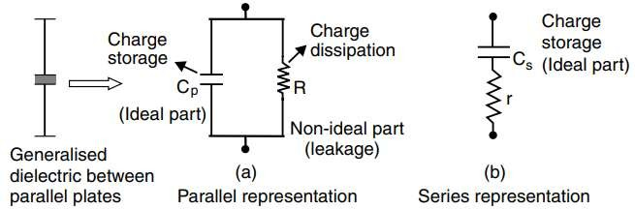
Non-ideal Dielectrics
In the circuit (a), the charge storage part is represented by the capacitor, C_{p} and the dissipation part (due to the reduction in voltage upon de-energization) is represented by a resistive element, R, called the leakage resistance.
In circuit (b), the applied voltage should be time varying as otherwise no current flows through the series equivalent resistor (the capacitor blocks the direct voltage).
Page 8

Slide 9
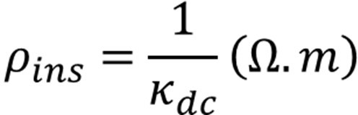
Insulation Resistance
The dc resistance offered by an insulating material is also known as the insulation resistance of a dielectric.
Generally, it is described in terms of specific insulation resistance “ρ_{ins}”, which is reciprocal of the dc conductivity k_{dc}.
The leakage resistance R_{dc} of an insulating material is determined by measuring the current when a constant d.c. voltage is applied.
For the measurement of dc resistance of the insulating material, a d.c. voltage of 100-1000 V is applied between electrode 1 and the earth.
Page 9

Slide 10
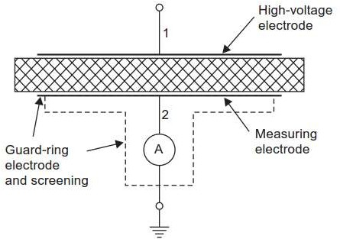
Insulation Resistance
The measuring electrode 2 is earthed through a sensitive ammeter.
The third electrode known as guard ring electrode that surrounds the measuring electrode is directly connected to ground to eliminate boundary field effects and surface currents.
Page 10

Slide 11
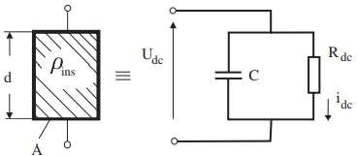
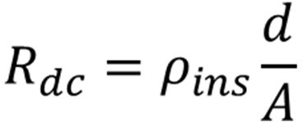
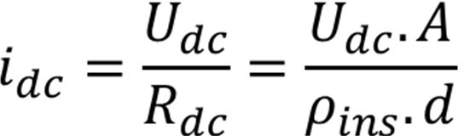
Insulation Resistance
Consider a direct voltage U_{dc} applied across two uniform field electrodes separated by a block of insulating material having an area A and length d.
From the equivalent circuit diagram constituting a capacitance C and a dc resistance
R_{dc} in parallel, the following relation can be derived,

Slide 12
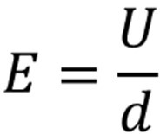
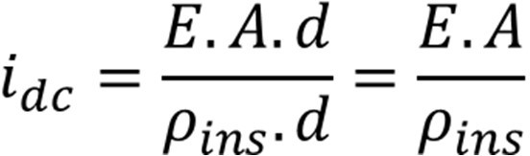



Insulation Resistance
For a uniform electric field,
For most of the insulating materials, the specific conductivity lies in the range of 10^{–16} to 10^{–10} S/cm, which gives currents to be measured of these specimen to be of the order of picoampers or nanoamperes.

Slide 13
Insulation Resistance
When we apply direct voltage across the insulation, a current starts passing through
the insulation. This current has two main components:
The current flowing through the leakage path over the surface of the solid insulator. This leakage path is formed mainly due to moisture, pollution, dust etc. which are naturally accumulated on the surface of the solid insulator. Since it is the current that creeps over the surface of the dielectric, it is also known as “creepage current”.
The current flowing through the volume of the insulator body.

Slide 14
Insulation Resistance
The current flowing through the volume of the insulator is further divided in three components:
Capacitive charging current, which is instantaneous in nature and effectively disappears within few moments.
Absorption current, which decays from high value to zero. The insulation resistance value taken within first few minutes of test is largely dominated by absorption current.
Conduction current, which remains constant throughout the insulation resistance test.
Both charging current and absorption current become insignificant, the test result is mainly predominated by the conduction current and creepage current.

Slide 15
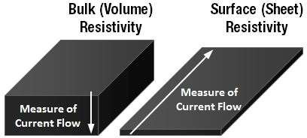
Insulation Resistance
Accordingly, a dielectric material is characterized by two different resistivities:
Volume resistivity
Surface resistivity
Volume resistivity, ρ_{vol}, is defined as the resistance between opposite faces of a 1- metre cube of the insulation.
Surface resistivity, ρ_{s}, may be defined as the resistance between two opposite edges of a unit square of material.

Slide 16

Dielectric Constant
The permittivity of a dielectric material (ε) describes its tendency to become internally polarize when subjected to an electric field.
A material with high permittivity polarizes more in response to an applied electric field than a material with low permittivity, thereby storing more energy in the material.
The permittivity of insulating materials ε is defined as the product of absolute permittivity of free space (vacuum) ε₀ and the relative permittivity ε_{r} of the material.
In insulating materials, polarization is basically a phenomenon of interaction between the applied external electric field and the charge carriers, such as the atoms, ions or molecules present in the dielectric material.

Slide 17
Dielectric Constant
Every atom or molecule in a dielectric is electrically neutral. For most dielectrics, centers of gravity of the positive and negative charges in an atom or molecule coincide in the absence of electric field.
When a dielectric is placed in an electric field, the positive and negative charges shift in opposite directions against their mutual attraction.
Consequently, a small electric dipole is formed which is aligned with the direction of electric field lines.
The alignment is of such a nature that positive charges tend to point towards the negative electrode and negative charges tend to point towards the positive electrode. This process is called polarization.

Slide 18
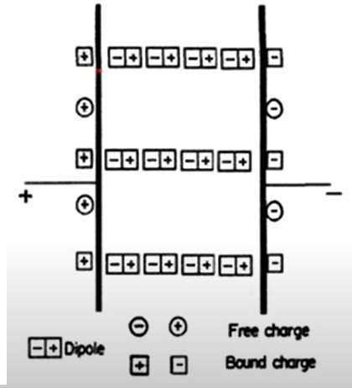
Dielectric Constant

Slide 19
Dielectric Constant
The positive and negative charges are bound with each other by atomic and molecular forces and can only shift positions slightly in response to the external electric field.
Since, the two charges in a dipole cannot separate one from the other and migrate across the material in opposite directions unde the electric field. Hence, these charges are called bound internal charges.
On the other hand, when an electric field is applied, the charges are brought from the supply and placed on the electrodes plates. These charges are called free charges.
The positive and negative charges near each other in the material cancel each other out.

Slide 20
Dielectric Constant
The dielectric material can be considered to have a positive charge on one side, and a negative charge on the other.
Thus, a dielectric begins generating its own electric field. This new field opposes the existing electric field that aligned the dipoles in the first place.
Thus, dielectrics are classified into two categories:
Non-polar
Polar
In non-polar dielectrics, the centre of positive and negative charges coincide so that the dipole arrangement is not present in the absence of electric field. However, when an external electric field is applied to it, an electric dipole is formed.
Page 20

Slide 21
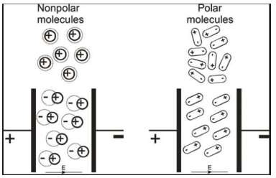
Dielectric Constant
In polar dielectrics (such as water), the centre of positive and negative charges do not coincide so that the dipole arrangement exist without the application of electric field.
However, such dipoles are randomly oriented so that under the application of electric field, the dipoles experience torque and they align with the direction of electric field.
Page 21

Slide 22


Dielectric Constant
The effect of polarization is analytically described by the relative permittivity ε_{r}.
When the dipole is formed due to polarization, there exists an electric dipole moment
p.
where
Q = magnitude of one of the two charges
d = distance vector from negative to positive charge
n = number of dipoles per unit volume
Δv = total volume of the dielectric
N = total dipoles = nΔv
Let
By principle of superposition, the total dipole moment is given by,
Page 22

Slide 23
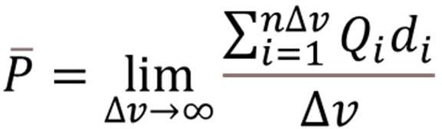


Dielectric Constant
If the dipoles are randomly oriented, p_{total} is zero but if dipoles are aligned in the direction of applied E, then p_{total} has a significant value.
The polarization P is defined as the total dipole moment per unit volume.
The unit of P is same as that of flux density, that is, coulombs per square meter (C/m²). Thus, the polarization increases the electric flux density in a dielectric material. Hence, flux density in the dielectric is given by,
For isotropic and linear medium, P and E are parallel to each other at every point and related by,
Page 23

Slide 24




Dielectric Constant
Note that χ_{e} is called electric susceptibility of the material. It is dimensionless proportionality constant that indicates the degree of polarization of a dielectric material in response to an applied electric field.
Substituting,
Thus, the quantity (χ_{e} + 1) is denoted ε_{r} and defined as relative permittivity or dielectric constant of the dielectric material. Finally, we may write,
where, ε = ε_{r}.ε₀ is called permittivity of dielectric material, ε₀ is the permittivity of free space = 8.85 × 10⁻¹² F/m.
Page 24

Slide 25
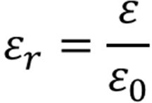
Dielectric Constant
Accordingly, the relative permittivity (or dielectric constant) is defined as the ratio of permittivity of dielectric to that of free space.
Page 25

Slide 26
Complex Permittivity
Consider an alternating electric field applied to a dipole. When the field first strikes the dipole, the dipole rotates to align itself with the electric field.
As time passes, the electric field reverses its direction, and the dipole must rotate again to remain aligned with the correct polarity.
As the diploe rotates, energy is lost through the generation of heat (friction) as well as the acceleration and deceleration of the rotational motion of the dipole.
Furthermore, there is a finite time lag between the application of the external field and the establishment of polarization mechanism, that is, a material does not instantaneously polarizes when an electric field is applied.
Page 26

Slide 27



Complex Permittivity
The electric field density comes into effect with a negligible time lag with respect to E
and according to Maxwell’s law, the free space flux density, D₀ is given by,
When a dielectric medium (condensed matter) of relative permittivity, ε_{r} is placed between the planes, the flux density vector, D can be written as,
where angle δ refers to the phase angular difference between the applied electric field and the establishment of the flux density vector.
It may also be noted that the permittivity ε_{r} is a measure of the excess charge a condensed dielectric can store over and above that of the free space.
Page 27

Slide 28
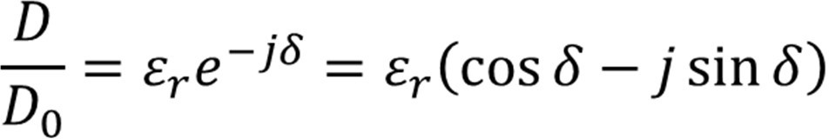


Complex Permittivity
This means that in the time domain, a finite time lag corresponding to δ. Since, the ratio of D to D₀ is the permittivity of the medium. Thus:
Since the quantity on the RHS is complex, the LHS also should be a complex quantity, denoted by ε_{r}*.
Separating the real and imaginary parts,
where
ε_{r}′ is called the permittivity, and
ε_{r}″ is called the loss factor.
Page 28

Slide 29
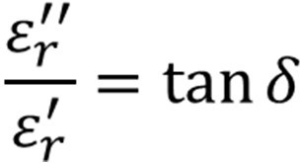

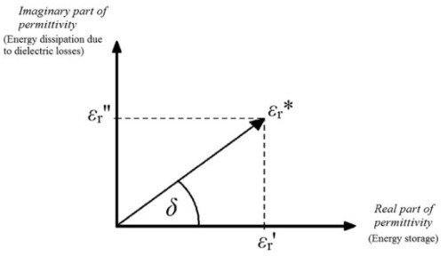
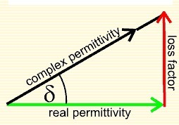
Complex Permittivity
The ratio of the imaginary part to the real part, called the dissipation factor or loss tangent, is:
A lossy dielectric is often used to imply a dielectric possessing considerable magnitude of the loss factor.
Page 29

Slide 30
Complex Permittivity
The degree to which the dipole is out of phase with the incident electric field and the losses that ensue determine how large the imaginary part of the permittivity is as a function of material and frequency.
The larger the imaginary part, the more energy is being dissipated through motion, and the less energy is available to propagate past the dipole.
Thus, the imaginary part of the relative permittivity is directly related to loss in the system.
Page 30

Slide 31
Dielectric Strength
The dielectric strength of a dielectric is the maximum electric field (or stress) that a dielectric can withstand without experiencing a breakdown.
Although it is often deemed as a characteristic of the material, it is found to be a function of several variables, such as, temperature, thickness of the specimen, geometry of the electrodes, waveform of the applied voltage and local conditions.
Even under controlled conditions, the dielectric strength shows a high degree of variability and hence, there is a need to specify not only its nominal value, but also the interval over which it may lie, along the conditions of measurement.
Normally, parallel plane, or plane-sphere electrode geometries are used to measure the breakdown voltage and hence the dielectric strength.
Page 31

Slide 32
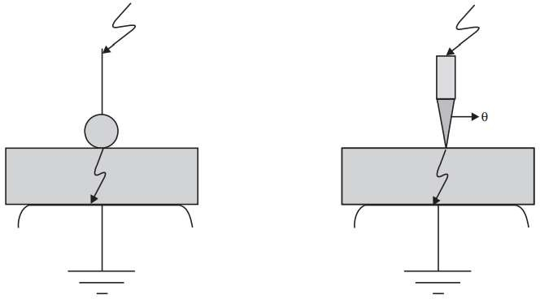
Dielectric Strength
When the electric field in a dielectric is sufficiently large, it begins to pull electrons completely out of the molecules, and the dielectric becomes conducting.
Dielectric breakdown is said to have occurred when a dielectric becomes conducting.
Page 32

Slide 33
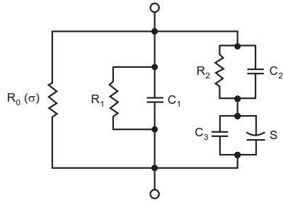
Losses in a Dielectric
Following are the mechanisms which lead to the loss:
Conduction loss P_{c} by ionic or electronic conduction
Polarization loss P_{p} by polarization
Ionization loss P_{i} by partial discharges internal or external zones
Conduction losses can be taken into account by a resistor R₀ (σ) in parallel.
Polarization losses produce a real component of the displacement current which is simulated by resistor R₁.
Pulse partial discharges are simulated by right hand branch.
Page 33

Slide 34
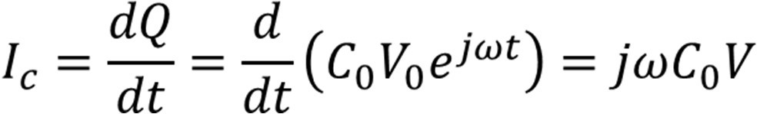
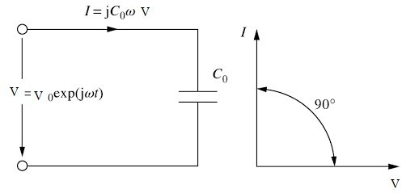
Losses in a Dielectric
Suppose that a vacuum capacitor with capacitance C₀ is connected to an ac voltage source V = V₀ exp (jωt) with an angular frequency ω = 2πf.
The charged stored by the capacitors is Q = C₀V and the current I_{c} flowing in the circuit,
Page 34

Slide 35
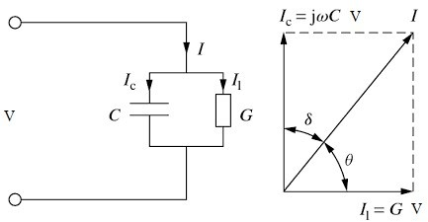
Losses in a Dielectric
Suppose that a dielectric material has been inserted into a capacitor as shown in the figure.
The total current consists of two components:
Charging current (I_{c}) that leads V by 90
Loss current (I_{l}) that in phase with V
Page 35

Slide 36
Losses in a Dielectric
The total current leads the voltage by an angle less than 90 and is given by,
where C is the capacitance of capacitor loaded with dielectric material G is the conductance of dielectric material
The angle between I_{c} and I is also known as loss angle δ, and is equal to (90 - θ)º. It is typically expressed in terms of tan δ (also called loss tangent or dielectric loss angle).
Dielectrics having high value of tan δ indicates high power loss and are regarded as poor insulating materials. Thus, high value of tan δ is undesirable.
The measurement of tan δ in insulating materials provides an indication of the quality of insulating material.
Page 36

Slide 37
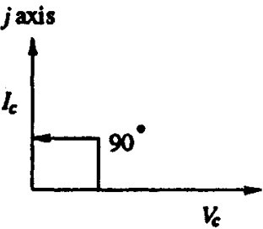

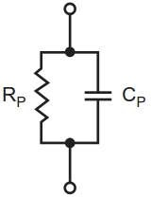
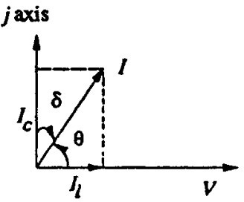
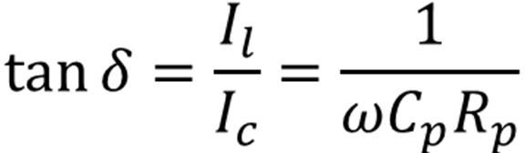
Losses in a Dielectric
The electrical behaviour of insulating materials under a.c voltages can be represented by two equivalent circuits, losses have been simulated by resistances.
Page 37

Slide 38

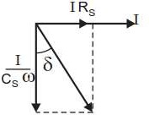

Losses in a Dielectric
Page 38

Slide 39

Losses in a Dielectric
As mentioned earlier, the dielectric loss consists of three components corresponding to the three loss mechanism:
For each of these, an individual loss tangent can be given such that,
If only conduction losses occur, then the conduction loss is measured in terms of specific dielectric loss.
The power losses per unit volume of the dielectric material is defined as specific dielectric loss denoted by W_{vol}.

Slide 40


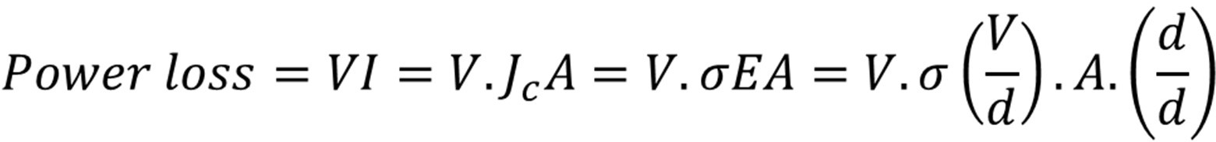
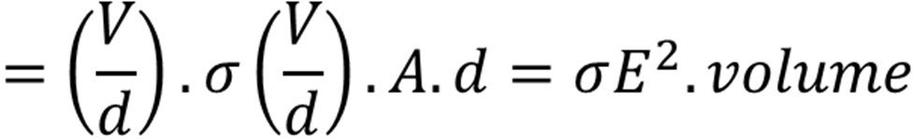
Losses in a Dielectric
When a dielectric is subjected to a steady state static electric field E, the current density J_{c} is given by:
Assuming a cuboid of the insulating material with an area A and thickness d, then

Slide 41
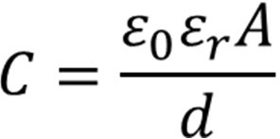
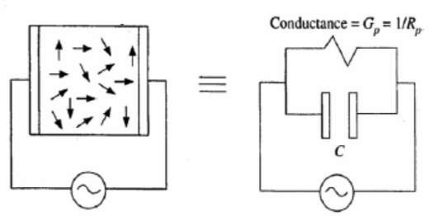
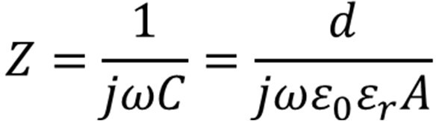
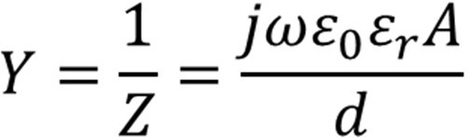

Losses in a Dielectric
Suppose that an alternating voltage is applied across a homogeneous dielectric material of area A and thickness d with lossy dielectric. The capacitance is given by,
Impedance of the circuit is given by,
Thus, the admittance of the circuit is given by,

Slide 42
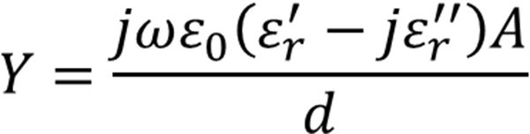
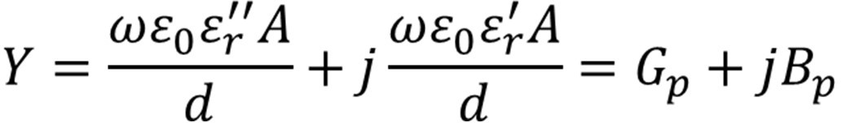

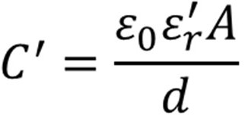
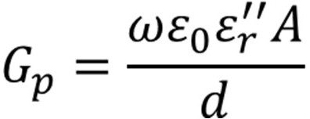
Losses in a Dielectric
The admittance can be expressed in the form,
Note: The admittance of the dielectric medium is equivalent to a parallel
where
combination of an ideal lossless capacitor C’ with a relative permittivity ε_{r}' and resistance of 1/G_{p} or conductance G_{p}.

Slide 43
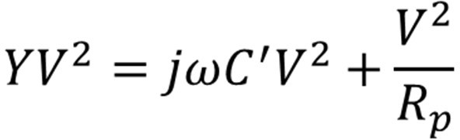
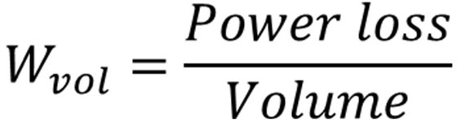
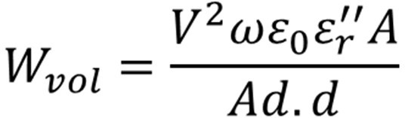
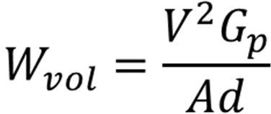
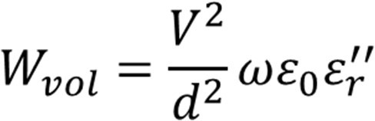
Losses in a Dielectric
The input power is given by,
Specific dielectric loss W_{vol} is given by,

Slide 44
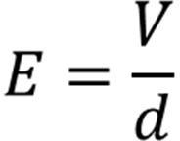
Losses in a Dielectric
where
E is the electric field
ω is the radian frequency
Conclusions:
Power loss is a function of ω, E and tan δ
Low tan δ is desirable to ensure low power loss for a good dielectric material
If tan δ varies and changes abruptly with the application of high voltage, it shows inception of internal partial discharge.

Slide 45
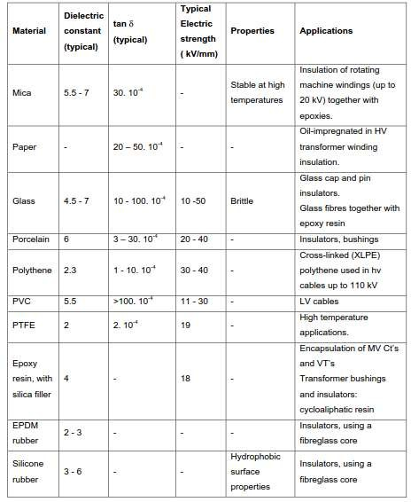
Losses in a Dielectric

Slide 46
Schering Bridge
The dielectric loss can be quantified by tan δ.
Too high losses during AC voltages may cause thermal breakdown.
Dielectric losses provide information about the quality of newly manufactured equipment.
Capacitance and dissipation factor shall be essentially constant with increasing voltage, as insulation systems are linear systems.
Schering bridge is widely used for the measurement of insulation resistance, capacitance and tan δ of high voltage insulators, cable sample and capacitors.
The bridge measures the capacitance C_{x} and tan δ of the test specimen by comparing it with a gas-filled standard capacitor C_{s} which has very low and nearly negligible loss over a wide range of frequency.

Slide 47
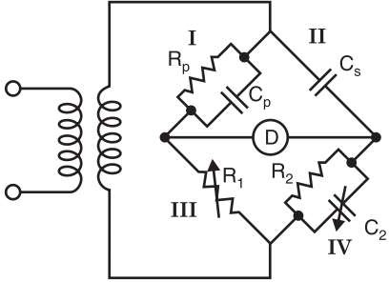

Schering Bridge

Slide 48
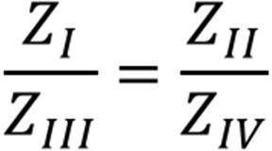




Schering Bridge
The bridge is balanced by successive variation of R₁ and C₂ until on the oscilloscope (detector) a horizontal straight line is observed.
At balance:

Slide 49
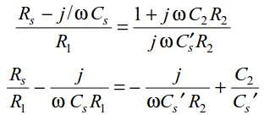
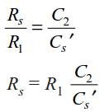
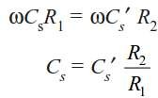
Schering Bridge
Balance equation becomes:
Equating the real and imaginary parts:

Slide 50


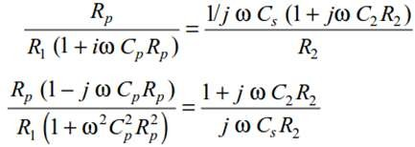
Schering Bridge
Thus, tan δ can be obtained as:
If, however, the specimen is replaced by a parallel equivalent circuit, then at balance:
From the balance equation:
Page 50

Slide 51




Schering Bridge
From the balance equation:
Equating real and imaginary parts:
Page 51

Slide 52



Schering Bridge
Page 52

Slide 53


Schering Bridge
Page 53

Slide 54
THANK YOU FOR YOUR ATTENTION

