Slide 1
EE450: High Voltage Engineering
Lecture 16

Slide 2
Outline
Generation of High AC Voltages
Generation of high AC Voltages
Single-stage testing transformers
Cascaded transformers
Resonant circuits
Series resonant circuits
Parallel resonant circuits
Resonant AC test system
Generation of high frequency AC voltages
Page 2

Slide 3
Generation of High AC Voltages
Generally, AC voltage tests are performed on all high voltage equipment at power frequency.
AC test voltages should be:
Sinusoidal
V_{pk}/V_{rms} = √2 ± 5% tolerance
Test voltage generated is single-phase voltage to ground. This implies that the insulation of one phase of the three-phase high voltage equipment can be only test at a time.
There are two methods for the generation of high AC voltages at power frequency:
Single-stage testing transformers
Resonant circuits
Page 3

Slide 4
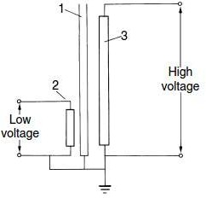
Single-Stage Testing Transformer
Single-stage testing transformers are used up to 300 kV.
High-voltage testing transformer usually have one end of high-voltage winding earthed.
The iron core is also earthed and one-terminal of low-voltage (LV) winding may also be earthed.
The LV winding may be fed from a motor- generator set or through an induction voltage regulator.
Rating of primary winding is usually less than 1 kV, but typically 230-240 V.
Page 4

Slide 5
Single-Stage Testing Transformer
A single-stage testing transformer possess following characteristics:
For the same voltage rating, a testing transformer usually has low power rating compared to a power transformer.
The flux density in the core should be kept low so that it does not draw large magnetising current which would otherwise saturate the core and produce higher harmonics.
A testing transformer designed at rated voltage and frequency may also be used at rated voltage and high/low frequency.
Two types of construction are possible for the testing transformer:
Tank-type
Insulated enclosure type
Page 5

Slide 6
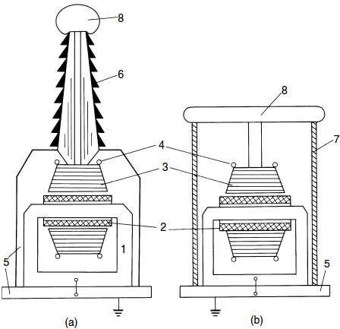
Single-Stage Testing Transformer
Iron core.
Primary LV or exciting winding.
Secondary HV winding.
Field grading shield.
Grounded metal tank and base.
H.V. bushing.
Insulating shell or tank.
H.V. electrode
Single unit testing transformers. (a) Tank-type. (b) Insulated-enclosure
Page 6

Slide 7
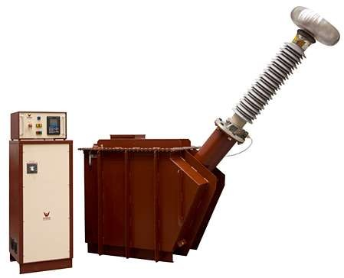
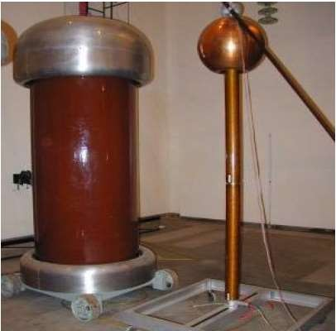
Single-Stage Testing Transformer
Single unit testing transformers. (a) Tank-type. (b) Insulated-enclosure
Page 7

Slide 8
Cascaded Transformers
For voltages higher than 400 kV, it is desired to cascade two or more transformers depending upon the voltage requirements.
Advantages:
The weight of the whole unit is subdivided into single units and, therefore, transport and installation becomes easier.
Transformer cost for a given voltage may be reduced, since cascaded units need not individually possess the expensive and heavy insulation required in single stage transformers for high voltages exceeding 345 kV.
The disadvantage of cascading is the heavy loading of the primary windings for lower stages.
Page 8

Slide 9
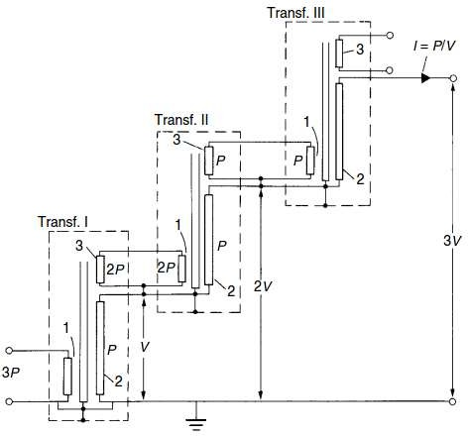
Cascaded Transformers
V₁
Page 9

Slide 10
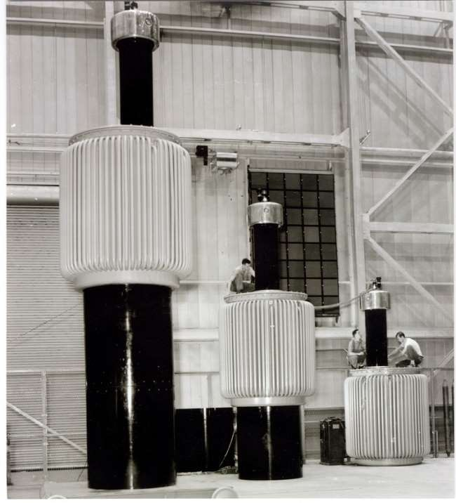
Cascaded Transformers
Three cascade transformers with an output voltage of 1050 kV (General Electric Company)
Page 10

Slide 11
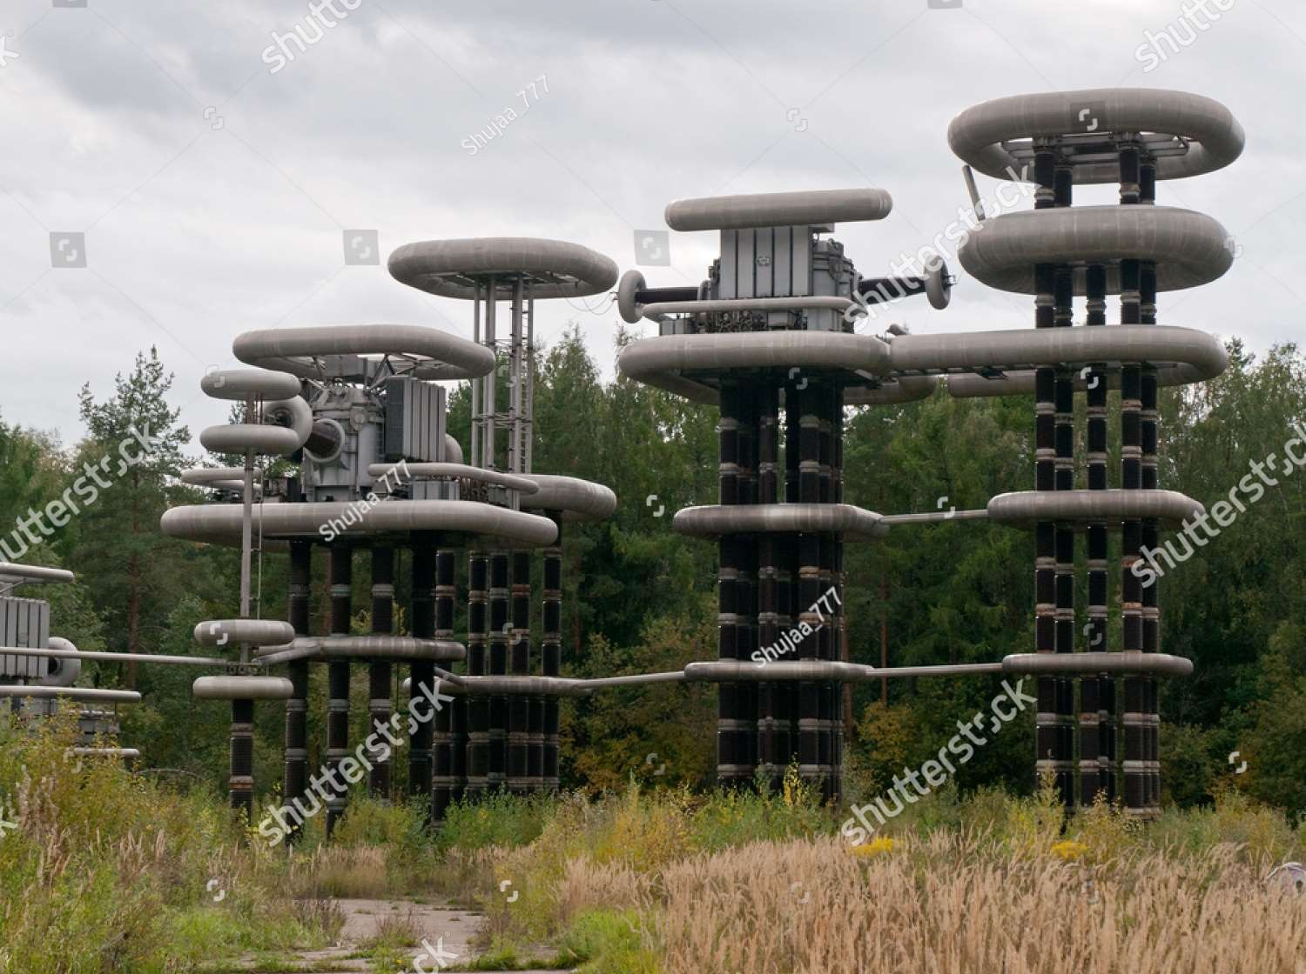
Cascaded Transformers

Slide 12


Resonant Circuits
Resonance occurs in electrical circuits due to the presence of energy storage elements, that are, inductances and capacitances.
There are two types of resonances:
Series resonance
Parallel resonance
This principle is utilized in testing at very high voltages and on occasions requiring large current outputs such as:
Cable testing,
Dielectric loss measurements,
Partial discharge measurements, etc

Slide 13
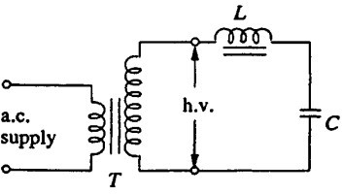
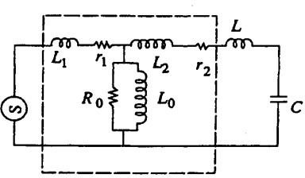
Series Resonant Circuits
Consider a high voltage testing transformer (T) whose secondary winding is connected in series with a choke (L₃) and C represents the capacitance of test object.
Let L₁, L₂ = leakage inductances of the transformer,
r₁, r₂ = resistances of the windings,
R₀ = resistance due to the core loss.
3
3

Slide 14

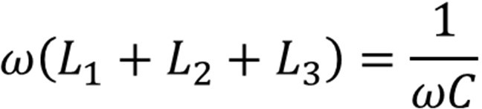
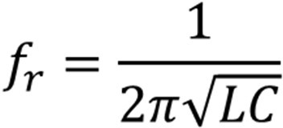
Series Resonant Circuits
If the supply frequency is varied such that:
then the resonance may occur in the circuit suddenly.
The frequency at which resonance occurs is called resonant frequency (f_{r}):
Alternately, at power frequency ω, the inductance is varied such that resonance is achieved.
When resonance occurs, the series combination of L and C can be replaced by a short circuit, and the current is limited by R only.

Slide 15
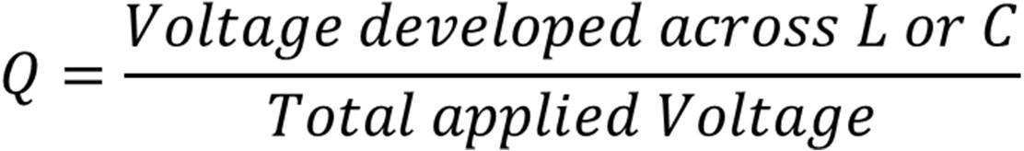
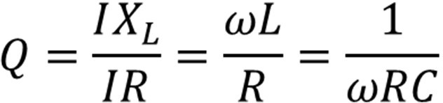
Series Resonant Circuits
If the quality factor of the circuit is denoted by Q,
For high voltage testing, Q-factor gives the magnitude of the voltage multiplication across the test object under resonance conditions and lies between 40-80.
Under series resonance, it may be noted:
I = V/R
V_{R} = V
V_{L} = QV
V_{C} = QV

Slide 16
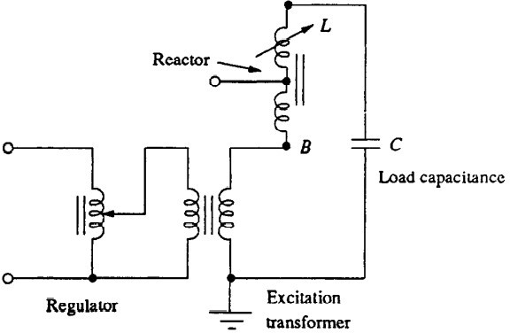
Series Resonant Circuits
In a series resonant test system, a voltage regulator of either an auto-transformer type or an induction regulator type is connected to the supply mains.
The secondary winding of the exciter transformer is connected across the high voltage reactor L, and the capacitance of the test object C.
The inductance of the reactor L is varied by varying its air gap.

Slide 17
Series Resonant Circuits
The specific weight of cascaded transformers varies between 10-20 kg/kVA whereas for series resonant circuit with variable high voltage reactor, it lies between 3-6 kg/kVA.
With the development of static frequency convertors, it is possible to reduce the specific weight of the circuit to approximately 0.5 kg/kVA.
In order to obtain resonance in the circuit, a choke of constant impedance can be used. As the load capacitance changes, the supply frequency should be changed.

Slide 18
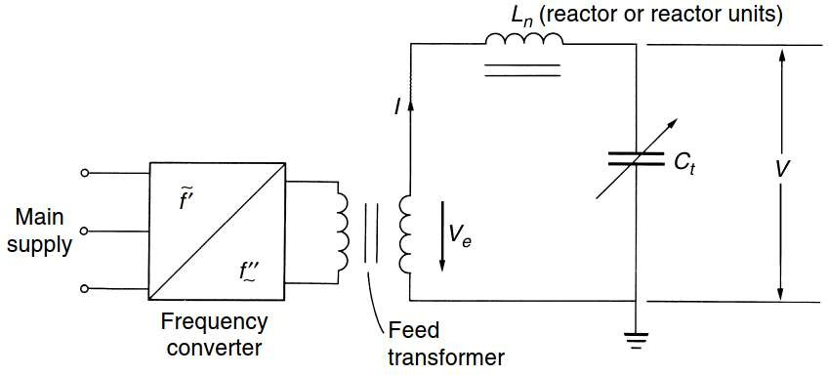
Series Resonant Circuits

Slide 19
Series Resonant Circuits
An exciter supply, connected to the LV mains, excites the series resonant circuit with a variable frequency; this supply is therefore designed as a controlled frequency converter, which are standard devices nowadays.
This converter supplies again only the losses of the testing circuit, which are usually less than about 2 per cent of the reactive power of C_{t}, if frequencies equal
or higher than 50 Hz are used.
The chokes can easily be designed for such high-quality factors, which increase with frequency up to some 100 Hz.
When testing objects with high capacitance, the saturation of core may take place.

Slide 20
Series Resonant Circuits
Clean sinusoidal output
Smaller power requirements
Series inductance compensates test object’s capacitive reactive power
No high-power arcing and heavy current surges occur if test object fails
Resonance ceases at the failure of the test object
Cascading is also possible (up to 3000 kV)
Simple and compact test arrangement
Reactor is considerably lighter than a transformer of equivalent power
The disadvantage is the requirements of additional variable chokes capable of withstanding the full test voltage and the full current rating.
Page 20

Slide 21
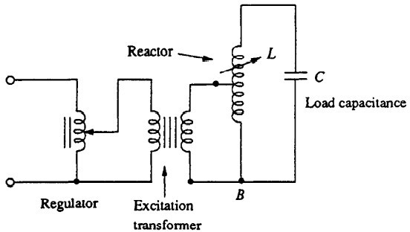
Parallel Resonant Circuits
In the parallel resonant mode, a high voltage testing transformer whose secondary winding is connected across a high voltage reactor (L) along with the capacitance of test object (C) is shown in figure.

Slide 22
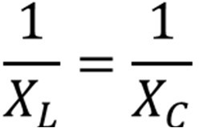

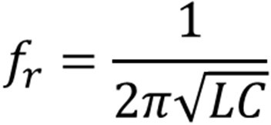
Parallel Resonant Circuits
If the supply frequency is varied such that:
then the resonance may occur in the circuit suddenly.
The frequency at which resonance occurs is called resonant frequency (f_{r}):
Alternately, at power frequency ω, the inductance is varied such that resonance is achieved.
When resonance occurs, the parallel combination of L and C can be replaced by an open circuit, and the current only flows through R.

Slide 23
Parallel Resonant Circuits
For a parallel resonance circuit, the Q-factor of the circuit is defined as the ratio of circulating branch currents to the supply current.
Under parallel resonance, it may be noted:
I = VY = V/R
I_{R} = I
I_{L} = QI
I_{C} = QI
The advantage of the parallel resonant circuit is that more stable output voltage can be obtained along with a high rate of rise of test voltage, independent of the degree of tuning and the Q-factor.

Slide 24
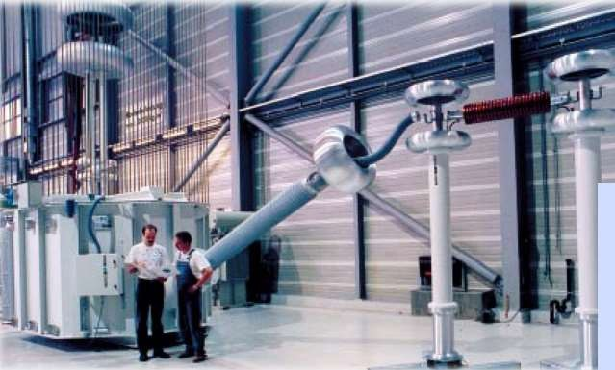
Resonant AC Test System

Slide 25
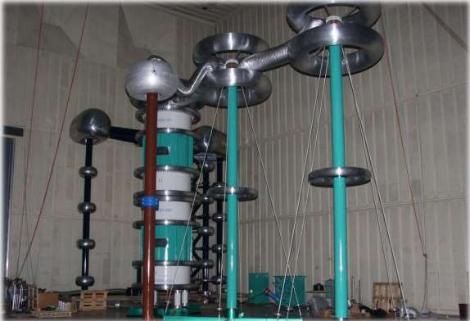
Resonant AC Test System
800 kV
Resonance Transformer (Series/Parallel)

Slide 26
Generation of High Frequency AC High Voltages
The commonly used high frequency resonant transformer is the Tesla coil, which is a doubly tuned resonant circuit shown schematically in Figure.
The primary voltage rating is 10 kV, and the secondary may be rated to as high as 500 to 1000 kV.
The primary is fed from a d.c. or a.c. supply through the capacitor C₁. A spark gap G connected across the primary is triggered at the desired voltage V₁ which induces a high self-excitation in the secondary.
The primary and the secondary windings (L₁ and L₂) are wound on an insulated former with no core (air-cored) and are immersed in oil. The windings are tuned to a frequency of 10 to 100 kHz by means of the capacitors C₁ and C₂.

Slide 27
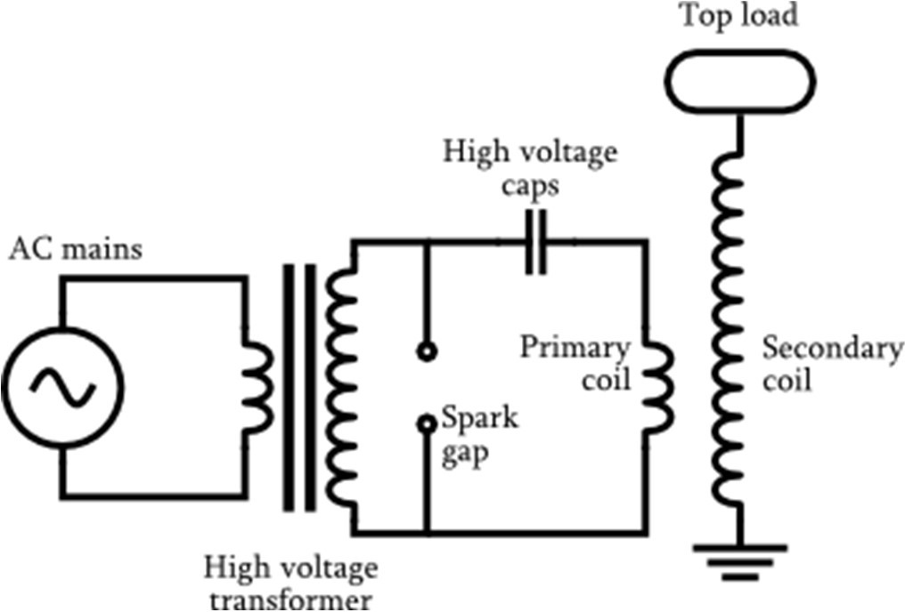
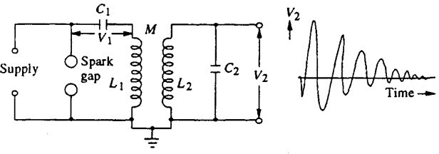
Generation of High Frequency AC High Voltages

Slide 28






Generation of High Frequency AC High Voltages
Let the capacitor C₁ be charged to a voltage V₁ when the spark gap is triggered. Let a current i₁ flow through the primary winding L₁ and produce a current i₂ through L₂ and C_{2.}

Slide 29




Generation of High Frequency AC High Voltages

Slide 30
Generation of High Frequency AC High Voltages
Page 30

Slide 31
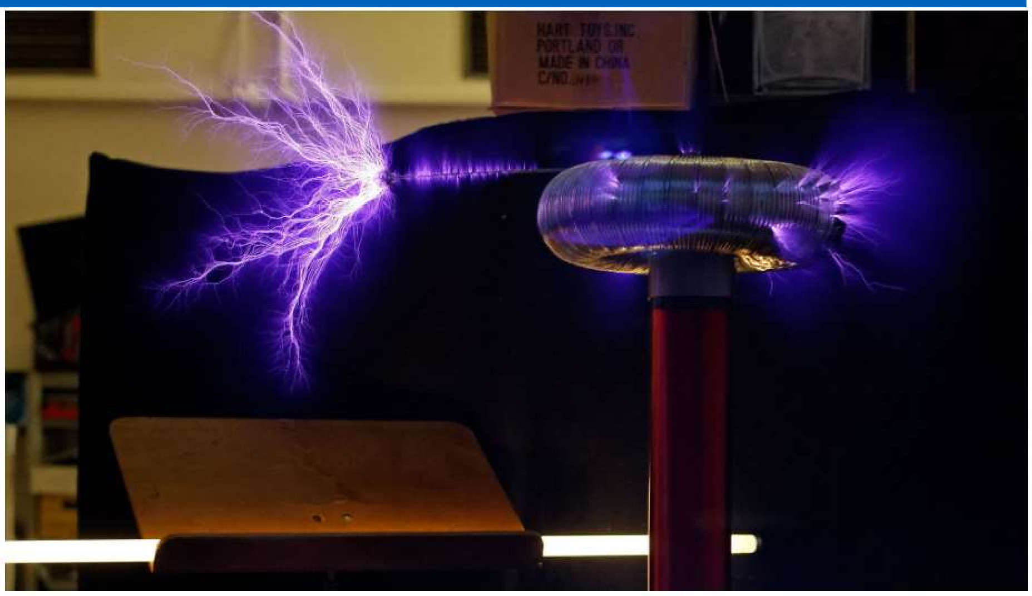
Generation of High Frequency AC High Voltages
Page 31

Slide 32
Suggested Readings
Suggested Reading: Chapter 2 (Kuffeel and Zaengl’s book)
Page 32

Slide 33
THANK YOU FOR YOUR ATTENTION

