Slide 1
EE451: High Voltage Engineering
Lecture 6 & 7

Slide 2
Outline
Electric Fields
Introduction
Fundamentals of electrostatics
Breakdown and electric strength of dielectrics
Partial breakdown in dielectrics
Classification of electric fields
Effect of grounding on field configurations
Control of electric field intensity
Page 2

Slide 3
Introduction
In power systems, the materials used are conductors (that carry current) and insulators (that prevent the flow of currents in undesired paths).
In high voltage engineering, we are particularly interested in the behaviour of insulating materials placed in the electric and magnetic fields.
Magnetic fields are produced by the currents flowing in conductors whereas electric fields are produced by the potential difference between electrodes.
The performance of an insulation system is governed by:
Dielectric strength of insulating materials
Electric field stresses developed in an insulating material when subjected to high voltages
Page 3

Slide 4
Fundamentals of Electrostatics
The electric charge is considered static when there is no movement of charge. This is possible only when the dielectrics have no or negligible conduction of current.
Unlike in metals, where the charge is turbulent, it can be considered to be relatively stationary in all dielectrics when static voltage is applied.
Electric fields are classified as:
Electrostatic field: field produced by static charge or direct voltage
Quasi-stationary electric field: field produced by power frequency alternating voltage
Both these fields are often assumed to be without any space charge and not influenced by the movement of charge carriers for analysis.
Page 4

Slide 5
Fundamentals of Electrostatics
Faraday described the space around a magnet to be filled with lines of magnetic force. These lines existed as mechanical structures in the surrounding medium (the dielectric) and could exert force on an object placed therein.
Similarly, the space around an energized object can be considered filled with lines of electric force.
The electric field lines also exert a force on the charged body according to relation, F
= q×E.
The electric field produced due to potential on a body stresses the insulating material.
Electric field intensity E (or electric field strength) is the measure of the strength
of an electric field at any point in the dielectric material.
Page 5

Slide 6
Fundamentals of Electrostatics
Electric field intensity is defined as the electrostatic force F per unit positive test charge q, placed at a particular point p in a dielectric.
The electric field intensity is expressed in Newtons per Coulomb or Volt per meter.
Since the potential is expressed in Joules per Coulomb (J/C), or Newton-meter per Coulomb (Nm/C), which is defined as Volt, the electric field intensity is measured in its more common practical units of Volt per meter (V/m, kV/cm or kV/mm).
Thus, the electric field intensity E is the measure of magnitude of electric stress on a dielectric material.
The configuration of electric field has a significant effect on the performance of a dielectric material.
Page 6

Slide 7
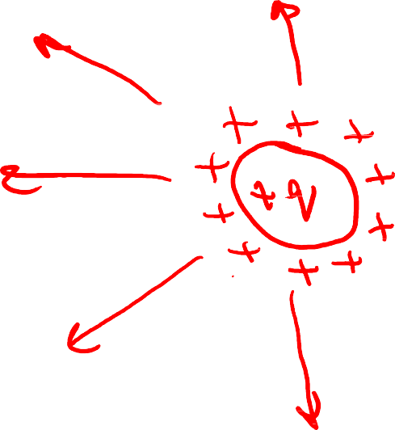










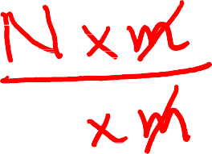

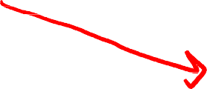







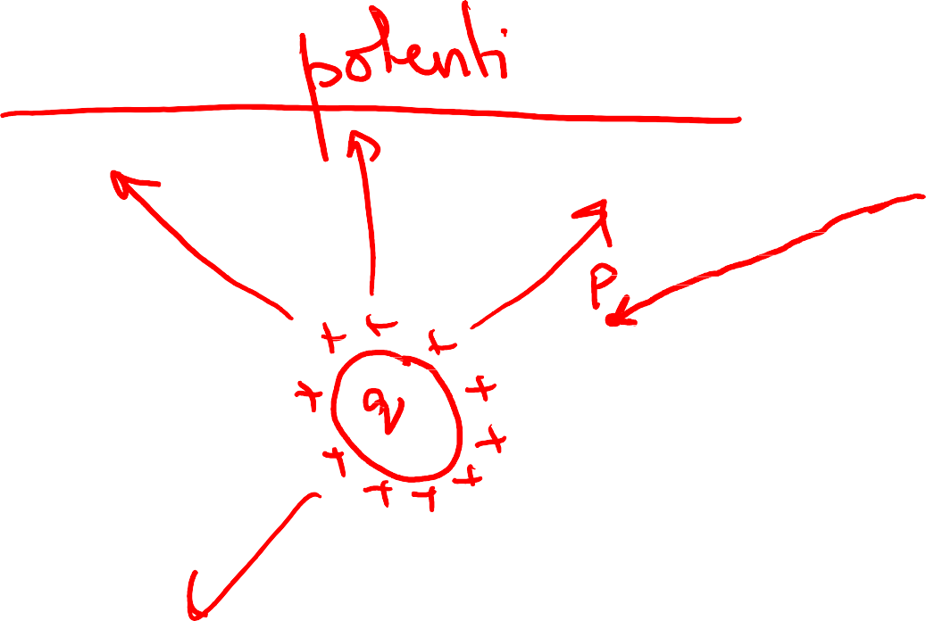










Slide 8

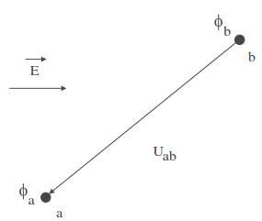
Fundamentals of Electrostatics
The potential difference U_{ab} between two points a and b (having scalar potentials φ_{a} and φ_{b} in an electric field E) is defined as the work done by an external source in moving a unit positive charge from b (last named) to a (ﬁrst named),
U_{ab} is positive if the work is done in carrying the unit positive charge from b to a.
Page 8

Slide 9

Fundamentals of Electrostatics
The magnitude of electric field intensity is given by the value of the rate of change of potential with distance.
The maximum magnitude of the field intensity can be obtained when the direction of the increment of distance is opposite to the direction of E.
In other words, the maximum value of the rate of change of potential is obtained when the direction of E is opposite to the direction in which the potential is increasing most rapidly,
Page 9

Slide 10

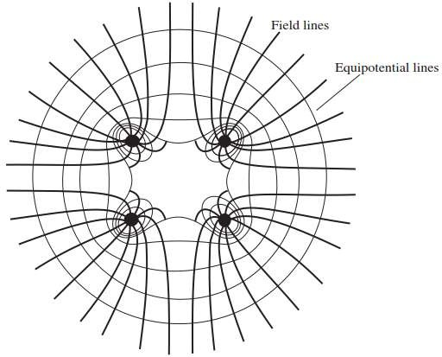
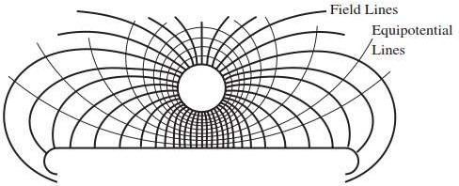
Fundamentals of Electrostatics
Thus, the electric field intensity can be obtained from the scalar potential φ. The operator on φ by which E is obtained is thus known as the gradient.
The relationship between φ and E written as:
The electric field intensity E is, therefore, numerically equal to the potential gradient.
Page 10

Slide 11
Breakdown and Electric Strength of Dielectrics
The qualitative definition of electric strength of a dielectric is the maximum electric stress a dielectric can withstand without rendering it to rupture completely.
However, a quantitative definition is complicated because a large number of factors affect the electric breakdown of a dielectric.
These factors include:
Composition of dielectric material
Presence of impurities and imperfections in the dielectric
Pressure, humidity, temperature
Electric field configuration (shape of the electrodes, their size and gap distance)
Electrode material
Duration, magnitude and waveform of the applied voltage

Slide 12
Breakdown and Electric Strength of Dielectrics
To understand the behaviour of dielectrics, the mechanisms of insulation breakdown and the factors on which the breakdown voltage depends is an important field of study and research.

Slide 13
Breakdown and Electric Strength of Dielectrics
In a time varying ac power frequency field (quasi stationary field), the maximum electric stress occur at the peak value of the applied voltage.
Intrinsic strength of a dielectric material: defined differently for different types of dielectrics.
Gaseous dielectrics: It is the magnitude of the breakdown voltage measured
across a gap distance of one cm in uniform electric field at normal temperature and pressure.
Liquid and solid dielectrics: It is the highest value of breakdown strength obtained after eliminating all known secondary effects which may influence the breakdown adversely.

Slide 14
Breakdown and Electric Strength of Dielectrics
Intrinsic strength is measured for the ideal conditions of the dielectric in a uniform
electric field.
Since, the intrinsic strength is very high for solid and liquid dielectrics compared to gaseous dielectrics, it is measured from mm and µm thin films of the liquid and solid dielectrics respectively instead of 1 cm gap distance in case of gaseous dielectrics.

Slide 15
Partial Breakdown in Dielectrics
On applying sufficient voltage, extreme electric field enhancement at a particular or at several locations within a dielectric may develop depending upon the electrode configurations.
At such location(s), the dielectric could get stressed excessively to the extent that it may lose its insulating capability restricted only to this region.
This gives rise to local breakdown of the insulation known conventionally as partial discharge (PD) in the dielectric material.
In a real sense, PD is a partial breakdown (PB) in the dielectric material.

Slide 16
Partial Breakdown in Dielectrics
The voltage applied across the dielectric at which PD activity begins locally somewhere in the dielectric is known as partial breakdown inception voltage (U_{i}).
Partial breakdown (PB) takes place in all the dielectrics but only under extremely non-uniform field conditions.
PB of dielectric material may happen in several ways:
Corona (when stable PB occurs at a free electrode in gaseous dielectrics)
Internal breakdown (when PB occurs inside a solid or a liquid dielectric)
Surface breakdown or tracking (when PB takes place on the surface of a solid or a liquid, or in a gas)

Slide 17
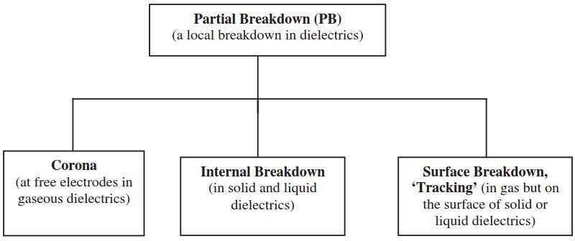
Partial Breakdown in Dielectrics

Slide 18
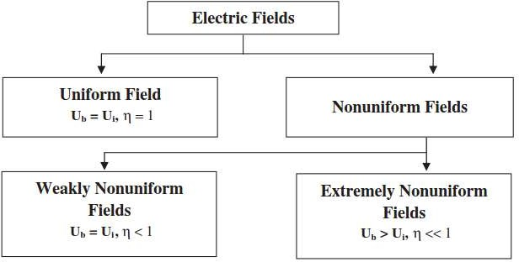
Classification of Electric Fields

Slide 19


Schwaiger Factor
The degree of uniformity η (also known as Schwaiger factor) is a measure of the uniformity of a field, and defined as follows:
where Eˆ_{mean} = peak values of the mean field intensity in a dielectric Eˆ_{max} = maximum field intensity in a dielectric
Uˆ is the peak value of potential difference applied between the two electrodes at a distance d apart.
The value of η lies between 0 to 1, and represents the degree of utilization of the dielectric between the two electrodes.

Slide 20
Schwaiger Factor
Higher value of η represents better use of the insulating properties of the dielectric.
Thus η, a dimensionless quantity enables a comparison of the uniformity of field conﬁgurations formed between different electrodes.
It compares the ideal condition of electric field intensity (uniform field between electrodes at the same gap distance d apart) with the existing actual maximum field intensity.
With the knowledge of the value of η for a particular field configuration, the maximum electric field intensity or the maximum electric stress on a dielectric can easily be estimated.
η serves as a ready reference that is important information for insulation design in equipments.
Page 20

Slide 21
Schwaiger Factor
The exact magnitude of maximum electric stress for simple geometries of the electrodes may be determined analytically.
However, for complicated shapes of electrodes, numerical estimation techniques such as finite difference method, finite difference time domain method, charge simulation method, finite element method etc. may be applied.

Slide 22
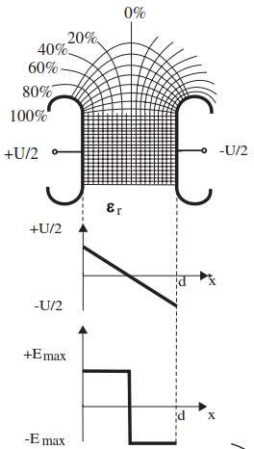
Uniform Electric Field
In a uniform field, the potential is linearly distributed so that the field lines and equipotential lines make perfect square in the main field region.
Hence, the electric field intensity is constant throughout the space between the two electrodes (see figure).
An important characteristic of the uniform field is that the insulation breakdown in such a field always takes place without any partial breakdown proceeding within the dielectric. For uniform fields,
U_{b} = U_{i}
η = 1

Slide 23
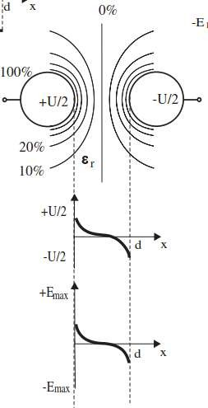
Weakly Non-uniform Electric Field
In weakly non-uniform fields, no stable partial breakdown
takes place before the complete breakdown in the dielectrics. Hence, in such fields,
U_{b} ≈ U_{i}
η < 1 ( ≥ 0.25)
The lower value limit of η depends upon the physical conditions of the dielectric between the electrodes.
Typical examples include:
Radial fields between two coaxial cylinders and concentric spheres
Field between two adjacent spheres

Slide 24
Extremely Non-uniform Electric Field
Non-uniform field configuration is very important as it is the most unfavourable
and widespread type of electric field in the power system.
Unlike in uniform and in weakly non-uniform fields, the breakdown of dielectrics in extremely non-uniform fields always takes place after stable partial breakdown phenomenon is able to set in.
For such electric field configurations,
U_{b} > U_{i} η < 1

Slide 25
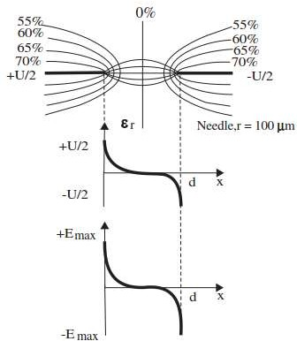
Extremely Non-uniform Electric Field
Figure shows a typical extremely non-uniform field in the dielectric between two symmetrical needle-needle electrode system.
It can be observed that at the tip of a sharp electrode, the dielectric is subjected to very high electric stress, but elsewhere in the same insulation system between the electrodes, it may be stressed moderately.

Slide 26
Effect of Grounding on Field Configuration
Previously, all the field configurations shown are formed between identical pair of electrodes having symmetrical voltage applied across the dielectric material.
In such cases, the electric field configuration has symmetry on either side of the zero potential line, a straight line that falls exactly in the middle of the dielectric between the two electrodes.
The equipotential lines are evenly distributed in the dielectric on either side of this centre line. However, in practice such symmetrical systems are rarely present.

Slide 27
Effect of Grounding on Field Configuration
Asymmetry in electric field configurations is introduced in two ways:
When the two electrodes are not identical
When the voltage applied across them is not symmetric (one of the two electrodes is grounded)
Unsymmetrical electrode combinations, such as sphere-plane, rod-plane etc., applied with unipolar voltage on one electrode and the other electrode grounded are typical examples of asymmetry.

Slide 28
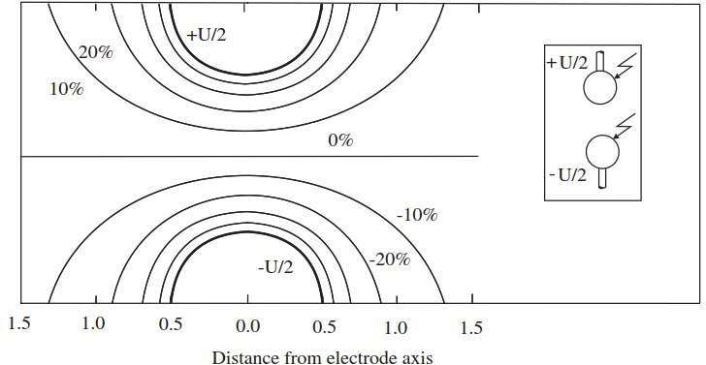
Effect of Grounding on Field Configuration
Figure shows the equipotential lines between identical pairs of spherical electrodes applied with symmetrical voltage +U/2 and −U/2 respectively.

Slide 29
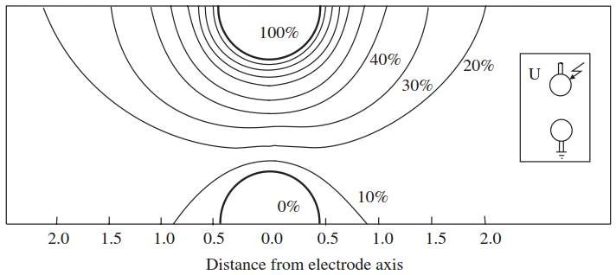
Effect of Grounding on Field Configuration
Figure shows the same electrode pair in which an equal magnitude of voltage U is applied on the top sphere and the lower sphere being grounded.

Slide 30
Effect of Grounding on Field Configuration
Following observations can be made:
The distribution of equipotential lines is unsymmetrical.
The equipotential lines have a tendency to shift closer to the high voltage electrode.
It results in higher maximum field intensity E_{max} in the dielectric for the same magnitude of voltage applied across the gap as in the first case.
It can conclude that the grounding of one of the electrodes introduces more non- uniformity in the electric field, hence a lower value of η.
Page 30

Slide 31
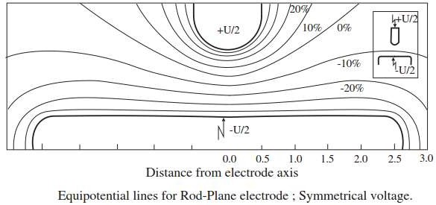
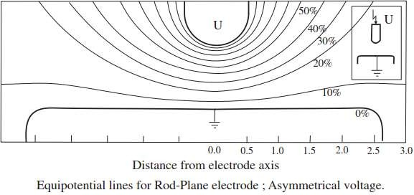
Effect of Grounding on Field Configuration

Slide 32
Control of Electric Field Intensity
More uniform is the field, better the use of the dielectric. An ideal use can be accomplished only in case of a totally uniform field, that is, when η = 1. However, it is not possible in practice.
Non-uniformity in the field leads to uneconomical use of the insulating materials. More is the non-uniformity, higher the electric stress in the dielectric material.
Insulation design in an equipment should be done with due consideration to the estimated maximum electric field intensity.
Following methods are adopted for the control of electric stress:
By shaping the conductors to reduce stress concentrations
By the insertion of higher dielectric strength at higher stress points
By the selection of materials of appropriate permittivity to obtain more uniform potential gradients

Slide 33
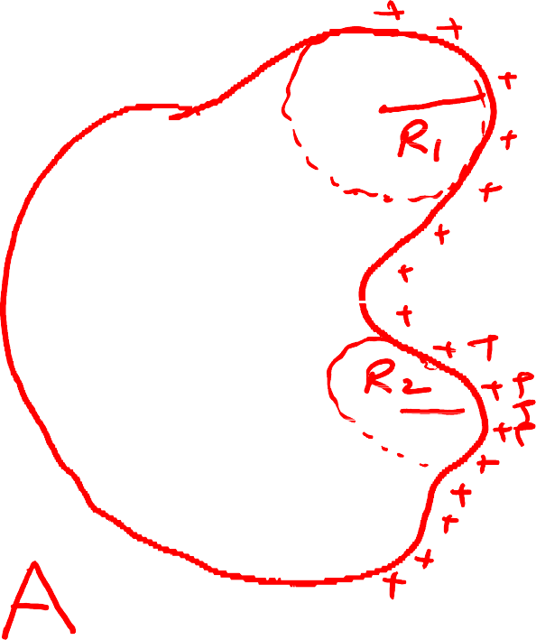




















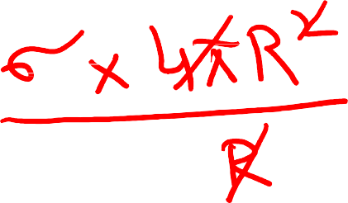












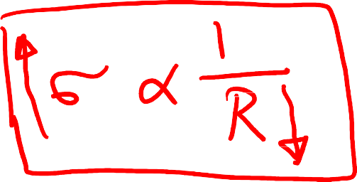








Slide 34
Control of Electric Field Intensity
It is possible to achieve a higher degree of uniformity of fields by giving suitable shapes and sizes to various electrodes in the equipment.
For example, an abrupt interruption of electrodes (at either anode or cathode) in high voltage equipment leads to concentration of electric ﬁeld at the brims. This results in a tremendous enhancement of electric stress on the dielectric.
Therefore, the volume of dielectric in the vicinity thus becomes highly vulnerable to complete breakdown of insulation.
In order to avoid this and to control the electric stress, the electrodes must be shaped suitably at the brim.

Slide 35
Control of Electric Field Intensity
For stress control, in principle the electrodes are extended and/or given forms so that higher ﬁeld intensity than in the main ﬁeld region does not appear anywhere in the dielectric.
To achieve this, Rogowski in 1923 suggested a shape by which the electrodes could be extended, known as Rogowski Proﬁle.
One can see that the ﬁeld intensity continuously reduces beyond the main field region.
Another shape of the electrode credited to Borda known as Borda Proﬁle, was actually worked out by him in in 1766.
This electrode profile achieves even lower field intensity beyond the main field region than in case of Rogowski profile.

Slide 36
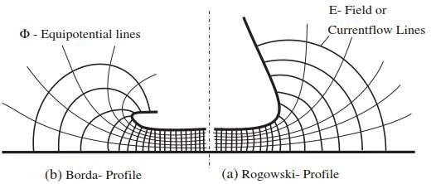
Control of Electric Field Intensity

Slide 37
Control of Electric Field Intensity
Electrodes at high potentials in the laboratory are given large, smooth, dome like bodies or other shapes, like toroid rings, to bring down the electric stress on the atmospheric air (dielectric medium).
The modern trend in such electrode design includes segmented electrodes. These constitute a number of small, identical, smooth discs brought together to give rise to a large desired continuous shape as per requirement.
The curvatures of the individual segment discs are worked out by optimization of the suggested proﬁles.
Figure (next slide) shows the single metallic body and the segmented electrodes used in high voltage test apparatus for stress control.

Slide 38
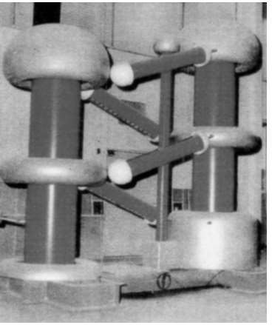
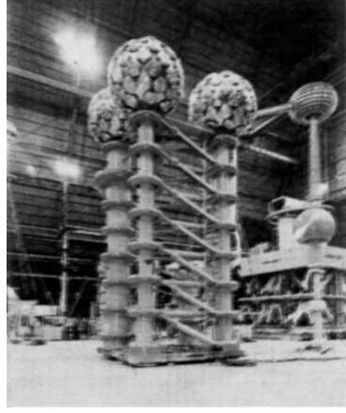
Control of Electric Field Intensity
Single Metallic body (DC Generator 900 kV)
Segmented Electrodes (AC Generator 600 kV)

Slide 39
Control of Electric Field Intensity
Bushing is a hollow insulator that allows a conductor to pass safely through the grounded tank of power transformer without making electrical contact with it.
In high voltage bushings, potential transformers, and cable terminations, the insulation is provided with capacitive grading in order to achieve a well-distributed potential gradient leading to a more uniform field distribution in the dielectric.
It is attained by inserting a few concentric conductive layers of calculated dimensions at appropriate positions in the dielectric, known as floating screens to control the electric stress as shown in figure. These ﬂoating electrodes work as equipotentials.
An economic use of the insulating material is thus achieved by evenly distributing the electric stress in the complete dielectric.

Slide 40
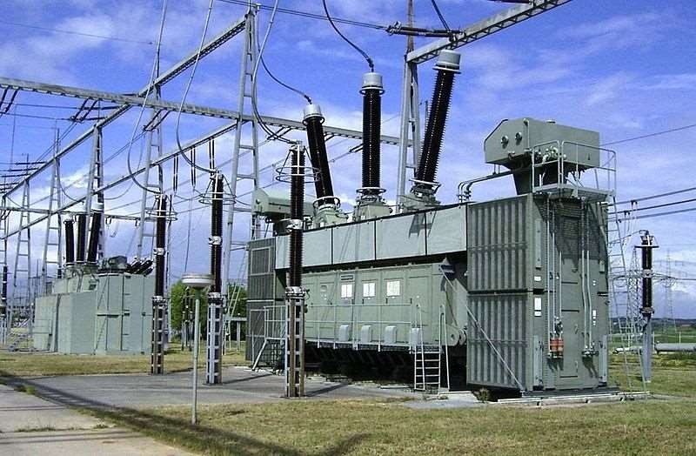
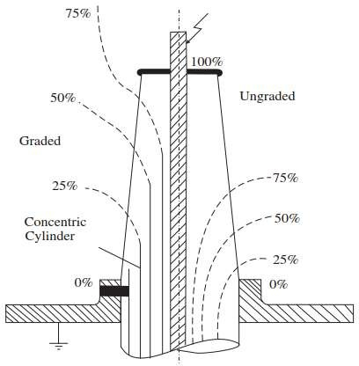
Control of Electric Field Intensity
Page 40

Slide 41
Control of Electric Field Intensity
Extended shapes of electrodes, also known as shields, are suitably provided on high voltage apparatus for electric stress control as shown in figure (next slide).
Sharp contacts are often enveloped by a large diameter hemispherical electrode having an aperture, or provided with concentric toroidal rings (doughnut shaped rings).
Large spheres with smooth holes are provided at bends are provided for the connection of circular and tubular electrodes.
Instead of wires, tubular electrodes of large diameters are used for the connections at substations and high voltage laboratories, which bring down the fields intensity at higher voltages considerably.

Slide 42
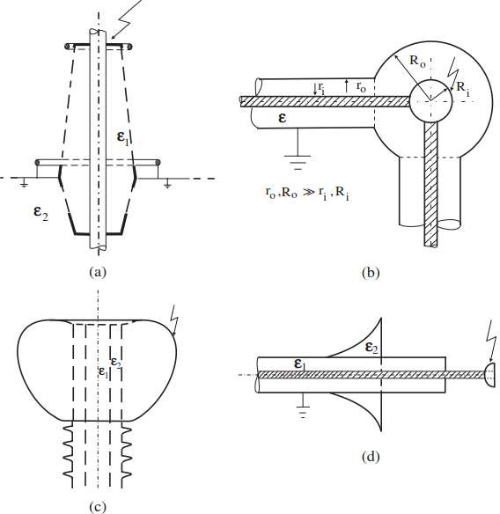
Control of Electric Field Intensity

Slide 43
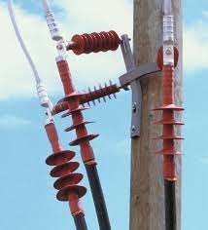
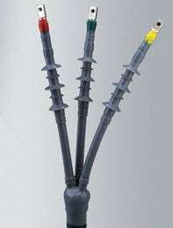
Control of Electric Field Intensity

Slide 44
Control of Electric Field Intensity
Use of screen (also known as shield or concentric conductor) over the insulation in coaxial high voltage cables is made to control the electric stress. The field achieved in these screened cables is radial and generally a weakly non-uniform field.
For making cable joints and terminations, the screen is extended in the form of a cone, known as ‘stress cone’ .
This helps in achieving a more uniform distribution of electric stress in the dielectrics at the end terminations and the joints, as shown in figure.
It is a common practice to use bundles of two or more conductors at the same potential instead of a single conductor in transmission lines and bus bars above 220 kV. It brings down the electric stress i.e. a method of stress control.
As the transmission voltages are increasing, bundles with eight or even more number of conductors are being used in practice.

Slide 45
Control of Electric Field Intensity
A modest rule of thumb to control electric stress in high voltage apparatus is to avoid sharp points and edges.
Symmetrical, smoothly shaped and large electrodes are preferable.
It must be borne in mind that even the roughness on metallic surfaces can lead to distortions in the ﬁeld at higher voltages especially when the gap distance is small.
Furthermore, microprotrusions in solid dielectrics may grow with PB and penetrate deeper in the dielectric when the electric ﬁeld intensity exceeds a certain minimum value and cause local ﬁeld enhancement.
These must be prevented from developing during manufacturing and subsequently in service and also maintenance.

Slide 46
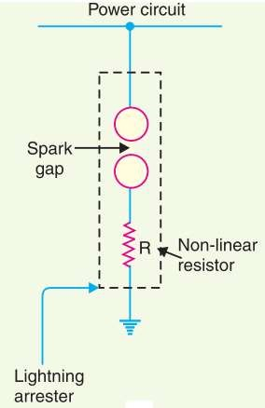
Control of Electric Field Intensity
Lightning arresters are connected between the line and earth to divert the incoming high voltage surge to earth.
It consists of a spark gap in series with a non-linear resistor.
One end of the diverter is connected to the terminal of the equipment to be protected and the other end is effectively grounded.
The length of the gap is so set that normal line voltage is not enough to cause an arc across the gap but a dangerously high voltage will break down the air insulation and form an arc.
The property of the non-linear resistance is that its resistance decreases as the voltage (or current) increases and vice-versa.

Slide 47
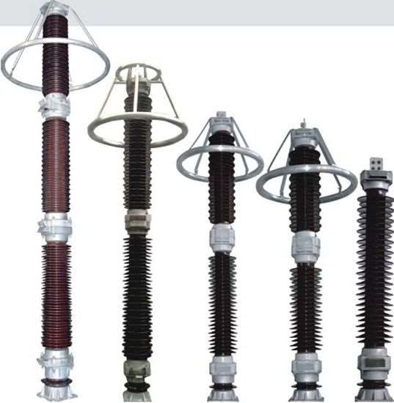
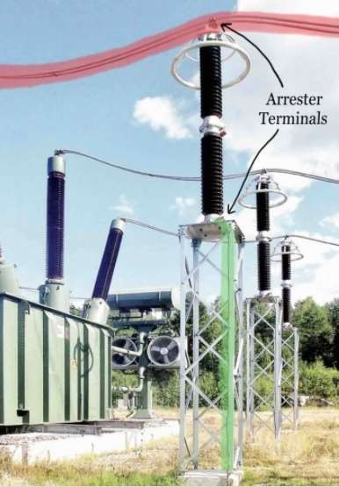
Control of Electric Field Intensity

Slide 48
THANK YOU FOR YOUR ATTENTION

