Slide 1
Introduction to MATLAB

Slide 2
What is MATrix LABoratory ?
It is developed by The Mathworks, Inc. (http://www.mathworks.com)
It is an interactive, integrated, environment
for numerical/symbolic, scientific computations and other apps.
shorter program development such as FORTRAN and C.

Slide 3
Getting Started With MATLAB
Double click MATLAB icon
Either case a MATLAB window with >> prompt.
>> % from % to end of line used for code documentation
>> version % this will tell you the running MATLAB version
ans = 8.6.0.267246 (R2015b)
>> help % lists available packages/toolboxes on system.
>> help sin % instructions on the sine function
>> lookfor sine % if you don’t know the function name …
>> doc sin % for full details of function
>> quit % to quit MATLAB

Slide 4
Rules on Variables and File Names
Variable, function, file names
is case sensitive, e.g., NAME and Name are 2 distinct names.
variable begins with a letter, e.g., A2z or a2z
can be a mix of letters, digits, and underscores (e.g., vector_A)
reserved characters: % = + – ~ ; : ! ' [ ] ( ) , @ # $ & ^
File name
MATLAB command files should be named with a suffix of ".m", e.g., myfile.m. An m-file typically contains a sequence of MATLAB commands that will be executed in order
A file may contain a collection of commands, functions
Note: To run, enter m-file, without .m, e.g.,
>> myfile

Slide 5
Reserved Characters % = ; ,
Some characters are reserved by MATLAB for various purposes. Some as arithmetic or matrix operators: =, +, - , *, / , \ and others are used to perform a multitude of operations. Reserved characters cannot be used in variable or function names.
>> % anything after % until the end of line is treated as comments
>>
>> a = 3 % define a to have the value 3
a =
3
>> a = 3; % “;” suppresses printing
>>
>> b = 4; c = 5; % “;” enables multiple commands on same line
>>
>> d = 6, e = 7; % “,” delimits commands but enables printing
d =
6

Slide 6
Reserved Characters : [ ] ( )
>> x = 1:2:9 % define vector x with : operator (begin:interval:end)
x =
1 3 5 7 9
>> y = 3:5 % interval is defaulted to 1; same as y=[3:5]
y =
3 4 5
>> X = [1, 2, 3; 4, 5, 6] % 2D array.
% [ ] for arrays. Prevents ambiguity
% ; concatenates vertically (new row)
% , concatenates horizontally (new columns)
X =
1 2 3
4 5 6
>> X(2,3) % ( ) for subscripting; why ans ?
ans =
6

Slide 7
Reserved Characters … and '
>> x = [1 2 3 … % … means to be continued on the next line
4 5 6]
x =
1 2 3 4 5 6
>> s = 'this is a character string'; % blanks preserved within quotes
>> x = [1 2 3]' % ' performs transpose (e.g., turns row into column)
x =
1
2
3
>> X = [1 2 3; 4 5 6]; size(X); length(X) % figure out the size (dimensions) of X and maximum length of X
ans =
2 3
>> X = [1 2 3; 4 5 6]; numel(X) % total number of entries in X
ans =
6

Slide 8
Array operations
>> a = 1:3; % a is a row vector
>> b = 4:6; % b is a row vector
>> c = a + b % c has same shape as a & b
c =
5 7 9
>> A = [a;b] % combines rows to generate 2x3 matrix A; A=a;b ?
A =
1 2 3
4 5 6
>> B = A' % B is transpose of A
B =
1 4
2 5
3 6

Slide 9
Matrix Operations
>> C = A*B % * is overloaded as matrix multiply operator
C =
14 32
32 77
>> D = A.*A % a .* turns matrix multiply to elemental multiply
D =
1 4 9
16 25 36
>> E = A./A % elemental divide
E =
1 1 1
1 1 1
>> who % list existing variables in workspace
Your variables are:
A B C D E a b d

Slide 10
For Loops
a=0;
for j=1:5 % use for-loops to execute iterations / repetitions
a = a + 1 ;
end
Utilities to initialize or define arrays: ones, zeros, rand, eye, . . .
Trigonometric and hyperbolic functions : sin, cos, sqrt, exp, . . .
These utilities can be used on scalar or vector inputs
>> a = sqrt(5); v = [1 2 3]; A = sqrt(v);

Slide 11
Cell Arrays
>> a = 1:3; b = [4;5;6]; s = 'This is a string.’;
>> b(1,:) % prints first row of cell array
>> b(1,1) % first element at first row and first column
>> b(:,1) % first column

Slide 12
Script m-file
If you have a group of commands that are expected to be executed repeatedly, it is convenient to save them in a file . . .
x=0:0.01:10;
a=sin(x); % compute sine x (radians)
b=cos(x); % compute cosine x (radians)
c=a+b;
Select File/Save to save it as myfile.m.

Slide 13
Function m-files
It is declared with the key word function, with optional input parameters on the right and optional output on the left of =. All other parameters within function reside in function’s own workspace.
Use MATLAB editor to create file: >> edit average.m
function avg=average(x)
% function avg=average(x)
% Computes the average of x
% x (input) matrix for which an average is sought
% avg (output) the average of x
avg = sum(x)/numel(x); % the average
end
Save the above with File/Save
Recommendation: saves file with name same as function name
It may be called from a script, another function, or on command line:
>> a = average(1:3) % a = (1 + 2 + 3) / 3
a =
2
>> help average % prints contiguous lines with % in average

Slide 14
Some Frequently Used Functions
>> zeros(n,m) % creates n x m matrix of zeroes (0)
>> ones(n,m) % creates n x m matrix of ones (1)
>> rand(n,m) % creates n x m matrix of random numbers
>> abs(x); % absolute value of x
>> exp(x); % e to the x-th power
>> fix(x); % rounds x to integer towards 0
>> log10(x); % common logarithm of x to the base 10
>> rem(x,y); % remainder of x/y
>> mod(x, y); % modulus after division – unsigned rem
>> sqrt(x); % square root of x
>> sin(x); % sine of x; x in radians
>> cos(x); % cosine of x; x in radians
>> acoth(x) % inversion hyperbolic cotangent of x
>> x^y % x power y

Slide 15
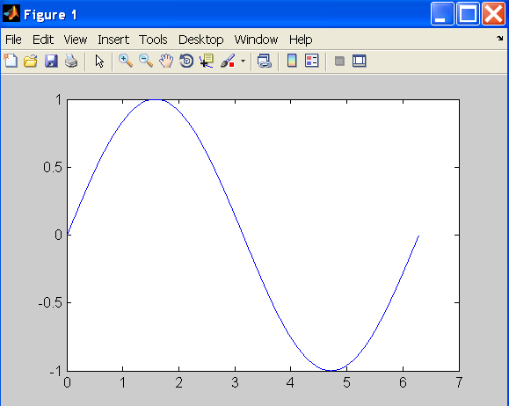
Line Plot
>> t = 0:pi/100:2*pi;
>> y = sin(t);
>> plot(t,y)

Slide 16
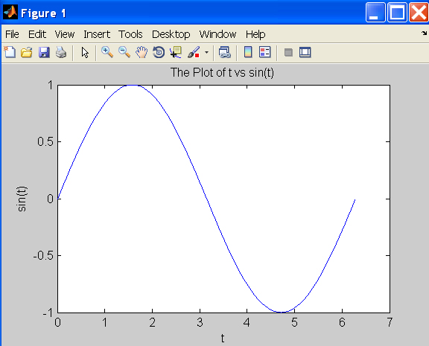
Line Plot
>> xlabel(‘t’);
>> ylabel(‘sin(t)’);
>> title(‘The plot of t vs sin(t)’);

Slide 17
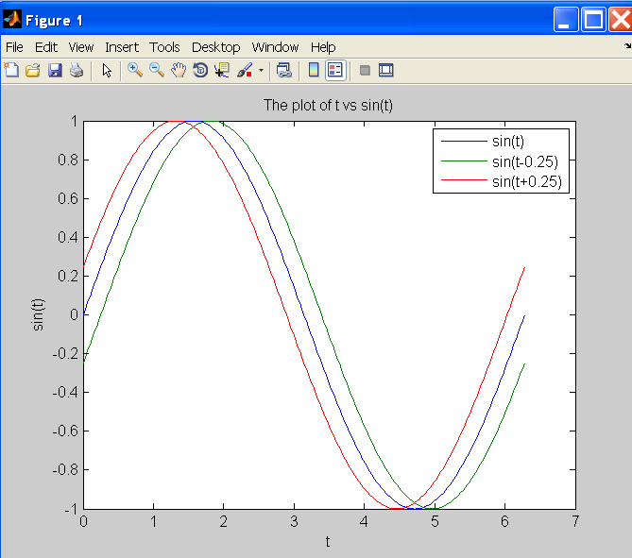
Line Plot
>> y2 = sin(t-0.25);
>> y3 = sin(t+0.25);
>> plot(t,y,t,y2,t,y3) % make 2D line plot of 3 curves
>> legend('sin(t)','sin(t-0.25)','sin(t+0.25',1)

Slide 18
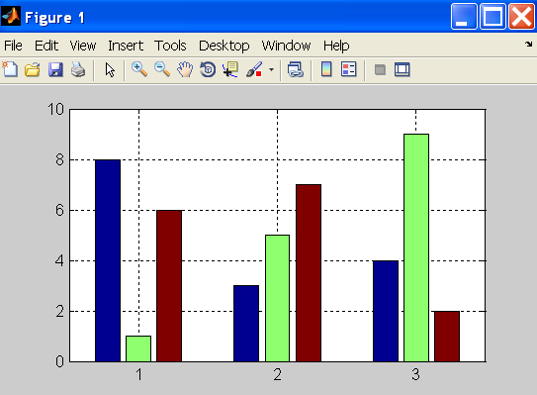
2D Bar Graph
>> x = magic(3); % generate data for bar graph
>> bar(x) % create bar chart
>> grid % add grid for clarity

Slide 19
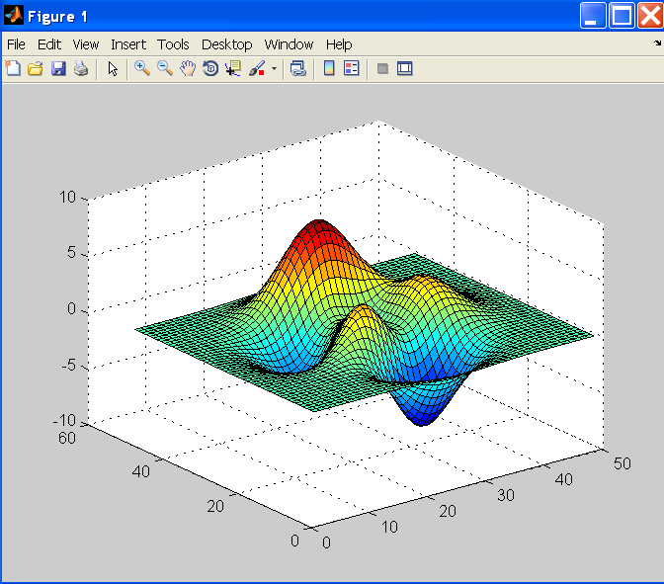
Surface Plot
>> Z = peaks; % generate data for plot; peaks returns function values
>> surf(Z) % surface plot of Z

