Slide 1
Chapter 13

Slide 2
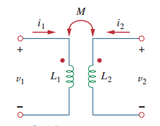
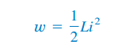
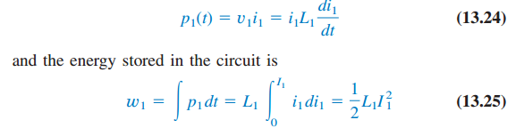

Energy in a Coupled Circuit
the energy stored in an inductor is given by
We assume that currents $i_{1}$and $i_{2}$are zero initially, so that the energy stored in the coils is zero. If we let increase $i_{2}$ from zero to $I_{2}$ while maintaining${ I}_{1}$, the power in coil 1 is

