Slide 1
Resonance and filters
Chapter 14

Slide 2
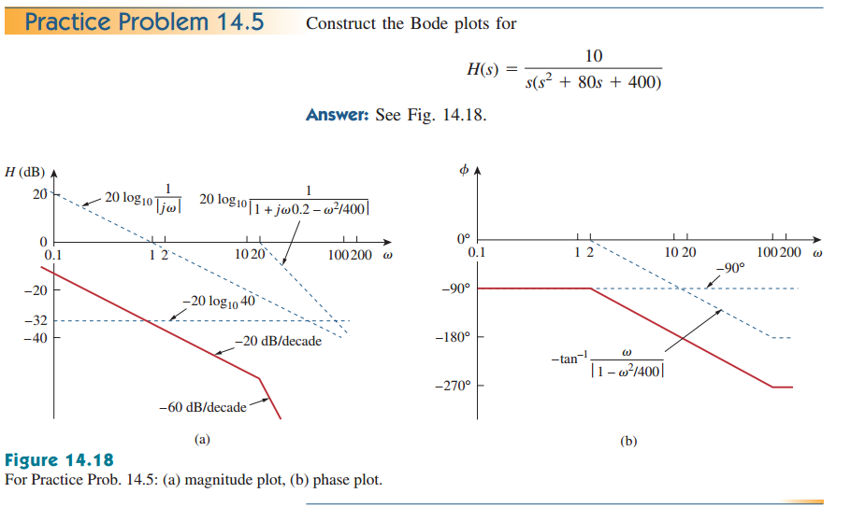

Slide 3
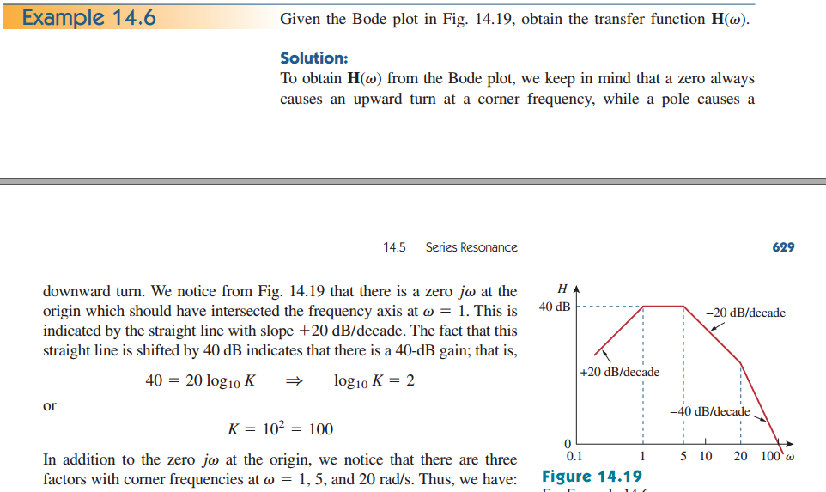

Slide 4
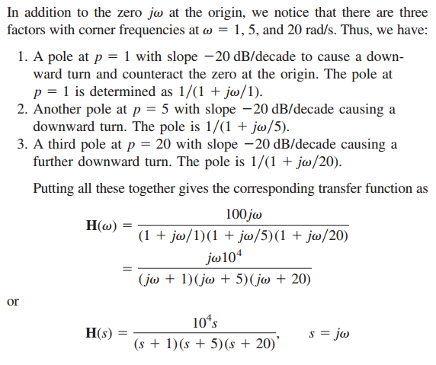
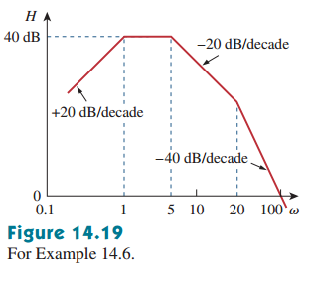

Slide 5
Series Resonance
The concept of resonance applies in several areas of science and engineering. Resonance occurs in any system that has a complex conjugate pair of poles; it is the cause of oscillations of stored energy from one form to another. It is the phenomenon that allows frequency discrimination in communications networks. Resonance occurs in any circuit that has at least one inductor and one capacitor.

Slide 6
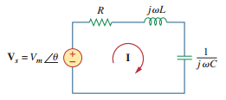

Resonance is a condition in an RLC circuit in which the capacitive and inductive reactances are equal in magnitude, thereby resulting in a purely resistive impedance

Slide 7
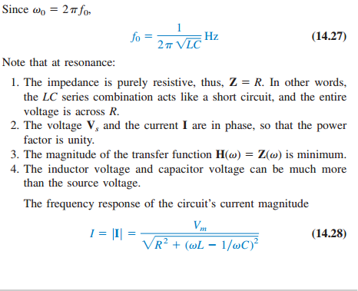

Slide 8
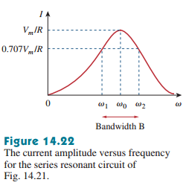
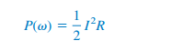
The average power dissipated by the RLC circuit is

Slide 9
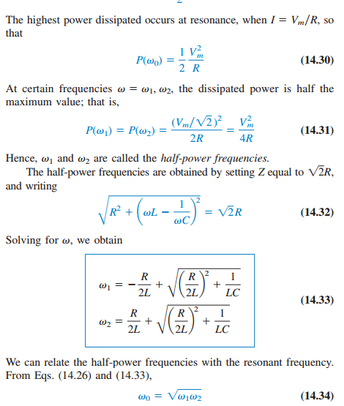

Slide 10
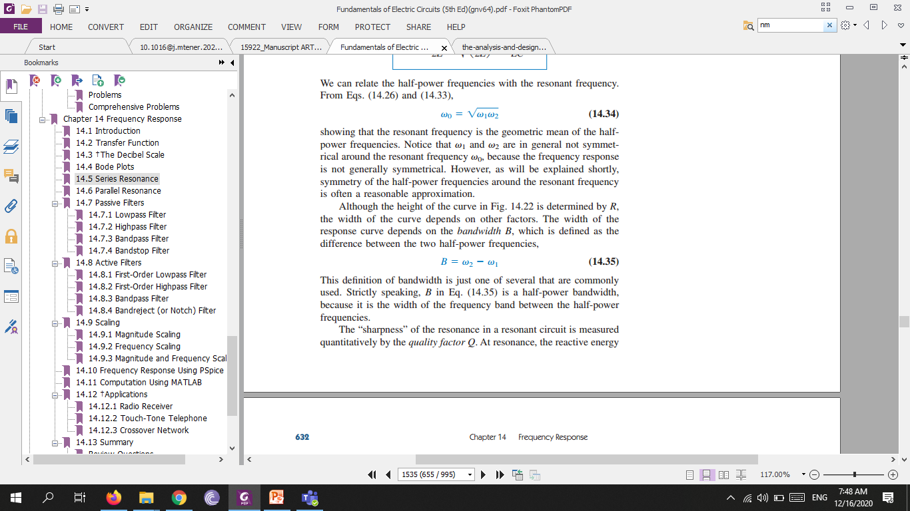
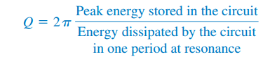
The width of the response curve depends on the bandwidth B, which is defined as the difference between the two half-power frequencies
The “sharpness” of the resonance in a resonant circuit is measured quantitatively by the quality factor Q. At resonance, the reactive energy in the circuit oscillates between the inductor and the capacitor. The quality factor relates the maximum or peak energy stored to the energy dissipated in the circuit per cycle of oscillation:

Slide 11
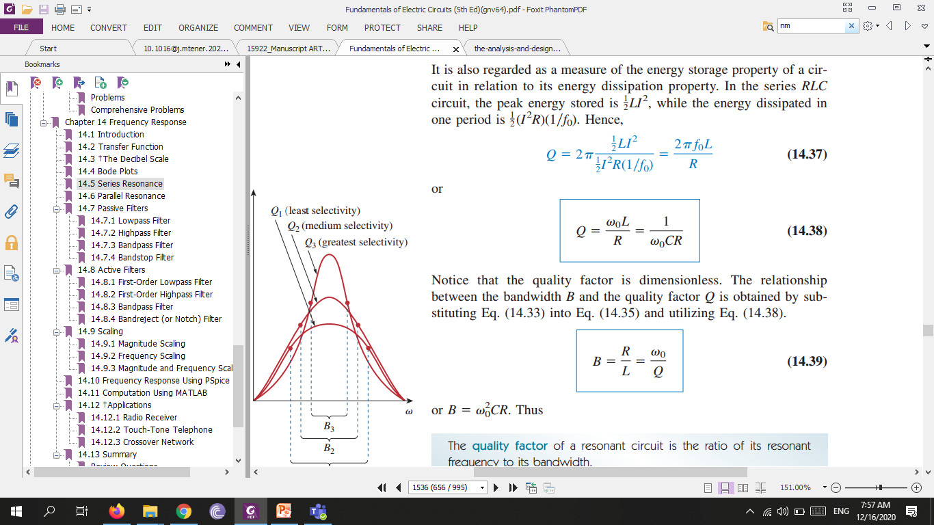
The quality factor of a resonant circuit is the ratio of its resonant frequency to its bandwidth.

Slide 12
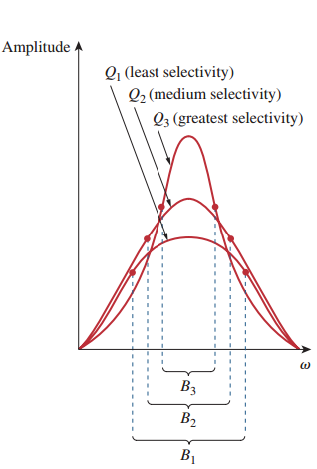

Slide 13
