Slide 1
Applications of Laplace transform
Chapter 15, 16

Slide 2
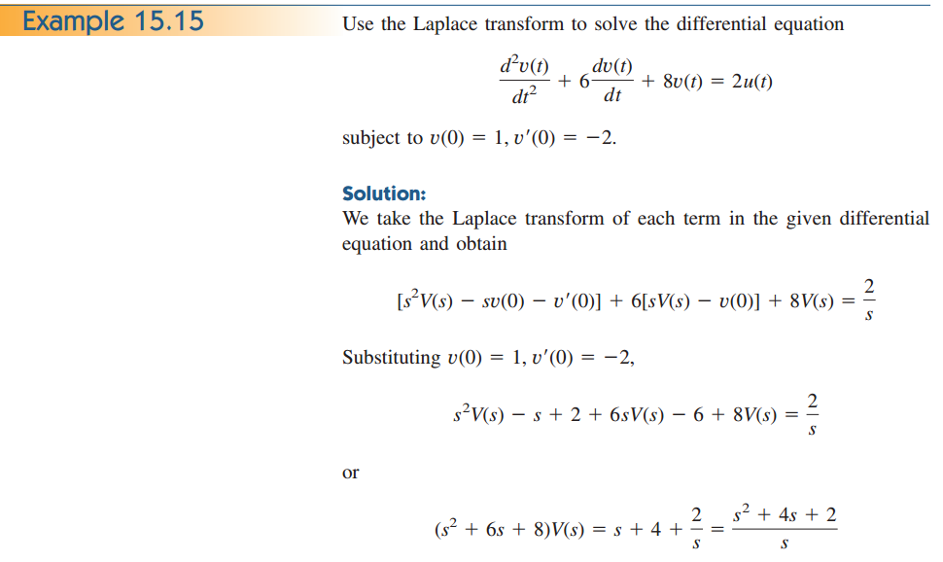
Application to Integrodifferential Equations

Slide 3
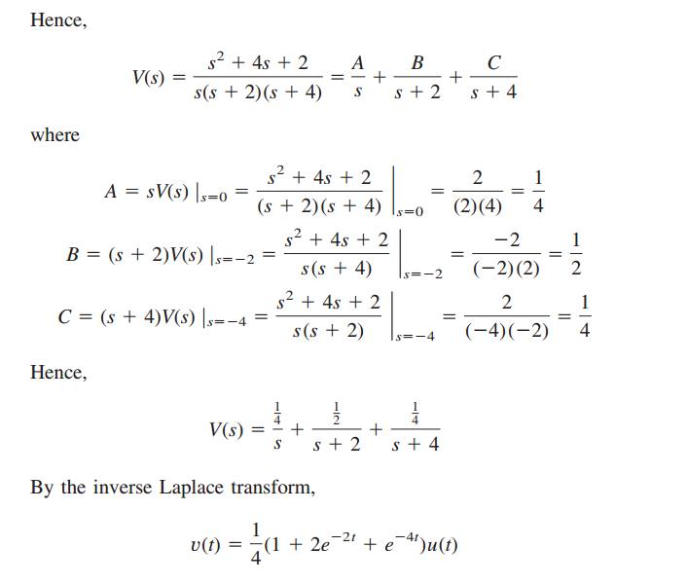

Slide 4
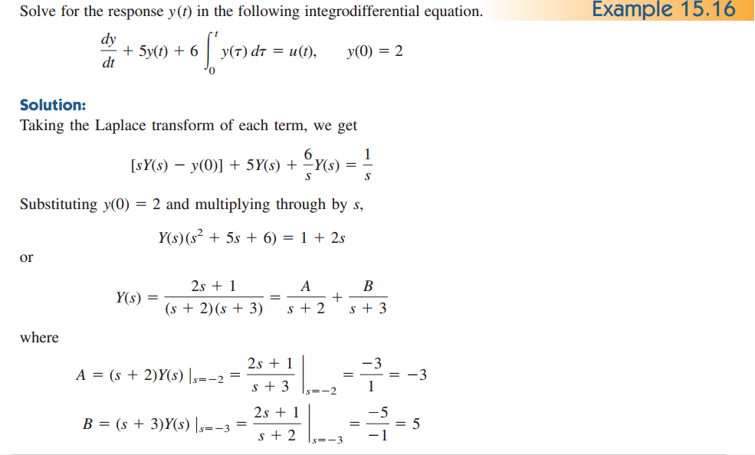

Slide 5
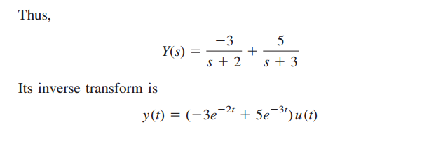
Steps in Applying the Laplace Transform: 1. Transform the circuit from the time domain to the s-domain. 2. Solve the circuit using nodal analysis, mesh analysis, source transformation, superposition, or any circuit analysis technique with which we are familiar. 3. Take the inverse transform of the solution and thus obtain the solution in the time domain

Slide 6
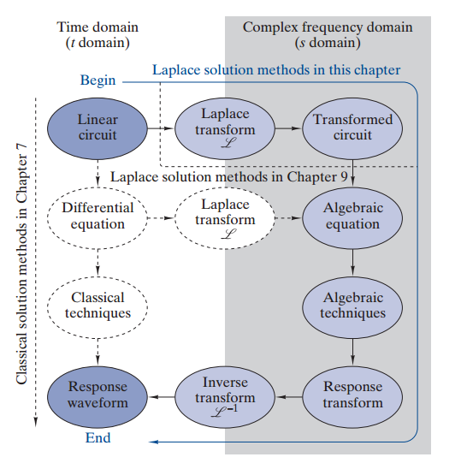

Slide 7
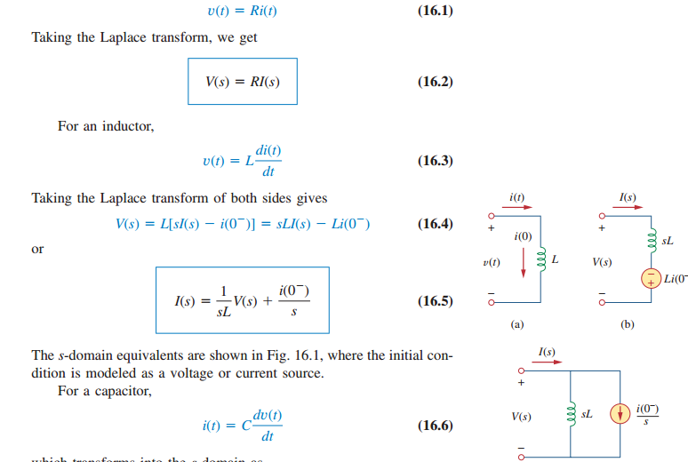

Slide 8
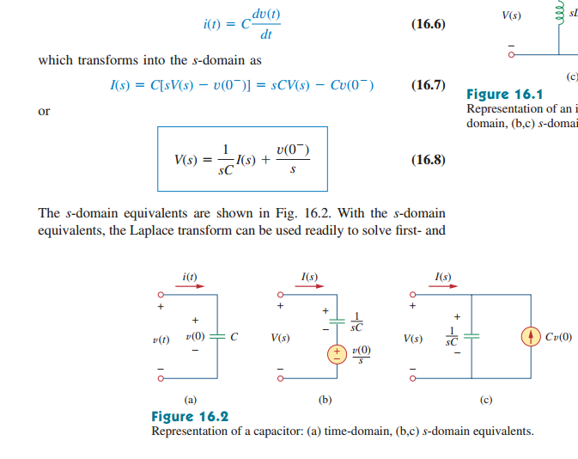

Slide 9
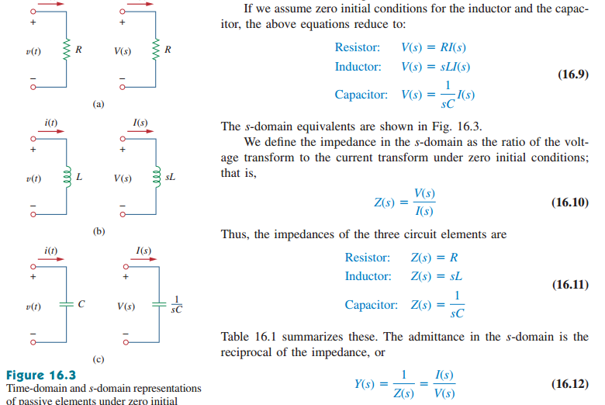

Slide 10
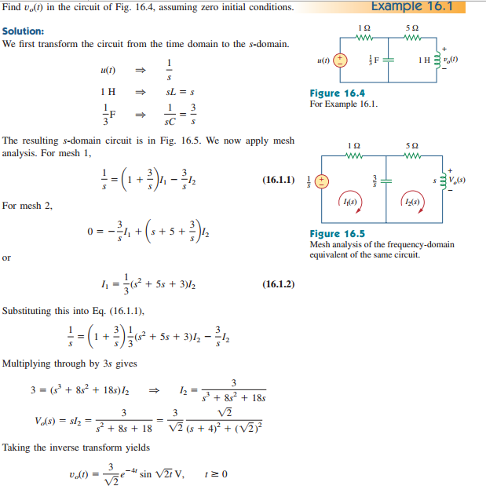

Slide 11
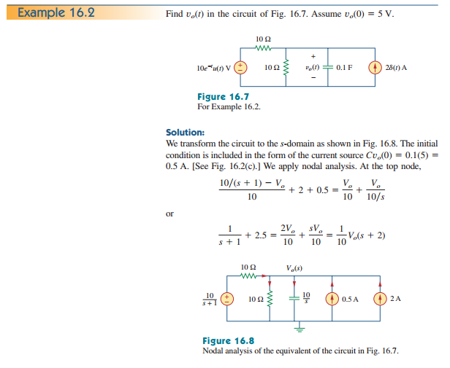

Slide 12
