Slide 1
Resonance
Chapter 14

Slide 2
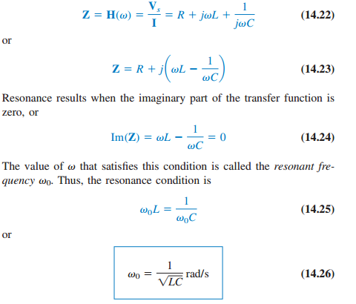

Resonance is a condition in an RLC circuit in which the capacitive and inductive reactances are equal in magnitude, thereby resulting in a purely resistive impedance

Slide 3
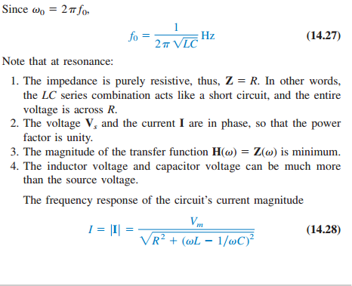

Slide 4
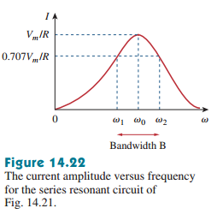
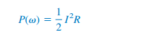
The average power dissipated by the RLC circuit is

Slide 5
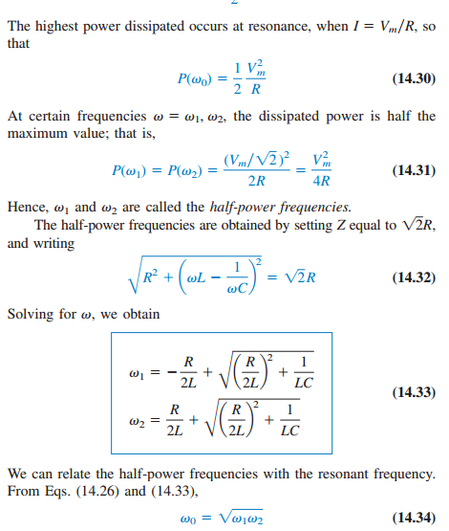

Slide 6
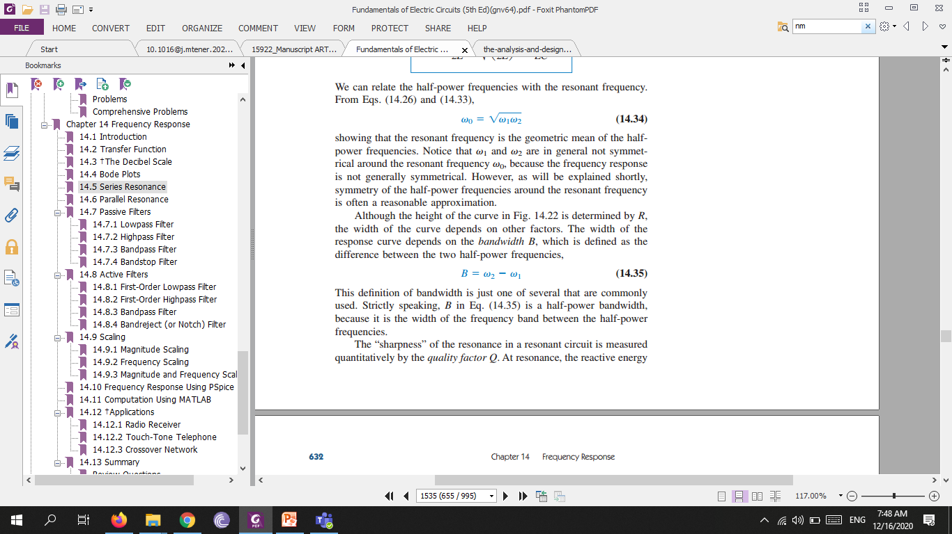
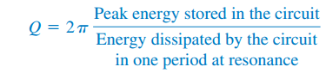
The width of the response curve depends on the bandwidth B, which is defined as the difference between the two half-power frequencies
The “sharpness” of the resonance in a resonant circuit is measured quantitatively by the quality factor Q. At resonance, the reactive energy in the circuit oscillates between the inductor and the capacitor. The quality factor relates the maximum or peak energy stored to the energy dissipated in the circuit per cycle of oscillation:

Slide 7
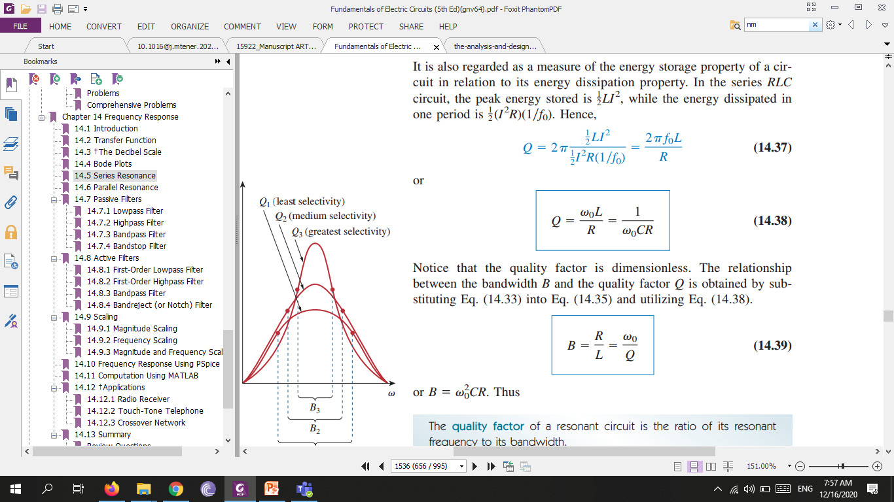
The quality factor of a resonant circuit is the ratio of its resonant frequency to its bandwidth.

Slide 8
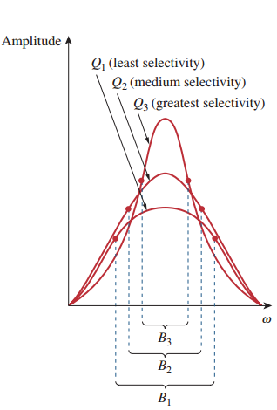

Slide 9
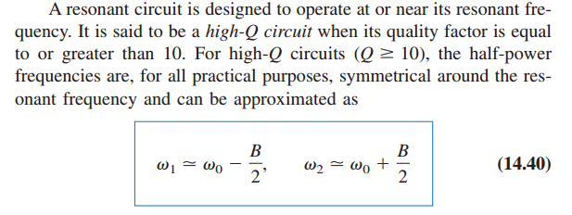

Slide 10
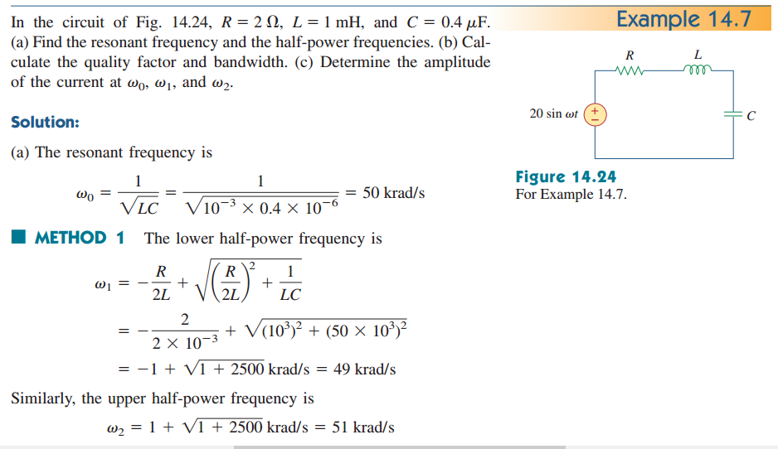

Slide 11
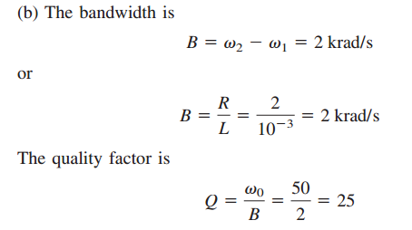

Slide 12
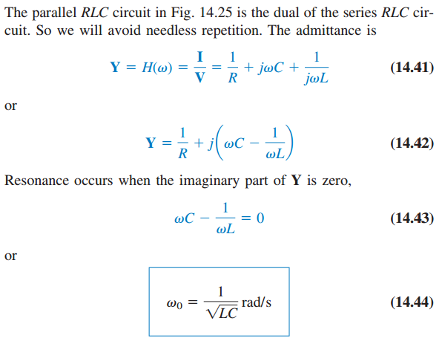
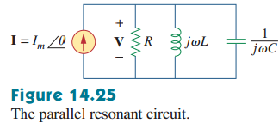
Parallel Resonance

Slide 13
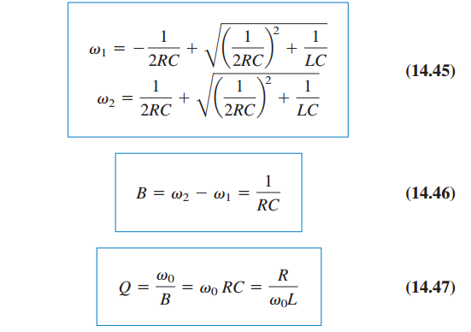
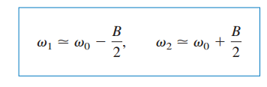

Slide 14
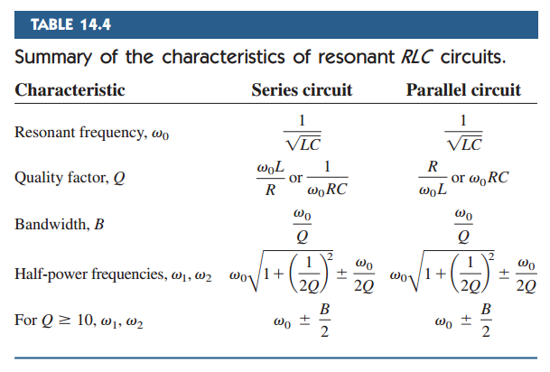

Slide 15
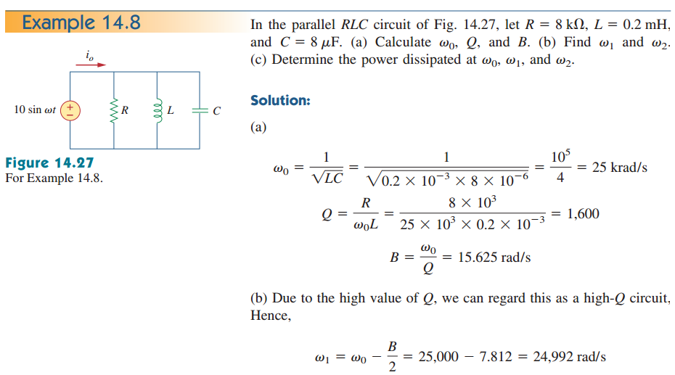

Slide 16
