Slide 1
Applications of Laplace transform
Chapter 16

Slide 2
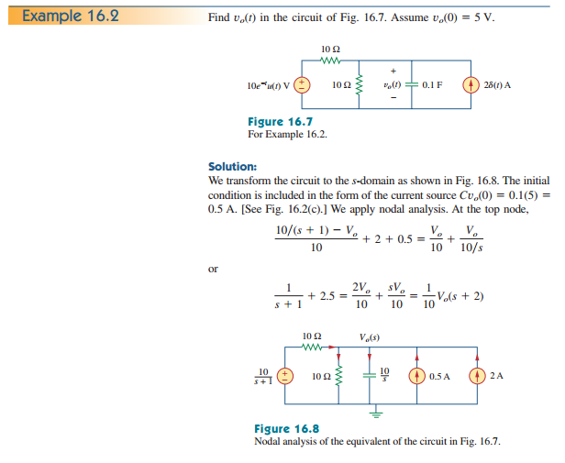

Slide 3
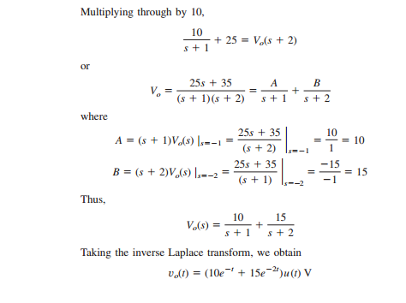

Slide 4
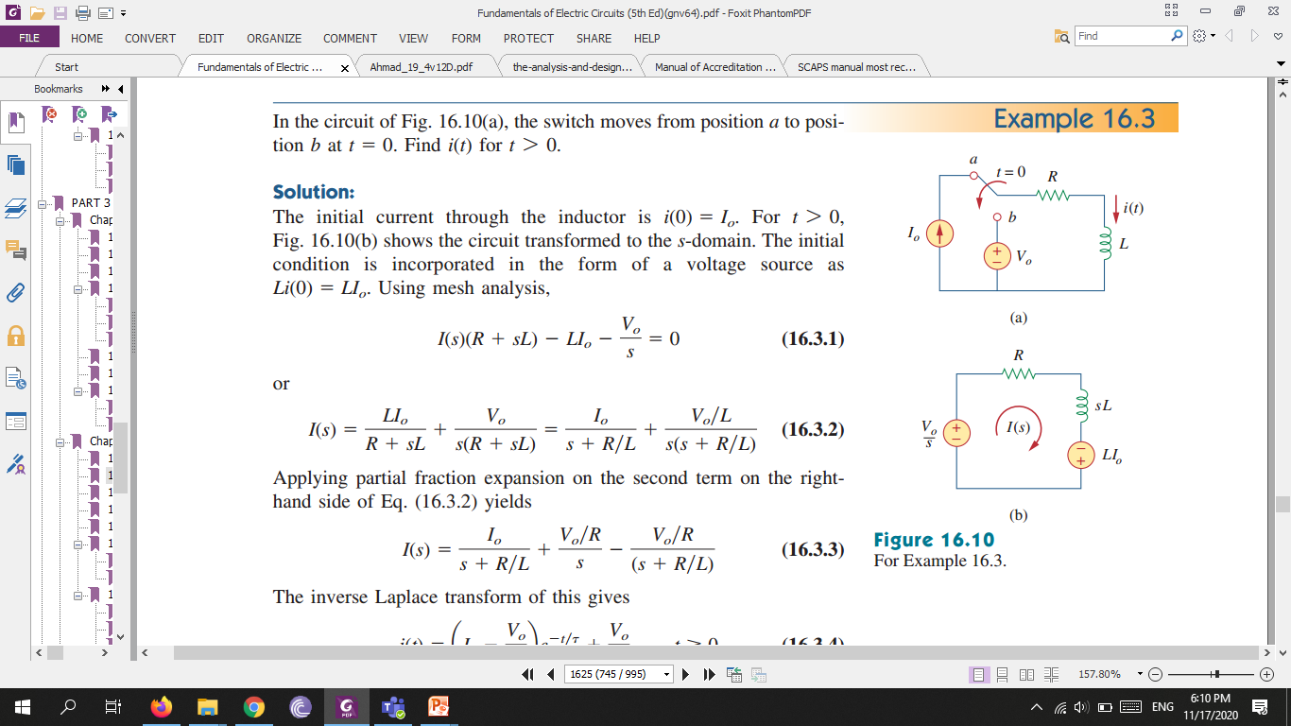

Slide 5
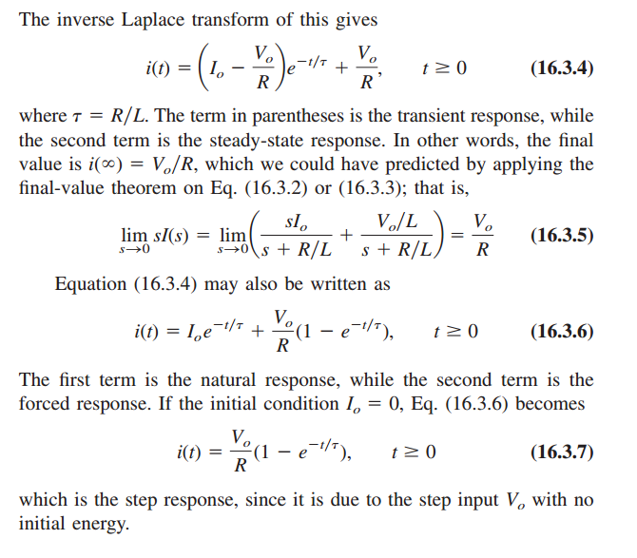

Slide 6
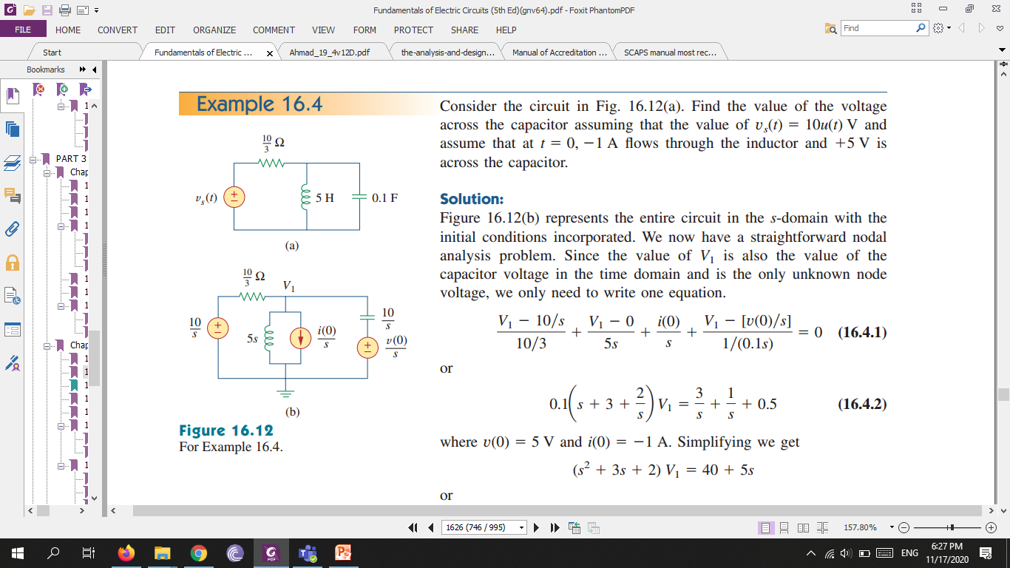

Slide 7
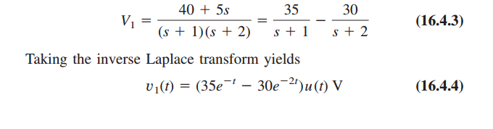
Remember, equivalent circuits, with capacitors and inductors, only exist in the s-domain; they cannot be transformed back into the time domain.

