Slide 2
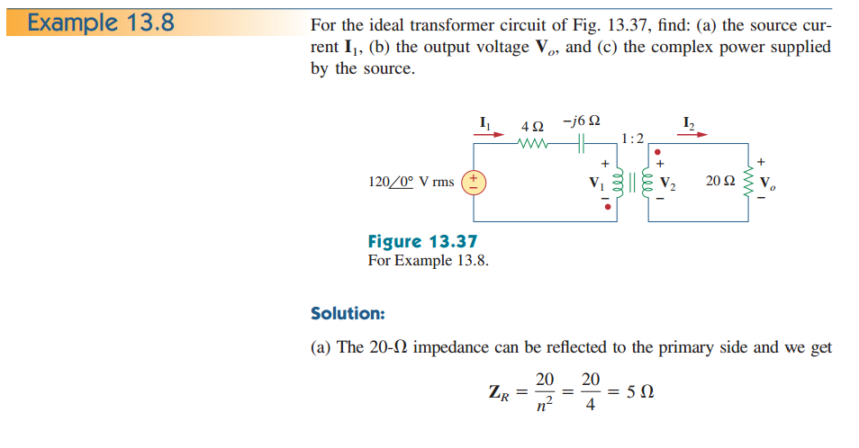

Slide 3
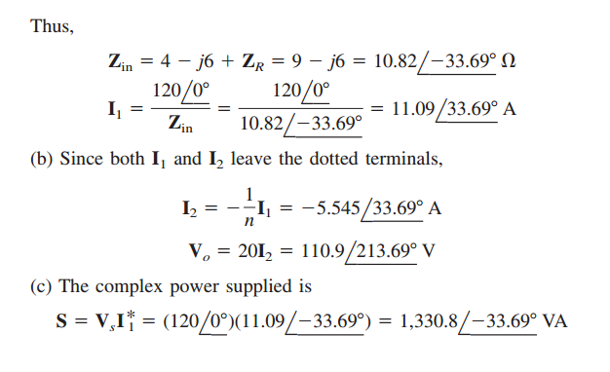

Slide 4
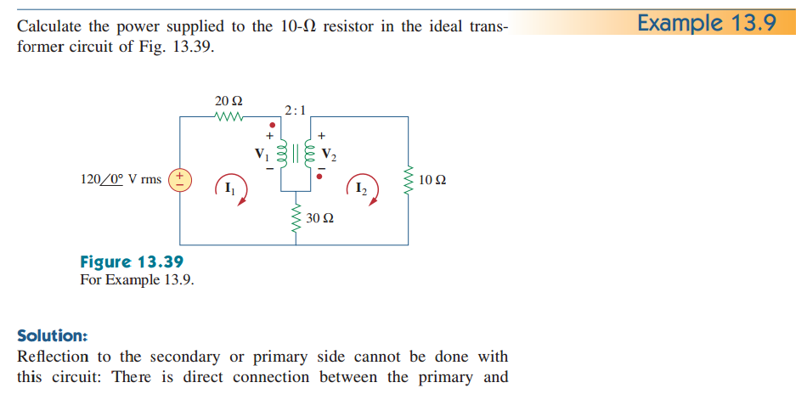
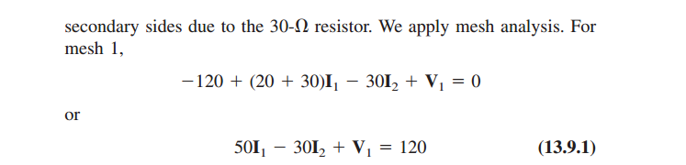

Slide 5
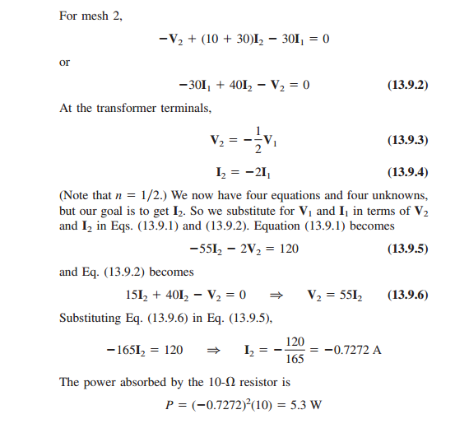

Slide 6
Ideal Autotransformers
Unlike the conventional two-winding transformer we have considered so far, an autotransformer has a single continuous winding with a connection point called a tap between the primary and secondary sides. The tap is often adjustable so as to provide the desired turns ratio for stepping up or stepping down the voltage. This way, a variable voltage is provided to the load connected to the autotransformer.
The autotransformer is a type of power transformer. Its major advantage over the two-winding transformer is its ability to transfer larger apparent power.
Another advantage is that an autotransformer is smaller and lighter than an equivalent two-winding transformer.
However, since both the primary and secondary windings are one winding, electrical isolation (no direct electrical connection) is lost.

Slide 7
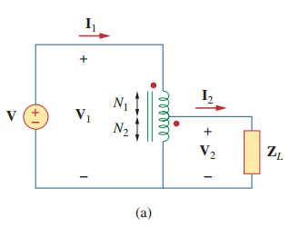
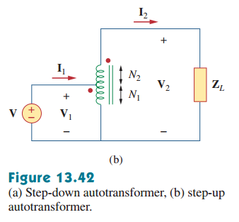

Slide 8
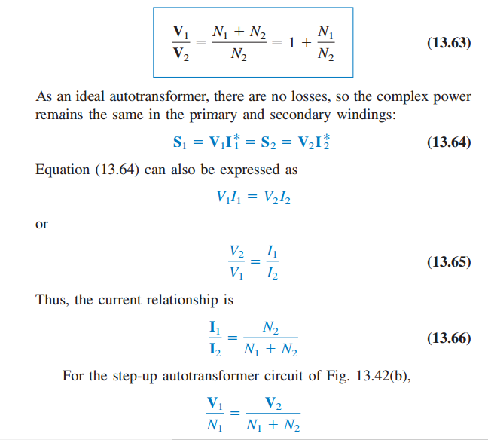

Slide 9
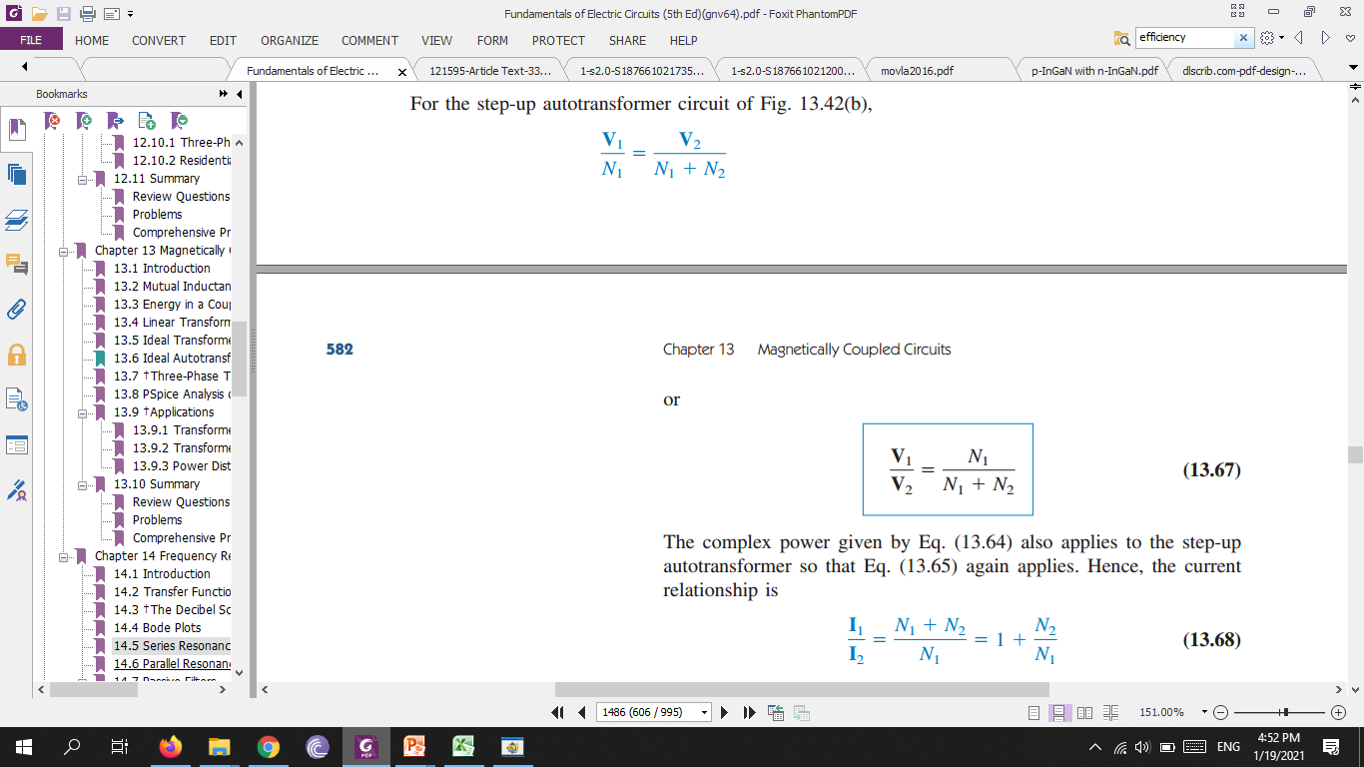
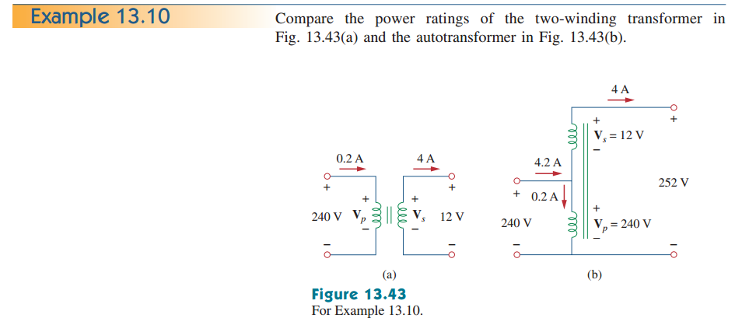

Slide 10
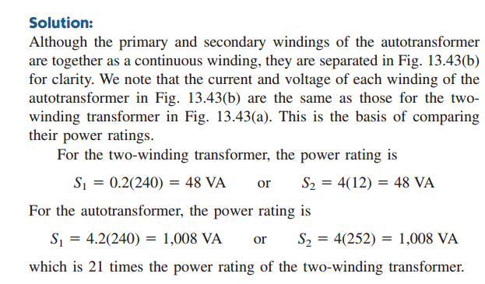

Slide 11
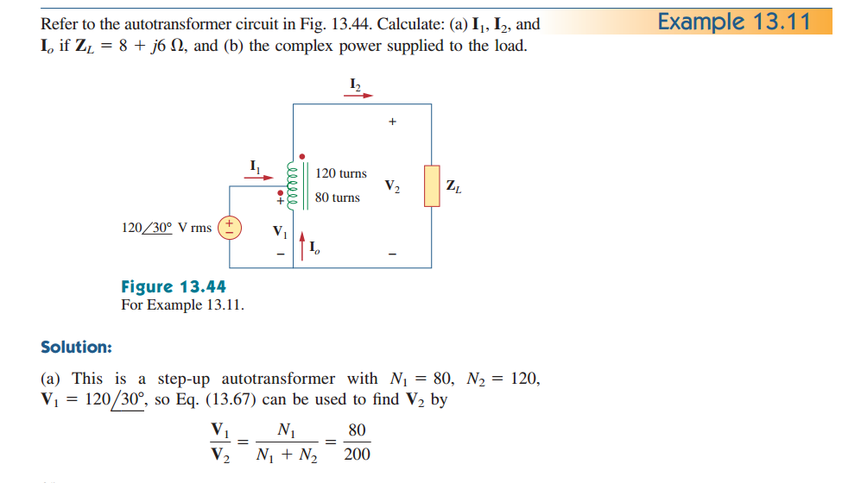

Slide 12
