Slide 1
Phasors
Chapter 9

Slide 2
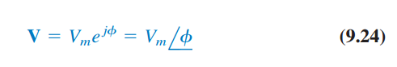
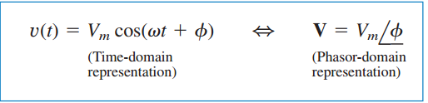
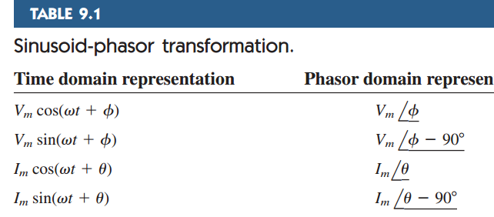

Slide 3
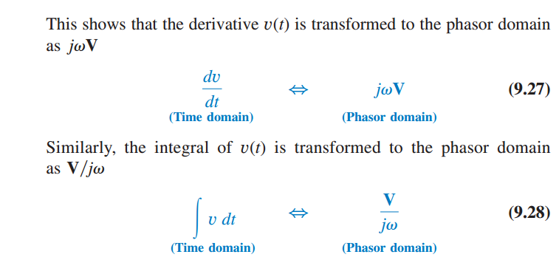
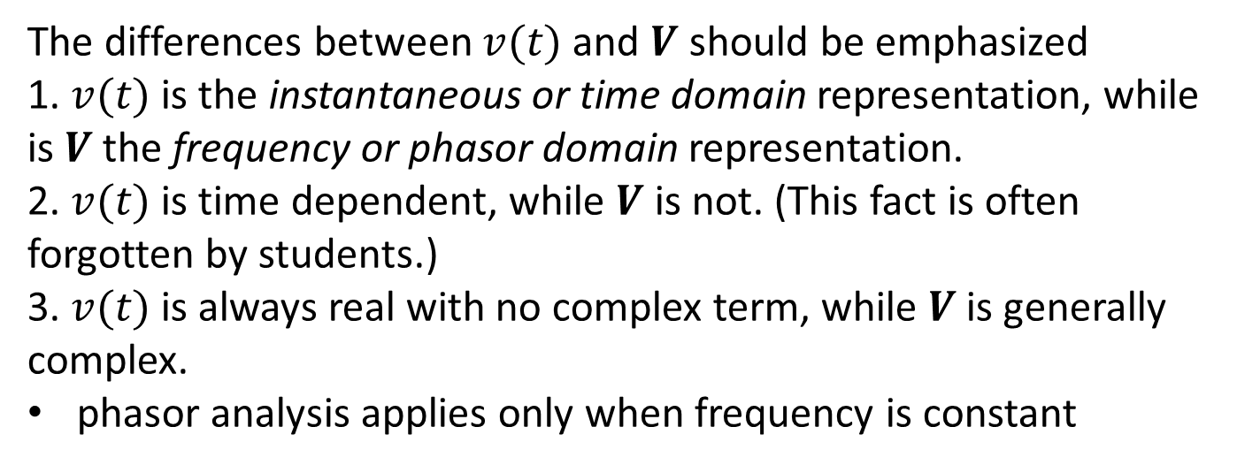
The differences between $v(t)$ and $V$ should be emphasized
1. $v(t)$ is the instantaneous or time domain representation, while is $V$the frequency or phasor domain representation. 2. $v(t)$ is time dependent, while $V$ is not. (This fact is often forgotten by students.) 3. $v(t)$is always real with no complex term, while $V$is generally complex.
phasor analysis applies only when frequency is constant

Slide 4
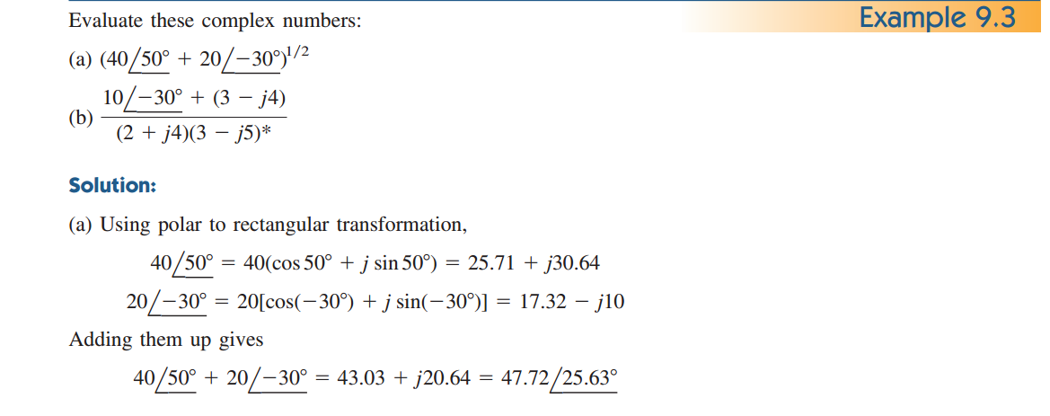
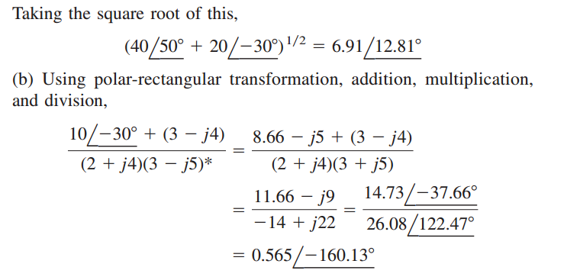

Slide 5
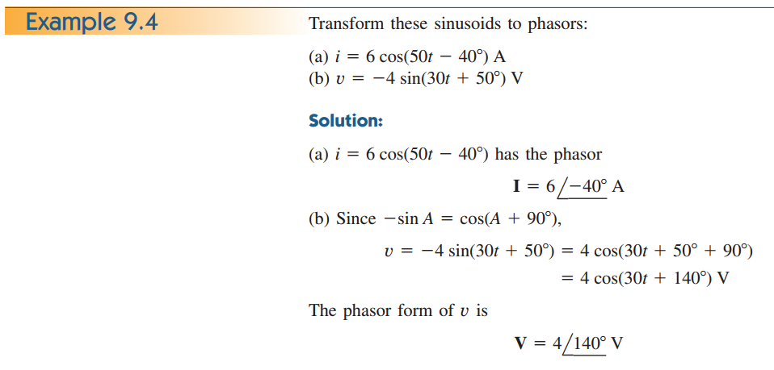

Slide 6
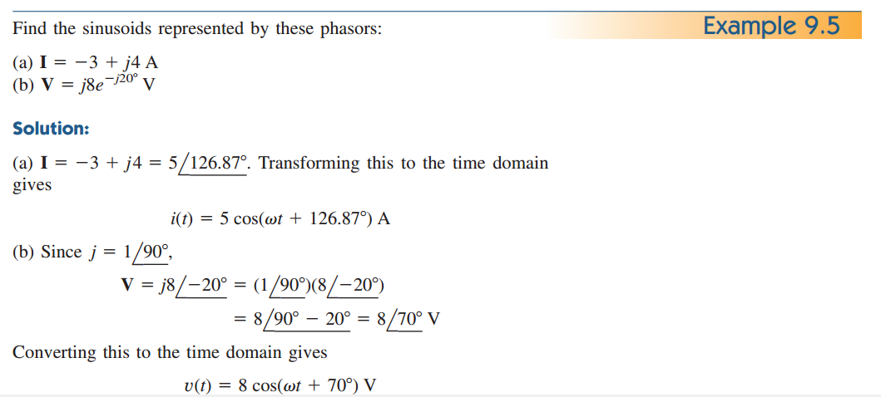

Slide 7
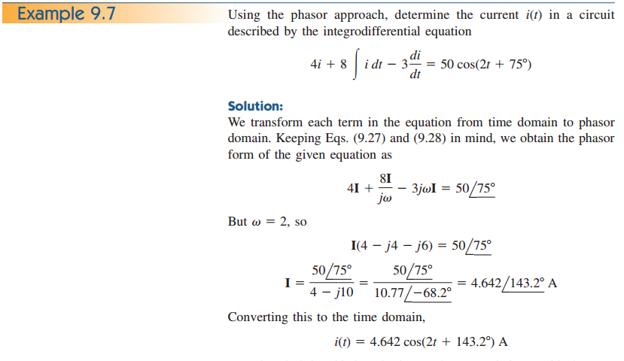

Slide 8
