Slide 1
Introduction to the Laplace Transform
Chapter 15

Slide 2
Introduction
Our goal in this and the following chapters is to develop techniques for analyzing circuits with a wide variety of inputs and responses.
Such circuits are modeled by differential equations whose solutions describe the total response behavior of the circuits.
We now introduce the powerful method of Laplace transformation, which involves turning differential equations into algebraic equations, thus greatly facilitating the solution process
we transform the circuit from the time domain to the frequency or phasor domain.
The Laplace transform is significant for a number of reasons. First, it can be applied to a wider variety of inputs than phasor analysis. Second, it provides an easy way to solve circuit problems involving initial conditions, because it allows us to work with algebraic equations instead of differential equations. Third, the Laplace transform is capable of providing us, in one single operation, the total response of the circuit comprising both the natural and forced responses.

Slide 3
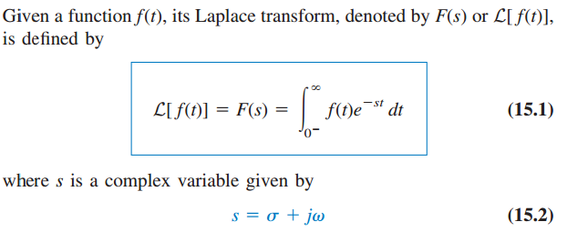
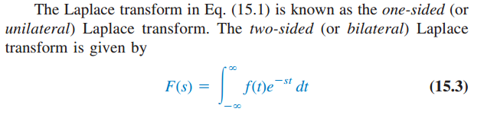
Definition of the Laplace Transform
Equation (15.1) illustrates the general concept of transformation. The function f(t) is transformed into the function F(s). Whereas the former function involves t as its argument, the latter involves s. We say the transformation is from t-domain to s-domain.

Slide 4
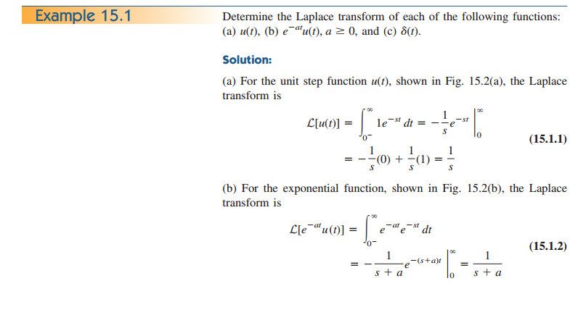

Slide 5
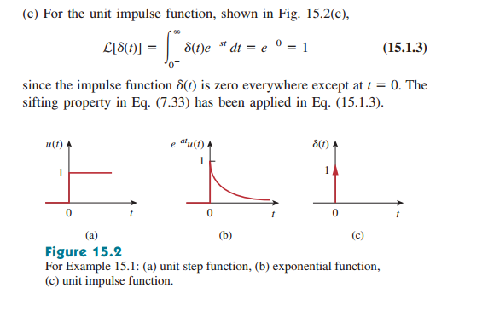

Slide 6
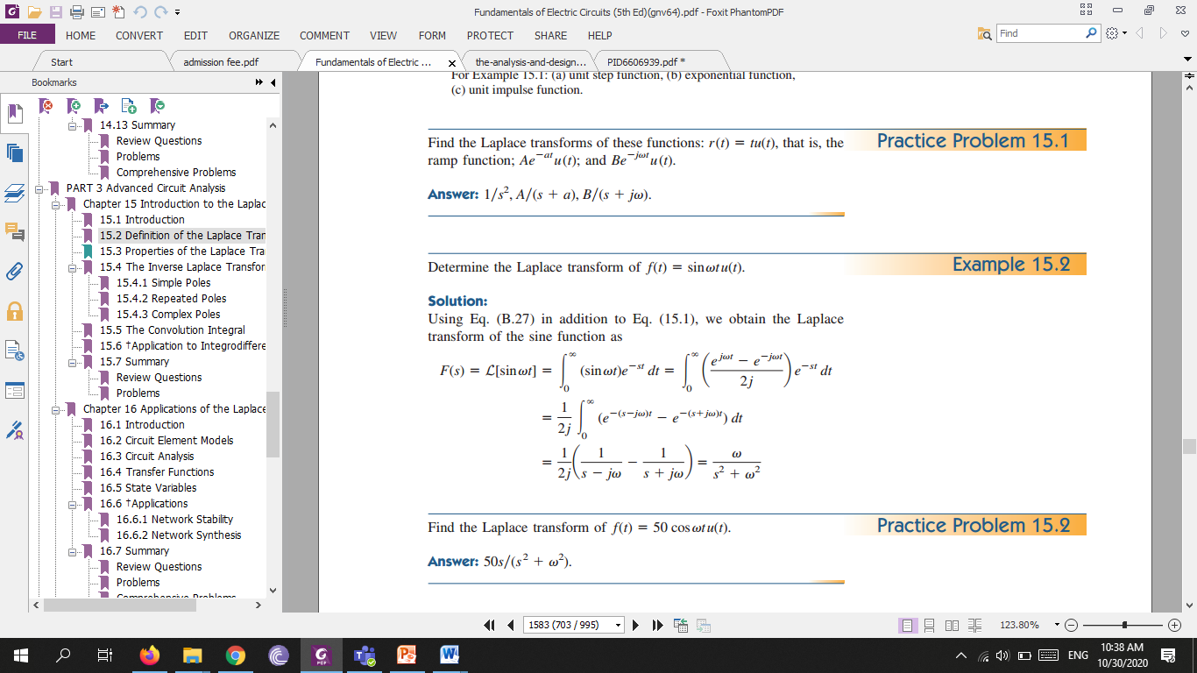

Slide 7
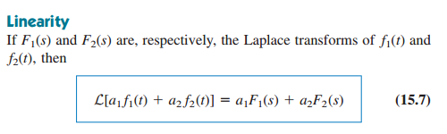
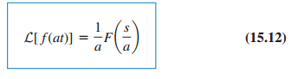
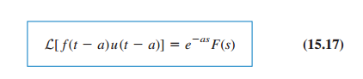
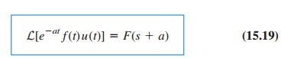
Properties of the Laplace Transform
Scaling
Time Shift
Frequency Shift

Slide 8
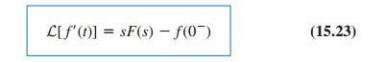
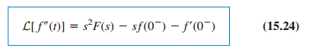

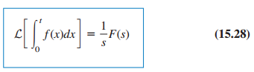
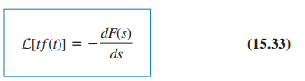
Time Differentiation
Time Integration
Frequency Differentiation

Slide 9
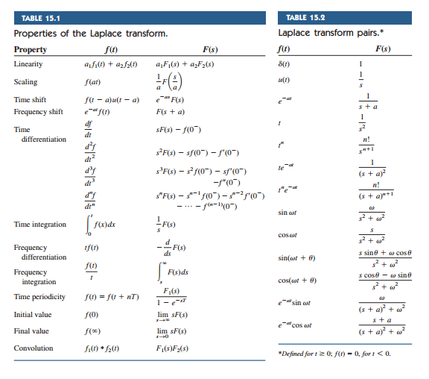

Slide 10
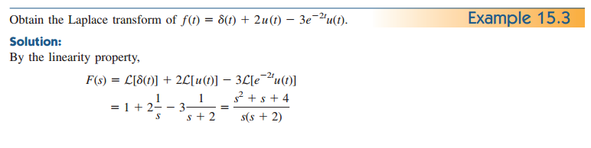
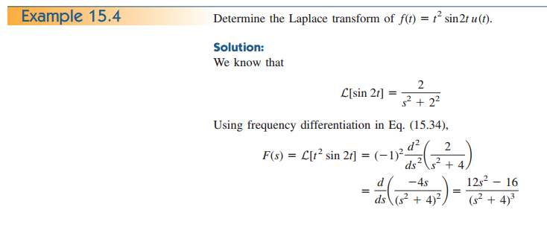

Slide 11
