Slide 1
Transfer function and frequency response
Chapter 16+14

Slide 2
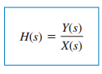
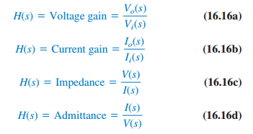
Transfer Functions in Laplace domain
The transfer function H(s) is the ratio of the output response Y(s) to the input excitation X(s), assuming all initial conditions are zero.

Slide 3
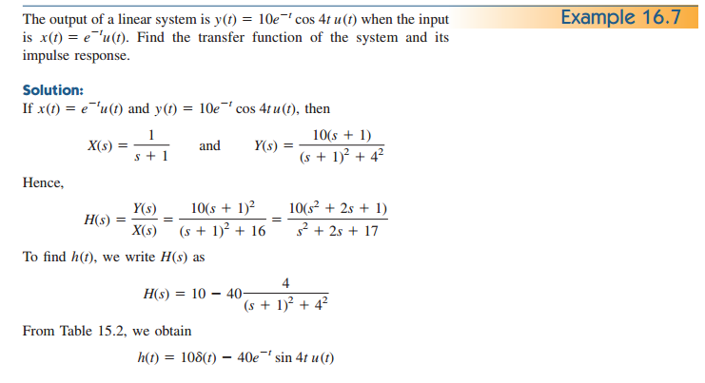

Slide 4
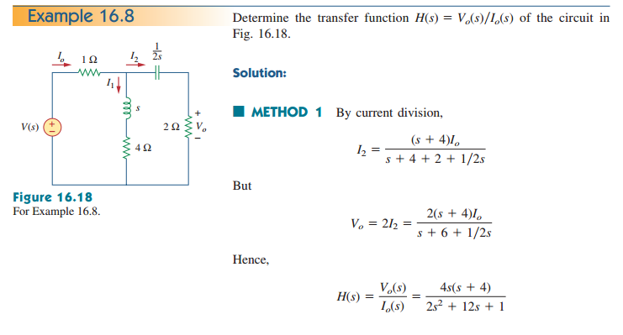

Slide 5
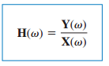
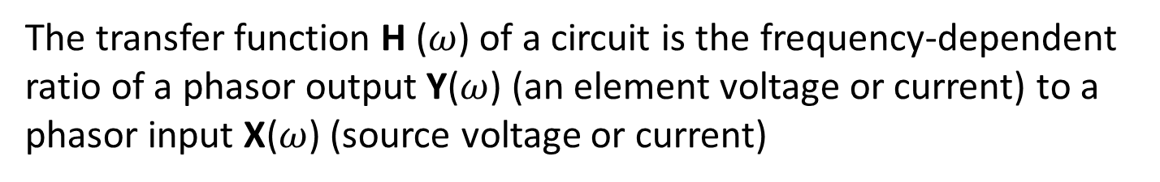
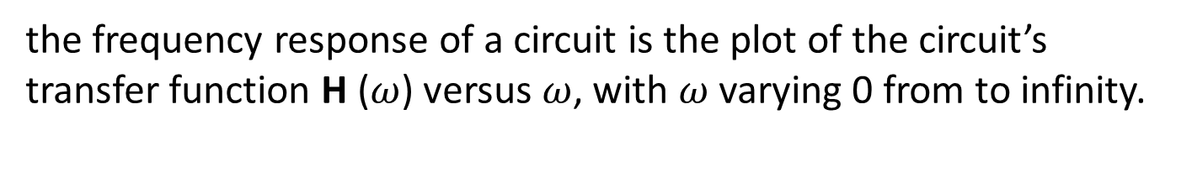
Transfer Function (Phasor form)
The transfer function H ($ω$) of a circuit is the frequency-dependent ratio of a phasor output Y($ω$) (an element voltage or current) to a phasor input X($ω$) (source voltage or current)
the frequency response of a circuit is the plot of the circuit’s transfer function H ($ω$) versus $ω$, with $ω$ varying 0 from to infinity.

Slide 6
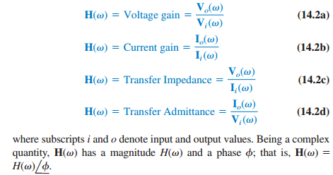
Steps to obtain transfer function
Convert circuit into phasor form
Use circuit techniques
Plot magnitude and angle against frequency
Poles and zeros

Slide 7
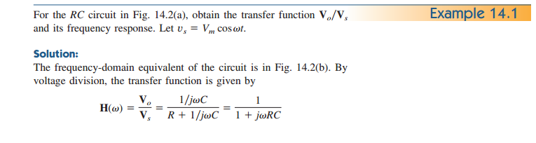
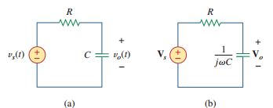
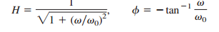
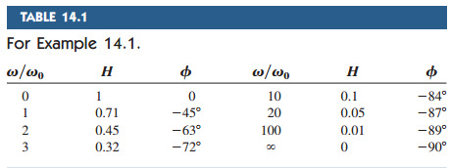
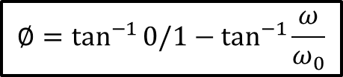
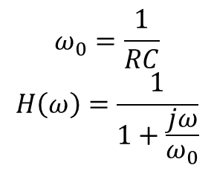
$$ω_{0}=\frac{1}{RC}$$
$$H\left(ω\right)=\frac{1}{1+\frac{jω}{ω_{0}}}$$
$$∅=\tan^{−1}{0/1}−\tan^{−1}{\frac{ω}{ω_{0}}}$$

Slide 8
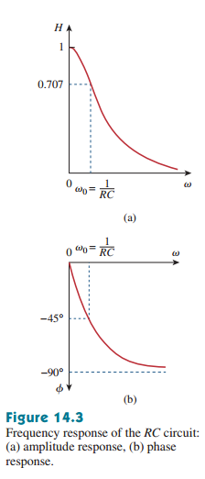

Slide 9
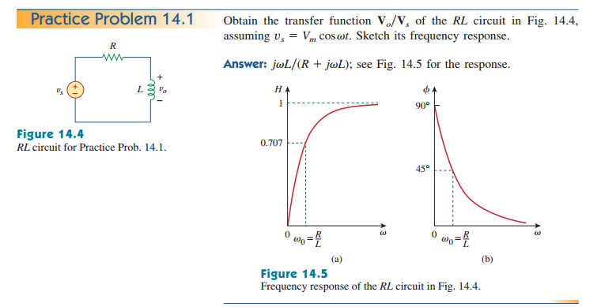
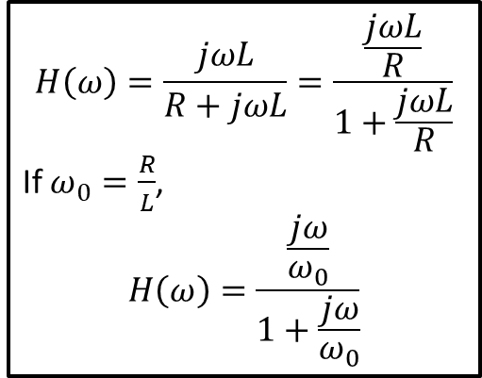
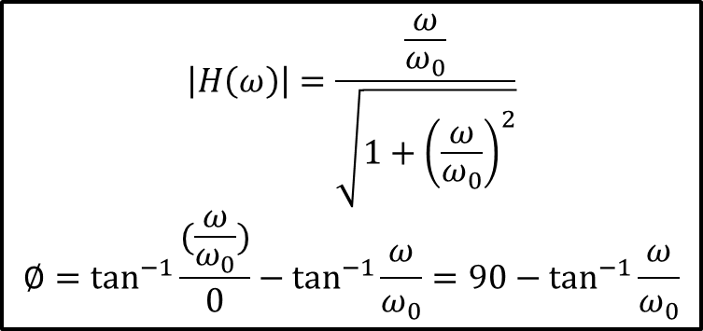
$$H\left(ω\right)=\frac{jωL}{R+jωL}=\frac{\frac{jωL}{R}}{1+\frac{jωL}{R}}$$
If $ω_{0}=\frac{R}{L}$,
$$H\left(ω\right)=\frac{\frac{jω}{ω_{0}}}{1+\frac{jω}{ω_{0}}}$$
$$\left|H\left(ω\right)\right|=\frac{\frac{ω}{ω_{0}}}{\sqrt{1+{\left(\frac{ω}{ω_{0}}\right)}^{2}}}$$
$$∅=\tan^{−1}{\frac{(\frac{ω}{ω_{0}})}{0}}−\tan^{−1}{\frac{ω}{ω_{0}}}=90−\tan^{−1}{\frac{ω}{ω_{0}}}$$

Slide 10
