Slide 1
Frequency Response
Chapter 14

Slide 2
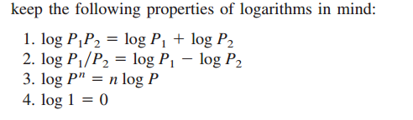
The Decibel Scale
It is not always easy to get a quick plot of the magnitude and phase of the transfer function. A more systematic way of obtaining the frequency response is to use Bode plots. Before we begin to construct Bode plots, we should take care of two important issues: the use of logarithms and decibels in expressing gain.

Slide 3
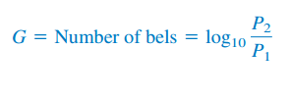
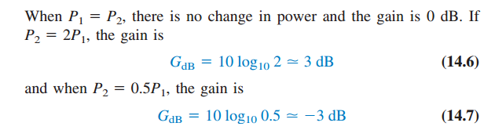
In communications systems, gain is measured in bels. Historically, the bel is used to measure the ratio of two levels of power or power gain G; that is
The decibel (dB) provides us with a unit of less magnitude. It is 1/10th of a bel and is given by

Slide 4
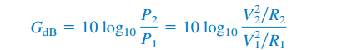
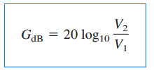
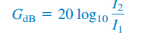
If R1=R2
That the dB value is a logarithmic measurement of the ratio of one variable to another of the same type. It can be used for unit less transfer functions.
It is important to note that we only use voltage and current magnitudes, Negative signs and angles will be handled independently

Slide 5
Bode Plots
Bode plots are semilog plots of the magnitude (in decibels) and phase (in degrees) of a transfer function versus frequency
The frequency range required in frequency response is often so wide that it is inconvenient to use a linear scale for the frequency axis. Also, there is a more systematic way of locating the important features of the magnitude and phase plots of the transfer function. For these reasons, it has become standard practice to plot the transfer function on a pair of semilogarithmic plots: The magnitude in decibels is plotted against the logarithm of the frequency; on a separate plot, the phase in degrees is plotted against the logarithm of the frequency. Such semilogarithmic plots of the transfer function—known as Bode plots—have become the industry standard.

Slide 6
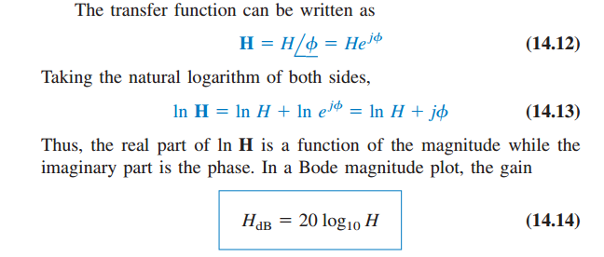
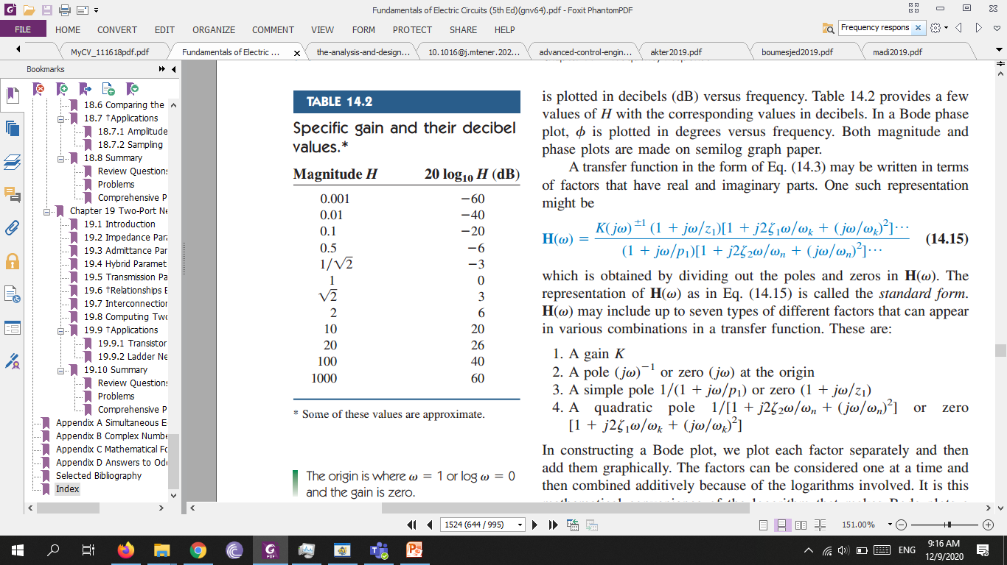

Slide 7
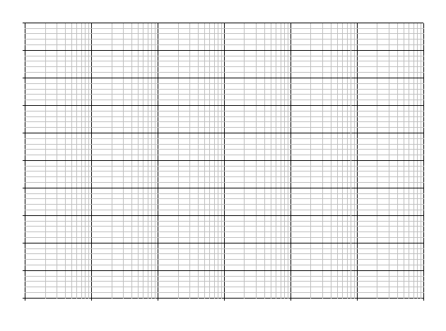
semi logarithmic graph

Slide 8
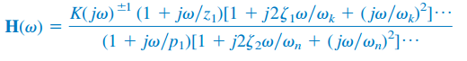
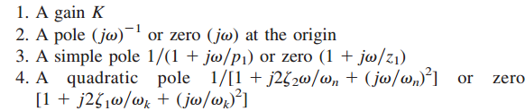
A standard transfer function representation
The origin is where $ω$=1 or log$ω=$ 0 and the gain is zero.

